Slide 1
Introduction to cardiothoracic and vascular surgery

Slide 2
What is cardiothoracic and vascular surgery

Slide 3
What is a cardiothoracic surgeon
All areas
Specific areas
Cardiac
Thoracic
Vascular

Slide 4
Who are the other team members?

Slide 5
What is needed to perform surgery
Team
Equipment
Supporting infrastructure
Patients and community

Slide 6
What to expect of your rotation
Introduced to patients and how to relate t them
Cardiothoracic and vascular environment
Common conditions

Slide 7
History thoracic
Endotracheal tube main driver

Slide 8
History cardiac
John Gibbon initiated workable concept of open heart surgery.
1953 first time extra coporal circulation used with good results. ASD closure.
1955 regular surgery commenced.
Lilleheli in 50’s used maternal circulation. Short lived.
First valve 1959*

Slide 9
History cardiac
First reliable valve 1963.
First heart transplant December 1968.
Heart lung.
Further developments.

Slide 10
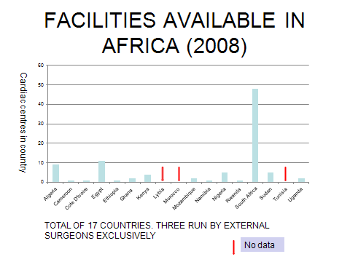
Africa

Slide 11
Country
Surgeries year
Population
surgeries/1,000,000 pop
Nigeria
5
114,700,000
0.0
Ethiopia
40
65,600,000
0.6
Namibia
9
1,900,000
4.7
Mozambique
90
17,900,000
5.0
Rwanda
40
7,700,000
5.2
Maturities
500
1,300,000
384
Cameroon
83
15,100,000
5.5
Ghana
120
19,600,000
6.1
Cote D'Ivoire
112
15,800,000
7.1
Kenya
250
30,500,000
8.2
Algeria
500
30,200,000
16.6
Sudan
750
31,400,000
23.9
South Africa
9,000
44,000,000
204.5
Egypt
20,000
67,800,000
295.0

Slide 12
Cardiac Surgery (Africa)

Slide 13
Country
Surgeries year
Population
surgeries/1,000,000 pop
Nigeria
5
114,700,000
0.0
Ethiopia
40
65,600,000
0.6
Namibia
9
1,900,000
4.7
Mozambique
90
17,900,000
5.0
Rwanda
40
7,700,000
5.2
Maturities
500
1,300,000
384
Cameroon
83
15,100,000
5.5
Ghana
120
19,600,000
6.1
Figures for 2008
Cote D'Ivoire
112
15,800,000
7.1
Kenya
250
30,500,000
8.2
Algeria
500
30,200,000
16.6
Sudan
750
31,400,000
23.9
South Africa
9,000
44,000,000
204.5
Egypt
20,000
67,800,000
295.0

Slide 14
OPEN HEART SURGERY IN KENYA
KNH 1973 - Hypothermia
KNH 1975 - CPB machine
NAIROBI HOSP - 1993
MATER - 1996
MOMBASA (AGK) - 2003

Slide 15
Principles Of Open Heart Surgery
Operate on “quiet” heart
Reduce metabolism
Cardiac arrest
Hypothermia
Continued supply of nutrients to myocytes.

Slide 16
Heart Lung Machine
Components of machine.
Mechanical pump
Takes over the function of the heart
Oxygenator
Takes over the function of lungs
Heat exchanger
Reduce metabolism
Warm patient after surgery

Slide 17
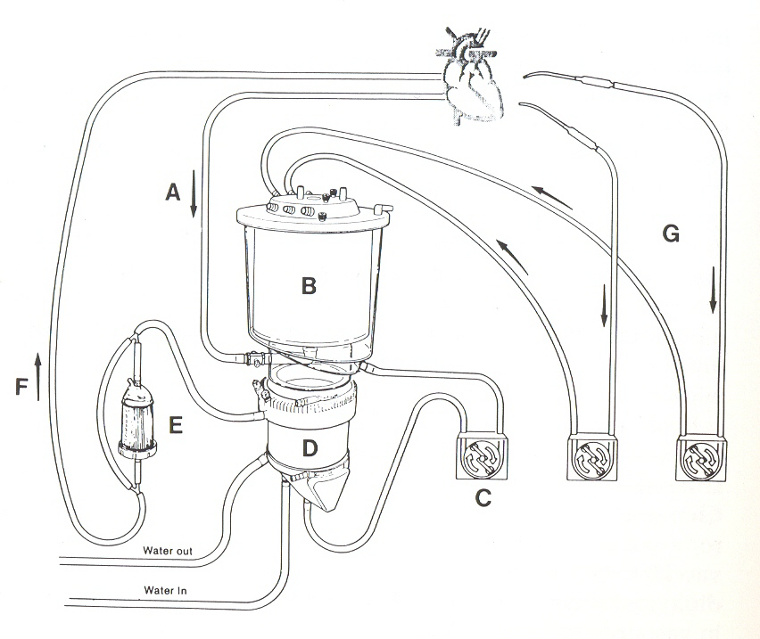

Slide 18
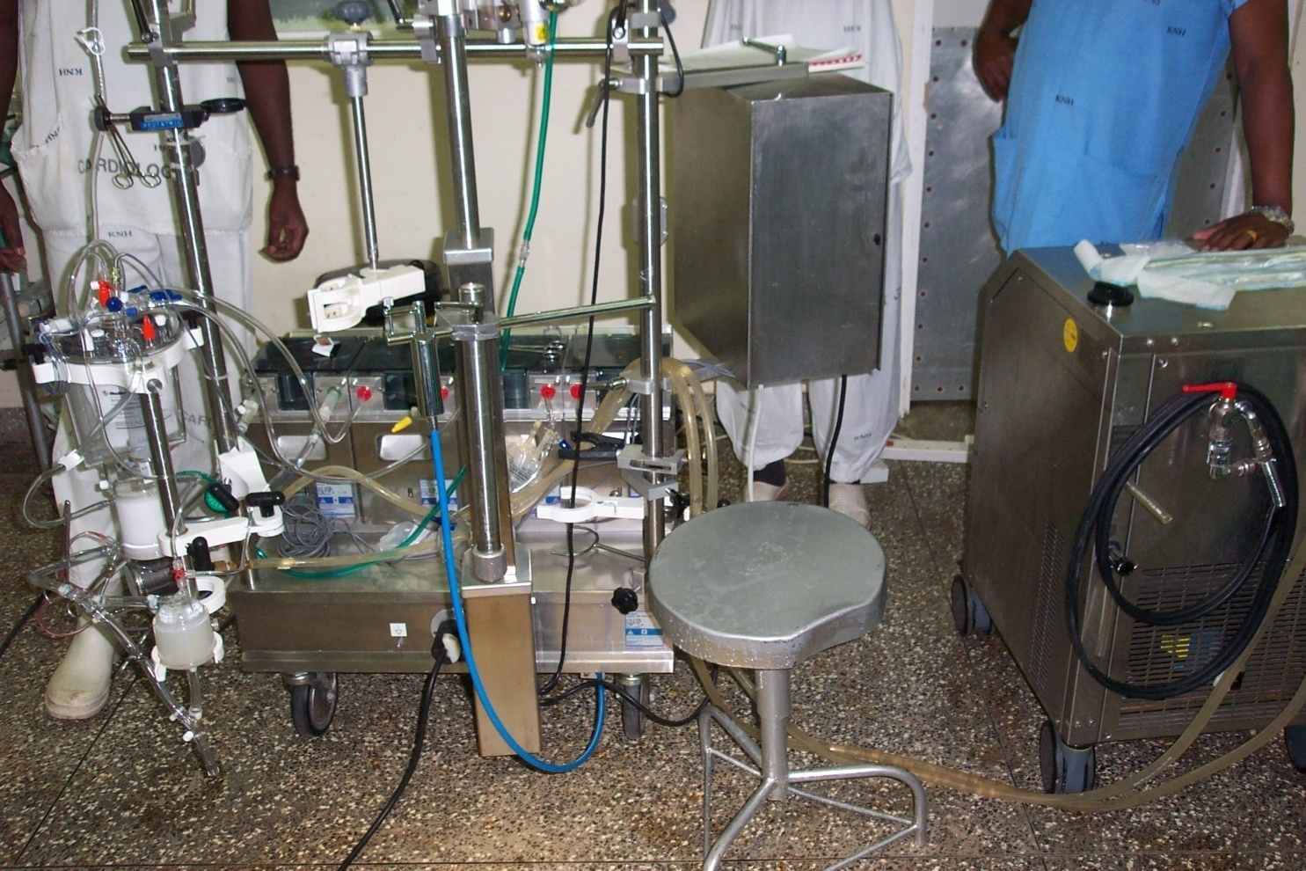
HEART LUNG MACHINE
Pumps
Oxygenator and heat exchanger
Thermoragulator

Slide 19
Preoperative preparation
Investigations
Preoperative workup + dental reviews
Psychological support
Anaesthetic review
Medication adjustment as required

Slide 20
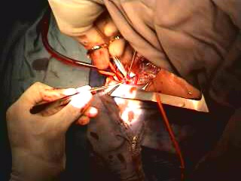
Connection To Heart Lung Machine
Arterial.
Aorta
Venous.
Inferior vena cava and superior vena cava
Right atrium
Femoral vein
Venous cannulation

Slide 21
Arresting The Heart
Cardioplegia.
Potassium as the arresting agent
Nutrients
Antiarrhythmic agent
Hypothermia
Both central and local
Reduced metabolism

Slide 22
Complications Of The Heart Lung Machine
Destruction of blood components (mechanical).
Microthrombi formation.
Protein denaturation.
Activation of complement system.

Slide 23
Valve Surgery
Valve replacement.
Valve repair.
Mitral valve
Aortic valve
Pulmonary valve
Valve dilatation now obsolete.

Slide 24
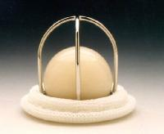
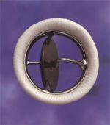
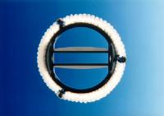
Types Of Valves Mechanical Valves
Peripheral flow
Ball and cage type
Starr-edwards
Tilting disc valve or monocusp
Medtronic hall
C e n t r a l f l o w
Bileaflet mechanical valve

Slide 25
Tissue Valves
Advantages.
Do not require lifelong warfarin
Ideal for young females and elderly patients
Follow-up not too critical as no warfarin needs
Disadvantages.
Not durable
Replacement after 5 – 10 years required for younger patients

Slide 26
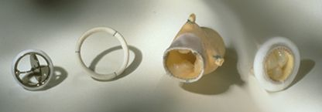
Homografts
Cadaver aortic roots.
Similar to tissue valves.
Long term results good.
Very good for elderly and aortic root replacement.
Aortic
Homograft

Slide 27
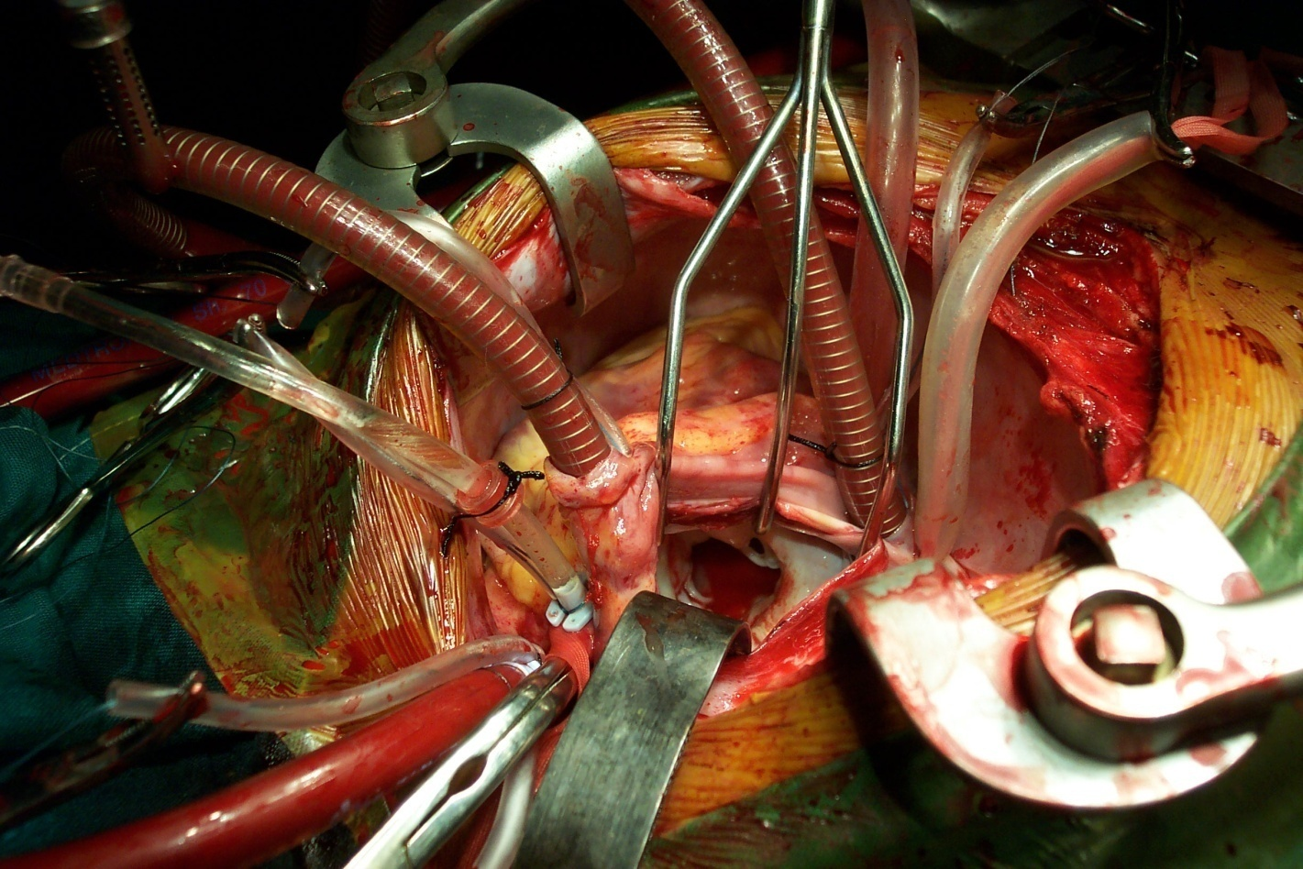
Mitral Incompetence
A wide open mitral orifice resulting in mitral valve incompetence

Slide 28
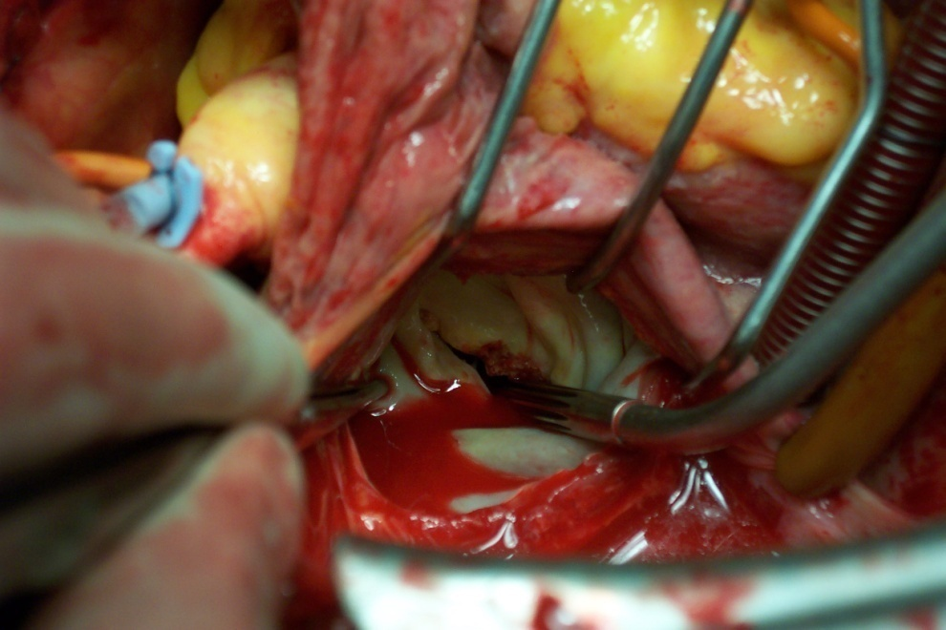
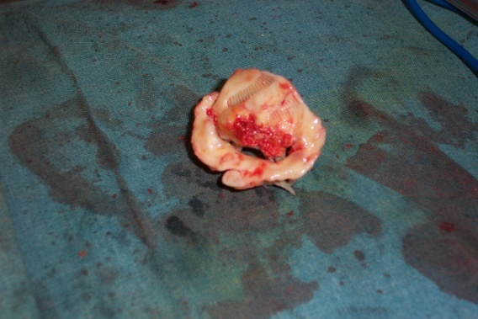
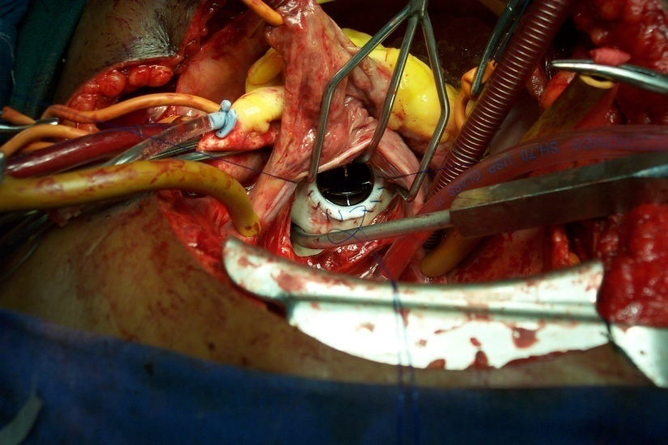
Mitral Stenosis
Excised valve
Tight mitral stenosis
Valve being sewn in place

Slide 29
Valve Repair
Advantage.
Natural tissue maintained
No anticoagulation needed
Allows safe pregnancy
Suitable for the elderly patient
Disadvantage.
Short lasting?

Slide 30
AETIOLOGY AND PROBABILITY OF MITRAL VALVE REPAIR
DEGENERATIVE 80%
ISCHAEMIC 70%
CONGENITAL 60%
RHEUMATIC 50%
INFECTIVE 25%

Slide 31
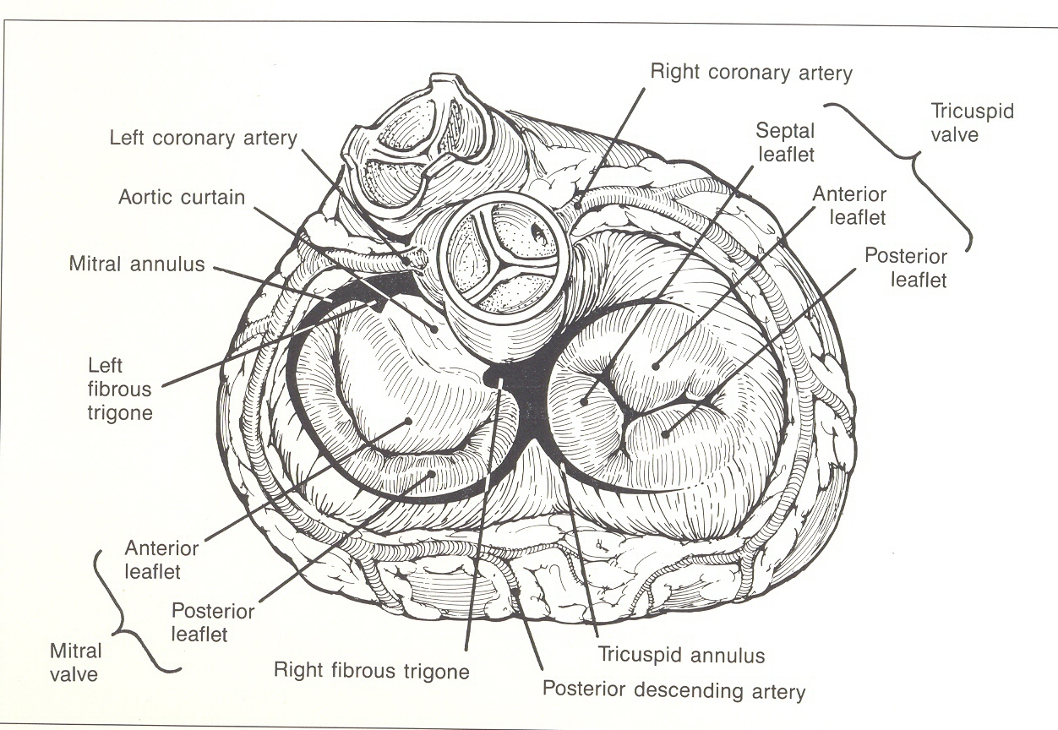
Relevant Anatomy 1

Slide 32
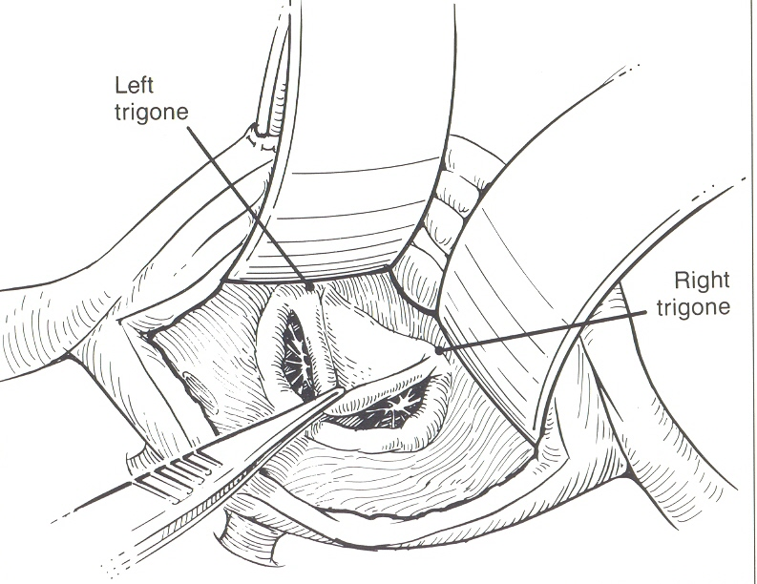
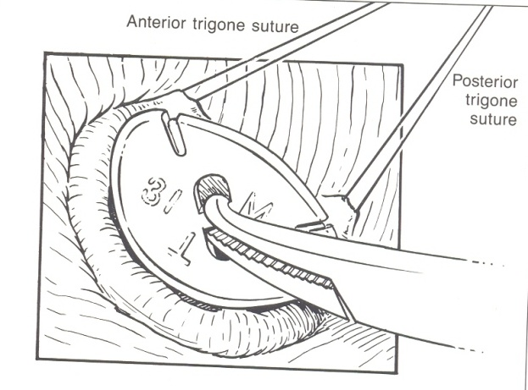
Relevant Anatomy 2
SIZER IN USE
DISTANCE BETWEEN TRIGON’S REMAINS FIXED THROUGHOUT. USED TO SIZE RING

Slide 33
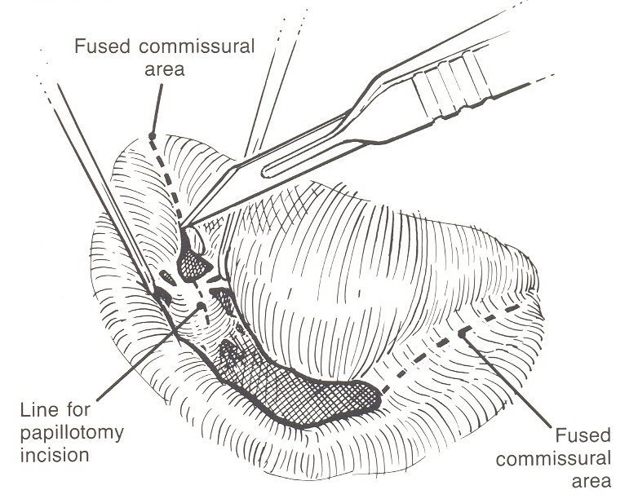
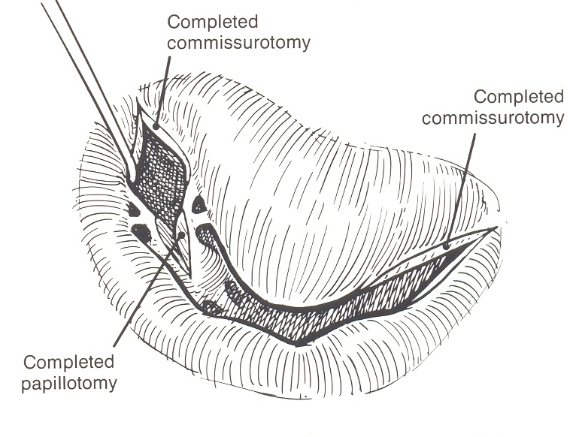
OPEN COMMISSUROTOMY
INCISE FUSED COMMISSURES

Slide 34
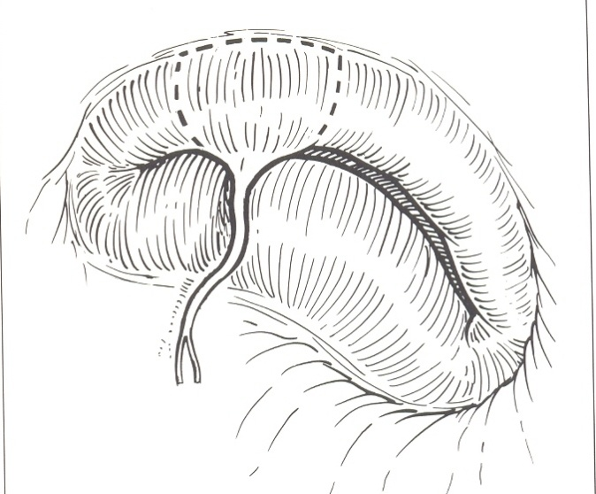
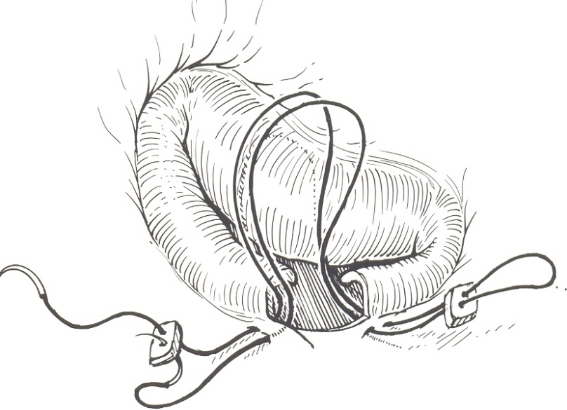
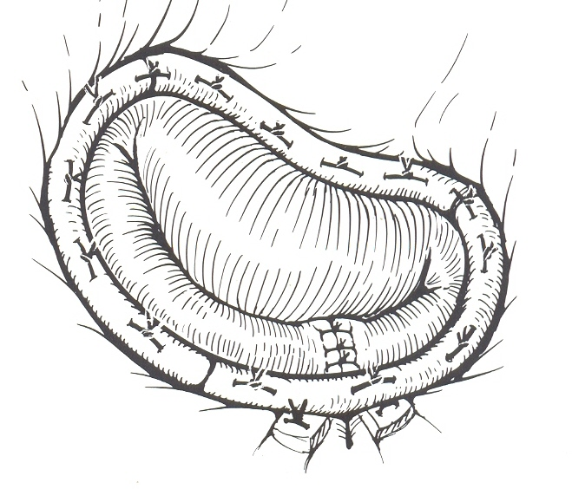
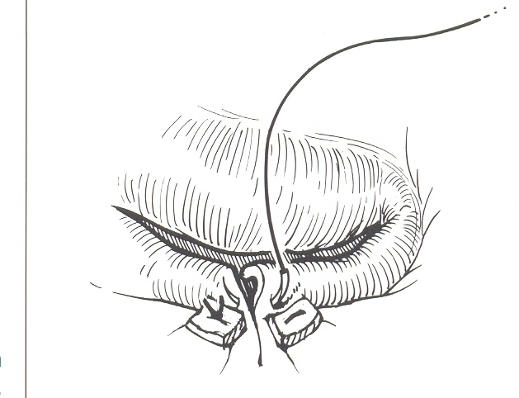
Leaflet Resection
A
B
C
D

Slide 35
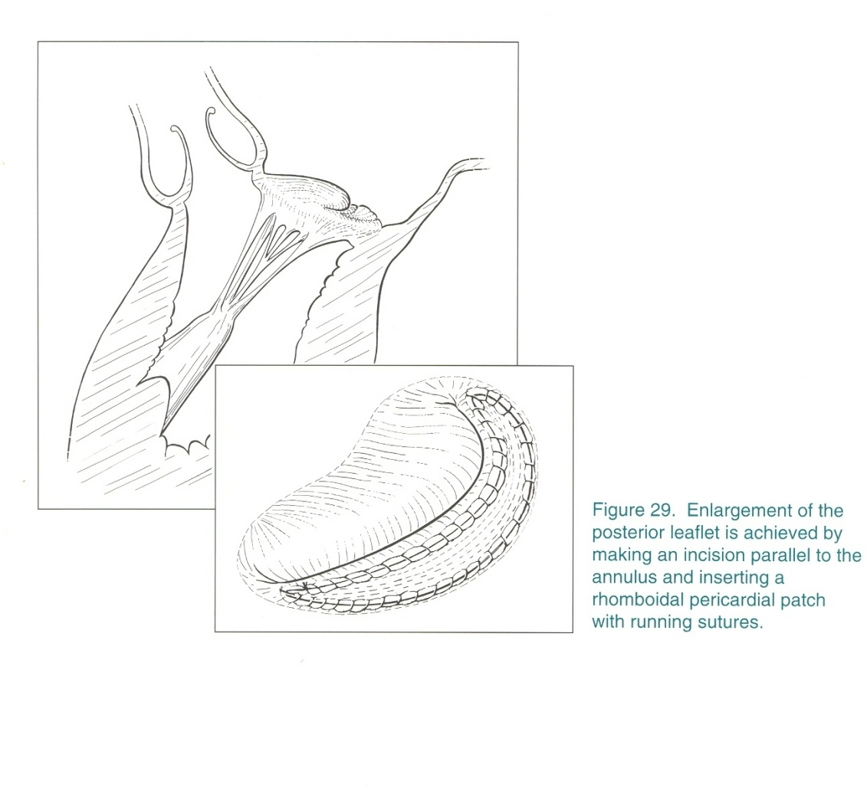
Leaflet Lengthening

Slide 36
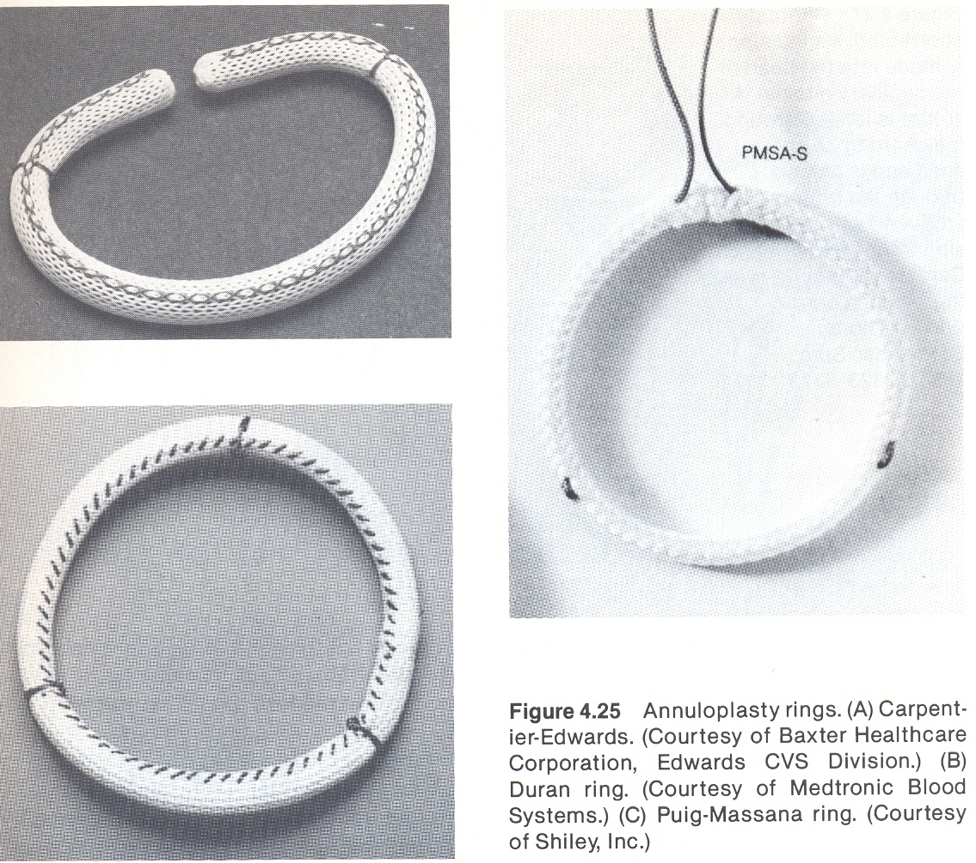
TYPES OF ANNULOPLASTY RINGS

Slide 37
Aortic Valve Surgery (Indications)
Stenosis.
<0.75cm² (and asymptomatic)
>80mmhg gradient across the valve
Angina
CCF
Syncope
Regurgitation.
Acute AR ± CCF
Angina or CCF
Left ventricular decompensation

Slide 38
Tricuspid Valve
Annuloplasty main procedure associated with mitral lesion.
Replacement rarely carried out.

Slide 39
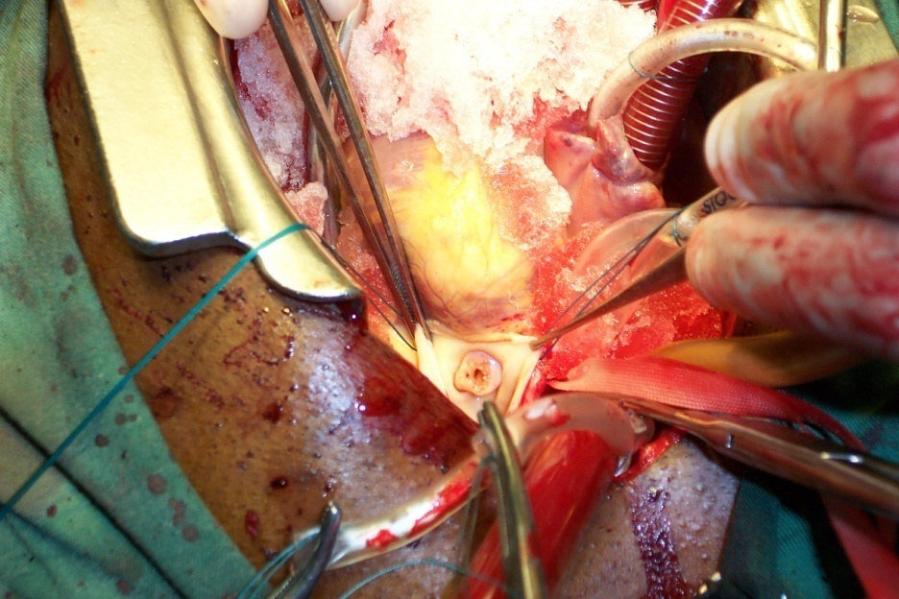
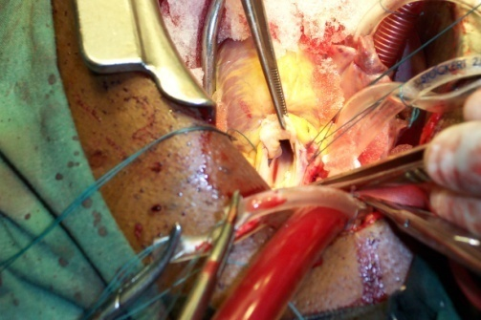
Pulmonary Valve Surgery
Pulmonary stenosis – valvoplasty an option.
Valve replacement in very rare situations.
Server pulmonary stenosis
Post valvoplasty

Slide 40
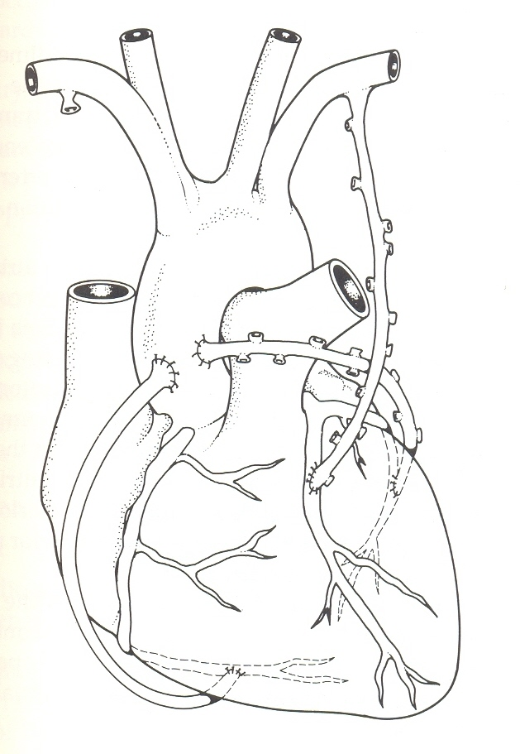
Coronary Surgery

Slide 41
Other Surgeries
Trauma of heart and vessels.
Neoplasm(s).
Conduction defects.
Cardiomyopathies?
Transplantation
Artificial hearts

Slide 42
Heart Transplant
End stage disease.
Cardiomyopathies
Eissenmenger’s
Heart transplant only.
Combined heart lung transplant.

Slide 43
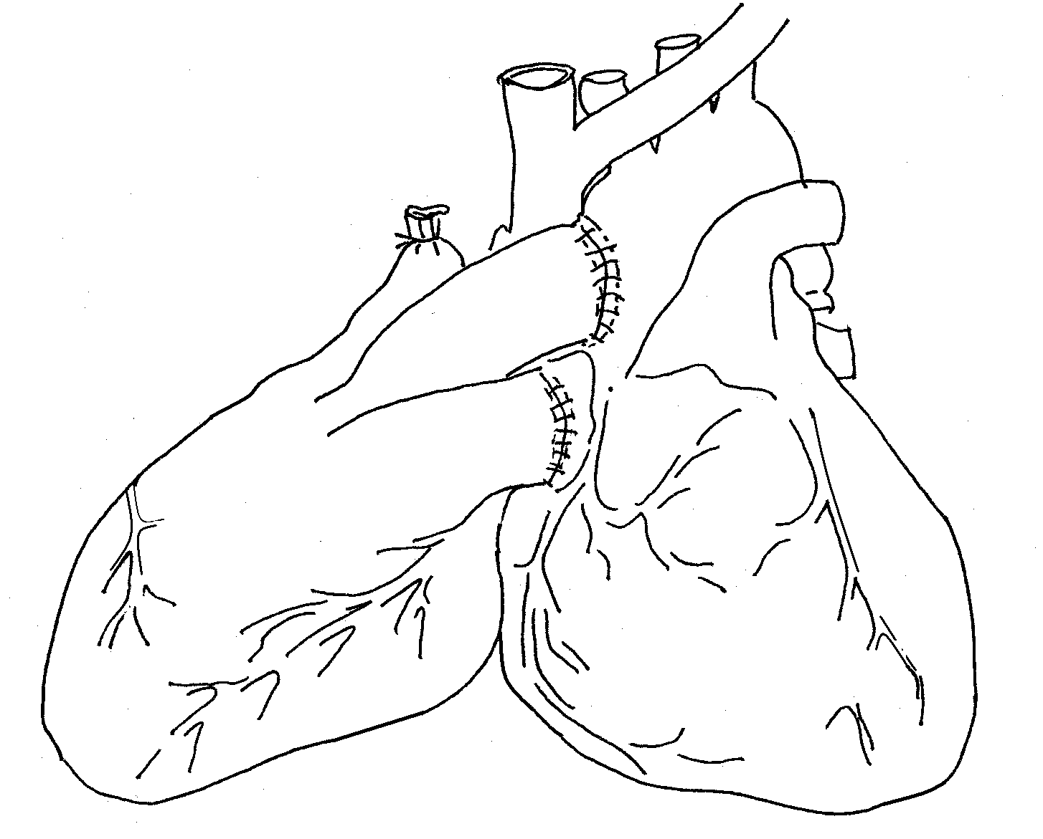
Types Of Heart Transplants
Orthotopic transplantation : Removal of diseased heart and replace with a healthy heart
Heterotopic : New heart piggy backed onto the old heart that is left in place.

Slide 44
Heart Transplantation, Why Not in Kenya?
Complex infrastructure not in place.
Networking and communications.
Legal framework not in place in Kenya.

Slide 45
Artificial Hearts
Shortage of donor hearts
Today centripetal pumps (small and portable)
Support the left, right or both ventricles. LVAD, RVAD and BVAD
Portable and battery operated
No ECG tracing

Slide 46
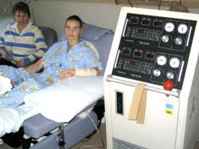
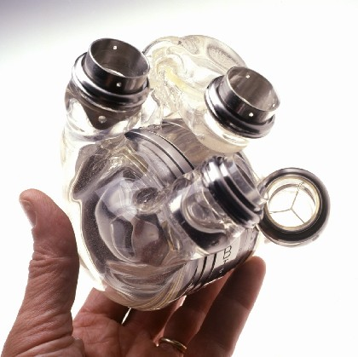
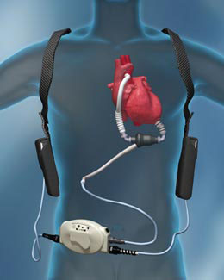
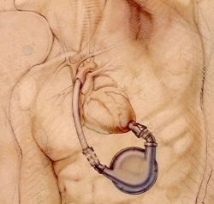
Different types of artificial hearts
Early days large and not mobile
LVAD
LVAD
Total artificial heart

Slide 47
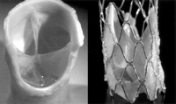
WHAT DOES THE FUTURE HOLD
Cardiac interventional laboratory.
Percutanious valve replacements.
Pulmonary valve
Aortic valve
Tissue cultures for new valves.
Aortic valve mounted on stent for percutaneous insertion

Slide 48
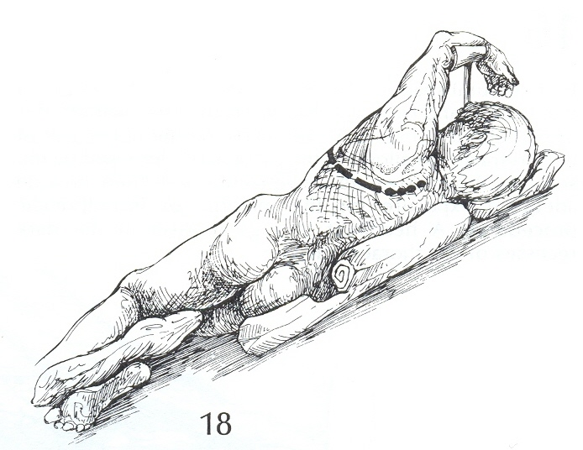
LATERAL THORACOTOMY
IDEAL FOR LUNG AND OESOPHAGEAL SURGERY
POSTERO-LATERAL THORACOTOMY
RIGHT SIDE
LEFT SIDE
MOST COMMON FOR LUNG AND OTHER MEDIASTERNAL SURGERIES LIMITED TO ONE SIDE

Slide 49
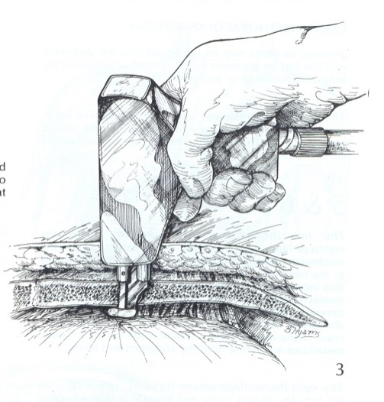
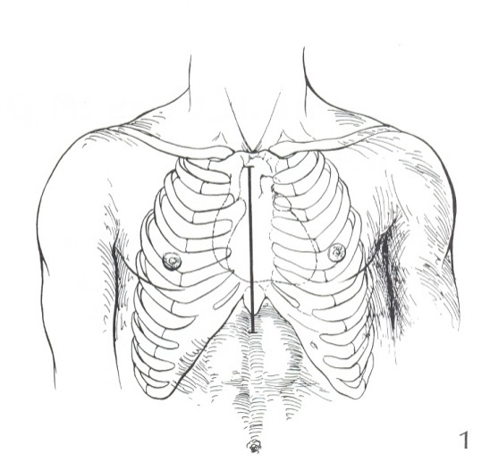
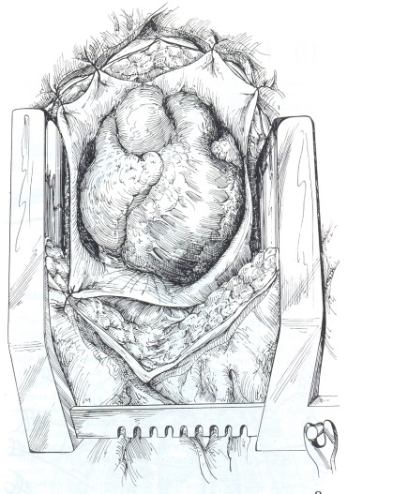
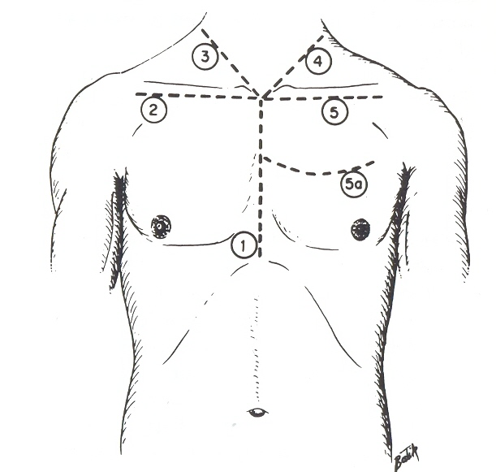
STERNOTOMY (ANTERIOR THORACOTOMY)
INCISION FROM SUPRASTERNAL NOTCH TO XYPHOID
SUITED FOR CARDIAC SURGERY
ANTERIOR MEDIASTERNAL MASSES
BILATERAL EXPOSURE OF PLURAE
LIMITERD STERNOTOMY FOR TYMECTOMY
STERAL SAW TO INCISE STERNUM
FINAL VIEW OF ANTERIOR MEDIASTERNUM
EXTENSIONS FOR GREAT VESSEL SURGERY

Slide 50
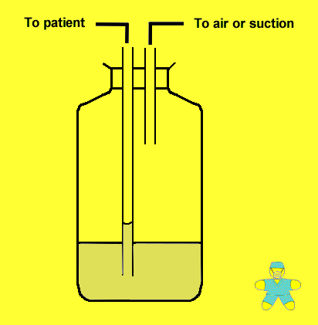
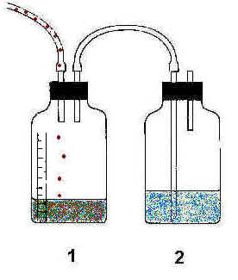
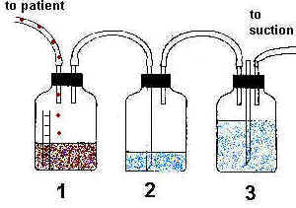
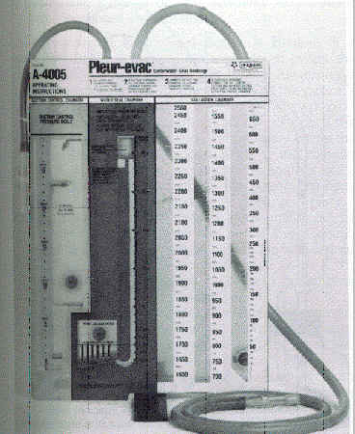
COMPONENTS OF THE UNDER WATER SEAL DRAINAGE SYSTEM
A
B
SINGLE TUBOR EDWARDS BOTTLE SYSTEM
SEPARATE RESERVOIR AND SEAL
CHEST TUBE
CONNECTING TUBE
BOTTLE
FLUID FOR SEAL
?SUCTION MECHANISM
D
C
THREE BOTTLE SYSTEM WITH CONTROLLED SUCTION
COMMERCIAL SYSTEM

Slide 51
Future
Valve replacement via percutanious route
Endoscopic, off pump coronary artery bypass grafting – 2004
Remote robotic surgery
?Do it yourself cardiac procedures from Uchumi or Nakumatt

