Slide 1
APPROACH TO THE CHILD WITH MALOCCLUSION
Dr. Nathan k. Psiwa

Slide 2
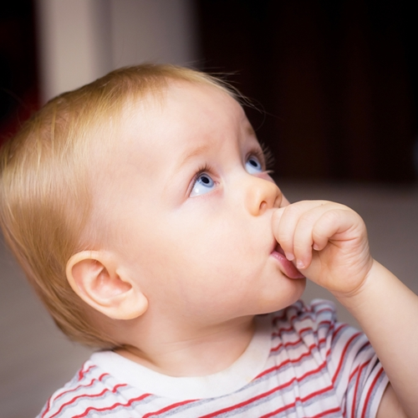
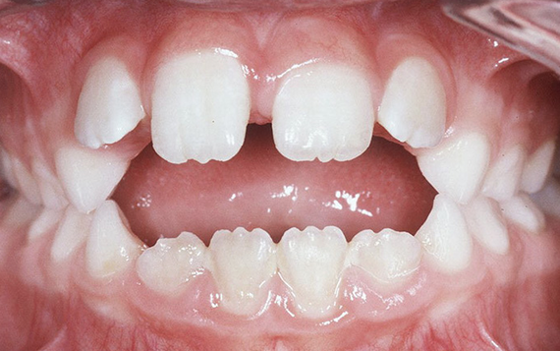

Slide 3
OBJECTIVES OF THE LECTURE
Dentists and Medics must acquire a number of skills to provide a patient with early detection or diagnosis of a malocclusion (orthodontic diagnosis).
Clinicians must recognize normal occlusion and normal facial morphology, differentiate from abnormal.
Additionally for Dentists must know when to treat and when to refer patients with malocclusions to an Orthodontic specialist or Orthodontist..

Slide 4
PATIENT’S CHIEF COMPLAINTS
The parent, guardian or parent will most likely complain of one or more of the following:
Teeth are crooked/ crowded/ not aligned well.
My bite is not correct, I bite my cheek etc.
In cannot close my teeth/mouth
People make fun of my teeth/ funny names etc
My face is not balanced, asymmetric
Aesthetic concern overrides function.
Psychosocial well being is a primary concern.
Self esteem is a key benefit.
NOTE THE ABSENCE OF DISEASE, PAIN AND OTHERS..

Slide 5
INTRODUCTION TO NORMAL OCCLUSION AND MALOCCLUSION
Occlusion is the way the maxillary and mandibular teeth articulate or relate.
The teeth relate in all dimensions of space:
Antero-posterior AP/Sagittal
Transverse
Vertical dimensions (VD).
Malocclusion therefore occurs in the above 3 planes of space.

Slide 6
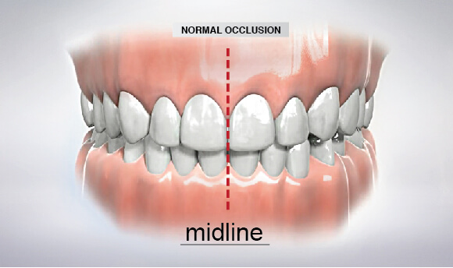
NORMAL OCCLUSION
There is good alignment of the teeth, normal overbite and over jet and coincident maxillary and mandibular midlines.

Slide 7
NORMAL OCCLUSION
Normal occlusion occurs frequently in a population, whereas ideal occlusion is rarity. It represents minor variations around the mean value.
It includes some variations in tooth positions and relationships that diverge in minor ways from the ideal.
They are aesthetically acceptable and functionally stable, with least amount of destructive interferences.

Slide 8
MALOCCLUSION
Malocclusion is the word used to describe a variety of problems involving misalignment of the bite and teeth.
A malocclusion is a malalignment, improper or incorrect relation between the teeth of the two dental arches when they approach each other.
Malocclusions are very common, and an orthodontist can treat these issues to help you have a winning smile.

Slide 9
FREQUENCY OF MALOCCLUSIONS
Varies among different ethnic groups
Class I malocclusions which are variations of normal occlusion are the commonest. It afflicts about 80% of the population, mainly Blacks and Americans of same descent.
Class II about 15-20% of the population commonest in the Europeans.
Class III has a higher incidence in Caucasians- Japanese and Chinese 1-14%.

Slide 10
TYPES OF MALOCCLUSIONS
DENTAL and
SKELETAL MALOCCLUSIONS
Dental malocclusions- the upper and lower jaws are normal or line up well / orthognathic but the teeth are: Crooked, Crowded, Turned / rotated, Spaced apart, Open bite, deep bite. They may present with Tooth size discrepancies or missing teeth or associated with Congenital anomalies like cleft lip/ Palate.

Slide 11
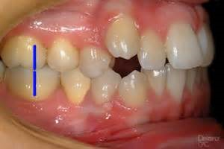
FEATURES OF DENTAL MALOCCLUSIONS
Crowding of teeth
Gingival health not good.

Slide 12
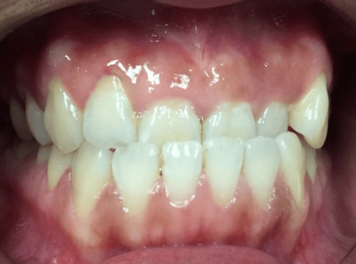
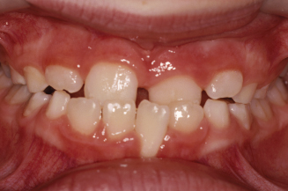
Anterior Cross bite

Slide 13
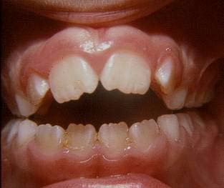
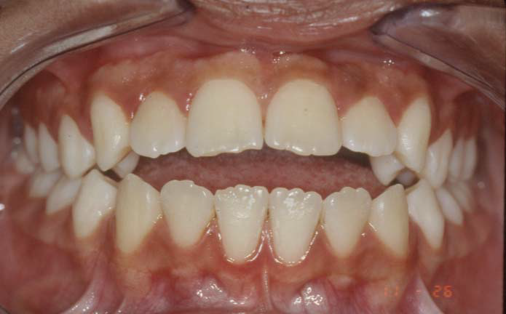
Anterior Open Bite
Thumb/ Digit sucking habit
Tongue thrust habit

Slide 14
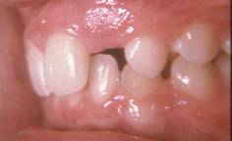
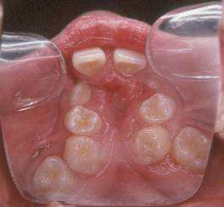
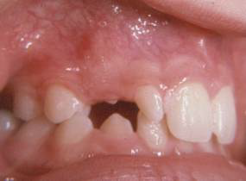
Some situations in Class I Malocclusion: Missing, peg-shaped lateral Incisors Cleft lip/ Palate

Slide 15
SKELETAL MALOCCLUSIONS
The jaws are not lined up or a discrepancy exists, more commonly the upper jaw is prognathic, normal, lower small or retrognathic jaw etc and vice versa.
The jaw discrepancies have dental and jaw compensations.. To reduce the severity and camouflage the malocclusion. Hence compensated malocclusions.

Slide 16
FEATURES OF SKELETAL MALOCCLUSIONS
Include:
Increased overjet,
Increased overbite or deep bite
Proclination of teeth
CLASS II MALOCCLUSIONS

Slide 17
SKELETAL MALOCCLUSION
Features:
Reduced or reversed overjet
Edge to edge bite
Lower anterior teeth retroclined.
CLASS III MALOCCLUSION

Slide 18
DENTAL COMPENSATIONS IN SKELETAL MALOCCLUSIONS
Skeletal malocclusions are compensated malocclusions.
These dental and jaw compensations tend to make the dental discrepancy less severe i.e. camouflage the malocclusion.

Slide 19
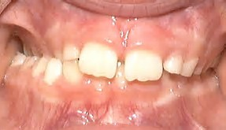
TRANSVERSE MALOCCLUSION
Posterior Cross bite

Slide 20
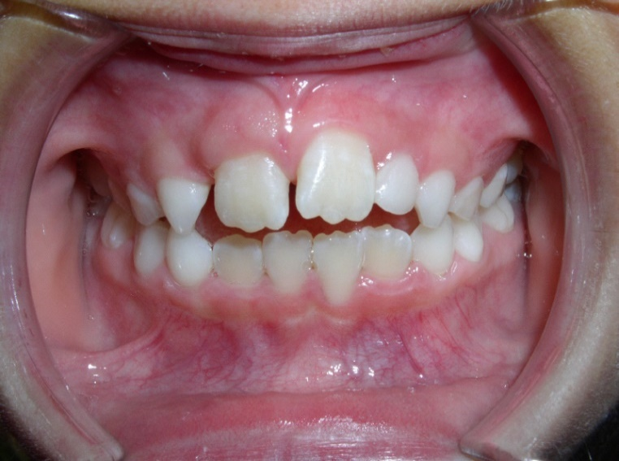
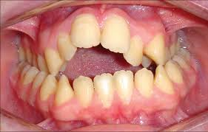
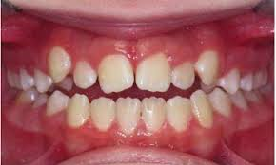
VERTICAL MALOCCLUSIONS OPEN BITES

Slide 21
AETIOLOGY OF MALOCCLUSIONS
Generally there are multifactorial
Heredity –largely for Class III malocclusions and syndromic cases.
Environmental – e.g. habits and mouth breathing.
Localized conditions where one or more teeth are abnormally related to that of the opposing side.
Tooth size discrepancies (Bolton ratios).

Slide 22
SOME OF THE SYMPTONS OF MALOCCLUSION
Typical symptoms of malocclusion include:
Improper alignment of the teeth
Alteration in the appearance of the face
Frequent biting of the inner cheeks or tongue
Discomfort when chewing or biting
Speech problems, including the development of a lips
Breathing through the mouth rather than the nose

Slide 23
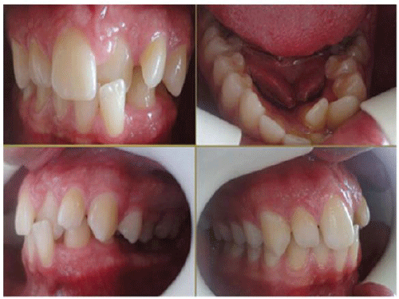
AESTHETICALLY NOT PLEASING

Slide 24
WHY TREAT A MALOCCLUSION?
Malocclusions occur quite frequently, in most societies it will average about 70-80% for Class I, 15- 20% Class II and 1- 3% Class III malocclusions
Malocclusion has important impact on the function and esthetics of the patient.
Malocclusion has a detrimental on the self- esteem of many children, adolescents and adults.

Slide 25
WHY EARLY ORTHODONTIC TREATMENT
Objectives are:
Preventing progressive, irreversible, soft tissue and bony changes.
Improving skeletal discrepancies and providing a more favorable environment for future growth
Improving Occlusal function
Simplifying late comprehensive therapy and minimizing the need for orthognathic surgery
Providing more pleasing facial aesthetics, thus improving the psychological development of the child.

Slide 26
ASSESSMENT OF MALOCCLUSION
Recognize malocclusion in an initial examination or screening and report the discovery to a patient or parent.
Refer the patient to a fully trained colleague.
Care giver develop a diagnosis from the records.
Develop a treatment plan.
Consult with the patient and parent about diagnosis and treatment plan.
Treatment begins after an agreement has been made by all parties at the consultation appointment.

Slide 27
DIAGNOSTIC AIDS
The following diagnostic aids are necessary:
Case history
Clinical examination
Study models
Radiographs:
a. Periapical radiographs
b. Lateral cephalogram
c. Orthopantomograms (OPG)
d. Bitewing radiographs
5. Facial photographs

Slide 28
Orthopantomogram OPG X-Ray

Slide 29
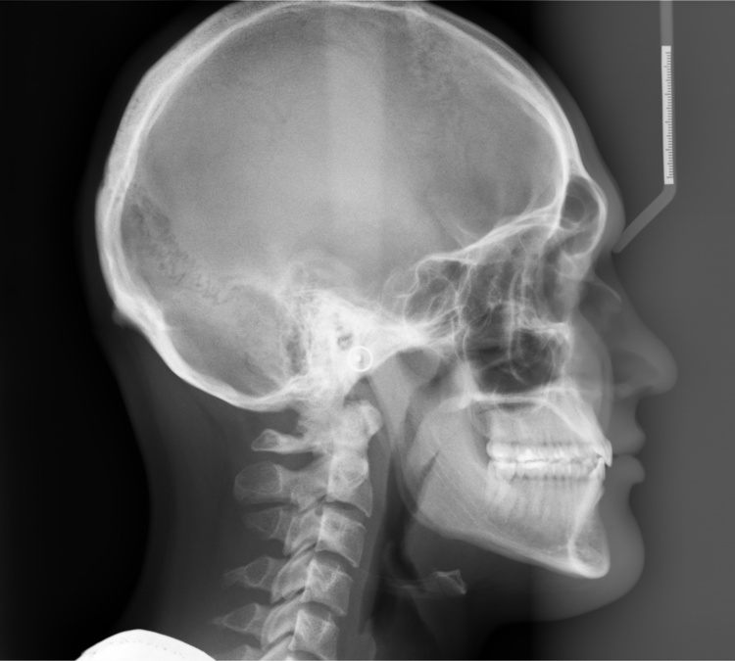
Lateral Cephalogram X Ray

Slide 30
DIAGNOSIS
It involves the development of a comprehensive and concise database of pertinent information, sufficient to understand the patient’s problem as well as well as answer questions arising in the treating clinicians mind.

Slide 31
MANAGEMENT OF THE ORTHODONTIC PATIENT
Malocclusions are treated with:
Fixed appliances in comprehensive therapy
Interceptive/ Early Treatment e.g. habit breaking appliances, fixed appliances.
Dentofacial orthopaedics or Growth modification procedures e.g. headgears, functional appliances
Orthognathic Surgery in adulthood in severe skeletal cases.

Slide 32
TREATED MALOCCLUSION
Keeping good records of all the patients treated before and after treatment is paramount.
Discuss the completed case with the patient and parent by display before and after records and evaluate the changes attained.

Slide 33
CONCLUSION
Recognition and reporting of a malocclusion or a condition that could lead to a malocclusion in a child is the most important orthodontic service that you can provide to your patients.

