Slide 1
INTRODUCTION TO DENTAL AND ORAL PATHOLOGY FOR MBCHB 6
DR EAO DIMBA (BDS, MBA, PHD, FRB)
ORAL PATHOLOGY, ORAL MEDICINE

Slide 2
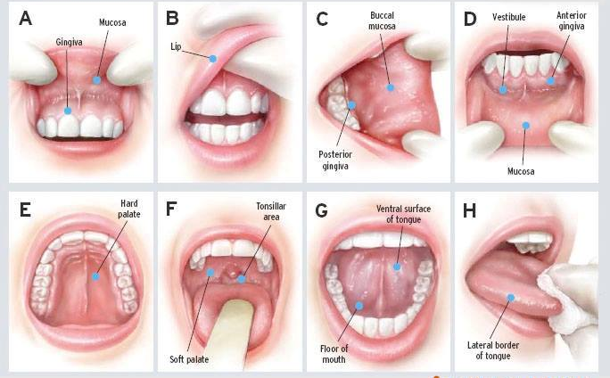
THE INTRA-ORAL EXAMINATION

Slide 3
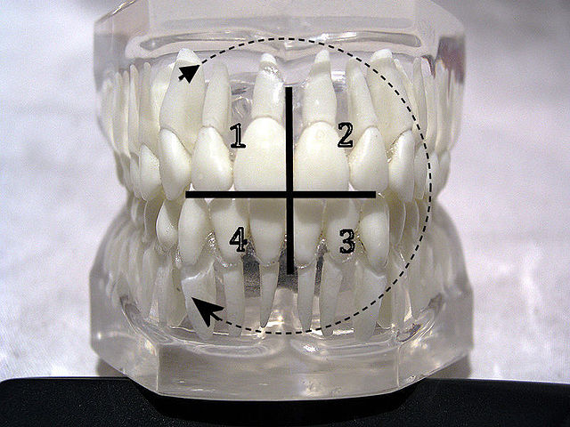
INTRA-ORAL EXAM FDI SYSTEM (2)
M M M PM PM C I I
18 17 16 15 14 13 12 11
M M M PM PM C I I
48 47 46 45 44 43 42 41
I I C PM PM M M M
21 22 23 24 25 26 27 28
I I C PM PM M M M
31 32 33 34 35 36 37 38

Slide 4
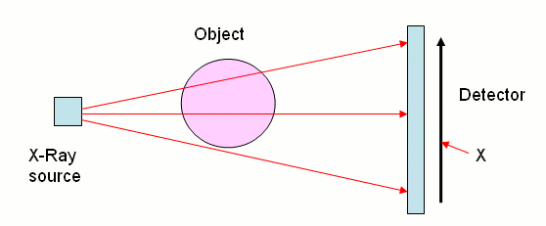
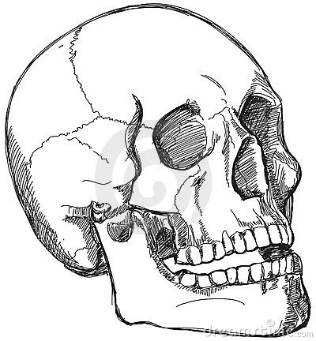
PART 1: PRINCIPLES OF IMAGING

Slide 5
Plain radiographs – 1st line
PLAIN RADIOGRAPHY: Details in radiology lecture series.
CONTRAST RADIOGRAPHY: Use of contrast agents/ radio opaque substances which when artificially introduced into the body will alter the contrast of tissues.
SIALOGRAPHY: Introduction of a contrast agent containing iodine for visualizing the ductal system of parotid/submandibular glands.
Indications: Ductal obstruction, Sjogren’s Syndrome.
Contraindications: Acute sialadenitis, Salivary masses.
ANGIOGRAPHY: A catheter is inserted into the artery (usually external carotid) and a fluoroscope (fluorescent dye) introduced into the vasculature. Indications: haemangiomas, arteriovenous malformations & suspected intracranial bleeding.
TMJ ARTHROGRAPHY: Introduction of radiographic contrast into the joint space. This procedure has largely been replaced by MRI because of the degree of patient discomfort.

Slide 6
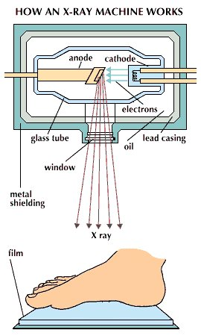
Simple radiography
ATTENUATION

Slide 8
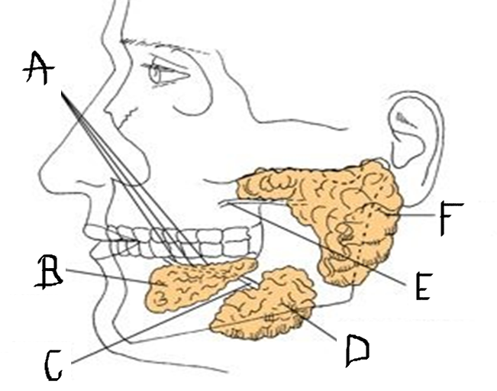
Contrast radiography – sialogram anatomy

Slide 9
Contrast radiography – sialogram anatomy
A – Bartholin’s (Rivinus) duct
B – Sublingual gland
C – Wharton’s duct
D – Submandibular gland
E – Stensen’s duct
F – parotid gland

Slide 10
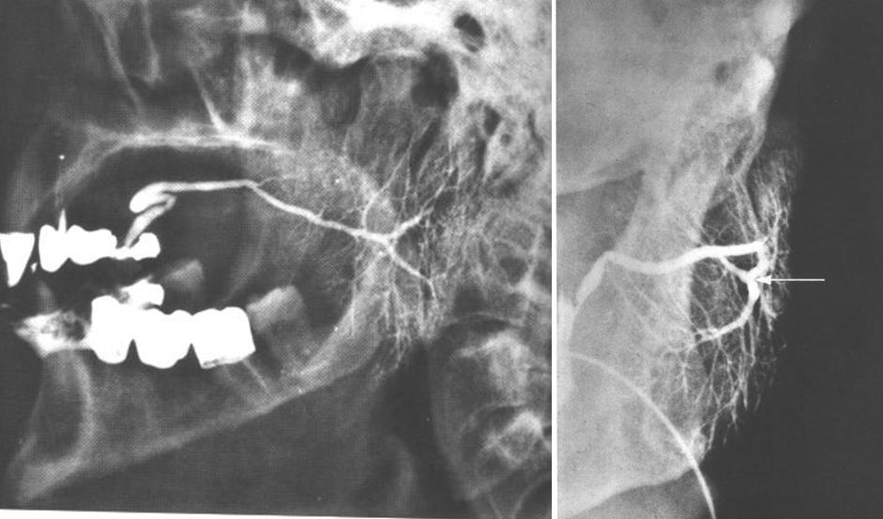
Sialogram

Slide 11
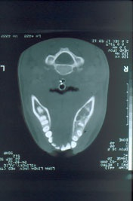
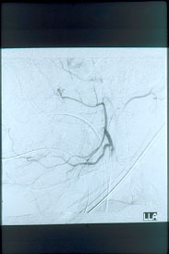
Angiogram

Slide 12
TOMOGRAPH = LOOKING AT MORE THAN ONE DIMENSION
CONVENTIONAL TOMOGRAPHY: Machinery similar to a panoramic unit but has a greater range of movement; able to image the tissue in slices.
COMPUTED TOMOGRAPHY (CT): A radiograph tube passes in a circle around the body. A series of detectors will measure the degree of attenuation (blocking) by the tissues. This value is then transformed into a numerical value (Hounsfield number) and then digitally reconstructed into a graphic image. Indications: Mid facial trauma and bone diseases.

Slide 13
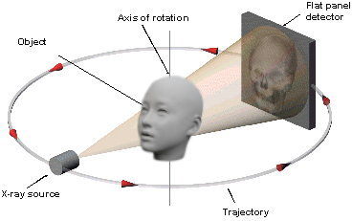
Tomography

Slide 14
OPG ANATOMY 1

Slide 15
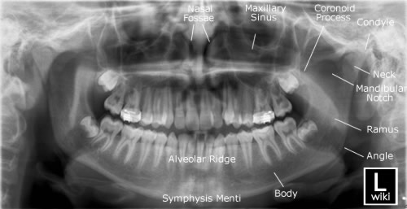
OPG ANATOMY 2

Slide 16
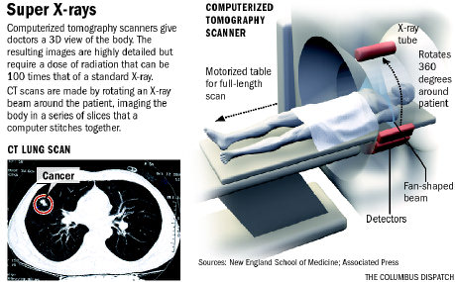
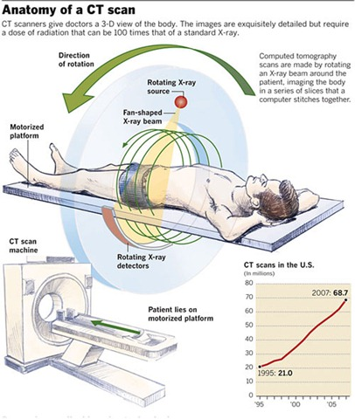
Computerized tomography

Slide 17
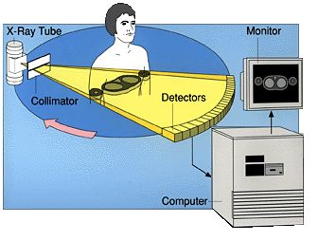
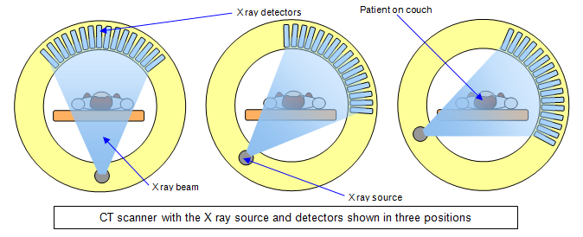
CT scan – rotation of Xray source

Slide 18
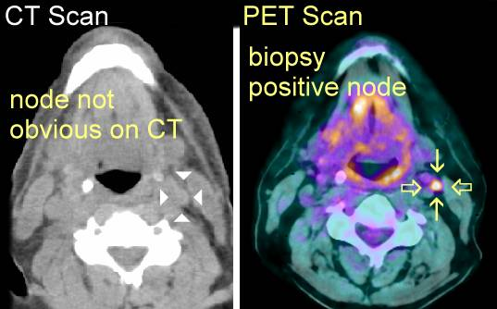
CT SCAN
A PET scan uses radiation, or nuclear medicine imaging, to produce 3-dimensional,
color images of the functional processes within the human body.
PET stands for positron emission tomography.

Slide 19
MAGNETIC RESONANCE IMAGING (MRI)
The patient is placed in a strong magnetic field and subjected to pulses of radio waves which are at frequencies that are known to impart energy to the hydrogen protons present in body fluids. The protons will then emit a radio signal that is detected and processed by computer.
Indications: Soft tissue detail.
Excellent for tumour staging.
Intracranial diseases.
Temporomandibular joint BUT useless for bone lesions.
Contra indications: Patients with pacemakers.
Ear implants.
1st trimester of pregnancy.
Ferromagnetic surgical clips.

Slide 20
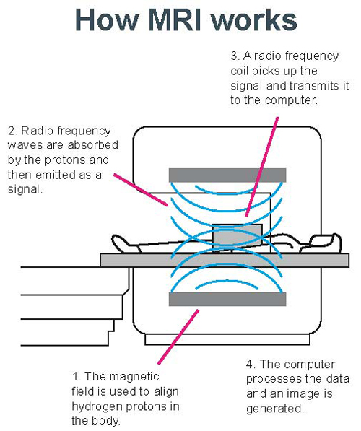
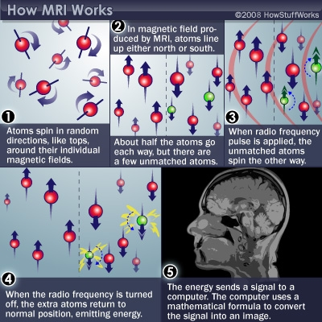
Magnetic resonance imaging

Slide 21
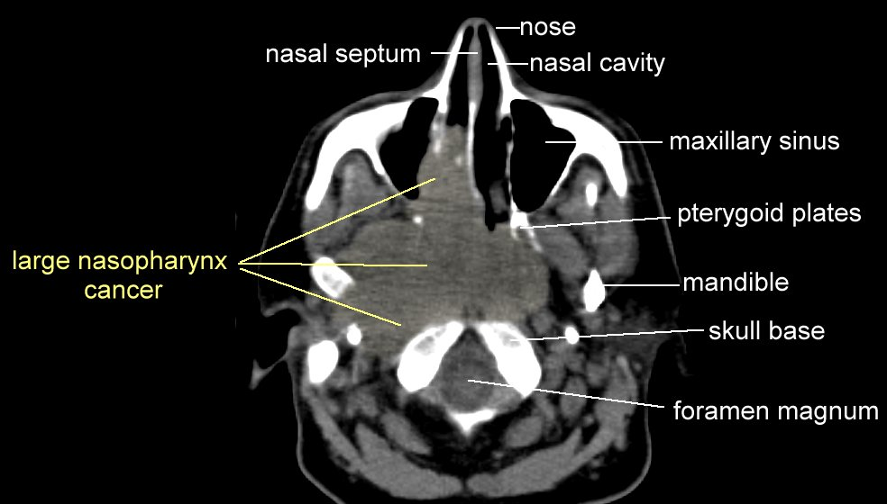
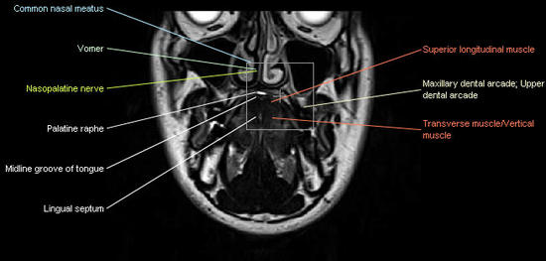
MRI

Slide 22
ULTRASONOGRAPHY
The patient is scanned with waves produced by a high frequency transducer (1 – 10 MHz). Various interfaces within tissue will reflect waves back to the machine; which restructures an image depending on the time taken to receive the reflected wave. Indications: Superficial soft tissue structures eg salivary glands, thyroid.

Slide 23
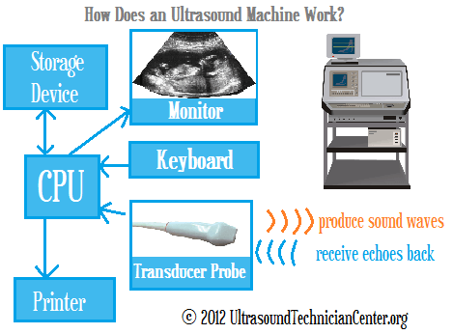
Ultrasound

Slide 24
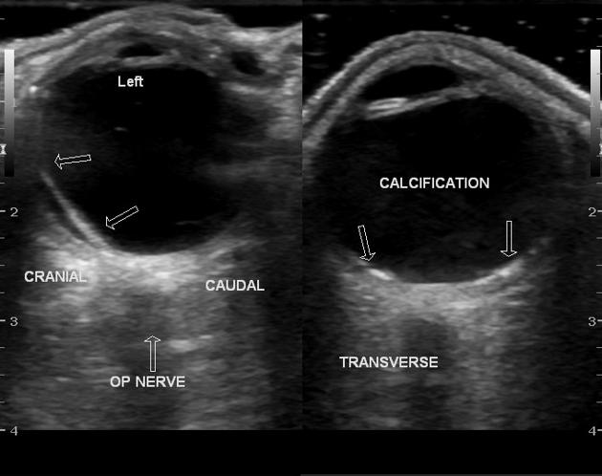
Ultrasound of the eye

Slide 25
NB: NO MNEMONICS IN THE PATIENT FILES!
/ ALLERGY
/ IDIOPATHIC

Slide 26
WHITE PIGMENTATION

Slide 27
CANDIDIASIS: Candida Albicans, a dimorphic fungus

Slide 28
LEUKOPLAKIA: a potentially malignant lesion (0 – 15% risk)

Slide 29
HAIRY LEUKOPLAKIA: Dual aetiology, EBV & HIV

Slide 30
RED/WHITE PIGMENTATION & OTHERS

Slide 31
LICHEN PLANUS: an oral & dermal condition – HLA incompatibility

Slide 32
JAUNDICE: Pre-hepatic, hepatic & post-hepatic classification

Slide 33
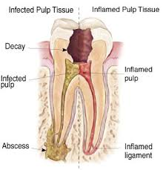

Slide 34
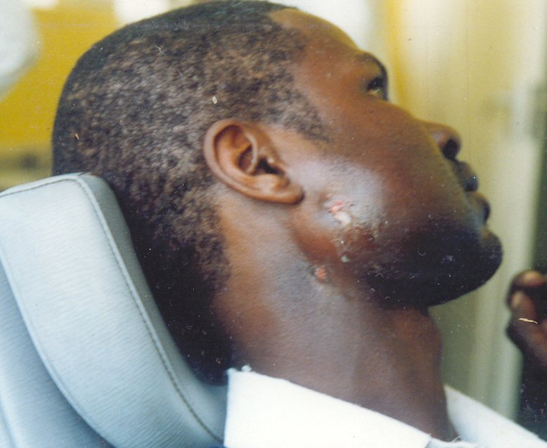
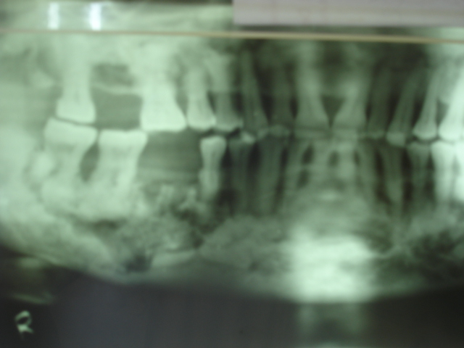
OSTEOMYELITIS: Infection extending into cortical and cancellous bone
Sequestrum
Pathological
fracture

Slide 35
TRISMUS: Limited mouth opening due to spasm to medial & lateral pterygoids

Slide 36
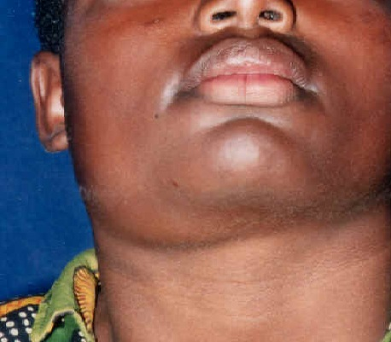
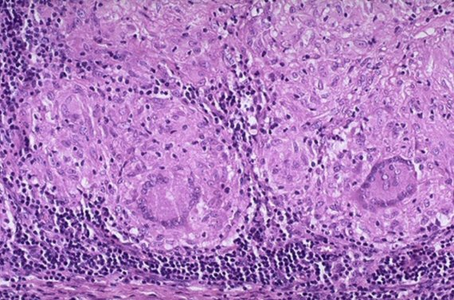
SCROFULA: TB adenitis caused by M. Bovis; M. Tuberculosis; atypical mycobacteria

Slide 37
NECROTIZING FASCITIS: Infection may track from the dental tissues into fascia

Slide 38
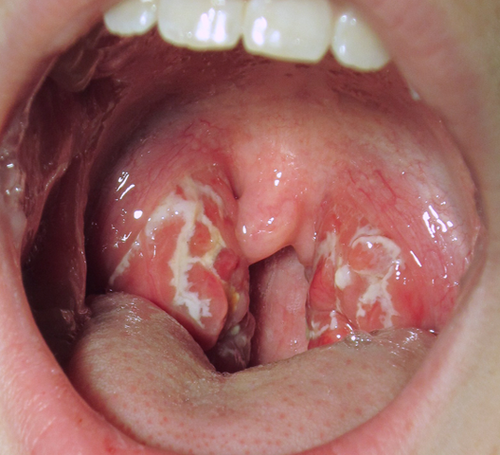
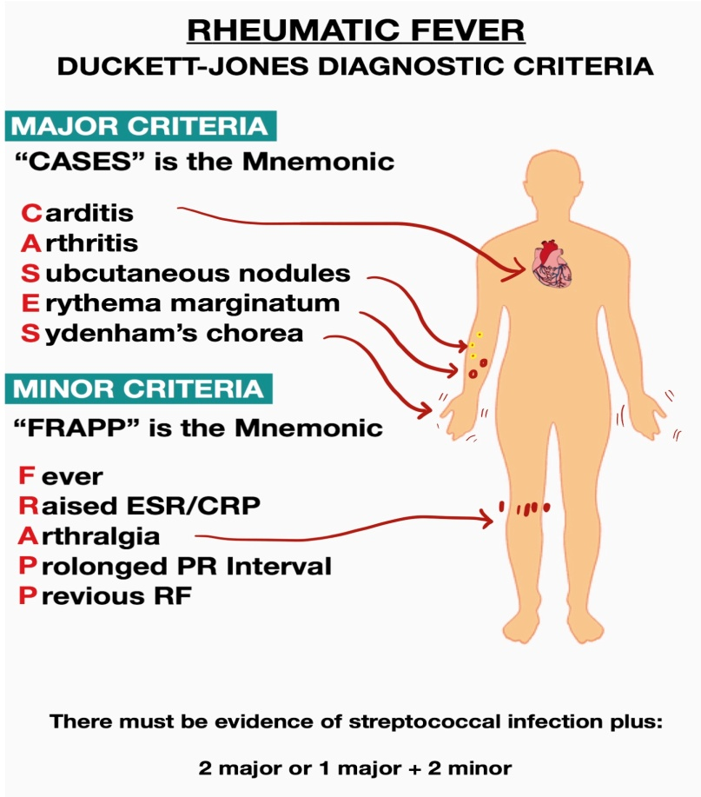
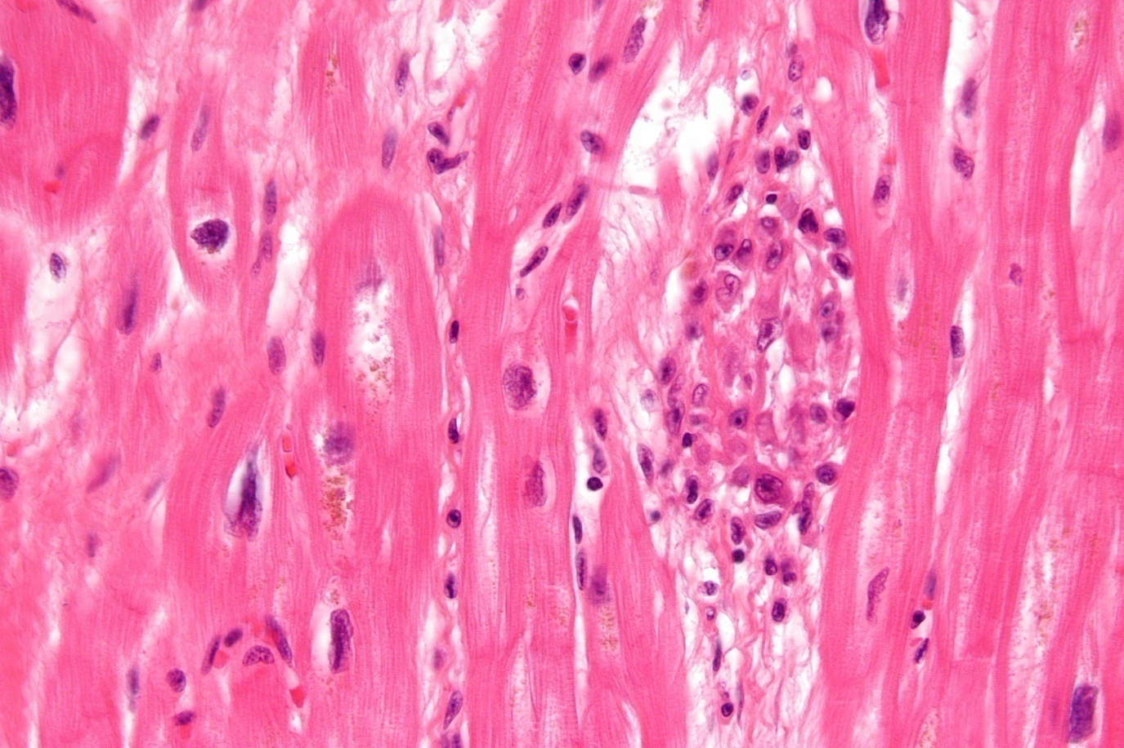
RHEUMATIC HEART DISEASE: a consequence of untreated strep throat
A
B

Slide 39
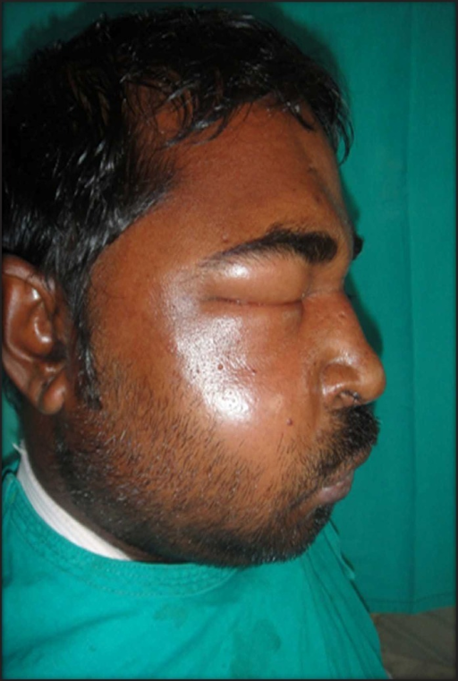
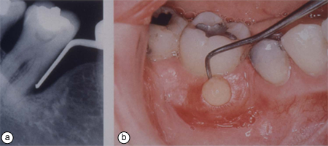
ABSCESS VS. CELLULITIS

Slide 40
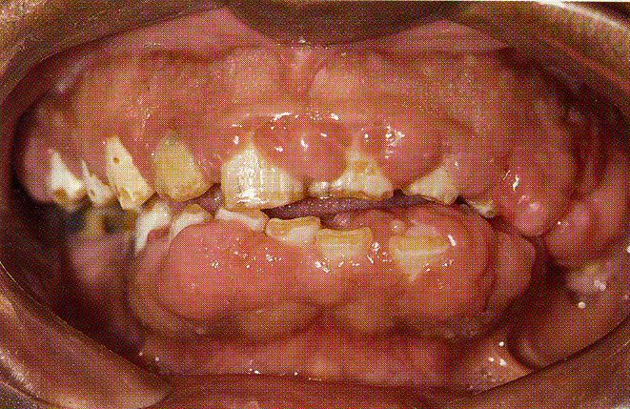
PERIODONTITIS

Slide 41
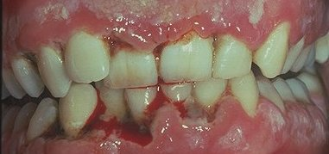
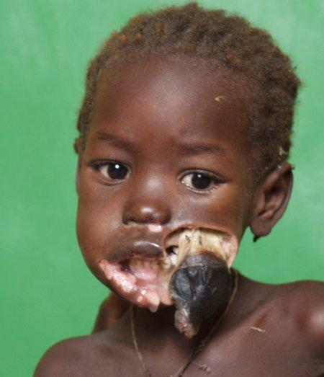
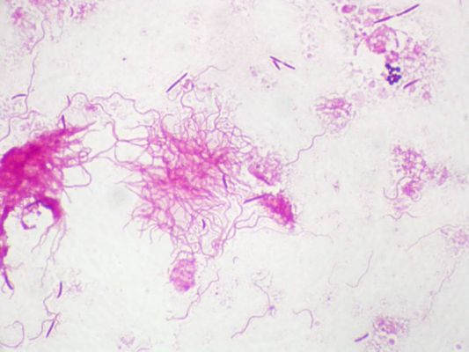
CANCRUM ORIS Necrotizing stomatitis
A
B
FUSO-SPIROCHAETAL COMPLEX

Slide 42
GROWTHS/ DEVELOPMENTAL ANOMALIES

Slide 43
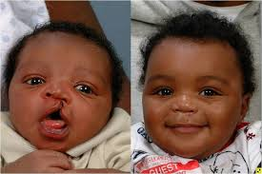
CLEFTS OF THE LIP AND PALATE

Slide 44
MANAGEMENT OF CLEFT LIP/ PALATE

Slide 45
GINGIVAL GROWTHS (EPULIS)

Slide 46
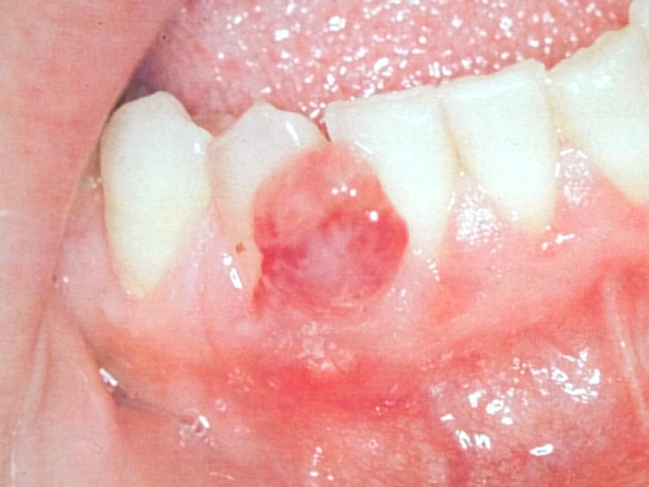
VASCULAR EPULIS

Slide 47
RECURRENT ORAL ULCERS

Slide 48
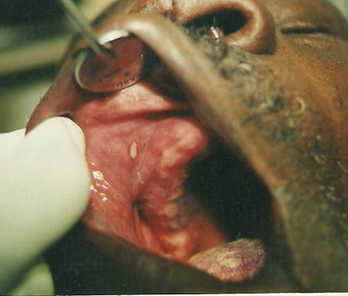
APHTHOUS ULCERS
Minor < 5 mm diameter, 5 - 10
Major > 5 mm diameter, 1 - 5
Herpetiform: approx 3 mm; up to 100

Slide 49
HERPES VIRUSES
HHV1: Herpes labialis
Latency in the Gasserian ganglion

Slide 50
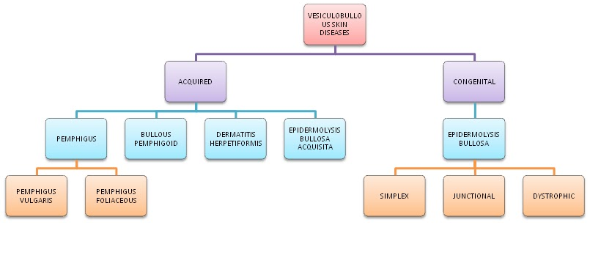
VESICULOBULLOUS DISEASES

Slide 51
PEMPHIGOID

Slide 52
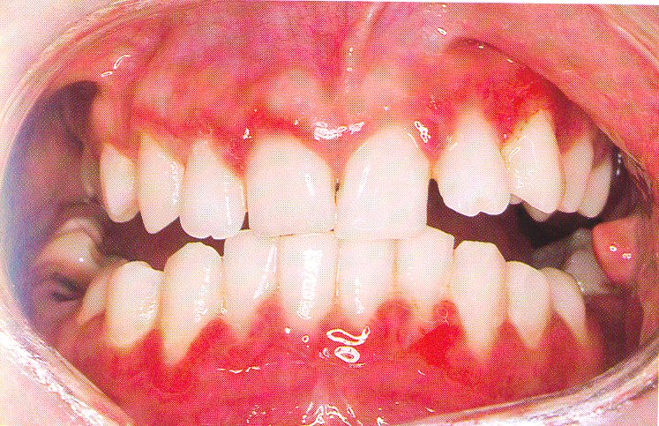
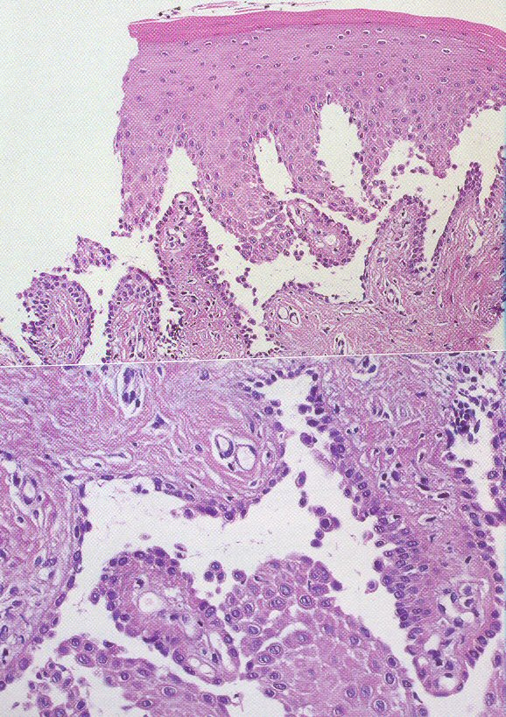
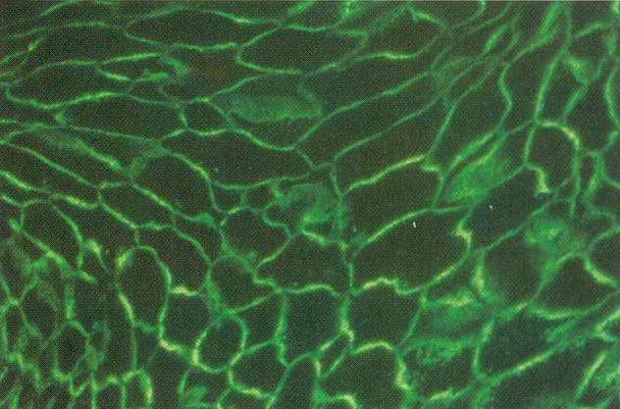
PEMPHIGUS

Slide 53
QUESTION: WHY DO SO MANY CYSTS AND TUMOURS OCCUR IN THE JAWS?

Slide 54
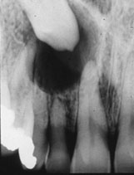
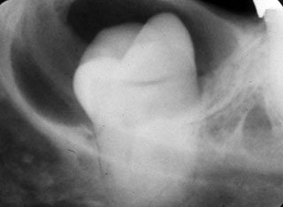
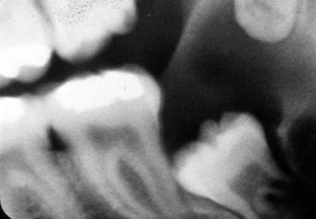
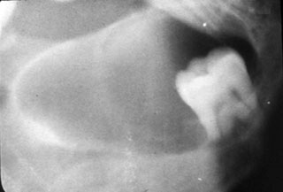
ODONTOGENIC CYSTS 1 Dentigerous Cyst (Follicular Cyst)

Slide 55
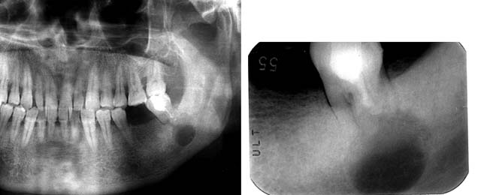
ODONTOGENIC CYSTS 2 Radicular Cyst

Slide 56
nb: CYSTS & TUMOURS ARE ALWAYS CLASSIFIED INTO ODONTOGENIC & NON-ODONTOGENIC IN DENTAL SCIENCES
NON-ODONTOGENIC NEOPLASMS/ CYSTS INCLUDE:
DERMAL/MUCOSAL TUMOURS/ CYSTS
VASCULAR TUMOURS/ CYSTS
LYMPHATIC TUMOURS/ CYSTS
BONE TUMOURS/ CYSTS
GLANDULAR TUMOURS/ CYSTS
MUSCULAR TUMOURS/ CYSTS
CONNECTIVE TISSUE TUMOURS/ CYSTS

Slide 57
Some examples of benign & malignant neoplasms

Slide 58
AMELOBLASTOMA – A BENIGN BUT AGGRESSIVE ODONTOGENIC TUMOUR

Slide 59
OROPHARYNGEAL CARCINOMA: 90%+ are squamous cell carcinomas

Slide 60
BURKITT’S LYMPHOMA: Non-Hodgkins lymphoma

Slide 61
RED/ melanotic PIGMENTATION

Slide 62
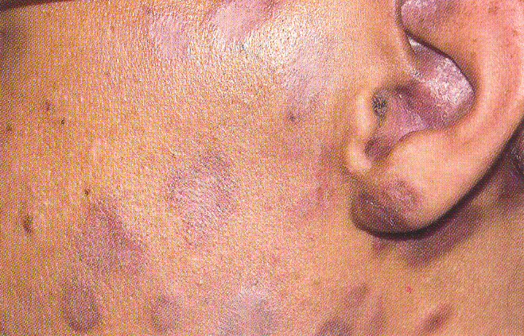
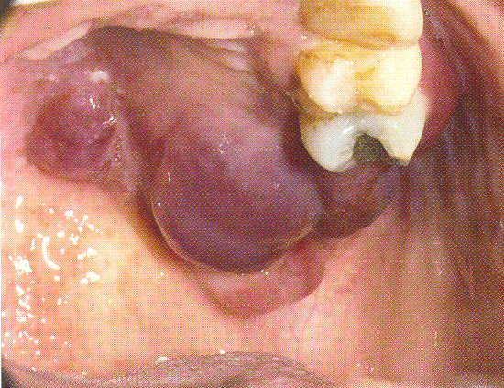
KAPOSI’S SARCOMA: Angiosarcoma
Which tests are
mandatory for this
patient?

Slide 63
MELANOMA: Asymmetry Borders irregular/ bleeding Colour change Diameter increase Induration Satellite lesions

Slide 64
ANY QUESTIONS?

