Slide 1
NON-NEOPLASTIC DISEASES OF THE SALIVARY GLANDS.
DR. MUGWE

Slide 2
OUTLINE
INTRODUCTION
ANATOMY
INFECTIOUS INFLAMMATORY DISORDERS
NON- INFECTIOUS INFLAMMATORY DISORDERS
NON-INFLAMMATORY DISORDERS
RECENT ADVANCES IN MANAGEMENT
CONTROVERSIES

Slide 3
INTRODUCTION
Over 80% of lumps involving the major salivary glands are benign.
Goal with benign lesions:
Preserve key anatomical structures.
Maintain optimal function

Slide 4
ANATOMY: EMBRYOLOGY

Slide 5
Surgical anatomy

Slide 6
INFECTIOUS INFLAMMATORY
VIRUSES
Mumps
HIV
CMV
Coxsackievirus A, Echoviruses, Influenza A, Lymphocytic choriomengitis virus

Slide 7
MUMPS
Paramyxovirus infection.
Droplet route with IP 14-21 days.
Peak incidence 4-6 years.
Prodromal phase: fever, malaise, headache, myalgia.
Bilateral SG enlargement, lymphadenopathy, trismus.
Self limiting 4-5 days.

Slide 8
Diagnosis:
Viral specific IgG and IgA.
Antibodies to mumps V and S antibodies.
Isolate virus from urine.
95% adults have neutralizing antibodies.

Slide 9
Complications:
orchitis, 20 to 30% .
Oophoritis 5%.
Aseptic meningitis 5%.
Pancreatitis occurs 5%.
Sensorineural hearing loss 0.5 to 4%.
Childhood diabetes.
Chronic obstructive sialadenitis.

Slide 10
HIV
May be 1st clinical manifestation.[1]
Secretory and intra-parenchymal lymph nodes.
disease | Clinical feature
HIV salivary gland disease | xerostomia
Kaposis sarcoma | Salivary gland enlargement
Non-Hodgkin's disease
lymphadenopathy
Acute suppurative sialaedinitis

Slide 11
HIV SALIVARY GLAND DISEASE
Multiple cysts lined by epithelial and lymphoid cells.
Most frequently arises in the parotid glands.
Designated as:
Sjogren-like syndrome
Benign lymphoepithelial lesions
Cystic lymphoepithelial lesions
Lymphoepithelial cysts

Slide 12
Incidence is 5-10% adults, while its more common in children.
Can occur in any stage of HIV infection.
Incidence in KNH-CCC (2007) acute parotitis 72.2%, chronic parotits 16.6%.[*]

Slide 13
Clinical presentation
Painless recurrent SG enlargement.
Xerostomia
bilateral
Mass is cystic, firm or fluctuant.
Multiple cysts

Slide 14
Investigations
FNA-Gold standard. Sensitivity 90% specificity 95%
Ct scans
MRI
HIV test
P24 antigens in cystic fluid.

Slide 15
Pathogenesis:
Direct viral damage[2,3]
Concomitant lymphadenopathy[4]
Autoimmune disease[5,6]
Exuberant lymphofollicular hyperplasia within salivary parenchyma.
2 Kornstein MJ, Parker GA, Mills AS:Immunohistology of BLL in AIDS-related lymphadenopathy:A case report.Hum Pathol 19:1359-61,1988.
3Seifert G: Tumor like lesions in salivary glands. The new WHO classification. Pathol Res Pract 188: 836-46, 1992
4Ioachim HL, Ryan JR: Salivary gland lymphadenopathies associated with AIDS: Reply. Hum Pathol 19:616-617, 1988

Slide 16
Microscopy:
perivascular, periacinar and periductal lymphocytic infiltration. CD8+
Progressive and florid follicular hyperplasia.[7]
Warthin-Finkeldey-type giant cells may be present in lymphoid tissue.[8]
7 Ihrler S, Zietz C, Riederer A et al. HIV-related parotid lymphoepithelial cysts. Immunohistochemistry and 3D reconstruction of surgical and autopsy material with special refernce to formal pathogenesis. Virchows Arch 1996;429:139-47
8 Orenstein JM. The Warthin-Finkeldey-type giant cell in HIV infection, what is it? Ultrastruct Pathol 1998;22:293-303

Slide 17
Management
ARVS
Oral hygiene, sialologues
Surgical excision.
Aspiration
Sclerosants: alcohol, tetracycline
EBRD 8-10Gys; 24Gys

Slide 18
DILS
CD 8 lymphocytosis and lymphocytic infiltration of the parotid, lacrimal, kidneys, muscles, nerves, lungs and lymph nodes.
Related to HLA-DR5 and HLA-DR6 phenotypes.
African-American predominance.[9]
4.5% African-American, 2% Hispanics, 3% Caucasians.[10]
7.8% in Greece, 0.8-6% USA.
9 Kazi S, Cohen PR, Williams F et al. The diffuse infiltrative lymphocytosis syndrome. Clinical and immunogenetic features in 35 patients. AIDS 1996; 10: 385-91.
10 Williams FM, Cohen PR, Jumshyd J et al. Prevalence of diffuse infiltrative lymphocytosis syndrome among HIV type 1 positive outpatients. Arthritis Rheumatol, 1998; 41: 863-8.

Slide 19
Clinical features.
Unilateral/ bilateral parotid enlargement.
Sicca syndrome
Xerostomia
Differential diagnosis
Sjogrens syndrome
Papillary cystadenoma lymphomatosum
Viral parotitis
TB
Sarcoidosis

Slide 20
Histopathological analysis
Periductal lymphocytosis
CD 8 lymphocytes
Acinar atrophy
Ductal ectasia
Negative CD 4 lymphocytes
Positive LMP-EBV.[11]
Positive p24 antigens
Negative CMV immunostaining
11 Helen R, Nikolaos G, Sleygh C et al. Histopathological analysis and demonstration of EBV and HIV p-24 antigen but not CMV expression in DIIS. J Oral Pathol Med 2003: 32;431-7

Slide 21
Treatment
ARVS mainly protease inhibitors
Corticosteroids
Aspiration
Sclerosants
Excision-no response to ARVS, non-compliant
Complication:
lymphoma

Slide 22
CMV
Congenital and primary infection.
1907- pathologic evidence of CMV in SG
15-50% of infants have active CMV SG disease in 1st year of life.[12]
Remains latent in major SG tissues.
12 Farber S, Wolbach SB. Intranuclear and cytoplasmic inclusions in salivary glands and other organs in infants. Am J Pathol 1907; 18:513-8.

Slide 23
BACTERIAL INFECTIONS
Acute suppurative sialadenitis
Neonatal suppurative parotitis
Recurrent parotitis of childhood
Granulomatous diseases

Slide 24
ACUTE SUPPURATIVE SIALADENITIS
Parotid gland most frequently involved.
Serous saliva deficient in lysosomes, Ig A and sialic acid.
Saliva in sublingual and submandibular glands contains high mwt glycoproteins.
Postop patients 30-40% and medically debilitated.
Age 50-60 years.

Slide 25
Predisposing factors:
DM
Hypothyroidism
Periodontal disease
xerostomia
Renal failure
Medications
Mechanical obstruction
Prematurity-aseptic sialadenitis
TPN
Anorexia bulimia
Depression
Poor oral hygiene

Slide 26
Micro-organisms
Facultative anaerobes- staph. Aureus50-90% [13]
Strep viridans.[14], strep pyogens, strep pneumoniae
Klebsiella
Anaerobes- bacteroides, peptostreptococcus, pervotella, fusobacterium spp.
H. influenza.
13 Raad II, Sabbagh MF, Caranasos GJ. Acute bacterial sialadenitis: a study of 29 cases and reviews. Reviews of infectious Diseases. 1990;12:591-601
14 Chiu CH, Lin TY. Clinical and microbiological analysis of 6 children with acute suppurative parotitis. Acta paediatrica. 1996;85:106-8

Slide 27
pathophysiology
Reduced salivary flow
Ascending infection
Acute suppurative sialadenitis
Chronic suppurative sialadenitis
Ductal obstruction,

Slide 28
Clinical presentation:
rapid onset of pain, swelling, induration,and fever.
The symptoms may worsen during eating.
Examination reveals induration, erythema, edema,
and tenderness over the gland and purulence at the
ductal orifice.
progress to abscess formation.

Slide 29
Investigations
CBC- leucocytosis, neutrophilia
culture
Sialography- benefits are unclear.
Scintiscanning
Ultrasound and CT scan(48-72H)

Slide 30
Management
Effective hydration and antibiotics.
Anti-staphyloccocal penicillins- flucloxacillin, amoxycillin, augmentin
Cephalosporins-1st gen
Clindamycin and flagyl
vancomycin
Sialologues
Massage and heat
Differential diagnosis
Lymphoma
Bezold’s abscess
Dental abscess
Sebaceous cyst
Branchial cyst
Cervical adenitis
Lymphangitis external otitis

Slide 31
Spread of parotid abscess

Slide 32
Indications for surgery
Lack of clinical improvement
Facial nerve involvement
Deep neck space infection
Recurrent or chronic disease

Slide 33
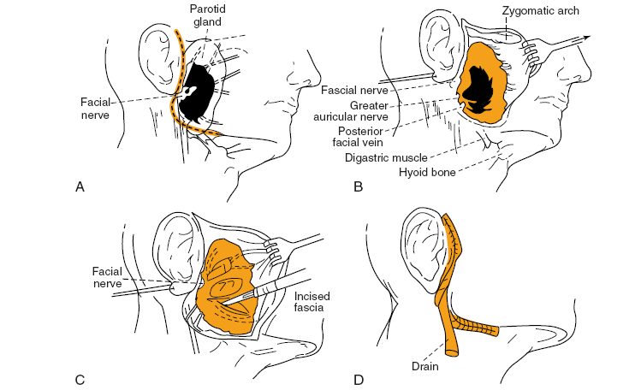
Approach to drainage of parotid abscess

Slide 34
NEONATAL SUPPURATIVE PAROTITIS
Risk factors: preterm ,male, dehydrated.
Organisms: staph aureus, E.coli, pseudomonas, group B strep.
Clinical features: fever, irritability, erythema, FTT, anorexia, bilateral parotid enlargement
Diagnosis: CBC, culture, FNA
Management: IV antibiotics, surgery

Slide 35
RECURRENT PAROTITIS OF CHILDHOOD
Associated with non-obstructive sialectasis.
Age of onset 3-6 years.
More common in males.
Localized pain and swelling that last 14/7.
Attacks 1-5/year.
Frequency of recurrence peaks 5-7 years. 90% resolution by puperty.
Analgesia is main stay of therapy.

Slide 36
Proposed aetiologies:
Congenital ectasia- bact colonization
Familial form with autosomal inheritance
Immunological abnormalities- IgG3 and IgA deficiency
Juvenile onset sjogren syndrome
Viruses-mumps, EBV, HIV

Slide 37
CLINICAL FEATURES
Acute/subacute parotid swelling
Fever, malaise
Pain
Bilateral inv 44%
Investigations
Sialography
Ultrasound
MR sialography
Treatment
Hydration
Heat and massage
Sialologues
Antibiotics

Slide 38
GRANULOMATOUS DISEASES
TB
Non-tuberculous mycobacterial disease
Actinomycosis
Cat scratch disease
Toxoplasmosis
Syphilis
Wegners granulomatosis
sarcoidosis

Slide 39
TUBERCULOSIS
Involvement of salivary glands is rare.
Postulated theories of source of infection[14]:
Trans-oral spread
Haematogenous spread from primary disease
Lymphatic spread from tonsil or EAC.
14 Alex L,Balakrishnan M, Ittyavirah AK. Tuberculosis of parotid gland-a case report. IndiaJ Radiol Imaging 2006;16:689-90

Slide 40
Primary TB- occurs in parotid.
secondary TB-sublingual and submandibular gland.
Presents in 2 forms:
Acute inflammatory lesion with diffuse glandular edema
Chronic tumorous lesion-discrete slow growing mass

Slide 41
Investigations
Acid fast staining
Culture of saliva
Mantoux skin test
CXR
imaging
DDX:
Tumors
Lymphoma
Sialadenitis
Nodal mets
Management
Anti-TB
surgery

Slide 42
NON-TUBERCULOUS MYCOBACTERIAL DISEASE
Children < 5years.
Organisms: M.kansasii, M.scrofulaceum, M.avium intracellulare, M.bovine.
Portal entry-mouth.
Rapidly enlarging neck mass with skin discoloration , draining sinus.
Excision of gland and nodes

Slide 44
ACTINOMYCOSIS
Caused by Actinomyces spp, gram +ve, anaerobic, non-acid fast bacilli.
Normal commensals tonsils and carious teeth.
Predisposing factors:
DM
ISS
Steroids
malnutrition

Slide 45
Clinical features:
Multiple draining fistulae
Painless indurated swelling
Chronic purulent discharge
History dental disease with manipulation
Diagnosis
FNA- gram +ve filamentous rods, sulfur granules
6/52 IV pen/clindamycin/doxycyline+6/12 oral
Incision and debridment

Slide 46
CAT SCRATCH DISEASE
Diagnostic criteria;
History contact with cat (dog 5%) and presence of scratch
+ve skin test for Bartonella henselae or +ve serologic test
+ve gram stain(Warthin starry silver) and culture
Characteristic histopathology

Slide 47
TOXOPLASMOSIS
Toxoplasma gondii.
Host cat
Trophozoites and cysts- infected and undercooked beef, chicken, lamb or cat faeces.
Diagnosis: serologic testing
Treatment: pyrimethamine+trisulfapyrimidines

Slide 48
NON-INFECTIVE INFLAMMATORY
Chronic sialadenitis
Sialolithiasis
Sjogren syndrome
Benign lymphoepithelial lesions
Sarcoidosis
Wegners granulomatosis
Kimura
Kuttner’s tumor
Necrotizing sialometaplasia
Adenomatoid hyperplasia

Slide 49
CHRONIC SIALADENITIS
Adulthood
Repeated episodes of pain and inflammation
Parotid gland is most affected.
Salivary duct obstruction due to sialolithiasis with salivary flow stasis.
Previous history of RPC, sialolithiasis

Slide 50
Duct obstruction is due to;
Sialolithiasis
Stenosis- scar
Extrinsic compression by tumor
Stricture
Congenital dilation
Foreign body
radiotherapy

Slide 51
Salivary changes during acute exacerbations:
Increase Nacl and glucose
Decrease phosphate
Increase IgA, IgG, IgM, albumin, transferring, myeloperoxidase, lactoferrin and lysozyme
Salivary IgG predominates in acute infection.

Slide 52
Investigations
Sialography- strictures, distortion of ducts
Ultrasound
Ct Scans
Histopathological features
Duct dilatation,acinar atrophy, interstitial fibrosis, periductal inflammatory infiltrate.

Slide 53
prognosis
50% spontaneous resolution
40% surgical intervention- subtotal or total removal of the gland.
Complications: kuttner’s tumor, BLL, parotid duct carcinoma.[15]
15 Hogg RP, Ayshford C, Watkinson JC. Parotid duct carcinoma arising in bilateral chronic sialadenitis. Journal of Laryngology and Otology 1999;113:686-8.

Slide 54
BENIGN LYMPHOEPITHELIAL LESIONS Mikulicz’s disease/Godwin tumor
Non-neoplastic unilateral or bilateral enlargement.
May be assoc with sjogren syndrome
Women in 5th-6th decade.
Lymphoreticular infiltrate with acinar atrophy, irregular nuclei and ductal metaplasia.
Treatment: symptomatic, surgery
Complications: lymphoepithelial carcinoma, low grade B lymphoma, NKL, KS

Slide 55
SIALOLITHASIS
80-90% submandibular gland, 10% parotid and1- 7% sublingual gland.
Females> males.
Adults>children
CP: pain and swelling with gustation or eating.
Diffuse swelling, burning-like pain
Defect of migration of autophagosomes or calcification of mucus plugs.

Slide 56
pathophysiology
Calcium phosphate and carbonate, organic matrix of glycoprotein and muccopolysaccharides.
salivary stasis, ductal inflam and injury.
Intermittent stasis- alteration of mucoid elements of saliva forming an organic gel.
Gel-framework for the deposition of salts.
Development of calculi.

Slide 57
Investigation
Plain radiograph
Ultrasound
sialography

Slide 58
Treatment
Marsupilization
Excision of gland
Non-surgical: laser lithotripsy.
sialoendoscopy

Slide 59
SJOGREN SYNDROME
2nd most common autoimmune connective tissue disorder.
Profound lymphocytic infiltration into salivary and lacrimal glands.[33]
F:M 9:1, 4th-5th decade
Drug allergies, 44% allergic to penicillin.
Primary and secondary SS.

Slide 60
Aetiology
Genetic HLA-DR3, HLA-B8
Environmental- viral infections
Serological markers
ANA- 50-80%
RF -75%
Ro/SS-A antibodies
La/SS-B antibodies

Slide 61
Clinical presentation
Xerostomia- dysarthia and dysphagia.
Dental carries.
Acute gingivitis.
Candidiasis
Acute suppurative parotitis.
Dysgeusia
Lymphoma 5%.
Keratoconjuctivitis sicca

Slide 62
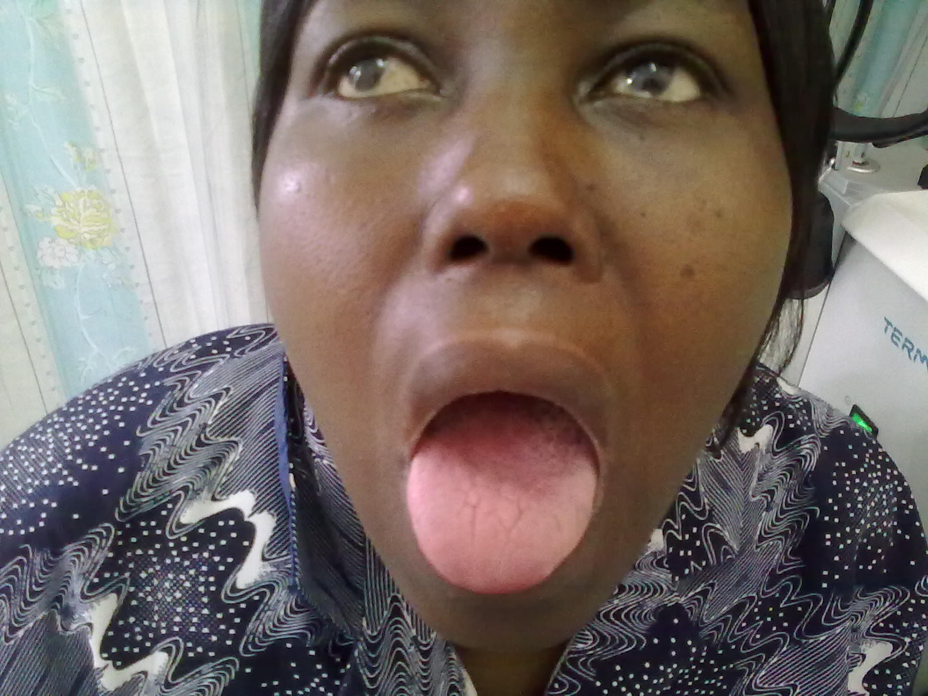
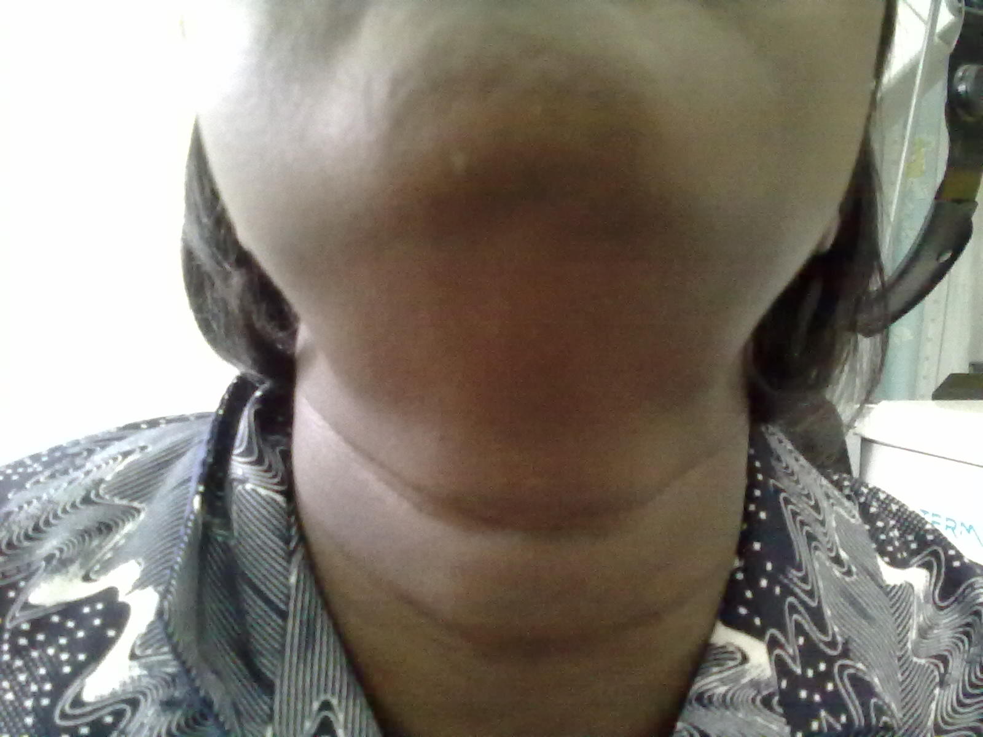

Slide 63
American-European Diagnostic criteria
Ocular symptoms
Persistent dry eyes for 3/12
Recurrent sensation of sand/ gravel
Use of tear substitutes for >3 times a day
Oral symptoms
Feeling dry mouth every day for >3/12
Recurrent swollen salivary glands as an adult
Need to drink liquids to swallow dry foods
Objective evidence of dry eyes
Schimmer’s test <5mm +ve
Rose Bengal test stain red damage in conjuctiva/ corneal cells

Slide 64
Salivary gland biopsy >50 lymphocytes per 4mm glandular tissue.
Objective evidence of salivary gland involvement.
Salivary gland scintigraphy-delayed uptake technetium-99m
Parotid sialography
Unstimulated whole sialometry<1.5ml in 15 minutes +ve.
6. Lab abnormalities- Ro, La, ANA. RF

Slide 65
Primary sjogren- 4/6
Secondary sjogren-autoimmune disease and positive category 1 or 2 and be positive in 2 of the remaining 4 criteria.
Exclusion criteria;
Previous radiation
Hep C
AIDS
Pre-exsisting lymphoma
Sarcoidosis
Graft vs host disease
Anticholinergic drugs

Slide 66
management
Local agents
Systemic agents
Immunosuppresants
Electrostimulation
Dietary stimulation.

Slide 67
Kuttner tumor (chronic sclerosing sialdenitis)
Rare chronic inflammatory disorder of adults.
Submandibular gland
Long-standing asymptomatic swelling.
Treatment: excision.
DDX: benign lymphoepithelial lesions

Slide 68
Necrotizing sialometaplasia
Benign self limiting.
1st described by Abrams et al in 1973.[16]
Most common sites: minor salivary glands of oral cavity and oropharynx.
Mean age 46 years
2:1 male predominance.

Slide 69
Firm, erythematous nodule, ulcerated.
Bilateral lesions 20%
Painful or painless with associated paraesthesia or anesthesia.[17]
Unknown aetiology.
Predisposing factors: tobacco use, vascular diseases, trauma and bulimia.
16 Abrams AM, Melrose RJ, Howell FV. Necrotizing sialometaplasia. A disease simulating malignancy. Cancer 1973;32:130-5.
17 Keogh PV, O’Regan E, Toner M. Necrotizing sialometaplasia: an unusual bilateral presentation associated with antecedent anaesthesia and lack of response to intralesional steroids. Case report and review of the litreture. Br Dent J 2004;196:79-81.

Slide 70
NON-INFLAMMATORY LESIONS
Sialadenosis
Cysts
Radiation-induced
Drugs

Slide 71
SIALOSIS
Non-neoplastic non-inflammatory disorder
Bilateral non-painful enlargement.
Females> males
Peak incidence 5th and 6th decade
?neuropathy
Associated diseases: DM, hypothyroidism, alcohol, malnutrition, liver cirrhosis.
Microscopy- acinar hypertrophy with fatty replacement.
Treatment- underlying cause, pilocarpine, surgery

Slide 72
cysts
Branchial type 1 and 2
Dermoid
Mucocele
Ranula
Polycystic disease

Slide 73
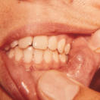
MUCOCELES
3 types: extravasations, retention and superficial.
Extravasations mucoceles
90%
Trauma to excretory duct.
Most common site- lower lip.
Other sites: buccal mucosa, FOM, ventrum of tongue, palate .

Slide 74
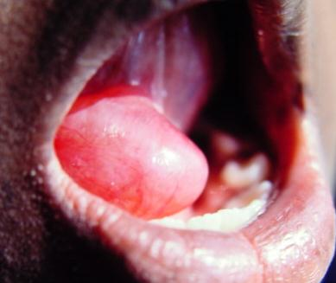
RANNULAS
Congenital/traumatic
Partial obstruction of sublingual duct.
Partial severance or ligation of sublingual duct.

Slide 75
Plunging rannulas
Sublingual gland may project through mylohyoid or ectopic gland.
Cyst may penetrate through mylohyoid.
Duct from sublingual gland may join the submandibular galnd or its duct.

Slide 76
MUCOUS RETENTION CYSTS
Older people.[18]
Caused by intermittent duct obstruction.
Form uncystic cavities.[19]
Lined by modified duct epithelium cuboidal or columnar
Seen in palatoglossal fold.
Multiple, more in females.
18 Southam JC. Retention mucoceles of the oral mucosa. J Oral Pathol 1974;3:197-204
19 Eversole LR. Oral sialocysts. Arch Otolaryngol Head Neck Surg 1987;113:51-6

Slide 77
CHEILITIS GLANDULARIS
Minor labial salivary glands.
Characterized by swelling and focal ulceration.
Adult male preponderance.
4 Williams HK, Williams DM. Persistent sialadenitis of the minor glands- stomatitis glandularis. Br J Oral Maxillofac Surg 1989;27:212-21.
5 Musa NJ, Suresh L, Hatton M et al. Multiple suppurative cystic lesions of the lips and buccal mucosa: a case of suppurative stomatitis glandularis. Oral Surg Med Oral Pathol Oral Radiol Endod 2005;99:175-9.
3types: simple, superficial suppurative and deep suppurative.
DDX: cystadenoma, cystadenocarcinoma. Mucoepidermoid carcinoma
MX: steroids, antibiotics excision.

Slide 79
Radiotherapy-salivary dysfunction
Xerostomia is irreversible.
Damage to cell membrane receptor G protein.
Pilocarpine does lessen severity.[20, 21]
Bethanechol increases stimulated and unstimulated salivary flow.[22]
Other agents carbecholine and anethole trithone.
20 Fattahi TT, Lyu PE, Van Sickels JE. Management of acute suppurative parotitis. Journal of Oral and Maxillofacial Surgery. 2002;60:446-8.
21 O’Brien CJ, Murrant NJ. Surgical management of chronic parotitis. Head and Neck.1993;15:445-9
22 Epstein JB, Burchell JL, Emerton S, Le ND, et al. A clinical trial of bethanechol in patients with xerostomia after radiotherapy. A pilot study. Oral Surgery, Oral medicine, Oral pathology. 1994;77:610-4.

Slide 80
pseuoparotomegally
Hypertrophy masseter
Obesity
Malnutrition
Malabsorption states
Uraemia
Hypothyroidism
Myxedema
Testicular and ovarian hypertrophy
Pregnancy and lactation
Chronic relapsing pancreatitis
pneumoparotitis

Slide 81
RECENT ADVANCES IN MANAGEMENT
FACIAL NERVE STUDIES
Buccal branch 4cm anterior to tragus along the alatragal line.[23]
Identification of the main trunk is difficult in obese and recurrent tumors.
Advantages:
Selective exposure obviates need for dissection along main trunk.
Easier dissection.
23 Anjum K, Revington PJ, Irvine GH. Superficial parotidectomy: antegrade compared with modified retrograde dissections of the facial nerve. Br J Oral Maxillofac Surg 2008;46:433-4

Slide 82
Lumpectomy
Fewer complications.
Tumor is adjacent to facial nerve and there is no cuff of normal parotid.
Salivary stones and obstructive sialdenitis
Endoscopic surgery- limitations adhesions, narrow ducts, strictures, acute angles, stones in parenchyma.

Slide 83
surgical incisions for parotidectomy
face-lift incision- fat grafts and sternomastoid platysmal flaps for residual hollowing.
preservation of superficial lobe when removing tumors of deep lobe. Avery et al.
Anand et al, nasal intubation to facilitate access to retromandibular area.
24Avery CM, Fleming K, Siegmund CJ. Preservation of the superficial lobe with tumors of the deep lobe of the parotid. Br. J Oral Maxillofac Surg 2007;45:652-5.
25 Anand R, Manek P, Wilbourn M et al. Nasotracheal intubation to facilitate surgical access in parotid surgery. Br J Oral Maxillofac Surg 2007;45:684-5

Slide 84
CONTROVERSIES.
Frey’s syndrome- when to use the tests.
Facial nerve monitoring- false alarms.
Surgical excision and pathologic examination of HIV-SGD.
Relationship between EBV and pathogenesis of SS.

Slide 85
DRUG ASSOCIATED SALIVARY GLAND DISEASES
xerostomia | swelling | Sjogren syndrome | pain | Salivary discoloration
antimuscarinics | cimetidine | hydralazine | cytotoxics | rifabutin
Tricyclic antidepressants | Anti-thyroid agents, iodide | levamisole | methyldopa | rifampicin
antihistamine | chlorhexidine | sucralfate | clonidine
antiemetics | clonidine | procainamide | bethanidine
tranquillizers | insulin | practolol | guanethidine
decongestants | methyldopa
broncodilators | nifedipine
Appetite suppressants | phenothiazines
HIV protease inhibitors | sulphonamides
diuretics

Slide 86
SUMMARY

