Slide 1
EPISTAXIS
DR J. AYUGI SENIOR LECTURER

Slide 2
DEFINITION
Acute hemorrhage from the nostril, nasal cavity, or nasopharynx.

Slide 3
Introduction
One of the most common ENT emergency
Male to female ratio 1.6:1
Higher incidence in older patients
Clinically- bleeding either from the lateral nasal wall or from the septum.

Slide 4
Lateral nasal wall bleeding is usually seen from the region of the sphenopalatine artery
Septal bleeding is usually from the anterior region.
Most cases are minor but can be life threatening e.g. in elderly

Slide 5
Minor epistaxis usually originates from the anterior nasal septum
Is often the result of minor trauma to the septal mucosa.
Children- A result of nose picking
Adults- A result of desiccation of the mucosa.

Slide 7
VASCULAR ANATOMY OF THE NOSE
The nasal mucosa has a rich arborizing network of submucosal vessels.
Arterial blood supply from internal and external carotid arteries.
Confluence of the two systems occurs particularly at the caudal end of the septum.
A number of arteries anastomose with each other- Little's area.

Slide 8
The anterior septal plexus is termed Little's area or Kiesselbach's plexus
Is a confluence of
Septal branch of sphenopalatine (Ext. Carotid artery)
Septal branch of superior labial artery (Ext. Carotid artery)
Greater palatine artery (Ext. Carotid artery)
Anterior ethmoidal (Int. Carotid artery)
This is the site of most anterior epistaxis

Slide 9
Retrocullumellar vein runs 2mm parallel and behind the collumellar
Is superficial
Is a common reason for venous bleeding in children
Venous epistaxis from retrocollumelar vein tends to occur in subjects <35yrs
Venous epistaxis usually short lived

Slide 10
Woodruffs plexus is a plexus of vessels lying inferior to the posterior end of the inferior turbinate.
It is a frequent site of adult epistaxis.
It causes a venous posterior bleed.
70% of the bleeding occurs from the septum

Slide 11
Fig 1: Vascular supply of the nasal septum

Slide 12
Fig 2: Vascular supply of the lateral nasal wall

Slide 13
AETIOLOGY
Local causes
General causes
Idiopathic causes

Slide 14
AETIOLOGY
Primary and Secondary epistaxis
70 - 80% of all cases are idiopathic: Primary epistaxis.
Standardised description:
Anterior: Bleeding from a source anterior to the plane of the piriform aperture (anterior septum, vestibular skin, mucocutanoeus junction.)
Posterior: Bleeding posterior to the piriform aperture
May be multifactorial, with each factor playing a minor role.

Slide 15
LOCAL CAUSES
Trauma
Nose picking, facial trauma, RTA, fracture base of skull.
Idiopathic (from Little’s area)
Inflammatory
Rhinitis (infective, allergic), Sinusitis, Specific nasal infections (bacterial, fungal, TB)
Anatomical/structural deformities of the nose
Congenital or acquired
Deviated nasal septum
Nasal spur
Hypertrophied or rotated turbinates (paradoxical) drying, crusting, bleeding

Slide 16
Neoplastic (Benign or malignant)
In the nose or paranasal sinuses and postnasal space tumours
Juvenile angiofibroma (exclusively in the adolescent males, recurrent and severe episodes of epistaxis. Never biopsy since patient will bleed excessively)
Aneurysms of internal carotid artery
Environmental;
High altitude
Air conditioning
Toxic or chemical irritant
Cold winter weather

Slide 17
Foreign bodies;
Unilateral, purulent nasal discharge and bleeding.
Usually in children or the mentally retarded
Iatrogenic;
Excessive prescription of intranasal topical steroids
Can lead to changes in mucosa and bleeding
After nasal surgery (septoplasty, FESS)

Slide 18
GENERAL CAUSES
Hypertension - associated with local factors
Elderly; arteriosclerostic vessels do not contract well and the nasal mucosa becomes atrophic hence dries up and cracks easily and vessels may rupture especially during a hypertensive episodes
Blood dyscrasias
Vary in ability to cause epistaxis
Usually diagnosed in early life by excessive bleeding after minor trauma.
Deficiency of factors VIII (Heamophilia A), (Heamophilia B), Factor IX
Von willebrands factor VII impaired PLT adhesiveness.
Leukemia, lymphomas, Idiopathic thrombocytopenic purpura ITP, ossler Rendeu weber syndrome.
Alcohol abuse - poor diet especially Vitamin C, K deficiency
Parenchymal liver damage (decreased fibrinogen and prothrombin)

Slide 19
Pregnancy especially folic acid deficiency (decreased platelets)
Drugs (anticoagulants, aspirin, Nsaids, CAF, carbenicillin).
Systemic toxic agents- phosphorous, mercury.
Infectious diseases (Typhoid, rheumatic fever, whooping cough)
Cardiovascular disorders (MS, CHD, CCF, COA)
Immuno-suppresion (HIV)
Allergic diseases
Malnutrition

Slide 20
CLINICAL PRESENTATION
Sudden onset
Occasionally preceding headache
May be unilateral
Smell of blood in the throat, trickling in the throat
Swallow and vomit fresh blood
Anxiety (increased PR, BP), increased bleeding
Elderly decompensate very fast (hypovoleamic shock)

Slide 21
MANAGEMENT
1. Medical history
2. Physical examination
3. Laboratory investigations
4. Radiological investigations
5. EUA/Endoscopy

Slide 22
GENERAL MANAGEMENT
ABC
Depends on the degree of haemorrhage,
Site (ant, post),
Age of patient,
Hx of precipitating factors.
An accurate patient history (Onset, location, duration, amount and frequency), trauma, nasal blockage, rhinorrhea
Family history, drug history, tobacco and alcohol usage
History of chronic illness (kidney, liver leukemia)
History of prior bleeding is important, general state of the patient (eg shock)
Blood for GXM, coagulopathy
Dark colored vomitus due to posterior bleed

Slide 23
Assessment of blood loss
Class I 10-15% of total blood volume (minimal blood loss <700ml)
Class II 15-30%
Class III 30-40%
Class IV >40% (>2000ml)

Slide 24
Trivial haemorhrage- first aid measures.
Mild-moderate (patient may develop shock)
Main aim is to stop haemorrhage.
Firm pressure to the nostrils 5-10 mins seated upright, head facing downwards.
Advice the patient to breath thru the mouth.
Arrange for good light, nasal cannula and suction machine.
Anaesthetic agent + vasoconstrictor in solution

Slide 27
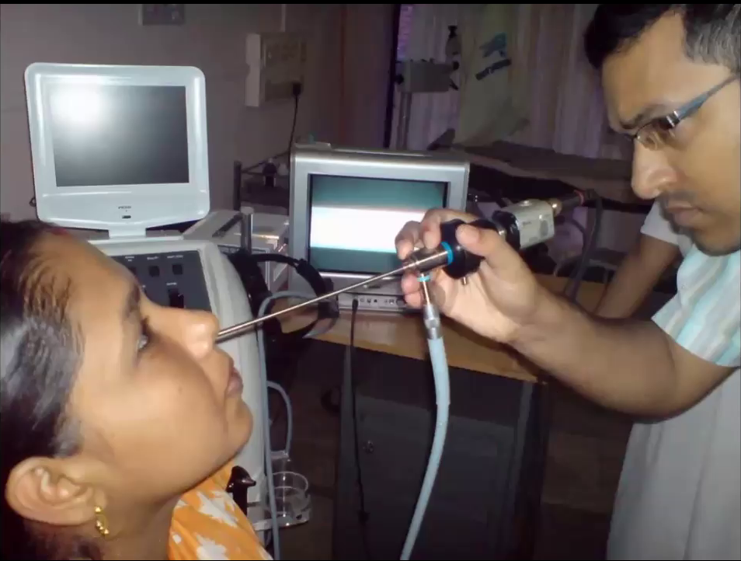
Rigid Nasal Endoscope

Slide 28
Rules of fluid replacement:
Crystalloid fluid= 3:1
Colloids fluids= 1:1
The patient is evaluated in the seated position.
Adequate light suction anaesthetic solution.
Packing materials and cautery.
Topical vasoconstrictor and anaesthetic agent. (oxymetazoline and xylocaine)
Most bleeding sites are anterior and accessible to local treatment.
Bleeding sites that are not visible on anterior rhinoscopy most likely from posterior (sphenopalatine artery)

Slide 29
NON-SURGICAL MANAGEMENT
Anterior nasal packing
Posterior nasal packing
Local cautery with silver nitrate
Endoscopic guided cautery

Slide 30
Nasal packing
Anterior-ribbon gauze impregnated with petroleum jelly or bismuth iodoform paraffin paste (BIPP).
Left in situ for 24 to 72 hrs.
Complications include sinusitis, septal perforation, alar necrosis and hypoxia.
There are special nasal tampons and ballon catheters.
Posterior- Under GA preferably. Can also use foleys catheter
Hot water irrigation at 50 degrees (activates clotting system)
Systemic medications- Tranexamic acid, inhibits fibrinolysis

Slide 31
Anterior Nasal Packing

Slide 32
Nasal Tampons

Slide 33
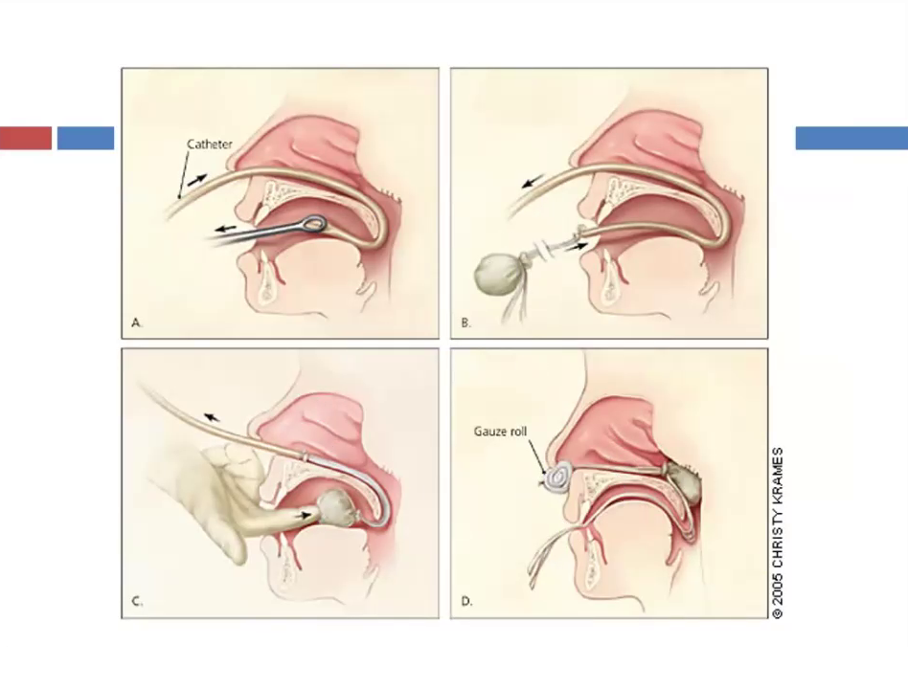
Posterior Nasal Packing

Slide 34
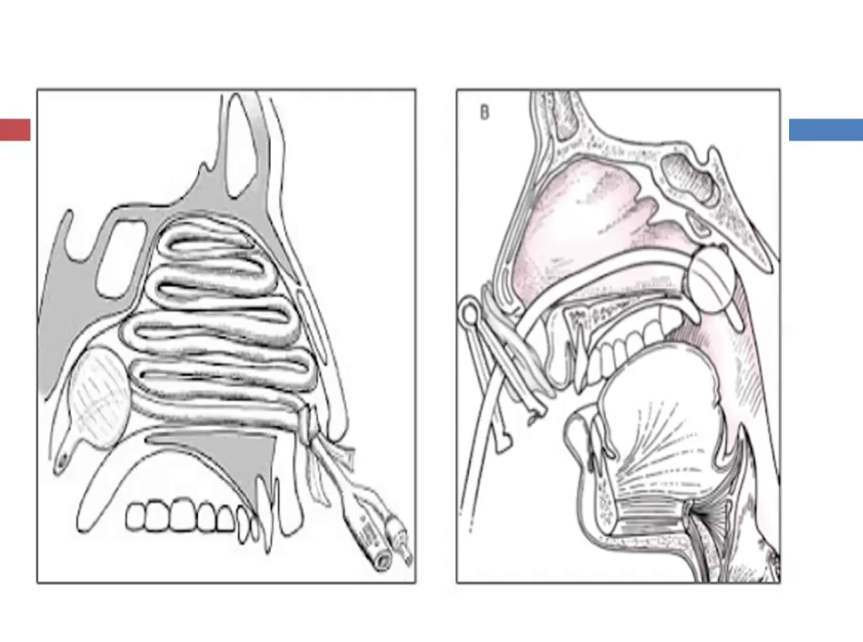
Anterior and Posterior Nasal Packing

Slide 35
Both Anterior and Posterior Nasal Packing

Slide 37
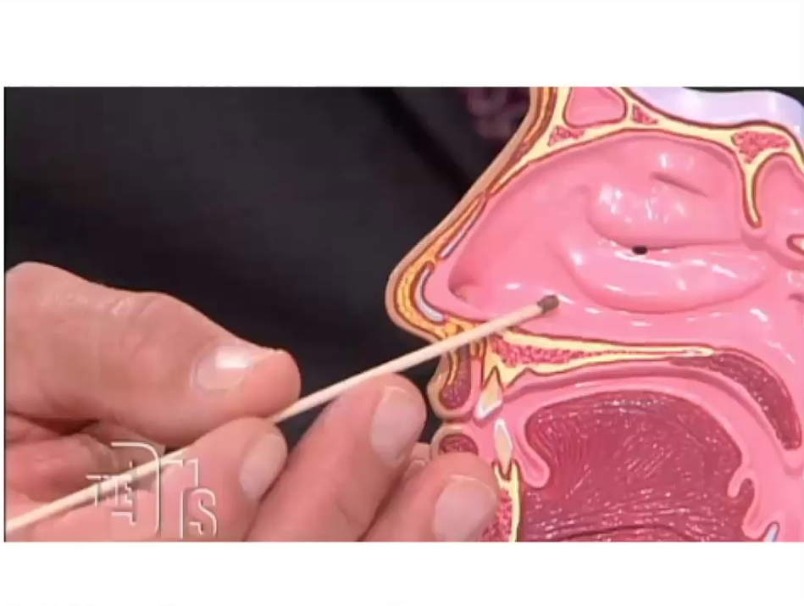
Silver Nitrate Stick

Slide 38
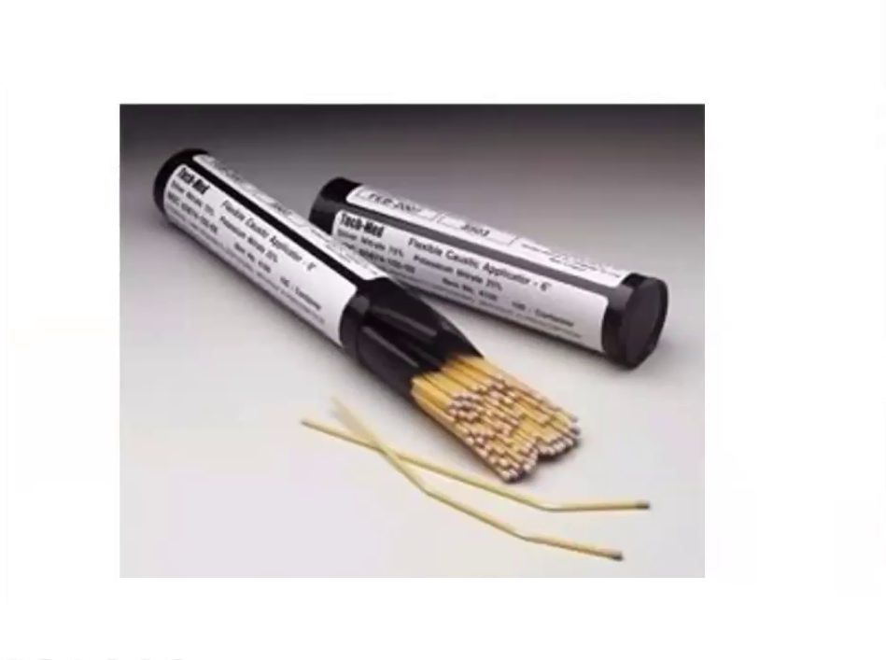
Silver Nitrate Stick

Slide 40
Cautery Machine and Diathermy

Slide 41
SURGICAL MANAGEMENT
In cases of intractable bleeding ligation of arteries is performed:
Sphenopalatine artery.
Maxillary Artery.
External carotid artery.
Ant and Posterior ethmoids.
Embolization with the use of polyvinyl alcohol foam

Slide 42
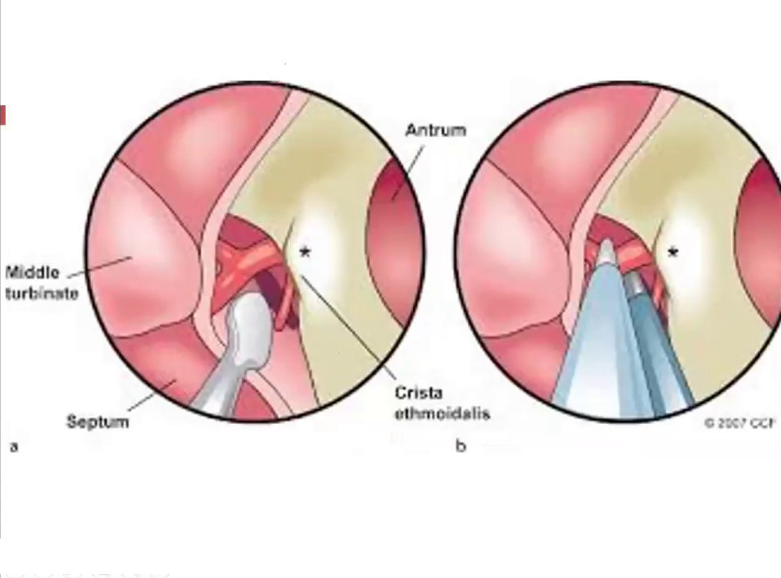

Slide 44
THE END

