Slide 1
Pathophysiology of Death, Post-Mortem Changes and Assessment of Time of Death
Dr E Walong
Department of Human Pathology,
University of Nairobi
Level VI Forensic Medicine Lecture Series

Slide 2
Death
Irreversible Cessation of Physiological processes
Death is established by irreversible injury to the brain stem
Diagnosis of death depends upon demonstration of brain stem dysfunction

Slide 3
Diagnosis of Death
Absence of pupillary reflexes
Absence of nystagmus
Absence of the gag reflex
Cardiorespiratory arrest does not define death
The student is advised to study basic and advanced life support to understand resuscitation of acutely ill individuals

Slide 4
Diagnosis of Death, continued
This is important because there are instances where an individual may be brought and admitted to the mortuary while still alive.
In such cases you need to react to the situation and begin resuscitation as such individuals would have significant disease.

Slide 5
Documentation required to ascertain death
Letter from the physician (doctor) or their assistants (clinical officers) as governed by the laws of Kenya (Kenya medical practitioners and dentists act, clinical officers act.
Police notes, abstracts (or by anyone defined by the police act, criminal procedure act and relevant acts that govern military officers’ procedures.
A duly filled death notification form (registration of birth and death act)

Slide 6
The death notification form
This is filled by medical officers (or clinical officers) as per the relevant acts
Chiefs and other officials from the provincial administration can act as registration assistants, but must never fill section 13 which determines the cause of death
Read the attached document on the death notification form

Slide 7
Death postmortem changes
Presence of significant post mortem changes are evidence of death
Post mortem changes are described below

Slide 8
Scope and Objectives
Discuss changes that occur after death, for assessment of time of death, artifactual changes
Objective 1: to discuss postmortem changes and relate to time of death, artifacts
Objective 2. to discuss microscopic features of postmortem changes, and other useful techniques in assessing time of death.

Slide 9
Pictures and illustrations may be of a distressing nature, their use is for educational purposes only

Slide 10
Algor Mortis (Body Cooling)
Process of cooling
Rectal temperature (core temperature) evaluation
Loss of 1.5-2 degrees centrigrade during the first 12 hours of death on average
Accelerated by ambient temperatures, surroundings, IV infusions
Slowed by body habitus, ambient temperatures
A responding officer must have a thermometer!

Slide 11
Rigor Mortis (Skeletal/Cardiac Muscle Spasm)
Develops as a result of ATP depletion
Develops in all muscles simultaneously
First evident in smaller muscle groups
Appears 1-2h, peaks at 12 hours, diminishes over 12h

Slide 12
Erector Pili

Slide 13
Livor Mortis (Lividity)
Appears 30 min to 2 hours
Sooner – cardiac failure
After 12 h, extravasation of rbcs
Before then, blanching occurs
Also affects organs

Slide 14
Livor Mortis
Affects internal organs
Decomposition over areas of lividity – tissue breakdown
Mimics trauma
Pattern of livor-associated with postmortem position

Slide 17
Tardieu Spots
Petechial haemorrhages
Present secondary to blood vessel rupture
Marked at site of lividity
Seen in dependent areas
During strangulation – seen on the face, mucosa

Slide 18
Purge Fluid
Foul smelling red fluid
Oral and nasal passages
Purged after compression of the body
May simulate haemorrhage

Slide 21
Tache Noire
Darkening of exposed sclera
Also other mucus membranes

Slide 23
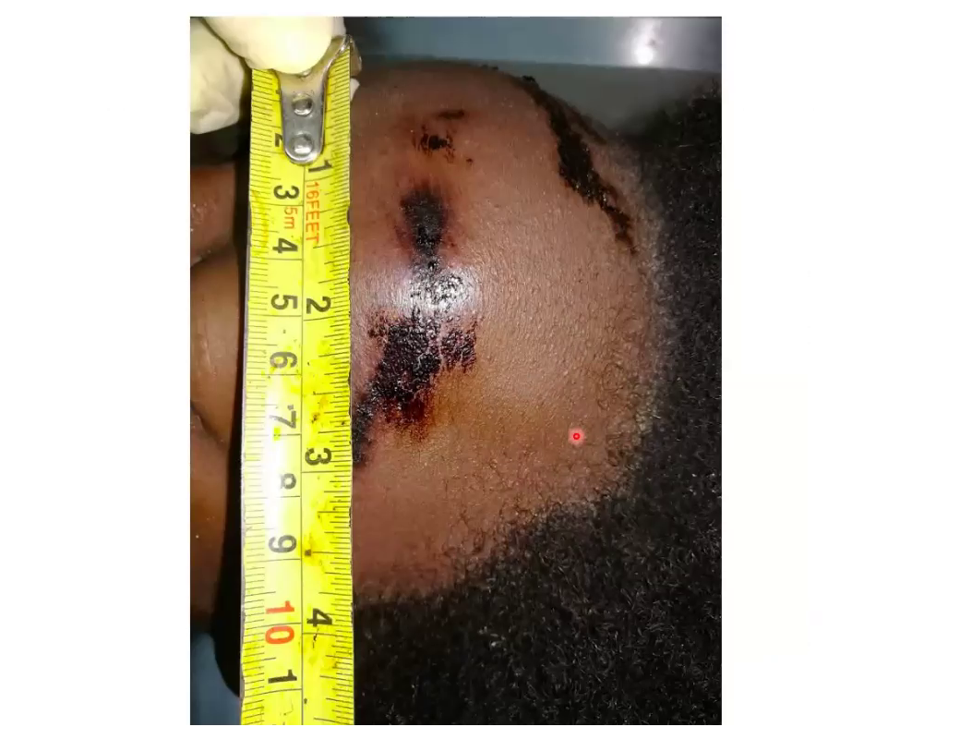

Slide 24
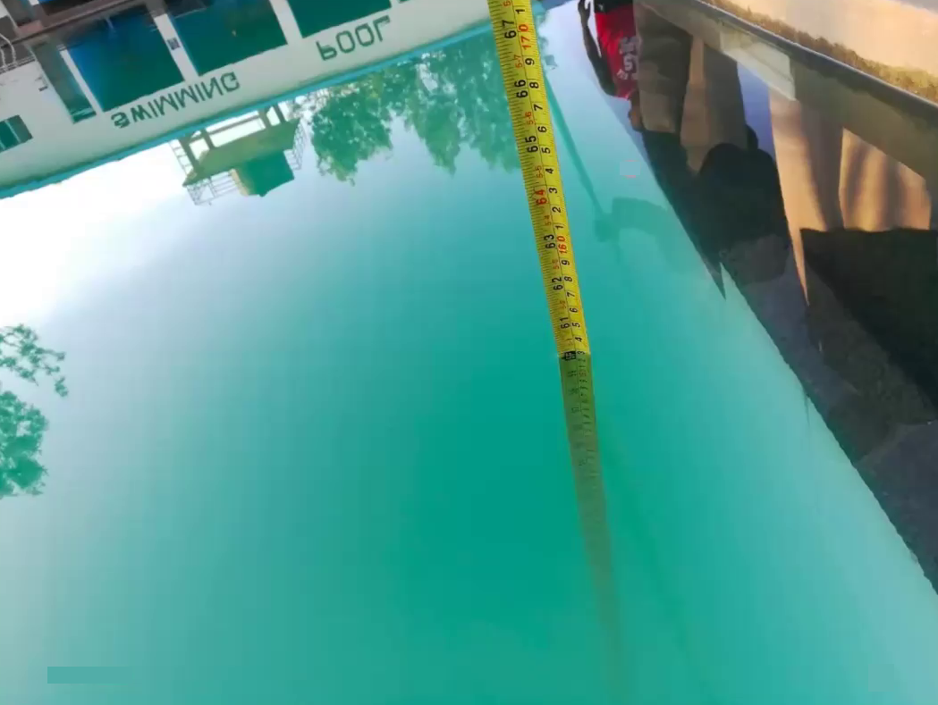

Slide 25
Gastric emptying
Emptying – half-hour to six hours after meal
To use this to assess time of death, ante mortem information on timing of the last meal is important
In this case, we found 150ml of food (rice, green grams)
What is the likely time of death?

Slide 26
Decomposition
Sets in 24-36 hours,
Manifested by green discoloration
Results in Marbling
Bloating of the body
Other manifestations – degloving of the skin

Slide 27
Decomposition

Slide 30
Mummification
Occurs in warm, dry environments
Tissues rapidly desiccate
External injuries are well preserved

Slide 31
Adipocere
Occurs in bodies submerged in water, or in warm environment
Tissues converted to waxy, pasty material
Tissues resist degradation.
They are however, friable

Slide 33
Fly Eggs/Larvae/pupae
Lay eggs in exposed mucosae, wounds
Hatch in 1-2 d
Larvae consume tissues and may distort wounds
Insect and larval collection requires entomologists

Slide 35
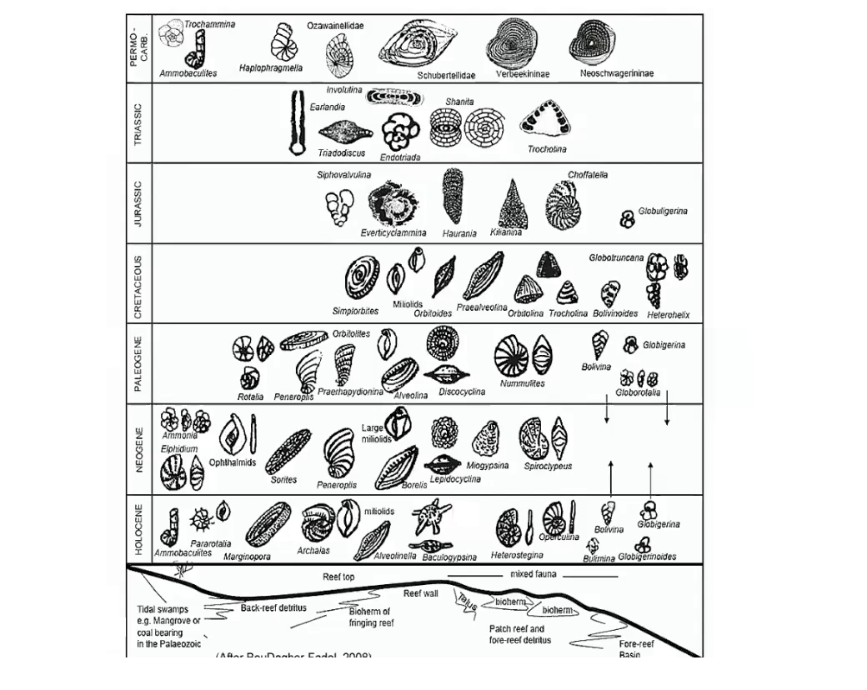

Slide 39
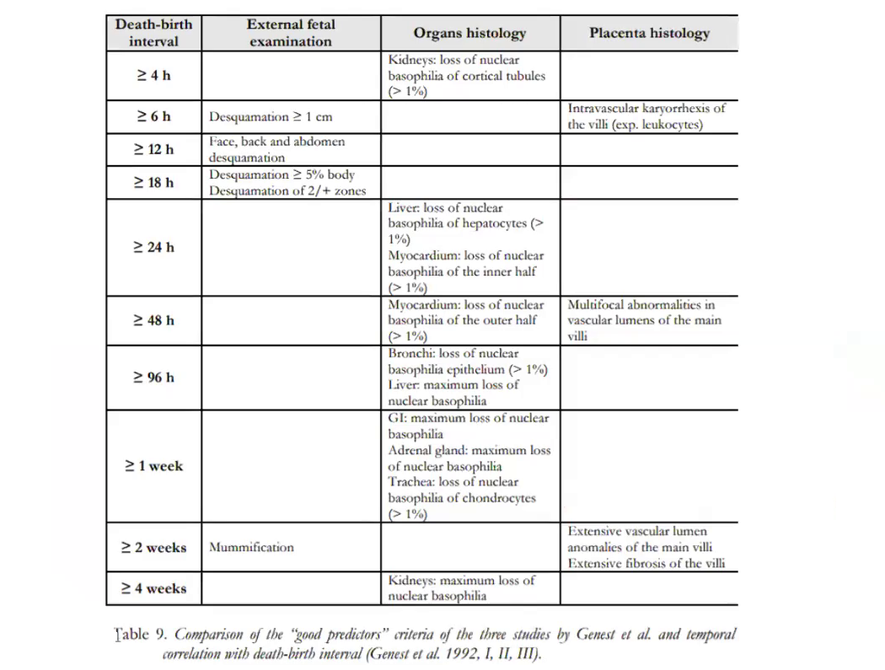

Slide 40
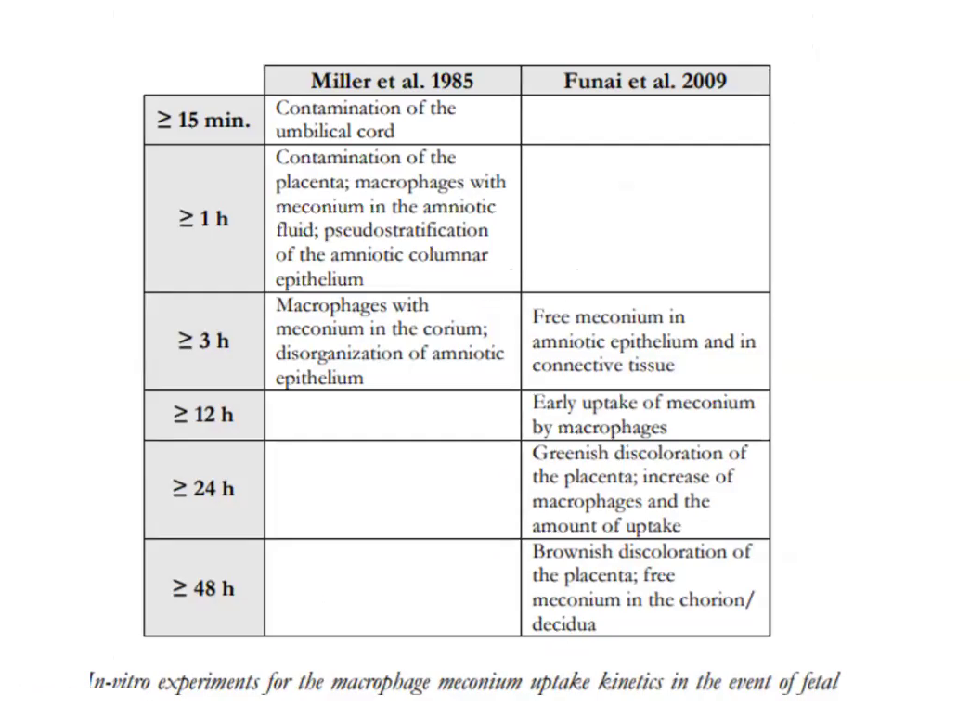

Slide 41
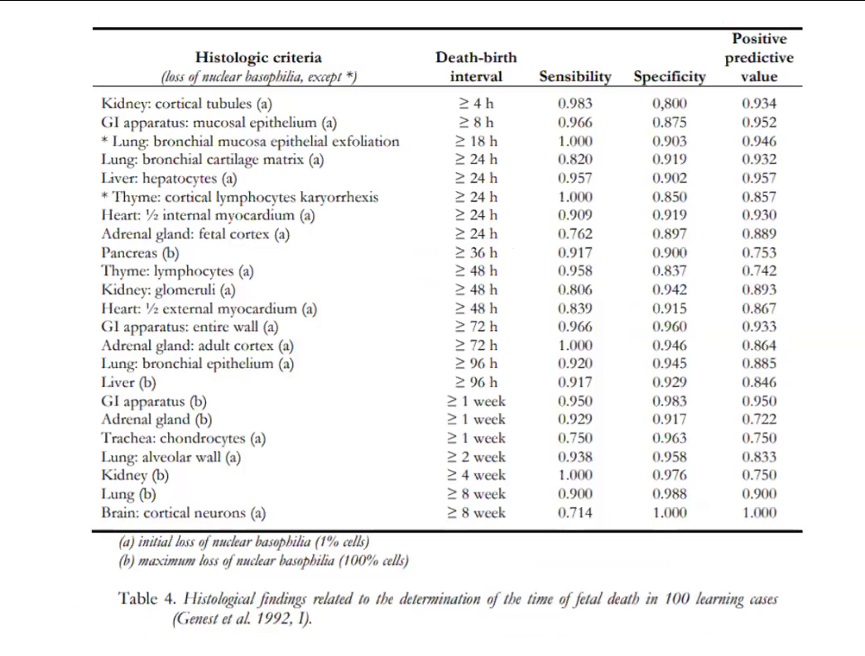

Slide 42
Maceration
Skin slippage
Loosening of joints
Congealing of body fat
Seen in intrauterine fetal death

Slide 44
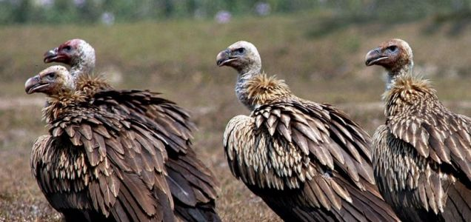
Artefacts due to animals
Vultures, hyenas, dogs
Marine animals – may mimic ante mortem injury

Slide 45
histology
Important in evaluation of wounds, to distinguish ante from postmortem injury
Evaluation of autolysis, putrefaction

Slide 50
Biochemistry
Vitreous Humour Potassium levels
Calmodulin complexes

Slide 51
Techniques Useful
Thorough external examination of the body, and appropriate documentation
Photography of wounds, artefacts
Thorough internal examination
Use of radiology, consultation with entomology
Histology

Slide 52
Summary
Early changes that occur after death – algor mortis, rigor mortis, livor mortis
Intermediate – early putrefaction, autolysis, effects of insects, animals
Late changes – mummification, skeletonization.
Their assessment at postmortem is important for estimation of time of death

