Slide 1
MDR TB LECTURE.

Slide 2
OBJECTIVES OF THE LECTURE.
To outline the global and local epidemiology of MDR TB
Discuss factors contributing to drug resistance in Kenya.
Diagnosis and overview of management of MDR TB In Kenya

Slide 3
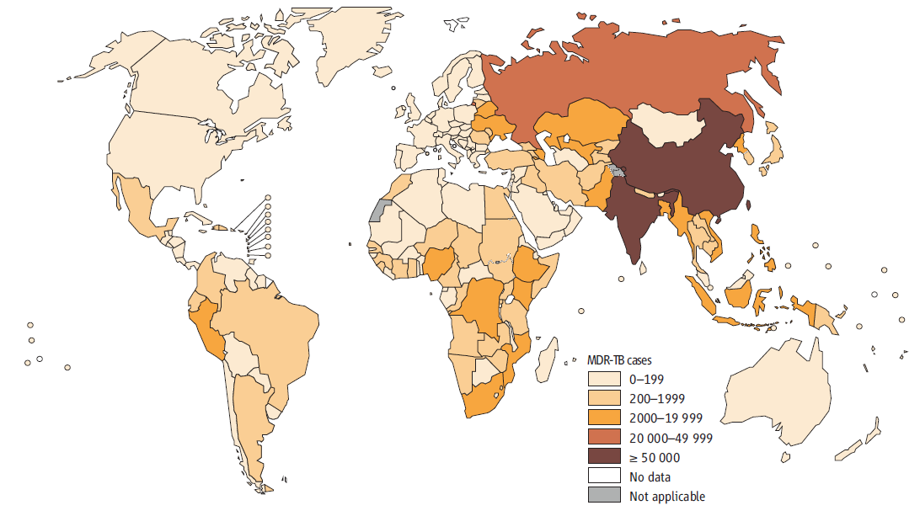

Slide 4
TB and HIV co-infection……………………
Kenya
WHO estimates 2,780 of MDR TB (2012)
2.5% Among the new cases (1800)
10% Among the retreatment cases (980)
Total number diagnosed till 2006 -2013: 1191
MDR TB HIV co infection – 27%

Slide 5
MDR-TB cases from 2006 to 2013 in Kenya

Slide 6
Current treatment status
Treated patients to Dec 2013: 808
Cured to date 150
TS= 216
On treatment 550
Treated 3 XDR TB cases
285 patients enrolled to treatment in 2013 alone
Treatment sites: 226
Provision of medicines/patient support done
MDR TB outcomes 2011
TSR = 80%

Slide 7
Discussion..
What has led to the increase in MDR TB cases over the last 7 years?

Slide 8
Factors Contributing to Drug Resistance
Provider risk factors
Patient risk factors
Inadequate treatment regimen
Poor dosing regimen
Addition of a single drug on a failing treatment regimen
Shortage of medicines
Lack of DOTS
Poor adherence to treatment
History of previous TB treatment
Severe disease: Extensive cavities, fibrosis
Contact with MDR TB patient
Side effects / Adverse effects of Anti-TB drugs
Malabsorption
Co-morbidity

Slide 9
Programmatic risk factors
Lack of standardized therapeutic regimen
Frequent or prolonged shortages of drugs
Political instability or lack of political commitment
Use of anti-TB drugs of unproven quality- Manufacturing services – counterfeit drugs
The sale of medications over the counter and on the black market
Incorrect management of individual cases and poor patient education leading to non adherence to treatment
Knowledge gap amongst HCWs
Notes:
Ask participants to discuss how each one poses a risk to development of MDR TB and where possible, they give examples
9

Slide 10
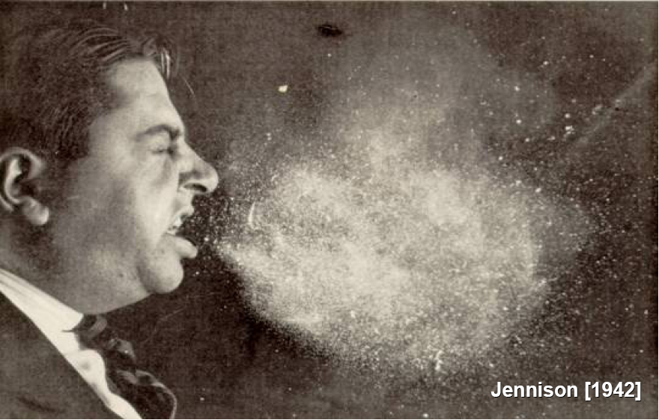
Violent sneeze
Resistant organism are spread the same way as sensitive organisms

Slide 11
Drug Resistance
Occurs when micro-organisms are not killed or inhibited by a specific antibiotic due to the selection of naturally occurring resistant mutants through inadequate therapy
Clinically manifested by disease progression despite treatment, failure to achieve negative sputum or cultures, and/or treatment failure

Slide 13
Classification of drug resistance (old classification)
Primary resistance – infection with a resistant strain.
Initial resistance – Patient with DR-TB and past history of TB treatment but duration of treatment unclear or no documentation available
Acquired resistance – infection with a susceptible strain which becomes resistant due to inadequate treatment or patients with history of past TB treatment lasting more than 1 month

Slide 14
Pathophysiology of resistance
Mono-therapy is one of the causes of drug resistance
Mutations lead to resistance to drugs.
These mutants are:
normally resistant to a single drug
independent of each other,
occur in predictable frequencies in non-treated populations of tuberculosis mycobacteria.
Resistance to H and S occur naturally in one in a million bacilli.
Resistance to R: one in 100 million bacilli.
Notes:
Mutations leading to resistance to one drug occur independent of mutations leading to resistance to another drug
The mutations occur to naïve mycobacteria bacteria in the populations i.e. mycobacteria that has not been exosed to antiTbs before
14

Slide 15
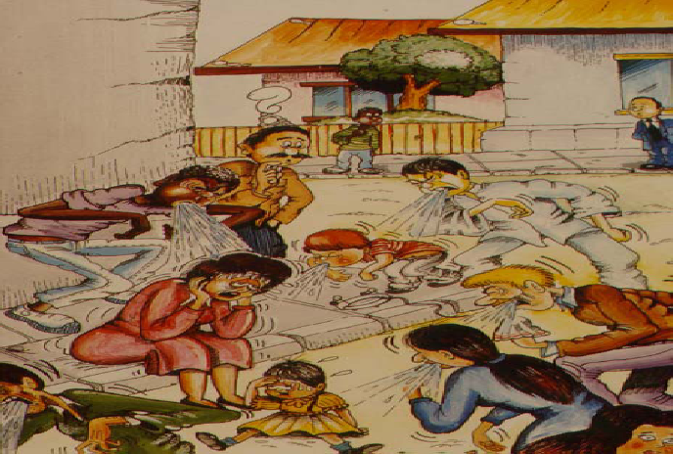
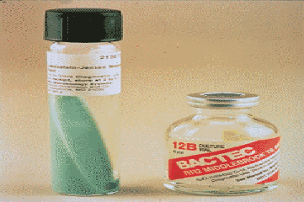
Diagnosis of MDR-TB and XDR-TB
History!!! Culture and DST

Slide 16
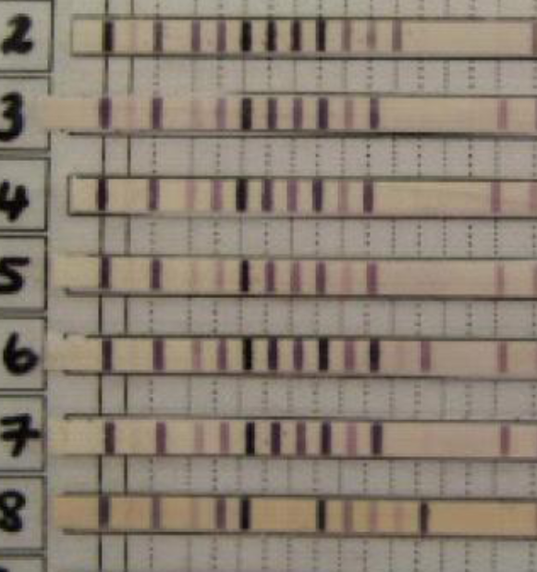
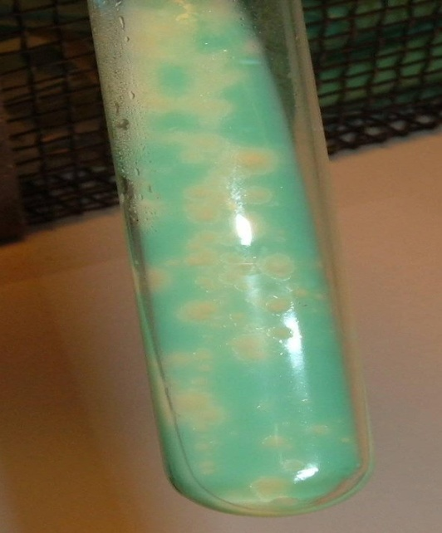
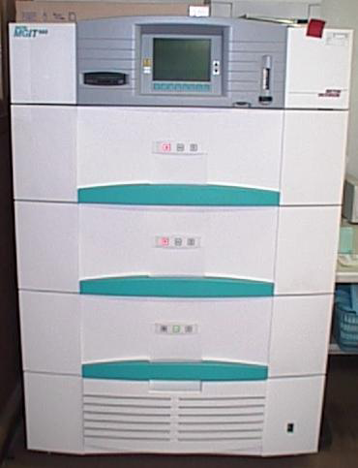
MDR TB Diagnosis
TB Microscopy
Chest XR
GeneXpert
Line probe assay
Culture & 1st & 2nd line DST

Slide 17
History taking
History of mono / single drug use /therapy of one month or more is best predictor of MDR
Use of any second line drug?
Proper history is key, but takes time

Slide 18
SURVEILLANCE
MDR TB Surveillance – High risk groups
All previously treated patients: a)Failures b)Relapses c)Treatment after loss to follow up
DR TB contacts
Refugees with Symptoms of TB
Health care workers with TB symptoms
Smear positive at 2 months
Patients who develop TB on IPT
TB Diagnosis** - using Xpert
HIV positive with TB symptoms after screening with TBICF/IPT tool
Children under 15 years with TB symptoms
All people living with HIV with TB symptoms
In areas with GeneXpert: this should be the first test.
Patients diagnosed with GeneXpert should be followed up with microscopy

Slide 19
Indications for Culture and DST
Retreatment- RAD, failures, relapses.
Smear + at 2 months of antiTB treatment.
MDR-TB contacts
Drug resistance to establish the resistance pattern either for survey or for the implementation of DOTS-Plus
Patients who develop active TB while on or after IPT
As a gold standard in research and before implementation of new diagnostic tools

Slide 20
TB Treatment
Aims of TB treatment
To cure patient of TB
To prevent death from TB
To decrease TB transmission
To reduce TB relapse/recurrence
To prevent drug resistance
Basic Principles
Never use single drugs
Always use drugs in combinations- fixed Dose Combinations (FDCs)
Drug dosage based on weight
Drug intake should as far as possible be directly observed.
Ensure the entire 6-8 months treatment is taken
Notes:
20

Slide 21
Classification of drug-resistant TB
Term | Resistance profile
Presumptive MDR TB - | patient who presents with symptoms or signs suggestive of TB(previously MDR TB suspect- no bacteriological confirmation))
Mono-resistant | Resistance to One drug
Poly-resistant | At least two drugs (excluding both H and R)
Multidrug resistant (MDR) | At least H and R
Rifampicin resistant (RR) | At least R resistance (detected using phenotypic or genotypic methods, with or without resistance to other anti-TB drugs)
Pre- XDR | MDR TB plus resistance to either a Fluoroquinolone or injectable but not both
Extensively drug resistant (XDR) | H and R plus a second line injectable and a quinolone
Notes:
21

Slide 22
Classification of drugs.....
Group 1- oral 1st line | Isoniazid,Rifampicin,Ethambutol,Pyrazinamide
Group 2- injectable agents | Streptomycin,Amikacin,Kanamycin, capreomycin
Group 3- quinolones | Ofloxacin,ciprofloxacin,levofloxacin, Moxifloxacin
Group 4- Agents | Ethionamide,Cycloserine,PAS
Group 5-Other agents | AMX/ CLV, Clofazimine, Clarithromycin, Linezolid

Slide 23
Standardized Treatment Regimen
Constructing an Individualized Category 4 Regimen
Include at least 5 drugs.
Include Pyrazinamide from the first line anti TB drugs.
Include an injectable for a prolonged period.
Include a quinolone
Include 2 drugs from Grp4
Consider drug resistance data (of individual or region) and patient treatment history when designing a regimen.
Notes:
Please insert the Dr TB regimen
23

Slide 24
Management Of Types Of Drug Resistant TB
Mono-resistant TB
Duration of 9 months
Drugs used are: kanamycin, levofloxacin, Rifampicin, pyrazinamide
Poly resistant drug TB
Duration of 18 months
Drugs used are: kanamycin, levofloxacin, rifampicin, pyrazinamide

Slide 25
Treatment strategies for MDR-TB
Total duration of 20 months
Intensive phase
8 months
Drugs used: Kanamycin, prothionamide, levofloxacin,cycloserine and pyrazinamide
Continuation phase
Duration of 12months
Drugs used: protinamide (Pto), levofloxacin,cycloserine, pyrazinamide

Slide 26
Common adverse reactions of second line drugs
Ethionamde/ protionamide: GI disturbance, hepatitis, hypothyroidism
PAS: GI disturbance, hepatitis, hypothyroidism
Cycloserine: depression, suicidal ideation, convulsion
Aminoglycoside: pain at injection site, renal toxicity and ototoxicity, hypokalemia
Fluoroquinolone: better tolerated than other second line drugs

Slide 27
Clinical and Lab follow up
Clinical follow up:
Patient to be seen at diagnosis, two weekly, then monthly till completion of treatment
Audiometry ( those on Aminoglycosides) at baseline, then monthly for the first 8 months
Weight and height at baseline, then monthly

Slide 28
Lab monitoring:
LFTs (those on PAS/ Ethionamide/protionamide ) at baseline, monthly up to 3rd month, then month 6,9,12,15,18
Creatinine and potassium ( those on Aminoglycosides) at baseline, monthly up to 8 months
TSH ( those on PAS/ Ethionamide / prothionamide ) at baseline, month 6,12 and 18
Chest x-ray – at baseline, month 6, 12,18
Full haemogram- at baseline , month 3,6,12,18
Smear and culture- baseline then monthly till completion of treatment
Drug sensitivity test( DST)- baseline then at 6 months

Slide 29
Thank you

Slide 30
Reference
SLIDES | Reference
Slide 3 | WHO global TB report 2014
Slide 4 | WHO global TB report 2013
Slide 5 | Kenya national TB program
Slide 7,8,9, | WHO and National TB program
Slide 10,11,12,13,14,15,16,17,18,19,20,21,22,23,24, | Kenya national TB program

