Slide 1
Cerebral Toxoplasmosis in Hiv Infection

Slide 2
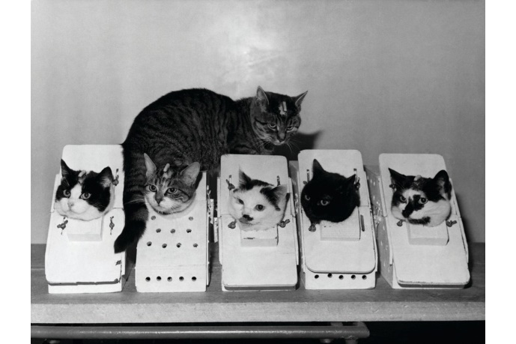
Notes:
In May 1941, the German battleship Bismarck was sunk, with only around 110 of the 2,300-strong crew surviving. But from the water, a cat was rescued by the crew of HMS Cossack, who named him Oscar.
The Cossack then suffered a torpedo attack and sank near Gibraltar. Oscar survived again – and became ‘Unsinkable Sam’ – but bad luck still stalked the poor cat. He was picked up by HMS Ark Royal, which was later torpedoed near Malta.
Félicette was sent into space by CNES (the French government space agency) on October 18, 1963; they studied her neural responses via electrodes implanted in her brain. She earned her literal 15 minutes of fame, spending just a quarter of an hour up there before retrieval by parachute descent

Slide 3
Notes:
is a ghost cat that haunts the United States Capitol in Washington, D.C. The tale of its origin varies by who you ask. Some say the cat is the mother of a litter that was disturbed during construction of the Capitol. Others say it is the last, undead survivor of a colony of cats brought in to clear the rat population in a bygone era. Most sightings have taken place prior to national disasters, such as assassinations of public figures or stock market crashes

Slide 4
Toxoplasmosis is caused by Toxoplasma gondii, a small intracellular protozoa
Cats are definitive hosts; humans acquire it through ingestion of oocysts from cat faeces or from tissue cysts in undercooked meat
Vertical transmission causing Congenital Toxoplasmosis may occur in pregnant mothers with acute toxoplasmosis
Notes:
T. gondii was first described as a human pathogen in 1939 at Babies Hospital in New York City.^{[10][81]} Wolf, Cowen and Paige identified T. gondii infection in an infant girl delivered full-term by Caesarean section.^{[36]} The infant developed seizures and had chorioretinitis in both eyes at three days. The infant then developed encephalomyelitis and died at one month of age. Wolf, Cowen and Paige isolated T. gondii from brain tissue lesions. Intracranial injection of brain and spinal cord samples into mice, rabbits and rats produced encephalitis in the animals.^{[10]} Wolf, Cowen and Page reviewed additional cases and concluded that T. gondii produced recognizable symptoms and could be transmitted from mother to child.^{[36]}

Slide 5
Toxoplasmosis Cycle

Slide 6
In PLHIV. toxoplasmosis disease is almost always (>95%) a result of reactivation of old CNS lesion or spread through the blood stream of previously acquired infection
CD4 usually <100 cells/mm3 with greatest risk of disease in those with CD4 <50. Clinical disease is rare in patients with >200cells/mm3.
Prevalence in Kenya unknown but is however seen less than TBM and Cryptococcal Meningitis.
Leading cause of focal CNS disease in PLHIV
Notes:
Due to its asymptomatic nature,^{[11][12]} hosts easily become infected with T. gondii and develop toxoplasmosis without knowing it. Although mild, flu-like symptoms occasionally occur during the first few weeks following exposure, infection with T. gondii produces no readily observable symptoms in healthy human adults.^{[7][17]} In most immunocompetent people, the infection enters a latent phase, during which only bradyzoites (in tissue cysts) are present;^{[18]} these tissue cysts and even lesions can occur in the retinas, alveolar lining of the lungs (where an acute infection may mimic a Pneumocystis jirovecii infection), heart, skeletal muscle, and the central nervous system (CNS), including the brain.^{[19]} Cysts form in the CNS (brain tissue) upon infection with T. gondii and persist for the lifetime of the host

Slide 7
Clinical Presentation
Symptoms
Headache
Fever
Confusion, altered mental state
Muscle ache , joint pain
Signs
Fever
Focal neurological signs- hemiparesis , hemianopia ,aphasia , ataxia, cranial nerve palsies
Pneumonitis
Chorioretinitis
Hepatosplenomegaly

Slide 8
Diagnosis
A *presumptive* diagnosis is considered in patients who are
severely immunocompromised (CD4 <100 cells/mm3)
Focal encephalitis features with headache fever seizures altered mental state and
Focal neurological deficits
Anti-toxoplasma IgG Serology – if rising in patients with the above symptoms, it supports our diagnosis. However, it doesn’t tell us whether the infection is currently active or was a past infection.
IgM testing can be done to ascertain if it is current, especially in pregnant mothers
CSF findings are non-specific.

Slide 9
Imaging
CT Scan
Ring enhancing hypodense lesion with contrast indicating mass effect.
Could be single(30%) or multiple
Often in the basal ganglia ( approx.75%) or cortico-medullary region
Calcifications seen in treated pts
Pathologically :
a central avascular zone of coagulative necrosis
an intermediate vascular zone containing numerous organisms
an outermost zone of encysted organisms; Toxoplasma lesions do not have a capsule
Notes:
following the IV administration of contrast medium, CT scan studies demonstrate thin-walled cavitating lesions with ring enhancement. Edema of the surrounding white matter is often depicted as well.
Toxoplasmosis has a propensity to involve the basal ganglia. Approximately 75% of the nodules are located in the basal ganglia, but others are scattered throughout the brain at the gray matter–white matter junction. In addition, lesions may occur within the cerebellum, brainstem, and spinal cord

Slide 10
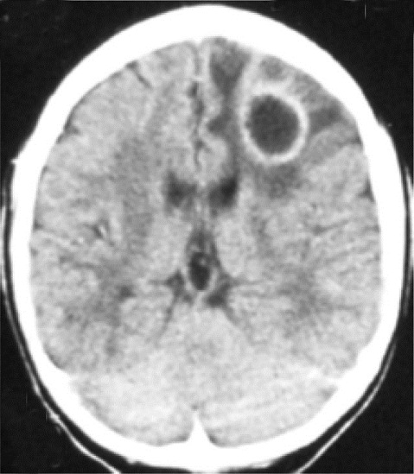
Notes:
Non-contrast CT scan showing an extensive hypodense lesion in the area of the right basal ganglia with mass effect. (b) Contrast enhancement shows multiple ring enhancing lesions within the hypodense mass
CT scan image of the brain showing solitary ring enhancing lesion in the left frontal lobe in a patient with HIV/AIDS

Slide 11
Notes:
Panel (a) Post-contrast axial CT showing a large deep lesion in the left hemisphere with significant edema, mass effect, and contrast ring enhancement. A second smaller lesion seems to be present behind the bigger one. Panel (b) Post-contrast axial T1-weighted MRI taken 3 weeks after anti-Toxoplasma treatment showing a marked reduction in lesion size, mass effect, and edema

Slide 12
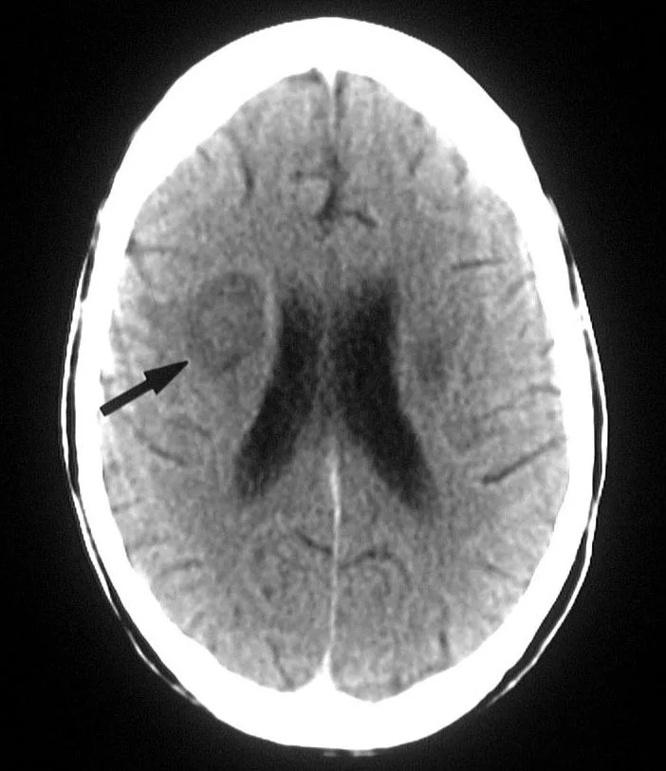
MRI
Notes:
T1-weighted axial brain magnetic resonance image at the level of the basal ganglia in a 24-year-old man with human immunodeficiency virus infection. The image shows hypointense lesions in the region of the thalami (arrows) caused by toxoplasmosis
T1-weighted axial brain magnetic resonance image at the level of the upper lateral ventricles in a 24-year-old man with human immunodeficiency virus infection (same patient as in the previous image). The image shows a hypointense mass compressing the right lateral ventricle (arrow)

Slide 13
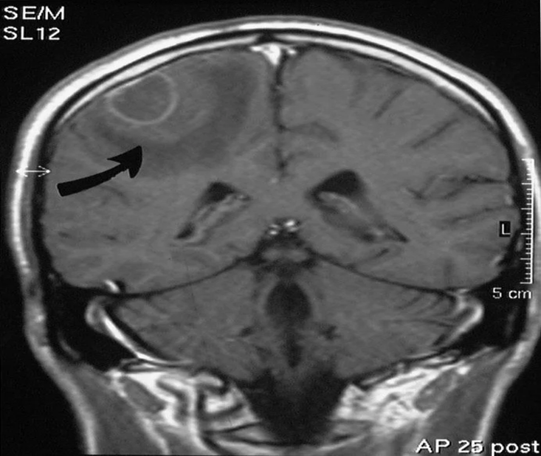
Notes:
T1-weighted axial gadolinium-enhanced magnetic resonance image at the level of the basal ganglia in a 37-year-old patient with human immunodeficiency virus infection. The image shows 2 complex, ring-enhancing lesions in the basal ganglia on the right, surrounded by notable white matter edema.
T1-weighted gadolinium-enhanced magnetic resonance image at the level of the fourth ventricle in a 32-year-old patient with human immunodeficiency virus infection. The image shows a peripheral, right frontoparietal ring-enhancing lesion (arrow). The patient presented with a solitary space-occupying lesion, which was confirmed to be secondary to toxoplasmosis.

Slide 14
Differential DIagnosis
Usually difficult to differentiate it from CNS Lymphoma on imaging
If multiple, more likely to be Toxo because lymphomas are more likely to be solitary
CNS Lymphoma have subependymal spread as compared to basal ganglia and corticomedullary regions in Toxo
PET/SPECT with Thallium to distinguish them; Minimal or no uptake (cold lesion) in Toxo
Also, if no improvement to adequate anti-toxoplasma treatment also consider alternative diagnosis
CXR as part of consideration of a diagnosis of TBM. Differentiation of toxo from tuberculous meningo-encephalitis may be impossible on clinical and radiological findings alone.

Slide 15
Treatment
Preferred Regimen
Pyrimethamine 200mg LD , then 50-75mg/day +
Sulfadiazine 1000-1500 mg P.O 6hrly +
Folinic acid (Leucovorin) 10-20 mg/day PO
*Folinic acid dose may be increased to >50mg/day to decrease Pyrimethamine associated hematological toxicity. Folate is not a substitute for folinic acid
Alternative Regimen
Cotrimoxazole 5mg/kg of Trimethoprim or 25mg/kg of CTX BD for 6wks
Treatment lasts for 6 weeks

Slide 16
Treatment
Improvement demonstrated on CT or MRI within 2 weeks with reduction in mass effect and ring enhancing lesion.
If no improvement suspect Primary CNs Lymphoma or TB Brain Abscess
If intracerebral oedema suspected clinically ( papilloedema on fundoscopy or on CT scan) give Dexamethasone 4mg PO or IV QID
CNS Lymphoma likely to improve with steroid use, so this may confuse diagnosis
Anticonvulsants may also be used in patients with seizures and continued at least during acute illness
Toxoplasma antibody levels are not useful for monitoring response to treatment

Slide 17
Maintenance and Prophylaxis
Pyrimethamine 25-50 mg/day PO + Sulfadiazine 500-750mg QID PO + Folinic acid 5mg/day
OR
Cotrimoxazole in the standard prophylactic dose of 960mg OD
Continued until documented sustained immune reconstituition ( CD4 >200cells/mm for > 6months)
Primary prophylaxis is still CTX 960mg OD and is continued indefinitely regardless of immune status of the patient

Slide 18
Take Home Message

