Slide 1
OSCE 006

Slide 2
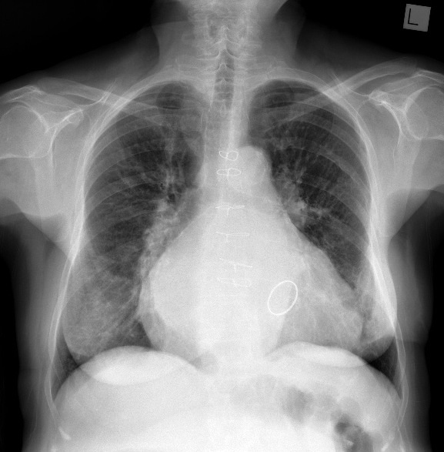
QN 1
Notes:
Case courtesy of Dr Alexandra Stanislavsky, Radiopaedia.org, rID: 20314

Slide 3
Interpret the above finding
Give the diagnosis
What signs are expected on cvs exam
Describe the management

Slide 4
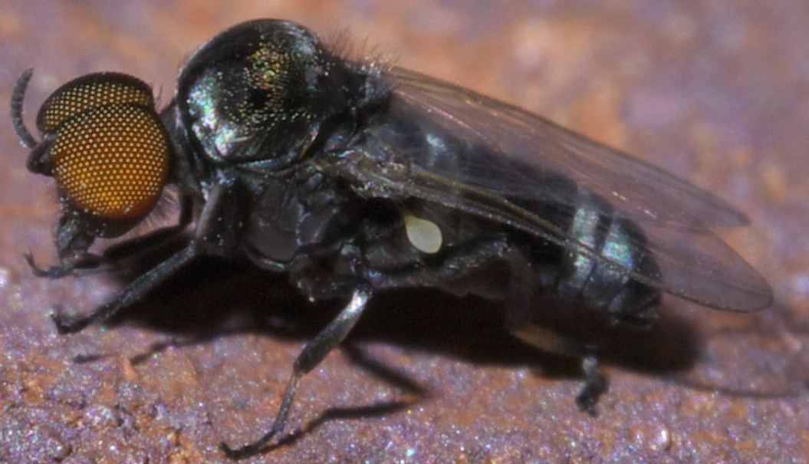
QN 2
Notes:
By xpda - Own work, CC BY-SA 4.0, https://commons.wikimedia.org/w/index.php?curid=67748232

Slide 5
Name the above vector and its disease
Name the stages of the life cycle
Describe the management with respect to the stage

Slide 6
QN3
A 12 year old girl with known Diabetes Mellitus presents to you in casualty with suspected DKA
Give the diagnostic criteria
Describe the management steps

Slide 7
QN 4

