Slide 1
iMed

Slide 3
A 19 year old male with known Heart disease presents with progressive difficulty in breathing, lower limb swelling. On examination you find the apex is displaced to 6th ICS AAL, with a pansystolic murmur radiating to the axilla, loudest in expiration.
What targeted History and Physical examination would you look out for?
Your full hemogram reveals a significant leukocytosis and raised ESR; List two priority laboratory and imaging investigations would you request? [give reasons]
Formulate your diagnosis.
Describe the principles of management for this patient.
Notes:
History relevant for HF [triggers], RHD [risk factors and previous dx], IE
Lab [Blood culture, UECs, CRP, BNPs, Coagulation] imaging [ECG, Echocardiogram, CXR]
Known RHD with MR, in CHF secondary to IE [infection]
prophylaxis,
Heart Failure [ABCs, - Oxygen, Prop Up, Fluid & Salt restriction, Medication [Diuretics, ACE, B Blockers(Carvedilol, Bisoprolol, Metoprolol, Nebivolol) , MRA (Spironolactone, Eplerenone)] in MS use Atenolol
RHD [Surgery, prophylaxis]
ARF [Antibiotics, Salicylates & NSAIDs, CHF, Bed Rest, Chorea, Prophylaxis]
IE [IV Antibiotics, antithrombotics, Surgery]
Counselling

Slide 4
A 45 year old known hypertensive who has been managed for two episodes of heart attacks and non compliant to medication, presents with an acute onset of left sided body weakness and facial nerve palsy. Examination reveals an irregularly irregular radial pulse.
Relevant Further History and Physical Exam.
What principal investigations would you carry out? 2 Laboratory, 2 Imaging
What is the likely diagnosis?
Outline the Principles of management of this patient
Notes:
RF of A fib and Ischemic Stroke
Lipid profiles, RBS
A Fib, Ischemic Stroke
Stroke
ABCs
Hx & E
Monitor
If within 4.5 hrs – tPA
Later: Start
npo
Thrombolysis
Antiplatelet
Anticoagulants
Statins
A Fib
ABCDE
Rythm Control: Acute [Cardioversion – Defibrillators DC or Flecainide (CI in structural Haert dx)or Amiodarone] Chronic >
Rate Control [B Blockers]
Anticoagulation [CHADVASC Score 1 – Equivocal, 2 – Anticoagulate]
Correct underlying cause

Slide 5
A 25 year old known asthmatic presents with 2 hour history of wheeze. Talks in words, hunched forward, resp rate of 32, pulse of 124, SPO2 of 89%.
Further History and Physical Examination [Report possible findings]
Two most important investigations you will carry out for this patient.
Outline the Principles of manegent for this patient. Include a written plan of treatment.

Slide 6
A 24 year old who recently visited western Kenya now presents with a history of progressive muscle aches, paroxysmal fevers, for which he took antibiotics but has not improved. He is comatose and the lab results from the peripheral facility show a Haemoglobin of 5g/dl.
What findings do you expect to on further history and Physical examination.
What is the diagnosis
Based on your diagnosis, what other critical investigations would you carry out to guide the management [give reasons and possible findings]
Outline the possible causes of death in this patient.
Outline the supportive and definitive management of this patient.
Chemoprophylactic agents

Slide 7
A 12 year old boy presents to the casualty with history of increased thirst and appetite over tha past 3 months, and abdominal pain and shorteness of breath over the last 24 hours.
What further History and Physical Examination would you elicit from the patient?
What is your diagnosis?
Outline the critical tests you would do to confirm your diagnosis
Outline the principles of managing the boy.
Outline the follow up plan and possible complications of this condition and their management.

Slide 8
20 yr old boy with 4 day history of progressive ascending paralysis with no sensory loss or sphincter disturbances.
Important History and Physical Examination Findings
Outline the 3 most important Investigations and findings
What is the most likely diagnosis?
Outline your plan of Management
What are the possible complications.

Slide 9
56 year old presented with cough, sputum production and exertional dyspnea. On general inspection the patient is in the tripod position and is cyanosed.
What is the most likely diagnosis
Outline
Risk Factors
Important Physical findings
Laboratory Investigations
Management principles in the acute exacerbations and stable state.

Slide 10
30 year old 4 month pregnant female presented with a history of hot flushes, irritability and awareness of her heartbeat.
What further history would you evaluate for?
Outline the possible findings on physical examination
What 3 most important investigations would you carry out.
Outline the medical management of this patient

Slide 11
A 17 year old female presents with a progressive morning facial puffiness, and foamy urine followed with a generalized body swelling.
What are the important diagnostic studies for this patient? [outline the possible findings]
What are the possible causes of this condition?
Outline the principles of management for this patient.
Outline the haematologic and cardiovascular complications associated with the condition over time.
How would you intervene to slow down the progression to ESRD?

Slide 12
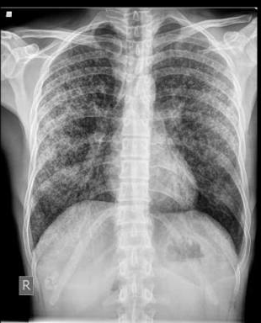
This is a CT scan of a 34 year old male who has been on prednisone for 4 months who presents with productive cough, fever headache and neck stiffness over 2 weeks.
What is the most likely diagnosis from the imaging done? [give reason]
What confirmatory test would you do? [describe findings]
Would you do a lumbar puncture for this patient? [Give reasons]
Outline the management of this patient

Slide 13
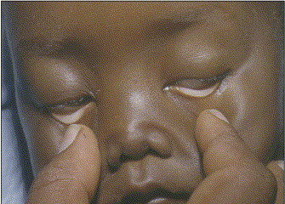
7 year old presented with severe hands and toes following the onset of febrile pharyngitis. The elder brother passed on following a similar episode.
What is the most likely diagnosis?
Describe the confirmatory tests you would do?
Outline the management of this patient.

