Slide 1
BACTERIOLOGY SPOT TEST REVISION
KIMAIGA H.O
MBChB (University of Nairobi)

Slide 2
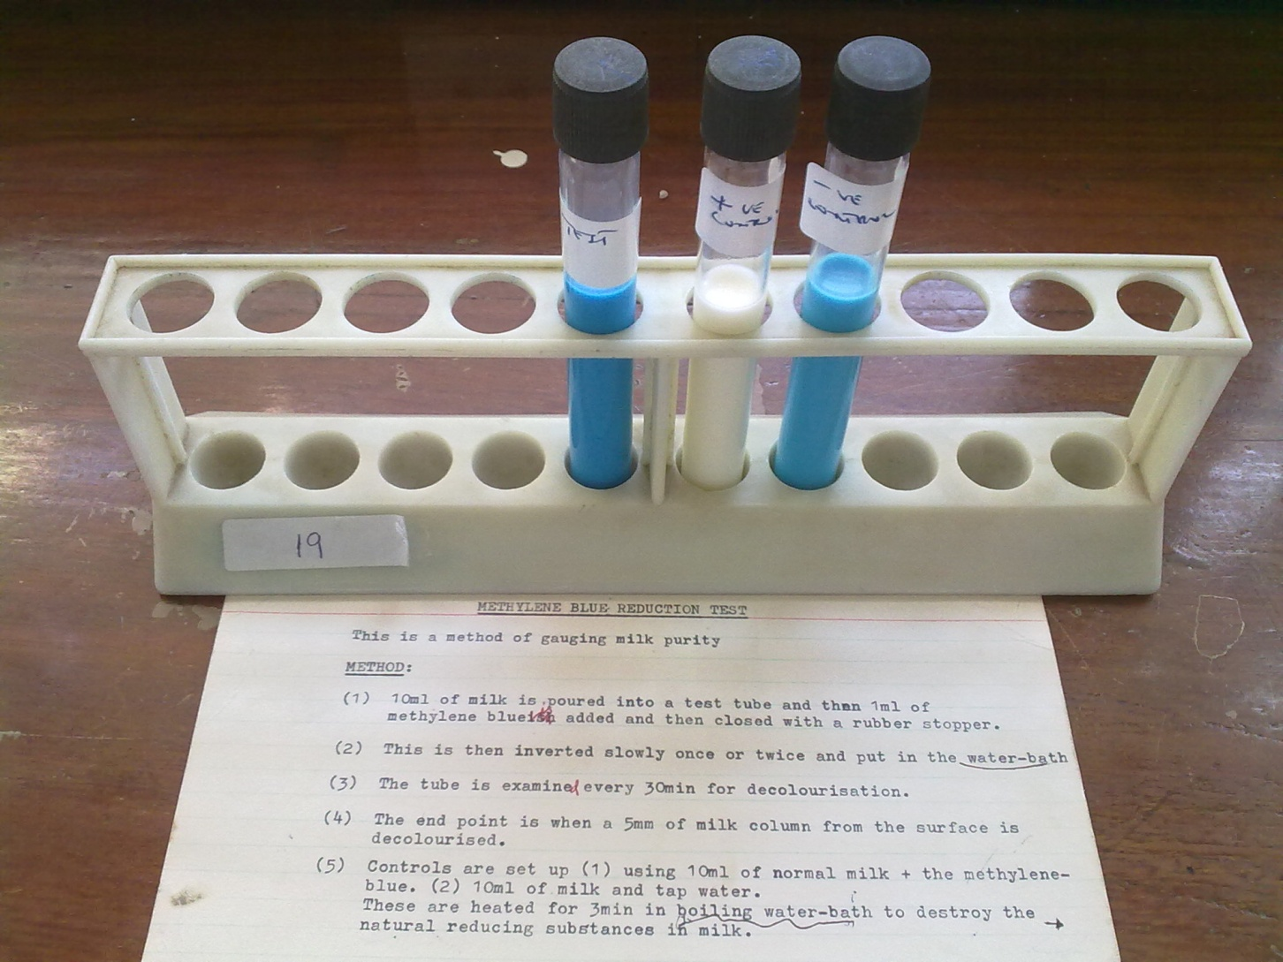
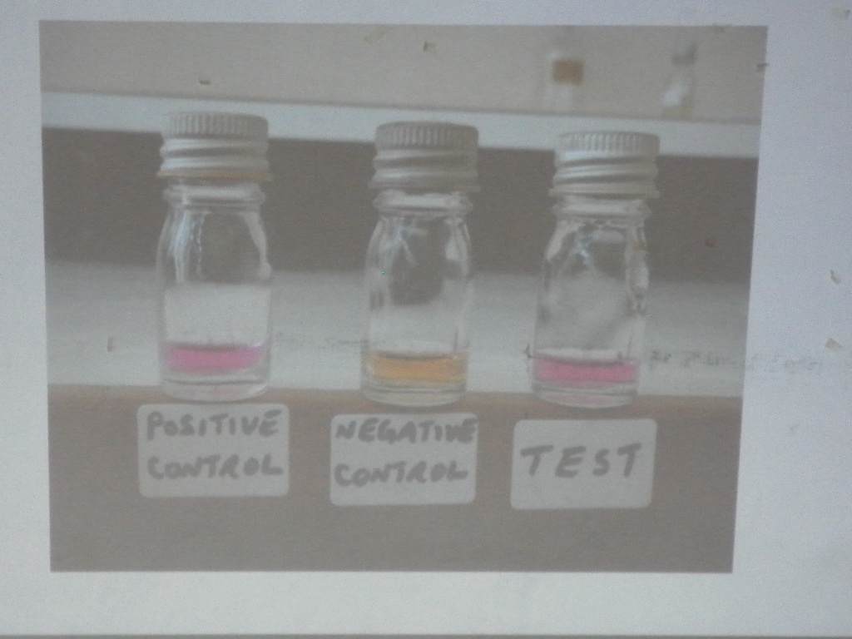
Lab results from patient with pyrexia of unknown origin after drinking milk
Identify the test shown?
  Milk methylene blue reduction test
Whats the relevance?
  Gauging milk purity. If pure it doesn’t reduce methylene blue.
Name the most likely organism
What is the characteristic pyrexia observed in the patients?

Slide 3
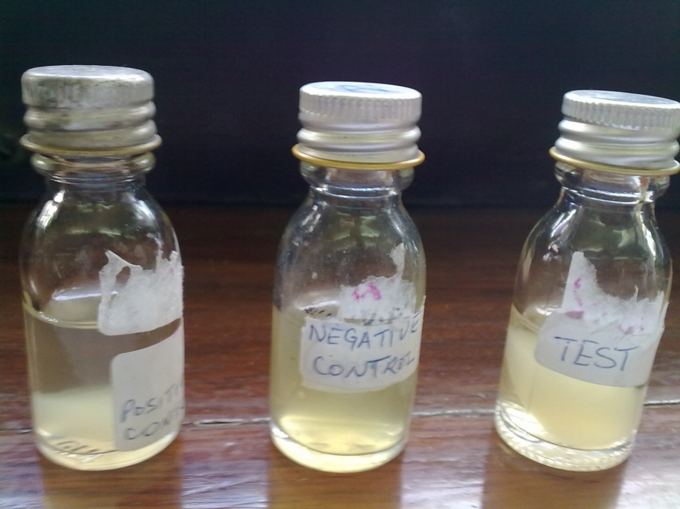
Name two organisms that can be differentiated using this test
  S. Epid, S. Aureus.
Name three virulence factors associated with positive test organism.
  Hyaluronidase, enterotoxin, beta lactamase, exfoliatin, coagulase, protein a, lipase

Slide 4
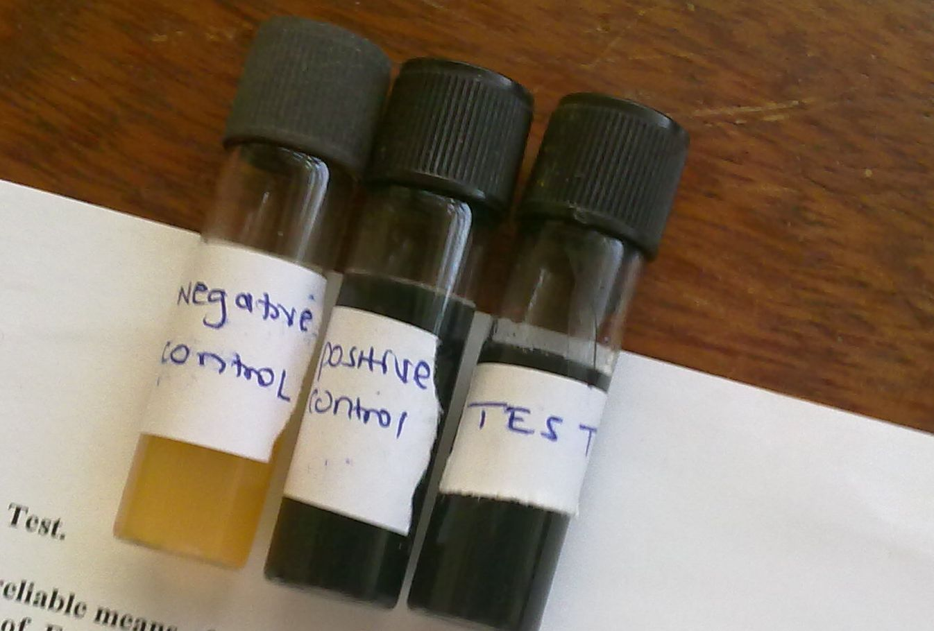
Name the organism that tests positive?
  Enterococcus faecalis.
List two diseases associated with it?
  Puerperal sepsis, enterocolitis, sub-acute bact endocarditis, UTI’s, wound infections , meningitis, resp tract infections

Slide 5
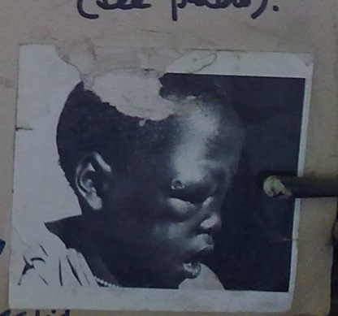
Name the dx and the causative microorganism? Maligant pustule of cutaneous anthrax. Caused by bacillus anthracis.
Name two other diseases caused by the microorganism? Pulmonary haemorrhage, septicaemic anthrax, severe fulminating gastroenteritis,

Slide 6
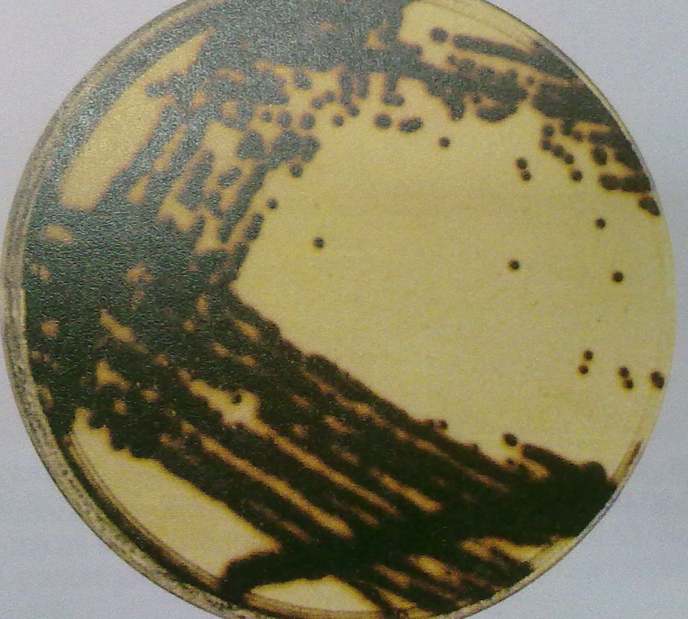
Name the media and the microorganism isolated?
Mention to other test used to identify the microorganism?

Slide 7
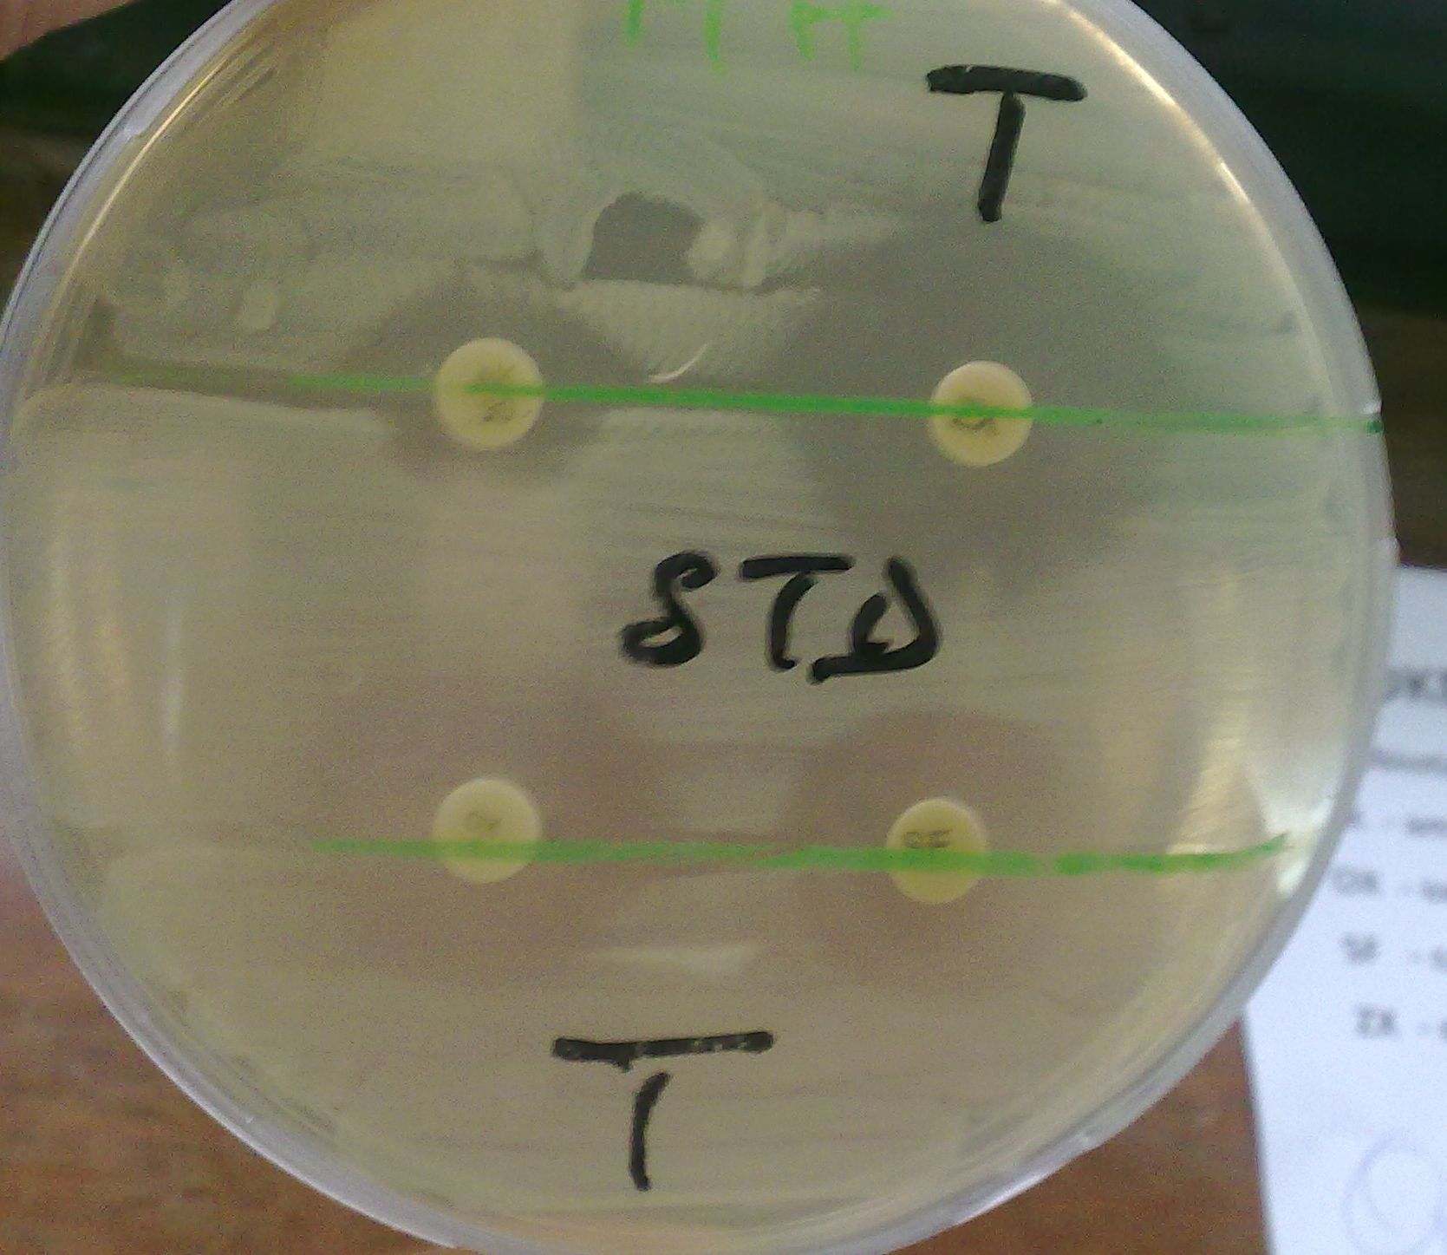
Name the method of antibiotic sensitivity testing
  Stokes method
Read and record the results.

Slide 8
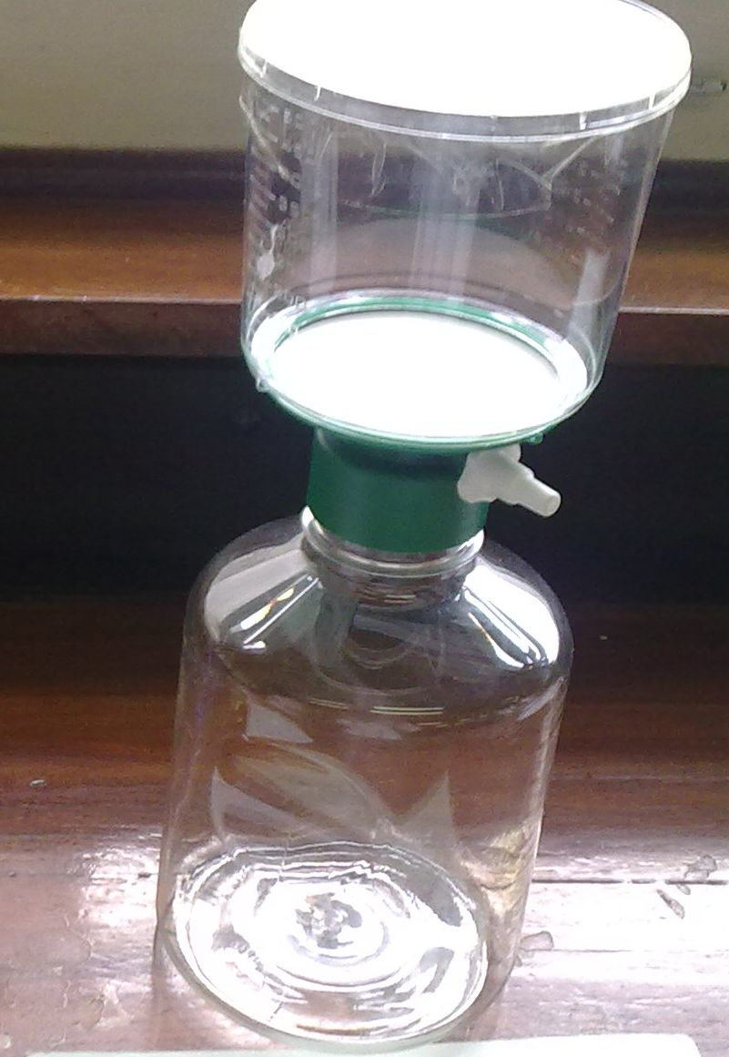
Name the setup below?
  Microfilter
Name three vital uses and its relevance?
  Purifying antibiotic solutions
  Filtering microfilaria from blood
  Serum.

Slide 9
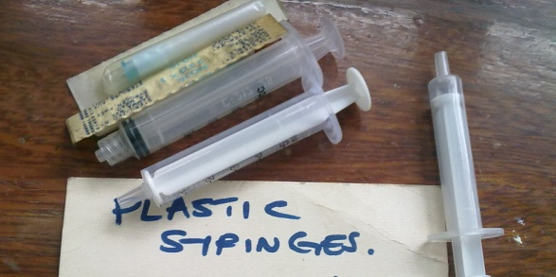
What do we use to sterilise the equipment shown?
  Gamma radiation
Mention three methods of testing the efficacy of sterilisation procedures?
  Spores of bacillus stearothermophilus(autoclave), bacillus subtilis( hot air oven), brown’s tube, bowie dick tapes, autoclave tapes.

Slide 10
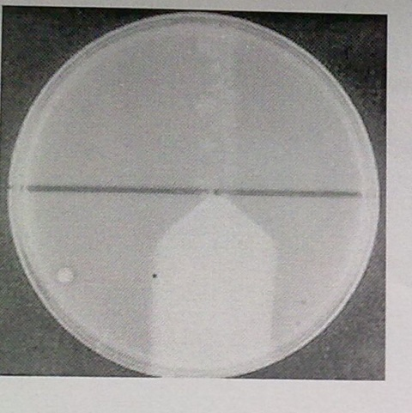
Give the name of the test shown? Nagler reaction
Name the organism that shows the feature and the disease it causes? Clostridium Perfringens

Slide 11
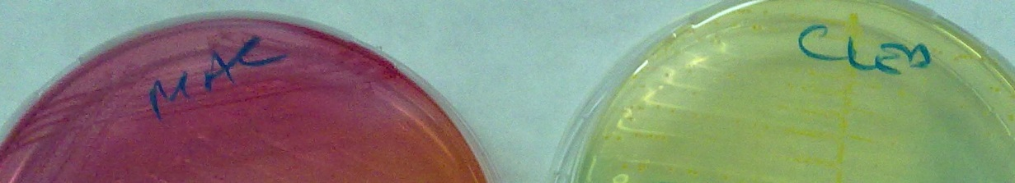
Give two organisms that shows the feature shown? E. Coli, Klebsiella, enterococcus faecalis
Name two methods used to diff the two? TSI: e.coli( acid acid gas no h2s), KSM, kleb tsi( acid acid gas no h2s) urease test… ecoli(+) klb(-)

Slide 12
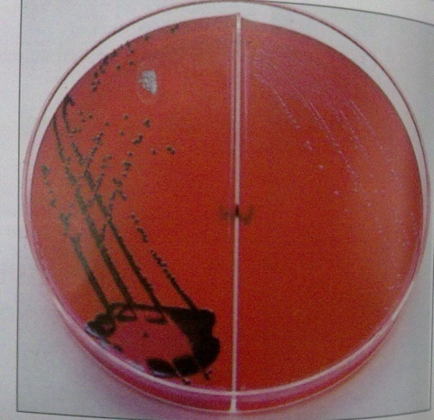
Name the organism in the culture shown? Salmonella Typhi, shigella
How can you differentiate the two organisms? TSI. Sal(alk acid gas h2s), shigella(alk acid nogas no h2s) XLD

Slide 13
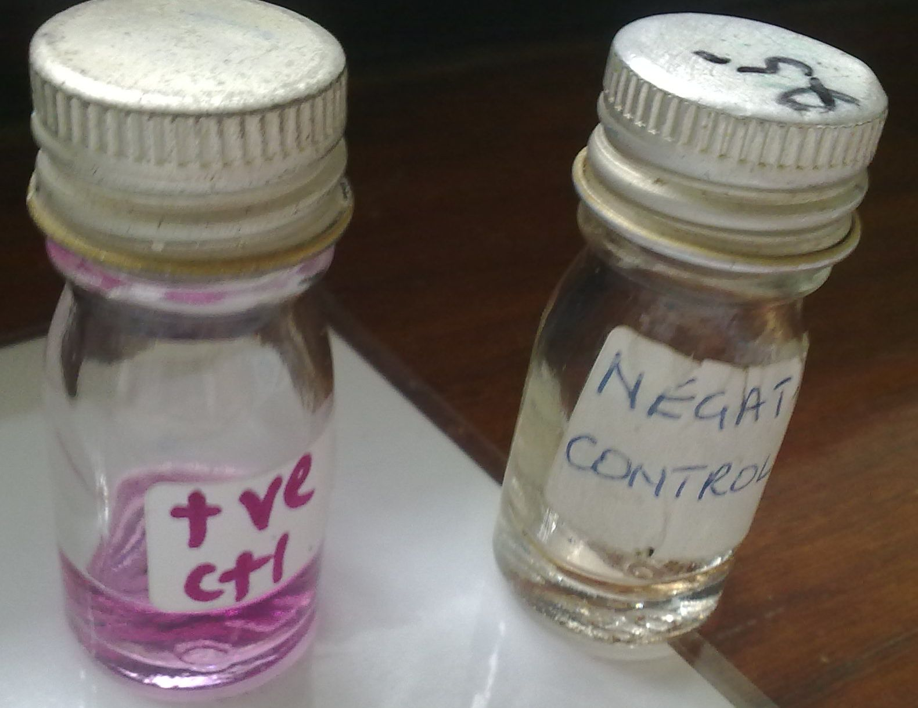
Identify the +ve test organism
List two dx ass with organism mentioned? Proteus, ureaplasma, morganella, klebsiella, serratia, H.pylori, cryptococcus neoformans,, brucella.
Diseases include:
H.Pylori-gastric and
duodenal ulcer.
stomach cancer
gastric MALT
lympoma .
Proteus: UTI, wound
infection, ear infxn
brain abscess

Slide 14
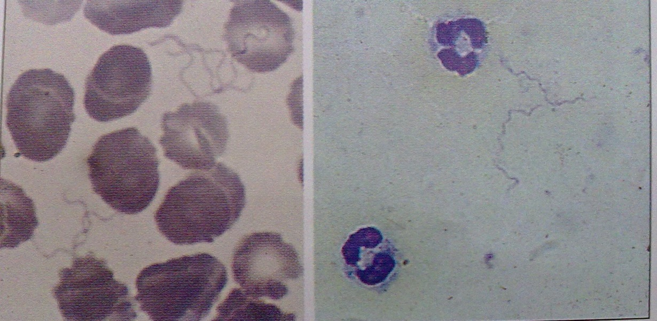
Borrelia.romanowsky stain. Thin and thick blood stain (L$R)
Name the vector for the organism shown? Borrelia recurrentis causes louse-borne
Relapsing fever.

Slide 15
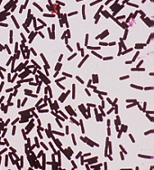
Name two organisms which show the same feature?
G+ve rods(corynebacterium, bacillus, clostridium)
Probably C. diphtheria (pallisade arrangement)
Name dx ass with the organism shown?
Pseudomembrane formation, difficulty in breathing,
Swelling around neck
Complications: damage to peripheral nerves, heart muscle and adrenal glands.

Slide 16
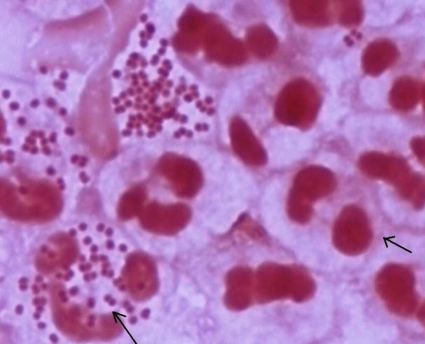
Mention two virulence factors of the organism shown?
Org is N.gon
IgA protease
LOS, Pili, Porin A(inactivates C3b component
Of complement.
Name the dx in newborns caused by the organism?
Ophthalmia neonatorum.

Slide 17
Mention three virulence factors of the organism shown?

Slide 18
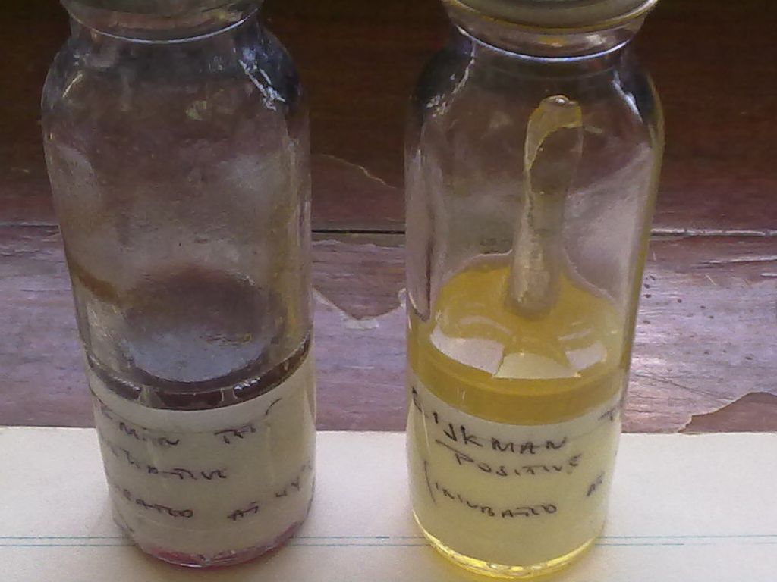
Name the test shown and the +ve org? Eijkmans test forfeacal strain of e.coli

Slide 19
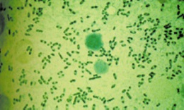
Identify the bacteria shown below. yersinia
State one reason for your identification.
Bipolar staining
Name the stain used in identification of the organism.
Wayson, or Giemsa

Slide 20
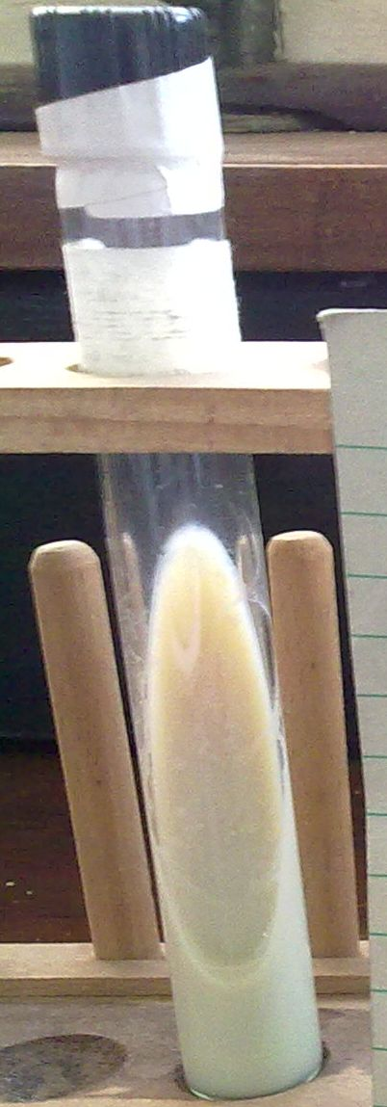
Identify the organism cultured in the media below? Loefflers serum slant
Name the 2 components of the media?serum, nutrient broth,
glucose

Slide 21
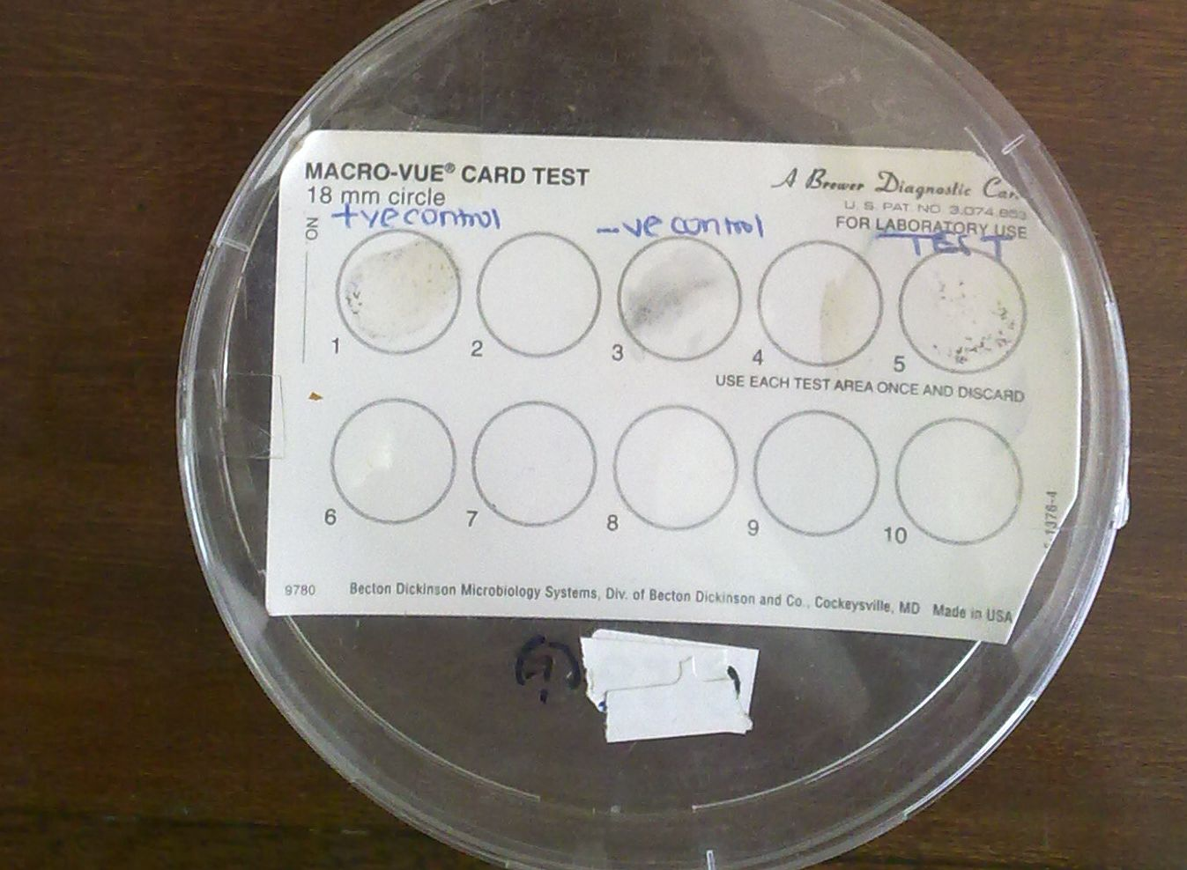
Give the name of the test org.?
Treponema pallidum

Slide 22
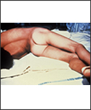
Identify the condition shown and the causative organism.
Tetanus(Arching back)
Clostridium tetani.

Slide 23
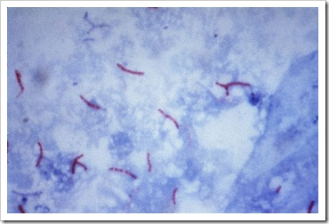
Name the organism isolated from sputum and the staining technique used.ZN stain. MTB

Slide 24
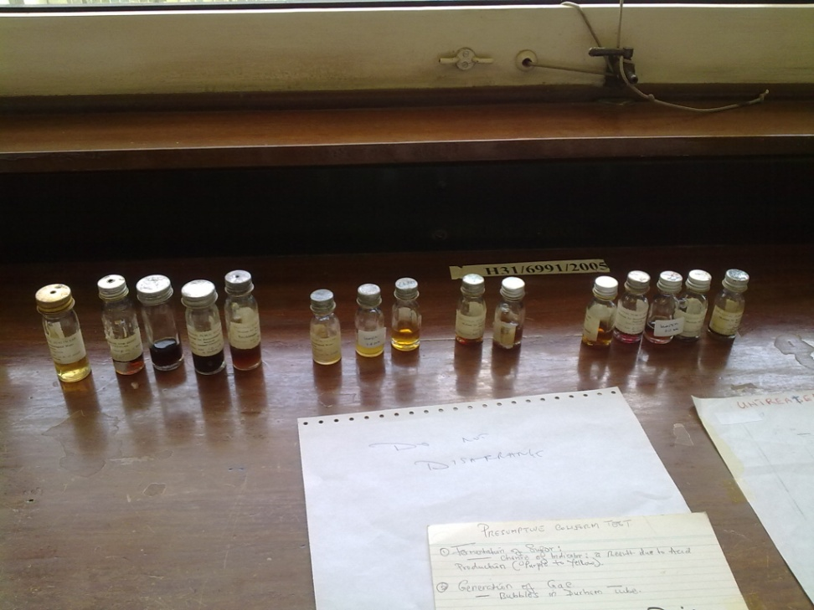
The bottles are arranged 10ml,1ml,0.1ml
In bacteriological examination of untreated piped water
Read and record the MPN of org./100ml
Comment on the suitability of the water for drinking.

Slide 25

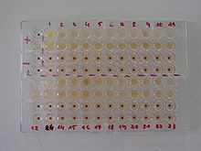
Serological test on a specimen from a patient with history of genital ulcer disease
Name each test. RPR test, ELISA…
Read and report the results

Slide 26
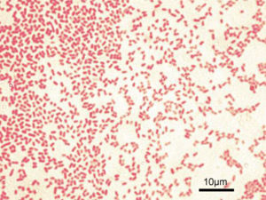
An organism isolated from a patient with otitis externa.
What is the most likely diagnosis Pseudomonas aeroginosa
Name one antibiotic that can be useful for treatment.
Aminogly-amikacin,gentamycin
Penicillin(carbenicilli, piperacillin)
Cephalosporins(ceftazidime)

Slide 27
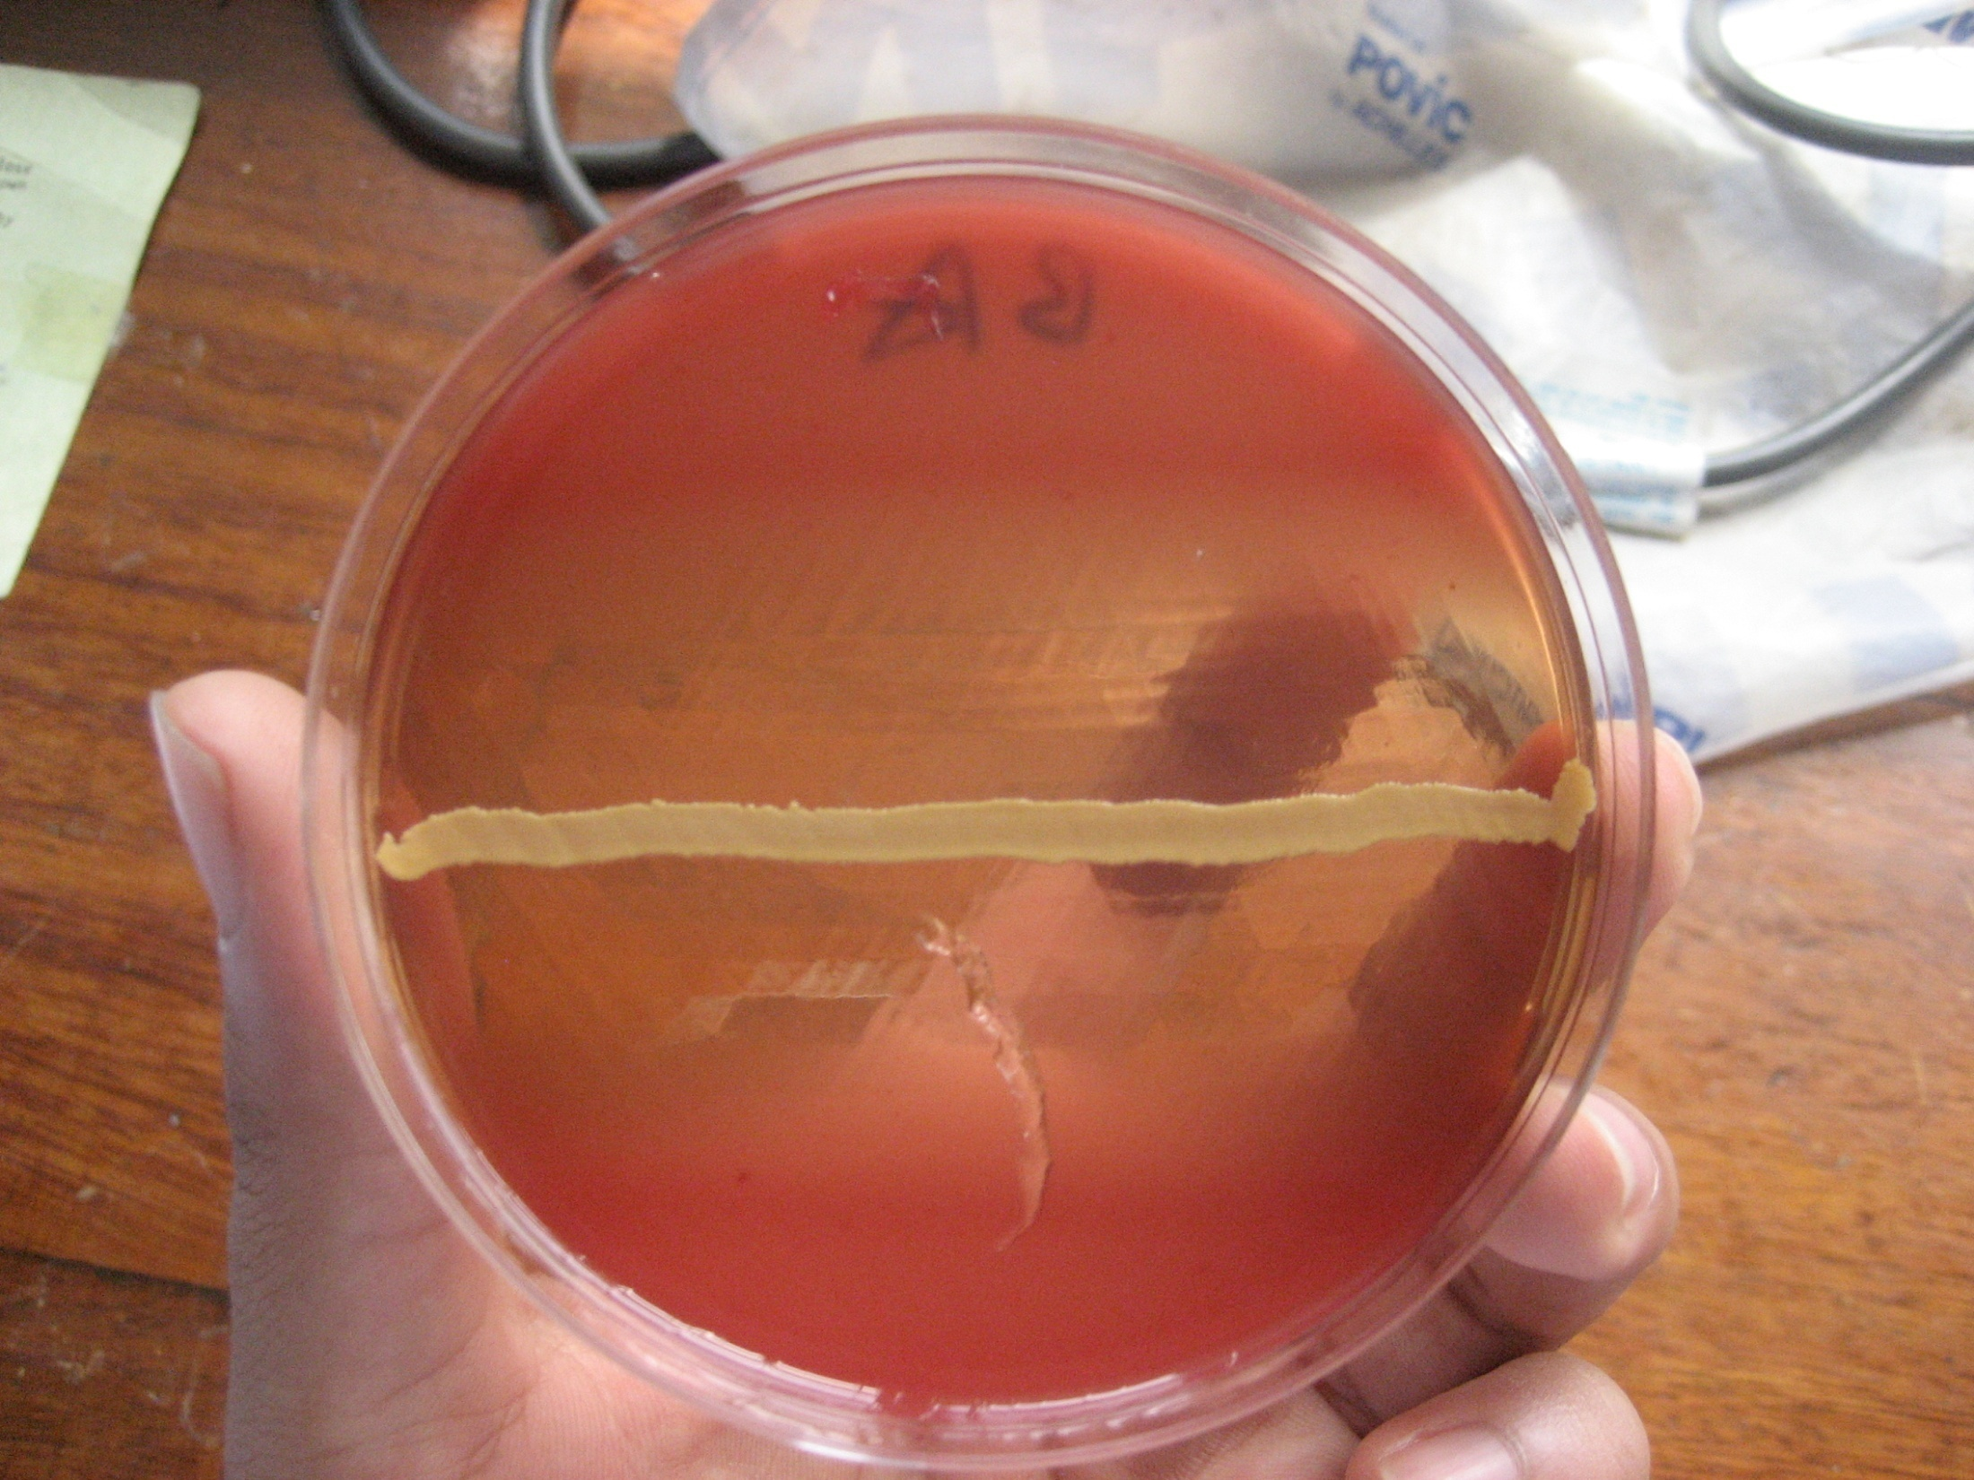
Name the phenomena what is the basis of this phenomenon

Slide 28
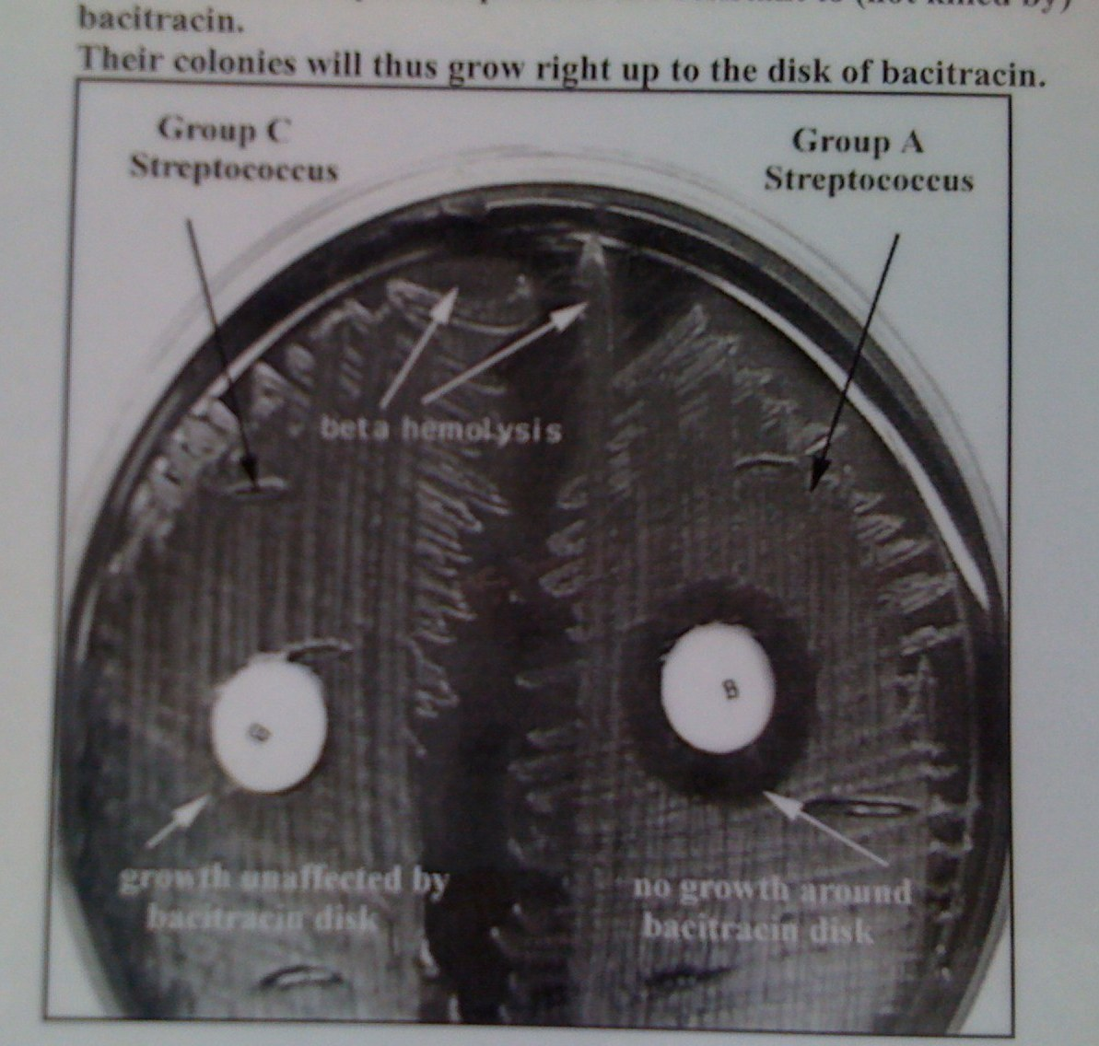
Test shown is bacitracin
what is it’s indication?

Slide 29
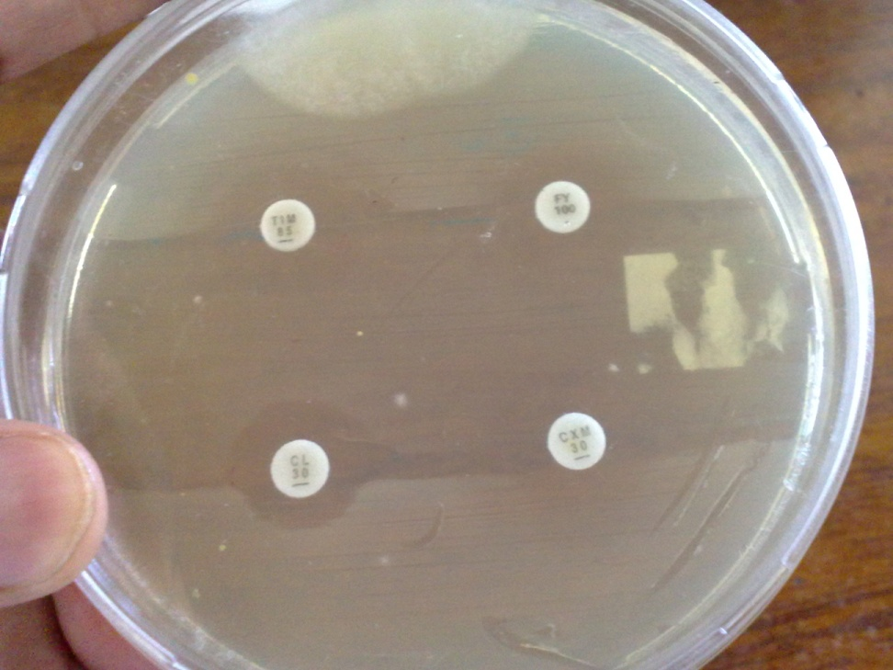
Name the method of testing for antibiotic susceptability shown.
Name two other methods of testing for antibiotic susceptability.

Slide 30
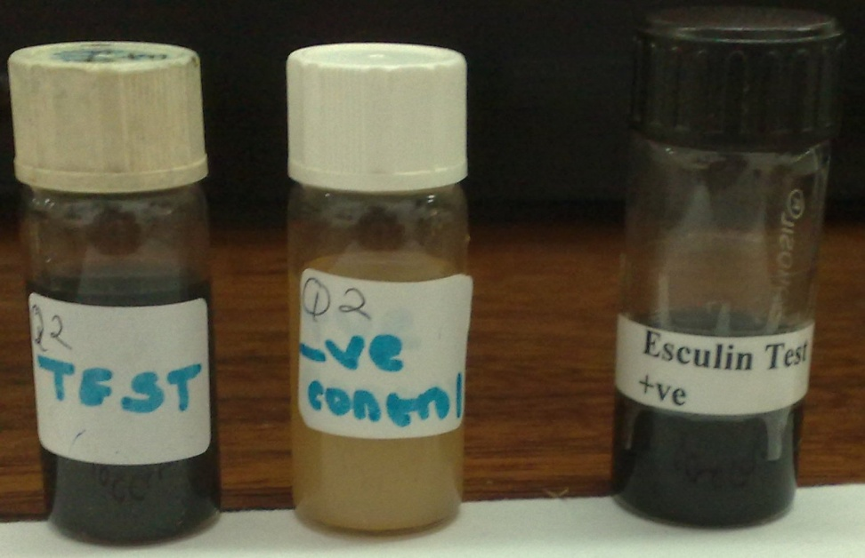
State the indication of the test shown.
What is the basis of the colour change in this test?

Slide 31
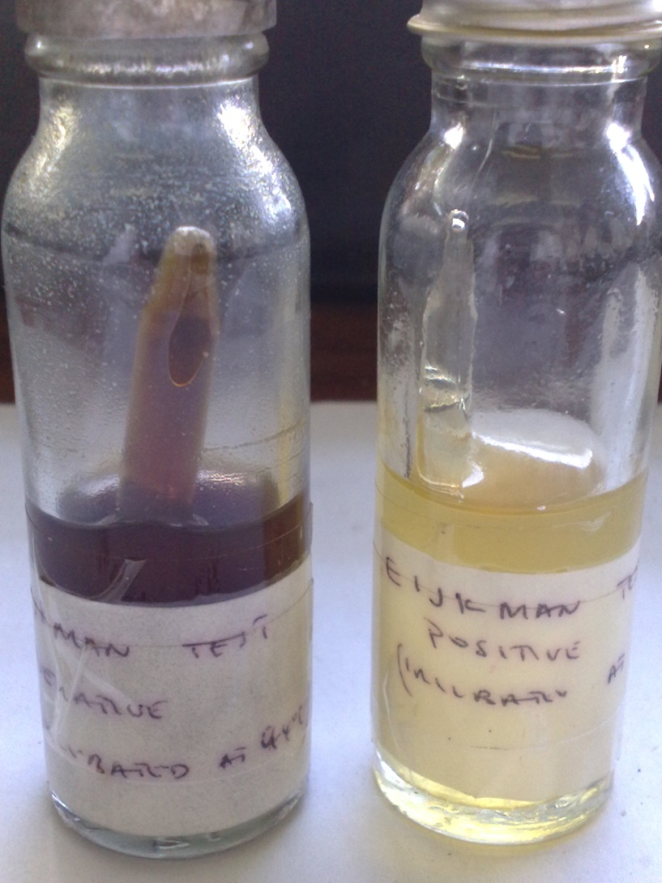
What is the indication of this test

Slide 32
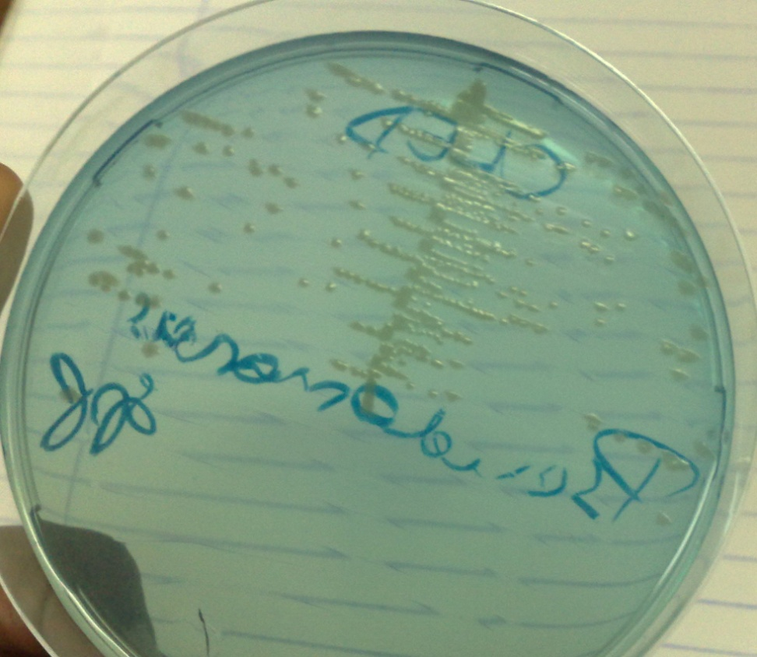
List two pigments produced by the microbe cultured.
List two diseases caused by organism.

Slide 33
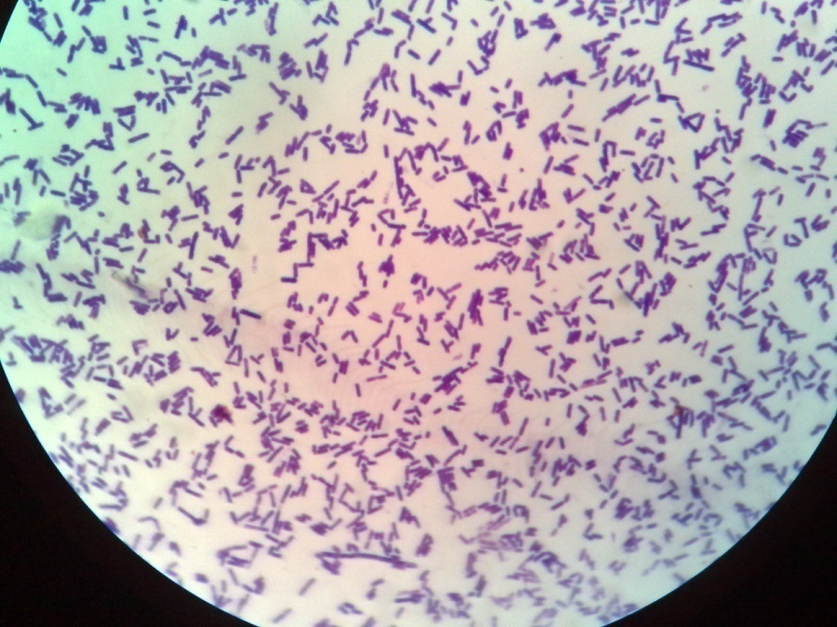
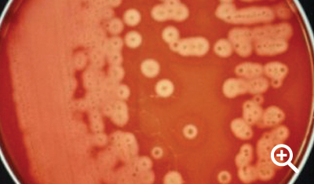
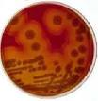
Culture from high vaginal swab from a female with pueperal sepsis and gram stained. Identify organism.
What is the selective media for this organism
RCM
FLUID THIGLYCOLATE MEDIUM
SOY TRIPTICASE

Slide 34
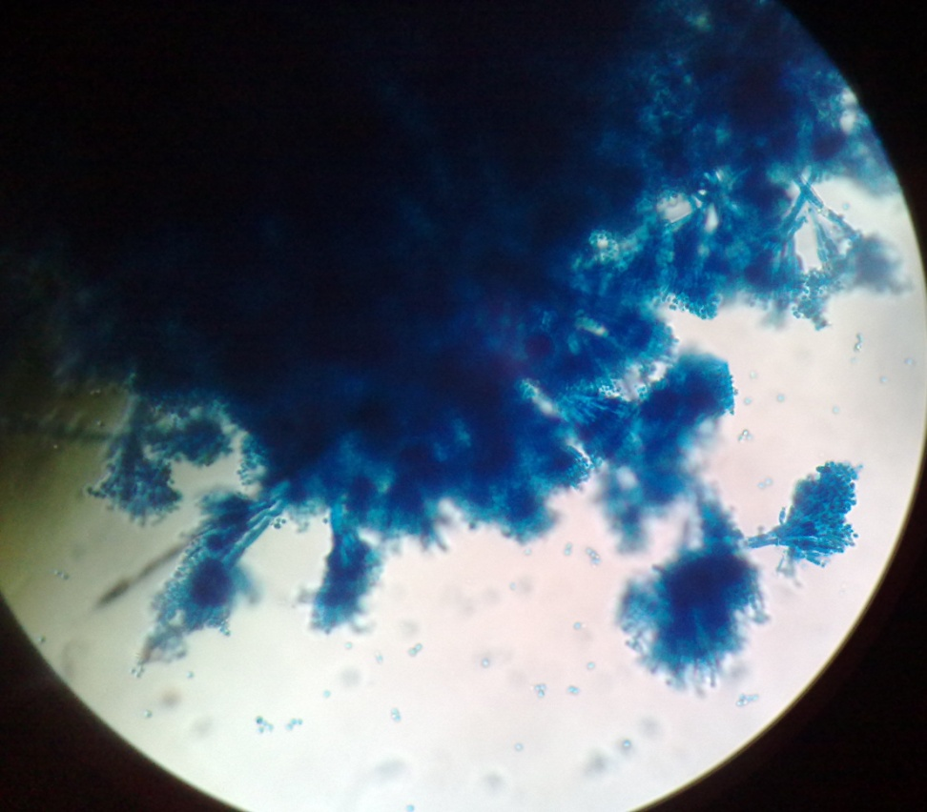
Identify genus of the photogragh shown
What is the staining techinique used?
What pathological conditions does it cause?

Slide 35
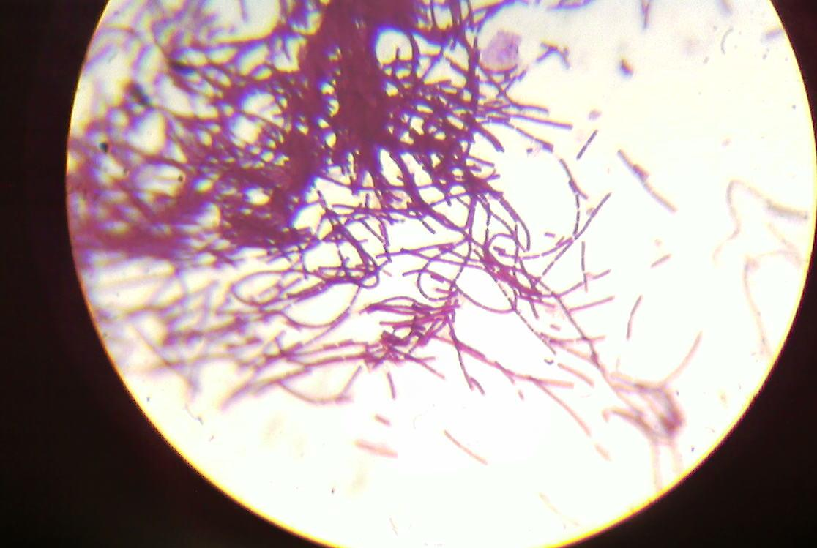
List three conditions caused by organism depicted on microscopy.
What is the mod of transmission.

Slide 36
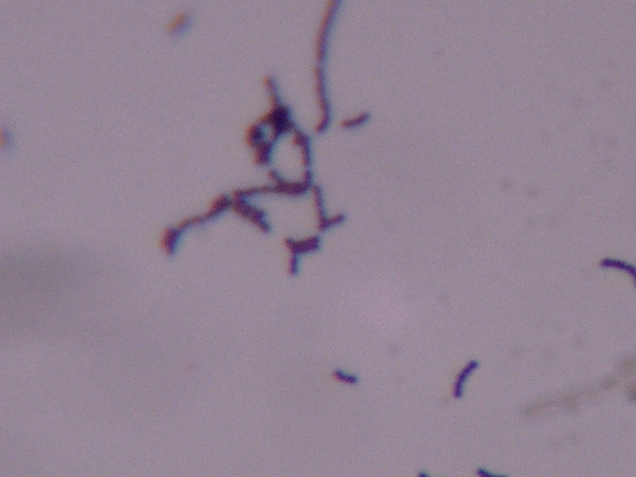
Specimen is sputum
List three virulence factors of the bacteria shown.
List three pathogenic conditions it causes.

Slide 37
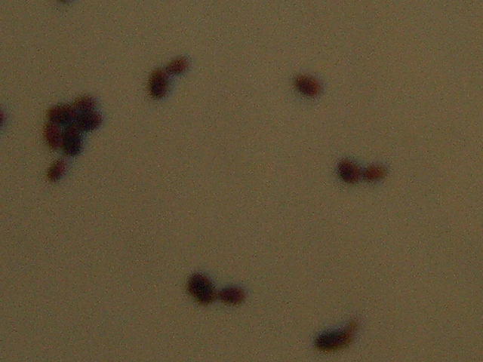
Identify species
Classify disease conditions caused.

