Slide 1
BACTERIOLOGY SPOT TEST REVISION
KIMAIGA H.O
MBChB (University of Nairobi)

Slide 2
Name the apparatus
MacFieldes/ McIntosh
Describe how it functions
It provides an anaerobic environment through pumping in of hydrogen and pumping out of oxygen.its has a pallidium catalyst, an indicator to show that the anerobic environment for bacterial growth has been achieved
What is the catalyst used?
Pallidium catalyst
Mention 2 organisms isolated using this item
Actinomyces, Bacteroides, Clostridium

Slide 3
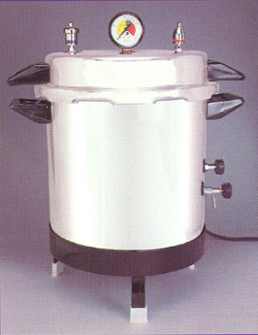
Name this equipment
Autoclave
Mention 2 methods used for monitoring its efficacy.
Using Browne’s tubes
Using Bowie Dick tapes
Using Bacillus stearothermophilus
State the conditions for sterilization
15 pounds per sq .inch (100kpascals) at 121°c for 15 minutes
30 pounds per sq.inch (200k Pascal’s) at 134°c for 3 minutes(reusable instruments)
State two materials that can be sterilized using this equipment
Needle syringes, glassware

Slide 4
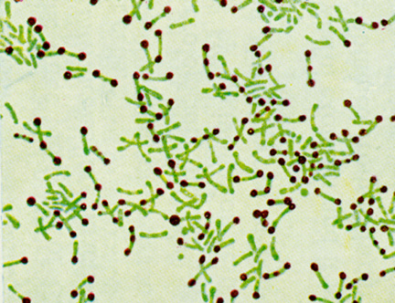
Differential staining of an upper respiratory tract pathogen
Name the staining technique used.
Alberts staining
Mention 2 culture media used for isolating the organism
Potassium tellurite
Loeffler’s serum agar
Name the organism under investigation
C diphtheria

Slide 5
Name the org that shows the features shown.
C. diphtheria
State its clinical presentation.
Pseudomembrane
Mycocarditis
Cranial nerve paralysis
Name the stain used.
Albert, neissers, gram stain

Slide 6
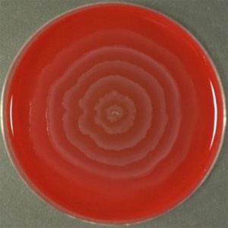
Culture on Blood Agar and identification test for a Gram Negative Bacilli
Name the phenomenon demonstrated
Diane’s Phenomenon
Name the test and Comment on the results
Urease test-Positive
Name the most likely genus
Proteus
State two clinical conditions caused by the organism
UTI
Wound infections
Septicemia
Mention the TSI result of this organism
TSI; Alkaline slant, acid butt, gas (NLF);

Slide 7
Identify the media shown
Name two components of this media

Slide 8
Name two likely organisms to cause such a reaction on the TSI media.
Salmonella typhi
Proteus mirabilis
Whats the appearance of each organism on BA?
Proteus, highly motile and swarming effect on blood agar.
Salmonella:grey non haemolytic and mucoid
List at least two ways of differentiating the two organisms.
Urease test
Positive Weil Felix reaction

Slide 9
Mention two diseases associated with the representetive organism?
Enteric fever(necrosis, sloughing, typhoid ulcers, hepatospleno, int . Haemorrhage and perforation.)
Gastroenteritis, Enterocolitis, septicaemia (bacteraemia),
Two drugs used for treatment?
Enteric fever- ciproflaxacin and ceftriaxone
Gastroenteritis- replacement of fluids
Enterocolitis- usually self-limiting
Bacteremia- ciprofloxacin, co-trimoxazole, ampicillin, amoxicillin.
Salmonella meningitis- cefotaxime and ceftriaxone
Chronic asymp carriers (cholecystectomy)

Slide 10
Posible Organisms?
Acid acid gas, no H2S ( E.coli and Klebsiella)
How does the colonies of the organism shown appear on BA?
Klebsiella- Mucoid colonies on BA
E. coli BA - Beta heamolytic
Mention two methods used to differentiate the organisms above?
E. coli- IMViC (++--), Urease negative, KSM -ve
Klebsiella- IMViC(--++), Urease positive, KSM+ve
Notes:
CEEK

Slide 11
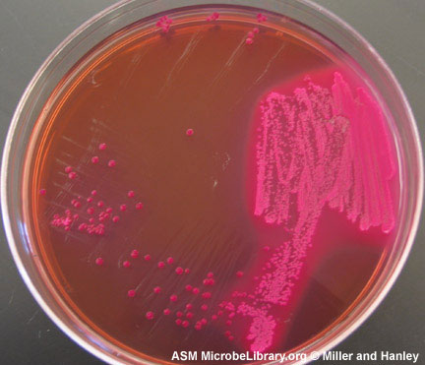
Culture on MacConkey
Name 2 genera of likely gram negative bacilli
CEEK
Mention two biochemical tests that can differentiate the two
Indole test
Urease test

Slide 12
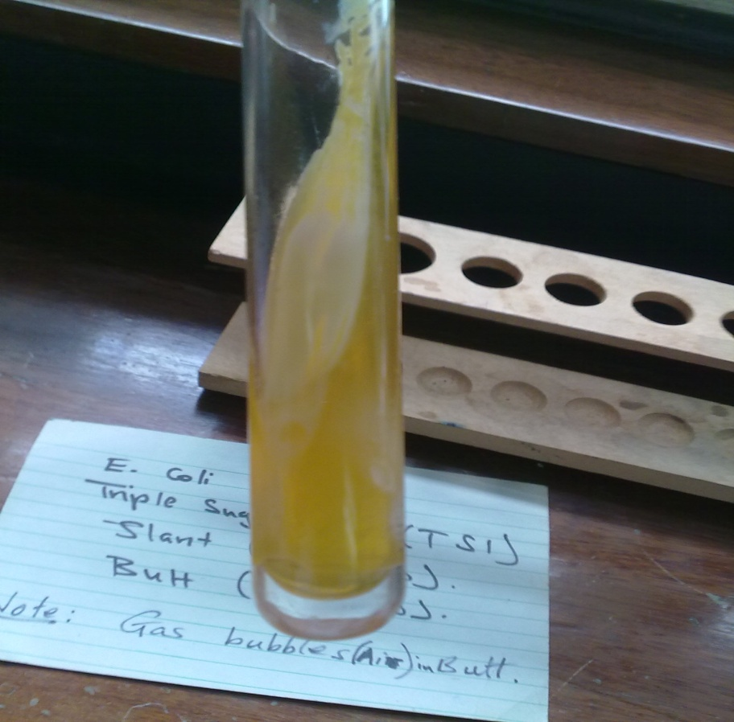
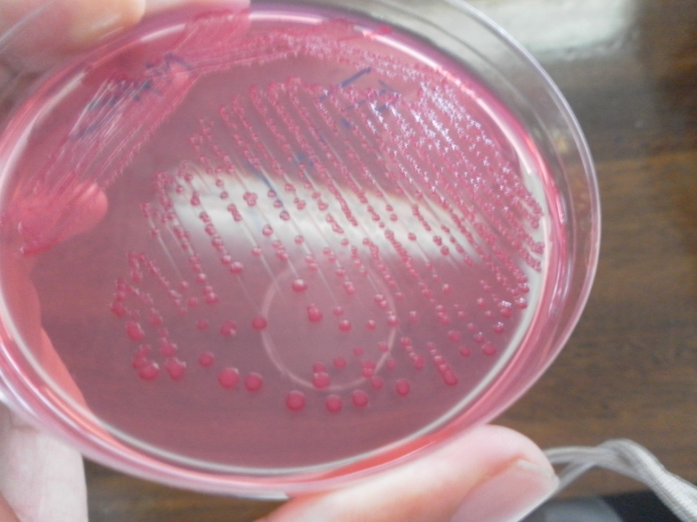
A culture of an enteric pathogen on a selective and special identification
Read and record the results on both media
Acid acid gas, no H2S
What is the most likely organism?
Serratia marcescens

Slide 13
Lab results for an organism isolated from a thick-currant sputum of a patient
Indole | Methyl red | Vogus Proskaer | Citrate
-ve | -ve | +ve | +ve
Name one bacteria in the same tribe of Enterobacteriacae as the organism suspected above
Klebsiella pneumonia
Name 2 most common bacterial organisms associated with atypical pneumonia
Mycoplasma pneumonia
Chlamydophilla pneumoniae

Slide 14
Identify the item shown
Castenada medium
Mention two clinical conditions for which it would be useful in investigating
Waterhouse – Friederichsen syndrome Complication of N. meningitis
State the bacteria normally isolated in the medium.
Brucella, salmonella(typhoid fever),
Neisseria meningitidis
State the advantage of the item
Trans

Slide 15
Stained smear of sputum
Name the staining technique used
Ziehl Neelsen
Comment on the result
Positive- Bacilli can be seen
Name an alternative staining technique to identify this organism
Kinyoun
Auramine
Rhodamine
Name the organism under investigation

Slide 16
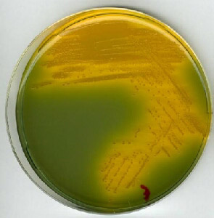
A diarrhoeal stool isolate on selective media
Name the most likely genus
Vibrio
Name an enrichment media used in its isolation
Alkaline peptone water
Name two components of the selective media
TCBS

Slide 17
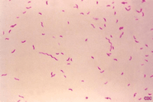
Gram stain of an isolate from a stool specimen
Name the most likely genus
E.coli
Mention the culture conditions for isolation of this organism
BA – some strains beta heamolytic
MAC- colonies are lactose fermenters (pink)
Eosin- methylene blue (EMB) medium
Characteristic green sheen- CLED

Slide 18
Stained preparation of a CSF specimen
Name the organism under investigation
Cryptocccus neoformans
Mention a biochemical test used for its identification
Carbohydrate assimilation test
Mention an agent used in treatment
Amphotericin B

Slide 19
Identify a likely genus from this photography
Treponema
Name two specific tests used to confirm diagnosis
Name two non-specific tests used in diagnosis

Slide 20
An identification test
Name the test
Coagulase test
Name the most likely TEST organism
S. aureus
Name one other identification test that can be used
Mannitol fermentation test

Slide 21
Mention 2 genera that give the staining reaction shown
Yersinia
Corynobacteria

Slide 22
Name the condition
Ophthalmia neonatarum.
Name the causative organism?
N. gonorrhea, Chlamydia trachomatis, Trichomonas Vaginalis.
What drug is used for treatment?
Topical Erythromycin, 1% aqueous silver nitrate

Slide 23
Name the condition
Malignant pustule
Name the most likely organism associated with the condition
B.antharacis
c. Name two antibiotics used in treatment
Doxycycline
Ciprofloxacin

Slide 24
Name the most likely organism under investigation
Name two clinical conditions caused by the organism
c. Name two antibiotics used in treatment
d. Name the selective media used in isolation

Slide 25
Name the most likely organism under investigation
Name two clinical conditions caused by the organism
c. Name two antibiotics used in treatment

Slide 26
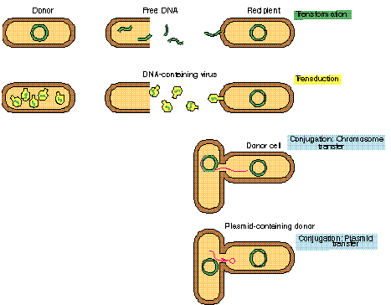

Slide 29
Name the medium shown
Name two organisms that can be isolated from the media above

Slide 30
1.Name the Media described above enriched media
2.An organism isolated from stool during an outbreak of diarrhea.
Name the most likely organism
E-coli,vibriocholerae
What are the constituents of the medium required for its growth?
Temp-35-37
5% Co2
Neutral ph

Slide 31
Name the condition in the above picture and its most common causative organism
An organism causing an epidemic of wound infection in a hospital. What is the most likely organism and why?

Slide 32
Name the method used above and its purpose
“Inverted fir tree “ appearance and gelatin liquefaction is associated with which microorganism?

Slide 33
Culture of an anaerobic organism isolated from a gunshot wound
a)Name the organism and likely diagnosis
b)Name an identification test used for the organism
c)Suggest treatment

Slide 34
Culture and Identification test of an organism from a high vaginal swab from a female with vaginal discharge
a)Name the organism and the test
b)Suggest two things useful for the treatment of this condition

Slide 35
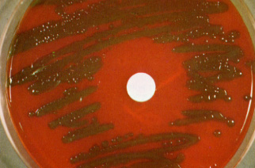
Culture and wet preparation of a microorganism isolated from sputum. a)Describe the culture (3 mks) b)What is the most likely cause? c)Mention two mechanisms though which the organism can cause disease

Slide 36
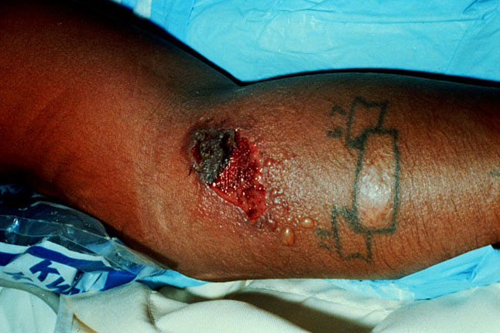
Describe the condition in the photograph above
Who are the most likely to obtain this disorder?
Mention a diagnostic test for the above-causing pathogen
Nagler reaction is associated with which microorganism? What does it aim to demonstrate?

Slide 37
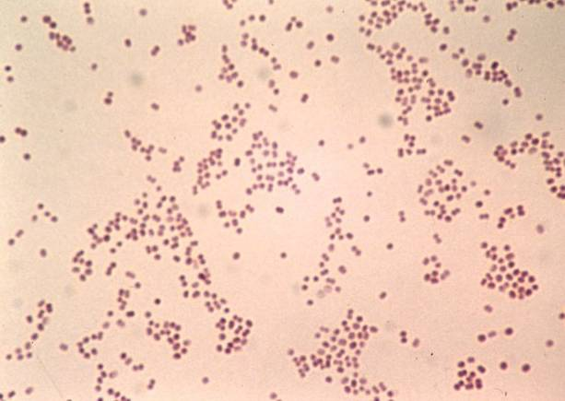
Culture and Gram stained smear of an organism from the CSF of a 2 year-old patient
What is the most likely organism?
Name one test for confirming the identity of the organism

Slide 38
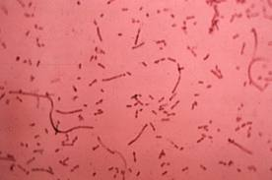
A stained smear of sputum fix from a patient
What is the organism? Describe the morphology of the culture
Name the staining technique used
Name three unique factors needed for its growth and culture in the lab

Slide 39
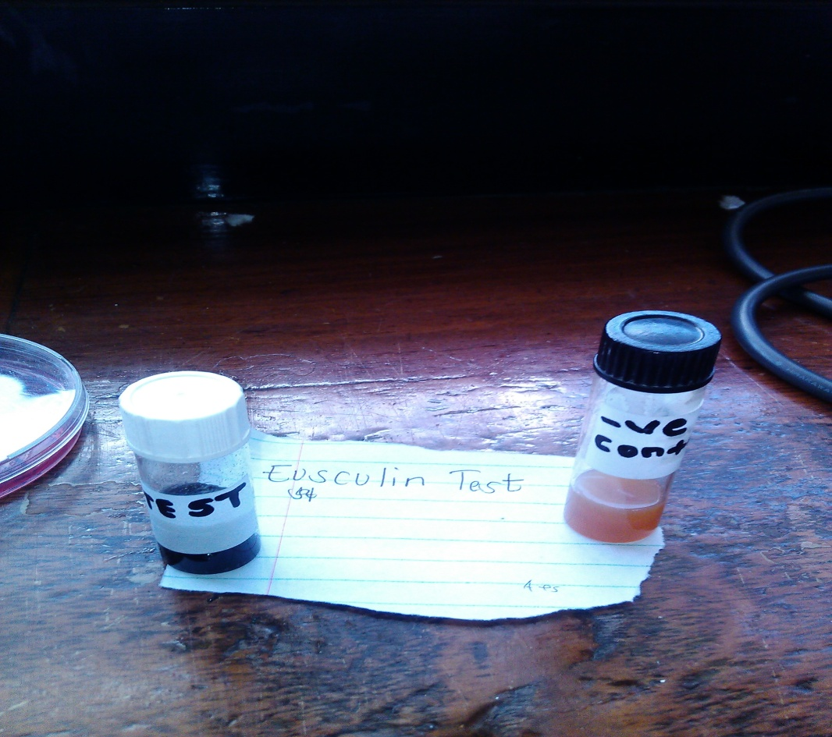
What organism does the aesculin test distinguish?
Enterococcus faecalis
Mention two other properties of the organism
It’s a strep,grmposive,cocci,and causes UTI,it can survive in 40 percent bile
Exotoxin B is associated with which organism and which condition?

Slide 40
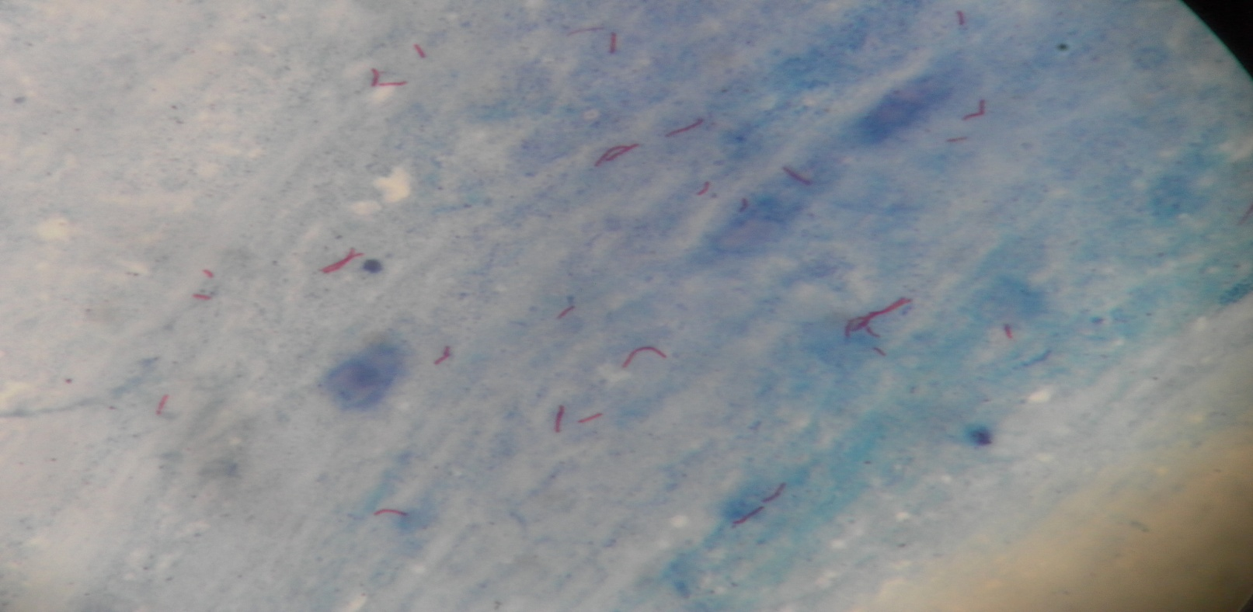
A stained smear from a patient with a history of chronic cough.
Name the staining technique.
What is the most likely diagnosis?
Name another bacterial organism that is most likely to have the above presentation

Slide 41
An organism isolated from stool during an outbreak of diarrhoea
Name the most likely organism.
What are the constituents of the medium it is growing on?

Slide 42
Culture of an organism isolated from a gunshot wound
Name the organism and the likely diagnosis.
Suggest treatment.

Slide 43
Microscopic results from a patient with a genital ulcer
Which type of staining is demonstrated above?
Name two confirmatory tests for the organism demonstrated above.

Slide 44
a) Name the most suitable method of sterilisation of the above equipment
b) What is the mechanism of action of the method given above

Slide 45
Stained smear of an organism from the pus from the conjuctiva of a neonate and right is distinct inclusion body in iodine staining
Name two diseases associated with the likely organism?
The form in which the organism exists intracellularly

Slide 46
An organism causing urinary tract infections with urinary catheters
Name the organism
Give reasons for the above

Slide 47
Microscopic results of an organism isolated from a patient
Name the most suitable enrichment media used for isolation
Two virulence factors associated with the organism

Slide 48
Y
Cell wall
Name one drug that has its mechanism of action at Part X
Name one drug with its action at Y and mode of resistance associated with it
X

Slide 49
Define the test above and classify it.
Define the term Minimum Inhibitory concentration

Slide 50
Staining technique used in bacteriology
Name the technique
Name genuses likely to be demonstrated

Slide 51
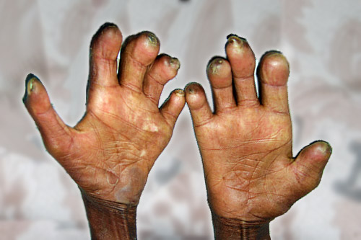
Give differences between tuberculoid and lepromatous leprosy
State why the causative agent of the lesion shown above doesn,t obey Koch’s postulates.

