Slide 1
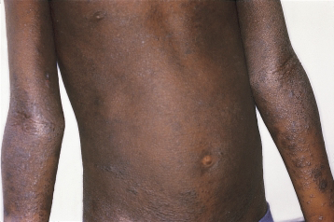
Photo of an 8 yr old boy who presents to you in the dermatology clinic.. A)describe the lesions b)what is the diagnosis C)list 3 specific therapies

Slide 2
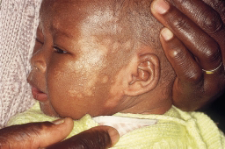
The patient below known to have atopic eczema presents to you in the clinic with the lesions below. A) describe the lesions B)what is the diagnosis pytiriasis alba C) briefly outline the specific mx PUVA

Slide 3
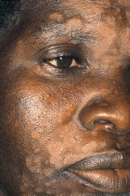
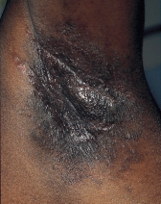
Hiv positive patient presents to you with the lesions below A)describe the lesions B)what is the diagnosis C)list 3 specific management

Slide 4
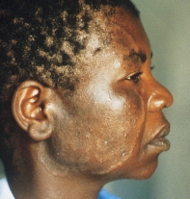
A)Describe the lesion B)whats the diagnosis Tinea faciei C)list the specific management

Slide 5
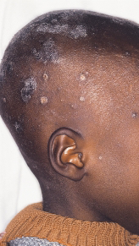
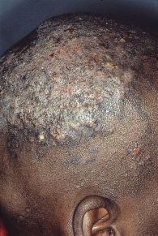
a)Describe the lesion B)whats the diagnosis C)list 2 specific treatment

Slide 6
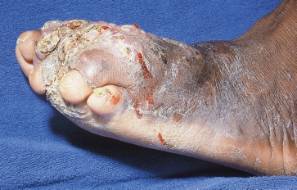
40 yr old man presents with the lesion below that has been progressively increasing in the last 2yrs and its painless A) what is the diagnosis B)list the treatment options
Notes:
Actinomyces
TMP-SMX, Pen G

Slide 7
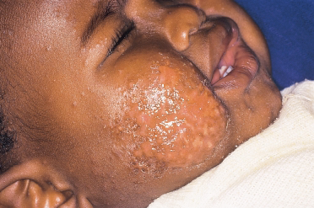
6month old with lesion below A) describe the lesion B)diagnosis C) list the specific mx
Notes:
Fifth’s disease

Slide 8
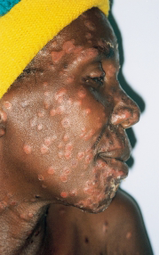
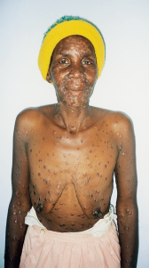
Hiv positive Patient presented with the lesions below and also gives a history of presence of genital ulcers A)describe the lesions B)diagnosis C)outline the specific treatment
Notes:
Secondary syphilis

Slide 9
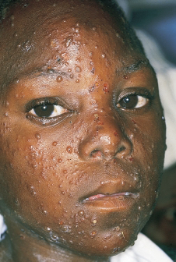
a)Describe the lesions B)diagnosis? C) list the specific treatment

Slide 10
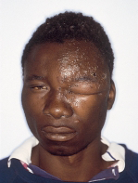
A)What is the diagnosis B)causative organism C) list one specific therapy
Notes:
HZO
Acylovir

Slide 11
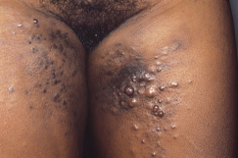
Hiv positive female with the lesions below A)describe the lesions B) what is the diagnosis C) list the specific treatment options available
Notes:
KS

Slide 12
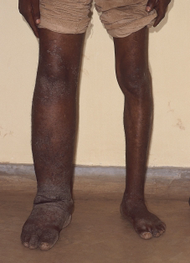
40yr old man from mombasa presents with the lower limb swelling below A)most likely diagnosis B)list the treatment options
Notes:
W.Bancrofti
Brugia malayi
Brugia timori ivermectin DEC

Slide 13
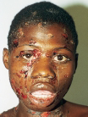
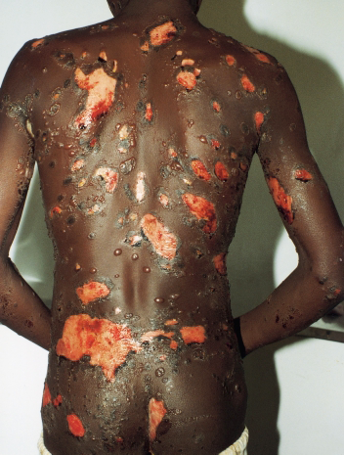
16yr old boy newly diagnosed hiv patient developed the lesions below after 3 days commencent of the standard hiv treatment regimen in kenya A) what is the likely diagnosis? B) outline the treatment

Slide 14
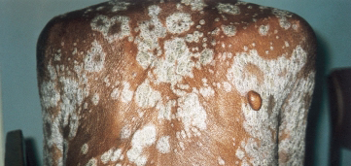
What is the diagnosis list the treatment options
Notes:
Psoriasis
-topical steroids
-topical retinoid
-TNF inhibitors
-tacrolimus

Slide 15
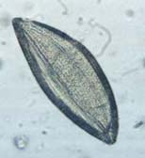
diagnosis?
Notes:
Enterobius
Pyrantel pamoate,,,, albendazole

Slide 16
Diagnosis?
Notes:
Trichuris trichuria
Albendazole, mebendazole

Slide 17
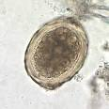
Diagnosis?
Notes:
Ascaris
-albendazole

Slide 18
Diagnosis?
Notes:
S. mansoni

Slide 19
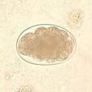
Diagnosis?
Notes:
Hook worm- ABZ

Slide 20
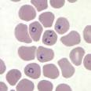
Diagnosis?malaria Specific treatment?artemether/lumefantrine combination 4complications that can occur-coma,DIC, acute RF,anaemia,hypoglycemia

Slide 21
Diagnosis? 4 causes?

Slide 22
Patient presents with hx of diziness. Hb done is 9g/dl and pbf is shown below a) diagnosis b)5causes

Slide 23
Diagnosis? List one cause?

Slide 24
Diagnosis?howell-jolly bodies(bulls eye) 3 causes-splenectomy,SCD, IDA, chronic liver disease

Slide 25
Diagnosis TEAR DROP n 3 causes of pbf below-SCD, marrow abnormalities,

Slide 26
Describe the radiograph below likely diagnosis?
Notes:
Thalasemia major, sickle cell disease, IDA , spherocytosis

Slide 27
Diagnosis? 5 Possible presentations?

Slide 28
Diagnosis?
Notes:
Spherocytosis
-test –osmotic fragility

Slide 29
Diagnosis? 3 possible causes?
Notes:
Elliptoctosis- hereditary , pyruvate kinase deficinecy, myelofibrosis

Slide 30
Describe the pbf below diagnosis? 3 causes?
Notes:
Stomatocytosis- autosomal dominant

Slide 31
Notes:
Heinz bodies

Slide 32
A)What is the diagnosis B)list the specific management

Slide 33
Most likely diagnosis? 3 physical signs that might be present in this patient? 2 investications?

Slide 34
Describe the main pathology in this CXR 3 possible causes?

Slide 35
Diagnosis? 5 possible causes? one other investigation you will do

Slide 36
Muscle biopsy in a patient with myalgia. Diagnosis? Specific treatment?
Notes:
Trichinella spiralis
Tx- ABZ, steroids

Slide 37
Diagnosis?
Notes:
Negative- needle shaped

Slide 38
List 3 major abnormalities on this CXR
Notes:
Dextrocardia

Slide 39
12lead ECG of a 30 yr old who presents with fatigue. A) diagnosis B)list one specific treatment

Slide 40
ECG of a patient who presents with syncope. A) diagnosis B)list 2 specific treatment

Slide 41
What is the most likely diagnosis list 2 specific treatments

Slide 42
Describe the abnormality list 5 causes

