Slide 1
GASTROENTEROLOGY SPOT

Slide 2
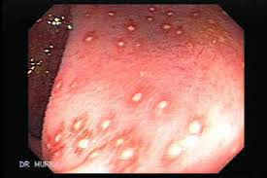
A 30 year old man presents with bloody diarrhoea. Sigmoidoscopy findings are as shown. What is the most likely cause?
Salmonellosis
Ulcerative colitis
Radiation colitis
Entamoeba histolytica
Campylobacter

Slide 3
The following are known causes of this condition except:
Cystic fibrosis
Malnutrition
Azathioprine
Alpha-1 antitrypsin deficiency
Alcohol

Slide 4
Which of the following medical therapy is effective for the condition shown in the barium swallow:
Diltiazem
Bismuth
Glycerine Trinitrate
Botulinum toxin
Glypressin

Slide 5
These are the colonoscopy findings of a 50 year old lady presenting with 10 weeks of bloody diarrhoea. The following medications are effective except:
A. Mesalazine
B. Corticosteroids
C. Mecarptopurine
D. Monoclonal antibodies to TNF-α
E. Intravenous gamma globulin

Slide 6
The diagram shows OGD findings of a 50 year old alcoholic man presenting with hematemesis. What would have been the most appropriate treatment while awaiting endoscopy
Insert a sengstaken-blakemore tube
Intravenous terlipressin
Intravenous pantoprazole
Nasogastric tube and aspiration
Sucralfate

