Slide 1
ECG REVISION
Dr. Kevin Ndede

Slide 2
The following drugs are indicated in treatment of the condition shown on the ecg EXCEPT
A) warfarin
B) amiadorone
C) carvedilol
D) enalapril
Notes:
The diagnosis is Atrial fibrillation. A) warfarin is indicated as prevention of intramural thrombi and cardioembolic stroke. A score of 2 or more on the CHA2DVASC necessitates use of warfarin. B). amiadorone may be used as form of chemical cardioversion in AF. C) Carvedilol or other beta blockers are useful as rate controllers and thus very useful in AF with rapid ventricular response, D) correct response. Enalapril has no role in AF.
ECG Features of Atrial Fibrillation
Key Features: Irregularly irregular rhythm. No P waves. Absence of an isoelectric baseline. Variable ventricular rate.
Complications – a. embolic stroke b. cardiac failure
Causes – a. IHD b. hypertension c. thyrotoxicosis d. valvular heart disease (e.g MR)

Slide 3
Notes:
Atrial fibrillation:
Irregular ventricular response. (: Irregularly irregular rhythm)
Coarse fibrillatory waves are visible in V1

Slide 4
Notes:
AF with rapid ventricular response
Irregular narrow-complex tachycardia at ~135 bpm. (: Irregularly irregular rhythm)
Coarse fibrillatory waves in V1

Slide 5
Which is the least likely condition to cause the features shown on the ecg
A) aortic stenosis
B) aortic regurgitation
C) mitral regurgitation
D) tricuspid stenosis
E) tetralogy of fallot
Notes:
The ECG shows features of left ventricular hypertrophy (notice the tall RV5 + SV2 >35mm with a strain pattern (inverted T waves). A,B,C and E are conditions that cause either pressure or volume overload of the LV hence hypertrophy. D) correct response. Tricuspid stenosis would cause pressure overload on the RA not LV. Other causes - hypertension
Complications – atrial fibrillation, systolic failure, diastolic failure
Diagnosis criteria –
a. Voltage criteria
- The most commonly used are the Sokolov-Lyon criteria (S wave depth in V1 + tallest R wave height in V5-V6 > 35 mm i.e >3.5mv)
b. Non Voltage Criteria
Increased R wave peak time > 50 ms in leads V5 or V6
ST segment depression and T wave inversion in the left-sided leads i.e v5/v6: AKA the left ventricular ‘strain’ pattern
Additional ECG changes seen in LVH
Left atrial enlargement.
Left axis deviation.
ST elevation in the right precordial leads V1-3 (“discordant” to the deep S waves).
Prominent U waves (proportional to increased QRS amplitude)

Slide 6
Notes:
Left – LVH by voltage criteria: S wave in V2 + R wave in V5 > 35 mm
Right - LV strain pattern: ST depression and T wave inversion in the lateral leads

Slide 7
Notes:
Markedly increased LV voltages: huge precordial R and S waves that overlap with the adjacent leads (SV2 + RV6 >> 35 mm).
R-wave peak time > 50 ms in V5-6 with associated QRS broadening.
LV strain pattern with ST depression and T-wave inversions in I, aVL and V5-6.
ST elevation in V1-3.
Prominent U waves in V1-3.
Left axis deviation

Slide 8
The characteristic clinical presentation in patients with condition shown on the ecg is
Bilateral pedal oedema
Palpitations
Shortness of breath on exertion
Angina pectoris
Orthopnoea
Notes:
This is 3rd degree heart block. Notice the complete AV dissociation : the p waves and the QRS waves have no association with each other but are independently regular. Patients with 3rd degree AV block characteristically present with Shortness of breath on exertion. They are unable to raise their cardiac output with exertion because their heart rate does not increase much due to the AV dissociation.

Slide 9
Definitive management of the condition shown is
Defibrillation
Pacemaker
Mitral valve replacement
Nebivolol
Notes:
Correct answer is B. ECG shows features of 3rd degree heart block. Definitive treatment is by pacing the heart to a pre set minimum heart rate.

Slide 10
Choose the incorrect statement concerning the ecg provided
Dual platelet blockade is indicated
UFH is indicated
LMWH may be used
Warfarin is indicated
Atorvastatin is recommended at high doses
Notes:
The ECG shows anteroseptal STEMI(note the ST elevation in V1-v3. Correct answer is D. warfarin has no role in acute STEMI. Dual antiplatelets of aspirin plus either clopidogrel or ticagrelor is indicated. High dose atorvastatin is indicated and generally functions to stabilize atherosclerotic plaque. Other pleiotropic effects of statins are antiinflammatory and anti clotting.

Slide 11
Concerning the ecg provided
This is atrial flutter
This is atrial fibrillation
This is ventricular fibrillation
the atrial rate is often between 300 -600bpm
Notes:
Correct answer is A. Atrial flutter typically gas a saw tooth appearance best appreciated in lead V1 in this image. Atrial fibrillation has fibrillatory waves( multiple tiny p wave forms that are hardly discernible). Ventricular fibrillation appears as rapid wide complex QRS waves, absent p waves. Atrial rate in atrial flutter is between 240-350bpm while in Afib it is 300-600bm. Ventricular rate varies depending on degree of AV block.

Slide 12
The next most useful test in a patient presenting at A & E with this ecg is
Troponin T
Echocardiogram
Coronary angiogram
CT pulmonary angiogram
Sensitive D – dimer test
Notes:
Best response is C. ECG shows anteroseptal STEMI. Coronary angiogram is likely to show the site and extent of coronary artery occlusion and guide any potential percutaneous coronary intervention. TpT is useful and will most likely be elevated, an echo is useful and is likely to show regiona wall motion abnormality. CTPA has a role in pulmonary embolism and none in STEMI, D dimer test is useful in thromboembolic states

Slide 13
The patient whose ECG is shown presented with chest pain that worsened on exertion. The most likely diagnosis is
STEMI
NSTEMI
Pulmonary embolism
Heart failure
Notes:
Correct response is B. ECG shows T wave inversion or flattening in lateral and inferior leads. Coupled with the above symptomatology is suggestive of NSTEMI. A mild to moderate elevation of troponin confirms the dx.

Slide 14
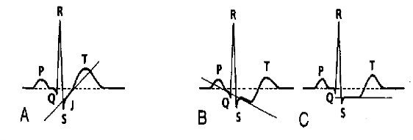
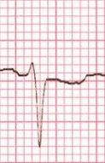
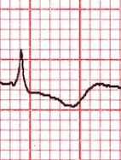
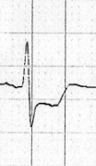
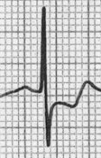
ST depression: upsloping (A), downsloping (B), horizontal (C) ST segment morphology in myocardial ischaemia
Notes:
Various types of st depression

Slide 15
Note – st segment depression in lateral leads v4-v6
Notes:
There are two main ECG abnormalities seen with NSTEACS:
ST segment depression - ST depression due to subendocardial ischaemia is usually widespread — typically present in leads I, II, V4-6 and a variable number of additional leads
T wave flattening or inversion

Slide 16
Widespread T wave inversion due to myocardial ischaemia (most prominent in the lateral leads)
Notes:
T wave inversion
T wave inversion may be considered to be evidence of myocardial ischaemia if:
At least 1 mm deep
Present in ≥ 2 continuous leads that have dominant R waves (R/S ratio > 1)
Dynamic — not present on old ECG or changing over time

Slide 17
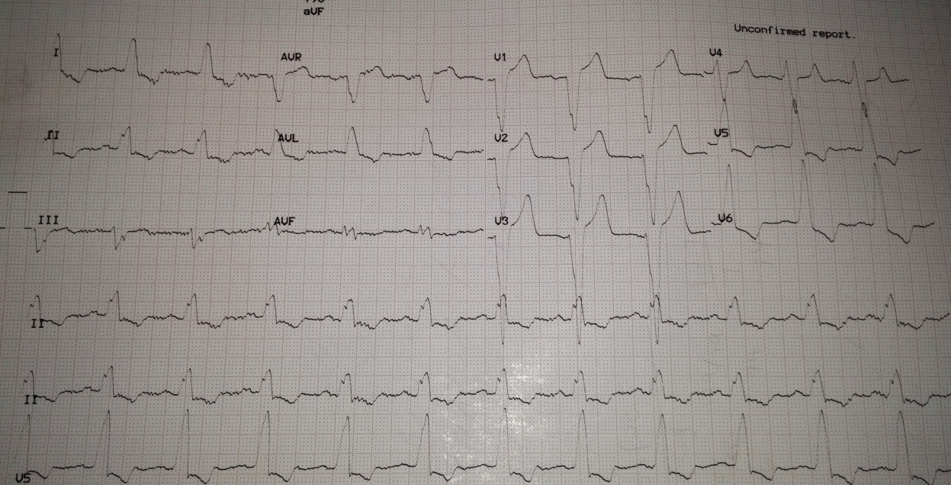
Choose the correct diagnosis
Anterolateral myocardial ischemia
Left bundle branch block
Right bundle branch block
Bifasicular block

Slide 18
STEMI
Patterns of Anterior Infarction
The precordial leads can be classified as follows:
Septal leads = V1-2
Anterior leads = V3-4
Lateral leads = V5-6
The different infarct patterns are named according to the leads with maximal ST elevation:
Septal = V1-2
Anterior = V2-5
Anteroseptal = V1-4
Anterolateral = V3-6, I + aVL
Extensive anterior / anterolateral = V1-6, I + aVL
Notes:
CAUSES
Atheromatous plaque rupture and thrombus formation and occlusion of vessel
CLINICAL FEATURES
Prolonged excruciating chest pain unrelieved by rest, with radiation to arm etc
Fever
Syncope, sweating, tachycardia, bradycardia
OTHER INVESTIGATIONS
Troponins and ckmb
MANAGEMENT
1. Aspirin
2. MAIN – primary percutaneous coronary intervention
COMPLICATIONS
Arrythmias
Heart failure
Acute ventricular rupture – cardiac tamponade
4. Papilaary rupture – acute MR

Slide 19
Example 1 – Hyperacute Anteroseptal STEMI
Notes:
ST elevation is maximal in the anteroseptal leads (V1-4).
Q waves are present in the septal leads (V1-2).
There is also some subtle STE in I, aVL and V5, with reciprocal ST depression in lead III.
There are hyperacute (peaked ) T waves in V2-4.
These features indicate a hyperacute anteroseptal STEMI

Slide 20
Evolving Anterior STEMI
Notes:
There is progressive ST elevation and Q wave formation in V2-5
ST elevation is now also present in I and aVL.
There is some reciprocal ST depression in lead III.
This is an acute anterior STEMI – this patient needs urgent reperfusion!

Slide 21
HYPERKALEMIA
Causes
Increased intake –
a. diet
2. Decreased excretion
Decreased GFR – acute or chronic renal failure
Decreased excretion – RTA 2/4
3. intra- to extracellular shift
Metabolic acidosis
Drugs – beta blockers
4. Increased endogenous production
a. hemolysis
Signs and symptoms
Generalised muscle weakness
Flaccid paralysis and parathesia of the hands and feet
Lethargy, Confusion, Weakness and Palpitations
Management
1. myocardial stabilization – calcium gluconate
2. increased excretion
- calcium resonium
3. drive back into cells
- IV fast acting insulin plus glucose

Slide 22
Notes:
ECG changes
Serum Potassium (mmol/L)Predicted ECG status - 5.5-6.5Tall tented T waves, 6.5-7.5Loss of P wave, 7.5-8.5Widening QRS, - >8.5QRS continues to widen, approaching to sine wave

Slide 23
HYPERKALEMIA

Slide 24
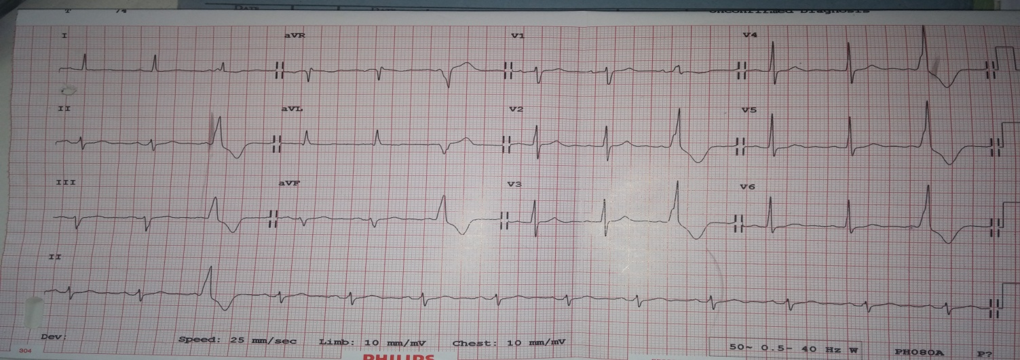
A patient who has the above ECG recording commonly presents with which of the following symptoms/signs?
Nausea and vomiting
Dizziness
Palpitations
Irregular heart beat
B and C
C and D

Slide 25
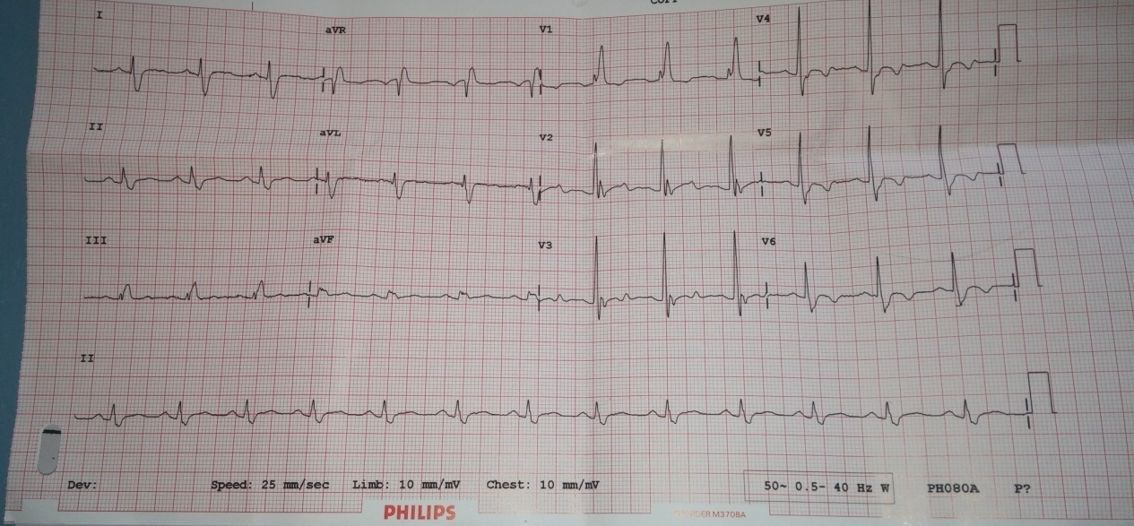
Choose the correct diagnosis
Right bundle branch block
Left bundle branch block
1st degree heart block
2nd degree heart block

Slide 26
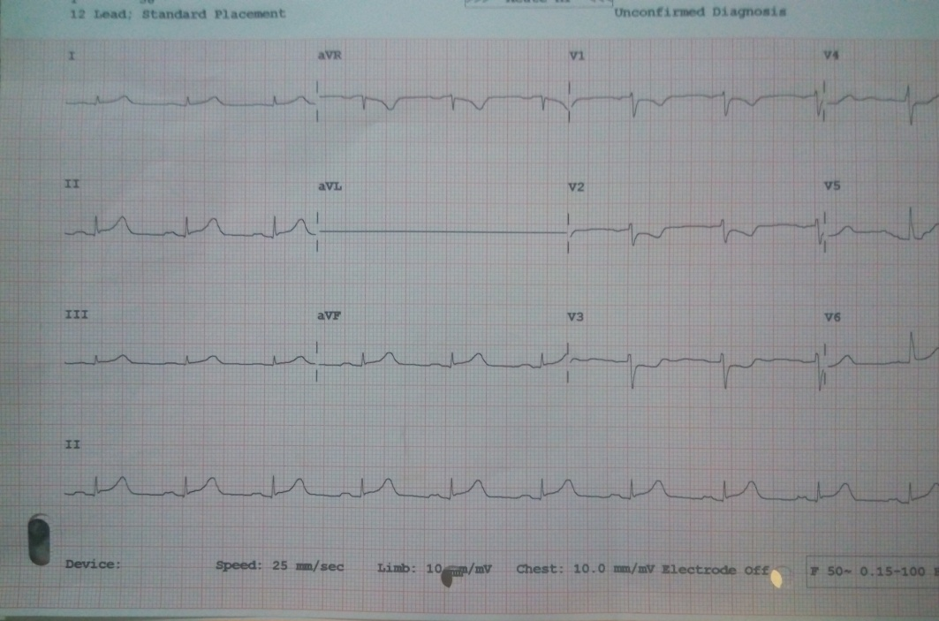
The patient whose ECG is shown presented with new onset crushing chest pain at rest. He previously only experienced chest pain on exertion. Cardiac troponin levels were normal. The most likely diagnosis is
Stable angina
STEMI
NSTEMI
Unstable Angina

Slide 27
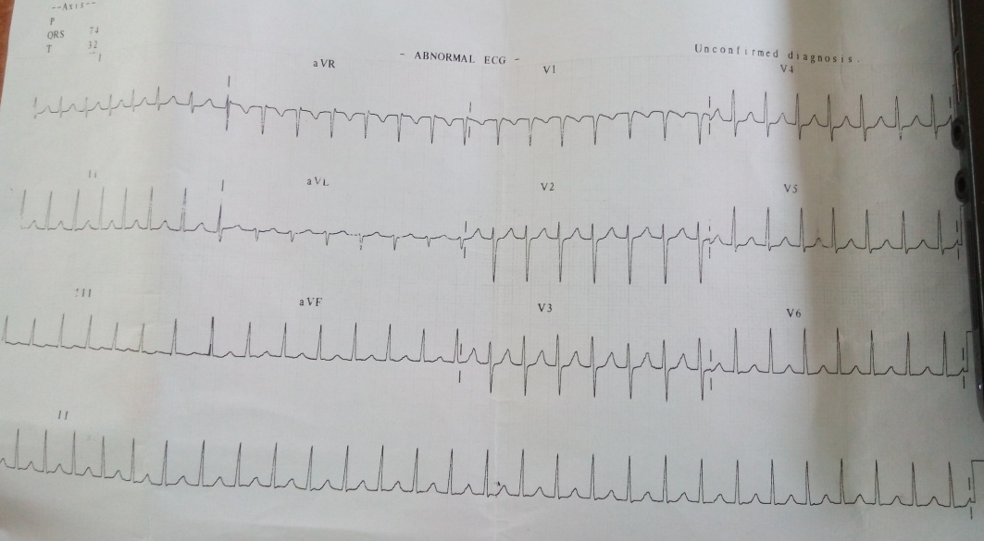
The patient whose ECG is shown presented to ER with c/o intractable palpitations. You diagnose an arrhythmia. Which of the following physical measures is likely to terminate the arrythmia?
Jog on the spot
Clench their fist
Lie supine and elevate their lower limbs
Carotid massage
Notes:
Credit for picking the correct response! Distiction if you can explain the mechanism. No stress if you cannot crack it, there are many of us!!

