Slide 1
SPOT REVISION

Slide 3
Interpret the investigation above
What findings do you expect on examination

Slide 5
Interpret the radiograph
What is the most common presenting complaint

Slide 7
What is the vector associated with the condition
What is the management

Slide 8
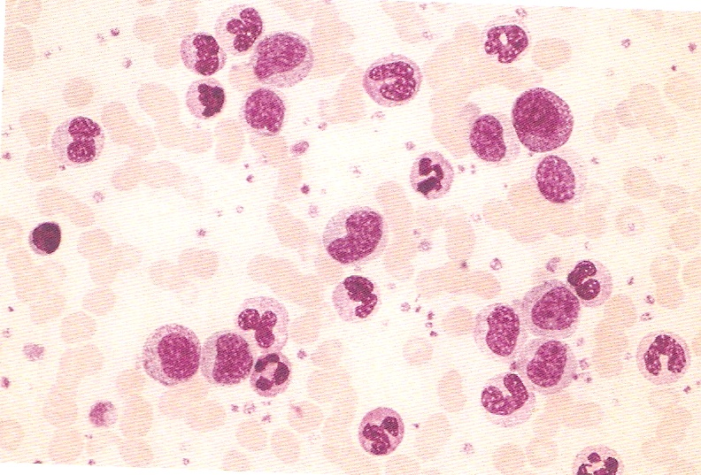

Slide 9
Interpret the PBF
What genetic abnormality do you expect

Slide 10
Case 3
1 month old male presents with projectile vomiting for 2 days.
pH - 7. 51
PCO₂ - 40mmHg
HCO₃ - 30mmol/L
What is the metabolic disturbance
Give 3 other causes

Slide 12
This is a 7 yr old boy from Bungoma who came to you with the above presentation. He also complained of headache, chills, fever, generalised malaise and vomiting. What is the most likely diagnosis
What genetic abnormality do you expect

Slide 14
Describe the lesions
Give the diagnostic criteria

Slide 16
Describe the lesions
Give the different types

Slide 18
Which connective tissue disease has the following presentation
A SLE
B Scleroderma
C Rheumatoid arthritis
D Dermatomyositis
Which syndrome is it associated with and what are the features of this syndrome

Slide 20
What condition does the vector transmit
List 5 complications

Slide 21
The blind leading the blind

Slide 22
Identify the condition related with the image shown
What other manifestations do you expect

