Slide 1
SPOT Revision prepared by Rhythm and Rajvi

Slide 3
Which examination is this?
What underlying systemic disease is suggested by the result?
What are the stages of this condition?
Give one method of treatment for this condition.

Slide 5
What is abnormal about the ECG?
What is suggested by that abnormality?
What is the common presentation?
Which is the most common artery affected?

Slide 7
Describe the lesions
What condition does the patients have?
Give one aetiological cause.
What is the more severe form of this condition?

Slide 9
What investigation is shown?
What pathology is shown?
What can cause it?
Give one method of treatment?

Slide 11
What is suggested by the CSF findings?
Which is the most common organism?
What is your next step in management?

Slide 13
Identify the organism
Name an area where it is commonly found in Kenya
The commonest presentation?
Treatment

Slide 15
Identify the organism?
What is a preventative measure to acquiring this organism?
Name other organisms in the same genus species.

Slide 17
Identify the organism.
Name one species?
Name of the disease caused?
Name the vector?

Slide 19
What is your diagnosis?
Supporting features for your diagnosis?
Pharmacological treatment?

Slide 21
In this blood slide, what do you see?
When do you see this type of slide?
What investigations would you ask to support your observation

Slide 23
Describe what you see?
What is your most probable diagnosis?
What other investigations would you carry out?

Slide 25
What is the lesion seen?
In what condition is this most commonly seen?
Where else could you look for this lesion?

Slide 26
This is an OGD showing the stomach.

Slide 27
Which organism is most commonly associated with this condition
Common presentation?
Treatment?

Slide 29
Identify the organism
How do humans acquire this organism?
Common complication?
Treatment

Slide 31
What is the result of the test shown?
What is your first line treatment?
What would you like to tell the patient about their management?

Slide 32
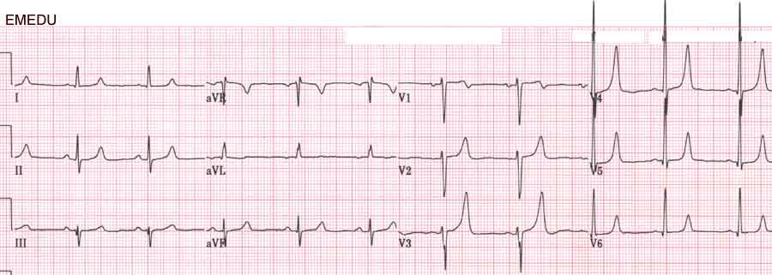
Identify the abnormality
Possible Cause
Management

Slide 33
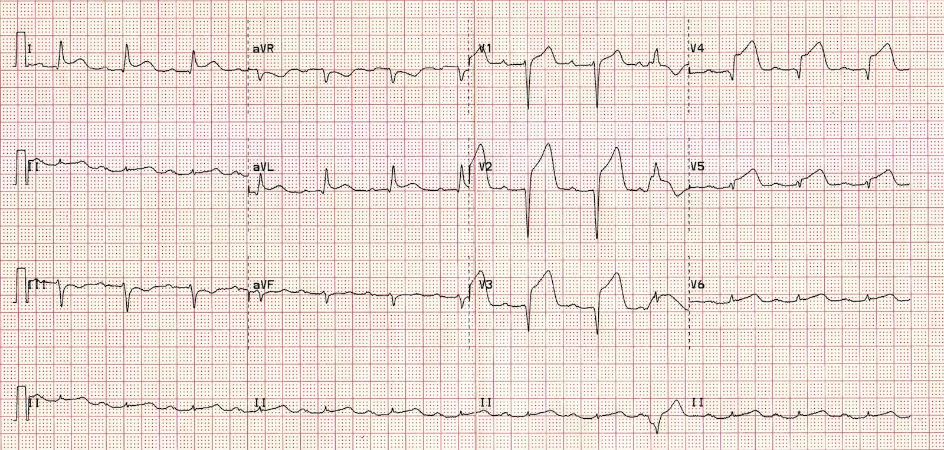
Identify the most likely etiology
Describe the progression in ECG changes
Immediate Management

Slide 34
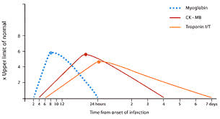
Identify each cardiac biomarker
Which is the most sensitive?
Name a biomarker for Cardiac Failure

Slide 35
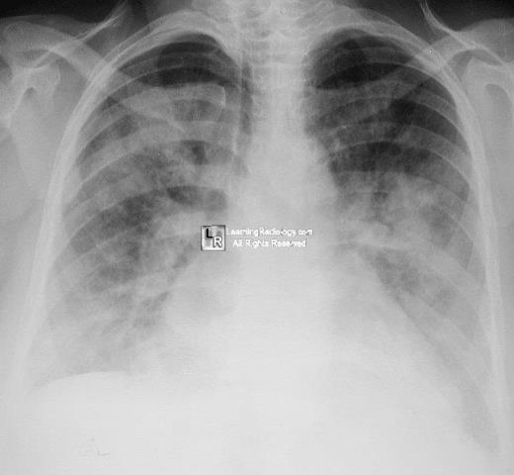
Describe the pathology
List a common cause and Management of this condition

Slide 36
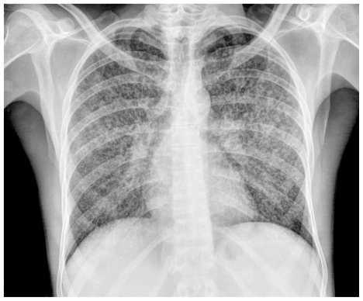
1. Describe your major finding on this Xray
2. Cause
3. What other investigations would you carry out?

Slide 37
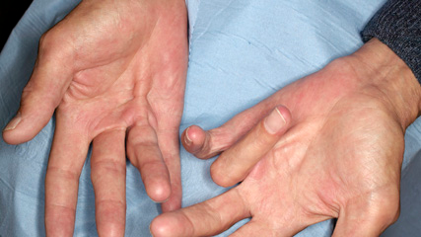
Identify the problem
Causes?
List at least 3 other possible findings on General examination of this patient

Slide 38
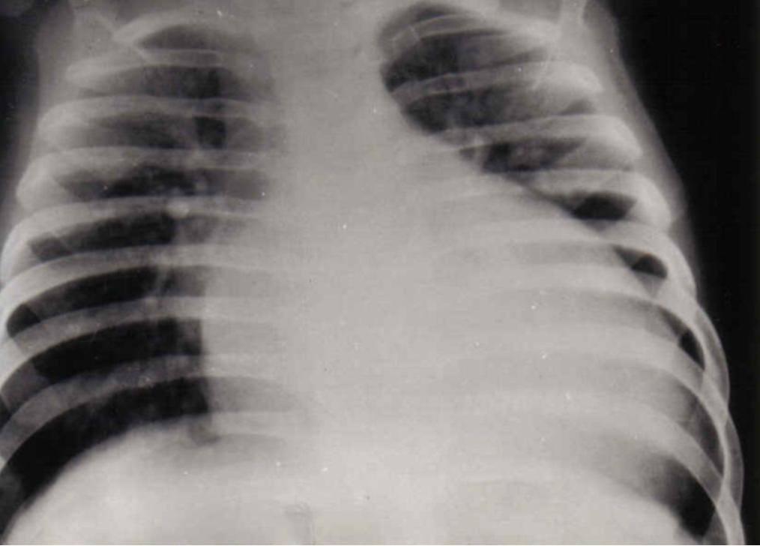
Describe your major finding
List at least 3 causes
Other investigations?

Slide 39
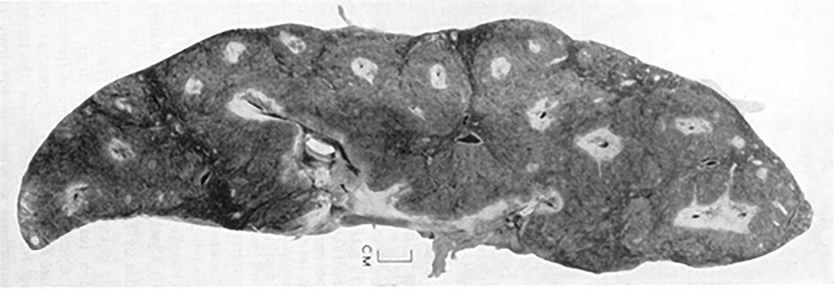
Describe your findings
Causative agent
At least 3 complications

Slide 40
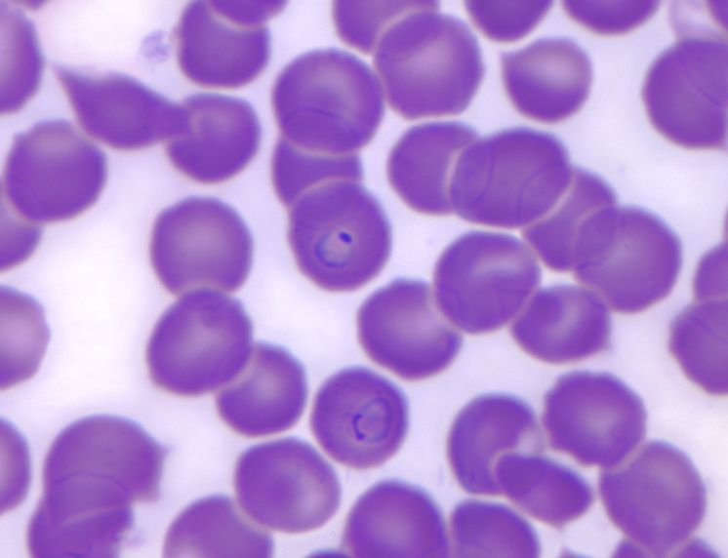
Report your findings indicating the stage of the development the parasite is in
Recommended Rx
5 complications

Slide 41
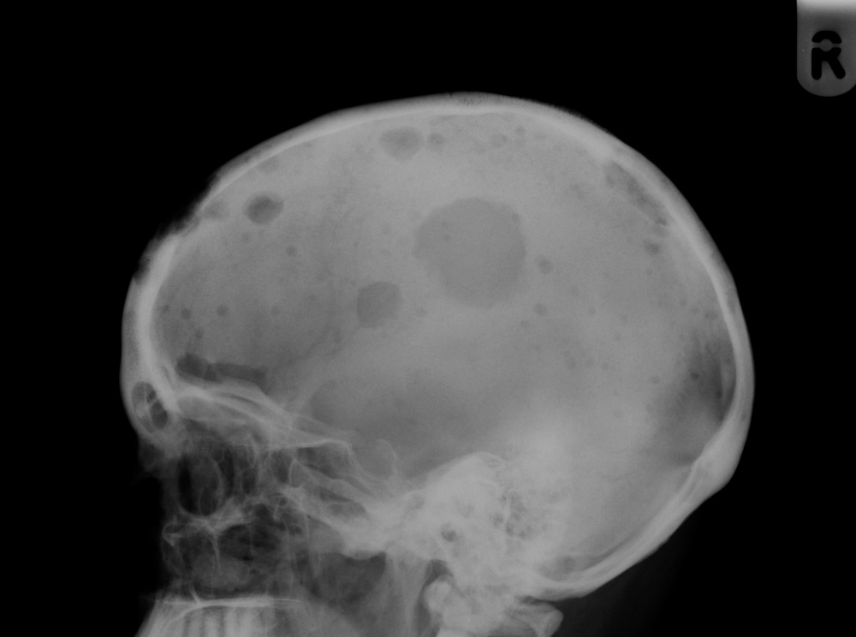
Describe the pathology
Main cause
Management of complications

Slide 42
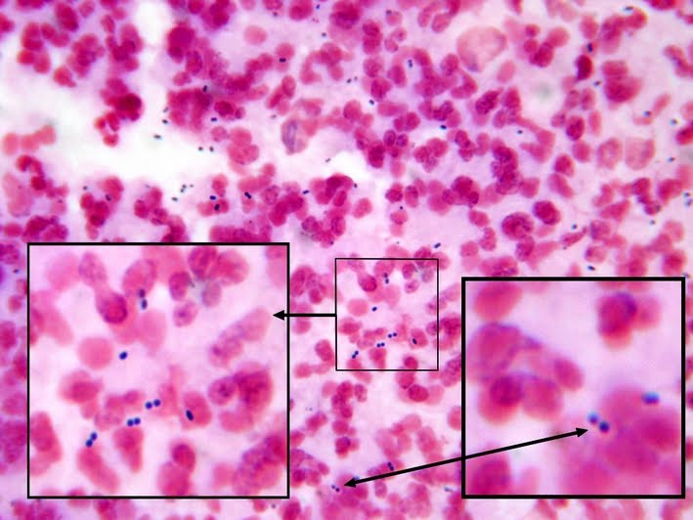
Identify the organism
Condition it causes
What other organisms can cause
Which antimicrobial agent would you use for this organism?

Slide 43
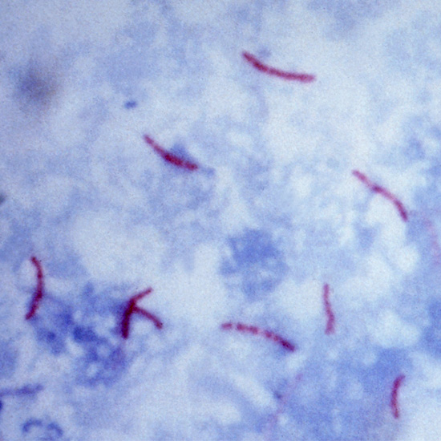
Identify the organism showed
First line Treatment schedule for the disease cause by this organism
5 important things you would ask in history

Slide 44
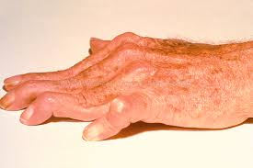
What 2 deformities do you notice?
Diagnosis
X-ray findings
Tests you would do to confirm

Slide 45
RBC normal
HB low
Hct low
MCV high
MCH low
MCHC low
What is your diagnosis?
Classify the causes with examples in each?
Important history to establish cause?

Slide 46
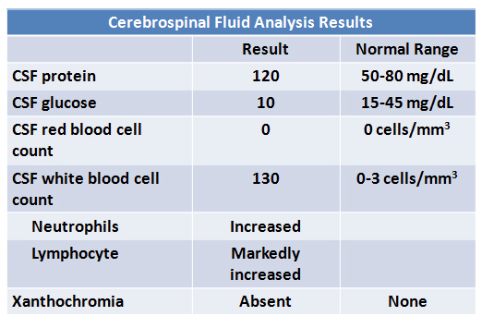
Interpret the results shown
Differentials?
How would you perform an LP?

Slide 47
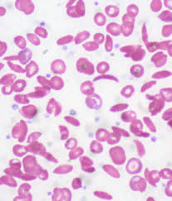
Interpret the blood film shown above
List 4 major complications of this disease
What other tests would you do to confirm your diagnosis?

