Slide 1
ESSAY QUIZ
A 63 year old man presents with a 3 month history of cough, frank hemoptysis and weight loss. He has a 30 pack-year history of cigarette smoking. Sputum microscopy and culture negative for TB

Slide 2
QUESTIONS
WHAT IS THE DIAGNOSIS
OUTLINE OTHER CLINICAL FEATURES THAT WOULD BE INDICATIVE OF THE DIAGNOSIS UNDER THE AREAS
  GENERAL EXAM
  LOCAL EFFECT
OUTLINE 4 PRIORITY INVESTIGATION AND EXPECTED FINDING
OUTLINE 2 APPROCHES TO THE MANAGEMENT
Notes:
INVESTIGATION

Slide 3
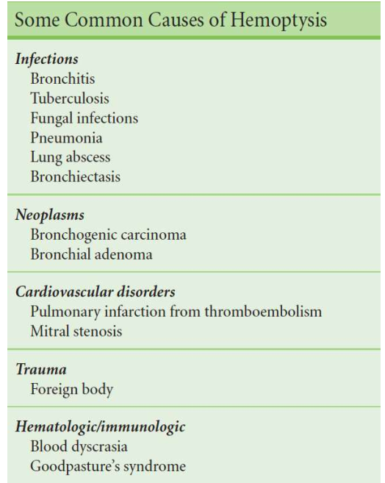
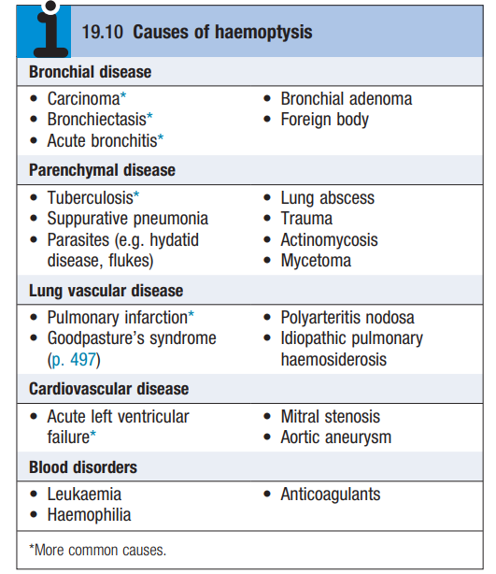

Slide 4
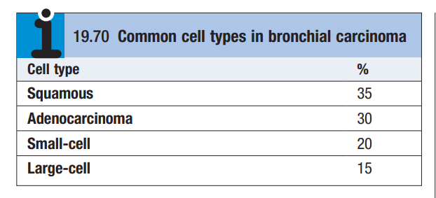
Classification of bronchogenic CA
Squamous (35%)
Adenosquamous (30%)
Small Cell (20%)
Large Cell (15%)

Slide 5
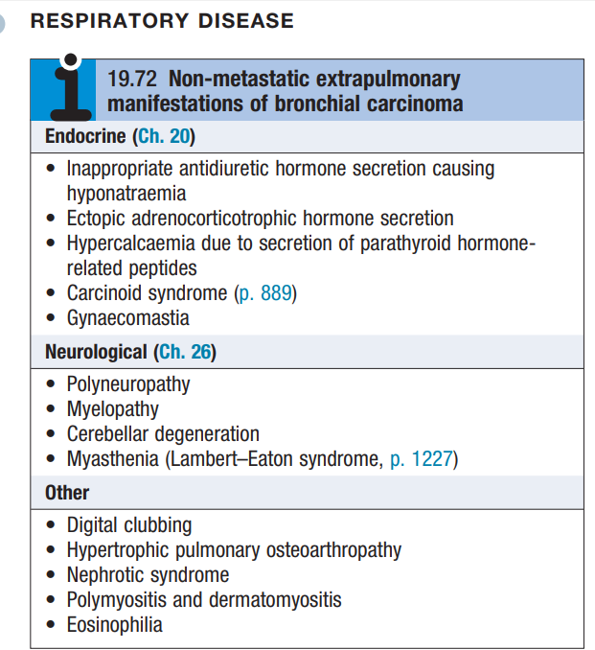

Slide 6
1. Direct
2. Lymphatics
3. Hematogenous
1. Direct
Invades pleura
Invades Chest wall
Invades Intercostal nerves
Invades Brachial plexus
Hematogenous
Liver
Bone
Brain
Adrenal
Skin
Lymphatics
Mediastinal lymph nodes
Compressing:
Pericardium
Esophagus
Superior vena cava
Trachea
Phrenic/ left recurrent laryngeal nerve

Slide 7
A. WHAT IS THE MOST LIKELY DIAGNOSIS?
LUNG TUMOUR ( bronchogenic carcinoma)
LUNG ABSCESS
BROCHIECTASIS,
TB
SUPPARATIVE PNEUMONIA
Aspergilloma
PULMONARY INFARCTION
AORTIC ANEURYSM
M

Slide 8
B. OUTLINE OTHER CLINICAL FEATURES THAT WOULD INDICATIVE FOR THE DIAGNOSIS UNDER
GENERAL EXAM
GENERALIZED WASTING
PALLOR, CENTRAL CYANOSIS
RESPIRATORY DISTRESS
FINGER CLUBBING
LYMPHADENOPATHY( CLAVICULAR, AXILLARY, CERVICAL)
LOCAL EFFECT
Hoarse voice (tumour invasion of the left recurrent laryngeal nerve)
Dysphagia
Raised hemidiaphragm (phrenic nerve paralysis)
SVCO
Horner’s syndrome (miosis, ptosis, enophthalmos, anhydrosis) due to apical or pancoast’s tumour damaging sympathetic chain
Pancoast’s tumours can also directly invade the rib and brachial plexus, causing C8–T1 dermatome numbness, shoulder pain, and weakness of small muscles of the hand

Slide 9
LOCAL EFFECT
Persistent cough or change in usual cough
Haemoptysis
Chest pain (suggests chest wall or pleural involvement)
Unresolving pneumonia or lobar collapse
Unexplained dyspnoea (due to bronchial narrowing or obstruction)
Wheeze or stridor
Shoulder pain (due to diaphragm involvement)
Pleural effusion (due to direct tumour extension or pleural metastases)

Slide 10
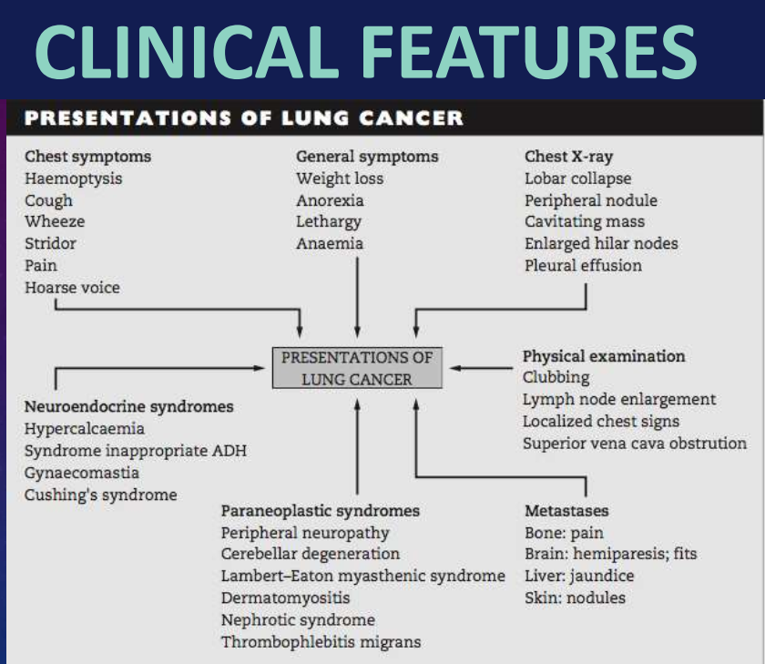

Slide 11
Late invasion of upper lobe tumors :
• Right upper lobe tumors or LN’s compress SVC →
Superior Vena Cava Syndrome
• Apical tumors ‘Pancoast’tumor :
– Brachial plexus → Pain in distribution of ulnar nerve
– Destruction of 1st.&2nd.rib ± vertebrae
– Sympathetic chain invasion→Horner’s Syndrome
(ipsilateral enophthalmus,ptosis,miosis &anhydrosis )

Slide 12
1- Local extension
pleura , pericardium & mediastinum ,
nerves & vessels
2- Lymph node metastases regional L.N. ,bronchial, tracheal and mediastinal
3-Distant metastases :
Adrenal (> 50% ) , Liver , Brain , bone …

Slide 13
Lymphatic : carina, mediastinum & neck
- Mediastinal invasion →
– Recurrent laryngeal n. on left →vocal cord
paralysis
– Phrenic nerve → diaphragmatic paralysis
– Esophagus → bronchoesophageal fistula
– Cardiac & pericardial invasion
– Chest wall invasion → Pain & pleural effusion

Slide 14
C. OUTLINE 4 PRIORITY INVESTIGATION AND EXPECTED FINDING
INVESTIGATION | EXPECTED FINDING
CHEST X-RAY | SITE OF THE TUMOUR,(MOSTLY PERIPHERAL), MEDIASTINAL ENLARGEMENT, RIBS DESTRUCTIONS, IPSILATERAL NODULES , PLEURAL EFFUSION
BRONCHOSOCPY | directly visualize the tumor, distortion of mucosal fold, partial occlusion, abnormal tissue
BIOPSY AND HISTOPATHOLOGY | DEMONSTRATION OF MALIGANACY CELLS
CT-CHEST | MEDIASTINAL SPREAD AND STAGING OF THE TUMOUR , ENDOBROCHIAL US- CAN BE USED IF TUMOR IS IN UPPER LOBE
SPUTUM CYTOLOGY | coal black= denisties, malignant cells visualized

Slide 15
LAB
CBC- ANANEMIA AND MARKED NEUTROPHLIA >1000, REDUCED HB, THROMBOCYTOPENIA
Electrolyte- hypercalcemia – mets to the bones. Raised LDH- POOR PROGONISTIC FACTOR
BRAIN AND SPINAL CORD IMAGING STUDIES- for brain mets
THORACOCENTESIS- PLEURAL EFFUSION FOR CYTOLOGY
PET- SCAN
Bone scan

Slide 16
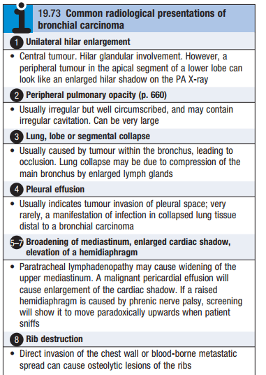
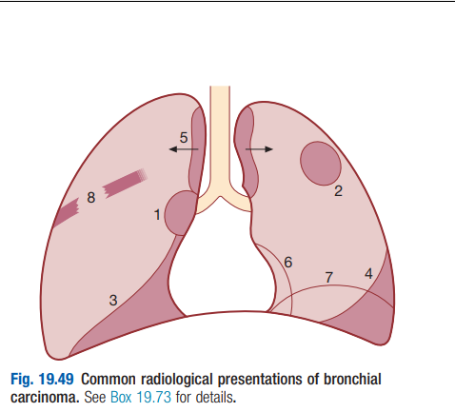

Slide 17
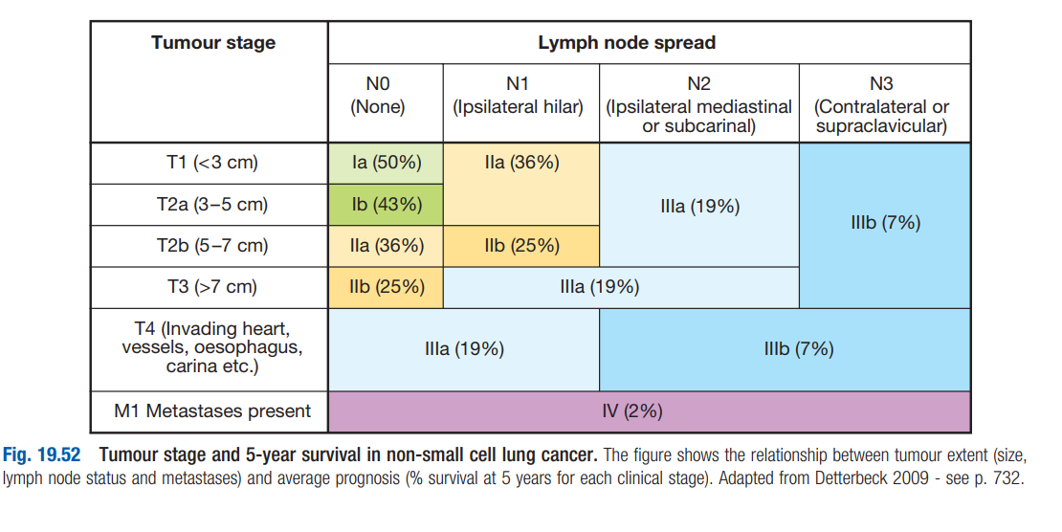
Management depends on TUMOUR STAGING

Slide 18
D.State two approach of MANAGEMENT
Surgical
Radiotherapy
Chemotherapy
Laser therapy and stenting
supportive

Slide 19
SURGICAL
FOR STAGE 1 AND 2
5 YEAR SURVIVAL RATE >75% IN STAGE 1 AND 55% IN STAGE 2- MAY INCLUDE IPSILATERAL PEROBRONCHIAL OR HILAR NODE INVOLVMENT

Slide 20
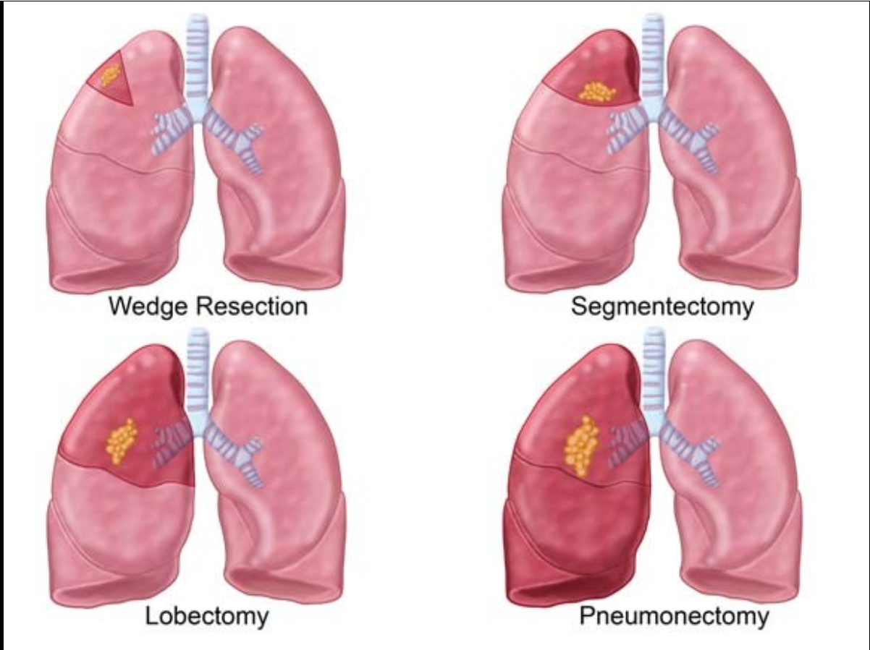

Slide 21
RADIOTHERAPY
Less effective than surgery,
Radical radiotherapy can offer long-term survival in selected patients with localised disease in whom comorbidity precludes surgery.
Radical radiotherapy is usually combined with chemotherapy when lymph nodes are involved (stage III). Highly targeted (stereotactic) radiotherapy may be given in 3–5 treatments for small lesions.

Slide 22
Radiotherapy
SVCO
Recurrent hemoptysis
Pain caused by chest wall invasion or skeletal
metastasis
To relieve obstruction of trachea & main bronchi With chemotherapy,it can prevent brain metastasis in small cell carcinoma

Slide 23
CHEMOTHERAPY
Indications
• Postoperative chemotherapy – patients in
stage II and III who have been operated.
• Chemotherapy in combination with
curative radiation treatment - patients in
stages IIIa and IIIb who can receive
curative radiation treatment.
• Palliative chemotherapy – patients with
stage IV, recurrent NSCLC

Slide 24
CHEMOTHERAPY
Small cell carcinoma – Combined treatment with cytotoxic drugs & radiotherapy
IV Cyclophosphamide
Doxorubicin
Vincristine
Etoposide
IV Cisplatin
These ARE NOT EFFECTIVE AGAINST NON SMALL CELL CA except platinum group of chemo, advised to do surgery before chemo- enhace survival

Slide 25
chemotherapy in combination with radiotherapy
Improve local control as a radiation sensitizer but
also to eradicate microscopic disease and decrease the development of distant metastases Combinations
• Induction chemotherapy of 2-3 courses before
radiation treatment
• Chemotherapy given in parallel with curative
radiation therapy as a radiation sensitizer
(concomitant treatment)
• A combination of the above alternatives
• Adjuvant chemotherapy after concluded curative
radiation therapy

Slide 26
Laser Therapy
Via fiber optic bronchoscopy
Palliative treatment
To destroy tumour tissue occluding major
airways & to allow re aeration of collapsed lung

Slide 27
General Management
Pain relief
Good diet
Specific therapy to treat anxiety & depression
Treat Hypercalcemia
Manage malignant pleural effusions.

Slide 28
Poor prognostic factors
• WHO/ECOG status ≥ 2
• Greatest tumor diameter ≥ 9 cm
• Weight loss > 5–10% in the last 3 months
• Good prognostic factors
• WHO/ECOG status < 2
• Greatest tumor diameter < 9 cm
• Weight loss < 5–10% in the last 3 months

Slide 29
ECOG STATING
WHO performance status
• 0: Asymptomatic (Fully active, able to carry on all
predisease activities without restriction.)
• 1: Symptomatic but completely ambulatory (Restricted
in physically strenuous activity but ambulatory and
able to carry out work of a light or sedentary nature.
For example, light housework, office work)
• 2: Symptomatic, <50% in bed during the day
(Ambulatory and capable of all self care but unable to
carry out any work activities. Up and about more than
50% of waking hours)
• 3: Symptomatic, >50% in bed, but not bedbound
(Capable of only limited self-care, confined to bed or
chair 50% or more of waking hours)
• 4: Bedbound (Completely disabled. Cannot carry on
any self-care. Totally confined to bed or chair)
• 5: Death

Slide 30
Alternative way of investigation froma different source
Spirometry pre-biopsy or surgery
3. CXR (PA and possibly lateral)—location of lesion, pleural involvement, pleural
effusion, rib destruction, intrathoracic metastases, mediastinal
lymphadenopathy. CXR can be normal
4. Blood tests, including sodium, calcium, and LFTs. Check clotting if biopsy
planned
5. Sputum cytology only indicated in patients who are unfit for bronchoscopy
or biopsy
6. Diagnostic pleural tap, if effusion present
7. FNA of enlarged supraclavicular or cervical lymph nodes.

