Slide 1
Imed Essay

Slide 2
Question
Classify the causes of portal hypertension, giving one example for each of the classes
List the modalities of management of an acute variceal bleed in a ? year old boy from Machakos
How would you prevent a re-bleeding in the patient in (b)?

Slide 3
Portal Hypertension
Portal hypertension is an increase in the blood pressure within a system of veins called the portal venous system or hepatic portal system.
Most commonly occurs in hepatic cirrhosis when the liver tissue is replaced by fibrotic tissue.
The normal hepatic venous pressure gradient (difference between the wedged hepatic pressure and free hepatic venous pressure) is 5-6 mmHg. Clinically significant portal hypertension is present when the gradient exceeds 10 mmHg and risk of variceal bleeding increases beyond a gradient of 12 mmHg.

Slide 4
Causes
Pre - hepatic
- Portal vein thrombosis due to sepsis or procoagulopathy or secondary to cirrhosis
- Abdominal trauma including surgery
Intra - hepatic
- Pre - sinusoidal: Schistosomiasis, Congenital hepatic fibrosis, Drugs, Vinyl chloride, Sarcoidosis
- Sinusoidal: Cirrhosis, Polycystic liver disease, Nodular regenerative hyperplasia, Metastatic malignant disease
- Post - sinusoidal: Veno-occlusive disease

Slide 5
Post hepatic
- Budd chiari syndrome
- Right heart failure
- Constrictive pericarditis

Slide 6
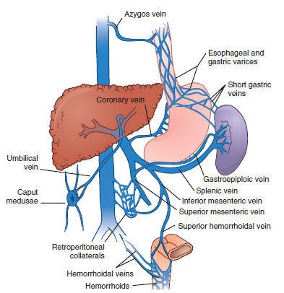
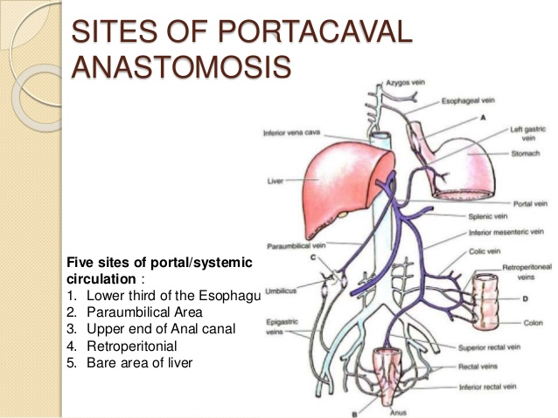
Pathophysiology

Slide 7
Portal venous system connects with the systemic venous system; where blood moves from systemic to the portal venous system:
Inferior portion of the esophagus
Superior portion of the anal canal
Round ligament
When there is obstruction of blood flow from the portal vein to the IVC, venous blood accumulates in the portal system. Pressures > 12mmHg result in portal hypertension. This results in porto-systemic shunts - blood is diverted away from the portal system and backs up in systemic veins. This results in the following:

Slide 8
Decrease blood flow to the liver
- reduction in liver function
- dec. in blood detoxification, resulting in build up of toxic metabolites e.g. NH3; passes through the BBB resulting in hepatic encephalopathy
Porto-systemic shunts:
- Esophagus: esophageal varices/enlarged esophageal veins; these varices are very fragile and rupture easily causing massive UGIB
- Rectum/anal canal: anal varices/enlarged veins which could bleed aswell
- Round ligament: blood shunted from portal system to abdominal veins; dilated superficial abdominal veins (caput medusae)

Slide 9
Backflow of blood and pooling into the spleen resulting in splenomegaly and hypersplenism
Endothelial cells release increased NO; mech. unclear. This results in dilation of the arteries, causing a drop in BP. This stimulates aldosterone production and retention of Na+ and water in the kidneys. Overtime inc. in plasma volume which causes fluid in the blood vessels to move out into tissues and spaces e.g. peritoneal cavity resulting in ascites
Bacteria can also invade the peritoneal cavity causing spontaneos bacterial peritonitis

Slide 10
Clinical features
May be asymptomatic until complications occur
Visible signs :
- distended abdomen (ascites)
- engorged superficial abdominal veins (caput medusae)
GI bleeding secondary to esophageal varices
- hematamesis
- hematochizia or melena
Liver impairment
- Jaundice

Slide 11
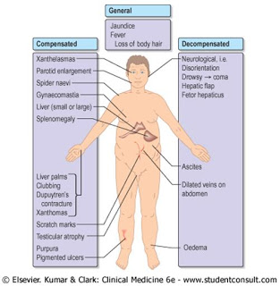
Hepatic encephalopathy
- Asterexis
- Altered conciousness
- Lethargy
- Seizure
- Coma
Splenomegaly
Rarely, a venous hum on auscultation (Cruveilhier-Baumgarten syndrome)

Slide 12
Complications
Variceal bleeding
Congestive gastropathy; frequent cause of UGI bleed in patients with portal hypertension, is thought to involve venous congestion with gastric mucosal capillary dilatation
Hypersplenism
Ascites
IDA
Renal failure
Hepatic encephalopathy

Slide 13
Investigations
Diagnosis is often made clinically
Labs
- FBC - anemia, leucopenia, thrombocytopenia/ infection
- LFTs
- Hepatitis, CMV, EBV serology
- UECs
- Coagulation profile (PT/INR)
Endoscopy - GE varices; once diagnosis of cirrhosis is made, screen for esophageal varices, then endoscopy every 2 years
Abd. US - features of portal hypertension such as splenomegaly and collateral veins and cause of portal hypertension i.e. liver disease, portal vein thrombosis
CT/MRI - identify extent of portal vein clot and also used to identify hepatic vein patency
Doppler flow studies of portal vein (and hepatic vein in suspected Budd-Chiari syn.)

Slide 14
Management
The management of portal hypertension is largely focused on the prevention and/or control of the complications

Slide 15
Management of acute variceal bleed
Initial Management
ABCs
Insert 2 large bore IV cannulae and take blood for FBC, UECs (U>C indicative of massive blood loss), LFTs, Coagulation profile, GXM
Give IV fluids to restore intravascular volume while waiting for x-matched blood. If hemodynamically detoriating despite fluid resuscitation, give O -ve blood. N/B: avoid saline if cirrhotic/varices.
Insert urinary catheter and monitor hourly urine output
Consider a CVP line to monitor and guide fluid replacement
Admin Omeprazole (don't know the cause but start treatment for PUD) (+Ocreotide - dec. blood flow and dec. HCl production)

Slide 16
Correct clotting abnormalities (Vit K, FFPs, Platelets)
If suspicious of varices then give terlipressin IV 1-2mg 6hrly for 72hrs
Initiate IV antibiotics cover (IV cephalosporins)
Monitor pulse, BP and CVP atleast hourly until stable
Arrange an urgent endoscopy

Slide 17
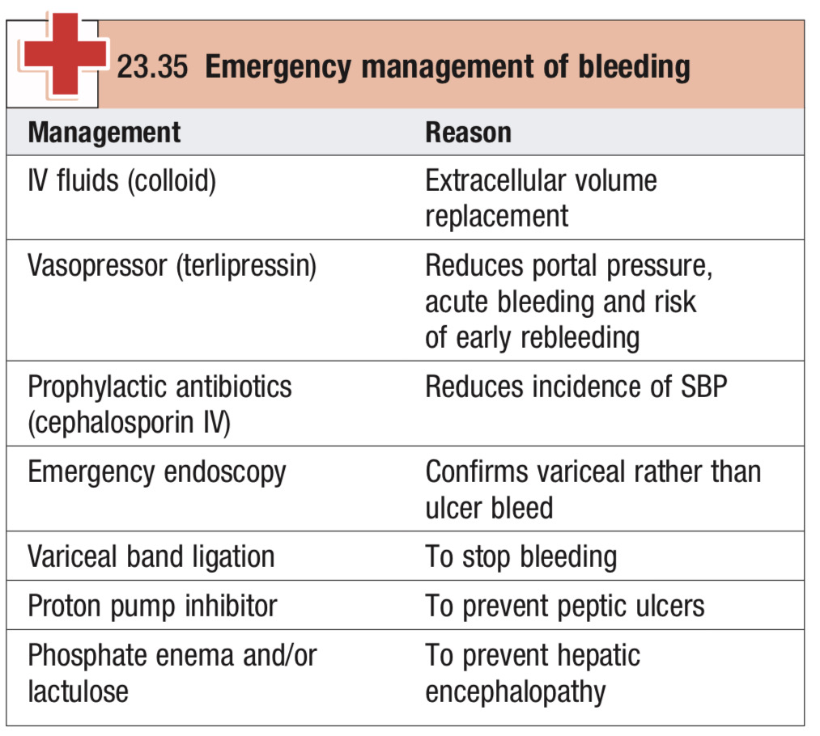

Slide 18
Definitive management for acute variceal bleed
Band ligation and sclerotherapy
- This is the most widely used initial treatment and is undertaken if possible at the time of diagnostic endoscopy
- Banding is repeated every 4-6 weeks until the varices are obliterated
- Band ligation has fewer side effects than, and has largely replaced, sclerotherapy, a technique in which varices are injected with a sclerosing agent
Balloon tamponade
- This technique employs a Sangstaken-Blakemore tube possesing two balloons that exert pressure in the fundus of the stomach and in the lower esophagus respectively

Slide 19
- Additional lumens allow material to be aspirated from the stomach and from the esophagus above the esophageal balloon. This technique may be used in the event of life threatening hemorrhage if early endoscopic therapy is not available or unsuccessful
TIPSS
- This technique uses a stent placed between the portal vein and hepatic vein within the liver to provide a portosystemic shunt and therefore reduces portal pressure
- TIPSS is more effective than endoscopic treatment in reducing variceal bleeding, but it doesn't reduce survival and is associated with more encephalopathy
Others : Portosystemic shunt surgery, Oesophageal transection

Slide 20
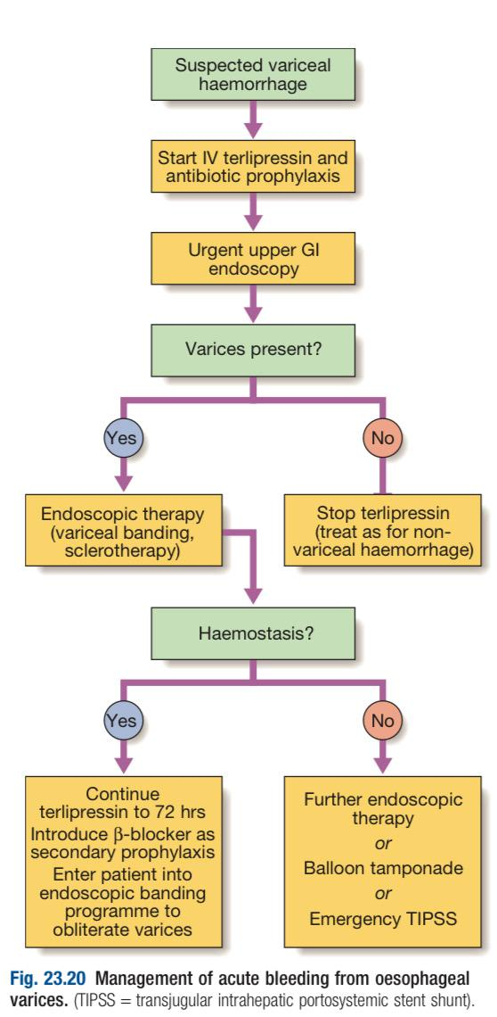

Slide 21
Prevention of re-bleeding
Beta-blockers e.g propranalol 40-80mg/12hrly PO
Repeat endoscopic banding ligation until the varices are obliterated
TIPSS for varices resistant to banding

Slide 22
Question
Use short notes to discuss the mechanism for the formation of ascites in a patient with liver cirrhosis

Slide 23
Ascites
Ascites is pathological accumulation of fluid in the peritoneal cavity. Small amounts of ascites are asympomatic, but with larger accumulations of fluid (>1L) there is abdominal distention, flank fullness, shifting dullness on percussion and when ascites is marked, a fluid thrill.
Other features include eversion of the umbilicus, herniae, abdominal striae, divarication of the recti and scrotal edema.
Dilated superficial veins may be seen if the ascites is due to portal hypertension.

Slide 24
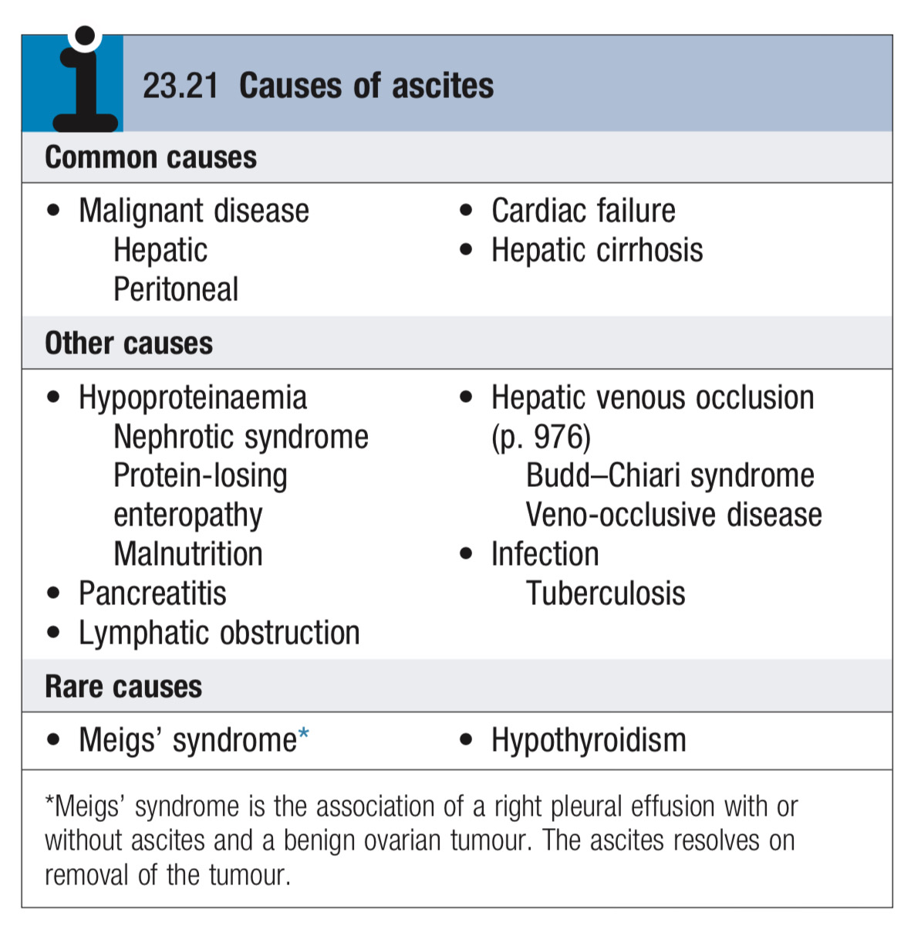
Causes of Ascites

Slide 25
Mechanism for formation of ascites
Ascites results because of:
Inc. portal venous pressure
Low plasma proteins (hypoproteinemia)
Chronic peritoneal irritation
Leakage of lymphatic fluid into the peritoneal cavity or
Fluid overload

Slide 26
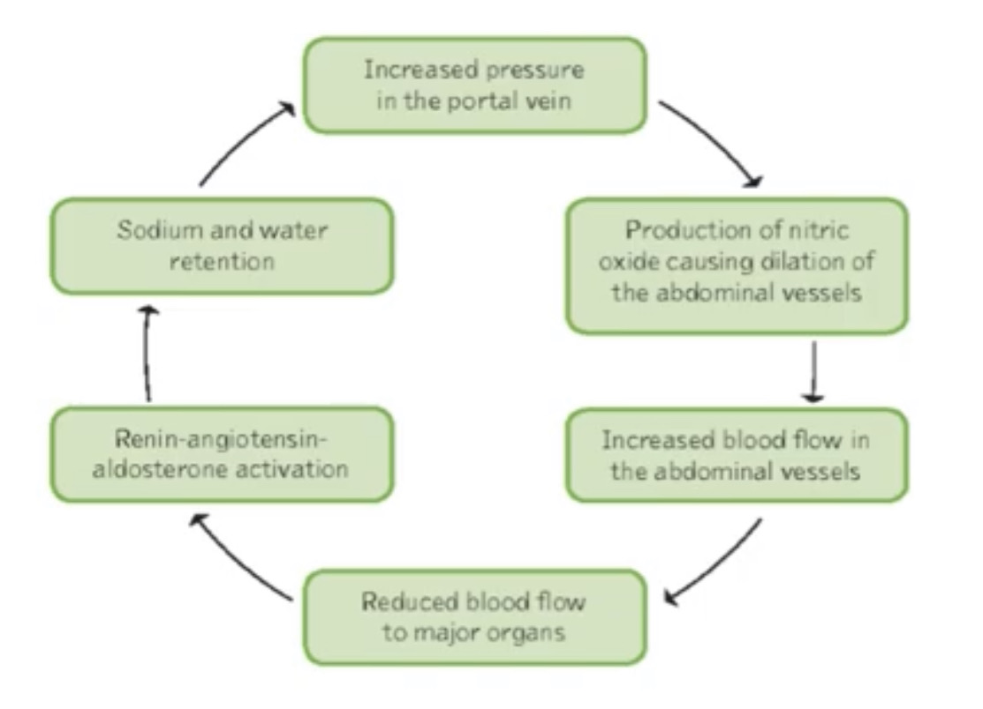
One of the major cause of ascites is increased portal venous pressure related to cirrhosis

Slide 27
The presence of portal hypertension contributes to the development of ascites in patients who have cirrhosis. Apart from cirrhosis, any cause of increased resistance to hepatic or portal venous flow can lead to ascites.
There is an increase in intrahepatic resistance, causing increased portal pressure.
This increased pressure within the hepatic veins or post sinusoidal level increases hydrostatic pressure within the hepatic sinusoids and portal veins.
In late stages of liver cirrhosis there is collateral vein formation, shunting of blood to the systemic circulation and also vasodilation of the splanchnic arterial system.
This in turn results in an increase in portal venous inflow.
All these abnormalities result in increased production of splanchnic lymph.

Slide 28
Lymphatic flow is increased proximal to the point of vascular obstruction and when the normal capacity of the lymphatic system is overwhelmed the transudate fluid moves across the surfaces of the liver, mesentry and intestines into the peritoneal cavity.
Vasodilating factors such as NO are responsible for the vasodilator effect.
These hemodynamic changes (dec. in BP) result in sodium retention by causing activation of RAAS with an inc. in aldosterone.
The renal effects of increased aldosterone leading to Na retention also contributes to the development of ascites.
Na retention is the consequence of a homeostatic response caused by underfilling of the arterial circulation secondary to arterial vasodilation in the splanchnic vascular bed

Slide 29
Because the retained fluid is constantly leaking out of the intravascular compartment into the peritoneal cavity, the sensation of vascular filling is not achieved, and the process continues.
The increased portal venous pressure in combination with splanchnic vasodilation alters normal permeability and capillary pressure.
This alteration enables movement of vascular fluid through the poles between capillary vascular endothelial cells of the portal system into the extravascular space of the liver and intestines.

Slide 30
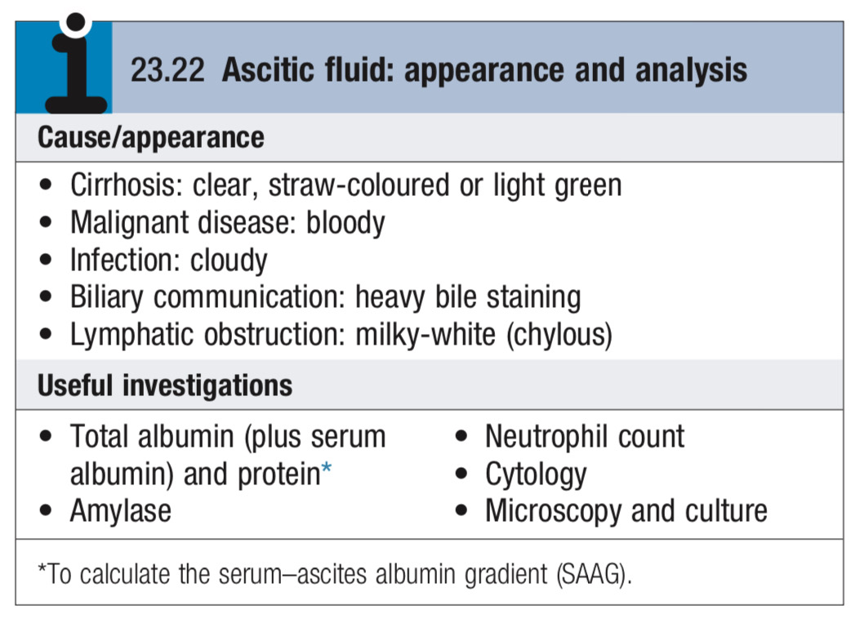
Investigations
Abdominal US - best means of detecting ascites, particulary in the obese and those with samll volumes of fluid
Paracentesis (if neccessary US-guided) - for ascitic fluid analysis

Slide 31
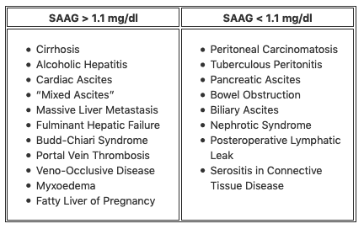
> 1.1 mg/dl - transudative ascites
< 1.1 mg/dl - exudative ascites

Slide 32
Ascites Amylase activity > 1000U/l - indicates pancreatic ascites
Low ascites glucose conc. - malignant disease or TB
Cytological exam may reveal malignant cells
PMNLs >250*10⁶/l - suggest infection (spontaneous bacterial peritonitis)

Slide 33
Management
Fluid restriction <1.5L/day
Low salt diet
Give spironolactone 100mg/24h PO; Inc. dose as tolerated (max. 400mg/24h)
Chart daily weight and aim for weight loss ≤ 1/2kg/day.
If response poor, add furosemide 160mg PO (N/B: Lasix:Aldosterone; 2:5) - do U&Es (watch Na+) often
Therapeutic paracentesis with concomitant albumin infusion (6-8g/l fluid removed; 100mls of 20% human albumin solution for every 1.5-2L of fluid drained)
- Done when patient has respiratory distress, malignancy or refractory or diuretic resistant ascites

Slide 34
Complications
Renal Failure
Hepato-renal syndrome
Spontaneous bacterial peritonitis

