Slide 1
Imed Essay

Slide 2
Question
Write short notes on typhoid fever under the following sub-headings:
pathology
clinical presentation
diagnostic workup
complications

Slide 3
Introduction
Typhoid fever, also known as enteric fever, is a potentially fatal multisystemic illness caused by:
- Salmonella typhi (S. typhi has serovars; serova enterica is pathogenic)
- Salmonella paratyphi (S. paratyphi has subtype A,B and C)
N/B: Typhoid fever is primarily caused by S. typhi and to a lesser extent S. paratyphi
In Greek 'typhos' means an etheral smoke or cloud that was believed to causes disease and madness - in the advanced disease the patient's level of conciousness is truly clouded

Slide 4
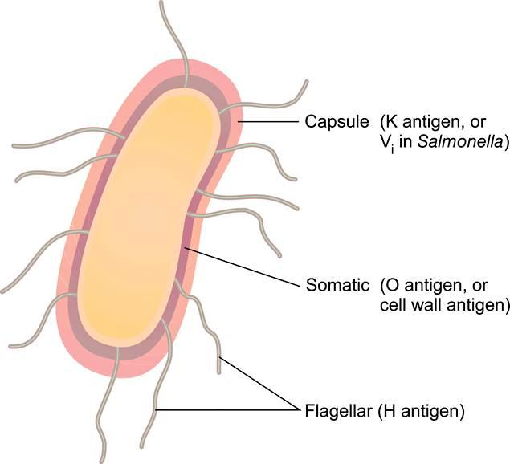
Etiology
Typhoid fever is caused by S. typhi and S. paratyphi
Is a gram -ve bacilli, aerobic, non-spore forming organism
It contains:
- Lipopolysaccharide
- Oligosaccharide somatic antigen “O” antigen
- Flagella “H” antigen
- Virulence “Vi” antigen

Slide 5
Transmission: Via Faeco-oral route
Ingestion of contaminated food and beverages; food handlers are often asymptomatic and chronically shed the bacteria through feaces or less commonly urine - due to poor personal hygiene of these people food is usually contaminated with the bacteria
Drinking sewage contaminated water and shellfish
Using contaminated toilets and neglecting hand hygiene

Slide 6
Risk Factors
Typhoid is common in areas with poor infrastructure in terms of hygiene and disposal or waste esp. in developing countries with low SES
Children are at a greater risk of developing typhoid infection
Overcrowding
In the developed countries, most infections are due to travelling - those who work or travel to endemic areas
Those who have close contact with infected people are susceptible
Immunosupression is a risk factor

Slide 7
Typhoidal salmonellae are able to survive in low pH (1.5); reduction in gastric acidity may increase the risk on developing typhoid fever by facilitating bacterial growth:
- Antacids
- PPIs
- H2 receptor blockers
- Gastrectomy
- Acchlorhydria
- Pernicious anemia
Some individuals may present genetic polymorphisms which dampen the macrophage activity and facilitate macrophage growth

Slide 8
Pathophysiology
Bacteria enters the body via the oral route.
All pathogenic Salmonella species, when present in the gut are engulfed by phagocytic cells, which then pass through the mucosa and present them to macrophages in the lamina propria.
Non - typhoidal salmonellae species are phagocytized throughout the distal ileum and colon. With toll-like receptors; TLR-5 and TLR-4/MD2/CD-14 complex, macrophages recognize pathogen associated molecular patterns (PAMPs) such as flagella and lipopolysaccharides. Macrophages and intestinal epithelial cells then attract T cells and neutrophils with IL-8 causing inflammation and suppressing the infection.

Slide 9
In contrast to the non-typhoidal salmonellae, S. typhi and S. paratyphi enter the host's system primarily through the distal ileum. They have specialized fimbriae that adhere to the epithelium over clusters of lymphoid tissue in the ileum (Peyer's patches). The bacteria are then phagocytosed by the macrophages in the Peyer's patches. The bacteria then induce their host macrophages to attract more macrophages.
Typhoidal salmonella co-opt the macrophages' cellular machinery for their own reproduction as they are carried through the mesenteric lymphnodes to the thoracic duct and the lymphatics and then to the reticuloendothelial tissues of the liver, spleen, bone marrow and lymphnodes. Once there, they pause and continue to multiply until they reach critical density. This is followed by bacteria induced macrophage apoptosis, breaking out into the blood stream to invade the rest of the body.

Slide 10
The bacteria then infect the gallbladder via either bacteremia or direct extension of infected bile. The result is that the organism re-enters the GIT in the bile and re-infects the Peyer patches. Bacteria that do not re-infect the host are typically shed in the stool and are then available to infect other hosts.

Slide 11
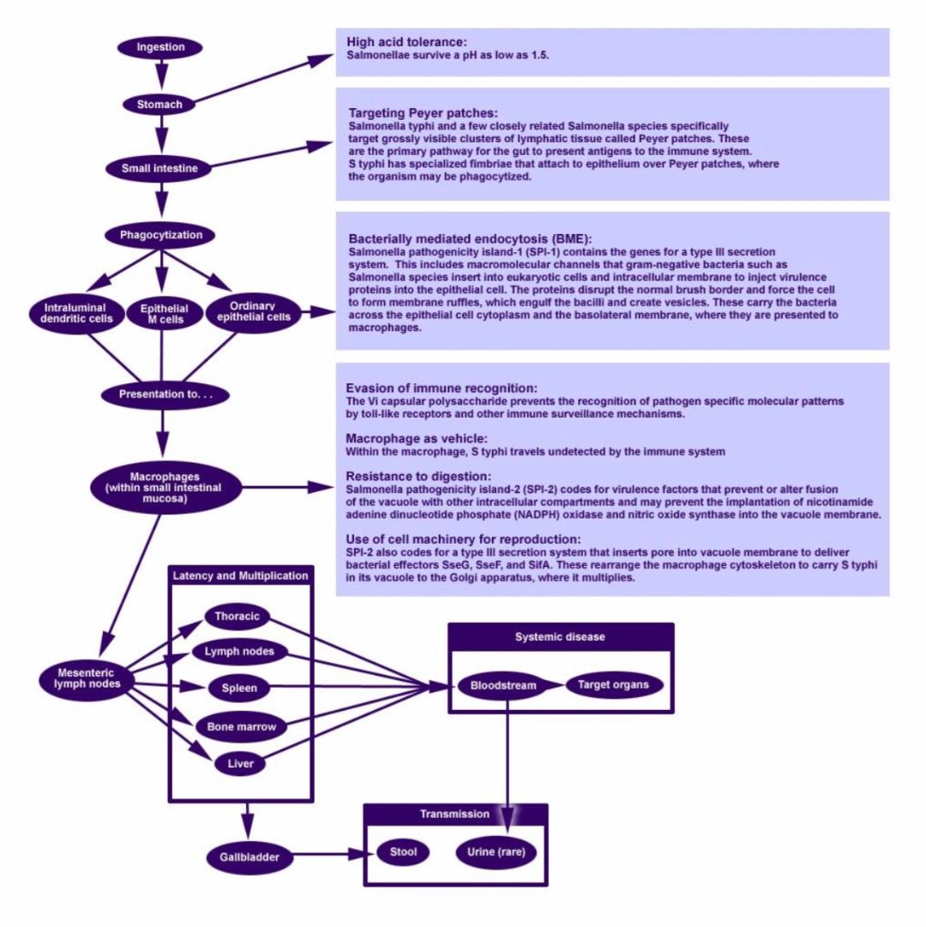

Slide 12
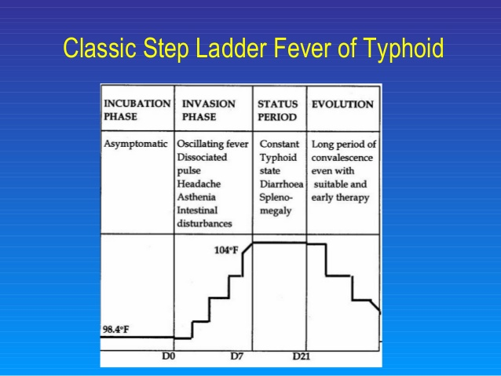
Clinical Presentation
Classic disease:
Clinical syndromes assoc. with S. typhi and S. paratyphi are indistinguishable
Usually beings 10-14 days after ingestion
Fever - temperature rises in a step ladder fashion with a relative bradycardia (Faget sign)

Slide 13
Over the first week of infection
GI manifestations
- Diffuse abdominal pain and tenderness
- Right upper quadrant pain
- Constipation (swelling of lymphoid tissue around the ileocecal junction)
- Diarrhea and vomiting prominent in children early in the illness
Malaise
Headache
Myalgia

Slide 14
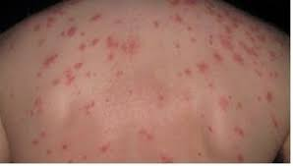
End of the 1st week
Fever platueas at 39-40℃
Rose spots on trunk; red macules about 2-4 mm and blanch easily
Apathetic look: typhoid facies
Dry cough

Slide 15
During the 2nd week
The above signs and symptoms progress
Distention of the abdomen
Splenomegaly
Relative bradycardia

Slide 16
In the 3rd week
Patient becomes more toxic
Anorexia - weight loss
Infection of conjuctiva
Patient is tachypneic with a thready pulse
Crackles over lung bases
Severe abdominal distention
Some patients - foul, green-yellow, watery diarrhea (pea soup diarrhea)
Bowel peritonitis and perforation
Toxemia, myocarditis, intestinal hemorrhage may cause death

Slide 17
4th week
Fever, mental confusion and abdominal distention increases
Instestinal and neurologic complications may still occur
Weight loss and weakness increases
Some survivors - become asymptomatic carriers

Slide 18
Diagnosis
The diagnosis of typhoid fever is primarily clinical
CBC
- Normocytic anemia
- WBC - typical leucopenia (however maybe increased in children)
- Thrombocytopenia
Raised ESR
Elevated PT and APTT and decreased fibrinogen levels

Slide 19
Culture - considered 100% specific
Blood culture; in the 1st week maybe positive in nearly all patients
Bone marrow culture; most sensitive
Stool and urine culture - when abdominal symptoms predominate (usually 2nd - 3rd week)
PCR
Puncture biopsy from the rose spots
Widal test is not sensitive or specific and is no longer used
- measures agglutinating antibodies to H and O antigens of S. typhi
- positive if prior infection or immunization
- O titer more specific, H more sensitive

Slide 20
Treatment
Fluid replacement and good nutrition
1st line Antibiotics: Ciprofloxacin 500mg/12h PO for 10 days
Alternatives: Ceftriaxone 2g IV/24hr for 14 days or Azithromycin 1g PO on day 1 with 500g PO on day 2-6
In severe disease, give IV Ciprofloxacin or Cefotaxime for 10-14 days
In encephalopathy +/- shock, give dexamethasone 3mg/kg IV stat just before antibiotics, then 1mg/kg/6hr for 48hrs
N/B: Perforation is managed by surgery and if severe GI bleeding, may require blood transfusion

Slide 21
