Slide 1
Imed essay
A 57 year old man presents with a seven month history of progressive LUQ swelling, early satiety and fatigue, physical exam reveals an enlarged spleen extending 20cm below the left costal margin.

Slide 2
WHAT ARE YOUR DIFFERENTIAL DIAGNOSIS
Lets focus in our setting

Slide 3
A. LIST FIVE DIFFERENTIAL DIAGNOSIS FOR THIS PRESENTATION

Slide 5
CML INTRODUCTION
A myeloproliferative neoplasm arising from a primitive hematopoietic stem cell in the bone marrow that involves all three myeloid lineages: granulocytes, erythroid cells, and megakaryocytes.
It is defined by the presence of the BCR/ABL1 fusion gene, which results from the reciprocal translocation t (9; 22) (q34; q11.2). The Philadelphia chromosome refers to the abnormally short chromosome 22 in CML.

Slide 6
CML occurs in three phases: Chronic/Stable phase (most patients are first diagnosed here), accelerated phase and blast transformation/crisis (acute myeloid or lymphoid leukemia). Most cases occurring sporadically. The M: F ratio is 1.4:1 and median age of occurrence is about 50years. In Kenya, Abinya et al found an M: F ratio of 1.26:1 with median age of 44years.

Slide 7
Clinical Evaluation The most common presenting symptoms include: • Fatigue (usually related to mild to moderate anemia) • Weight loss ( B symptoms) • Left upper quadrant fullness/pain • Early satiety from splenomegaly.

Slide 8
Other presentations that are less common include:
• Priapism caused by marked leukocytosis +/- thrombocytosis
• Gouty arthritis due to increased uric acid levels
• Bleeding caused by platelet dysfunction or low platelets
• Deafness
• Upper git ulceration and bleeding due to histamine release associated with basophilia.
• Hyperviscosity symptoms can occur due to sludging of cells in pulmonary or cerebral vessels resulting in confusion, drowsiness or dyspnea.
• In accelerated phase, constitutional symptoms of fever, sweat and weight loss are present.
• Bleeding can occur especially in accelerated and blast phase.

Slide 9
Physical examination 1. Pallor. 2. Splenomegaly: record spleen size by palpation (cm below costal margin). 3. Hepatomegaly. 4. Lymphadenopathy and skin infiltration are rare.

Slide 12
His complete blood count reveals WBC 348×10^9, PLATELETS- 602 HB-9g/dl
What is the most likely diagnosis?
Chronic myeloid leukemia

Slide 13
LIST 4 PRIORITY INVESTIGATION AND EXPECTED FINDINGS
INVESTIGATION | EXPECTECTED FINDINGS
PERIPHERAL BLOOD SMEAR | demonstrate full maturation spectrum of myeloid series NORMOCHROMIC NORMOCYTIC picture
2. BONE MARROW ASPIRATE | hypercellular with granulopoietic predominance. characterization of phase of CML.
3. PCR | for BCR-ABL1 DETECTION
4.FISH | to detect translocation t (9, 22) PHILADEPHIA CHROMOSOME
5. URIC LEVELS | HYPERURICEMIA

Slide 14
White blood cells. Characteristically, there is marked leucocytosis (approximately 200,000/μl or more at the time of presentation). The natural history of CML consists of 3phases—chronic, accelerated, and blastic.
• Chronic phase: begins as a myeloproliferative disorder and consists of excessive proliferation of myeloid cells of intermediate grade (i.e. myelocytes and metamyelocytes) and mature segmented neutrophils.
• Accelerated phase: increasing degree of anaemia, blast count in blood or marrow between 10-20%, marrow basophils 20% or more, and platelet count falling below 1,00,000/μl.
• Blastic phase or blast crisis: blood or marrow blasts >20%. Myeloid blast crisis in CML is more common and resembles AML.
– Auer rods are not seen in myeloblasts of CML in blast crisis.
– Platelets. Platelet count may be normal but is raised in about half the cases.

Slide 15
BONE MARROW EXAMINATION
• Cellularity: hypercellularity with total or partial replacement of
fat spaces by proliferating myeloid cells.
• Myeloid cells: predominate in the bone marrow with increased
myeloid-erythroid ratio. The differential counts of myeloid cells
in the marrow show similar findings as seen in the peripheral
blood with predominance of myelocytes.
• Erythropoiesis: normoblastic but there is reduction in
erythropoietic cells.
• Megakaryocytes: are conspicuous but lare usually smaller in
size than normal.
• Cytogenetics: the characteristic chromosomal abnormality
called Philadelphia (Ph) chromosome (90-95%)

Slide 16
LIST 3 PHASES IN THE NATURAL COURSE OF THE DISEASE
CHRONIC PHASE
ACCELERATED PHASE
ACUTE/ BLASTIC PHASE

Slide 18
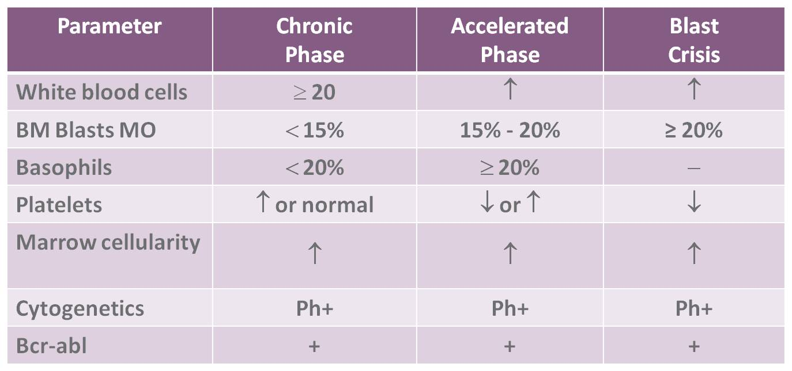

Slide 19
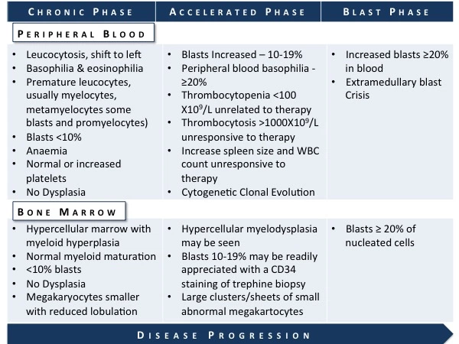

Slide 20
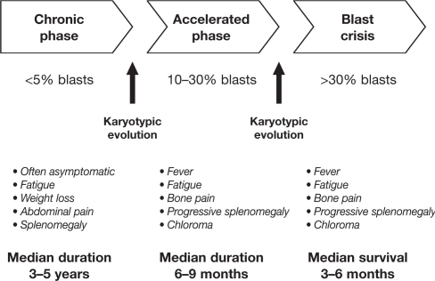

Slide 21
Management
This is achievable by the following approaches
– Imatinib oral therapy
– Allogenic bone marrow (stem cell) transplantation.
– Interferon-α.
– Chemotherapy
– Others: splenic irradiation, splenectomy and leucopheresis.

Slide 22
NAME THREE DRUGS USED IN MANAGEMENT

Slide 24
TKI- 1ST GEN- IMATINIB MESYLATE
2ND GEN- DASATANIB-avoid in lung disease and pleural effusion, NILOTINIB- Higher affinity for BCR-ABL1 avoid in any vascular disease available
PONATINIB- given when theres is resistence to the above medication and there is mutation T3151

Slide 25
HYDROXYUREA- used to control WBC, but has no effect to CML MOLECULAR abnormality same applies to ALLOPURINOL, used before patient is transformed to TKI
Hydroxyurea is given at a dose of 1-2g/day then reduced weekly to 0.5-1g/day
Alpha interferon- used only when WBC has been controlled hydroxyurea and is used to maintain WBC <4

Slide 26
RESPONSE CAN BE
OPTIMAL
SUB OPTIMAL
FAILURE

