Slide 1
QUESTION
A 27 year old man presents with a 3 week history of progressive shortness of breath, dry cough and low grade fever.
He has received a dose of oral amoxicillin without much improvement.
He completed treatment for sputum positive Pulmonary Tuberculosis (PTB) 2 months ago; and had responded well to the TB treatment
Physical examination reveals a cachexic patient in severe respiratory disease and with florid oral thrush.
His pulse rate is 111 beats/ minute, temperature is 37.9⁰C, respiratory rate is 32 breaths per minute, BP is 110/75 mmHg and O₂ saturation on pulse oximetry is less than 90% on room air.
He weighs 46 kg.
HIV test done after counselling comes back as positive

Slide 2
DIAGNOSIS
Most likely diagnosis is Pneumocystis jiroveci Pneumonia in a 27 year old male, newly diagnosed with Retroviral disease (HIV). He has in the recent past been treated for Bacterial pneumonia (Amoxicillin) & TB.
Differential Diagnosis
Bacterial pneumonia
Tuberculosis
Viral pneumonia
Acute respiratory distress syndrome
Mycobacterium avium complex (MAC) infection
Aspergillosis
Pulmonary KS
E.t.c

Slide 3
Why PJP (& not Bacterial pneumonia / TB)
PJP is the most common opportunistic infection in persons with HIV.
Duration of symptoms (3 weeks)- Bacterial pneumonia presents acutely.
Finding of other opportunistic infection (oral thrush)
Shortness of breath- With TB, weight loss and night sweats are prominent while with PJP, shortness of breath is prominent.
Dry cough-TB cough contains sputum more often than not.
He has been treated for bacterial pneumonia (Amoxicillin without much improvement)
He completed treatment for PTB 2 months ago & responded well to the TB treatment.

Slide 4
Pneumocystis Jiroveci Pneumonia
Commonly found in lungs of healthy individuals.
Disease occurs when both cellular and humoral immunity are defective.
Risk factors are:
Persons with HIV infection whose CD4+ count falls below 200 and those who are not receiving PJP prophylaxis
Persons with primary immune deficiencies
Persons receiving long term immunosuppressive regimens for Connective tissue disorders or solid organ transplantation.
Persons with malignancies.
Persons with severe malnutrition.

Slide 5
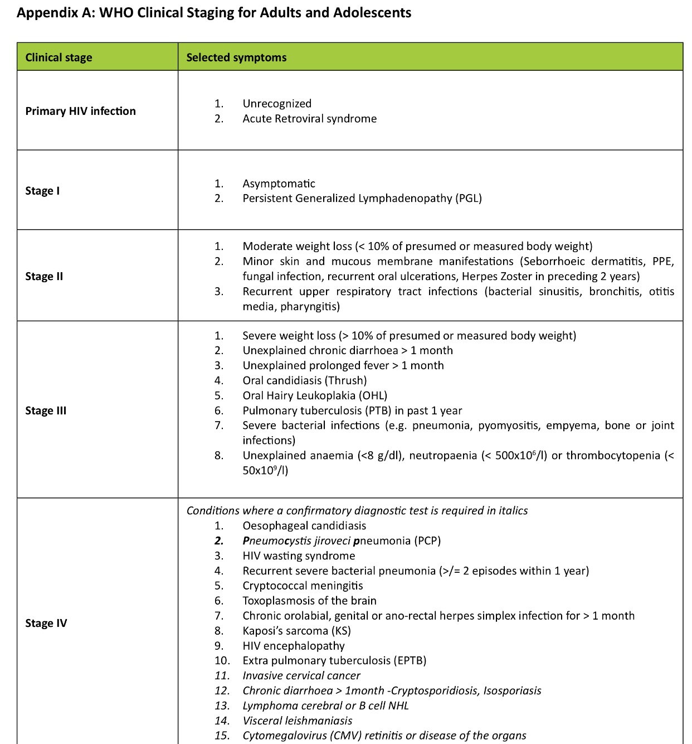

Slide 6
WHO CLINICAL STAGE
WHO stage 4 as evidenced by:
Clinical suspicion of PjP
HIV Wasting syndrome
Just worsened from stage 3
Oral Candidiasis (Thrush)
Pulmonary TB
Severe weight loss (>10%)
Unexplained persistent fever (>37.5⁰C)

Slide 7
INVESTIGATIONS & EXPECTED FINDINGS
LDH levels- usually elevated (>220 U/L)
Full blood count- Expected Anaemia & neutropenia.
Sputum induction for histopathologic testing- Staining then Trophozoites & cysts are seen.
Bronchoalveolar lavage if PJP is strongly suspected & the induced sputum sample findings are negative/ patient unable to cooperate with an induced sputum sample (e.g because of impaired mental status)
Quantitative PCR for sputum- Shows active infection and not just colonization.

Slide 8
INVESTIGATIONS & EXPECTED FINDINGS
CHEST RADIOGRAPHY
Bilateral, diffuse, often perihilar, fine, reticular opacification.
Opacification progresses to air space consolidation over 3-4 days.
May be normal in 10-30% due to lag behind clinical symptoms.
Pulmonary nodules & cysts are rare but may be found.
HIGH RESOLUTION COMPUTED TOMOGRAPHY (HRCT)
Ground glass attenuation in more than 90% of patients- Refers to parenchymal opacification, which does not obscure the underlying pulmonary architecture.
May be associated with thickening of interlobular septa due to edema.

Slide 9
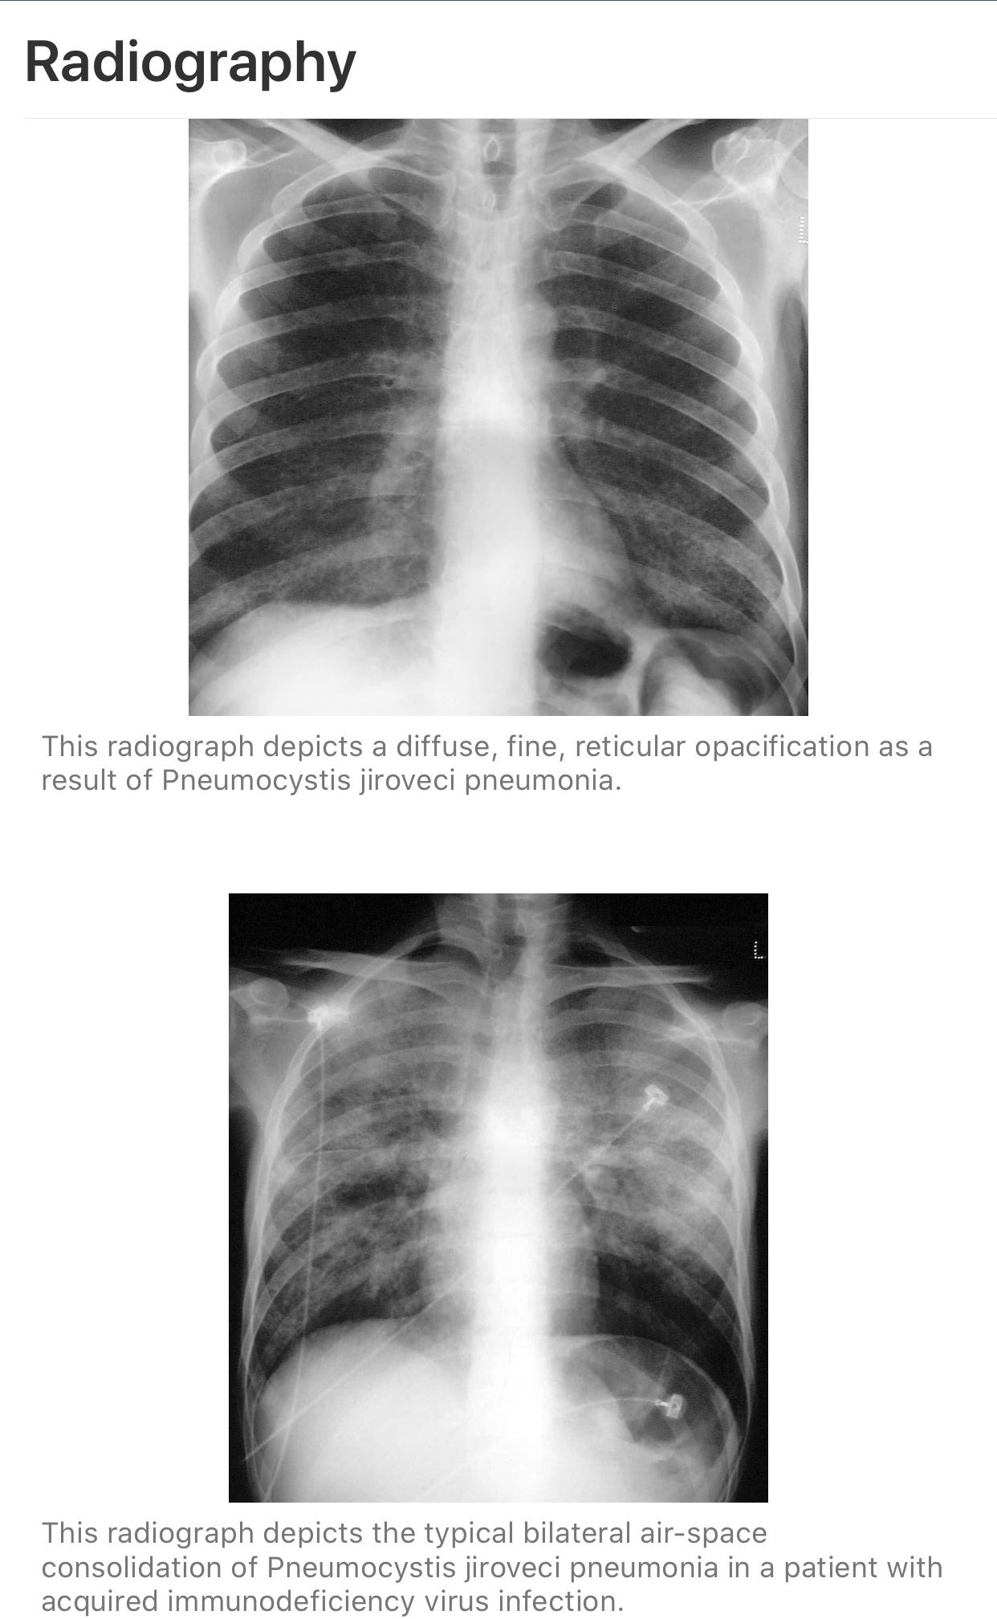
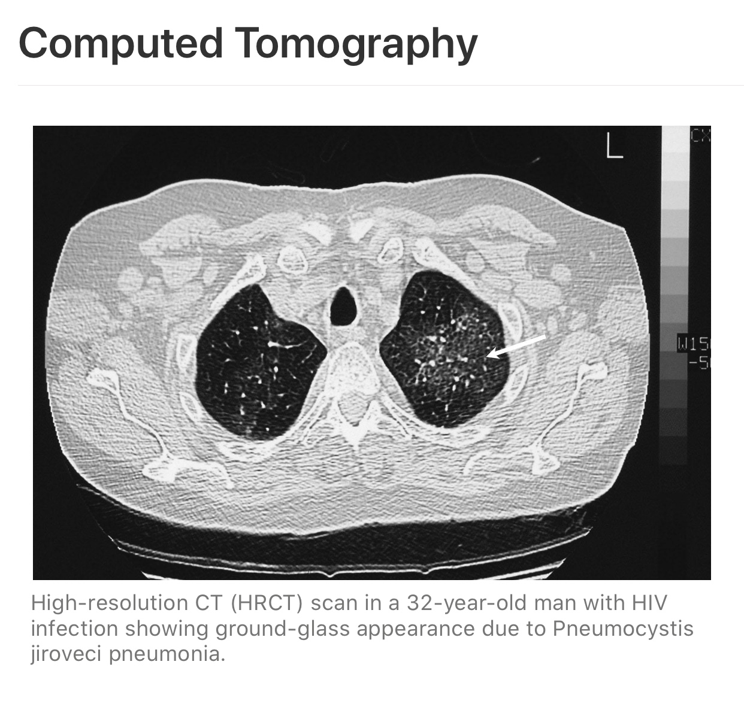

Slide 10
SEVERITY
Parameters that objectively indicate severity of respiratory disease and the need for adjunctive therapy:
Tachypnoea- >20 breaths per minute
O₂ saturation <90 on room air
Arterial Blood Gas –partial pressure of oxygen <70mmHg at rest on air)
Tachycardia >100 beats per minute
Cyanosis

Slide 11
PRINCIPLES OF MANAGEMENT
Although a histopathologic demonstration of the organism is required for a definitive diagnosis, treatment should not be delayed. Hence may be initiated before the workup is complete in severely ill high-risk patients.
First line-TMP-SMX 15-20 mg/kg/d for 21 days in those with HIV infection & 14 days in all other patients.
Second line- Clindamycin 600-900 mg 8hrly IV or 300-450mg 6 hourly PO plus primaquine 15-30mg/ day PO (Same duration as above)
Others- Pentamidine, dapsone (often in combination with pyrimethamine), or atovaquone.

Slide 12
PRINCIPLES OF MANAGEMENT
Adjunctive corticosteroids to reduce the incidence of mortality and respiratory failure.
In patients with severe illness (RR>30 breaths per minute, O₂ saturation <90 at rest on room air or an Arterial Blood Gas –partial pressure of oxygen <70mmHg at rest on air), oral prednisolone should be given concurrently with the CTX
Prednisone 40mg BD for 5 days, then prednisone 40 mg OD for 5 days, then prednisone 20mg OD for the remaining 11 days.

Slide 13
PRINCIPLES OF MANAGEMENT
ORAL CANDIDIASIS MGT
1st line: Nystatin oral drops 5ml QID for 7-14 days or miconazole gum patch.
2nd line: Fluconazole 100mg/day for 7 days or Itraconazole 200mg/ day for 7 days (Swished in mouth and swallowed on an empty stomach)
ART
ART Initiation during the first 2 weeks shows improved survival.
SUPPORTIVE MGT
Antipyretic Good nutrition
Supplemental oxygen Counseling
Fluid replacement Physiotherapy

