Slide 1
Radius and ulnar fractures
6th years
02/02/2021

Slide 2
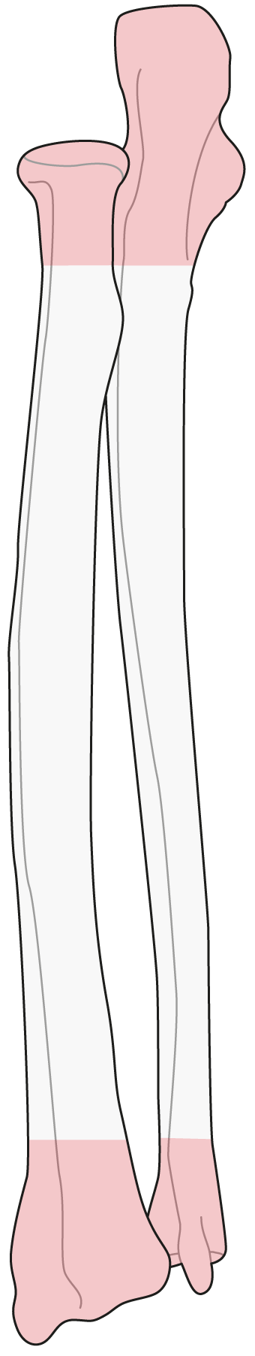
22
Notes:
The shafts are different and there is no unique menu to suit all. However, there are some principles that can be considered for all of them.

Slide 3
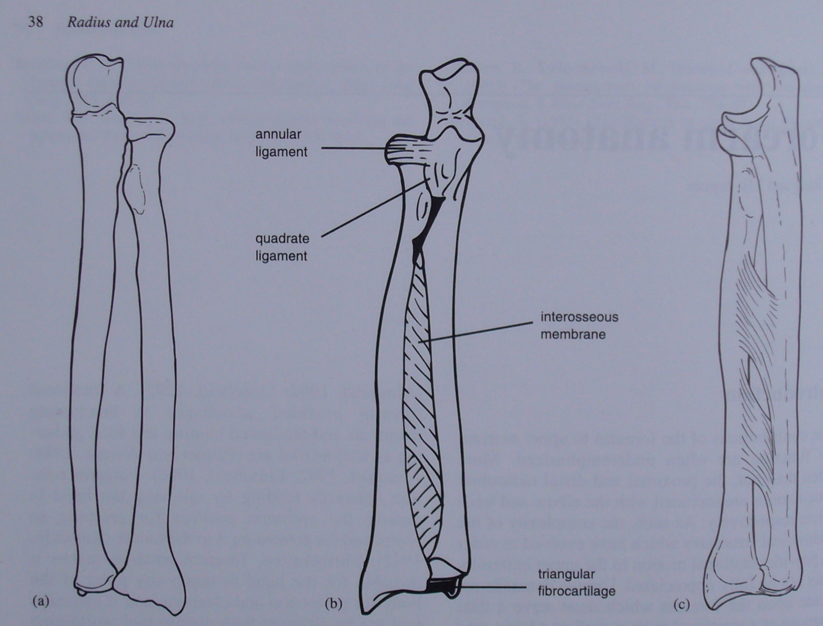
Functional Unit created by ligaments
Notes:
Ap view of the radius and ulna with the forearm in full supination. Note the double curvature of each bone in this plane. Even minor alterations in this curvature can interfere with the forearm rotation. The radius and ulna articulate via synovial joints at their proximal and distal ends.
Radioulnar association is maintained by three groups of soft tissue structures: the annular and quadrate ligaments proximally, the interosseous membrane in the mid-portion and the triangular fibrocartilage complex (tfc) distally.
Viewed laterally, the ulna has a gradual apex posterior bow whereas the radius again has a double curvature

Slide 4
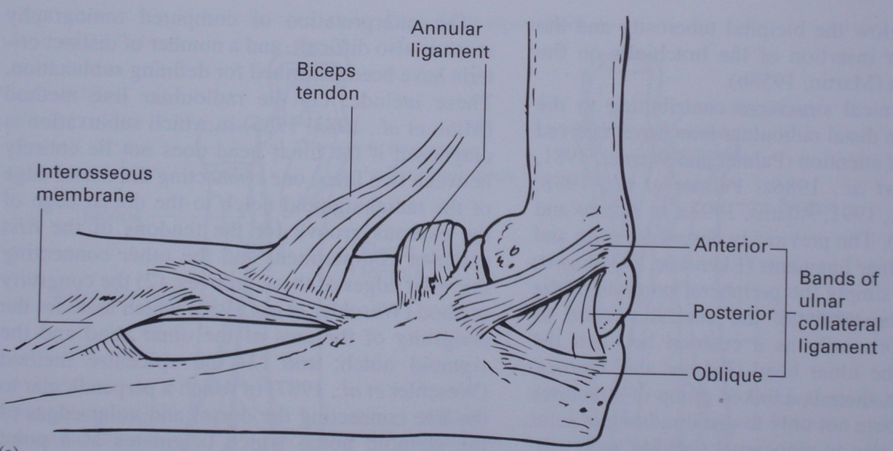
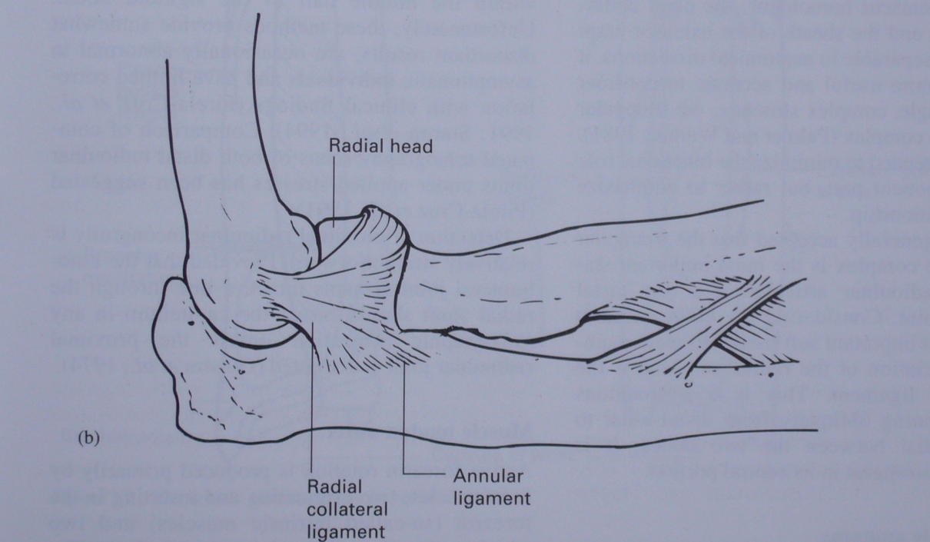
The ligamentous structures stabilizing the prox. radio-ulnar joint

Slide 5
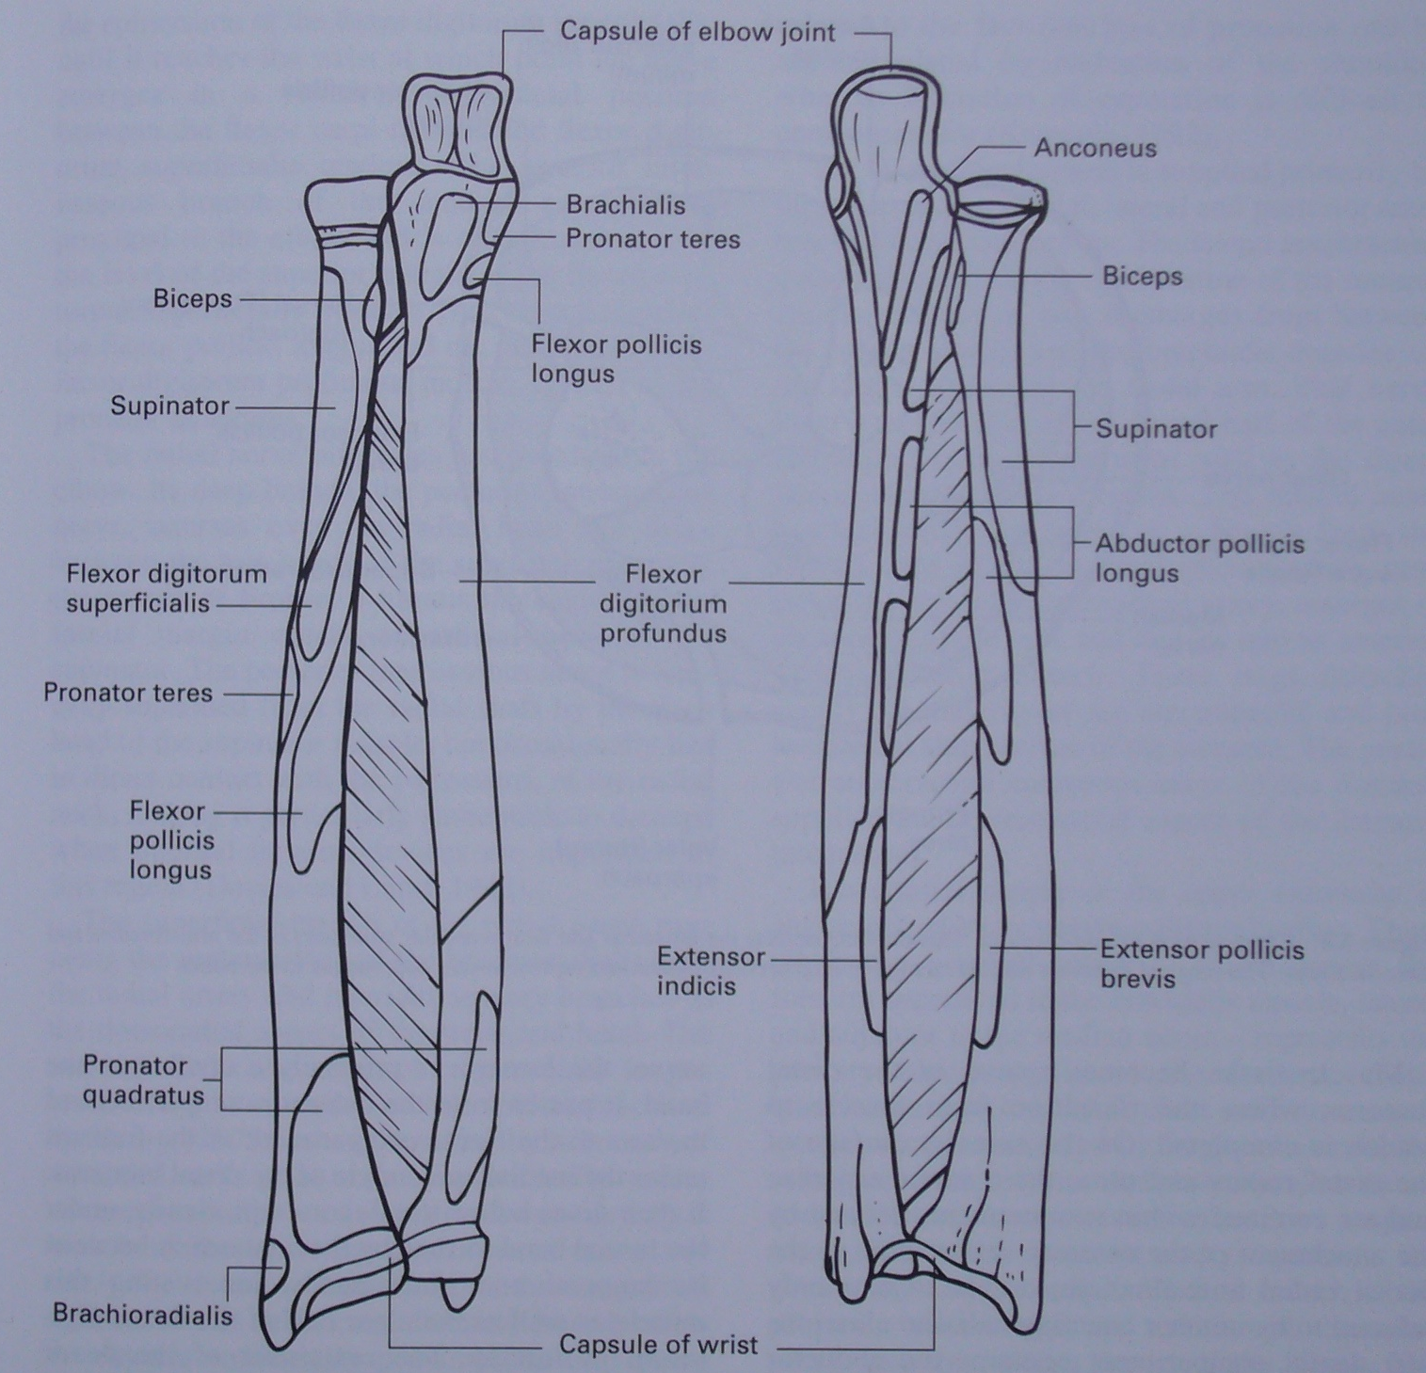
Notes:
The muscle attachments of the radius and ulna

Slide 6
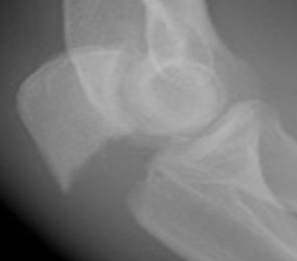
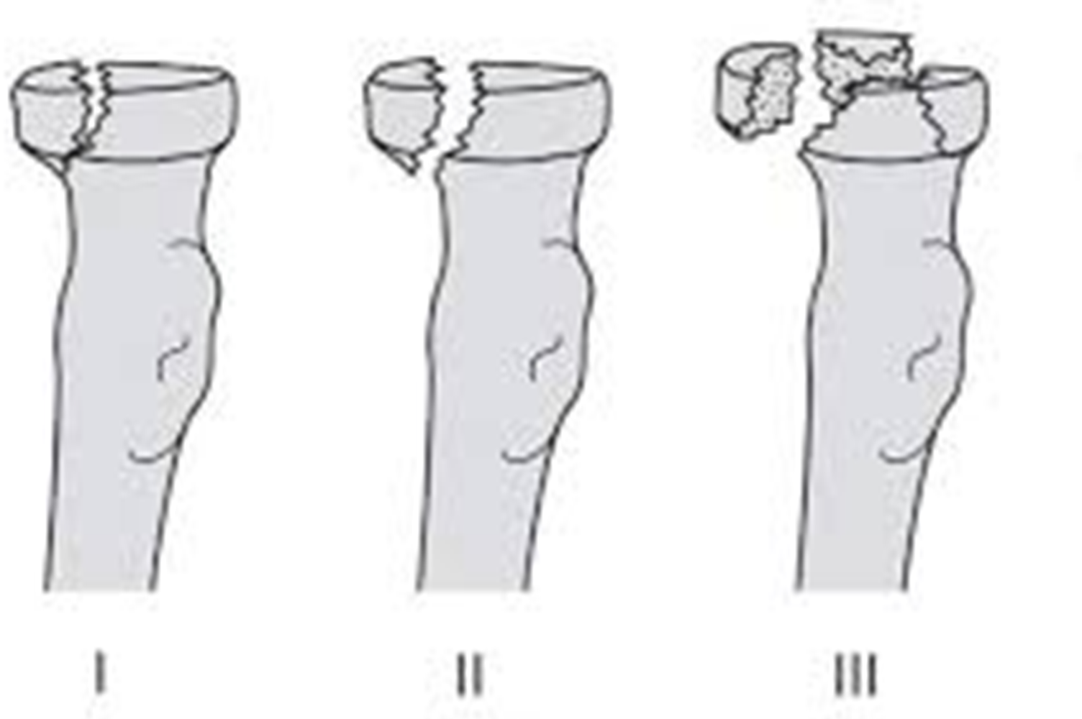
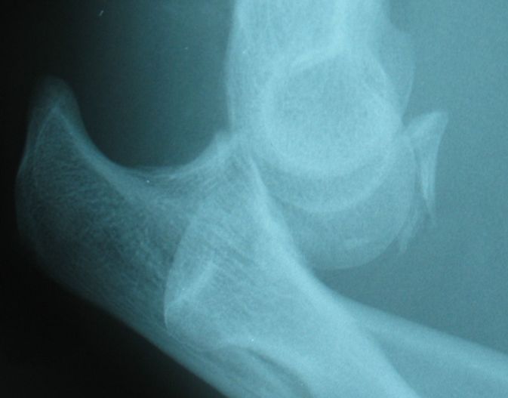
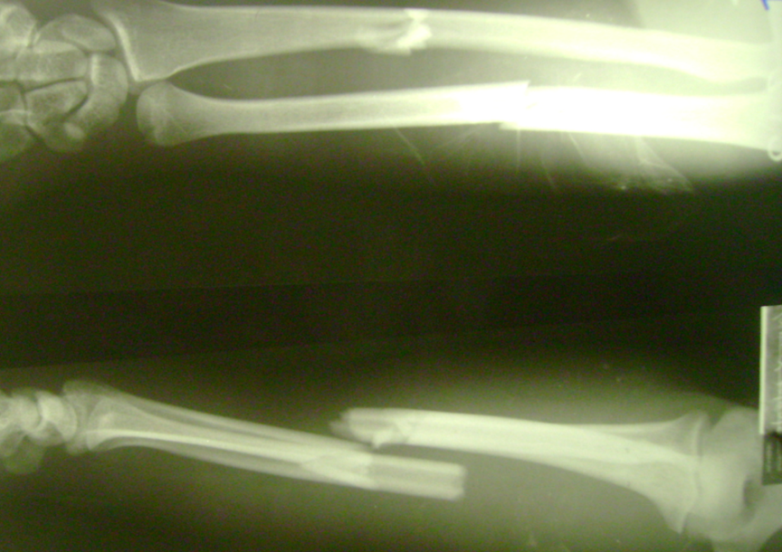
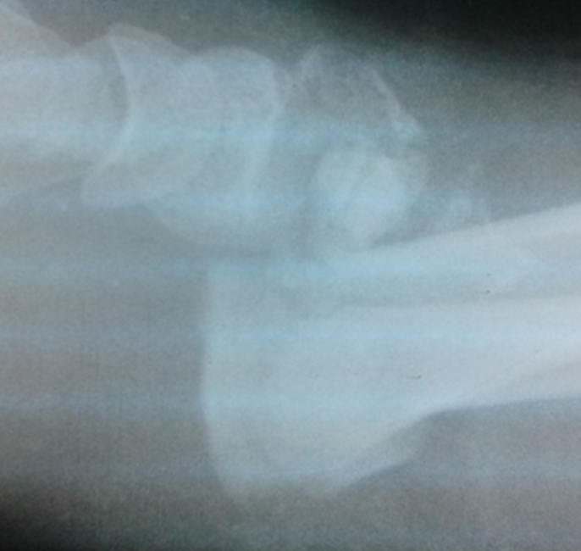
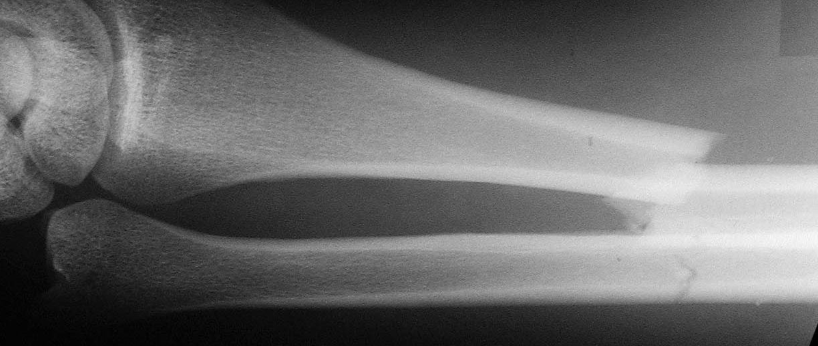

Slide 8
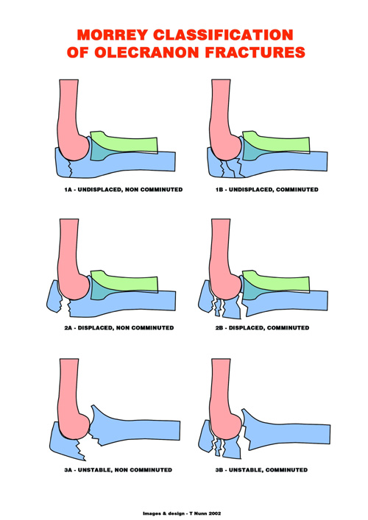
Notes:
8

Slide 9
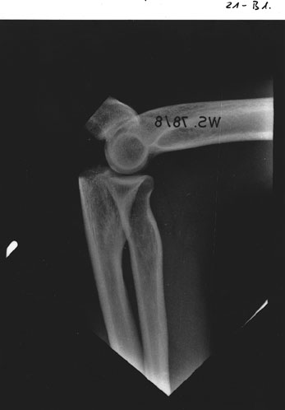

Slide 10

Displaced

Slide 11
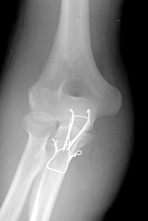
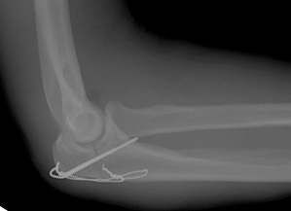
Tension band wiring

Slide 12
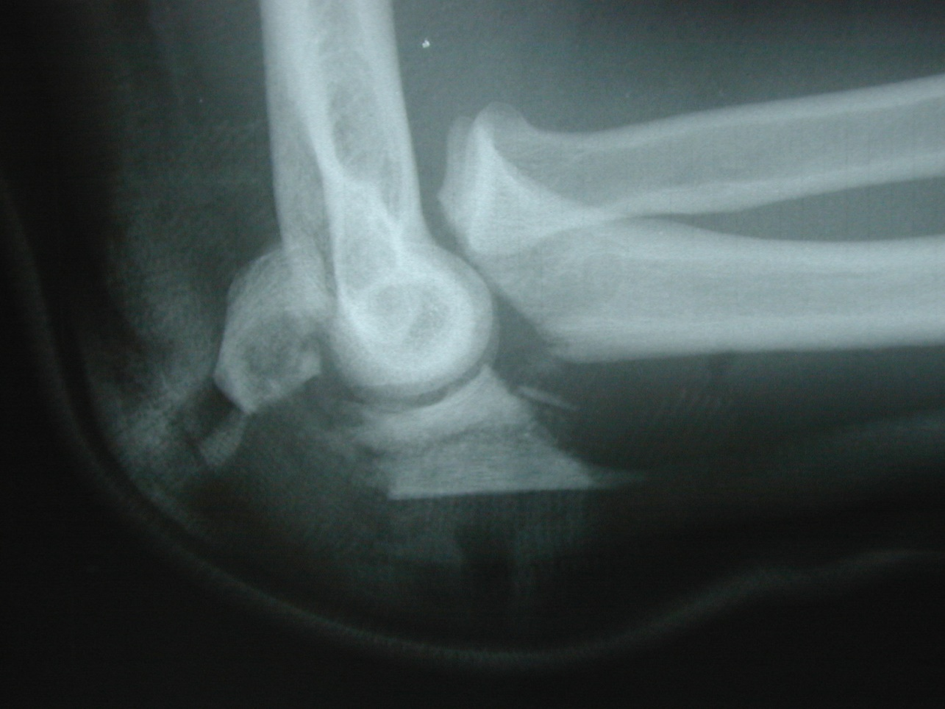
Unstable

Slide 13
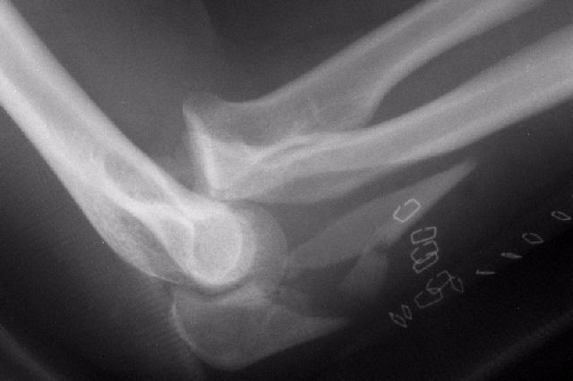

Slide 14
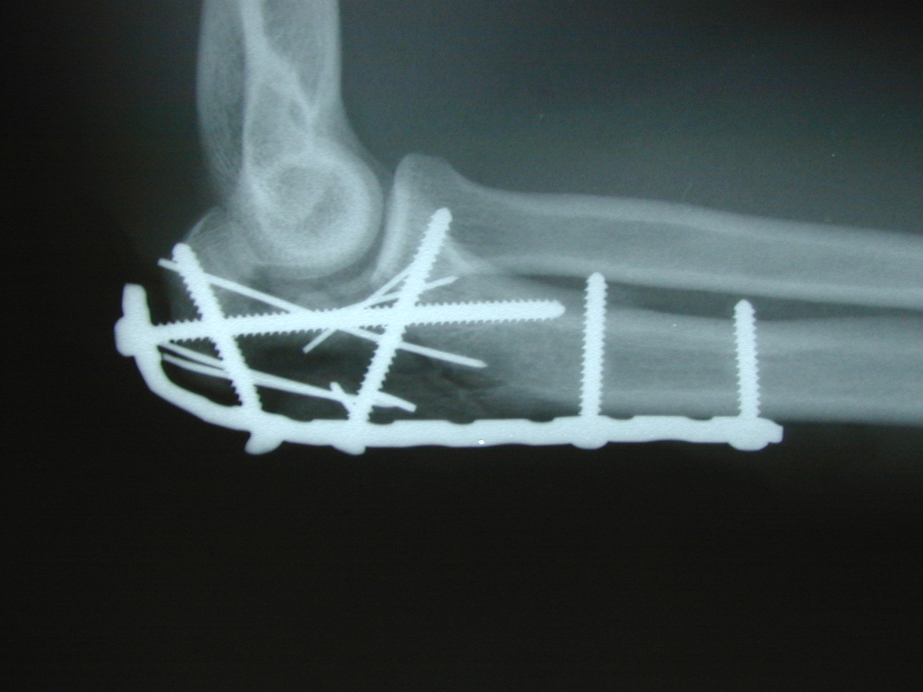
Plating Technique

Slide 15
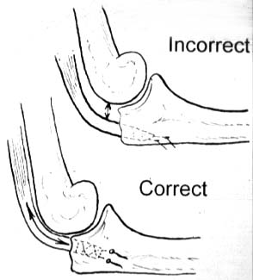

Slide 16
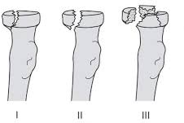
Radial Head Fractures
Split, undisplaced
Comminuted
Split, displaced

Slide 17
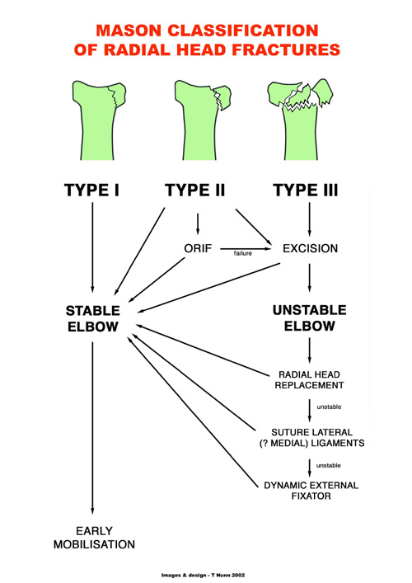
Notes:
17

Slide 18
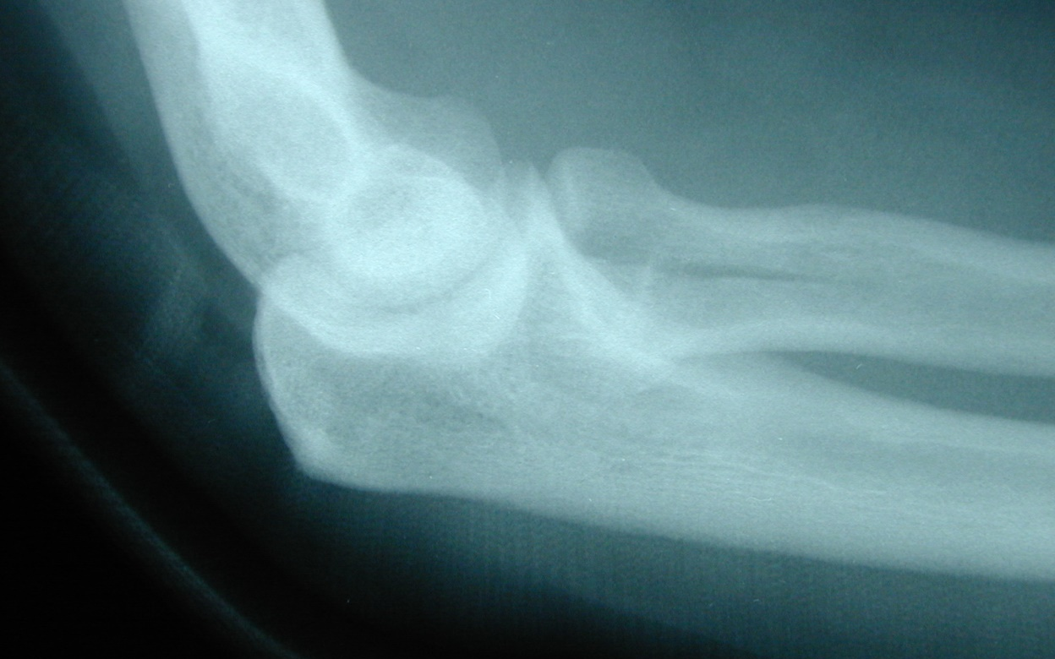
Radial Head Fractures-Simple Partial Articular

Slide 19
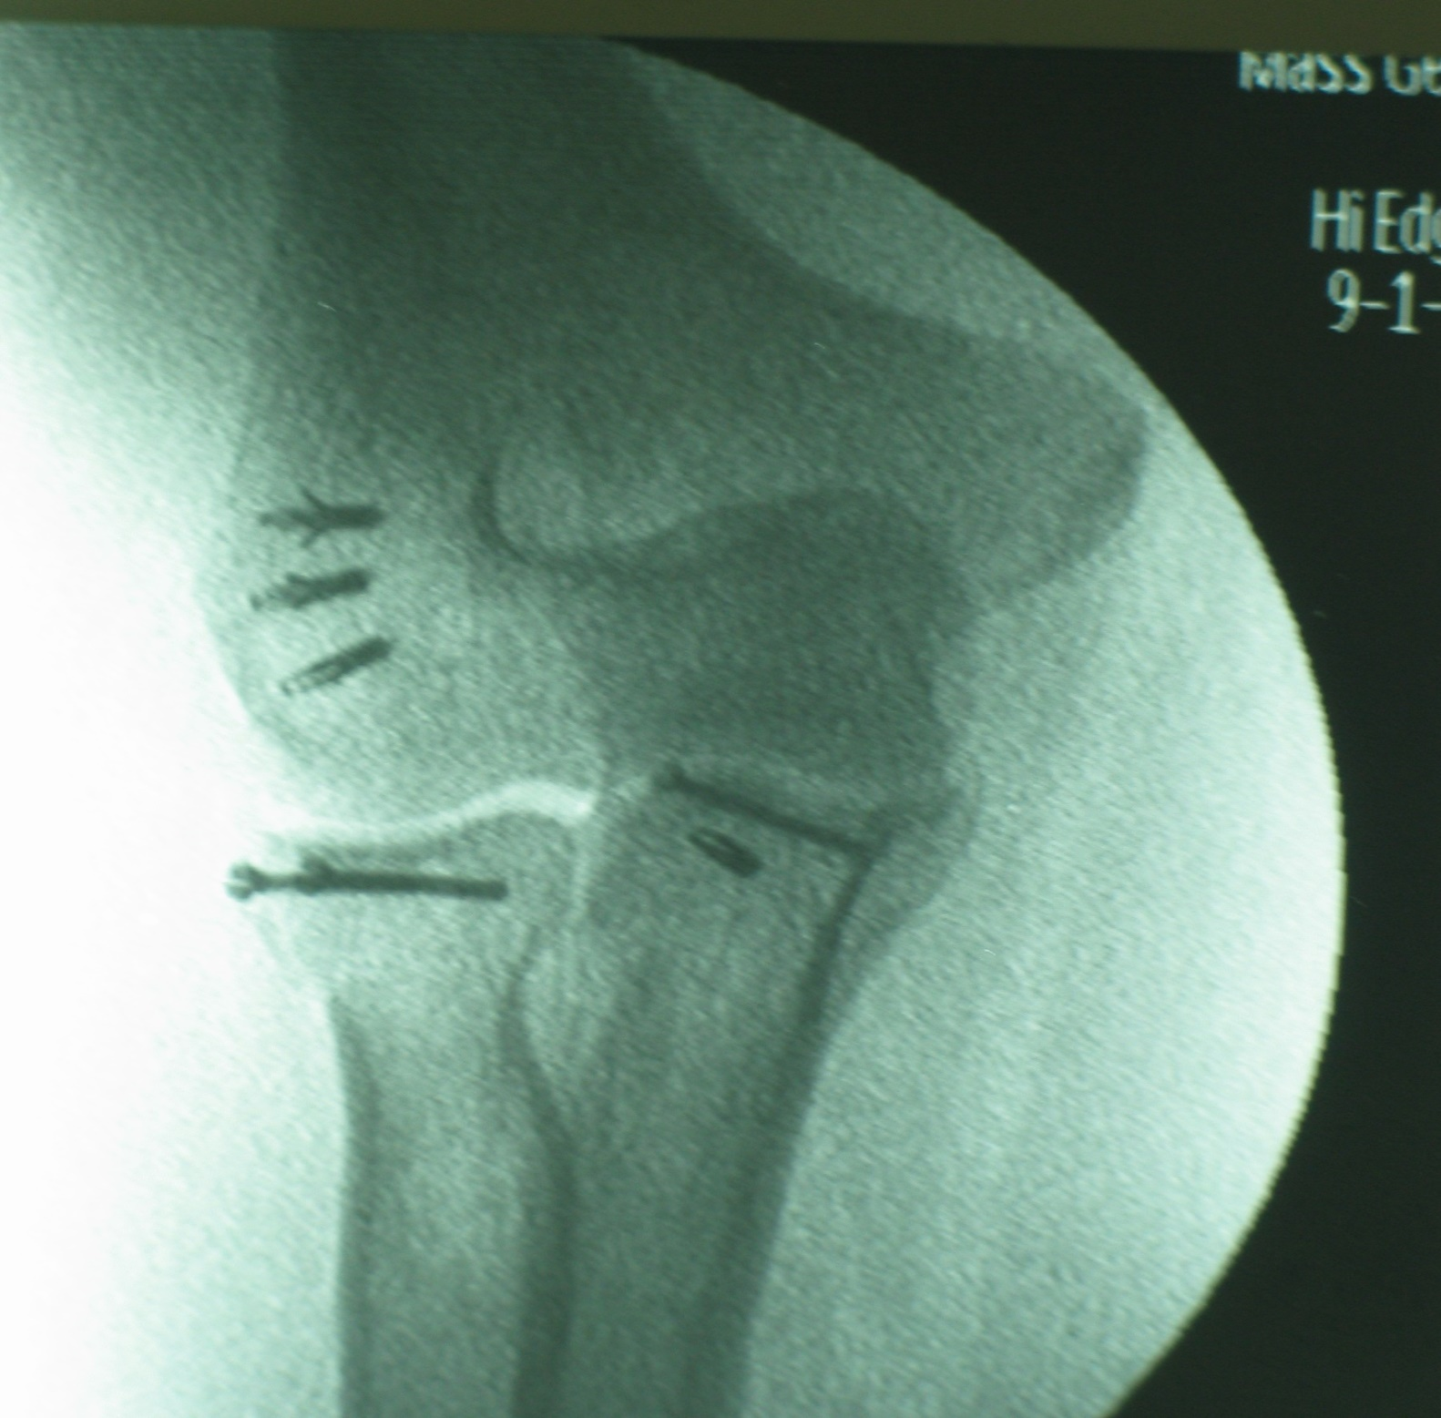

Slide 20
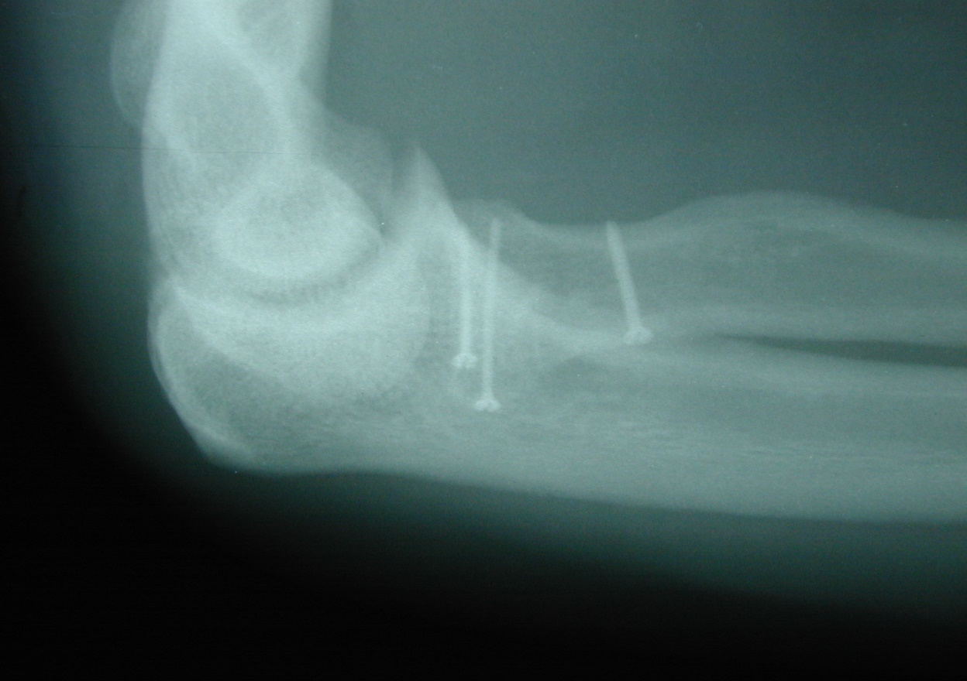
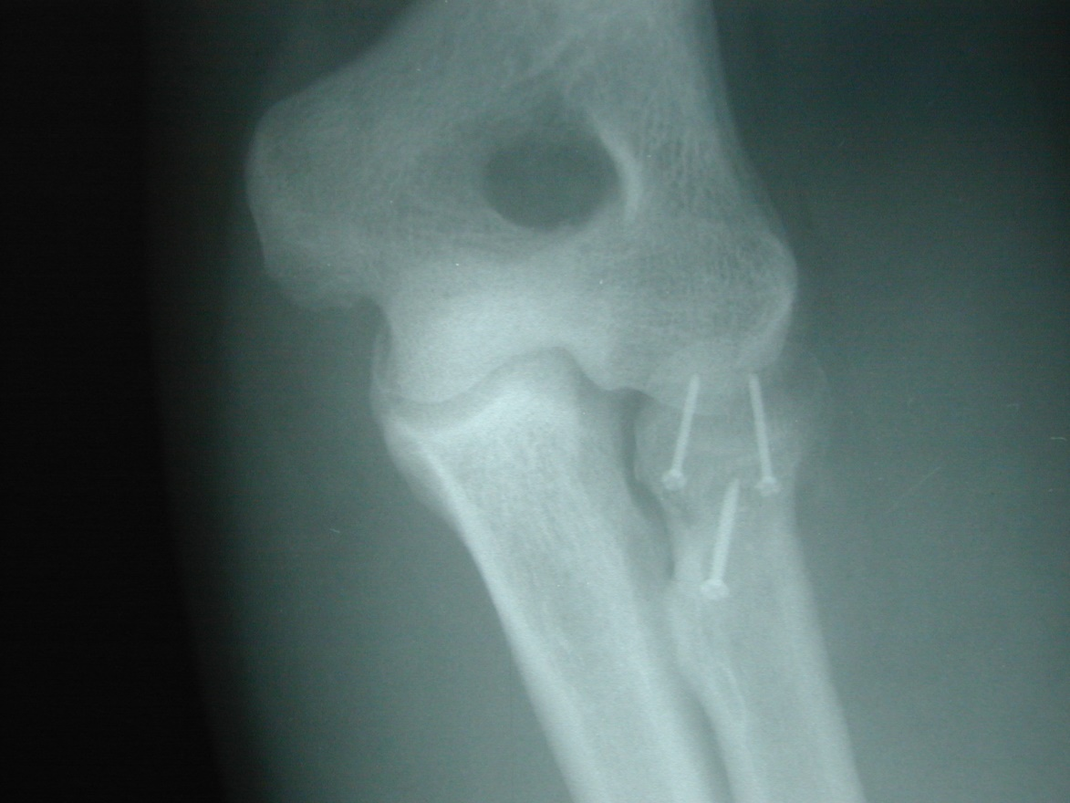
IF screws

Slide 21
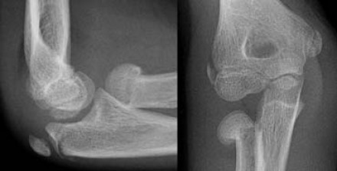
Radial Neck Fractures
Common in children, unlike radial head common in adults

Slide 22
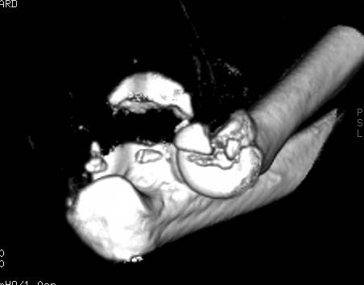

Slide 23
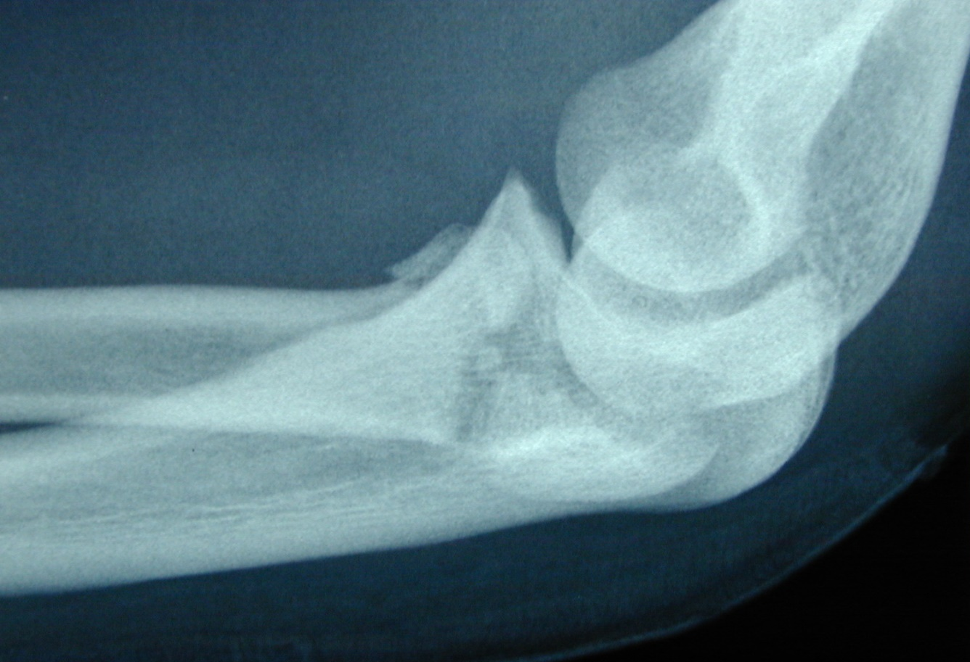
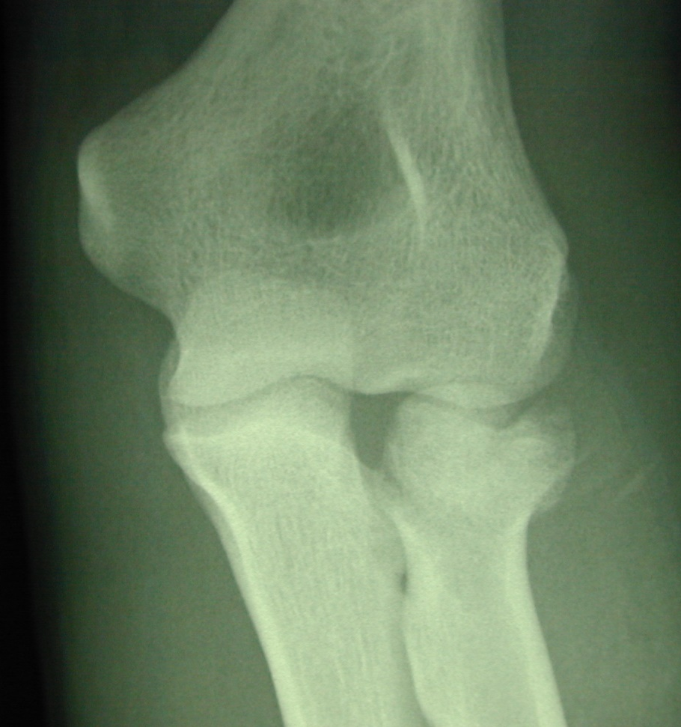

Slide 24
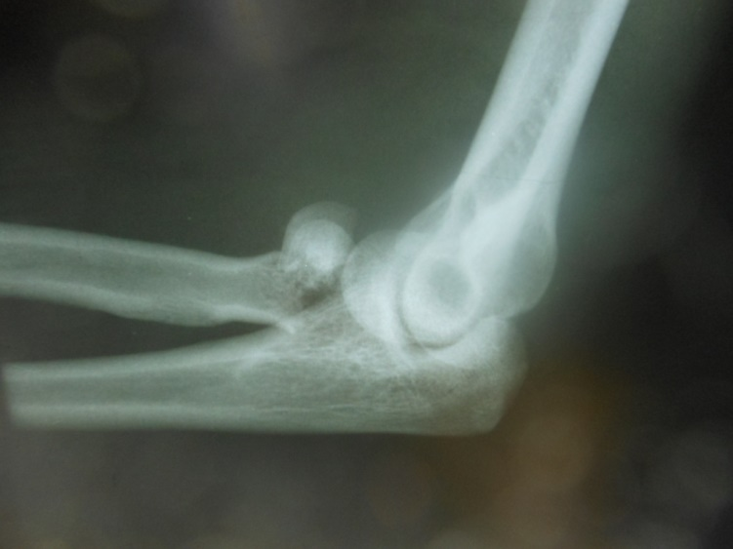

Slide 25
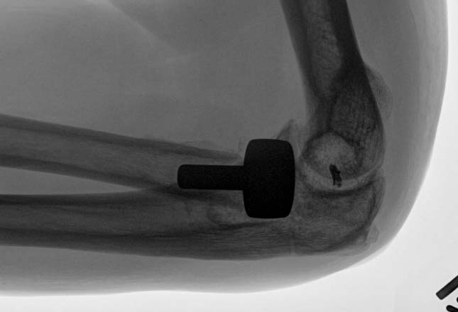

Slide 26
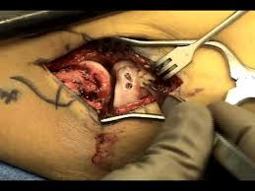
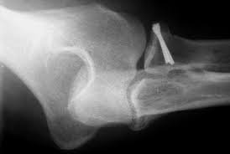
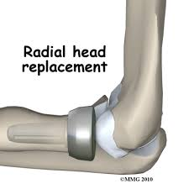
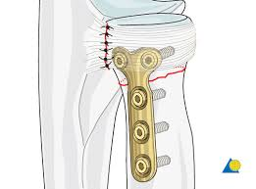

Slide 27
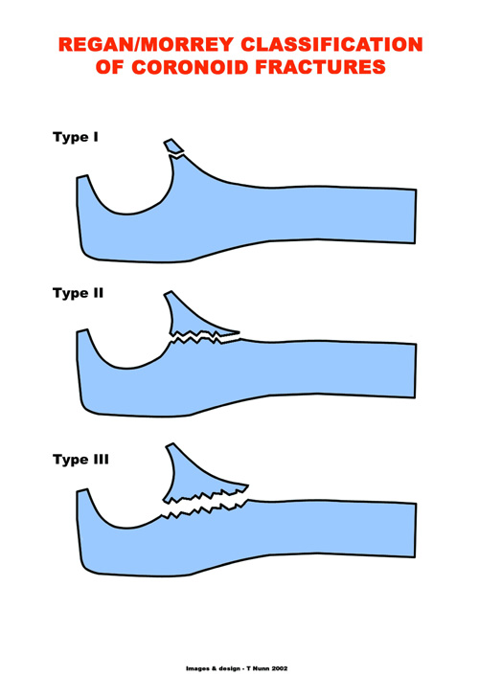
Small fragmentation <25%
Unstable, Fragment between 25-50%
Unstable, More than 50% fragment involved
Notes:
27

Slide 28
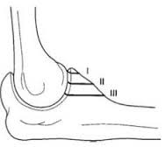
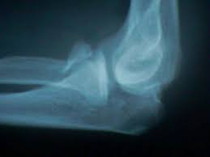
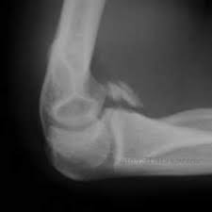
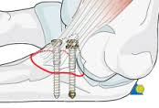
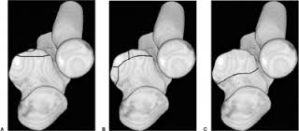

Slide 29


Slide 31
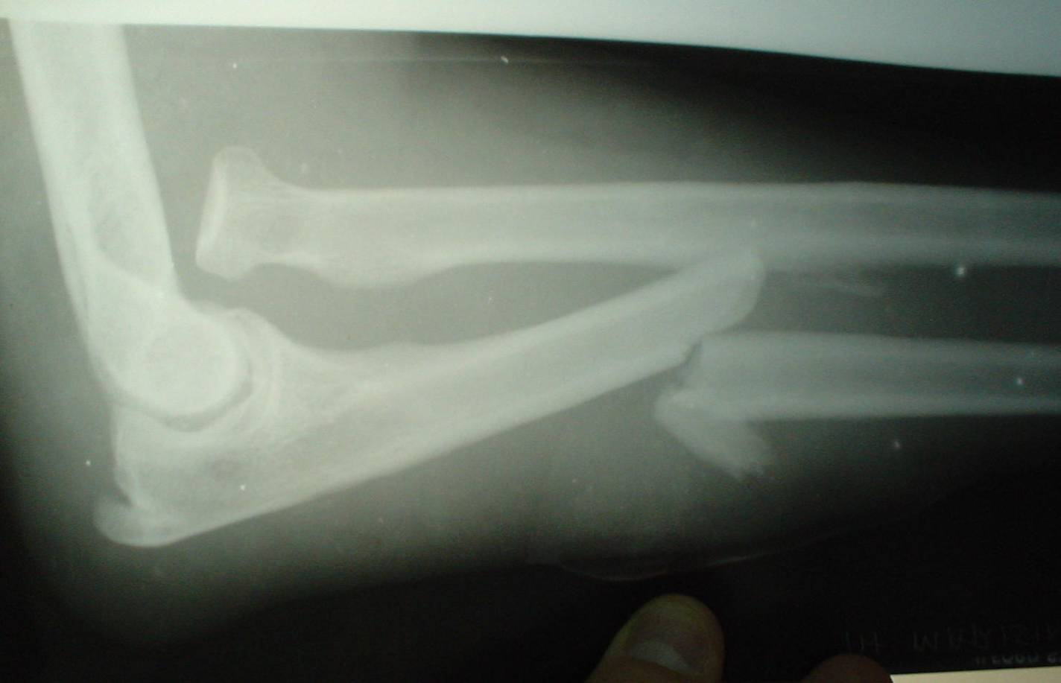
Monteggia Fracture
Fracture of proximal ulnar shaft with dislocation of proximal radio-ulnar joint, also dislocation of radio-capitulum joint

Slide 32
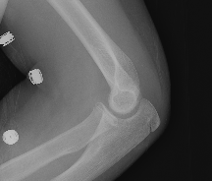
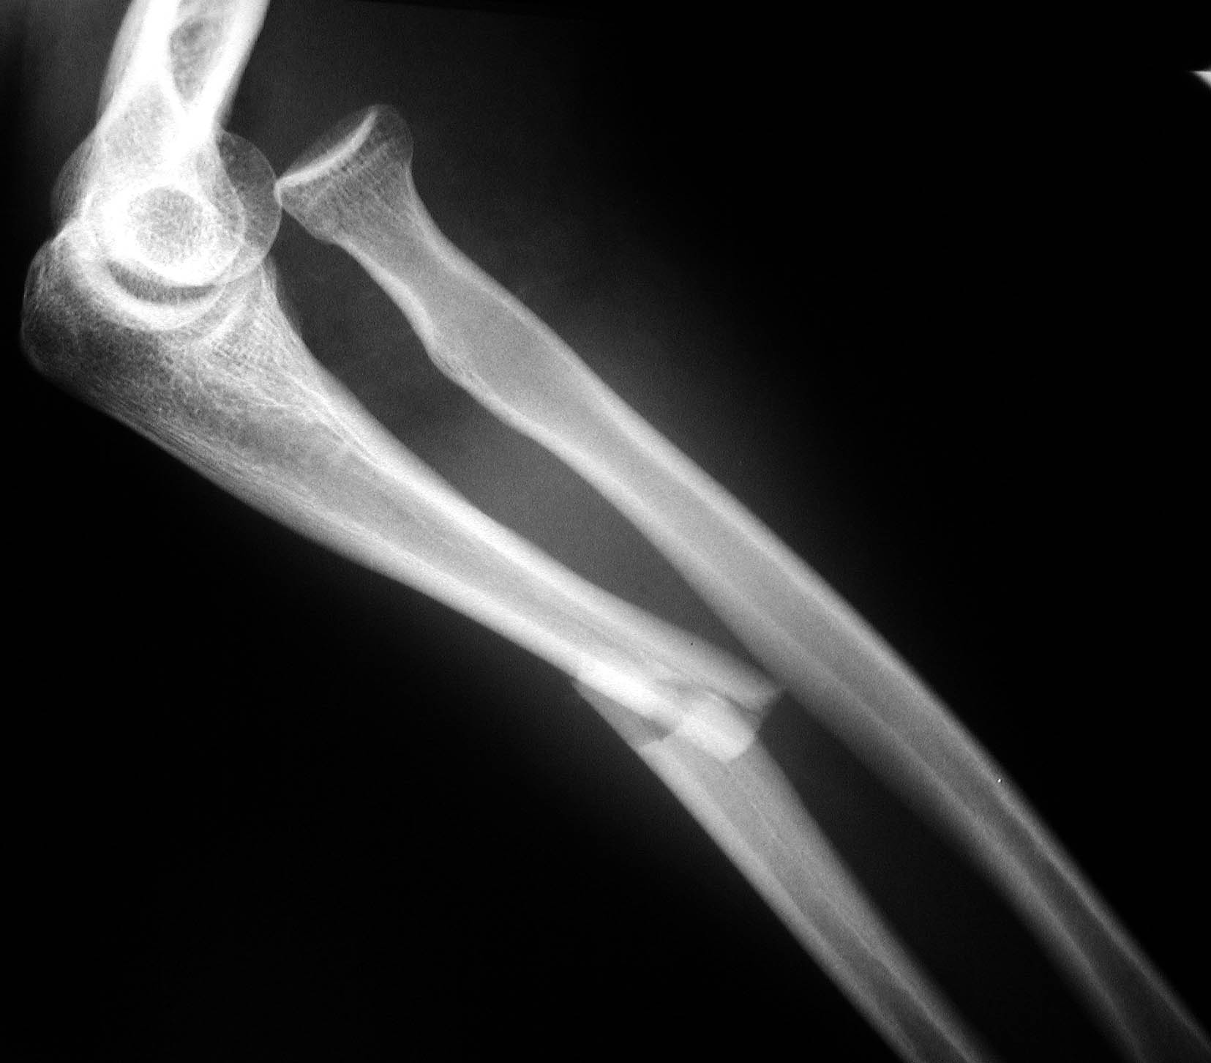

Slide 33
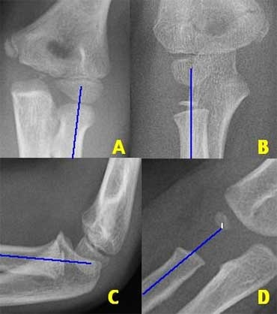
Alignment –Radiocapitellar line
Notes:
33

Slide 34
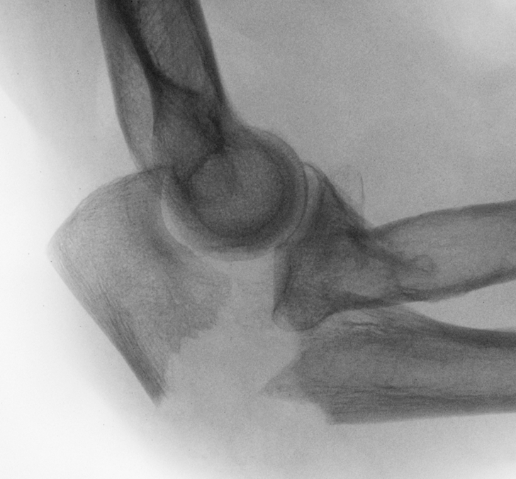

Slide 35
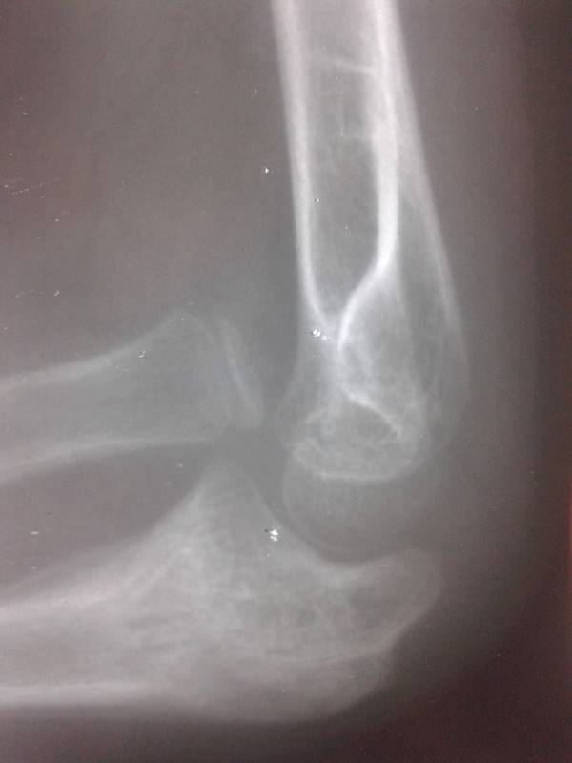
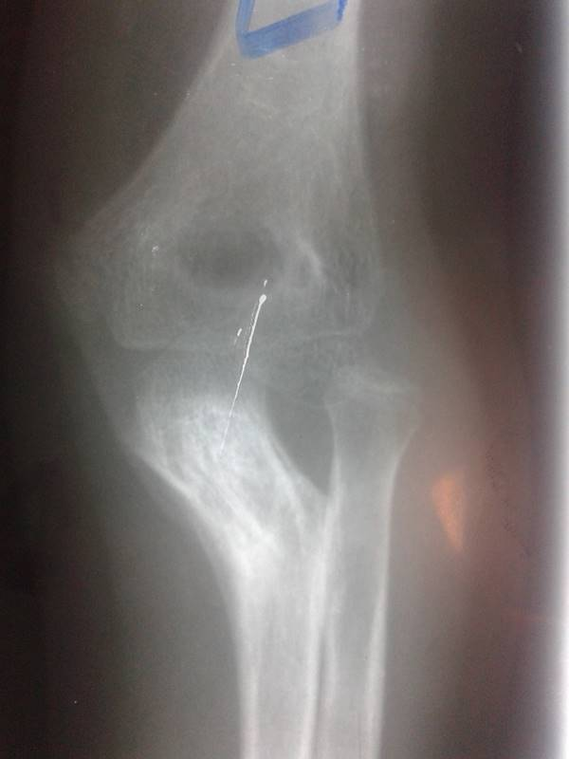

Slide 36
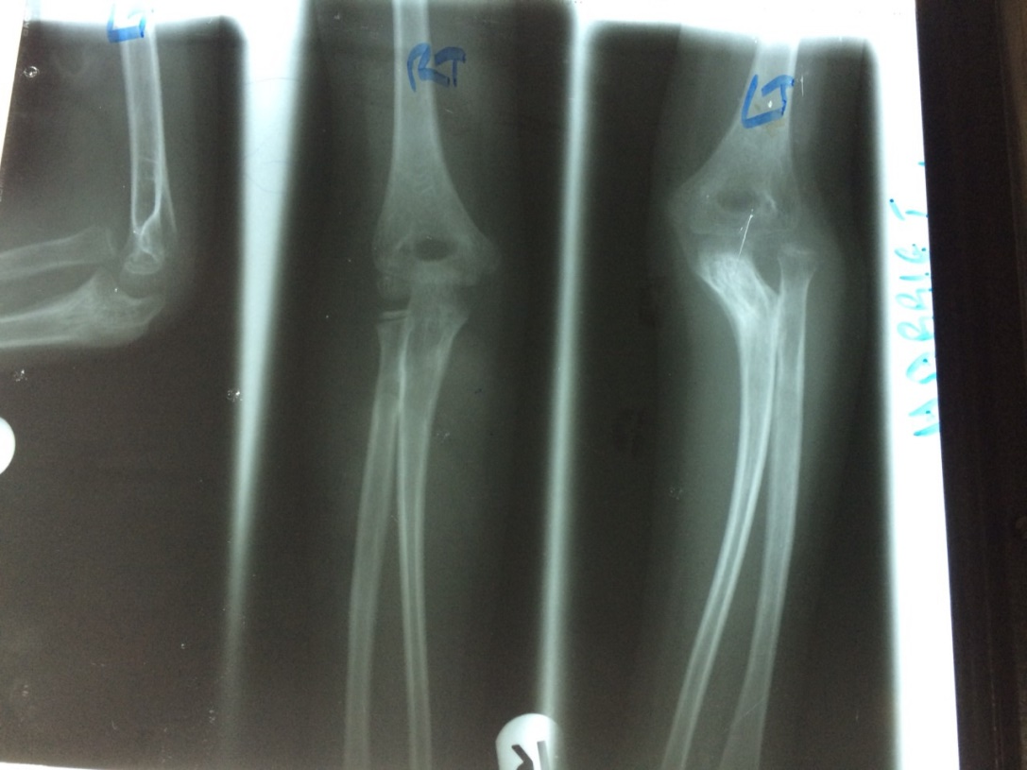

Slide 37
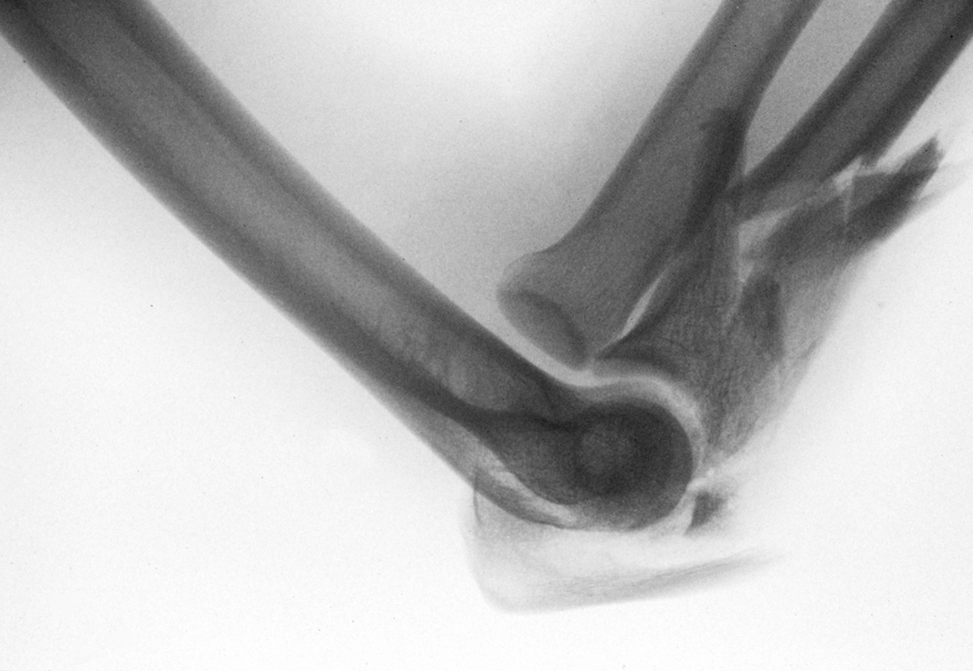

Slide 38

ORIF

Slide 39

Both Radius and Ulnar Shaft Fractures

Slide 40



Slide 41


Slide 42


Slide 43


Slide 44


Slide 45



Slide 46


Slide 47


Galeazzi Fracture
Distal radial shaft fracture with a dislocation of distal radio-ulnar joint/dislocation of ulnar head

Slide 48


Slide 49


Slide 50



Slide 51



Slide 52


Slide 53

Isolated Injuries of Forearm

Slide 54


Bullet injury

Slide 55

Rash pin for Radius

Slide 56

Nightstick Fracture
Direct hit, minimally displaced distal ulnar shaft fracture only

Slide 57

Completed above elbow PoP to immobilize a forearm fracture

Slide 58

Distal Radius Imaging

Slide 59


Slide 60


Slide 61

VOLAR TILT

Slide 62


Slide 63

RADIAL INCLINATION

Slide 64


Slide 65

RADIAL HEIGHT

Slide 66


Slide 67


Slide 68



Slide 69


Slide 70

OA classification
  Type A – Extra articularType
  Type B – Partial articularType
  Type C – Complete / complex articular

Slide 71

AO/ OTA Classification

Slide 72

Salter Harris Type 2 – Involving physeal growth plate through metaphysis

Slide 73

Colle’s Fracture
Extra-articular, due to fall on outstretched hand, extension Injury leading to fracture of distal forearm, radius bent backwards/dorsally leading to dinner fork deformity

Slide 74


Slide 75

Smith’s Fracture
Extra-articular, due to Flexion of wrists leading to fracture of distal radius featuring a volar/forward displacement or angulation of the distal fragment

Slide 76


Slide 77
EXTRA ARTICULAR CRITERIA
Radial inclination upto 11 degrees
Radial height upto 5mm
Volar tilt upto 10 degrees
Radio-ulnar joint

Slide 78


Slide 79



Slide 80


Crossed K-wires

Slide 81
Buttress plate – fix fragments back in position

Slide 82


Locking plate for comminution fracture

Slide 83



Slide 84



Slide 85


Slide 86


Slide 87


Slide 88


Slide 89


Slide 90

Styloid Fracture

Slide 92


Slide 93



Slide 94


Slide 95


Die-Punch Injury

Slide 96


Slide 97

Greenstick Fracture

Slide 98


Slide 99


Slide 100


Slide 101


Slide 102


Slide 103



Slide 104



Slide 105


Slide 106



Slide 107


Slide 108

Spanning External Fixator

Slide 109


Slide 110


Slide 111



Arthroscopy

Slide 112



Slide 113
Summary
The forearm is like a joint.
Good assessment of injury for adequate treatment planning.
Complete reconstruction of anatomy
Stable fixation
Complications

