Slide 1
Radius and ulnar fractures
6th years
02/02/2021

Slide 2
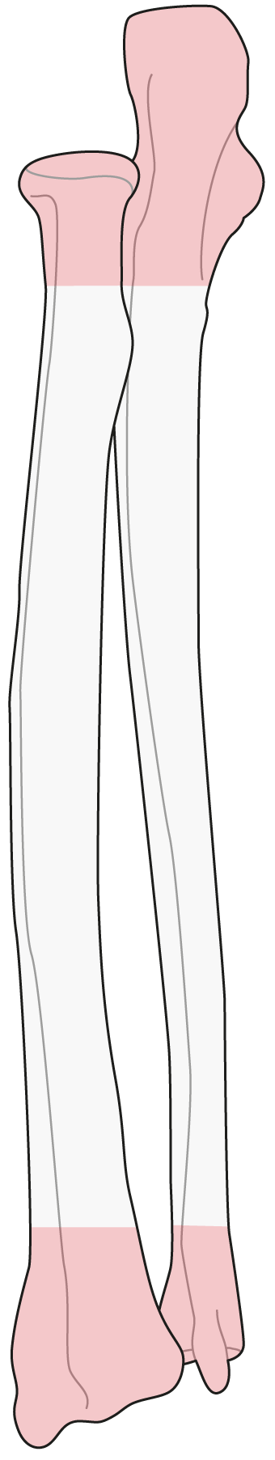
22
Notes:
The shafts are different and there is no unique menu to suit all. However, there are some principles that can be considered for all of them.

Slide 3
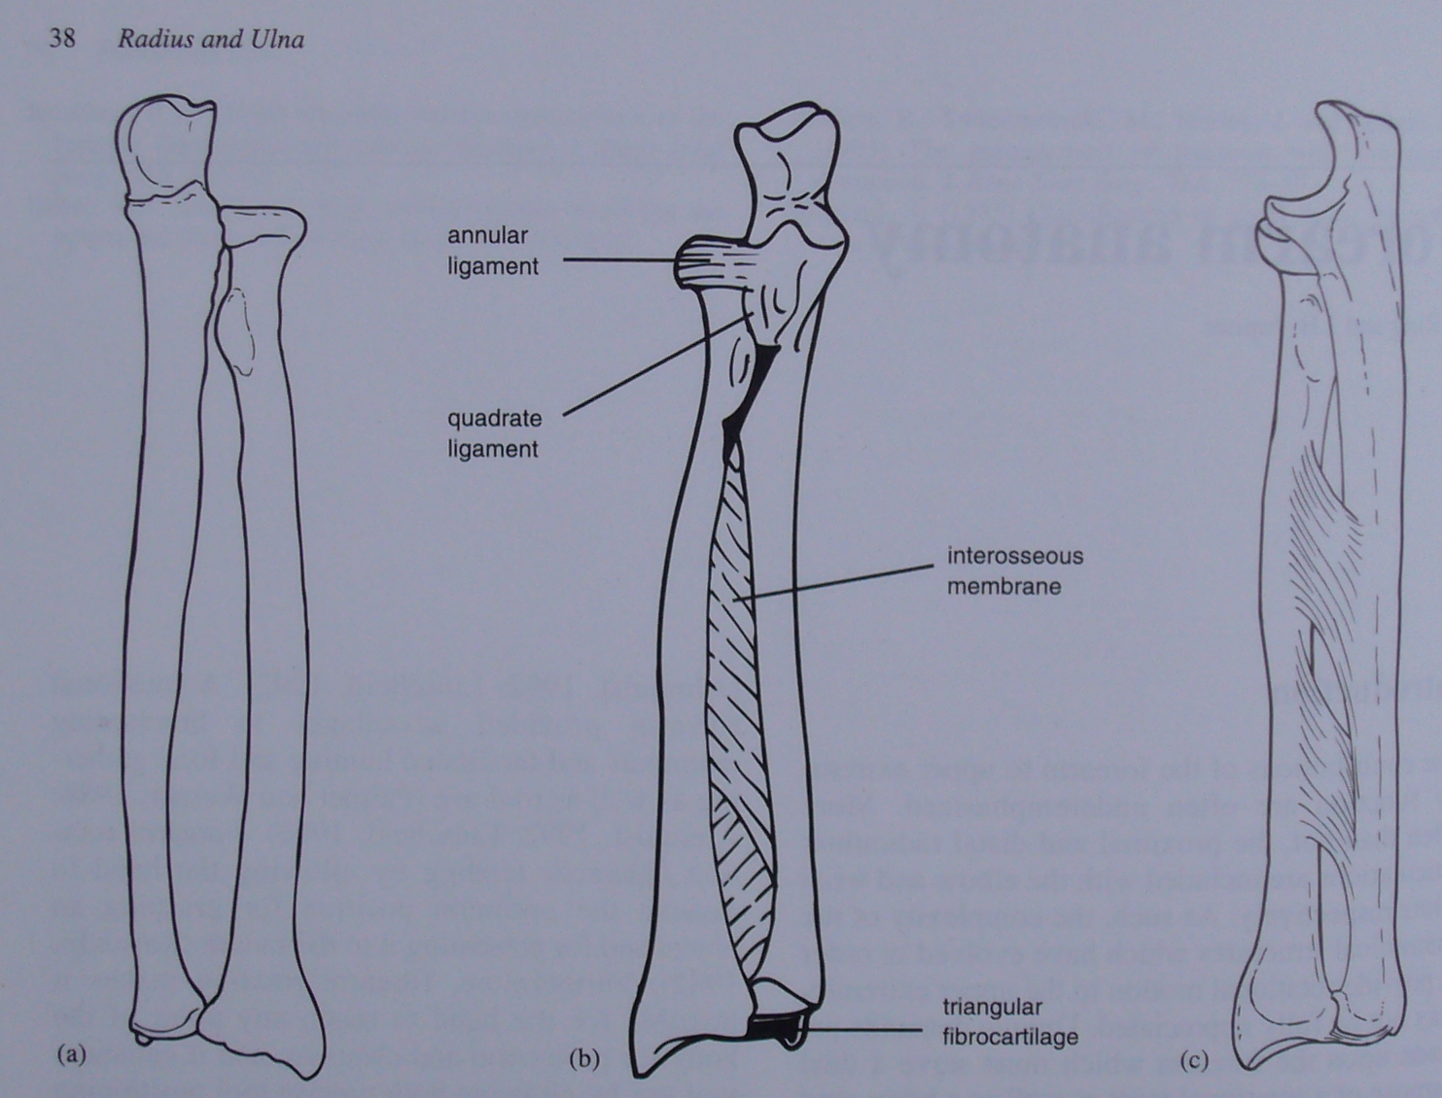
Functional Unit created by ligaments
Notes:
Ap view of the radius and ulna with the forearm in full supination. Note the double curvature of each bone in this plane. Even minor alterations in this curvature can interfere with the forearm rotation. The radius and ulna articulate via synovial joints at their proximal and distal ends.
Radioulnar association is maintained by three groups of soft tissue structures: the annular and quadrate ligaments proximally, the interosseous membrane in the mid-portion and the triangular fibrocartilage complex (tfc) distally.
Viewed laterally, the ulna has a gradual apex posterior bow whereas the radius again has a double curvature

Slide 4
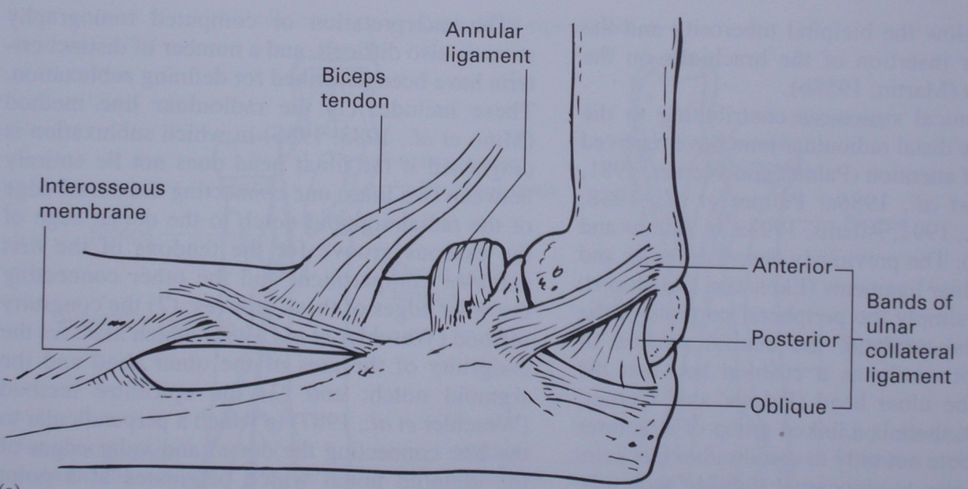
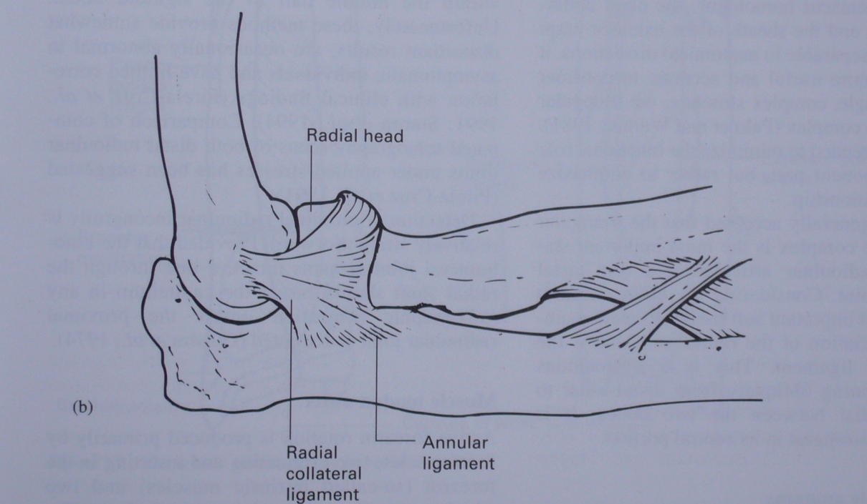
The ligamentous structures stabilizing the prox. radio-ulnar joint

Slide 5
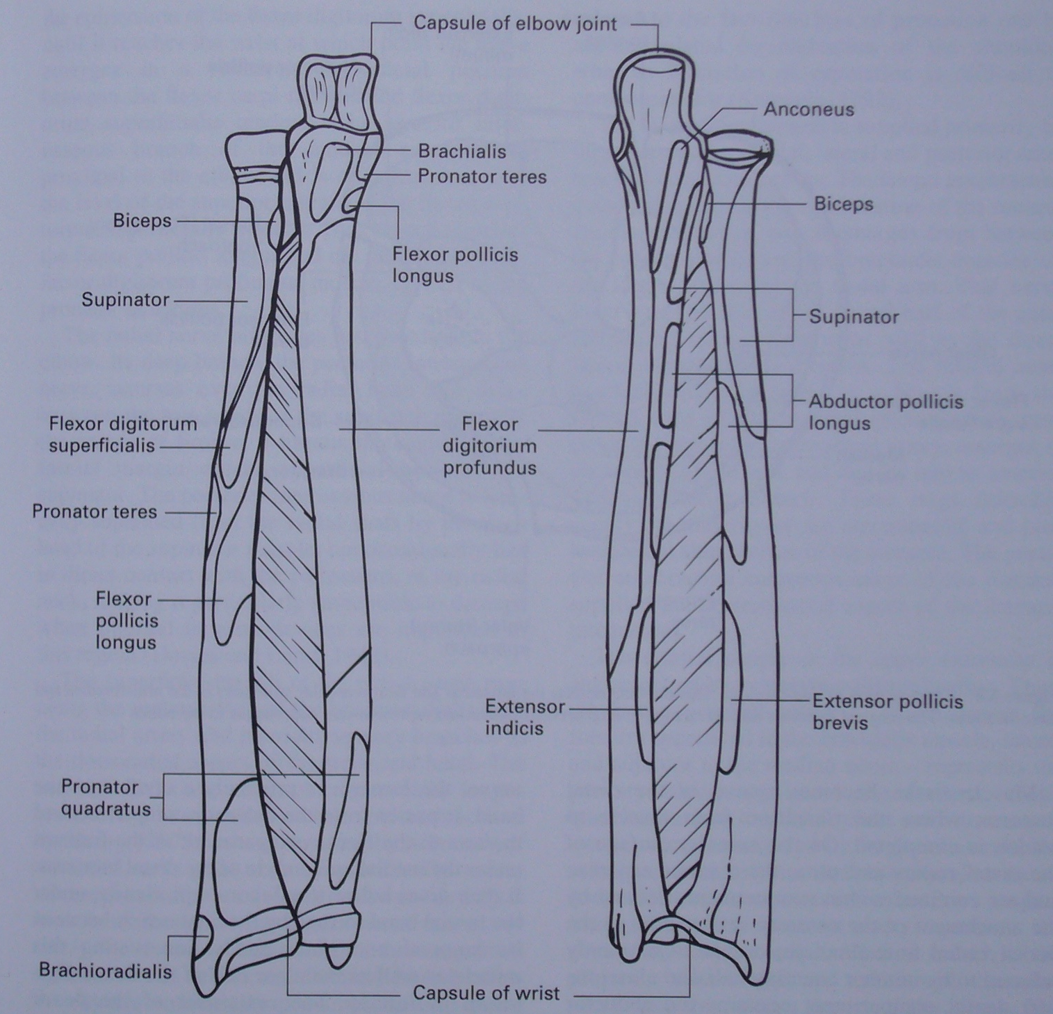
Notes:
The muscle attachments of the radius and ulna

Slide 6
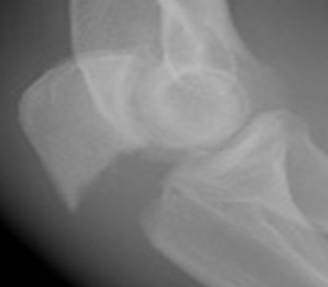
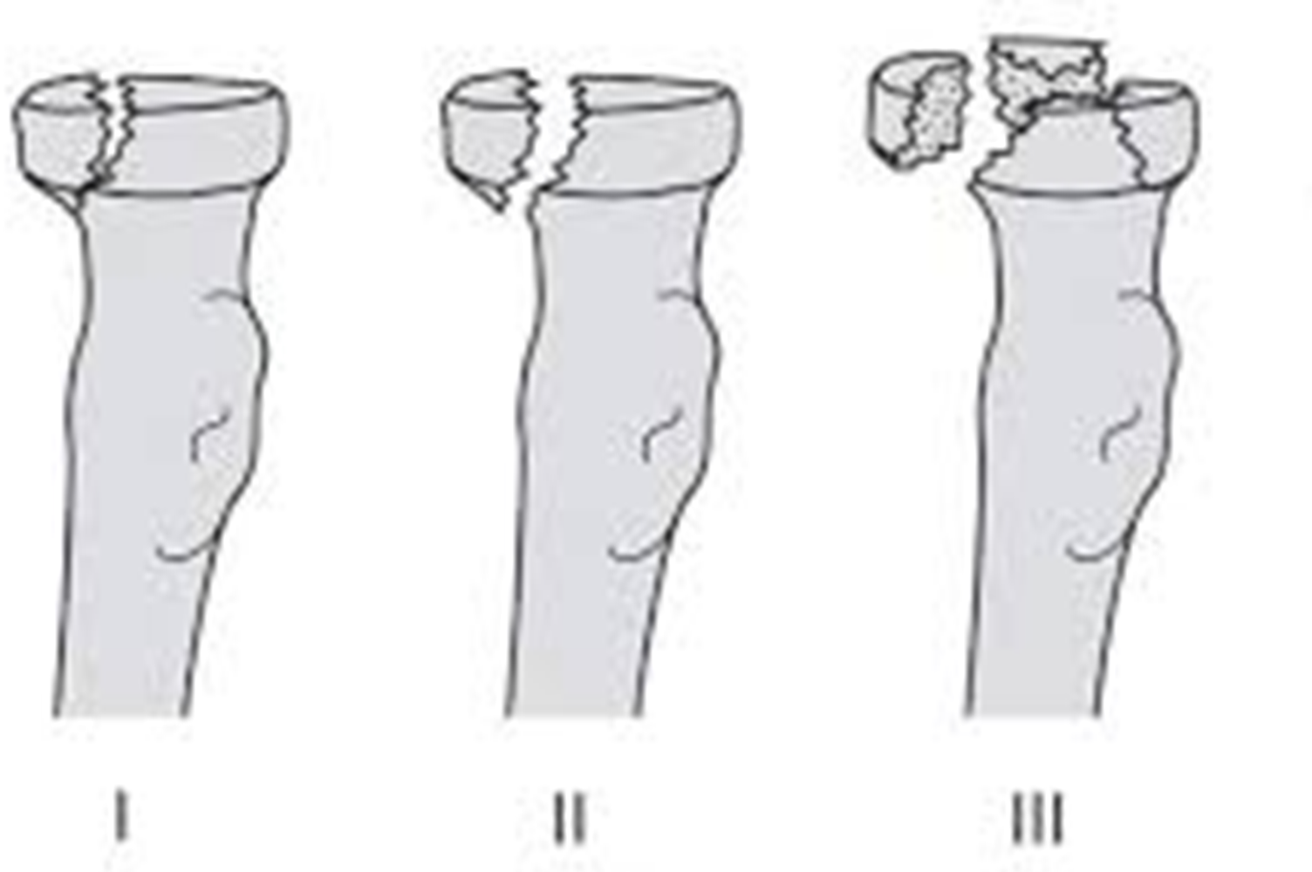
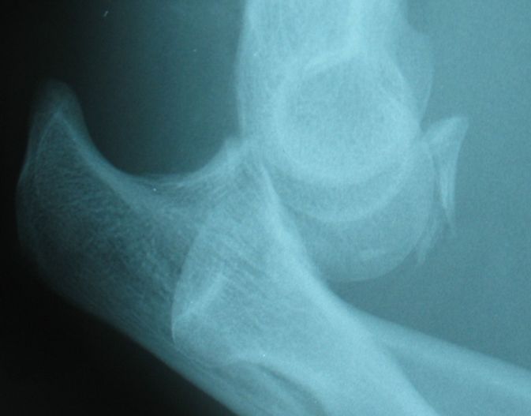
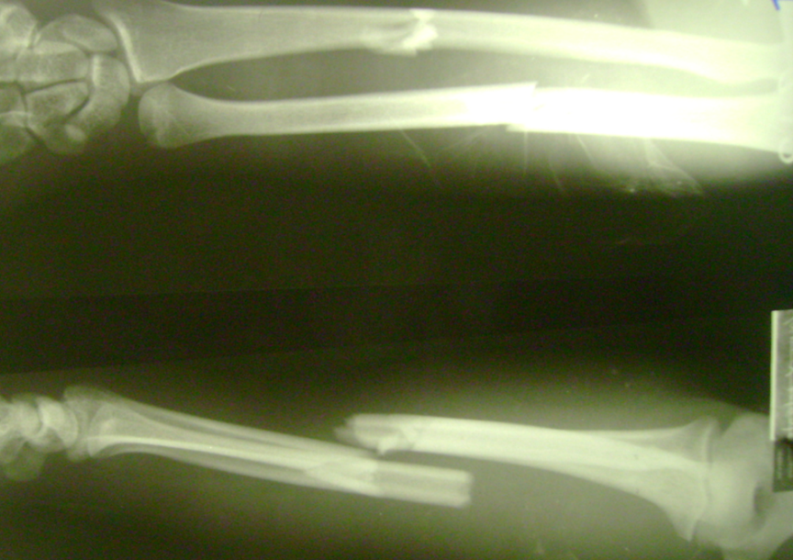
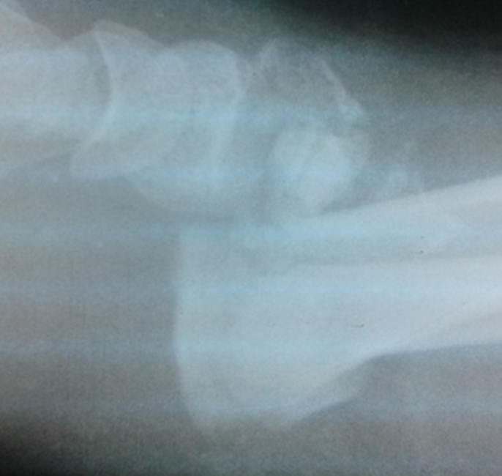
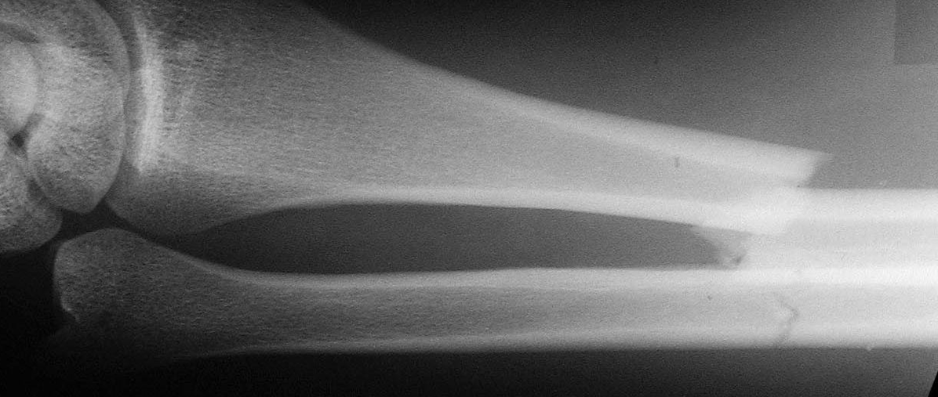

Slide 8
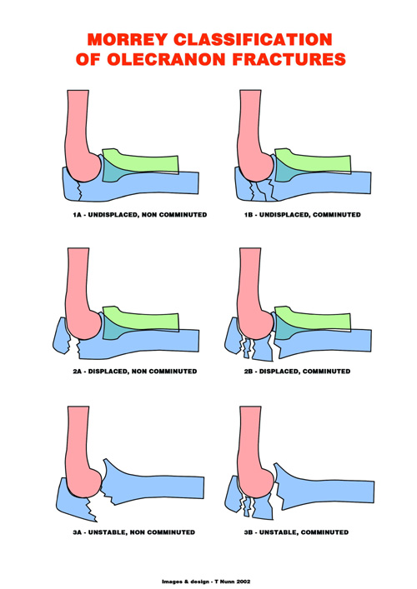
Notes:
8

Slide 9
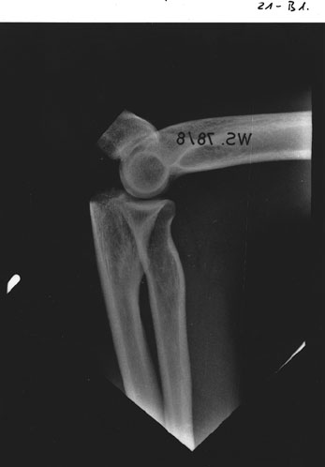

Slide 10


Slide 11
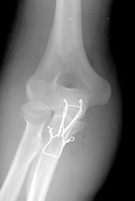
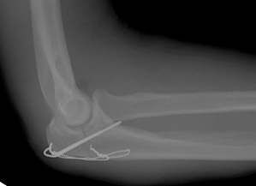

Slide 12
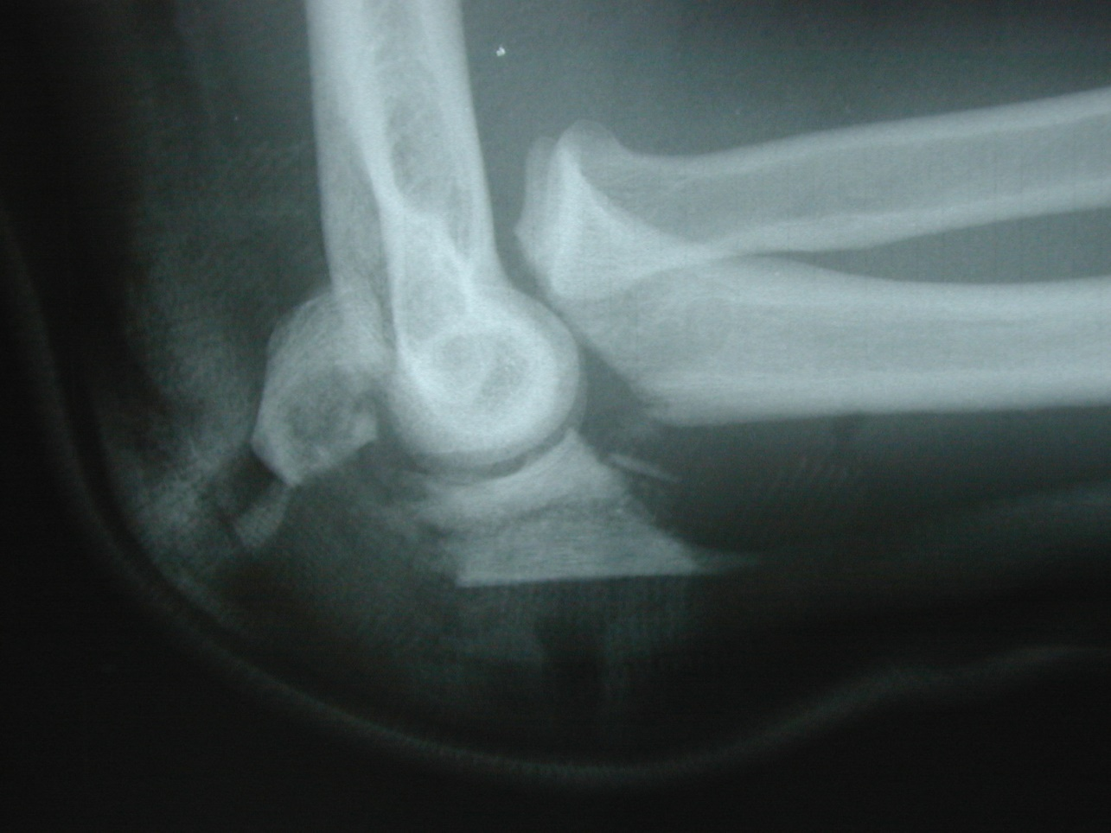

Slide 13
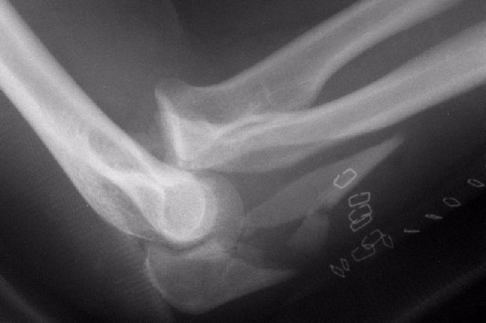

Slide 14
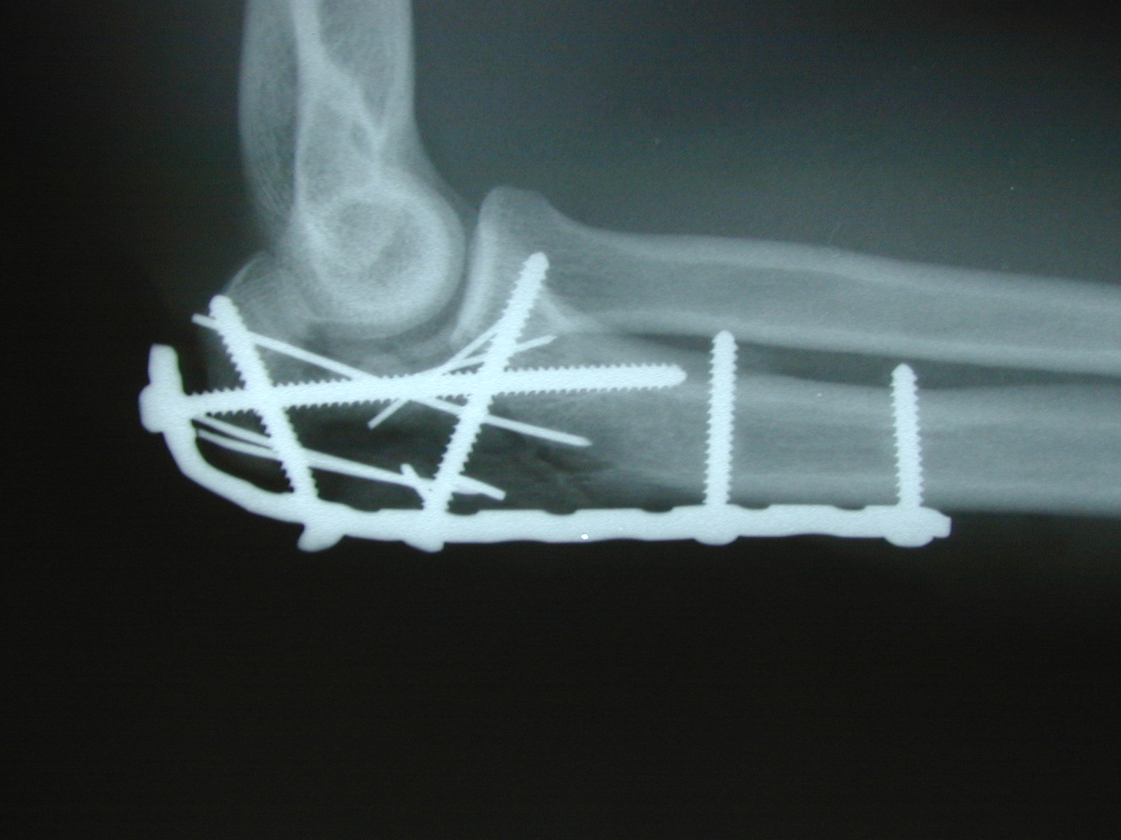

Slide 15
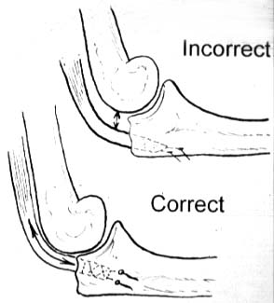

Slide 16
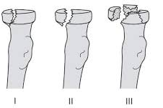

Slide 17
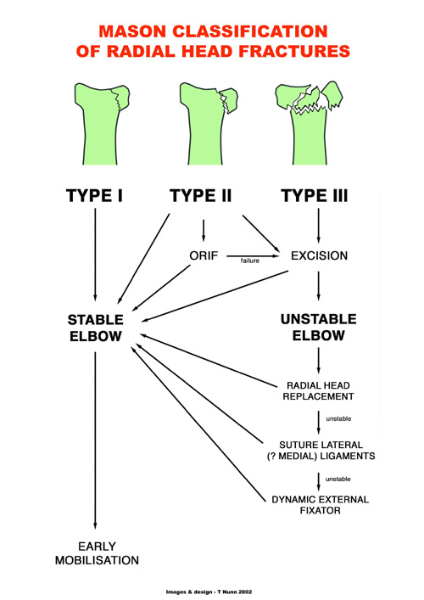
Notes:
17

Slide 18
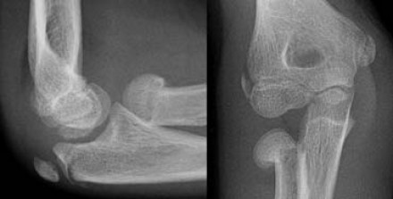

Slide 19
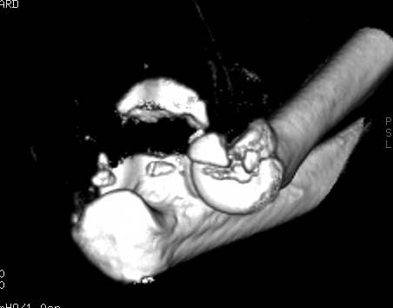

Slide 20
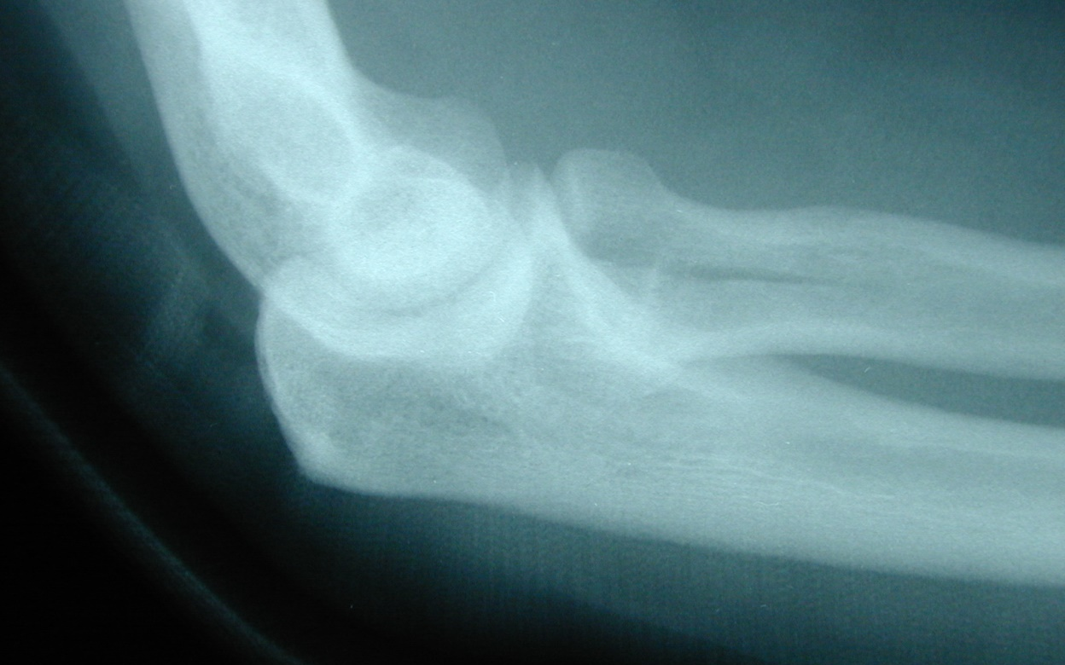
Radial Head Fractures-Simple Partial Articular

Slide 21
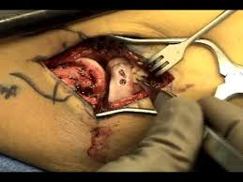
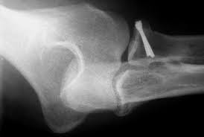
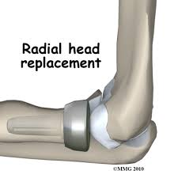
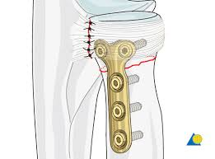

Slide 22
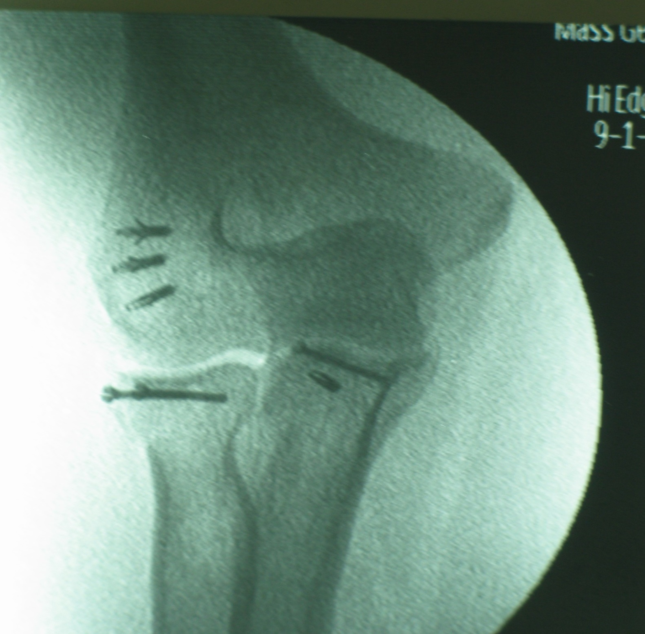

Slide 23
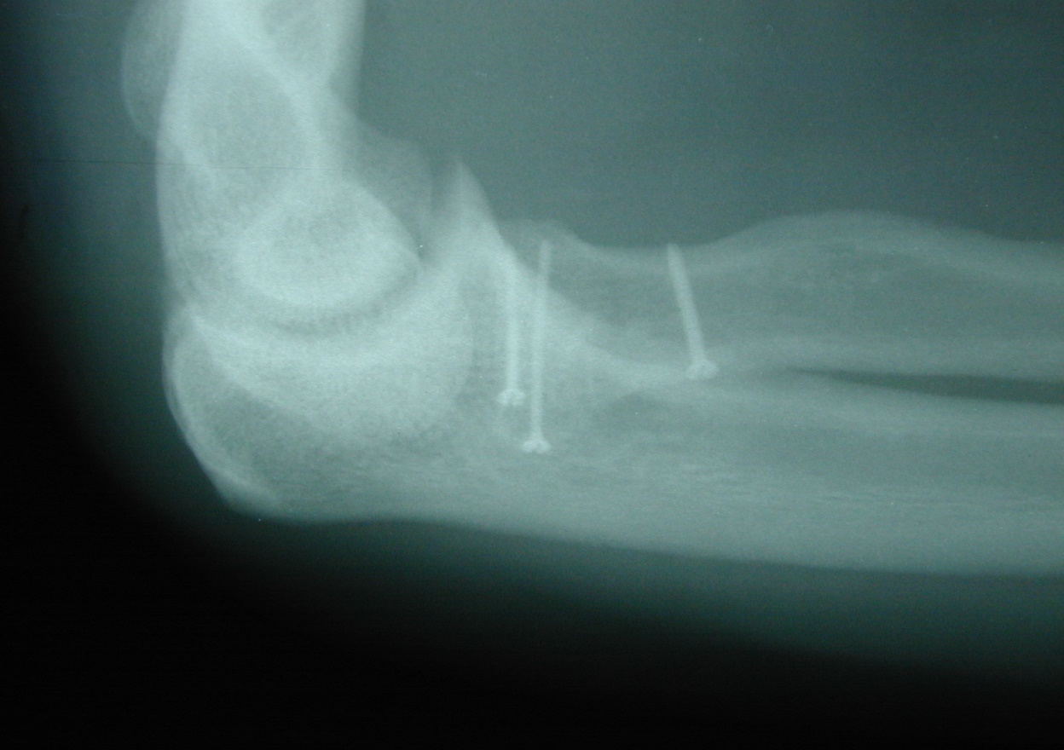
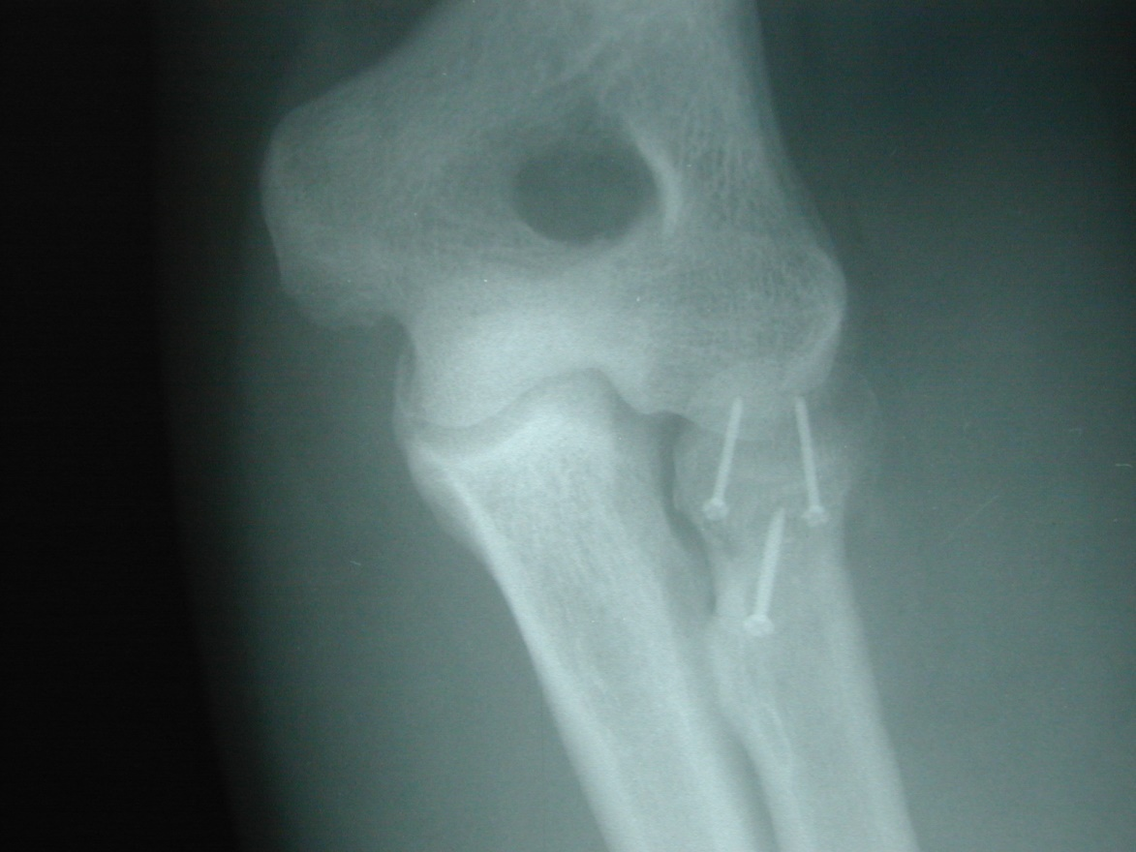
IF screws

Slide 24
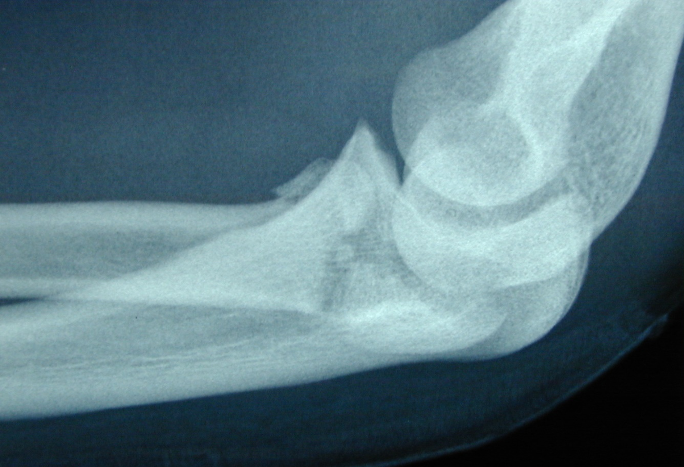
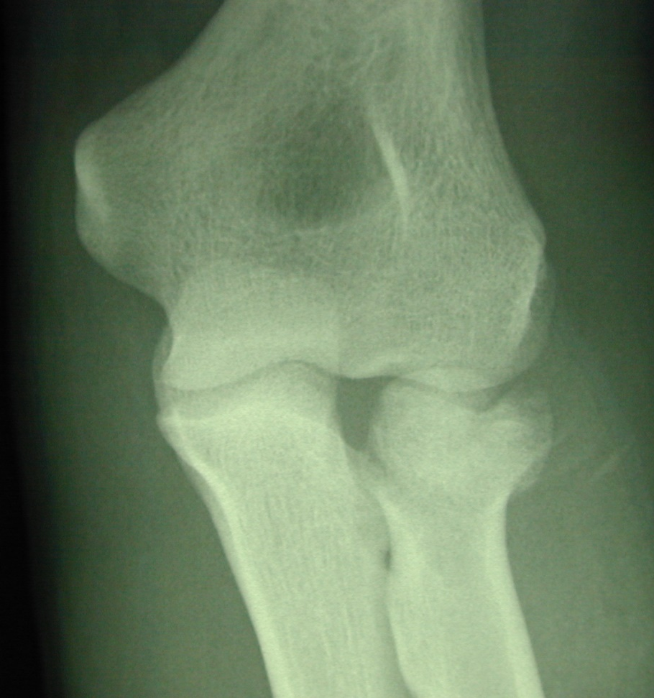

Slide 25
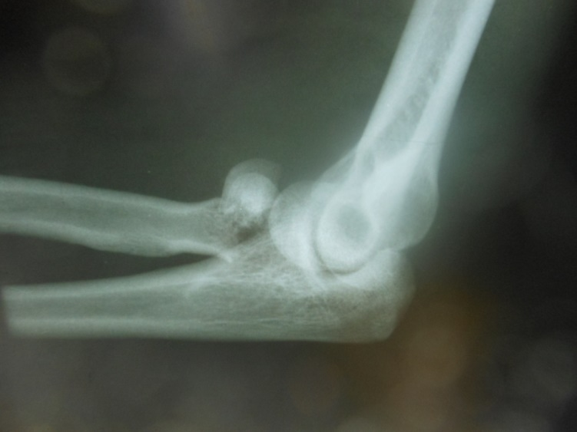

Slide 26
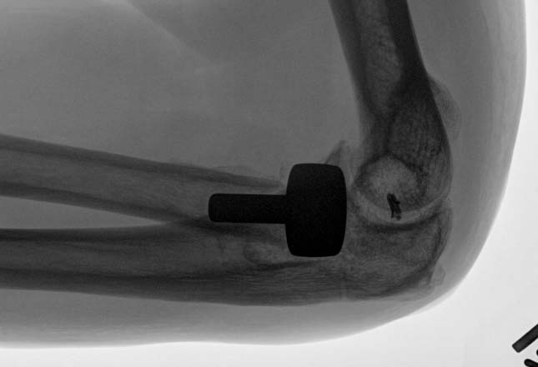

Slide 27
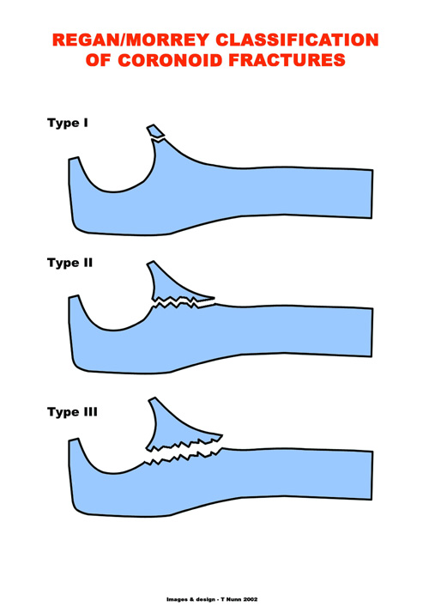
Notes:
27

Slide 28
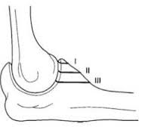
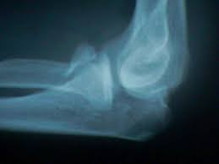
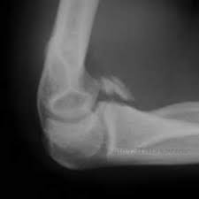
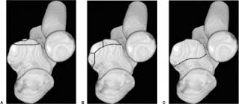
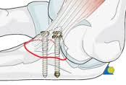

Slide 29


Slide 31
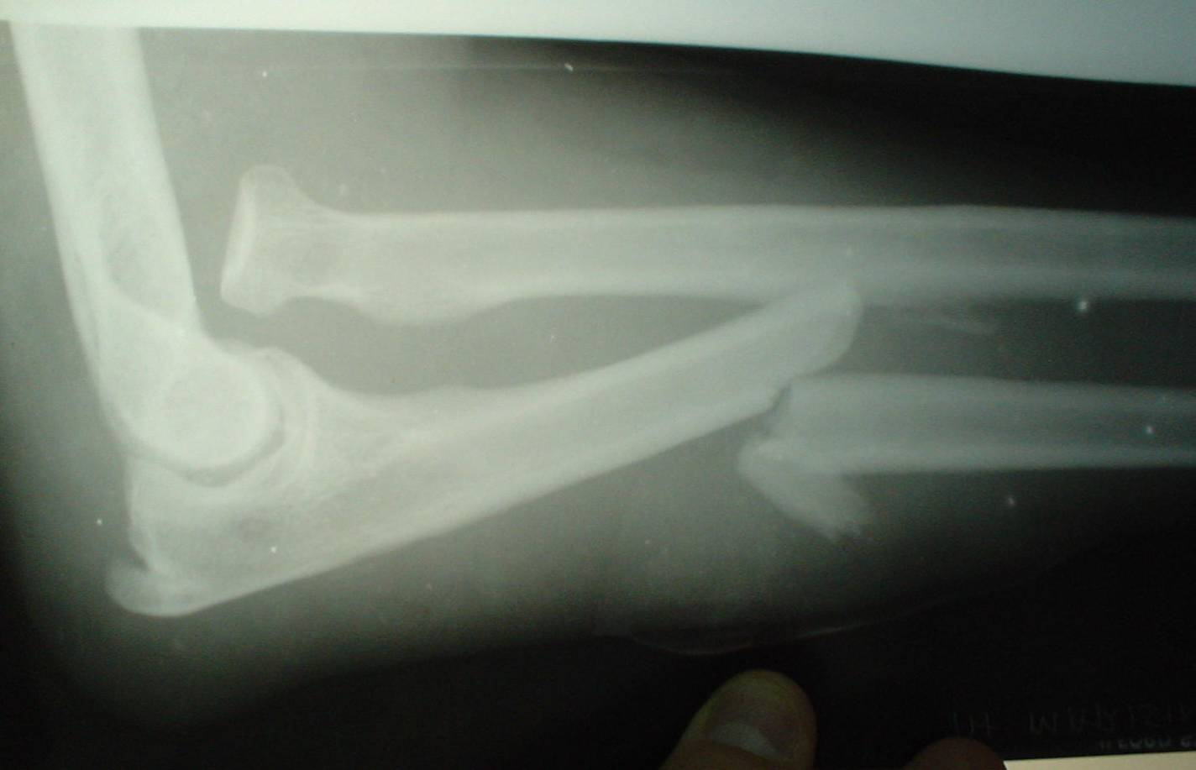

Slide 32
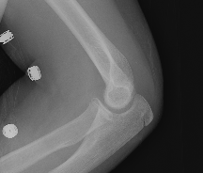
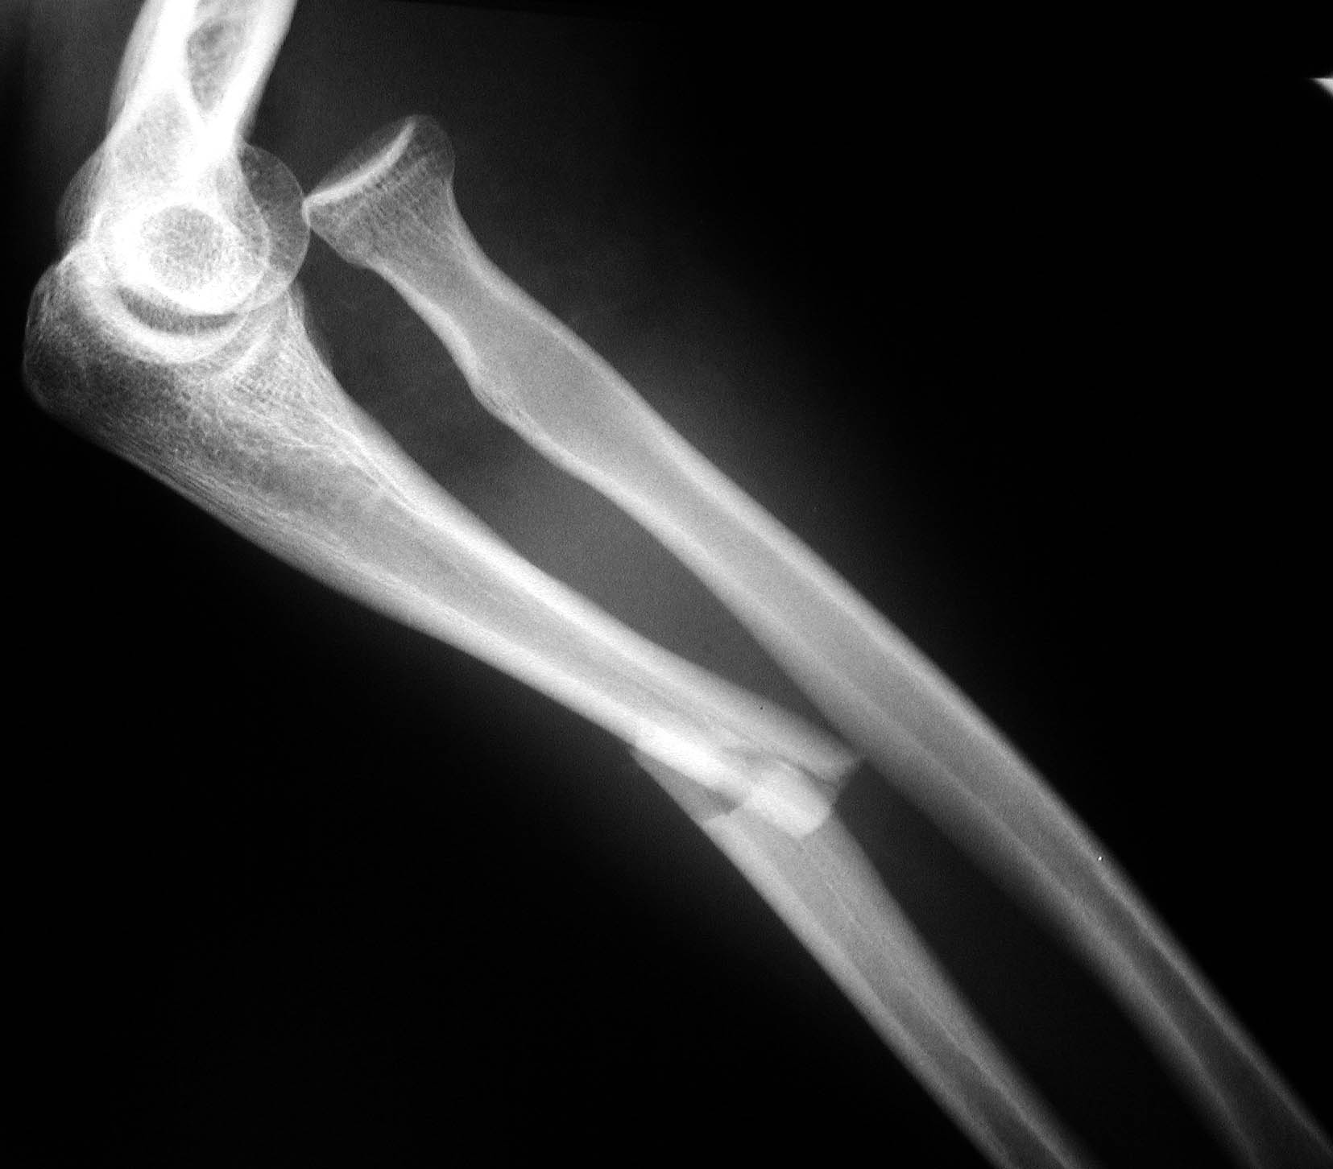

Slide 33
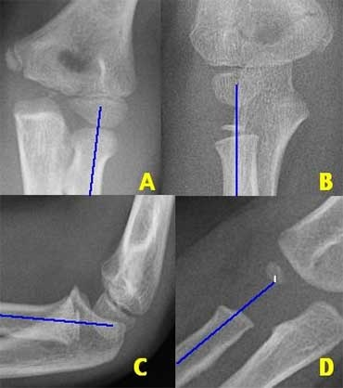
Alignment –Radiocapitellar line
Notes:
33

Slide 34
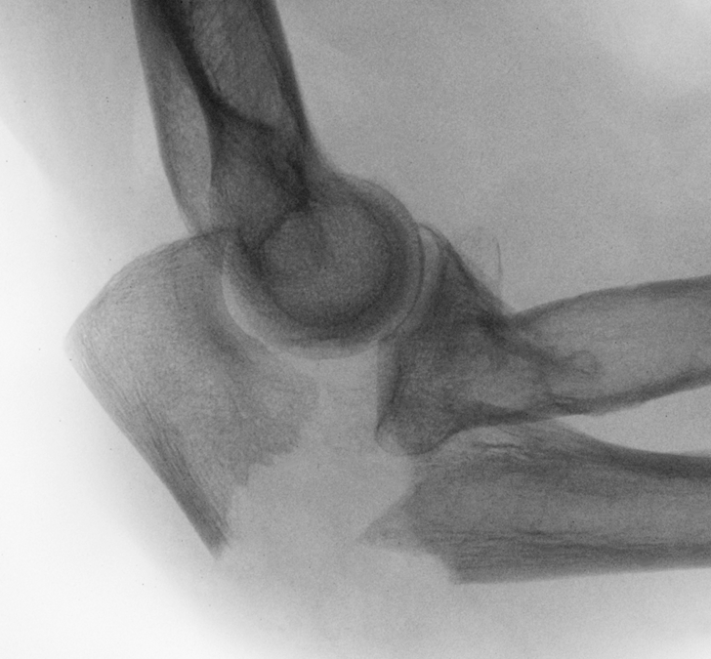

Slide 35
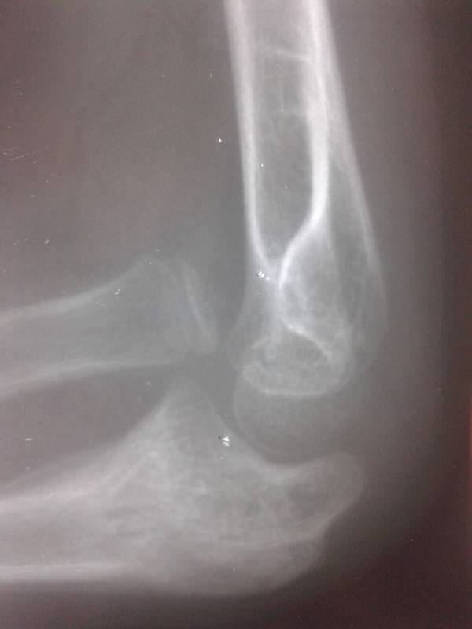
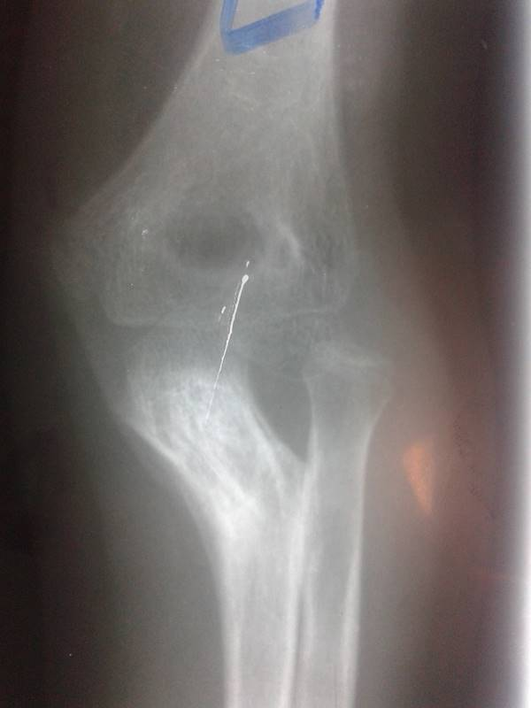

Slide 36
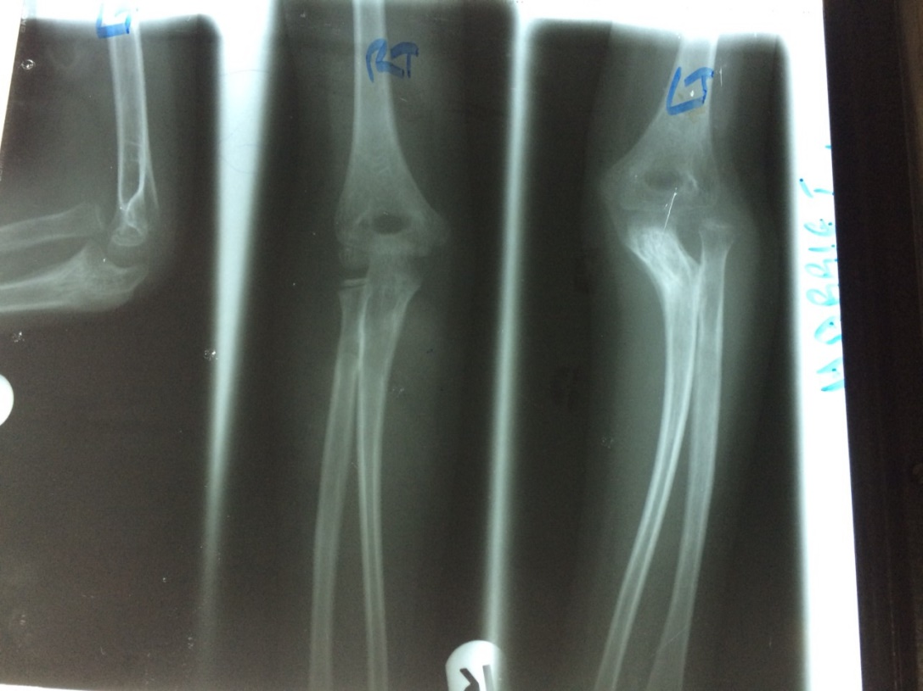

Slide 37
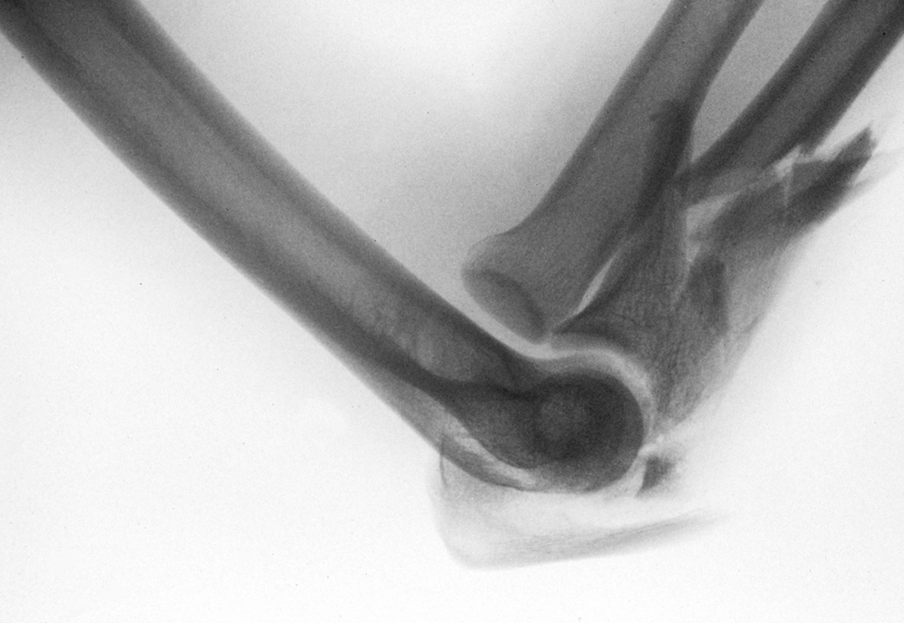

Slide 38


Slide 39


Slide 40



Slide 41


Slide 42


Slide 43


Slide 44


Slide 45



Slide 46


Slide 47



Slide 48


Slide 49


Slide 50



Slide 51



Slide 52


Slide 53


Slide 54



Slide 55


Slide 56


Slide 57

Completed above elbow PoP to immobilize a forearm fracture

Slide 58


Slide 59


Slide 60


Slide 61

VOLAR TILT

Slide 62


Slide 63

RADIAL INCLINATION

Slide 64


Slide 65

RADIAL HEIGHT

Slide 66


Slide 67


Slide 68



Slide 69


Slide 70

OA classification
  Type A – Extra articularType
  Type B – Partial articularType
  Type C – Complete / complex articular

Slide 71

AO/ OTA Classification

Slide 72


Slide 73


Slide 74


Slide 75


Slide 76


Slide 77
EXTRA ARTICULAR CRITERIA
Radial inclination
Radial height
Volar tilt
Radio-ulnar joint

Slide 78


Slide 79



Slide 80



Slide 82



Slide 83



Slide 84



Slide 85


Slide 86


Slide 87


Slide 88


Slide 89


Slide 90


Slide 92


Slide 93



Slide 94


Slide 95



Slide 96


Slide 97


Slide 98


Slide 99


Slide 100


Slide 101


Slide 102


Slide 103



Slide 104



Slide 105


Slide 106



Slide 107


Slide 108


Slide 109


Slide 110


Slide 111




Slide 112



Slide 113
Summary
The forearm is like a joint.
Good assessment of injury for adequate treatment planning.
Complete reconstruction of anatomy
Stable fixation
Complications

