Slide 1
OPERATIVE TREATMENT IN ORTHOPAEDICS
BY
PROF. J.A.O MULIMBA

Slide 2
Choice of Patients:
Not all deformities or injuries are amenable to operative treatment.
So make a diagnosis by:
  Taking history
  Examining
  Investigating
Then consider the following:
  Age of the patient
  Mitigating factors such as:
    Co-morbidities
    Complications associated with operative and non-operative measures
    Available facilities
  Patient’s circumstances

Slide 3
Preoperative Preparation
Assess the patient.
Do any measurements – Lengths.
- Angles
Investigations – Xrays
- Scans – ultrasound
- CT
- MRI
- PET
- Isotopic

Slide 4
Check for any possible sources of infection post operatively.

Slide 5
- Where available templates
- Blood works - Hb, U&E, screening
- Group & Cross match
- INR where indicated
- Blood gases where indicated

Slide 6
Theatre Environment:
Theatre design – air circulation
Theatre population – can only be determined during operation
Antibiotic Prophylaxis can be:
  Pre theatre
  Pre anaesthesia
  Post operative

Slide 7
Theatre Equipment:
Make sure relevant equipment is available e.g: - Drills
- Saws
- Osteotomes, Gouges, Chisels
- Bone holding forceps and reducing
clumps
- Plates, screws, wires
- Screw drivers of various sizes
- Specialised equipment for specialised
operations

Slide 8
Special Equipments:
Fluoroscopy – Image Intensifier (II).
Arthroscopes.
Casts: Plaster, Dynacast, Fibreglass.
Loupes for nerve and vascular surgery.
Tourniquet:
  Better pneumatic.
  Tourniquet time should be strictly observed.
  Write on the board starting time.

Slide 9
Operations on Bones:
Observe strict asepsis.
Operations include:
  Plating
  Nailing
  Wiring
  External fixation
  Osteotomies
  Bone grafting:
    Cancellous
    Cortical
    Artificial such as chronos

Slide 10
Before operation starts, make sure that the right patient and the right side is being operated on.
WHO check out list must be implemented at the beginning of every operation.

Slide 11
Other bone operations:
Lengthening or shortening.
Excision e.g exostoses, Tumours
Saucerization - for chronic osteomyelitis
Drilling e.g. in acute osteomyelitis or Garre’s sclerosing osteomyelitis
Transfer of bone e.g. tibialisation of the fibula

Slide 12
Operations on Joints:
Aspiration and/or washout.
Intraarticular injections.
Reduction.
Arthrotomy.
Osteotomy to re-align a joint.
Fusion (Arthrodesis).
Arthroplasty:
  Excision
  Interposition:
    Hemiarthroplasty
    Total arthroplasty

Slide 13
Amputations:
Considerations:
  Type of amputation e.g. definitive or provisional
  Length of stump
  Availability of prosthesis
Indications:
  Gangrene
  Malignancy
  Infection
  Dangerous limb
  Useless limb
  Trauma

Slide 14
Amputation Types:
Definitive.
Provisional – Guillotine.
There are various levels considered ideal e.g.
- End bearing.
- None end bearing.
Other levels of amputation determined by the disease process.
Amputations also have their complications.

Slide 15
Complications of Amputation:
Infection.
Breakdown of skin flaps.
Gangrene.
Ugly muscle bulbs.
Bleeding or further gangrene.
Neuromas.
Phantom limb.

Slide 16
Operations on Tendons
These include:
  Tendon repairs
  Tendon transfer
  Reattachment to bone in case of avulsion
  Tenodesis i.e. tendon release e.g. in De Quervain’s Syndrome
  Tendon lengthening

Slide 17
Operations on Nerves
Nerve repairs
Nerve Grafting
Transposition of nerves
Nerve decompression e.g. Carpal tunnel Syndrome

Slide 18
Operations on Blood Vessels
Increasingly being done by cardiovascular surgeons, but repairs also done by orthopaedic surgeons

Slide 19
Operations on Muscles
In reality, very little can be done because sutures don’t hold on muscle.

Slide 20
Microsurgery:
For finger or other limb reattachment.
Nerve repairs.

Slide 21
Complications of Operative Treatment:
Hematoma formation.
Swelling.
Delayed wound healing.
Infection.
Thromboembolism – Prophylaxis given:
Physical - Continuous movement.
Drugs - Injectable.
- Oral.

Slide 22
Rehabilitation:
Physiotherapy – Rest with splintage.
- Exercises - passive.
- active
- Heat e.g. SWD
- Ice.
- Manipulation.
- Electric stimulation.

Slide 23
Occupational therapy:
To retrain the patients in certain function.
May help start a new career.

Slide 24
Appliances:
Walking frames.
Crutches.
Collars.
Spinal supports.
Footwear.
Splints.

Slide 25
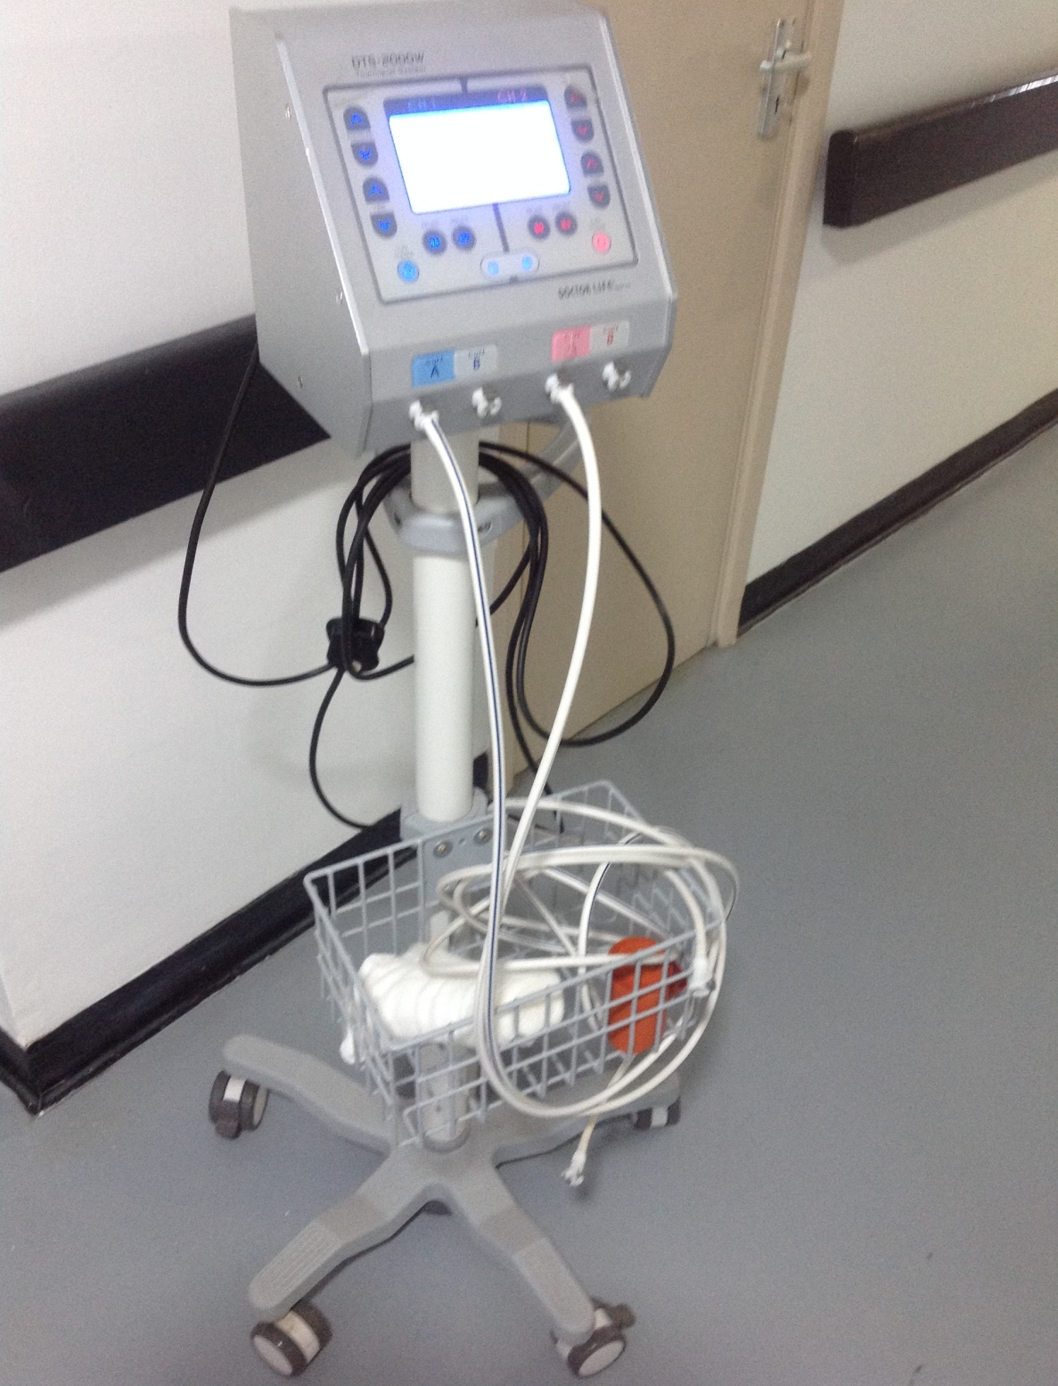
Pneumatic Tourniquet

Slide 26
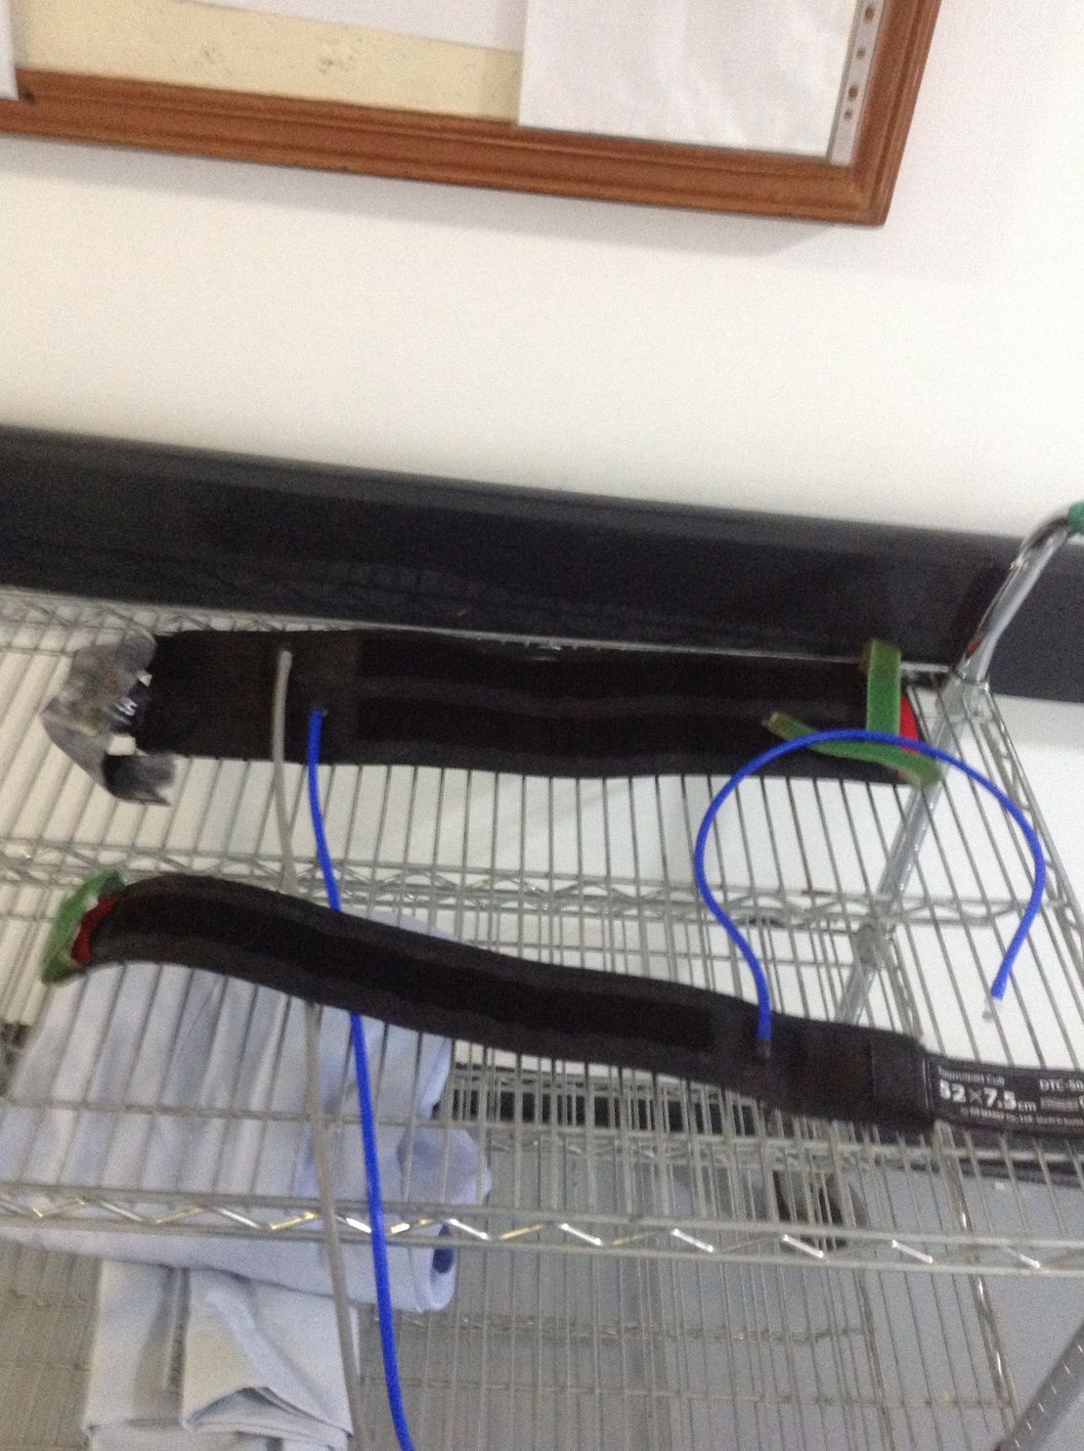
Cuffs

Slide 27
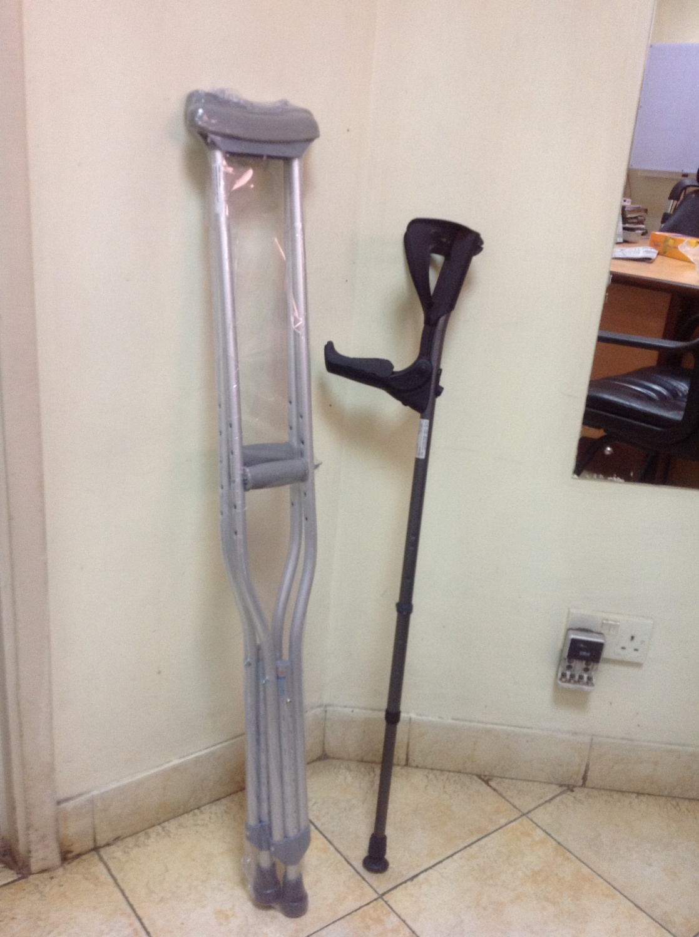
Axillary & Elbow Crutches

Slide 28
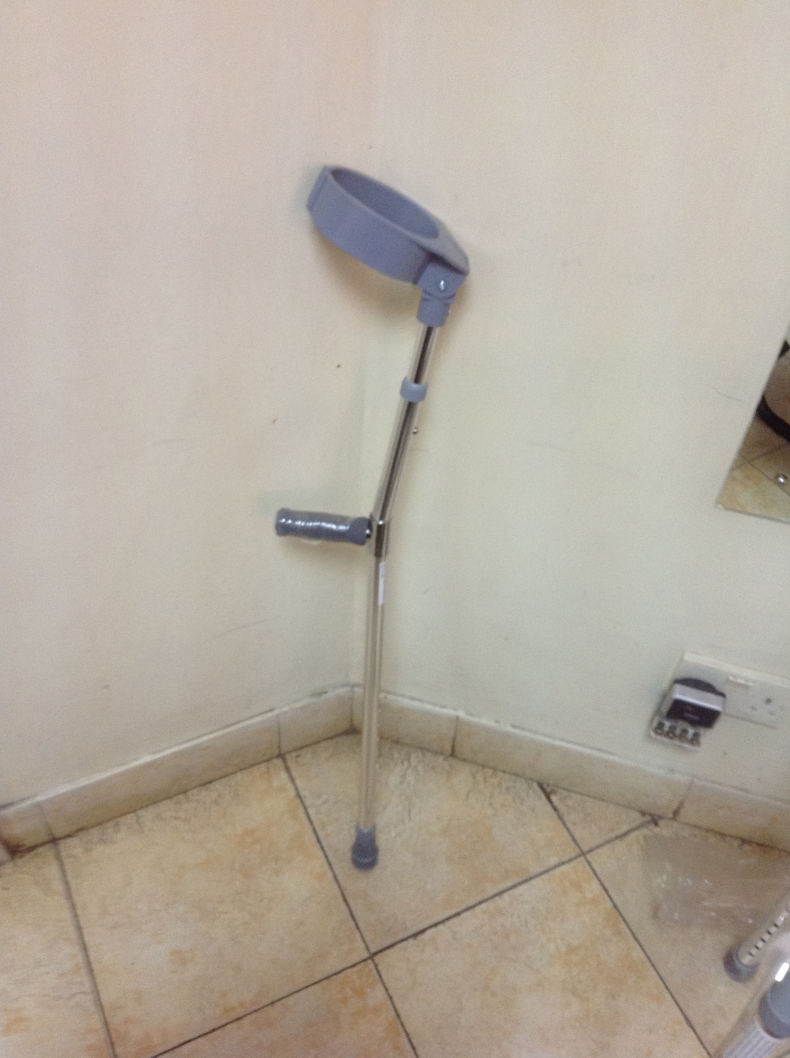
Elbow Crutches

Slide 29
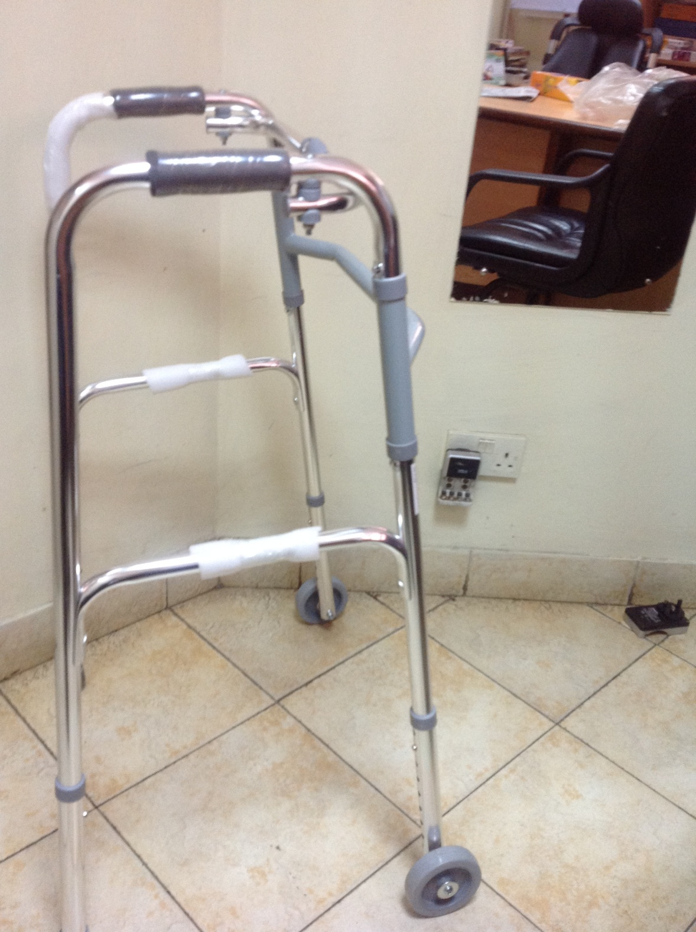
Walking Frame

Slide 30
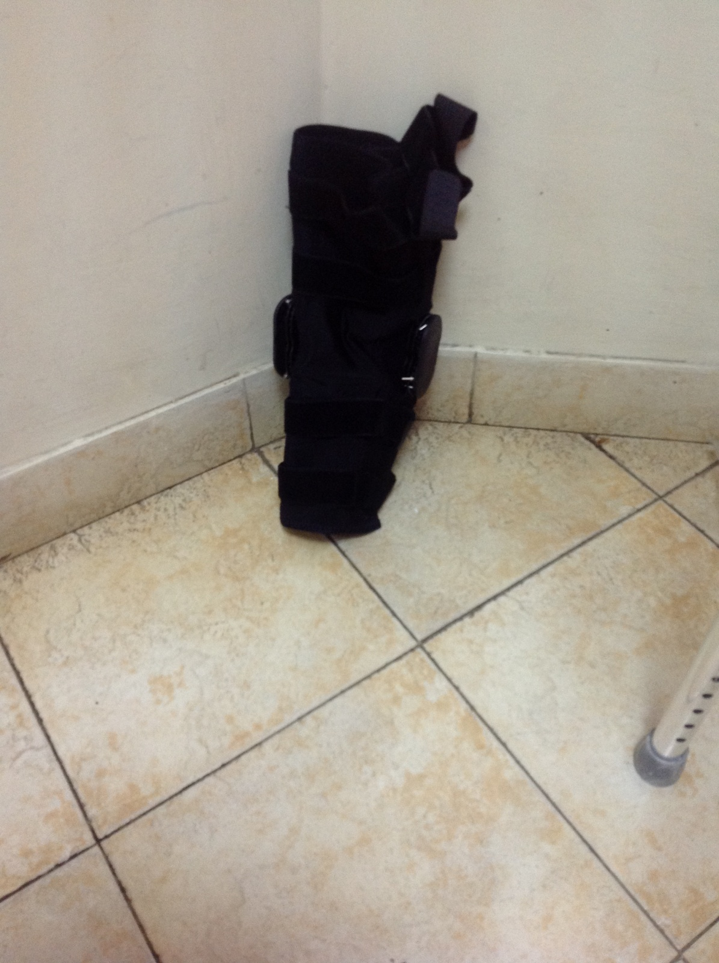
Hinge Knee Brace

Slide 31
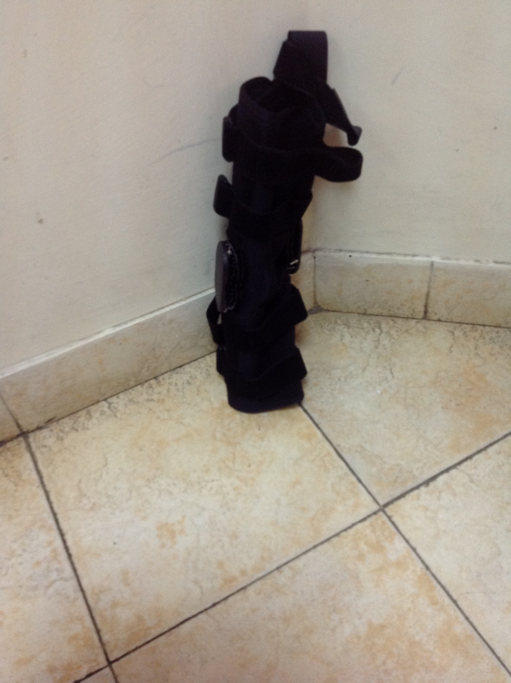
Hinge Knee Brace

Slide 32
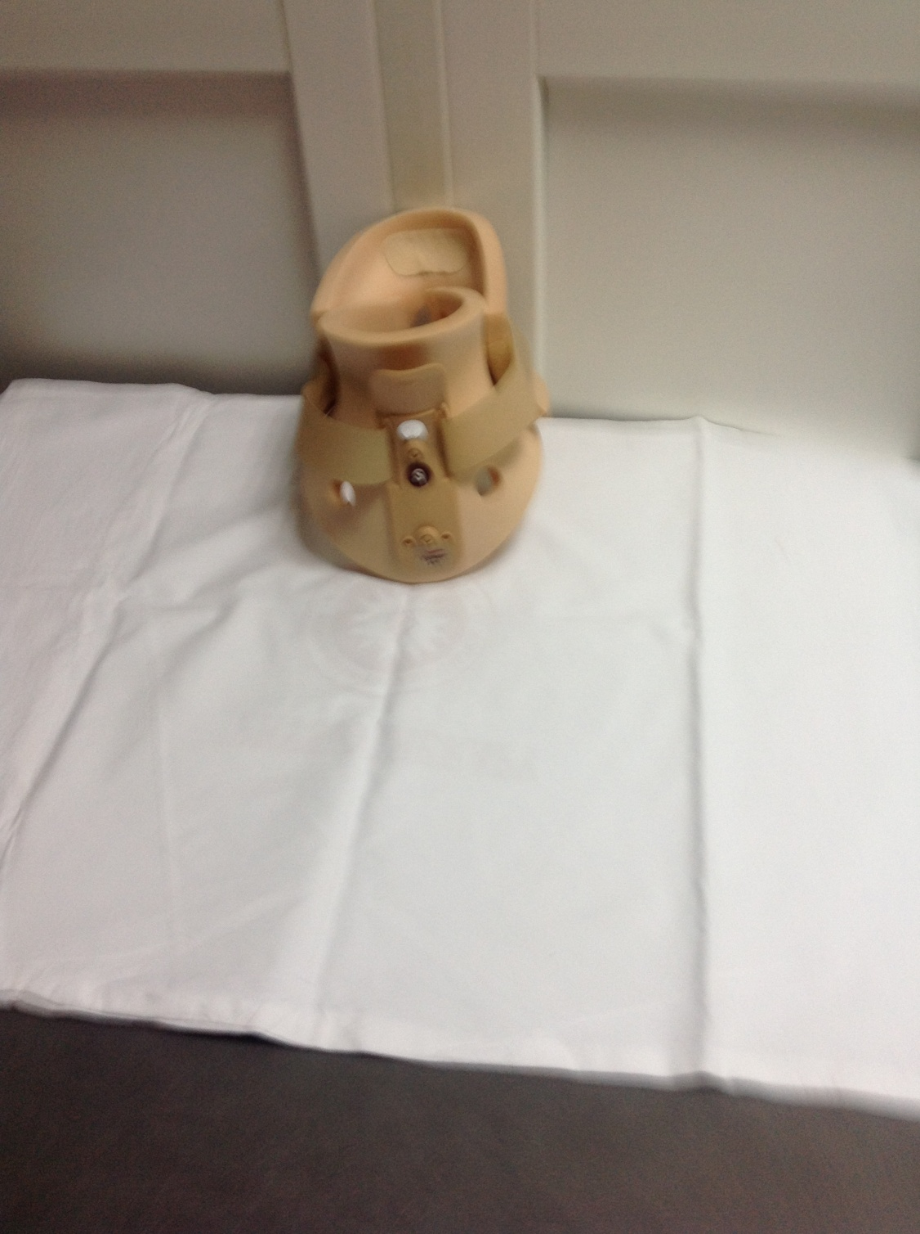
Cervical Collar

Slide 33
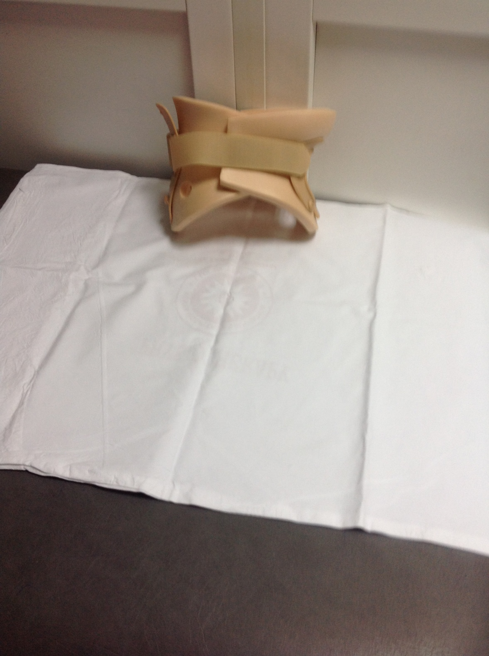
Cervical Collar

Slide 34
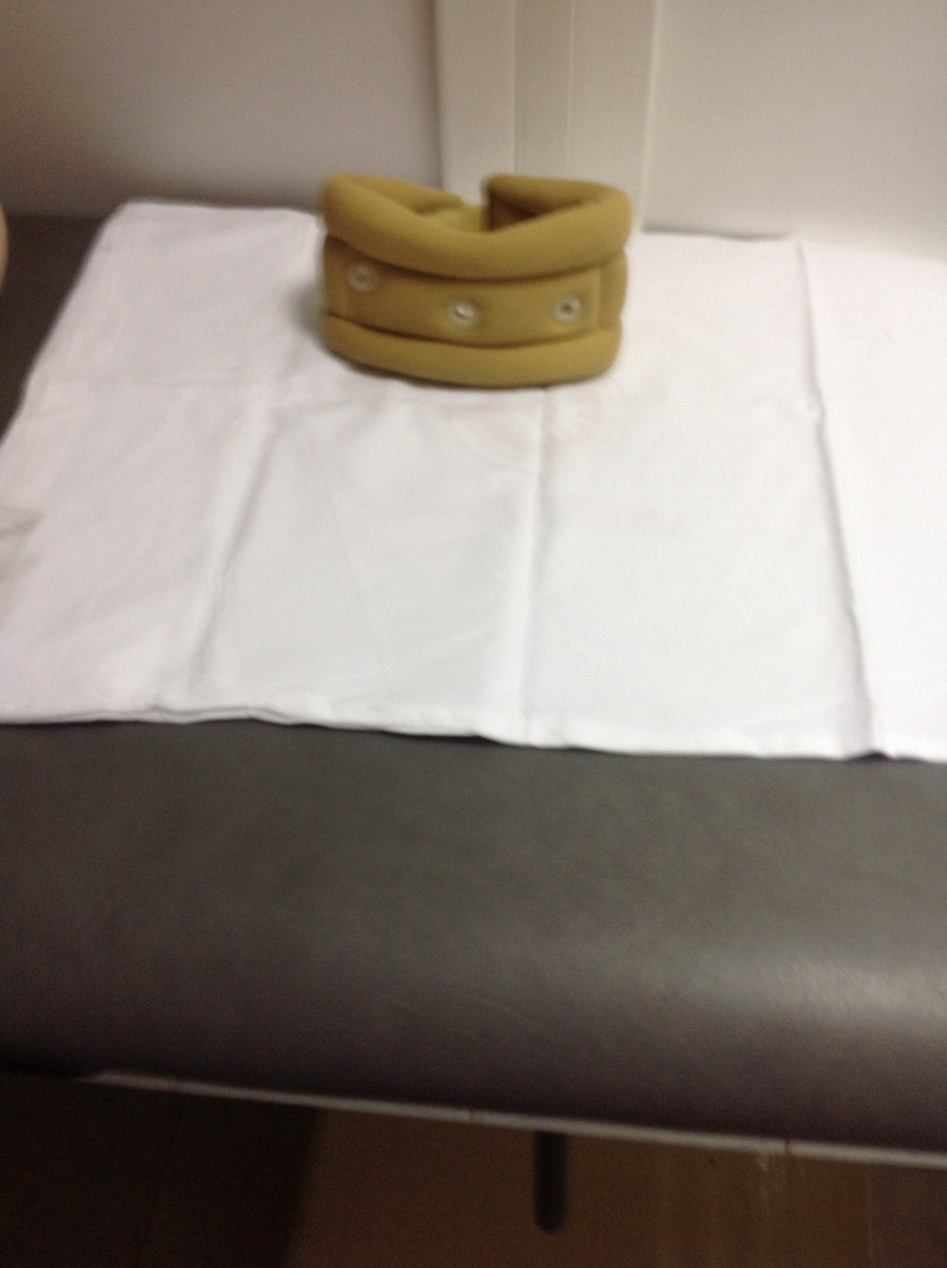
Cervical Collar

Slide 35
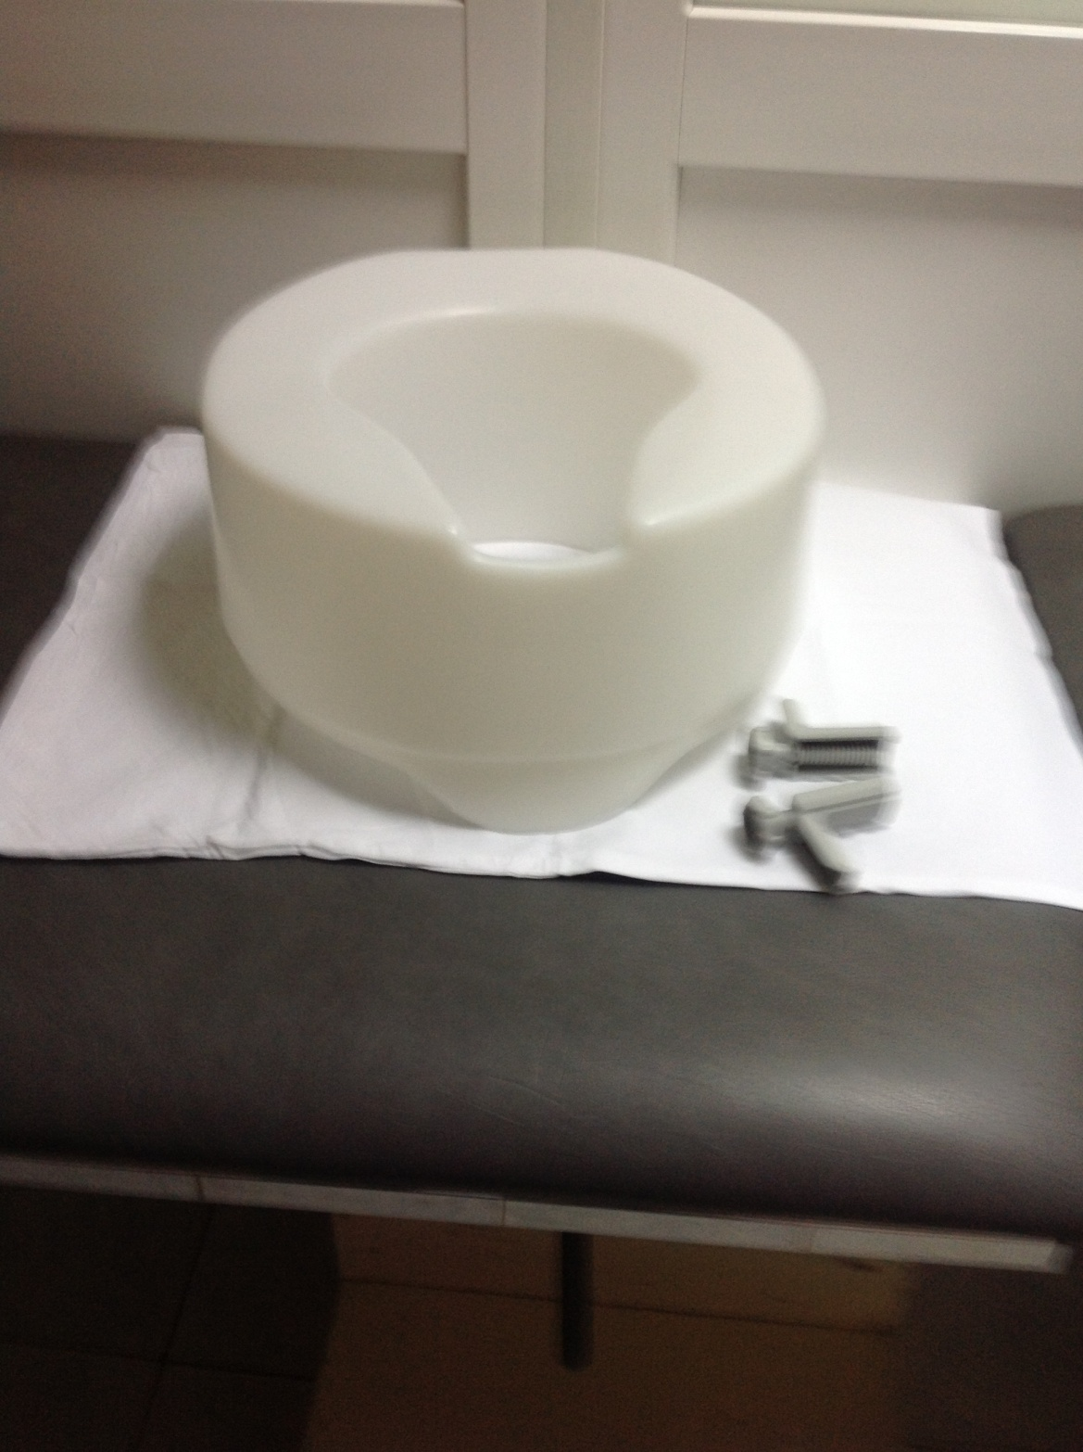
Toilet Sit

Slide 36
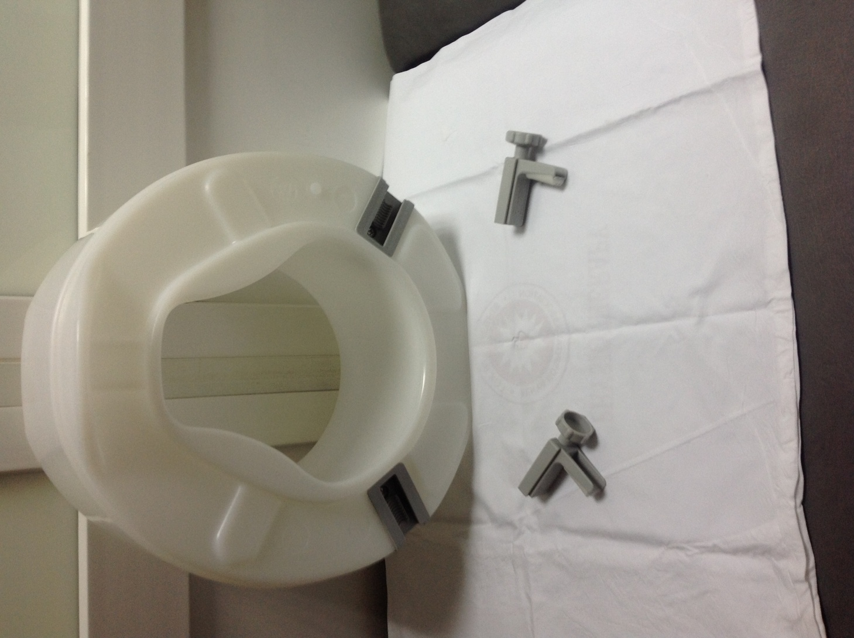
Toilet Sit

Slide 37
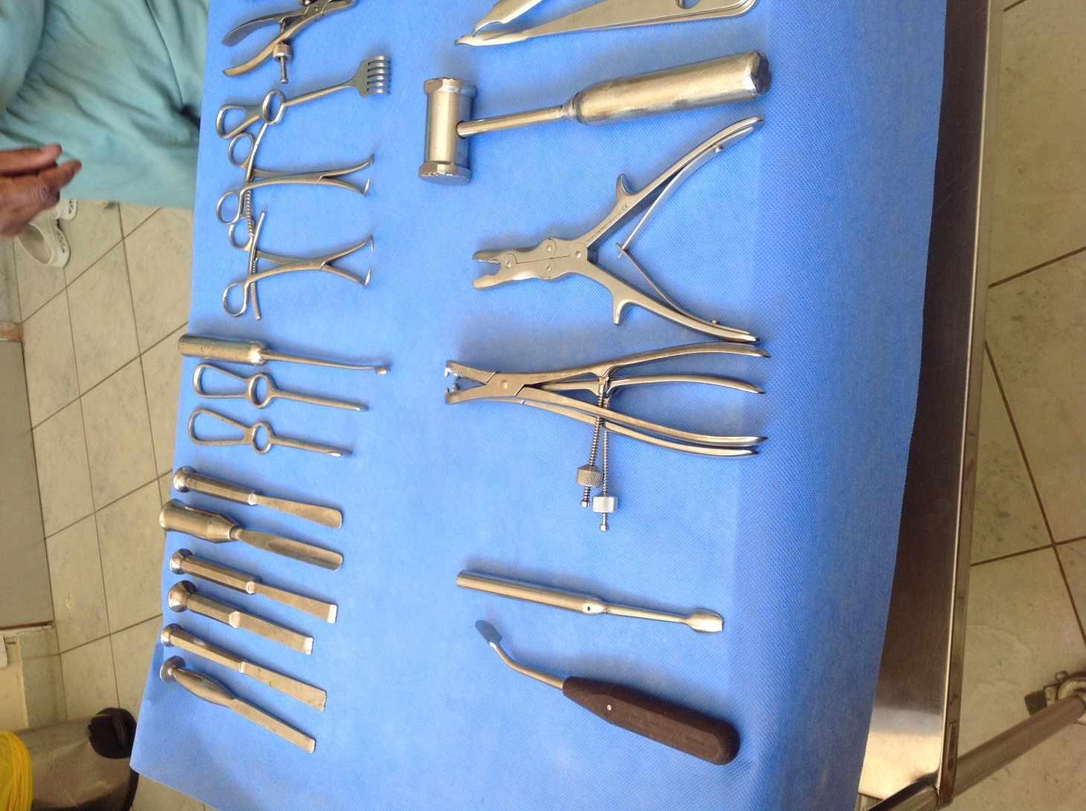
Theatre Instruments

Slide 38
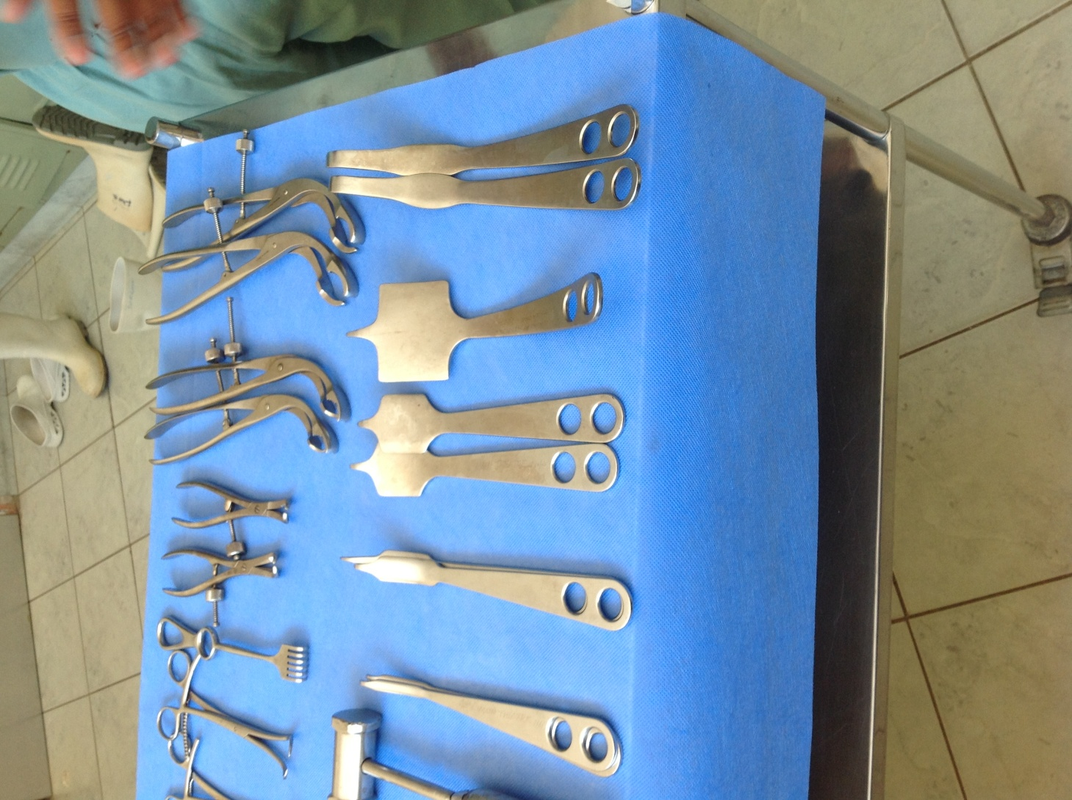
Theatre Instruments

Slide 39
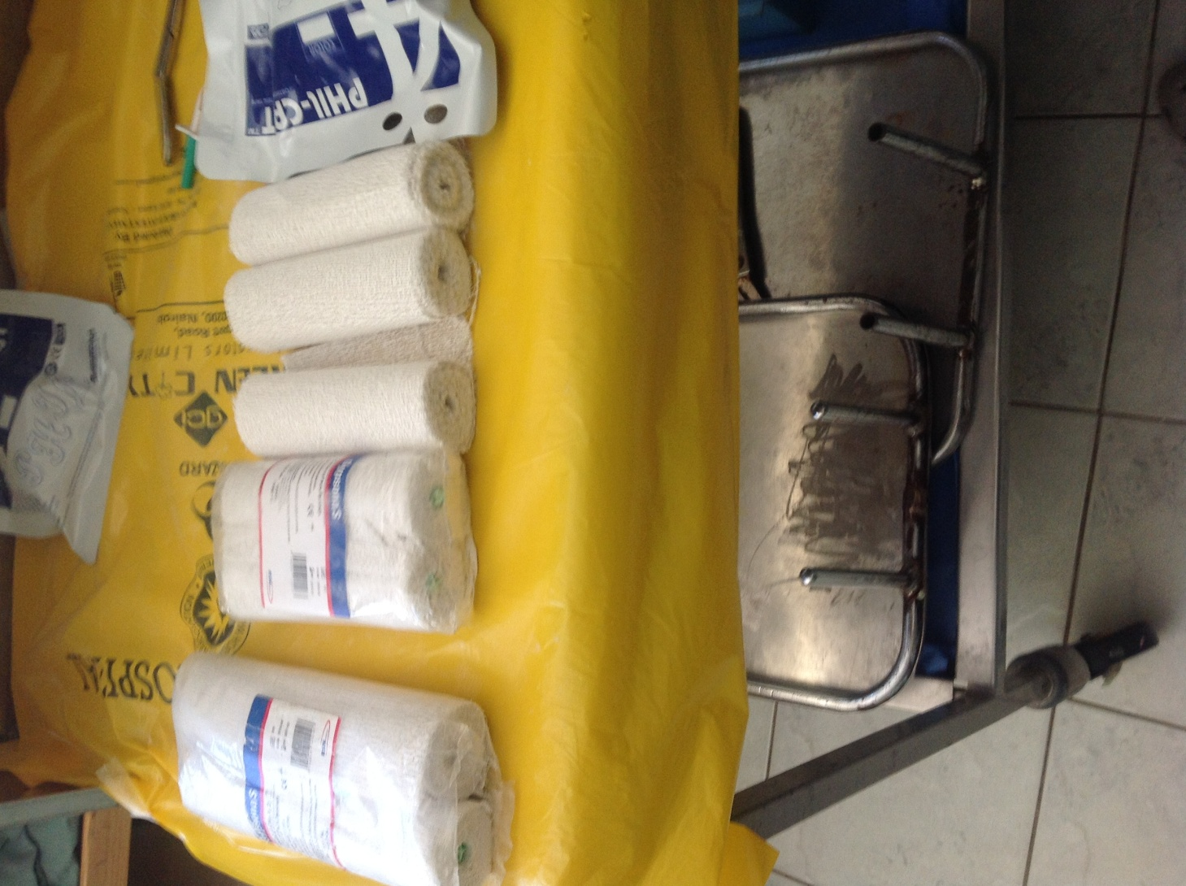
Plaster of Paris Cast

Slide 40
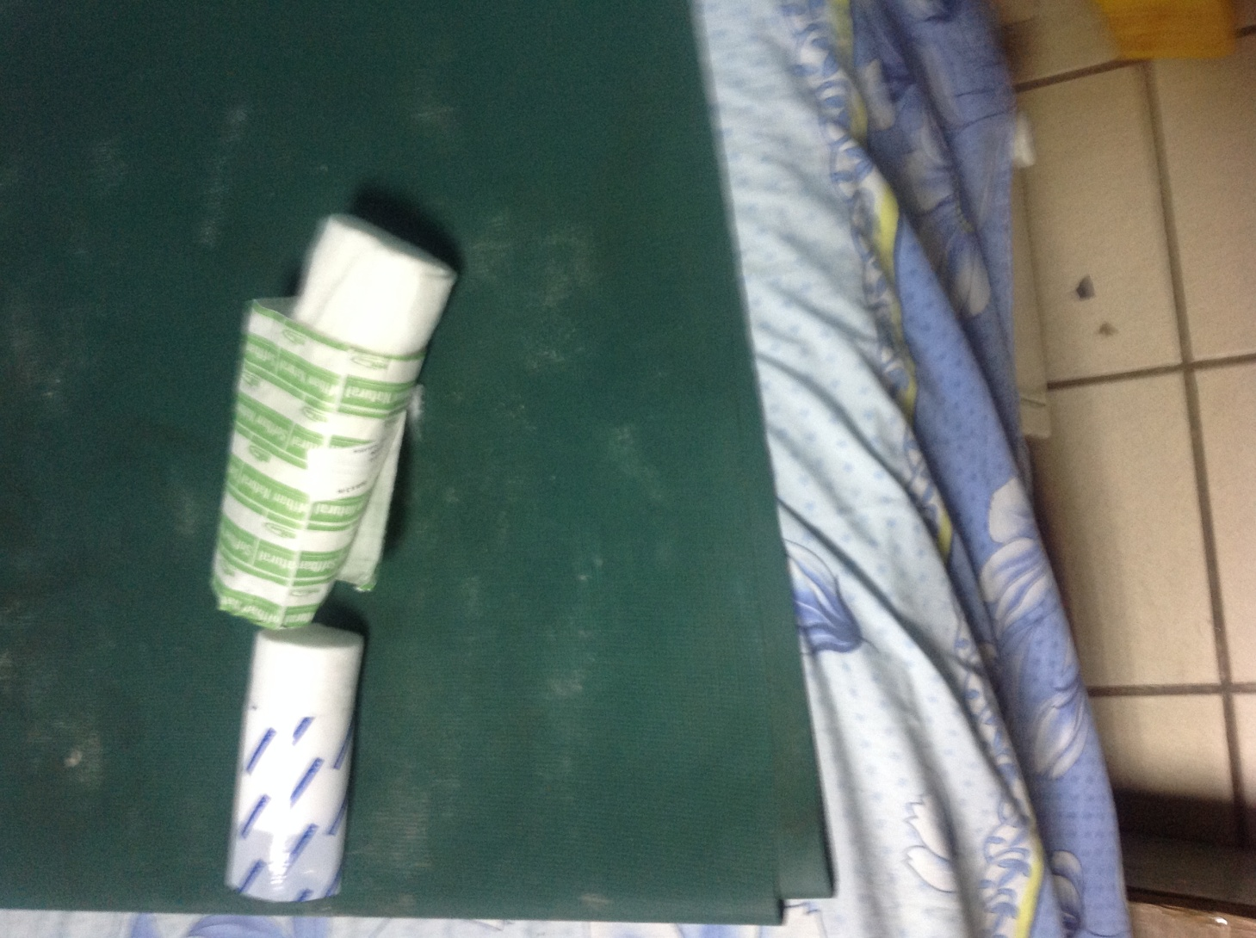
POP Padding Cast

Slide 41
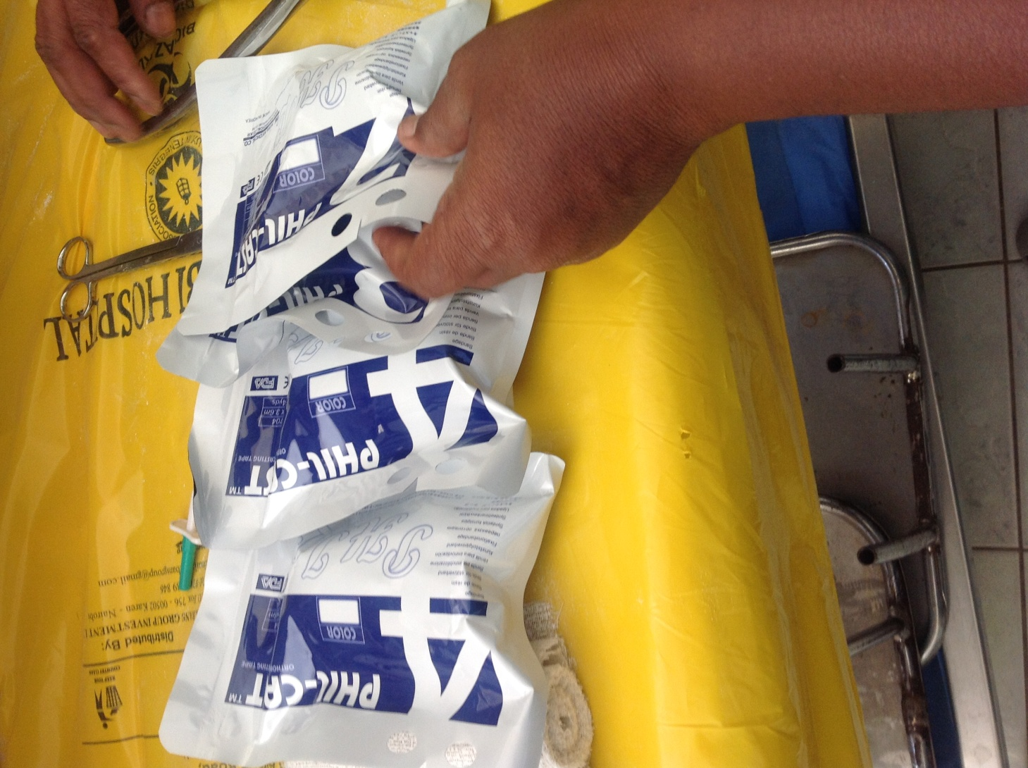
Fibre Cast

Slide 42
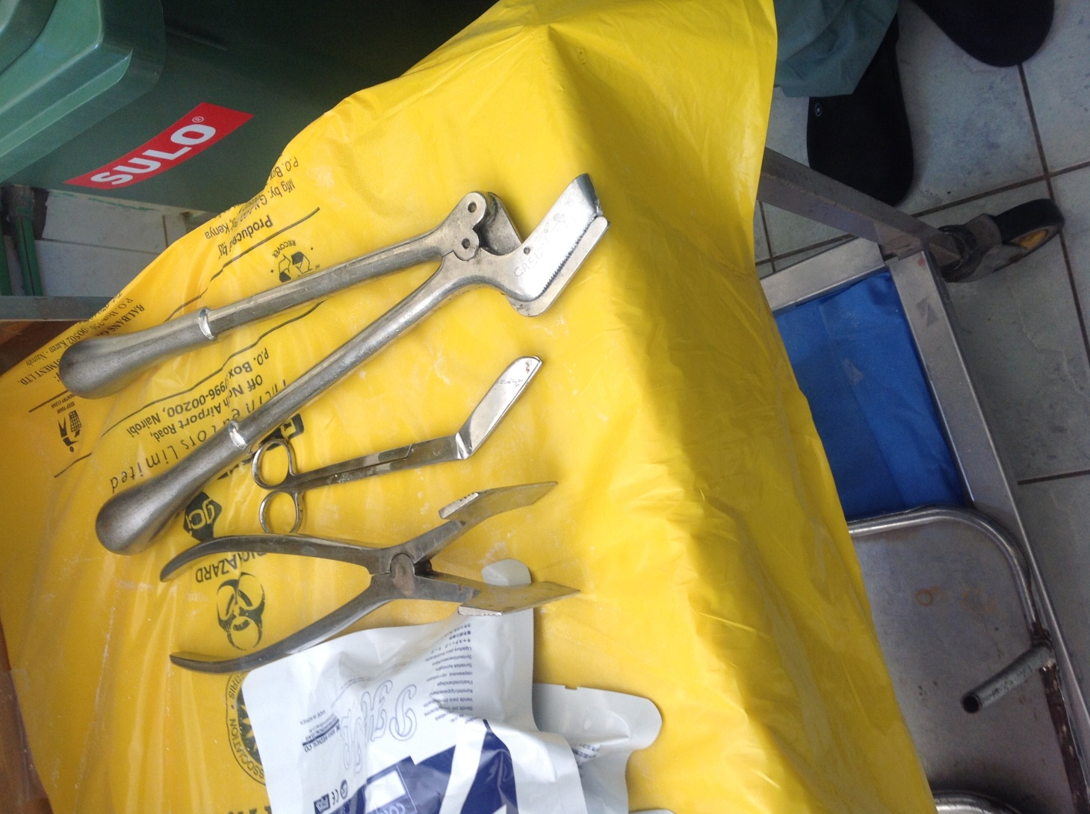
Plaster Shear

Slide 43
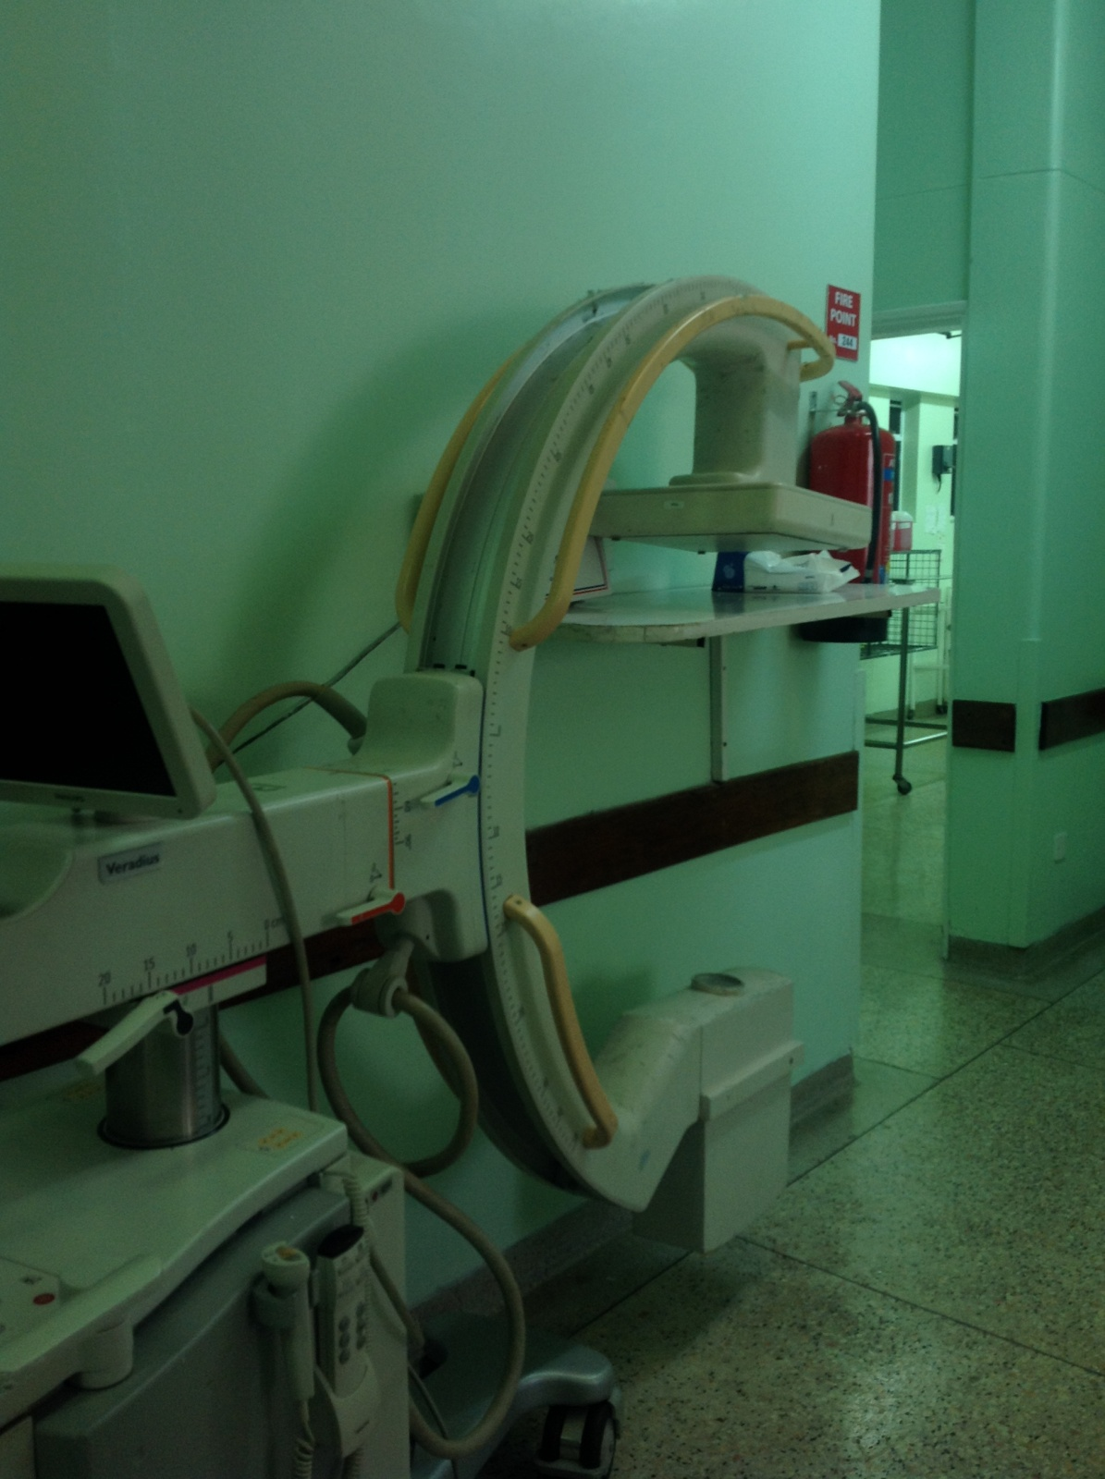
Image Intensifier

Slide 44
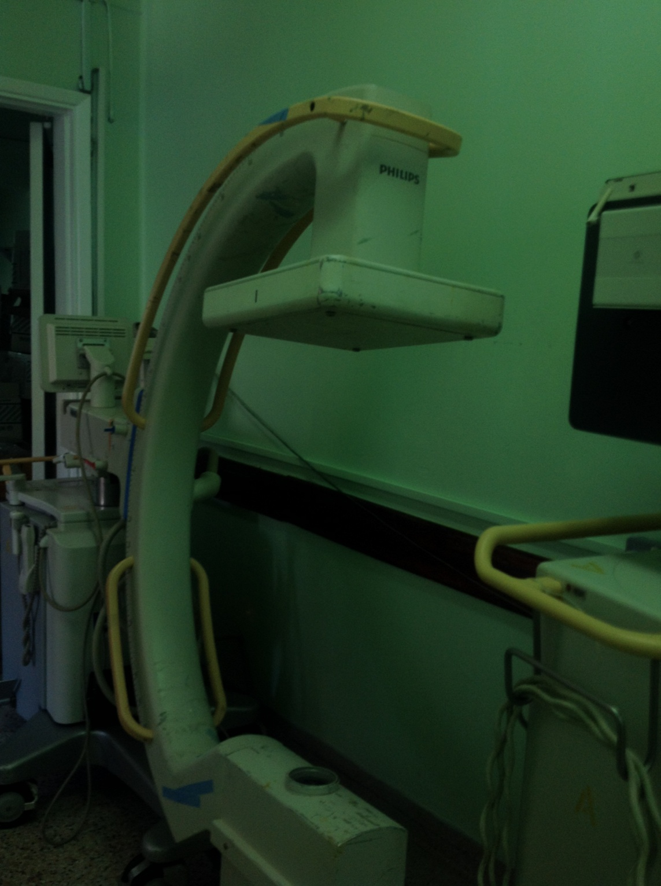
Image Intensifier

Slide 45
Thank you

