Slide 1
Fracture Femur
6th years 2021

Slide 3
Anatomy
Longest, strongest, heaviest, first to ossify
Zones: Proximal, diaphysis, distal
Neck-shaft angle 135
Anterolateral bowing
Isthmic at junction of proximal and middle 1/3rd
Adequate muscle envelope and blood supply
Length approximates tips middle finger to olecranon

Slide 4
Vascular supply

Slide 5
Epidemiology: Bimodal Distribution
Elderly
Incidence doubles each decade beyond age 50
Higher in white population
Smokers, small body size, excessive caffeine
Young
High energy trauma
Obstetric birth trauma

Slide 6
Fracture description
Mechanism of injury (traumatic, pathological, stress)
Anatomical site (bone and location in bone)
Configuration Displacement
Three planes of angulation
Translation
Shortening
Articular involvement/epiphyseal injuries
Fracture involving joint
Dislocation
Ligamentous avulsion
Soft tissue injury
Proximal
Diaphysis
Distal

Slide 7
Sequel
Local
Haemorrage (1000-1500)
Soft tissue injury
Neurovascular
Compartment syndrome
Fat embolism
VTE
Metabolic response
Inflammatory body response

Slide 8
Clinical features
Symptoms:
Loss of function
Musculoskeletal pain
LLD
Compartment syndrome
Cardiopulmonary
Central nervous
Renal funtion

Slide 9
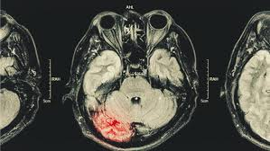
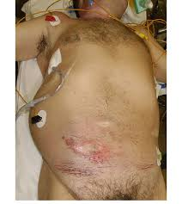
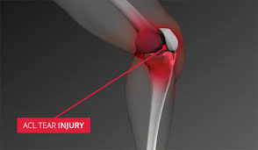
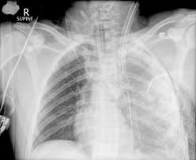
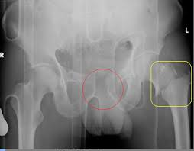
Associated injuries

Slide 10
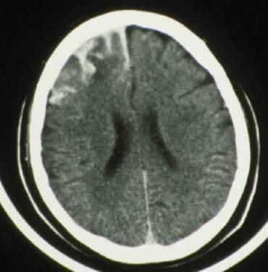
Head Injury + Femur Fx
Early fixation of long bone fractures does NOT promote secondary brain injury which may increase mortality, BUT hypoxia, hypotension and increased ICP DO
Poole J Trauma 1992
Schmeling CORR 1995
McKee J Trauma 1997
Velmahos Am J Surg 1998
Scalea J Trauma 1999
Notes:
‹#›

Slide 11
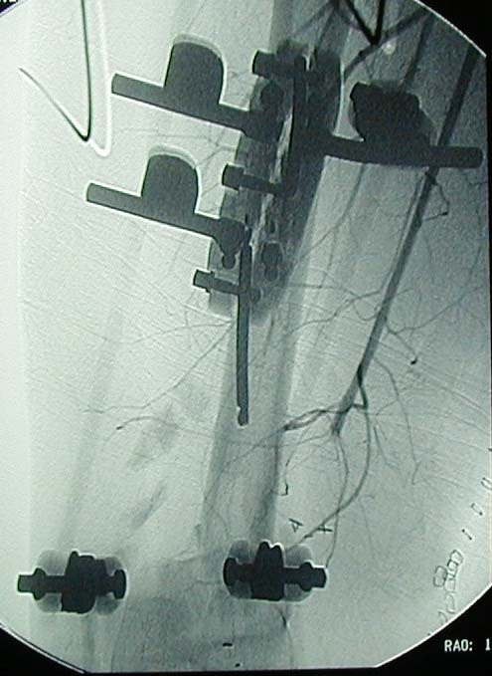
Femoral Shaft Fracture with Vascular Injury
Quick external fixation with restoration of length
Fasciotomies
Notes:
‹#›

Slide 13
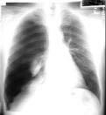
Chest Injury + Femur Fx
CHEST INJURY
Increased pulmonary morbidity (ARDS, fat embolism)
Early long bone stabilization questioned in patients with significant pulmonary injury
Thoracic trauma ITSELF is the major determinant of morbidity and mortality, NOT IM NAILING
Bone CORR 1995
Bosse JBJS 1997
Notes:
‹#›

Slide 14
Investigations
X- ray
MRI – for stress fractures
Ct scan for proximal and pathological
Bone scan for stress & pathological
Ct scan Intra – articular, impacted,
Others - arteriography
Compartment pressure measurement

Slide 16
Classification
AO/OTA
Pipkins
Pawel/garden
Russel tylor
Winquist

Slide 17
General treatment
Consider:
Age
Life and limb threatening
Open or closed
Associated injuries
Location of fracture (proximal, diaphysis, distal femur)
Stability
ATLS principles
Supportive - splintage, pain killers, resuscitation (shock),
TT, antibiotic for open fractures
Co-morbidities evaluation and treatment

Slide 18
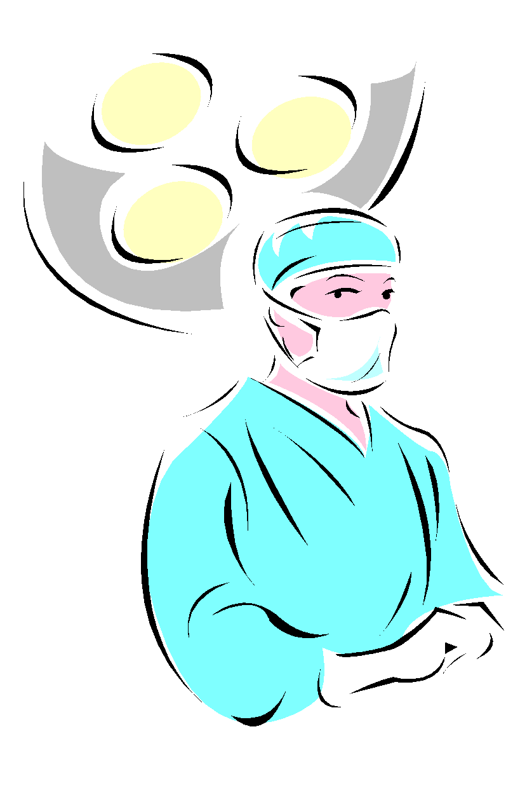
Hip fracture (proximal femur fracture)

Slide 19
General considerations
Extracapsular fracture with better healing potential (large surface area, good blood supply and cancellous bones)
Age: 10 years older than femoral neck fracture
RISK FACTORS
Treatment principles
Early mobilization
Early surgery (24 to 72 hrs)
Walk within two weeks after surgery

Slide 20
Goals of Neck of femur # treatment
Geriatric
Mobilize early
Minimal surgical morbidity
Reduce chance of reoperation
Young
Spares femoral head
Avoid deformity (varus)
Avoid blood supply injury

Slide 21
Treatment options Proximal femur
Stable fractures:
Close reduction & DHS (Dynamic hip screw)
Unstable fractures:
Close reduction &nail
CRIF & percutaneous screw
Arthroplasty/ hemiarthroplasty

Slide 22
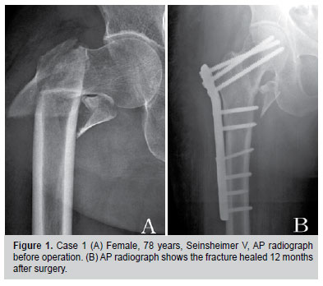
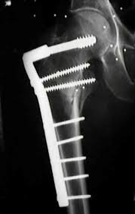
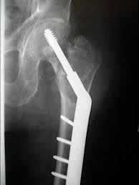
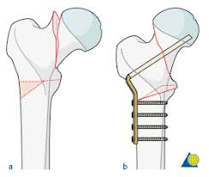
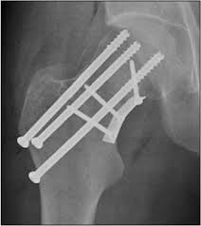
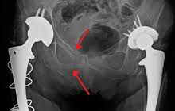
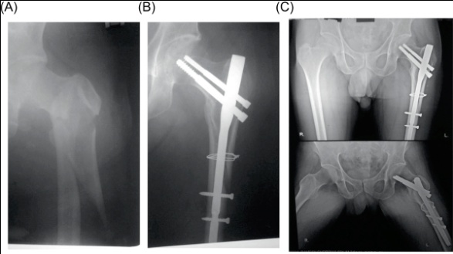
Proximal femur fixation

Slide 23
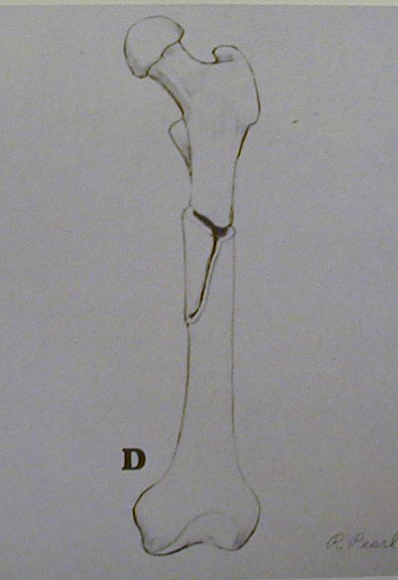
Diaphyseal Femur Fracture Classification
Type 0 - No comminution
Type 1 - Insignificant butterfly fragment with transverse or short oblique fracture
Type 2 - Large butterfly of less than 50% of the bony width, > 50% of cortex intact
Type 3 - Larger butterfly leaving less than 50% of the cortex in contact
Type 4 - Segmental comminution
Winquist and Hansen 66A, 1984
Axial and rotational stability
Notes:
‹#›

Slide 24
Femoral Shaft Fractures Definitive Management
Traction
No longer commonly employed
External fixation
Especially open and comminuted fractures
Intramedullary rods
Operation of choice for most fractures
Has been shown to decrease hospitalization and total disability

Slide 25
Non operative
Deforming muscular and gravity forces
Complications related to prolonged immobilization

Slide 26
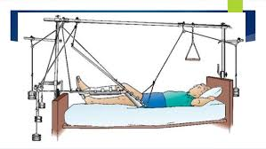
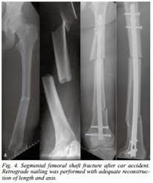
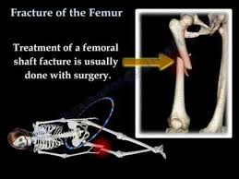
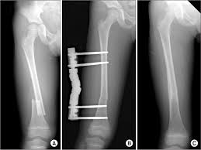
Treatment of femur fractures

Slide 27
Distal femur fracture
Gastrocnemius deforming forces
Tear of vein at hiatus canal
Extra articular
Partial intraarticular
Complete intra articular
Operative
Intra articular fractures intraoperative need anatomic reduction to restore anatomy and early mobilization

Slide 28
Special circumstances
Child abuse
Pathological fracture
Recurrent fracture

Slide 29
Paediatric pattern
Buckle (torus)
Plastic deformation
Green stick
Physeal injuries
Apophyseal avulsion

Slide 30
Properties of children bone
High resilience to stress
Thick periosteum
Enormous potential to remodel
Shorter healing times
Presence of growth plate
N/B: Avoid operation in children bones; pawlick harness used in infants

Slide 33
Salter harris

Slide 34
Physis injuries
Growth plate fractures often are treated non-surgical. Factors that influence treatment include the:
Severity, location and classification of the fracture.
Plane of deformity.
Patient age.
Growth potential of the affected plate.
The majority of type I and type II Salter-Harris fractures can be treated with closed reduction and casting or splinting.
To avoid additional damage, reduction often centers on traction and should be less than 6 hours.

Slide 35
Paediatric

Slide 36
Follow-up/Rehabilitation
Healing
Long term complication: OA, AVN, length discrepancy
Occupation and physical/psychological

