Slide 1
LOWER LIMB FRACTURES
PRAB and AISHA

Slide 2
PELVIC ANATOMY

Slide 3
BLOODSUPPLY

Slide 4
YOUNG AND BURGESS CLASSIFICATION

Slide 5
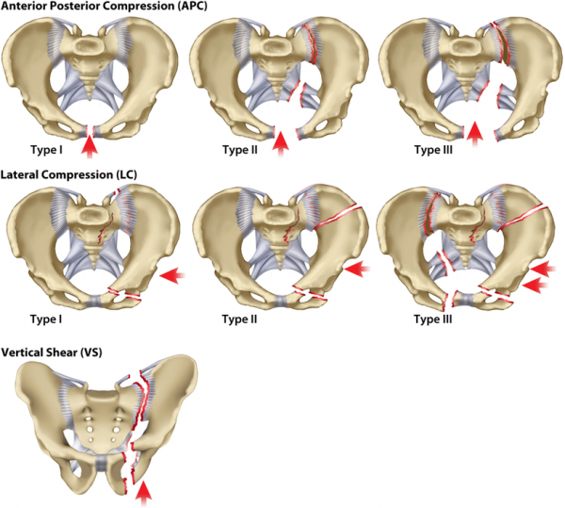

Slide 6
XRAY VIEWS
AP
LATERAL
INLET
OUTLET
OBLIQUE

Slide 7
MX
Airway with cervical spine control, Breathing, Circulation & haemorrhage control, Disability & Exposure
NO attempt should be made to pass a catheter, as this could convert a partial to a complete tear of the urethra. Instead, put a supra-pubic catheter if patient is unable to pass urine
Conservative -Early external fixation -Reduces haemorrhage & counteracts shock •
Definitive;
Isolated fractures & minimally displaced fractures -Bed rest + Lower limb traction. Heals within 4-6wks & the patient may be allowed up on crutches–
Open-book injuries;
APC-I-Bed rest + a posterior ring, elastic girdle or Hammock to help close the book
Others -External fixation
APC-II & VS -Skeletal traction + External fixator for 10wks
Open pelvic fractures -External fixation

Slide 8
TILES CLASSIFICATION- STABILITY

Slide 9
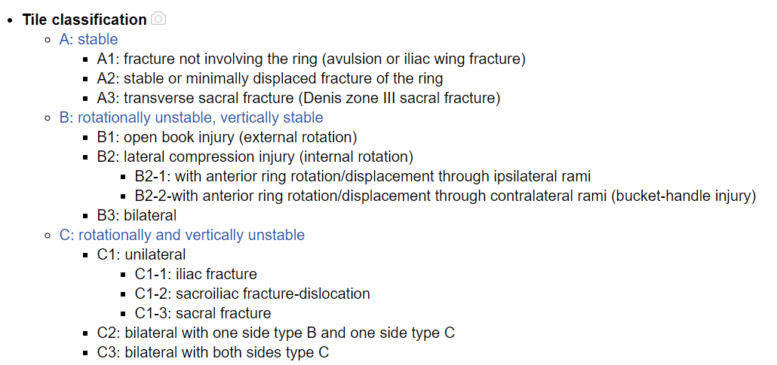

Slide 10
ACETABULUM ANATOMY

Slide 11
LETOURNEL CLASSIFICATION

Slide 12
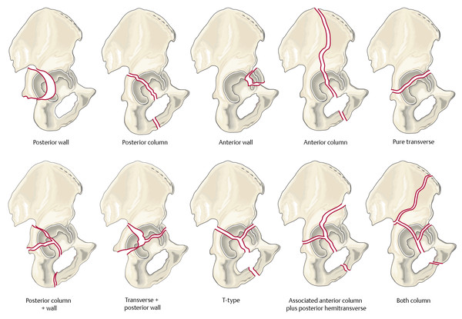

Slide 14
Read 10. Hip dislocation classnotes
https://drive.google.com/file/d/1ROFOjNGrUVCABaVtt3aCtLVU0DQ450dC/view?usp=sharing

Slide 15
HIP DISLOCATION

Slide 16
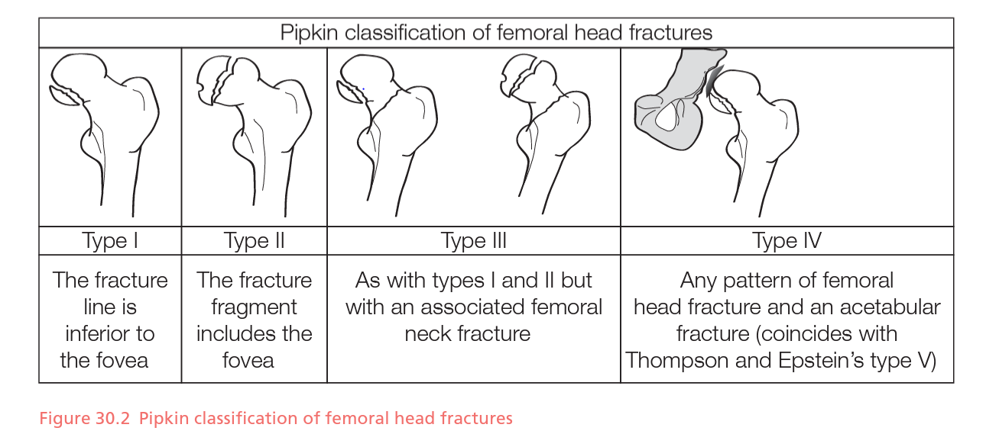
FEMORAL HEAD FRACTURES

Slide 17
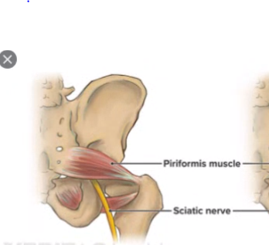
SCIATIC NERVE INJURY

Slide 18
FEMUR NECK FRACTURE- INTERTROCHANTERIC FRACTURES Anatomic Classification

Slide 19
GARDENS CLASSIFICATION FOR F.NECK

Slide 20
Pauwels Classification-f.neck

Slide 21
Poor Healing
The blood supply
No haematoma formation because intertrochanteric
Single periosteal layer

Slide 22
Extracapsular femoral neck fracture

Slide 23
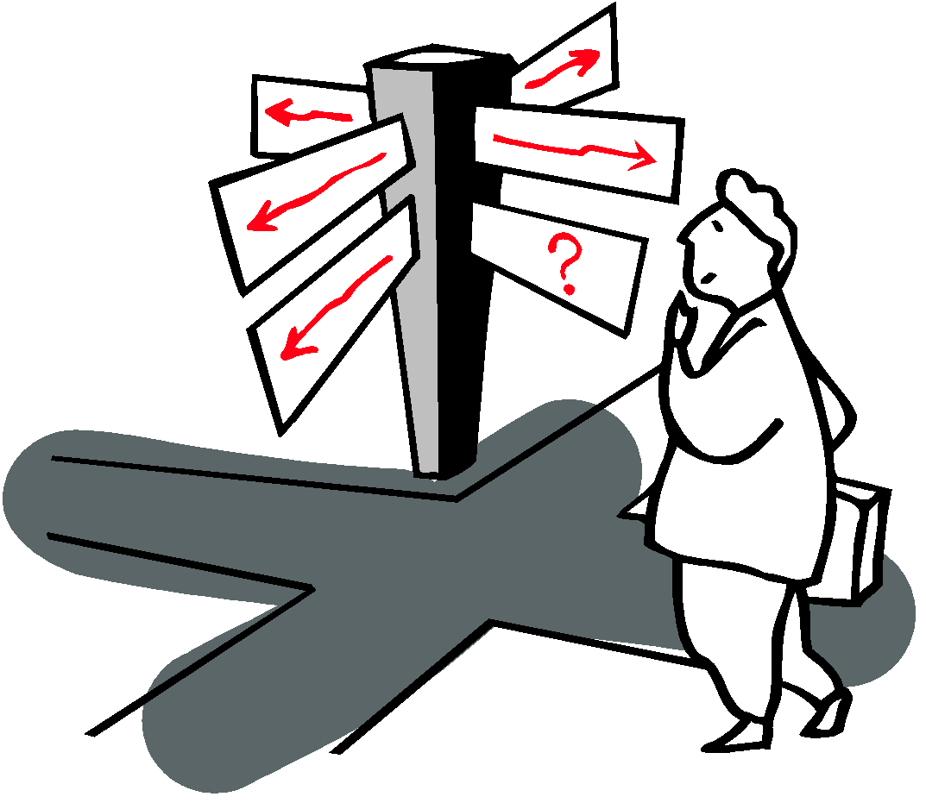
General considerations
Extracapsular fracture with better healing potential (large surface area, good blood supply and cancellous bones)
Age: 10 years older than femoral neck fracture
RISK FACTORS
Treatment principles
Early mobilization
Early surgery (24 to 72 hrs)
Walk within two weeks after surgery

Slide 24
Goals of Neck of femur # treatment
Geriatric
Mobilize early
Minimal surgical morbidity
Reduce chance of reoperation
Young
Spares femoral head
Avoid deformity (varus)
Avoid blood supply injury

Slide 25
Treatment options Proximal femur
Stable fractures:
Close reduction & DHS (Dynamic hip screw)
Unstable fractures:
Close reduction &nail
CRIF & percutaneous screw
Arthroplasty/ hemiarthroplasty

Slide 26
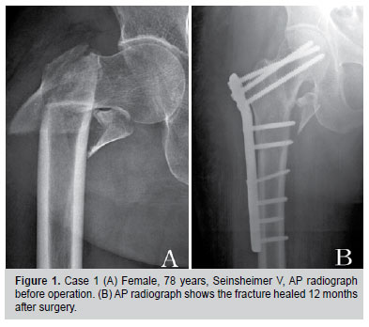
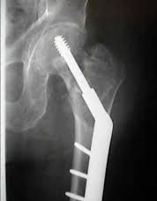
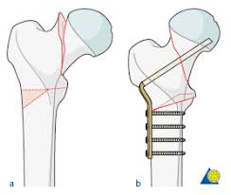
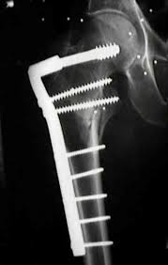
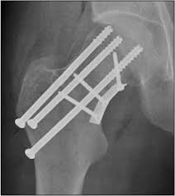
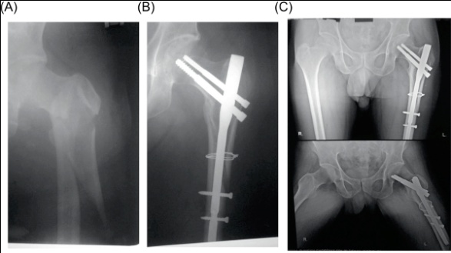
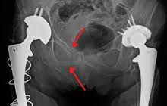
Proximal femur fixation

Slide 27
Sub-trochanteric fracture

Slide 28
Femur shaft fracture- AO classification

Slide 29
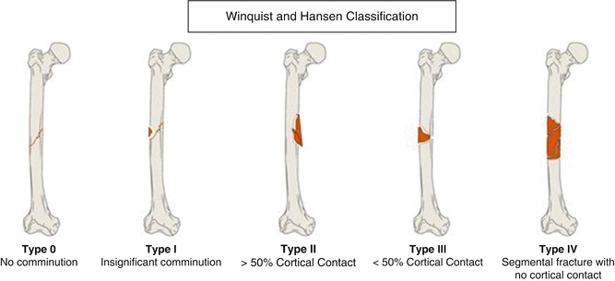

Slide 30
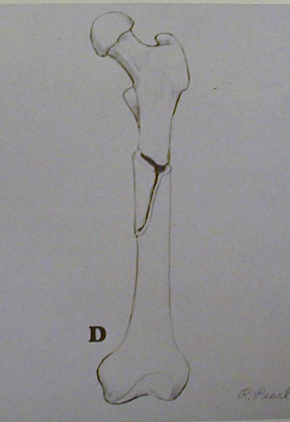
Diaphyseal Femur Fracture Classification
Type 0 - No comminution
Type 1 - Insignificant butterfly fragment with transverse or short oblique fracture
Type 2 - Large butterfly of less than 50% of the bony width, > 50% of cortex intact
Type 3 - Larger butterfly leaving less than 50% of the cortex in contact
Type 4 - Segmental comminution
Winquist and Hansen 66A, 1984
Axial and rotational stability
Notes:
‹#›

Slide 31
Femoral Shaft Fractures Definitive Management
Traction
No longer commonly employed
External fixation
Especially open and comminuted fractures
Intramedullary rods
Operation of choice for most fractures
Has been shown to decrease hospitalization and total disability

Slide 32
Non operative
Deforming muscular and gravity forces
Complications related to prolonged immobilization

Slide 33
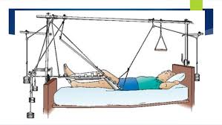
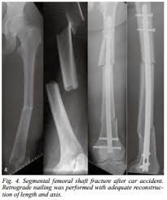
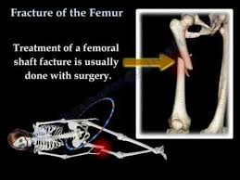
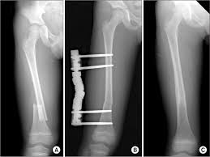
Treatment of femur fractures

Slide 34
Supracondylar Fractures
Mullers AO classification

Slide 36
Mechanism of Injury

Slide 37
Distal femur fracture
Gastrocnemius deforming forces
Tear of vein at hiatus canal
Extra articular
Partial intraarticular
Complete intra articular
Operative
Intra articular fractures intraoperative need anatomic reduction to restore anatomy and early mobilization

Slide 38
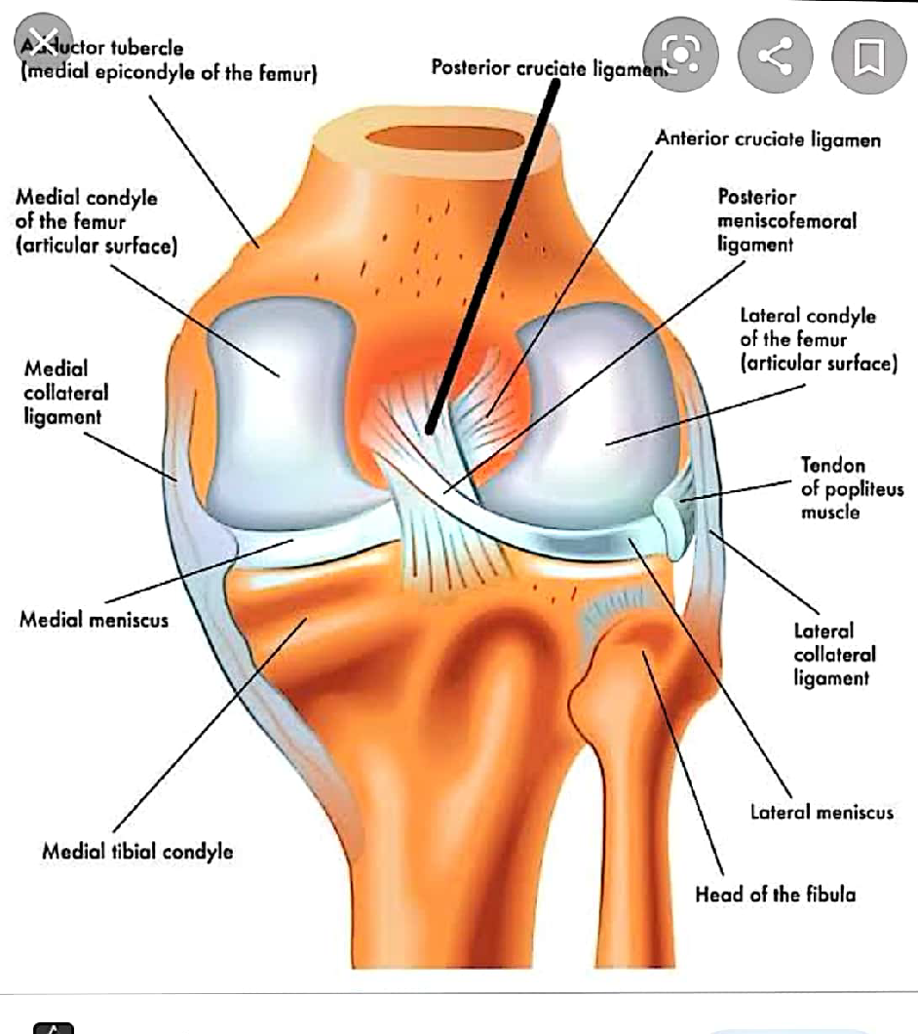
Knee Ligament Injury

Slide 39
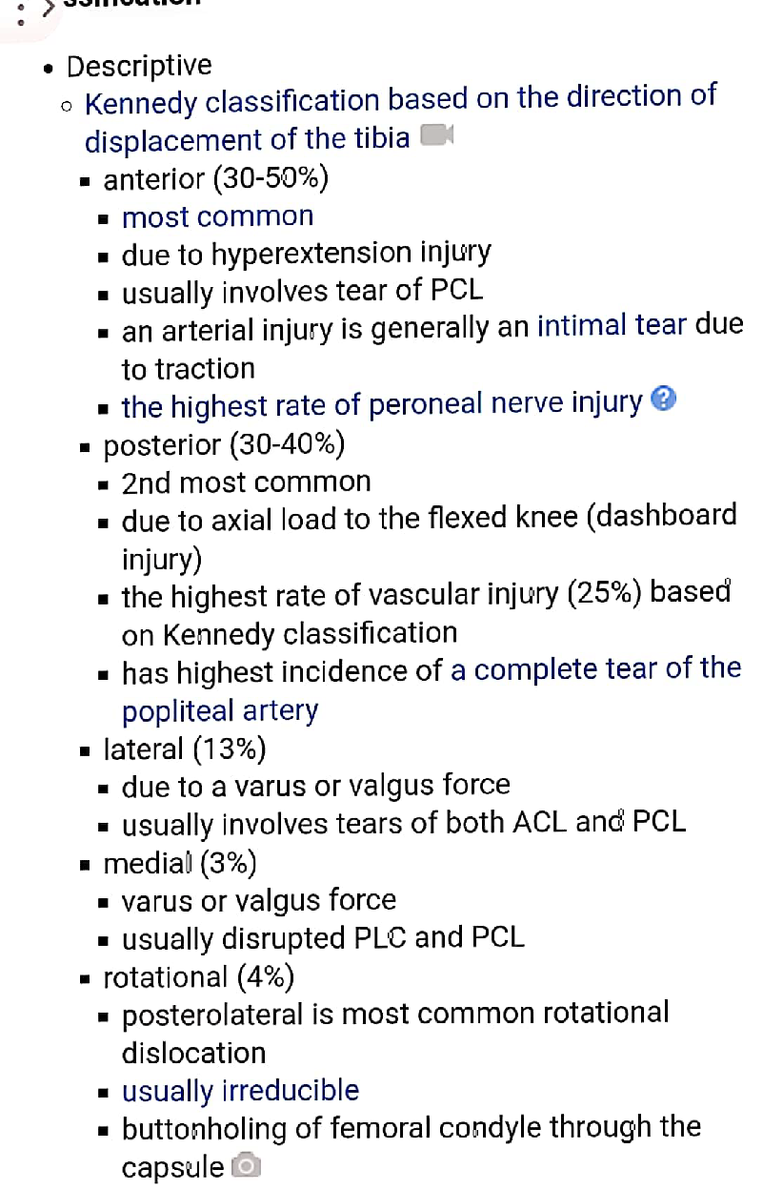
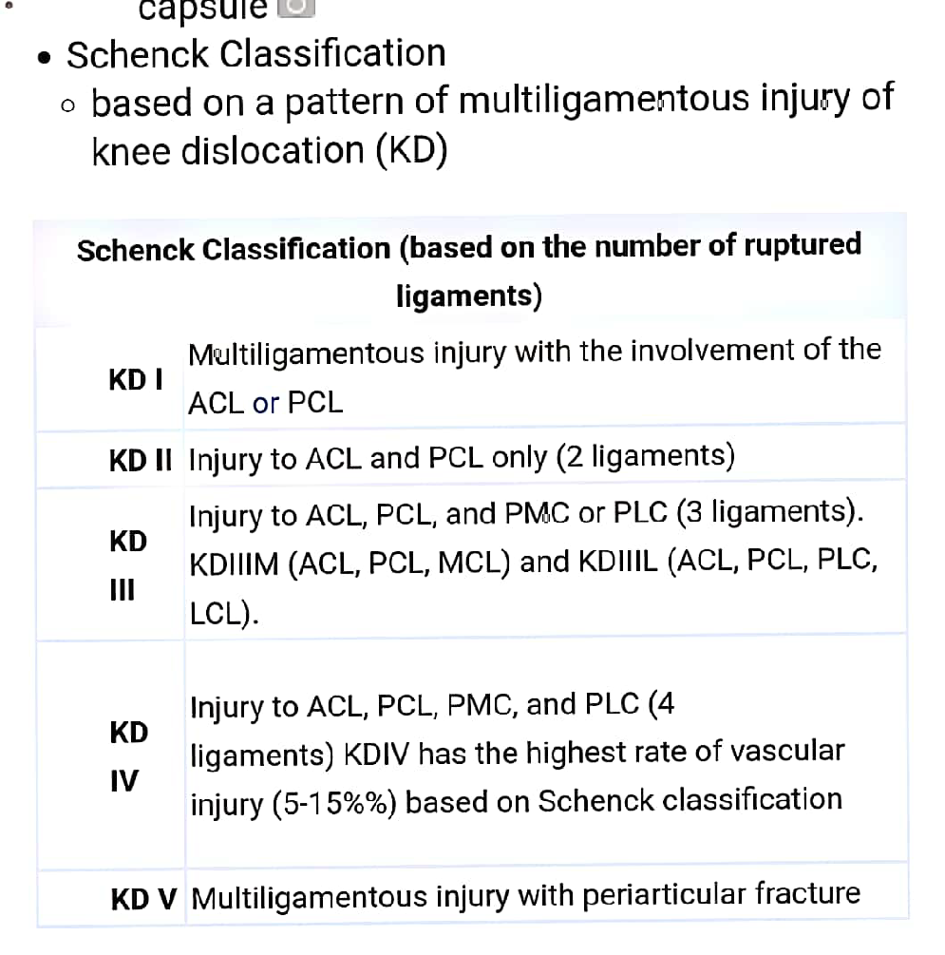

Slide 40
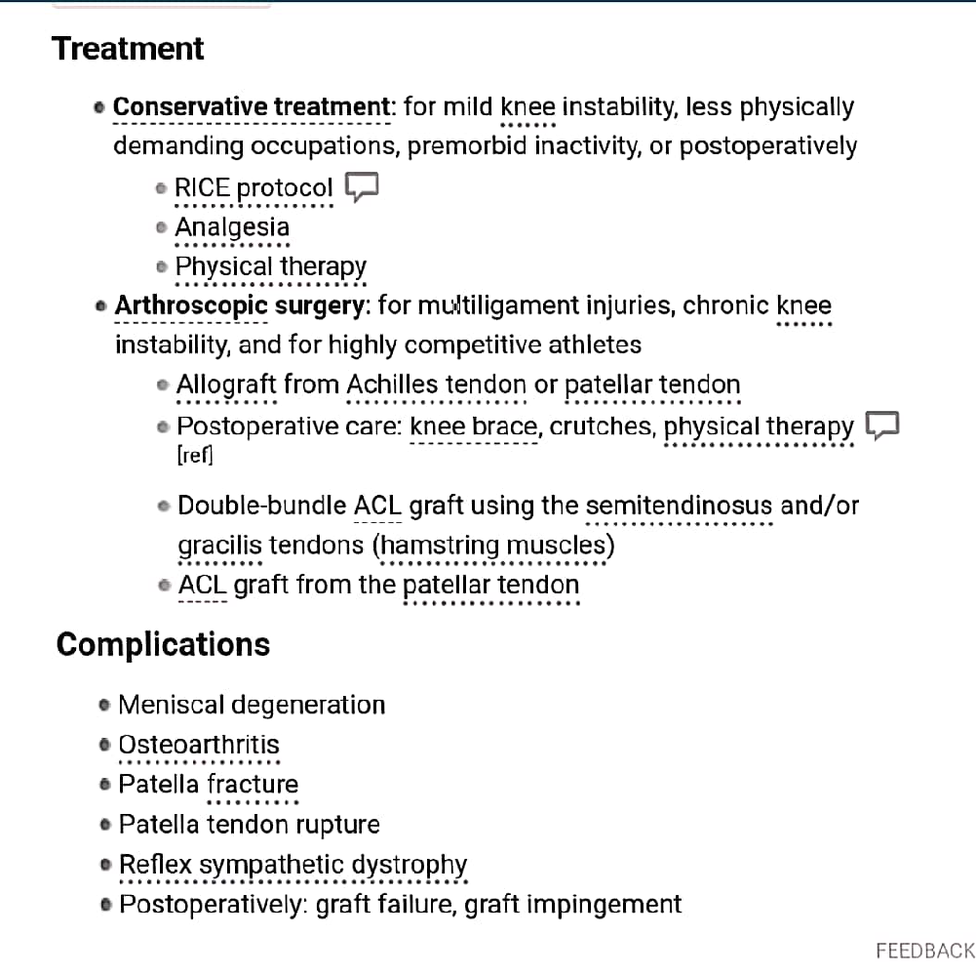

Slide 42
Read classnotes number 9 for tibia fractures
https://drive.google.com/file/d/1wztQeYc4zQB_TosB8mEqMMk3LUocyDhB/view?usp=sharing

Slide 43
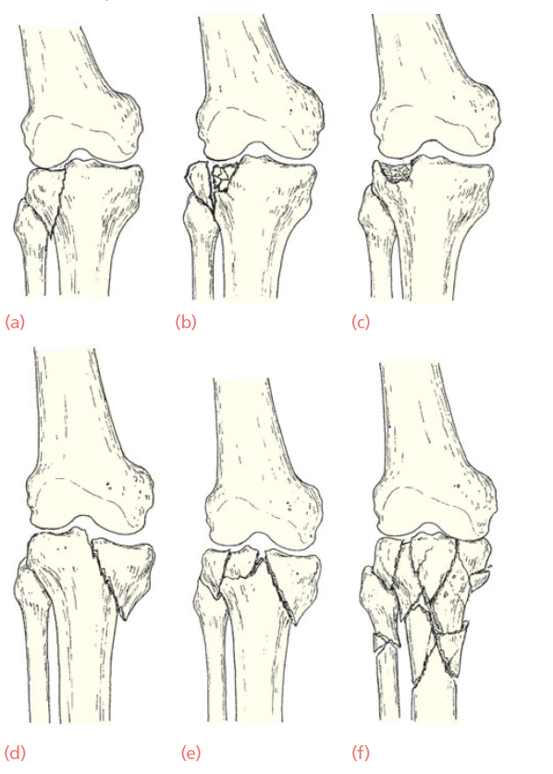

Slide 44
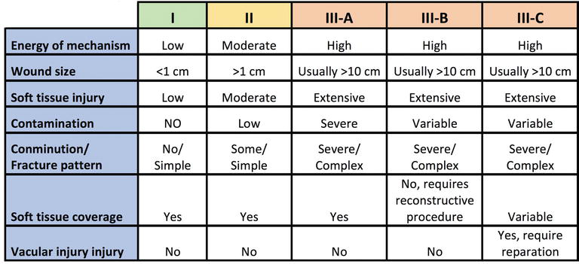

Slide 45
ruedi and allgower pilon fracture classification

Slide 46
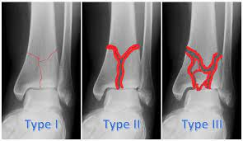

Slide 47
Salter Harris

Slide 48
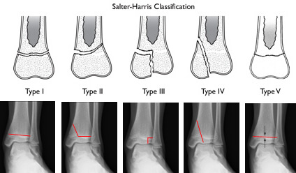

Slide 49
Physis injuries
Growth plate fractures often are treated non-surgical. Factors that influence treatment include the:
Severity, location and classification of the fracture.
Plane of deformity.
Patient age.
Growth potential of the affected plate.
The majority of type I and type II Salter-Harris fractures can be treated with closed reduction and casting or splinting.
To avoid additional damage, reduction often centers on traction and should be less than 6 hours.

Slide 50
Paediatric

Slide 51
Read ankle and foot class notes
https://drive.google.com/file/d/1iwguzTFhNn0I6BOaimoXbT7b-WF7Qzu-/view?usp=sharing

Slide 52
Danis and Weber- in relation to the fibula

Slide 53
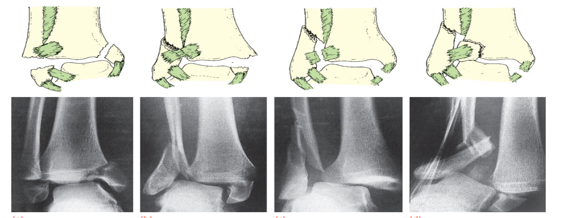

Slide 54
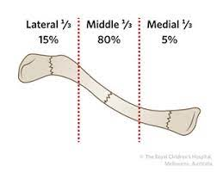

Slide 55
Add clavicle
Group 1 (middle one third of the clavicle)
is the most common type of fracture .
-represents 80 percent of clavicle fracture
-treated conservatively with an arm sling for comfort.
- Displaced fractures generally require operative treatment .

Slide 56
Group 2 (lateral one third of the clavicle)
-Nondisplaced fractures usually can be treated conservatively.
-Displaced fractures generally require operative treatment because they are unstable and have a high incidence of nonunion.

Slide 58
Group 3 fractures (medial one third of the clavicle).
-Displaced fractures have a fairly high rate of significant intrathoracic or neurovascular injury that may require emergency surgery.
-Nondisplaced fractures without associated injuries can be treated conservatively with a sling for comfort.

Slide 59
Surgery
- clavicle plate and screws
- K- wire

Slide 60
Complications of Fractured Clavicles:
Fractures of the medial & middle third of the clavicle have been associated with injuries to the neurovascular bundle.
Brachial plexus compression resulting from hypertrophic callus formation
Delayed union or nonunion
Poor cosmetic appearance
Post-traumatic arthritis

Slide 61
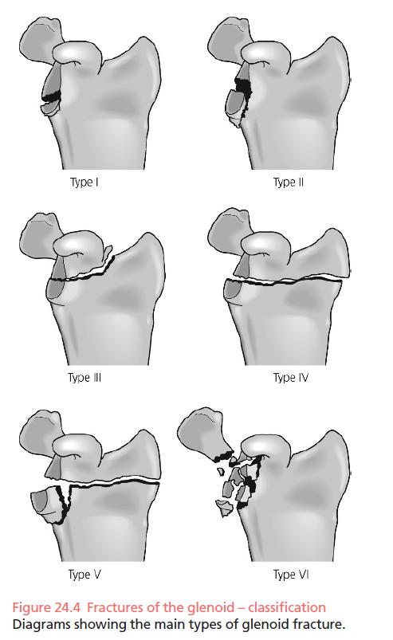
Fracture of Scapula

Slide 62
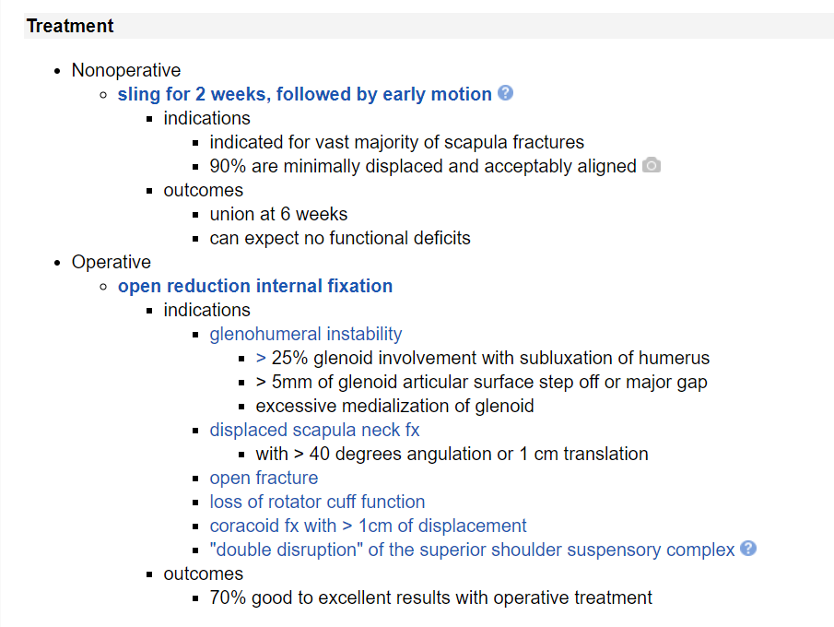

Slide 63
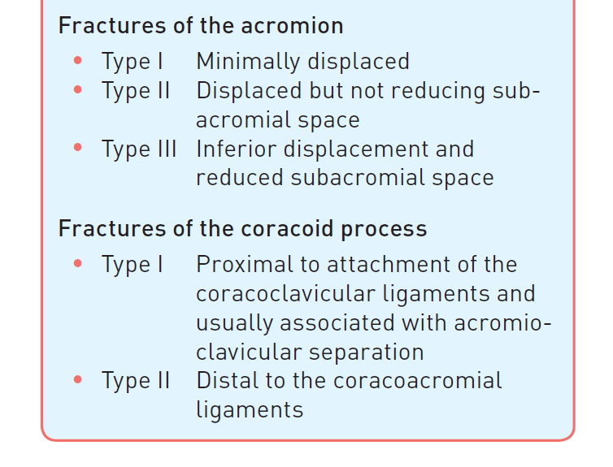

Slide 64
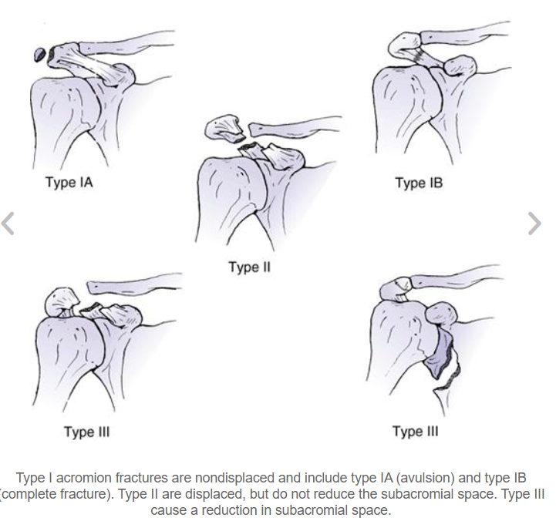

Slide 65
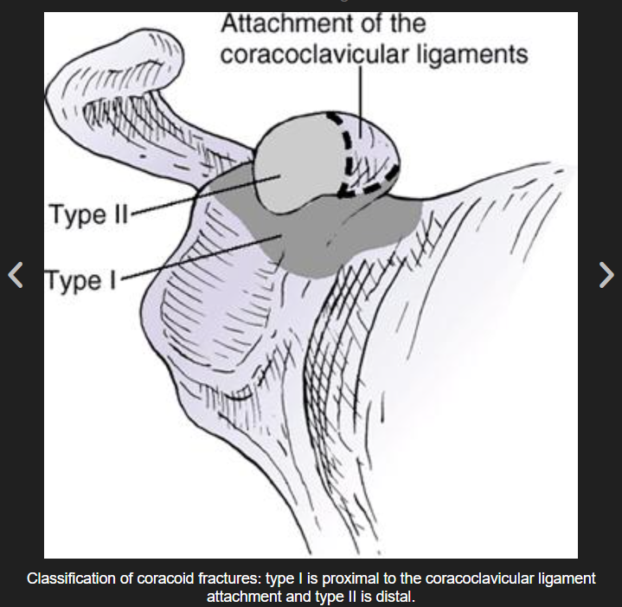

Slide 66
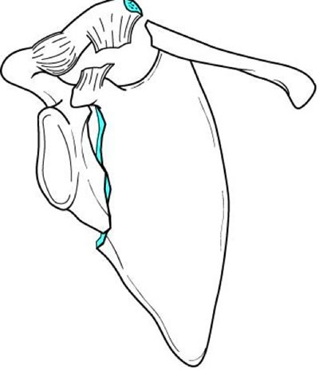
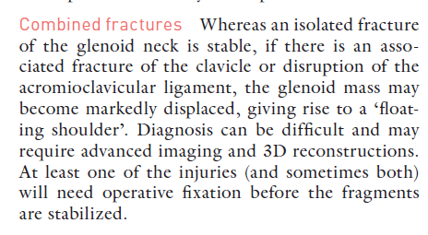
FLOATING SHOULDER

Slide 67
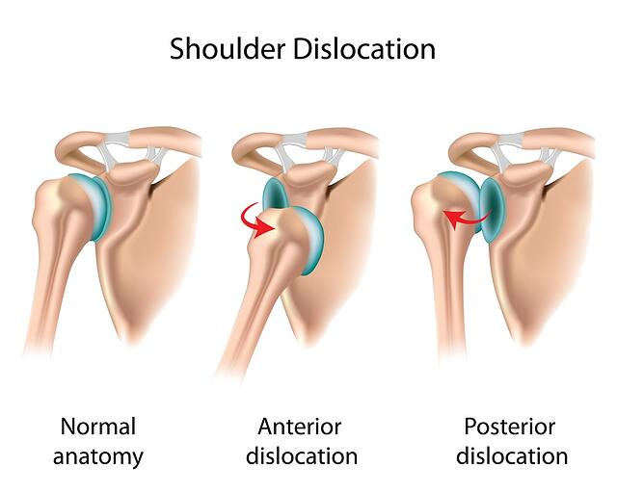

Slide 69
ANTERIOR DISLOCATION
POSTERIOR DISLOCATION

Slide 71
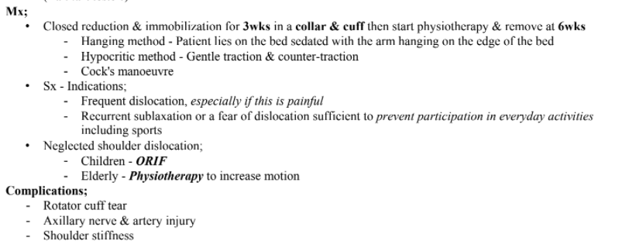

Slide 74
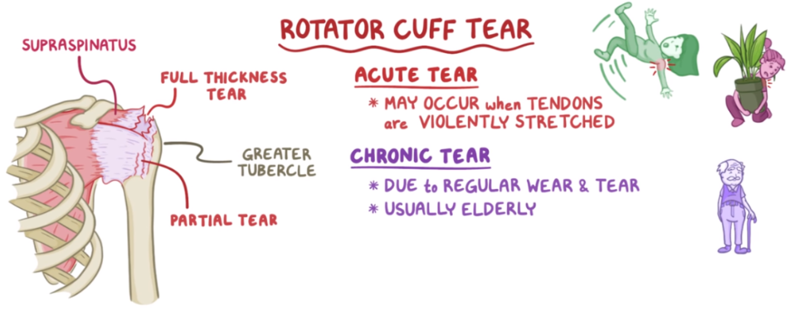

Slide 75
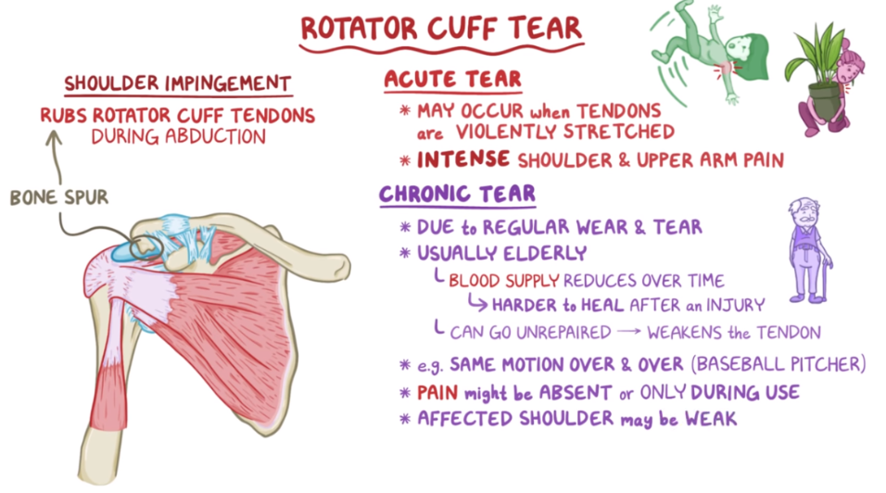

Slide 77
Some of the actions of the rotator cuff are: internal rotation
external rotation
abduction
A torn cuff may make the shoulder weak, and make daily activities more difficult. It is a common injury, particularly in people over 40 years old.
Tears may be partial or full thickness, and occur as the result of an injury, or occur as part of the degenerative process.

Slide 78
A complete or full thickness tear often occurs at or near the attachment of the tendon to the arm bone, or humerus and may cause significant disability, particularly in younger people.

Slide 79
Causes of a rotator cuff tear may be from a single incident, such as falling on ones arm or outstretched hand, or lifting something too heavy.
However, most tears are of the degenerative type, resulting from the tendons wearing down as the body ages.
A number of factors play a role in degenerative tears, including repetitive movements in sport or daily life such as overhead arm movements, such as in swimming, baseball, placing items on high shelves, painting and lifting.

Slide 80
Symptoms of a rotator cuff injury include pain and tenderness in the shoulder, pain on elevating the arm, weakness of the shoulder, and pain when sleeping on the affected side.
Pain from the tear may cause awakening at night.
Testing of the range of movement and strength of the shoulder, along with special directed tests, can help determine which of the muscles or tendons has been torn.
Sometimes rotator cuff tears can be without symptoms.

Slide 81
Risk factors for a rotator cuff injury include:
Being aged over 40.
Being an athlete who does repetitive overhead or lifting activities.
Working as a painter, carpenter or other tradesperson who performs repetitive overhead activities.

Slide 82
Investigations
MRI
Ultrasound

Slide 83
The mainstay of treatment includes treating the pain and restoring best possible function. This may include resting the shoulder from aggravating activities, taking anti-inflammatory medicines, and special exercises and physical therapy.
Corticosteroid injections with local anaesthetic are useful in some cases, if other conservative treatments have not helped.
Surgery may be needed in patients who have a large or full thickness tear, particularly if they are young, or for long term symptoms or significant weakness and poor function.

Slide 84
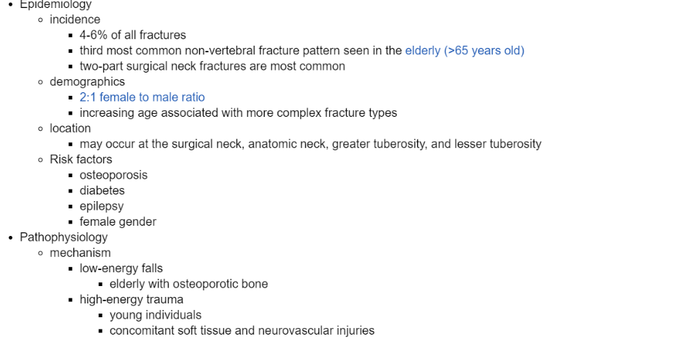
PROXIMAL HUMERUS FRACTURES

Slide 86
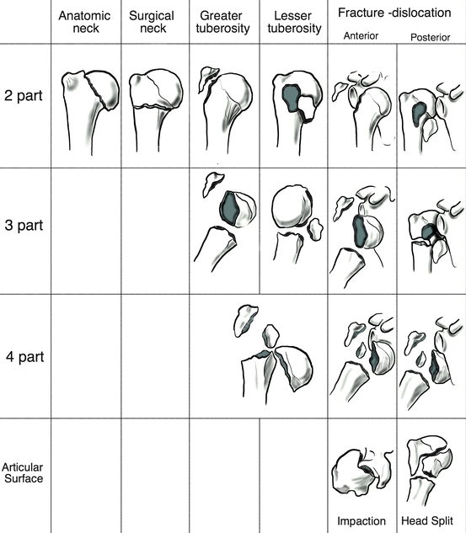

Slide 87
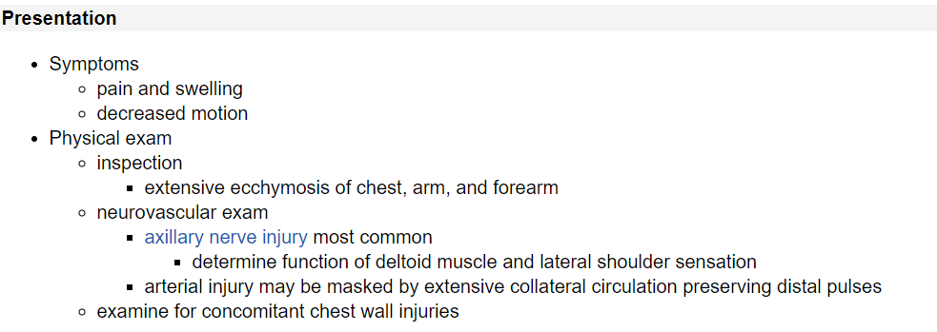
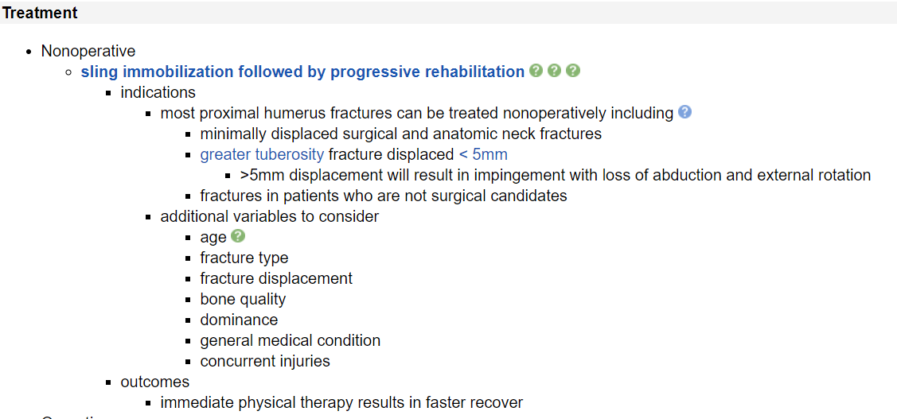

Slide 88
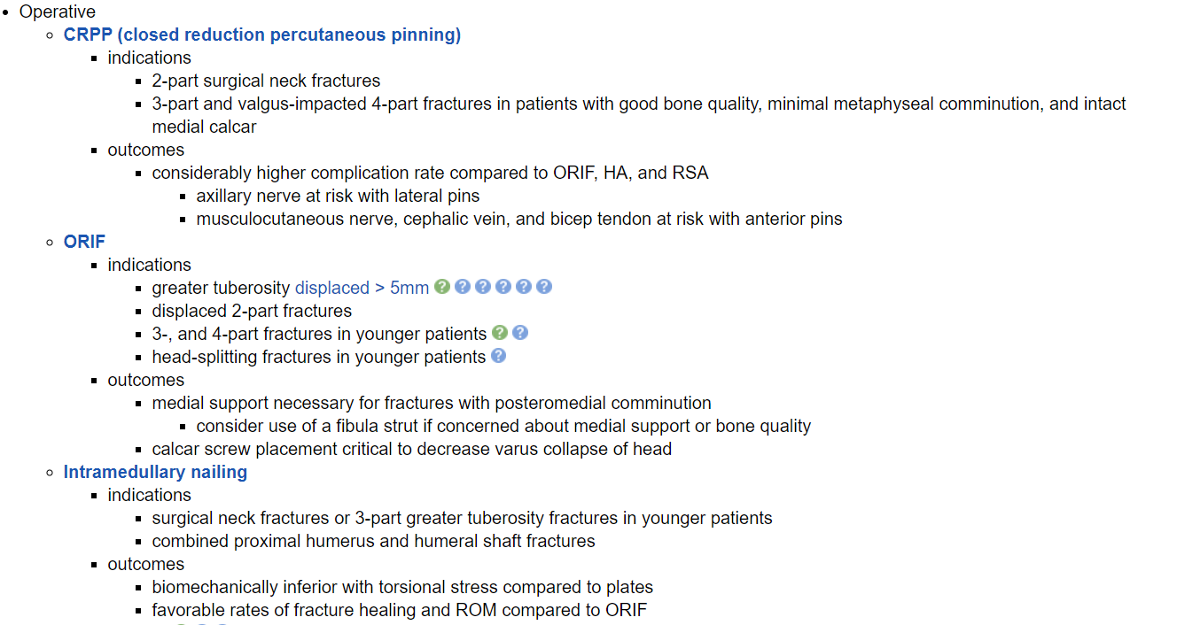

Slide 89
Up to 85% of proximal humeral fractures can be treated non-operatively. This involves the use of a sling or a shoulder immobiliser.
If displaced, surgery may be needed.
Surgery involves either closed reduction with percutaneous fixation, open reduction and internal fixation, or proximal humeral head replacement.

Slide 90
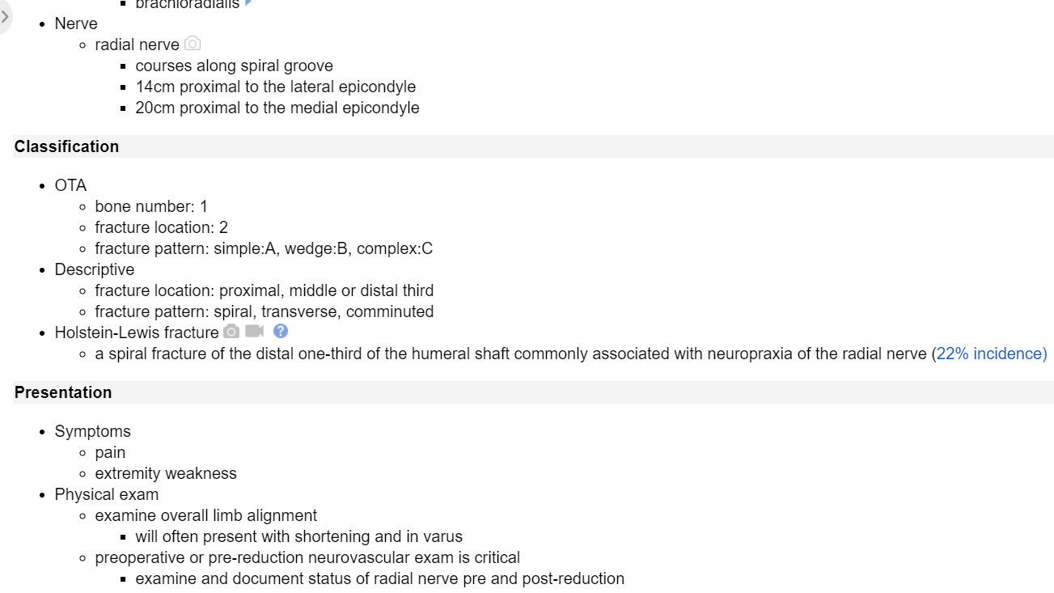
HUMERUS SHAFT FRACTURES

Slide 91
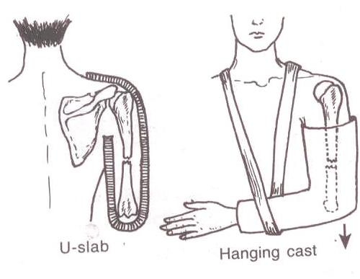
Most can be treated non-operatively in a
-hanging arm cast
-u-slab
coaptation splint
followed by a functional arm brace after 3 weeks.

Slide 92
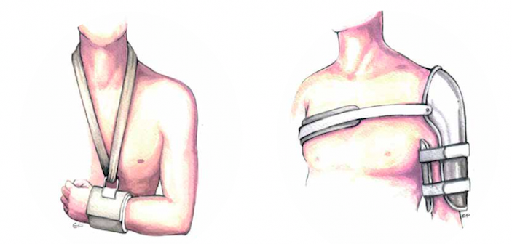
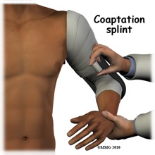

Slide 93
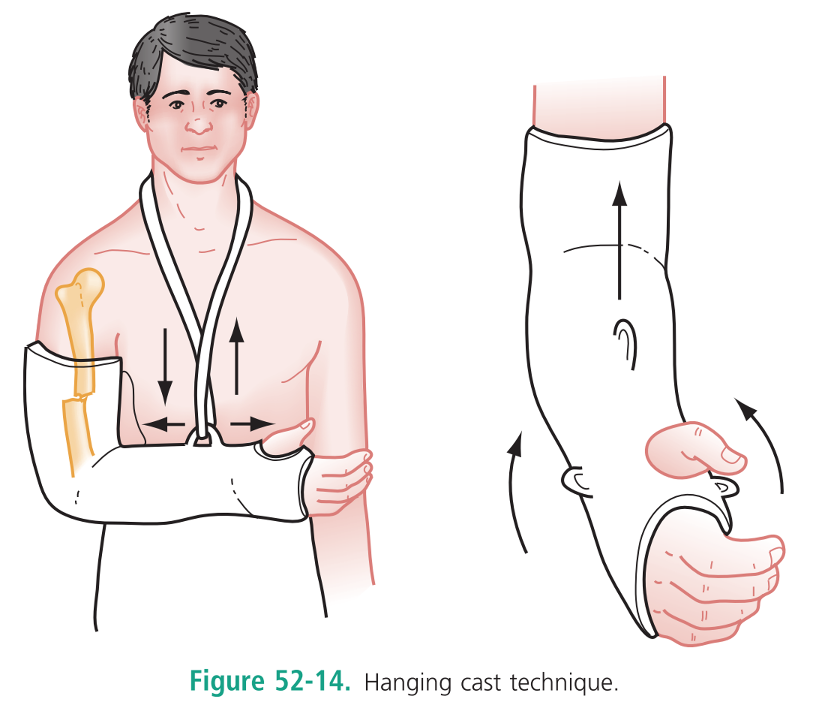

Slide 94
Mildly displaced/overlapping humeral shaft fractures may be treated by closed reduction and long arm splint from shoulder to wrist.
After any humeral closed reduction, neurovascular assessment and X-rays should be repeated.
Surgical fixation may be needed if the fracture is segmental or if there is vascular compromise. This involves open reduction and the use of plates and screws or intramedullary fixation/nailing.
Radial nerve injury, which may only be temporary, is a risk in any operative procedure.

Slide 95
Distal humerous-Most are intra-articular- ORIF
Scapular fractures
- Body-Direct blow – conservative treatment
- Glenoid surface- intra-articular- ORIF

Slide 122
Olecranon fractures- varieties- displaced triceps- t1 back slab or circular cast, unstable plus comminution
Proximal radius head fracture
Radial neck fracture t3 and t4 salter harris
Isolated radius and ulna fracture

