Slide 1
BIOFEEDBACK
BY RA OKOTH
DEPT OF PSYCHIATRY
UON //2019

Slide 2
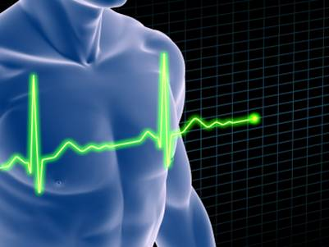
 | What is Biofeedback?

Slide 3
What is Biofeedback?
BASIC: Biofeedback is a technique that enables an individual to learn how to change maladaptive physiological activity and correct dysfunctional Autonomic Nervous System (ANS) activity
SCIENTIFIC: Biofeedback instruments are used to “feed back” information about physiological processes, assisting the individual to increase awareness of these processes and to gain voluntary control over body and mind.
HOLISTIC: Biofeedback is based on the recognition that changes in the mind and emotions affect the body, and changes in the body influence the mind and emotions.
RESILIENCE: Biofeedback emphasizes training individuals to self-regulate, gain awareness, increase control over their bodies, brains, and nervous systems, and improve flexibility in physiologic responding.
Notes:
Include this slide to appeal to any medical or scientific discipline

Slide 4
Historical Perspective
Biofeedback is a technique that gained popularity in the late 1960s
Most people’s exposure to biofeedback is from polygraph tests ……..

Slide 5
Benefits of Biofeedback
Psychologic
Skilled at Self-Regulation, Self-Soothing, Relaxation
Resilient to Effects of Stress
Improved Mood Stability
Able to Adjust Pain Perception

Slide 6
Benefits of Biofeedback
Physiologic
Recovery from Stress Response
Brain-Heart-Breath Entrainment
SNS and PNS Regulation
Pain Modulation
Notes:
And here are just some of the Physiological benefits you can expect. [READ SLIDE]

Slide 7
Overview of Biofeedback Modalities
Modality | Description
Brainwave (EEG) | Uses scalp sensors to monitor the brain’s electrical activity using (EEG) sensors
Breathing | Uses bands placed around the abdomen/chest to monitor breathing pattern and pace and calculate resonant breathing frequency.
Heart Rate Variability (HRV) | Uses a finger/earlobe sensor to measure heart rate and calculate heart rate variability and coherence.
Muscle (EMG) | Uses sensors placed over skeletal muscles to monitor the electrical activity that causes skeletal muscle contraction.
Sweat Gland (GSR) | Uses sensors placed around the fingers to monitor changes in skin moisture produced by sweat glands.
Temperature | Uses a finger sensor to measure changes in blood flow controlled by dialating and constricting blood vessels.
Source: BCIA
Notes:
Purpose of this slide is to demonstrate the wide range of approaches encompassed by the discipline of Biofeedback.

Slide 8
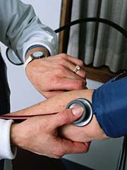
Major types of biofeedback
Temperature biofeedback is used to treat headache, high blood pressure, Raynaud’s disease, and swelling.

Slide 9
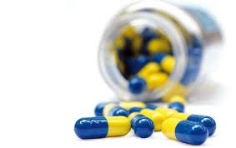
Biofeedback gives you exciting choices
Biofeedback provides you with the opportunity to take control of your health and to choose skills instead of MEDICATION.

Slide 10
Biofeedback
Biofeedback is a process of gathering information about specific physiological functions such as:
heart rate
respiration
body temperature

Slide 11
Clinical Biofeedback
Clinical biofeedback is the use of monitoring instruments to amplify the electrochemical energy produced by various body organs.

Slide 12
Clinical Biofeedback (continued)
Clinical biofeedback allows a person to increase awareness of his or her own physiological responses by learning to monitor them through data gathered by a particular instrument.

Slide 13
Clinical Biofeedback (continued)
The purpose of biofeedback is to teach people with stress-related disorders to recondition their responses so that they gain control over the physiological system responsible for their symptoms.

Slide 14
The Biofeedback Loop
Sensors
Detection,
Amplification
Signal
conditioning
Person
Program
logic
Recording
Feedback
Feedback
signal
processing
Auditory - variety of sounds
Visual - numbers, meters, lights

Slide 15
Biofeedback
Biofeedback teaches people how to monitor and change the frequency and amplitude of the electronic signals by controlling (relaxing) the body region to which the electrodes are attached. The three phases of biofeedback are:
Awareness of physiological response
Control of physiological response
Application of reconditioned response in everyday routines

Slide 16
Clinical Biofeedback
Clinical biofeedback, to strengthen the conditioned response, combines sophisticated technology and various other forms of relaxation, including:
diaphragmatic breathing
autogenic training
progressive muscular relaxation
mental imagery

Slide 17
Clinical Biofeedback (continued)
There are several types of clinical biofeedback, each monitoring a specific physiological system; these are:
electromyography (EMG)
electroencephalography (EEG)
electrocardiography (EKG)
electro dermal (EDR)

Slide 18
Best Application of Biofeedback
To learn to reduce chronic pain of:
Headaches
Stomach cramp
Colitis
Back pain
Raynaud’s disease
Insomnia

Slide 19
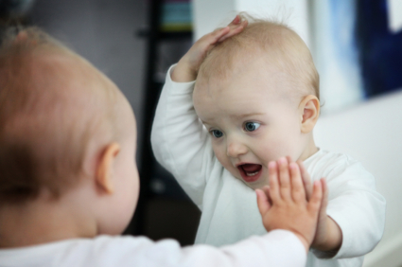
Biofeedback is information
Biofeedback displays your performance back to you.

Slide 20
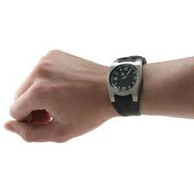
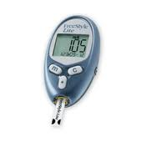
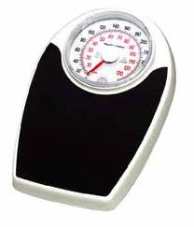
Biofeedback is information
You probably use biofeedback every day without recognizing it.

Slide 21
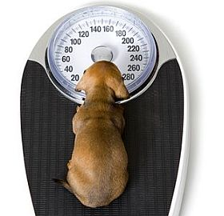
Biofeedback is information
You receive weight biofeedback whenever you step on a bathroom scale.

Slide 22
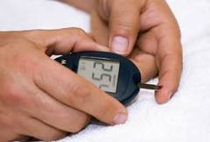
Biofeedback is information
If you are diabetic, you receive blood sugar biofeedback after pricking your finger.

Slide 23
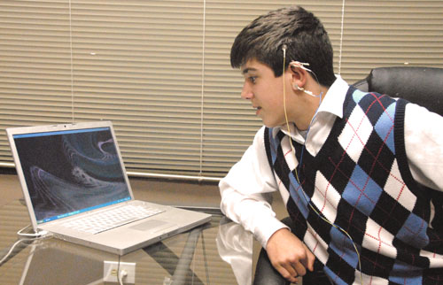
Biofeedback is information
Professionals use sophisticated devices called electroencephalographs to treat Attention Deficit Hyperactivity Disorder (ADHD) and addictive disorders.

Slide 24
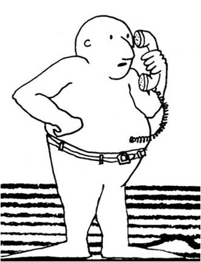
Biofeedback is information
Biofeedback provides you with information about your performance to increase your awareness and control over your own body.
© 1979 by Erik Peper

Slide 25
Major types of biofeedback
Six major types of biofeedback include:
Heart rate variability (HRV) biofeedback
Muscle biofeedback
Neurofeedback
Respiratory biofeedback
Sweat gland biofeedback
Temperature biofeedback

Slide 26
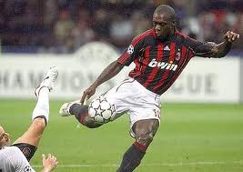
Major types of biofeedback
Professionals use these tools to treat medical and psychological disorders, and to train athletes and musicians to achieve optimal performance.

Slide 27
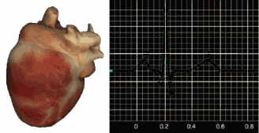
Major types of biofeedback
Heart rate variability (HRV) biofeedback uses sensors placed on a finger or earlobe, or on your chest and lower torso, or wrists to measure the time interval between each heartbeat.

Slide 28
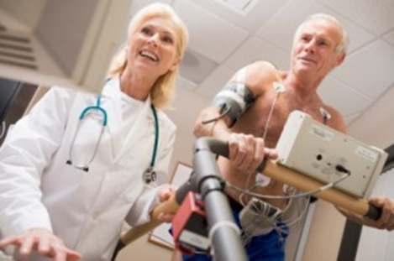
Major types of biofeedback
HRV biofeedback is used to treat anxiety, asthma, heart disease, depression, high blood pressure, irritable bowel disorder, Posttraumatic Stress Disorder (PTSD), and unexplained abdominal pain.

Slide 29
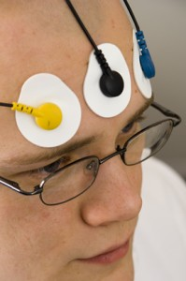
Major types of biofeedback
Muscle (or EMG) biofeedback uses sensors placed over skeletal muscles to monitor the electrical activity that causes muscle contraction.

Slide 30
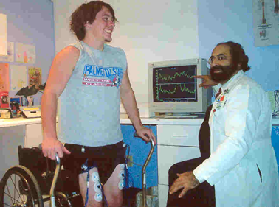
Major types of biofeedback
Muscle biofeedback is used to treat disorders as diverse as anxiety, asthma, cerebral palsy, headache, high blood pressure, low back pain, spinal cord injury, and stroke.

Slide 31
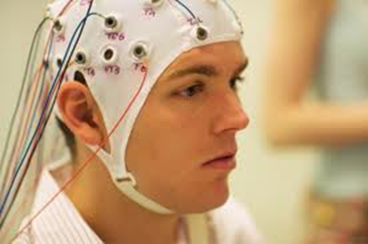
Major types of biofeedback
Neurofeedback (EEG biofeedback) uses scalp sensors to monitor the brain’s electrical activity.

Slide 32
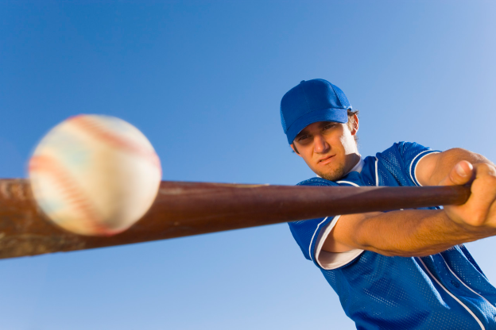
Major types of biofeedback
Neurofeedback is used to treat ADHD, alcoholism and abuse of other substances, epilepsy, migraines, PTSD, and traumatic brain injury.

Slide 33
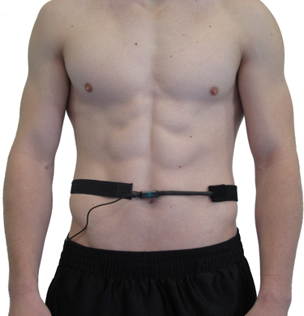
Major types of biofeedback
Respiratory biofeedback uses sensor placed around the abdomen and chest to monitor breathing patterns and respiration rate.

Slide 34
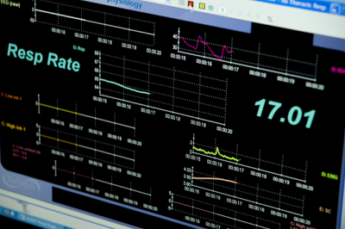
Major types of biofeedback
Respiratory biofeedback is used to treat anxiety, asthma, chronic obstructive pulmonary disease (COPD), hyperventilation syndrome (HVS), and high blood pressure.

Slide 35
Major types of biofeedback
Sweat gland biofeedback uses sensors placed on the fingers or palms to monitor changes in skin moisture produced by sweating.

Slide 36
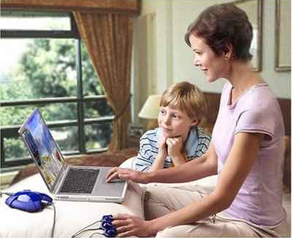
Major types of biofeedback
Sweat gland biofeedback is used to treat excessive sweating (called hyperhidrosis) and high blood pressure, and to teach relaxation.

Slide 37
Study Guide Questions
1. Explain the rationale for biofeedback as an effective relaxation technique.
2. Explain three different types of biofeedback.
3. List five health conditions that could possibly be improved with the use of biofeedback.

Slide 38
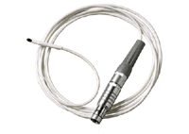
Major types of biofeedback
Finally, temperature biofeedback uses sensors placed on the hands or feet to measure blood flow to the skin.

Slide 39
Study Results in the Literature
Reduces blood pressure in hypertension (McCraty, 2001)
Improves asthma (Lehrer, 2000)
Increases calmness and well-being (Friedman, 2000)
Increases emotional stability (McCraty, 2001)
Improves cognitive performance (McCraty, 2001)
Improves hormonal balance (McCraty, 1998)

