Slide 1
Gender Based Sexual Violence And Management
Level VI
Dr. Muthoni Mathai

Slide 2


Slide 3
Objectives of this lecture
By the end of this lecture Student should be able to:
Define gender based sexual violence (SGBV)
Describe the magnitude of the problem
Discuss the socio-cultural factors associated with SGBV
Describe the impact of SGBV on Mental health
Describe Sexual violence/defilement in children
Discuss the concept of “one stop centers” in the management of Sexual Violence
Outline the management of sexual violence
Outline the steps in the collection of forensic evidence in cases of SV

Slide 4
Gender Based Sexual violence-and GBV Introduction I
GBSV/ sGBV is one component of GBV
What is – gender?
the term "gender" is used to refer to the social and cultural constructions of masculinities and femininities. It does not refer to biological difference, but rather cultural difference.

Slide 5
Gender Based violence- Introduction II
What acts of violence are referred to under GBV
Physical and emotional violence based on gender of victim
Domestic violence
Sexual violence
Cultural violence like Female Genital Cutting

Slide 6
Sexual violence
WHO def: „any sexual act, attempt to obtain a sexual act, unwanted sexual comments or advances or acts to traffic women‘s sexuality using coercion, threats of harm or physical force, by any person regardless of relationship to victim, in any setting including but not limited to home and work“
Sexual abuse refers to a range of sexual activities - non consensual between adults or consensual when a minor is involved.

Slide 7
Prevalence of GBV- sexual violence
On average it has been estimated that out of every 10 women born in a country 4 will be raped during their life time
Police statistics indicate a rape case every 26 minutes- 58 per day in Kenya
Increase in conflict situations: Humanitarian groups reported between 1000-1500 cases of sexual violence during the post election Violence 2007

Slide 8
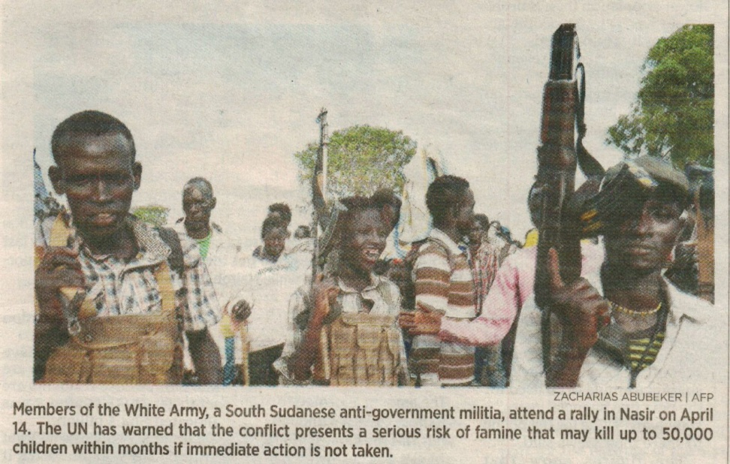
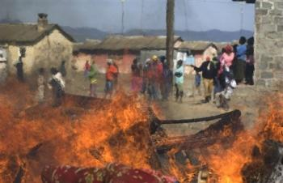
Sexual violence in armed conflict
“Sexual violence in warfare is among the darkest legacies of the 20th century, and it continues to ravage societies in the new millennium”. Leatherman 2012, pg 2

Slide 9
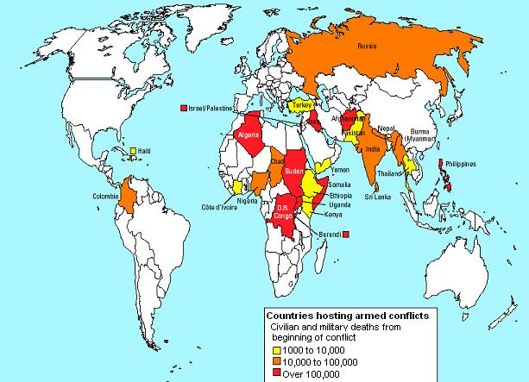
It is estimated that more than 150 million women and girls and 73 million boys experience sexual violence every year (WHO 2002).
Systematically organized rape as a weapon of war is as old as history
The arc of instability

Slide 10

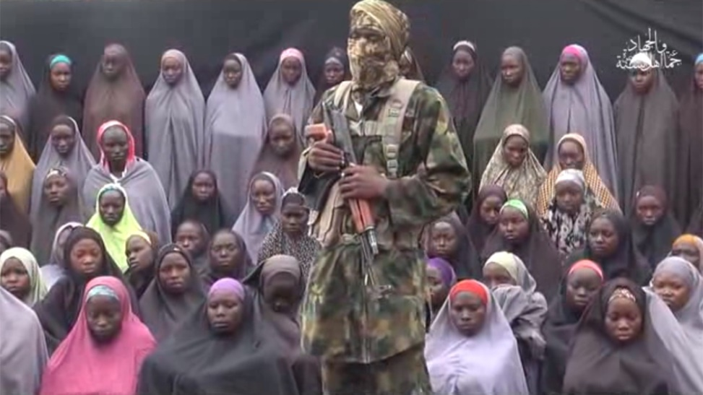
Atrocities against women’s bodies
The horror stories!
Rape and gang rape
Sexual humiliation and mutilation
Forced Incest
Forced prostitution and sexual enslavement
Kidnap and Forced marriages
Violent abortion of fetuses in pregnant victims
Forced pregnancy.
Deliberate infection with STIs and HIV

Slide 11
Gender Based violence- Introduction III
The rape of women is not about sexual pleasure
The rape of women is about the exercise of power and control
Acts of violence in most cultures are perpetrated against women by men by virtue of the female gender being:
Weaker physical strength
Low status in society
Lack of resources
Dependency
Socio-cultural norms

Slide 12
Sexual Offences Act
SOA of 2006 includes:
Includes 12 forms of sexual violence

Slide 13
Sexual Offences Act
SOA of 2006 includes:
Rape-penetration with his/her genital organs-No consent or consent obtained through force
Attempted rape
Sexual assault
Induced indecent acts- contact with private parts/ use of objects, bestiality

Slide 14
Sexual Offences Act cont
Defilement- Penetration with child
Pornography- manufacture/distributes/supplies/display
Child trafficking
Sex tourism
Child prostitution
Prostitution of persons with mental disabilities
Incest
Sexual harassment- Unwelcome Sexual advances

Slide 15
Psychological effects of sexual abuse
Include:
Anxiety disorders - any and particularly: Acute stress disorder and PTSD
Somatoform disorders/somatic syndrome disorders
Dissociative disorders
Depression
Substance abuse
Can provoke the onset or relapse of psychotic disorders

Slide 16
Rape and PTSD
Rape has been found to be the most adverse single event in the causation of PTSD (also referred to as rape trauma syndrome)- leading to PTSD in about half of the survivors.

Slide 17
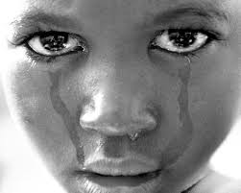
Sexual abuse in children
Defined:- Sexual behavior between a child and an adult
Between 2 children when one of them is significantly older and/or uses coercion
In the SOA referred to as defilement

Slide 18
Child sexual abuse- cont.
Child sexual abuse is usually associated with high levels of both physical and psychological damage
Psychological sequalae are worsened by the inability of the child to relate the event or the inatentiveness of important others
The trauma of abuse in children may result in permanent neurobiological damage of the brain
Most children are abused by known and even trusted people
Most children are repeatedly abused

Slide 19
Common psycholgical sequalae include:
Inability to trust
Depression
Anger
Guilt
Fear
Damaged good syndrome
Decreased Self esteem
Blurred boundaries and role confusion
Pseudo maturity/precocious sex behavior
PTSD

Slide 20
PART II:
Management of Gender Based Sexual violence
The management of gender based violence particularly rape should follow a multidisciplinary and multisectoral approach
It is therefore important that health workers and others in the first line of contact be well trained in different aspects of management
The trend now is towards setting up‚ one-stop centres‘ at all levels of health care

Slide 21
One stop centres
The concept of one-stop centres tries to incoorporate all post rape care services under one roof
These include:
Gynecological
Psycho-social
Surgical
Paediatric
Laboratory
Law enforcement and Legal

Slide 22
Presentation of cases
Acute
A few days later
Sometimes months or years
Acute presenting picture may vary from calm to shock, tearful, mute to severely agitated
Some calm presenting clients may develop severe psychiatric problems later

Slide 23
Emergency treatment
Physical examination and repair of any damaged tissues
Emergency prophylaxis – PEP, ECP, STIp, Analgesics
Post rape trauma counselling/crisis intervention

Slide 24
Collection of forensic evidence
Patient should not wash before examination and Collection specimens
Special PR kit should be used- if not present improvise- do NOT use Plastic bags to store specimens (paper/karatasi bags)
Include- perineal/vaginal/anal/oral swabs, pubic hairs (combed through), clothes (underwear)
Post Rape Care form 2/P3 be very specific, detailed and precise
Material should be handed over to a law enforcement agent who should sign for it

Slide 25
Psychiatric management
Psychiatric management includes treatment at contact and follow-up
Pharmacotherapy
Psychotherapy
Sociotherapy

Slide 26
Pharmacotherapy
Sedatives - short term or if needed for longer periods low doses of Major tranquilizers
Anti depressants: Selective serotonin reuptake inhibitors (SSRIs) or Tricyclic antidepressants
Mood stabilizers like the anticonvulsants

Slide 27
Psychotherapy
Can be individual, group or family or a combination of all three.
Psychological First Aid (PSA) = Crisis intervention with support, education and development of coping mechanisms - relaxation exercises.
Trauma focussed based CBT - follow-up.
Personal therapy.
NOTE: Debriefing has been found to result in retraumatisation.

Slide 28
Sociotherapy
One of the challenges in management include protection of survivors by providing safe refuge.
This is particularly important in children where the perpetrators are family members or primary care givers.

Slide 29
Role of MH workers in Prevention
Early diagnosis and treatment of survivors.
Treatment of psychiatric disorders.
Education - community, schools, parents.
Creating environments that ensure the safety of women and children at home, work/school and during conflicts and migration.
Laws - both local and international.

Slide 30
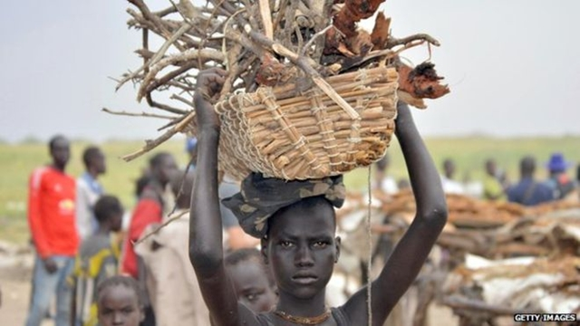
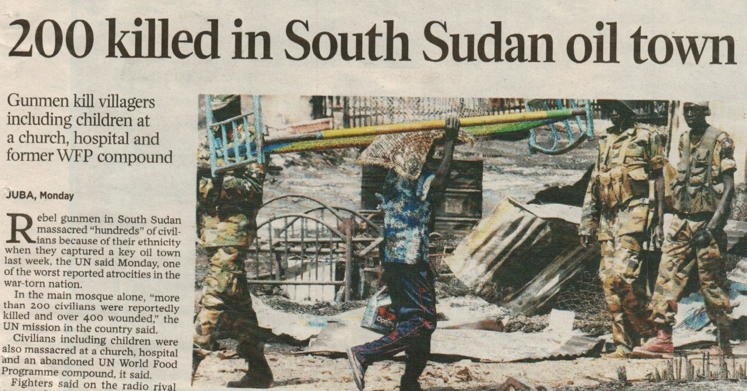
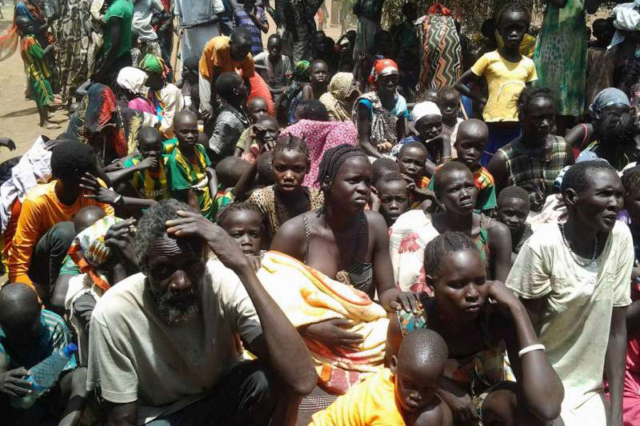

Role of politics

