Slide 1
SOMATIC SYMPTOM DISORDER AND RELATED DISORDERS MANAGEMENT
DR RACHEL KANG’ETHE
Consultant Psychiatrist
Senior Lecturer University of Nairobi

Slide 2
OUTLINE
Introduction
Objectives
Somatic Symptom Disorder and related disorders
Associated Co-morbidities
Diagnosis
Management
References

Slide 4
OBJECTIVES
Describe Somatic symptom disorders and related disorders [SSRD]
Outline assessment and diagnosis of SSRDs
Describe principles of treatment and management of SSRDs
List treatment methods used to manage SSRDs

Slide 10
Differences from DSM IV to DSM 5
D
DSM IV Somatoform Disorder
DSM 5 - Somatic Symptom Disorder & related disorders
Somatization Disorder
Hypochondriasis
Conversion Disorder
Pain Disorder
Body Dysmorphic Disorder
Undifferentiated Somatoform Disorder
Somatoform Disorder NOS
Somatic Symptom Disorder
Illness Anxiety Disorder
Conversion Disorder
Psychological # affecting medical condition
Factitious Disorder
Nonspecific somatic symptom disorders
Other specific somatic symptom disorders
Activity: For additional clarification on description of Somatic Symptom Disorder and changes in DSM-5, check out video: www.gmeded.com/dsm-5/somatic-symptoms-and-related-disorders-dsm-5

Slide 11
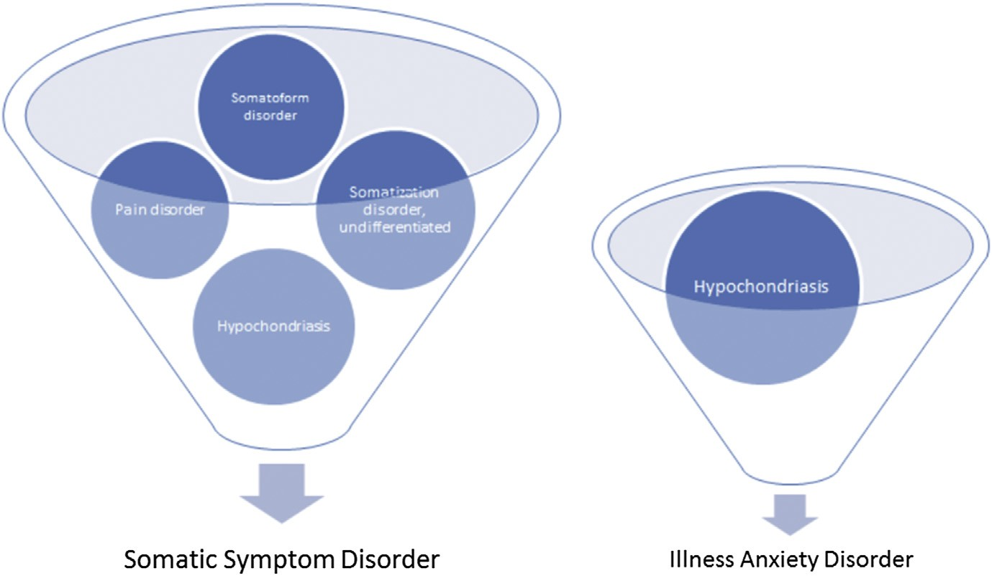
DSM IV
Somatoform Disorder
DSM IV
DSM 5
DSM 5

Slide 12
In somatic symptom and related disorders, there are physical symptoms suggesting a medical condition; however, no medical disease, substance misuse or other mental disorder can be found to account for the level and impact of the physical (somatic) symptoms. The symptoms cause significant distress or impairment in social, occupational or other areas of functioning. The physical symptoms are usually not intentional, with the exception of factitious disorder where there is deliberate falsification of physical or psychological symptoms.
In somatic symptom and related disorders, there are physical symptoms suggesting a medical condition; however, no medical disease, substance misuse or other mental disorder can be found to account for the level and impact of the physical (somatic) symptoms. The symptoms cause significant distress or impairment in social, occupational or other areas of functioning. The physical symptoms are usually not intentional, with the exception of factitious disorder where there is deliberate falsification of physical or psychological symptoms.
SSRDs DIAGNOSIS
SSRDs marked by prominent somatic symptoms suggesting a medical condition; but, no medical disease, substance misuse or other mental disorder found to account for the level and impact of the symptoms.
The symptoms cause significant distress or impairment in social, occupational or other areas of functioning.
DSM5 Somatic Symptom & Related Disorder
Somatic symptoms[s] disrupting daily life
High health related anxiety
Disproportionate persistent concerns of medical seriousness of one’s symptoms
Somatic symptom[s] last > 6/12
Excessive time & energy devoted to these symptoms or health concerns

Slide 14
SPECIFIC SSRDs
Somatic symptom disorder [somatization, hypochondriasis and pain disorder]-somatic ss distress+burden Diagnostic Criteria: A. One or more somatic symptoms; B. Excessive thoughts, feelings or behaviors; C. the state of being symptomatic is persistent (typically more than 6 months).
Illness anxiety disorder [preoccupation with fears of being ill] Diagnostic Criteria: A. Preoccupation with having or acquiring a serious illness; B. Somatic symptoms are not present or, if present, are only mild in intensity. Specify whether: (a). Care-seeking type or (b). Care-avoidant type
Conversion disorder [Functional Neurological Symptom Disorder] Diagnostic Criteria:
1 symptoms of altered voluntary motor or sensory function.
Specify symptom type: Weakness, paralysis, sensory loss, tremor, seizures, etc.
B. Clinical findings provide evidence of incompatibility between symptom and recognized neurological or medical conditions.

Slide 15
4. Psychological factors affecting medical illness: A medical condition must exist and psychological factors must negatively affect the condition. Diagnostic Criteria: A. Psychological factors have influenced course of medical condition shown by a close temporal association between psychological factors & development, exacerbation or delayed recovery from the medical condition B. The Psychological factors interfere with the treatment of the medical condition (e.g., poor adherence) C. The Psychological factors constitute additional well‐established health risks for the individual Examples: Alcohol abuse and liver disease, chronic occupational stress and hypertension, anxiety and asthma, depression and coronary artery disease, smoking and COPD.
5. Factitious disorder: Diagnostic Criteria: A. Falsification of physical or psychological signs or symptoms, or induction of injury or disease, associated with identified deception. [NB: No motivation included in DSM‐5 criteria ] B. The individual presents self (or another individual) to others as ill, impaired, or injured. C. The deceptive behavior is evident even in the absence of obvious external rewards. Divided into: Imposed on Self and Imposed on another (previously by proxy)

Slide 16
6. Other somatic symptom and related disorders
Examples of presentations that can be classified using the ‘other specified; designation include:
Brief somatic symptom disorder – duration of symptoms less than six months
Brief illness anxiety disorder – duration of symptoms less than six months
Illness anxiety disorder without excessive health-related behavior, so IAD criterion D not met.
Pseudocyesis: a false belief of being pregnant that is associated with objective signs and reported symptoms of pregnancy
7. Unspecified somatic symptom and related disorders
Symptoms consistent with somatic symptom disorder are present, but do not meet criteria for any of the above disorders; used only if there is insufficient information to make more specific diagnosis
QUESTION: In DSM-IV a patient with a high level of anxiety about having a disease and many associated somatic symptoms would be given the diagnosis of hypochondriasis. What specific SSRD DSM-5 diagnosis would apply to this patient?
hypochondriasis B. illness anxiety disorder
C. somatic symptom disorder D. generalized anxiety disorder E. somatoform disorder NOS

Slide 17
In somatic symptom and related disorders, there are physical symptoms suggesting a medical condition; however, no medical disease, substance misuse or other mental disorder can be found to account for the level and impact of the physical (somatic) symptoms. The symptoms cause significant distress or impairment in social, occupational or other areas of functioning. The physical symptoms are usually not intentional, with the exception of factitious disorder where there is deliberate falsification of physical or psychological symptoms.
ASSOCIATED CO-MORBIDITIES
Currently, higher percentages of Somatic Symptom Disorder found in persons with:
Depression
Irritable bowel syndrome
Fibromyalgia
Chronic pain
Post-traumatic stress disorder
Antisocial personality disorder
History if sexual or physical abuse

Slide 18
DIFFERENTIAL DIAGNOSIS
Disorders likely to be misdiagnosed as somatic symptom disorders:
Medical conditions
Early-stage connective tissue disorders (ex. systemic lupus erythematosus and rheumatoid arthritis)
Central nervous system disorders (ex. brain tumor, multiple sclerosis, epilepsy, dementia, stroke, and myasthenia gravis)
Endocrine disorders (ex. hypoglycemia, hyperparathyroidism, hyperthyroidism and porphyria)
Depression and anxiety disorders– 1 or 2 symptoms of acute onset & short duration
Panic disorder, generalized anxiety disorder, substance use disorder,
Delusional disorders - schizophrenia with somatic delusions or depression with hypochondriac delusions,

Slide 19
MAKING A DIAGNOSIS
1. History
Significant history suggesting somatic symptom & related disorders - may be multiple symptoms, often occurring in different organ systems. Symptoms that are vague or that exceed objective findings. Chronic course, psychiatric disorder, history of extensive diagnostic testing. Rejection of previous physicians.
2. Physical examination
A thorough physical examination and diagnostic tests are performed to rule out physical causes - which tests are done are determined by the symptoms present.
3. Mental state exam and psychological evaluation
MSE - however, finding evidence of other psychiatric condition does not rule SSRD in or out.
Screening instruments –eg, PHQ-15, History/severity traumatic events [HSTE-12], S4 Model
4. Diagnosis: DSM-criteria used to make specific SSRD diagnosis: assess symptoms, duration, severity, impact.
5. Biopsychosocial formulation: understanding of patient & their symptoms; familial, temperament vulnerabilities; symbolic meaning ascribed to symptoms, how this connects with formative & current life experiences; stressful life circumstances role; role of learning, as it applies to reinforcement of pathological illness behavior; broader overarching social and cultural context influence.
Assessments will determine the choice of a definitive treatment strategy, specifically tailored for each individual patient.
Notes:
Assessing Patients with SSD using S4 Model
Stress recently (last week) (yes/no)
Symptom count (checklist of 15 somatic symptoms; scored as positive if more than 5 symptoms)
Self-rated overall health poor or fair on a 5-point-scale [excellent, very good, good, fair, poor]; scored as positive or poor responses.
Self-rated severity of symptoms from 0 (none at all) to 10 (unbearable) scale, scored as positive for responses > 5

Slide 20
GUIDELINES FOR INVESTIGATION AND DIAGNOSIS OF SSRDs
Adequate evaluation of organic symptoms: planned and timely.
Recognition and explicit diagnosis of a somatic symptom and related disorder.
Patients with somatic symptom disorder can become organically ill in addition, so organic pathology needs to be excluded again where appropriate during the course of the disease, e.g., where there is a sudden change in symptom characteristics.
Where there is a suspicion of SSRDs, take a history beyond the primary symptom: other current symptoms, course of illness and treatments to date, past psychiatric history, current psycho-social stressors and triggers, maintaining factors, significant biographic information or life events.
Inquiry as to the patient's beliefs about causality: gives significant information about possible interactional problems.
Attention to concerns not directly voiced: a physical symptom can be used as a "calling card" for another, psycho-social concern (facultative somatization).
The diagnostic enquiry into psychological factors should be carried out at the first sign that symptoms are not organically explicable, and not delayed until all organic investigations are complete.
Possible social or occupational consequences of the physical illness should be established (drawing pension, court hearings, etc).

Slide 21
Treatment Aims:
Treatment focused on coping with symptoms & impairment rather than on symptomatic cure.
Target perpetuating factors -
Depression, anxiety or panic
Chronic marital or family discord
Dependent or avoidant personality
Occupational stress
Abnormal illness beliefs
Iatrogenic factors
Pending medical legal claim
Treatment Principles
Validate pt experience, eg, explain symptoms real and familiar to doctor
Provide framework - tell how psychological factors may exacerbate somatic symptoms
Offer opportunity for discussion of pt’s worries at earliest opportunity
Give practical advice on coping with symptoms and encourage return to normal activity as soon as possible
Discuss and agree a treatment plan that includes a planned follow up and review
Encourage specific tasks before next meeting, eg, identify 3 situations that worsen condition

Slide 22
Assessment part of treatment and helps manage patients with SSRDS:
Allows acknowledgement of patient’s experience of pain without attempting to validate its source
Allows doctors to reassure patients that pain does not mean continuous damage or more serious illness
BATHE
Quick exploration of psychosocial stressors
B
Background: ‘what is going on in your life?’
A
Affect: ‘How do you feel about it?’
T
H
E
Empathy: this a tough situation to be in. Your reaction makes sense to me
Handle: ‘what helps you handle that?’
Trouble: ‘what troubles you most about that situation?’
BATHE technique:
Ask open ended questions

Slide 23
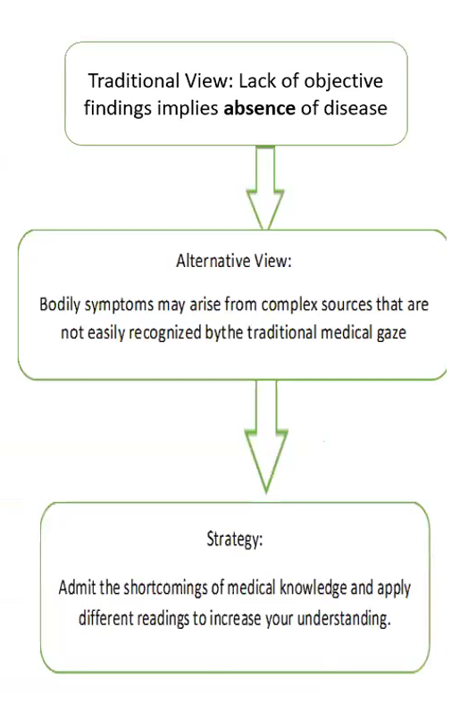
EXPLANATIONS
Once diagnosis of SSRD made, the goal of treatment is to help the person learn to control the symptoms. The first occasion that the diagnosis is discussed (after the initial investigations have failed to show any organic pathology) is a key moment in the physician-patient relationship.
Doctors' explanations of their symptoms are often at odds with these patients' own thinking and clinicians should take time to ensure their explanations are 'tangible, exculpating and involving’.
The challenge is to describe the condition to the patient in a manner that avoids any implication of a psychosomatic illness.
ALTERNATIVE VIEW
In SSRD a traditional medical frame of reference does not fully offer an adequate tool for understanding, so doctors may find it perplexing to apply knowledge from medical school, where disease implies symptoms, findings, diagnosis, and cure.
An underlying assumption in medicine is that health problems present as subjective symptoms accompanied by objective findings. Objective findings are supposed to provide the keys to diagnosis, which explains the cause of symptoms and assigns treatment.

Slide 24
ALTERNATIVE STRATEGY
The traditional disease- oriented medical frame of reference may be inadequate to understand the meaning of somatic symptoms. The situation is perceived as painful not only by the patient.
Doctors also find it difficult to help patients with these unexplained disorders. Feelings of helplessness may challenge the doctor’s professional identity of being in charge and result in blame being placed on the victim of the “unexplainedness,” permitting the physician and the discipline of medicine to escape shame.
Hence need to develop alternative medical frame of reference to accommodate these disorders as follows:
Traditional View: Lack of agreement between patient and physician, patient’s credibility is questioned.
Alternative View: Lack of agreement may mean a context of interpretation if patient’s narrative is discarded.
Strategy: Recognize and challenge power differences and possible stereotyping
Traditional View
Symptoms require objective confirmation
Alternative View
Symptoms are meaningful medical signs in themselves
Strategy
Acknowledge the patient’s symptoms description and consider diverse interpretations

Slide 26
Empowering explanations have been shown to improve these patients' well-being. For example: 'The results of my examination and of the tests we conducted show that you do not have a life-threatening illness. However, you do have a serious and impairing medical condition, which I see often but which is not completely understood. Although no treatment is available that can cure it completely, there are a number of interventions that can help you deal with the symptoms better than you have so far.’
Other treatments used as interventions for these components include:
1) Psychiatric consultation intervention (PCI)
2) Cognitive based therapy (CBT)
3) Other psychotherapies- Alternative/Holistic Management
4) Psychotropic medications

Slide 27
1). Psychiatric Consultation Intervention: Letter to Primary Care Doctor with following recommendations:
Schedule appointments with patients on regular basis instead of as-needed appointments.
Perform brief physical examinations focusing on area of discomfort at each visit.
Avoid unnecessary diagnostic procedures, invasive treatments and hospitalizations
Avoid explaining symptoms with statements such as "Your symptoms are all in your head“.
2). Cognitive Based Therapy focuses on stress management, activity regulation, emotional awareness, identifying, challenging illness-related misinterpretations and showing patients how they can create symptoms by focusing attention on certain body parts, cognitive restructuring, and interpersonal communication. Its goals include:
Reduce physiological arousal through relaxation techniques
Enhance activity regulation by increasing exercise, pleasurable and meaningful activities and pacing activities
Increase awareness of emotions
Modify dysfunctional beliefs
Enhance communication of thoughts and emotions
Reduce spousal reinforcement of illness behavior

Slide 28
3). Alternative/ Holistic Management
Numerous articles have suggested alternative management for SSRDs:
Massage therapy, Acupuncture
Physical therapy should be patient-specific and include manual therapy and/or manipulation.
Supplements (B-complex vitamins, flaxseed oil, DL-phenylalanine and many others)
Mindfulness or Mindfulness Cognitive Based Therapy (MCBT)
4). Psychotropic medications
Pharmacological treatment for SSRDs not widely accepted and not the preferred course of treatment.
Medications prescribed if comorbilities such as depression, anxiety present. TCA, SSRI, SNRI and rarely antipsychotics may be prescribed or used to help control depression and anxiety and aid in the treatment of SSRD. Comorbidites may make SSRD harder to treat and resolve.

Slide 30
REFERENCES:
The African textbook of psychiatry and mental health by Ndetei et al 2006
Kaplan and Saddocks Synopsis Psychiatry : Clinical Psychiatry , 2017

Slide 31
