Slide 1
Occupational Therapy

Slide 2
HOW WOULD YOU…
HAVE A SHOWER IF...........................
You have rigidity in your muscles?
You had poor balance?
You couldn’t reach your arms up to your hair?

Slide 3
HOW WOULD YOU…
HAVE BREAKFAST WITH FAMILY IF……………
You couldn’t hold a spoon/fork?
You take a long time to finish your meal?
You just couldn’t cope with getting out of bed?

Slide 4
HOW WOULD YOU…
DRIVE A CAR IF…………………
You were paralyzed from the waist down?
You were fearful leaving the garage?
You lost the use of your right hand?

Slide 5
HOW WOULD YOU ...........
HAVE COME TO ATTEND THIS MEETING
IF…
You had pain in your back?
You heard voices in your head?
You had tremors in your hands?

Slide 6
What is Occupational Therapy
A profession that helps people across the lifespan participate in things they want and need to do through the therapeutic use of everyday activities or occupations.
Occupations: The day to day activities we do every day: Feeding, Bathing, dressing, grooming etc.
A type of rehabilitation therapy that uses real life activities to reach a specific goal.

Slide 7
Occupational therapists treat injured, ill, or disabled patients through the therapeutic use of everyday activities. They help these patients develop, recover, improve, as well as maintain the skills needed for daily living and working.

Slide 8
The aim of OT services in mental health is to help individuals develop and maintain positive mental health, prevent mental ill health, challenges in order to live a full and productive lives

Slide 9
They emphasize the use of meaningful occupations to promote participation in occupations such as education, play, leisure, social participation, ADL, sleep and rest within a variety of environments such as school, home, community, work, residential and health care settings

Slide 10
Occupational therapists
………have the knowledge and the skills to help people overcome these and other barriers they may face in doing their everyday occupations!
They help patients increase their independence using meaningful activities
Broadly an OT will help the patient:
Develop personal goals
Understand what is preventing him/her from achieving the goals.

Slide 11
Achieve goals by using the patient strengths and support systems.
Specifically an OT will achieve these by helping the patient:
Develop skills of daily living e.g. shopping, cooking, budgeting, using public transport and home management.
Learn how to cope with stress or anxiety.
Take part in enjoyable activities.
Make friends and find social support.
Returning to or staying in work or education.
Return back to the community.

Slide 12
Who is an Occupational Therapist?
Health Care Professionals who enable people to lead a more productive, satisfying and independent life through purposeful activities.

Slide 14
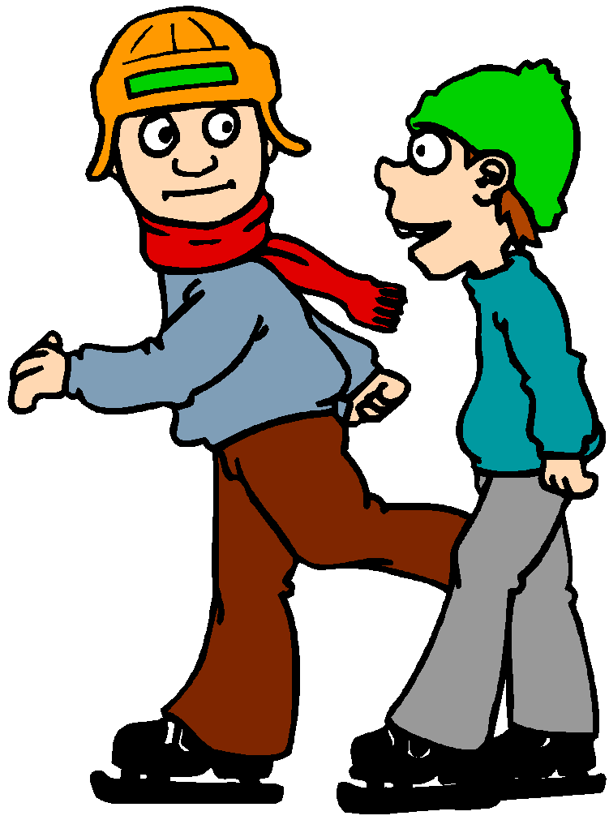
Who do Occupational Therapists work with?
Children
Adolescents

Slide 15
Where do occupational therapists work
Hospitals/nursing care homes
Work places
Mental health facilities
Rehabilitation Centres
Occupational therapy work settings
Armed Forces
Community Health centres
Private clinics
Schools and special schools

Slide 16
Aim of occupational therapy
Primary goal of OT is to enable people participate in activities of everyday life.
Help individuals develop interests, skills and abilities.
Helps individual gain control over himself and his environment.
Rehabilitate patients for their return home or former work.
Help patients overcome particular anxieties at work.

Slide 17
Help patient deal with difficult working relationships with others.
Help patient respond to treatment.
OT motto is helping patient’s “live life to its fullest.”
By helping people live life to its fullest, an OT help people consider not only their needs, strengths, abilities and interests, but also their physical, social and cultural environment.

Slide 18
General principles of OT
Used as a means of:-
Assessment of the patient capacity and skills for resettlement.
Restoring general health and function of the patient.
Helping the permanently disabled become independent.

Slide 19
Requiring assistance in returning to former employment.
Those who lack skills of daily living such as general hygiene and grooming, housekeeping, and use of public facilities (transport and community resources}
Looking for a job and lack skills interviewing and the ability to complete forms.
Chronic psychiatric patients who lack skills to maintain their jobs or find new ones.
Recovering from mental illness
Patients suitable for OT

Slide 20
Occupational therapy activities and benefits to patients
General Activities
Creative Intellectual
Recreation Industrial
Commercial Domestic
Used to improve secondary motor ability
Provide a realistic opportunity to increase personal and work efficiency
Therapeutic because they make one physically and mentally active

Slide 21
Activities for psychiatric patients
Related to work e.g. clerical work, gardening, printing etc.
Improve physical well-being e.g. relaxation exercises, health and beauty exercises, swimming, gardening, walking etc.
Enrich interpersonal relationships and socialization e.g. dancing, drama and any other group activities.
Encourage personal expression and creative use of leisure time e.g. music, painting, photography, gardening, drama etc.

Slide 22
The Biopsychosocial Model

Slide 23
The role of an occupational therapist in psychiatry
Psychiatrist
Employers
Clinical psychologist
Multidisciplinary team
Voluntary/governmental agencies
Psychiatric social worker
Relatives
Nurses

Slide 24
The roles
Plays two major roles
Assessment
The components of assessment are observation, evaluation and examination
Observation to determine ability to function and live alone safely (e.g. Schizophrenia) and
Interview to identify important roles and occupations.

Slide 25
Information obtained is used to determine the skills, supports, and environmental modifications necessary for planning programmes and rehabilitation.
Physical assessment
Movements, balance, perception, orientation, memory, concentration, comprehension, writing
Social assessment
Patient skills for occupational therapy activities and for resettlement.
Important for planning treatment, program adjustment and for reporting.

Slide 26
Some areas of social assessment
Activities of daily living (e.g. bathing, dressing, eating)
Instrumental activities of daily living (e.g. driving, money management, shopping)
Education
Work/occupation
Habits, roles and routines
Housing

Slide 27
Through comprehensive assessment OTs are able to identify:
An individual's abilities and limitations
The issues that prevent a person from fully participating in their chosen occupations.
The ability to assess competently is one of the hall-marks of an effective therapist.

Slide 28
Rehabilitation
Treatment:
Through use of purposeful activities:
Encourage new skills
Perfect poorly used ones and
Help patient relearn forgotten ones
All these results in restored self-confidence and more mature sense of responsibility.

Slide 29
Resettlement
Is the act of re-establishing a person in the community
Help develop skills for resettlement back into the community.
Like PSWs, OTs do home visits and improve patients environment for their recovery
Help patient retain his job or get a job and become self reliant.
OTs collaborate with educators, employers, and other agencies to rehabilitate and resettle patients.

Slide 30
Benefits of occupational therapy
Combination of the therapies can.....
Promote independence
Increase participation
Facilitates motor development and function
Improves strength
Enhances learning opportunities
Eases care giving
Promotes health and wellness

Slide 31
OT for specific psychiatric condition
Senile dementia
This is a psychotic condition resulting in part from cerebral deterioration
Aim of OT
Alleviation of anxiety which is the natural outcome of confusion.
Preserving good habits which still remains
Activities
For women: needlework, crochet, knitting.

Slide 32
Simple domestic work e.g. laying tables, preparing vegetables, polishing etc. may give satisfaction
For men: simple woodwork, gardening or industrial work.
Radio, television, can help to stimulate the patient and turn his attention outside the narrow confines of the ward.
Therapist observes any decline in the mental and physical condition and modify activities to avoid stress.

Slide 33
Contra-indications
Activities which involves:
Learning new processes
Judgment and initiative
The use of dangerous tools, equipment or materials i.e. boiling water etc.

Slide 34
Patient with Parkinson's disease
Increase and maintain independence in activities of daily living (ADL)
Increase mobility & co-ordination

Slide 35
Support for the patient and family
Reassure
Therapist should help the family to be realistic in their expectations.
The family should not expect the patient to perform activities beyond his capacity, but emphasize those he can do.

Slide 36
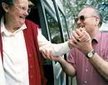
Social Activities
Work in small groups (to avoid isolation and to assist communication).
Positive and purposeful.
Familiar and interesting activities.
A wide variety of stimuli in the form of colour, sound and touch.
The therapist should work within the concentration span of the patient.
Maintain social contact through:
Hobbies
Pastimes.
Visits.
Outings.

Slide 37
Social Participation
This include participating in community activities.
The OTS will make sure that people with mental health issues participate and access to services in the society with an aim to curb stigma and discrimination.

Slide 38
Leisure Activities
People who suffer mental illness have less opportunities to participate in their leisure activities
OTS will facilitate their participation by engaging them in those activities.
Leisure activities gives one a moment of relaxation, fun and its way to exercise

Slide 39
WORK
Part-time work.
less responsibility at work may be considered.
It is unwise for the patient to persist with work to the point where he becomes exhausted and possibly unsafe.

Slide 40
Empowerment
This include school, vocational placement, livelihood opportunities, work and IGAS
People with mental health problems have minimal opportunities for empowerment
OTS will assess and place them in the appropriate field.

Slide 41
Support groups
These are groups comprising of people with mental health problems who come together for a purposeful meaning, also people without mental health problems are included in these groups.
These groups are meant for sharing experiences and social interaction.
The OT provides the dynamics of forming and conducting the sessions of these groups.

Slide 42
Summary
Mental illness is the leading cause of disability in the world (Scheinholtz, 2010).
It can significantly impact an individual's ability to engage in daily life activities that are meaningful and lead to productive daily routines.
Occupational therapy is a profession vital to helping individuals with mental illness develop the skills needed to live life to its fullest

Slide 43
OT is an active method of treatment in which the individual through the use of his/her hands influences his/her health.
The Occupational therapist plays two roles i.e. assessment and rehabilitation
Through development of skills the patient is able to live a full and independent life within the community.

Slide 44
Questions?

Slide 45
Dr. Teresia Mutavi Lecturer, department of Psychiatry

