Slide 1
INDIVIDUAL PSYCHOTHERAPY (BRIEF AND SUPPORTIVE)
BY RA OKOTH
DEPT OF PSYCHIATRY
UON/2021

Slide 2
WHAT IS BRIEF PSYCHOTHERAPY
This is an umbrella term for a variety of approaches including short –term Solution therapy.
Highly strategic
Exploratory
Solution oriented NOT problem oriented
Concerned with the current factors sustaining the problem and preventing change

Slide 3
EMPHASIS
Focus on specific problem
Direct intervention

Slide 4
Proponents of Brief Psychotherapy
Milton Erickson (clinical hypnosis)
Richard Bandler (Neuro linguistic programing)

Slide 5
Types of Psychotherapy
Psychoanalytic therapy – ID, EGO & SUPEREGO
Supportive psychotherapy
Hypnosis therapy – Absorption, dissociation
Reality therapy – condition or operationalized the behavior
Abreaction therapy – painful release of repressed emotions brought up into consciousness

Slide 6
Common factors in psychotherapy
Therapeutic relationship
Listening
Release of emotion
Restoration of morale
Providing information
Providing a rationale
Advice and guidance
Suggestion

Slide 7
Counselling and crisis intervention
Counselling
Counselling incorporates the non-specific factors shared by all kinds of psychotherapy.
Crisis intervention
Helps patients cope with a crisis in their lives, and to learn effective ways of dealing with future difficulties.

Slide 8
Counselling
Counselling for specific purposes
Debriefing
Relationship problems
Late effects of trauma
Risks
Students
In primary care

Slide 9
Crisis intervention 1
Problems leading to crisis
Loss problems
Role changes
Relationship problems
Conflict problems
Indications:
Well-motivated people with stabel personalities who are facing major but transitory difficulties.

Slide 10
Crisis intervention 2: methods
Stage Ⅰ:
Reduce arousal;
Focus on current problems;
Encourage self-help
Stage Ⅱ:
Assess problems;
Consider solutions;
Test solutions
Stage Ⅲ:
Consider future coping methods

Slide 11
SUPPORTIVE PSYCHOTHERAPY
It is a therapeutic approach that integrates
Psychodynamic psychotherapy
Cognitive – behavioral
Interpersonal conceptual model technique

Slide 12
SUPPORTIVE PSYCHOTHERAPY OBJECTIVE
The therapists objective is to reinforce the patient’s healthy and adaptive patterns of thought behaviors in order to reduce the intra psychic conflicts that produce symptoms of mental disorders.

Slide 13
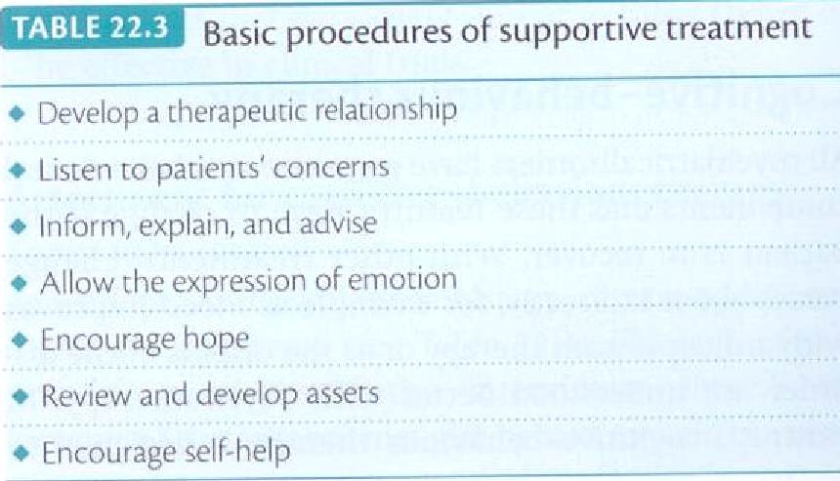
Supportive psychotherapy
Table22.3

Slide 14
AIMS OF SUPPORTIVE PSYCHOTHERAPY
Help patient to reach and maintain their best psychological and social functioning
Reduce subjective stress
Reduce behavioral dysfunction
Improve self esteem
Minimize relapses
Enhance the patients strengths and coping skills
ALLOW THE PT TO ACHIEVE MAXIMUM POSSIBLE SUPPORT FROM OTHER SOURCES

Slide 15
Advantages of Individual Psychotherapy
Set-up very quickly
Trained professionals to talk with individuals
Helps to define the problem, client is facing

Slide 16
Disadvantages of Individual Psychotherapy
Client not able to make real-life changes
There is usually no enough time and help from the psychotherapy to the individualist

Slide 18
Thank you for your attention!

