Slide 1
INDIVIDUAL PSYCHOTHERAPY (BRIEF AND SUPPORTIVE)
BY RA OKOTH
DEPT OF PSYCHIATRY
UON./2016

Slide 2
WHAT IS BRIEF PSYCHOTHERAPY
This is an umbrella term for a variety of approaches including short –term Solution therapy.
Highly strategic
Exploratory
Solution oriented NOT problem oriented
Concerned with the current factors sustaining the problem and preventing change

Slide 3
EMPHASIS
Focus on specific problem
Direct intervention

Slide 4
Proponents of Brief psychotherapy
Milton Erickson (clinical hypnosis)
Richard Bandler (Neuoro linguistic programing)

Slide 5
Common factors in psychotherapy
Therapeutic relationship
Listening
Release of emotion
Restoration of morale
Providing information
Providing a rationale
Advice and guidance
Suggestion

Slide 6
Counselling and crisis intervention
Counselling
Counselling incorporates the non-specific factors shared by all kinds of psychotherapy
Crisis intervention
Helps patients cope with a crisis in their lives, and to learn effective ways of dealing with future difficulties.

Slide 7
Counselling
Counselling for specific purposes
Debriefing
Relationship problems
Late effects of trauma
Risks
Students
In primary care

Slide 8
Crisis intervention 1
Problems leading to crisis
Loss problems
Role changes
Relationship problems
Conflict problems
Indications:
well-motivated people with stabel personalities who are facing major but transitory difficulties.

Slide 9
Crisis intervention 2: methods
Stage Ⅰ:
reduce arousal;
focus on current problems;
encourage self-help
StageⅡ:
assess problems;
consider solutions;
test solutions
StageⅢ:
consider future coping methods

Slide 10
SUPPORTIVE PSYCHOTHERAPY
It is a therapeutic approach that intergrates
psychodynamic psychotherapy
Cognitive – behavioral
Interpersonal conceptual model technique

Slide 11
SUPPORTIVE PSYCHOTHERAPY OBJECTIVE
The therapists objective is to reinforce the patient’s healthy and adaptive patterns of thought behaviours in order to reduce the intra psychic conflicts that produce symptoms of mental disorders.

Slide 12
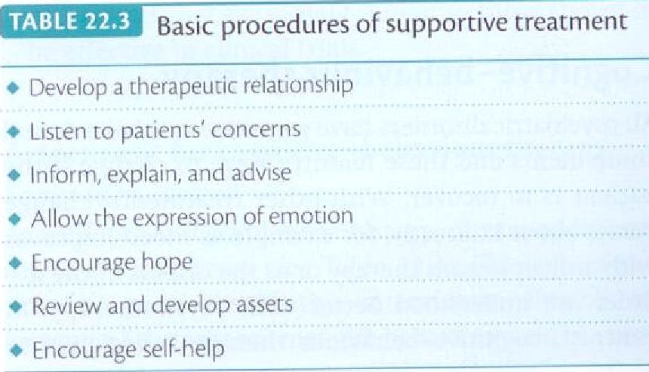
Supportive psychotherapy
Table22.3

Slide 13
AIMS OF SUPPORTIVE PSYCHOTHERAPY
Help patient to reach and maintain their best psychological and social functioning
Reduce subjective stress
Reduce behavioral dysfunction
Improve self esteem
Minimise relapses
Enhance the patients strengths and coping skills
ALLOW THE PT TO ACHIEVE MAXIMUM POSSIBLE SUPPORT FROM OTHER SOURCES

Slide 15
Thank you for your attention!

