Slide 1
HISTORY OF PSYCHIATRY
Level VI
Mathai June 2021

Slide 2
Objectives
The objective of this lecture is to give the students an overview on the evolution of Psychiatry
This includes
The Different epochs in the understanding of mental illness and the corresponding treatment

Slide 3
Introduction
The history of mental illness is as old as mankind and has been reported in all the ancient writings.
Egyptians
Greeks
Romans
Judaism and early Christianity and Koran
Arabs and Persian
The Sanskrit and Ayurvedic writings

Slide 4
Ancient beliefs
In most of the ancient writings- mental illnesses was ascribed to magic and the gods
Beliefs in Demonic possession was common in most of the ancient writings
And treatment was done in the temples by the priest
Casting out of demons/evils spirits has continued to the present day

Slide 5
Ancient Greek
Ancient Greek and Roman Philosopohers, considered the pioneers of Medicine viewed mental illnesses as psychological, organic or both.
Ancient Greek philosophers were probably the first to differentiate the mental illnesses they observed
Plato described 4 kinds of madness: Prophetic, Telestic, Poetic & Erotic madness

Slide 6
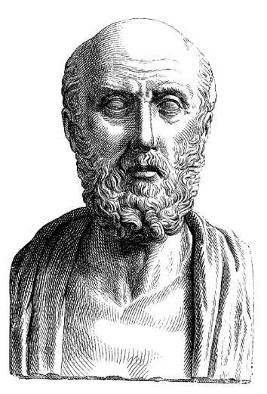
Hippocrates
Hippocrates- Referred to as “the father of modern medicine” – described mental illness as being caused by an imbalance of the body fluids
4 humours- phlegm, yellow bile, black bile and blood- also the basis of personality types: PHLEGMATIC • CHOLERIC • SANGUINE
Excess humours led to mental illness: Black bile to melancholia, yellow bile to manic rage and phlegm to dementia

Slide 7
Ancient Romans
Followed the Ancient Greeks in trying to explain the world of behavior and Mental illness
Galen a Roman philosopher- described 6 types of insanity: Phrenitis, Melancholia, delirium, Lathargus, Epilepsy
Recommended shock as Treatment

Slide 8
Middle East
In the 9th Century the Arabic world started building hospitals –Bimaristans (Baghad) which also admitted patients with Mental illness*
Persia/Iranian- Physicians Abu Bakr Muhammad ibn Zakariya ‘Al-Razi’ author of the Comprehensive Book on Medicine (Kitab al-Hawi fi al-tibb) propagated the psychological concepts of MI
Avicenna-Abu Ali Sina 980-1037- Mathematician, Physician, Philosopher astronomer
Considered the father of early medicine- wrote 450 works 40 on medicine and Psychology

Slide 9
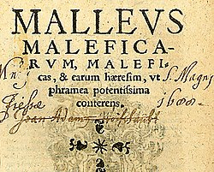
The Darkest Age of Psychiatry

Slide 10
Dark ages and the Inquisition
A reversal of scientific thinking characterised the times after the fall of Roman empire in Europe and gave birth to the Inquisition between 1400 to 1780
A lot of mentally ill most suffering from delusions and hallucinations were labelled possessed with demons, old medicine women as witches and these were hunted and killed following the edics of Heinrich Kramer a Catholic clergy.
HK wrote the infamous book- Malleus Maleficarum (Witches’ Hammer),

Slide 11
The Renaissance
The renaissance saw the return to reason and the Greek philosophy of humanism- 15th and 16th centuries.
The age of reason or the Enlightenment, was an intellectual and philosophical movement that dominated the world of ideas in Europe during the 17th to 19th centuries.: 'Dare to know! Have courage to use your own reason!‘- Emanuel Kant-

Slide 12
Renaissance and Advances in Psychiatry
Johann Weyer: In the Netherlands at the height of the inquisition tried to debunk the belief in witchcraft and possession and described these so called witches as “mentally ill” Pseudomornachia Daemon_The False Kingdom of the Demons
Said to have been the first person that used the term "mentally ill" or melancholy to designate those women accused of practicing witchcraft
1563 accurately described the general behaviour of the mentally ill and practiced psychotherapy.

Slide 13
Philippus Paracelsus: described the role of the imagination in disease- provided a new classification of diseases in his book “on diseases which deprive man of reason”
Proposed that mental disorders to be natural disease and not caused by demons.

Slide 14
Asylums in Europe
Bethlem hospital in London (later corrupted to Bedlam) was one of the first institutes for care of the mentally ill around 1400 AD
The York Retreat-established in1792 in London- was a pioneer in humane and moral treatment of the insane.
Salpetriere Asylum- 1656 established as a hospice for the poor women of Paris. It also served as a prison for prostitute, learning disabled and mentally ill patients- a place of rats vermin and chains
Notes:
https://www.nlm.nih.gov/exhibition/islamic_medical/islamic_12.html

Slide 15
Return of reason
François Boissier de Sauvages's 1772: Divided Diseases Into Ten Classes With Class Eight Representing Mental Illnesses- Nosologie méthodique (A Systematic Nosology)
William Cullen (Scottish Physician, Lecturer) Coined The Term “Neurosis” Which He Thought Was A Result Of Various Parts Of The Brain Being In Stages Of Collapse And Excitement
Franz Gall in Germany Introduced “Phrenology” And Said That The Brain Had Separate Organs That Occupied Separate Areas And Shaped The Personality And That The Organs Could Be Mapped On To The Surface

Slide 16
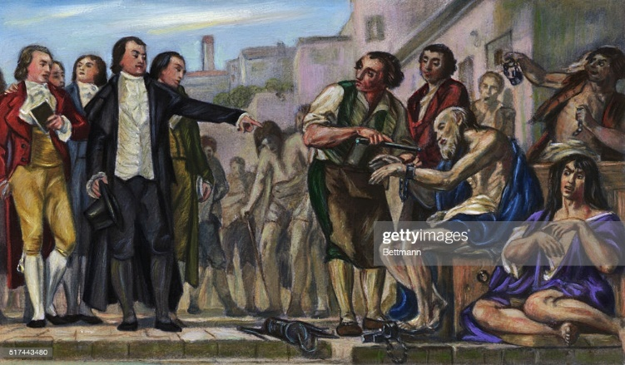
Phillipe Pinel
Phillipe Pinel- In France Classified Mental Illness Into 4 Types - Mania, Melancholy, Dementia And Idiocy. He is famous for pioneering the removal of chains- At Bicetre And Salpetriere Asylums In 1793 And 1800 Respectively. He Called This “Moral Treatment Of The Insane”

Slide 17
Modern Psychiatry
Psychiatry as a medical specialty dates back to the early 1800s
During that era- it was engaged in the handling or containing people with severe mental illness namely psychosis- asylums
Of concern were conditions- Mania, Schizophrenia, severe depression then called Melancholia and dementia

Slide 18
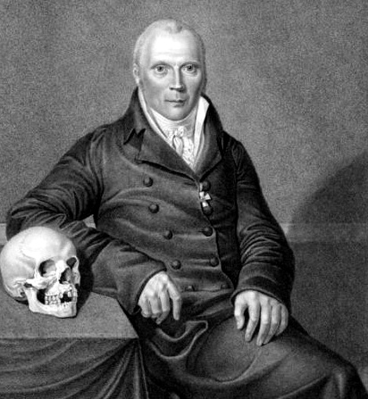
Ct
Johann Christian Reil German Physician/Psychiatrist was the first to use the ‘Psychiatry’ Psychiatrie-1808
In 1853, The British Journal Of Psychiatry Was First Published
In 1844 American Psychiatric Association Was Formed

Slide 19
Mental Illness and Organicity
Wilhelm Griesinger (1850) -Mental Diseases Are Brain Diseases- “so-called 'mental illnesses' are really individuals with illnesses of the nerves and brain”
Initiated reforms in treatment of the mentally ill in "asylum system“ and Integration of the mentally ill into society.
Henry Maudsley- Believed In Organic Etiology Of Mental Illness
Paul Broca- Discovered A Speech Area In The Brain Called Broca’s Area By Examining The Brain Of A Patient Of Aphasia At Postmortem.
Benedict Morel- Demence Precoce- The Influence Of Alcohol,syphilis

Slide 20
Ct
Emil Kraeplin- Classified Functional Psychoses into Manic Depressive Illness and Dementia Praecox
Eugene Bleuler- Coined the term “Schizophrenia” For Dementia Praecox
Introduced 4 A’s of Schizophrenia: Association, Affect, Autism, Ambivalence
Kurt Schneider (1887-1967) German Psychiatrist famous for defining the criteria for diagnosis of Schizophrenia- the first rank symptoms
Also coined the term endogenous depression vs reactive depression

Slide 21
Early treatment of Psychiatric disorders
Lucio Bini- Italian psychiatrist and Ugo Cerletti, a neurophychiatrist- electro-shock treatment later known as electroconvulsive therapy
Camphor Induced Seizure
Franz anton Mesmer and Jean Charcot- Hypnosis
Egaz Moniz and Almeida Lima- Psychosurgery to treat Mental Illness by Prefrontal Leucotomy/Lobotomy

Slide 22
COMA therapies
Insulin Coma Therapy (Sakel- Vienna)-1927 introduced ICT-patients diagnosed as good prognosis schizophrenia got daily injections of high doses insulin to induce a hypoglycaemic coma and convulsion which was reversed with glucose after 1 hour for up to 2 months
ICT was abandoned around 1960 in favour of phenothiazines
Barbiturate Coma
Narcotherapy- using barbiturates in the treatment of combat stress, anxiety disorders

Slide 23
Psychotherapy
Freud an Austrian neurologist after observing JEAN MARTIN CHARCOT PERFORMING HYPNOSIS, developed the psychoanalysis and is referred to as the father of modern psychotherapy

Slide 24
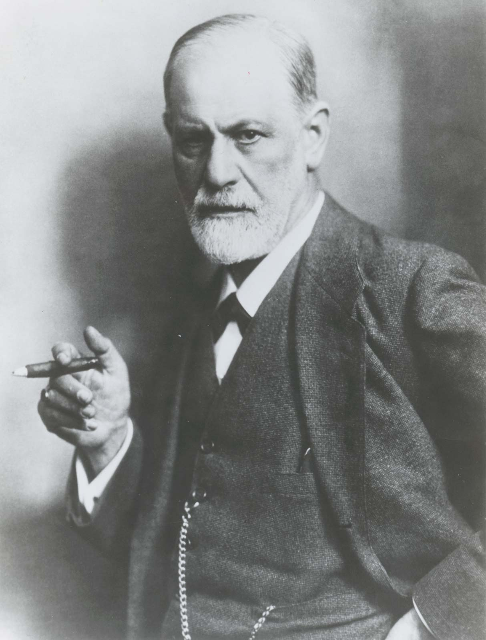
Freud and the Psychoanalysis
Some of the main contributions are:
• Interpretation of dreams
• Free association
• Psychodynamics
• Psychoanalysis
• Psychosexual development
• Personality development
• Structural model of mind

Slide 25
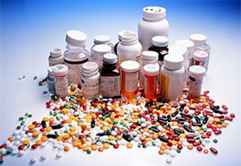
Advent of Psychopharmacology
Chloral hydrate was the first product of the organic-chemical industry to find application in psychiatry (in 1869)
Studied And Used Lithium To Treat Mania
Chlorpromazine ( Delay and Denikar (1952))- was the beginning of a great wave of phenothiazine antipsychotics.
A Drug that did not just calm Psychotic Patients, but also had an effect on the psychotic symptoms of delusions and hallucinations

Slide 26
1958 Haloperidol
1959 Clozapine – abandoned and reinstated around 1970
Atypical anti psychotics/ second generation Antipsychotics – Olanzapine, Risperidone, Aripiprazole etc.
Long Acting Injectables- modecate

Slide 27
Minerals and salts
Lithium is thought to have been a mineral component in some the healing waters and spas around the world
Was first used for treatment of gout around 1947
First used in Psychiatry around 1871 up to 1880
Reinstated in 1949 (Cade in Australia) for the treatment of mania and later as a prophylaxis

Slide 28
Antidepressants
Around 1958, it was noted that an anti-tb drugs had antidepressant effects.
Loomer, Saunders and Kline - iproniazid became the “first” successful pharmacological treatment for depression and is classified as a MAO inhibitor.
However it is now reported that Kuhn’s had already been working on a Tricyclic” Antidepressant Imipramine- the first tricyclic antidepressant
The tricyclics are giving way in time to other classes of antidepressants, Selective Serotonin Reuptake Inhibitors (SSRIs) and related in 1980s and 1990s starting with fluoxetine in 1987
Selective Norepinephrine re-uptake inhibitors (SNRIs)
New drugs include:
Ketamine for the treatment of depression
Agomelatine - melatonin based treatment for depression

Slide 29
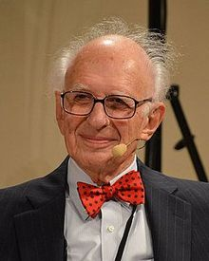
The New age of Psychiatry
Eric Kandel- Nobel Prize for Physiology and Medicine
In search of Memory: The emergence of a New Science of the Mind

Slide 30
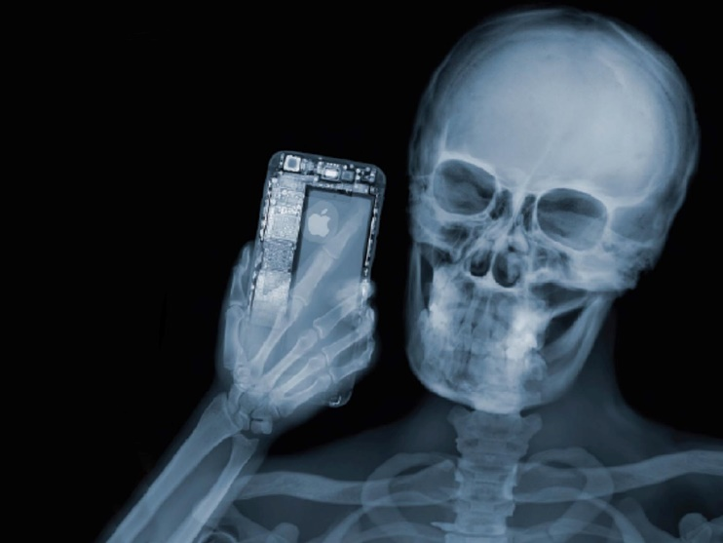
“Seeing” into the brain
Wilhelm Roentgen, Professor of Physics in Wurzburg, Bavaria, discovered X-rays in 1895

Slide 31
Neurobiology
A later of advances in the study of brain structure and function
Investigative EEG go as far back as 1924
Spectro-photofluorimeter for detecting the neurotransmitters in brain tissue in the 1950s
We are now in the era of neuroimaging
CT-Scan
MRIs and FMRI
Positron Emission Tomography
Magnetic resonance imaging
Single photon emission computerized tomography

Slide 32
CONCLUSION-1
New developments in the area of imaging and pharmacological treatment is moving Psychiatry away from the Psychological dominance to the biological platform and the Neuropsychiatry
The new frontier- is in genomic studies
Identifying the genes involved in different types of disorders
Developing targeted molecules for specific DNA types
And what about Transcranial Magnetic Stimulation ?

Slide 33

Every year in Kenya a number of old people are beaten and often killed in horrific attacks under the accusation of being witches and a danger to the community.

Slide 34

Burnt to death
“Feb 2009- Five elderly people accused of witchcraft were burnt to death in Kisii. The four women and one man were accused of abducting a child and making him dumb through black magic, on Thursday”

