Slide 1
EATING DISORDERS
DR. RACHEL KANG’ETHE
DEPARTMENT OF PSYCHIATRY
UNIVERSITY OF NAIROBI

Slide 2
References
Child Psychology and Psychiatry: Frameworks for Practice. Edited by David Skuse, Helen Bruce, Linda Dowdney and David Mrazek: © 2011 John Wiley & Sons, Ltd. Published 2011 by John Wiley & Sons, Ltd. ISBN: 978-0-470-97382-0
Kang’ethe R, et al. Child and Adolescent Psychiatry. In: Njenga FG, editor. Essentials of Clinical Psychiatry in sub-Saharan Africa. Milan: Masson; 2005.
The African textbook of psychiatry and mental health by Ndetei et al 2006

Slide 3
LEARNING OBJECTIVES
Students will be able to:
List and describe the Eating Disorders delineated in the (DSM-IV)
Recognize clinical features, assessment processes, and treatment modalities related to eating disorders

Slide 4
EATING DISORDERS (EDs)
DEFINITION:
Eating Disorders are disturbed eating habits and disturbed weight control behaviours.
Disturbed eating habits can include restricted food intake, strict dietary rules, preoccupation with food, binge eating and altered mealtime behaviours.
Disturbed weight control behaviours may involve excessive exercise, vomiting, or the misuse of laxatives or diuretics.
These eating habits and behaviours are termed ‘disturbed’ when they become harmful through extreme use.

Slide 5
DSM-IV EATING DISORDERS
Types of Eating Disorders
Anorexia Nervosa
Restricting Type
Binge-eating/Purging subtype
Bulimia Nervosa
Binge Eating Disorder
Eating Disorder not otherwise specified (EDNOS)
Types of Feeding or Eating Disorder of infancy/childhood
Pica
Rumination Disorder
Unspecified Feeding or Eating Disorder

Slide 7
ANOREXIA NERVOSA: DSM-IV CRITERIA
Refusal to maintain body weight at or above minimally normal for age and height
Intense fear of gaining weight or becoming fat, even though underweight
Disturbance in the way in which one’s body weight or shape is experienced, or shape on self evaluation, or denial of the seriousness of the current low weight
In post-menarcheal females, amenorrhea, i.e., absence of at least 3 consecutive menstrual cycles
Type:
a. Restricting type
b. Binge-eating/purging type

Slide 8
ANOREXIA NERVOSA: DSM-IV DIAGNOSTIC CRITERIA:
1. Refusal to maintain normal body weight –Less <85%
2. Intense fear of gaining weight & being fat –
*Can’t be ‘too thin’
3. Distorted body image or sense of body shape –
*Feel “fat” even when emaciated
4. Amenorrhea - Loss of menstrual period
5. Type:
a. Restricting type -weight loss by severely limiting food intake, with no binge-eating/purging last 3 months
b. Binge-eating/purging type - regularly engaged in binge- eating and purging during the last three months

Slide 9
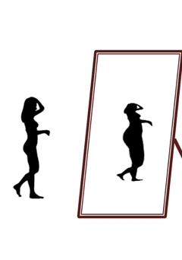

Slide 10
ANOREXIA NERVOSA: Etiology/Pathogenesis
Biologic/genetic evidence
-- Genetic factors explain > 50% risk 2developing eating disorder
Increased in monozygotic twins/Increased incidence in sisters
Increased prevalence of affective disorders in families
Psychological
Personality traits: negative emotionality, perfectionism, drive for thinness, poor interoceptive awareness, ineffectiveness,
Family characteristics: enmeshment, over-protectiveness, rigidity, conflict resolution#, early separation stress and sexual abuse hx
Socio-cultural stressors
Affluence in industrial countries
Social standard: thinness = beauty
Media bombardment: thinness = success/women-sex objects

Slide 11
Anorexia: Cognitive Behavioral View
Focus on body dissatisfaction and fear of fatness
Certain behaviors (e.g., restrictive eating, excessive exercise) negatively reinforcing/reduce anxiety about weight gain
Feelings of self control brought about by weight loss are positively reinforcing
Perfectionism and personal inadequacy lead to excessive concern about weight
Criticism from family/peers regarding weight can also play a role
Anorexia: Cross-Cultural Factors
Anorexia found in many cultures
Even those not under Western influence
May not include fears of getting fat
In some cultures, higher weight is a sign of fertility / healthiness
As countries become more like Western cultures, eating disorders increase

Slide 12
Anorexia Nervosa: Clinical Presentation
Onset: early to middle teen yrs/ dieting & stress triggered
Women 10x as likely to develop disorder as men
Symptomatology in men similar to that of women
Often comorbid with depression, OCD, phobias, panic, alcoholism and PDs/In men, comorbid with substance dependence, mood disorders, or schizophrenia
Suicide rates high in anorexia: 5% completed/20% attempt
Physical Changes in Anorexia
Low blood pressure, heart rate decrease, renal/GIT problems
Loss of bone mass, brittle nails, dry skin, hair loss
Lanugo -soft, downy body hair
Depletion of potassium and sodium electrolytes
Can cause tiredness, weakness, and death
12

Slide 13
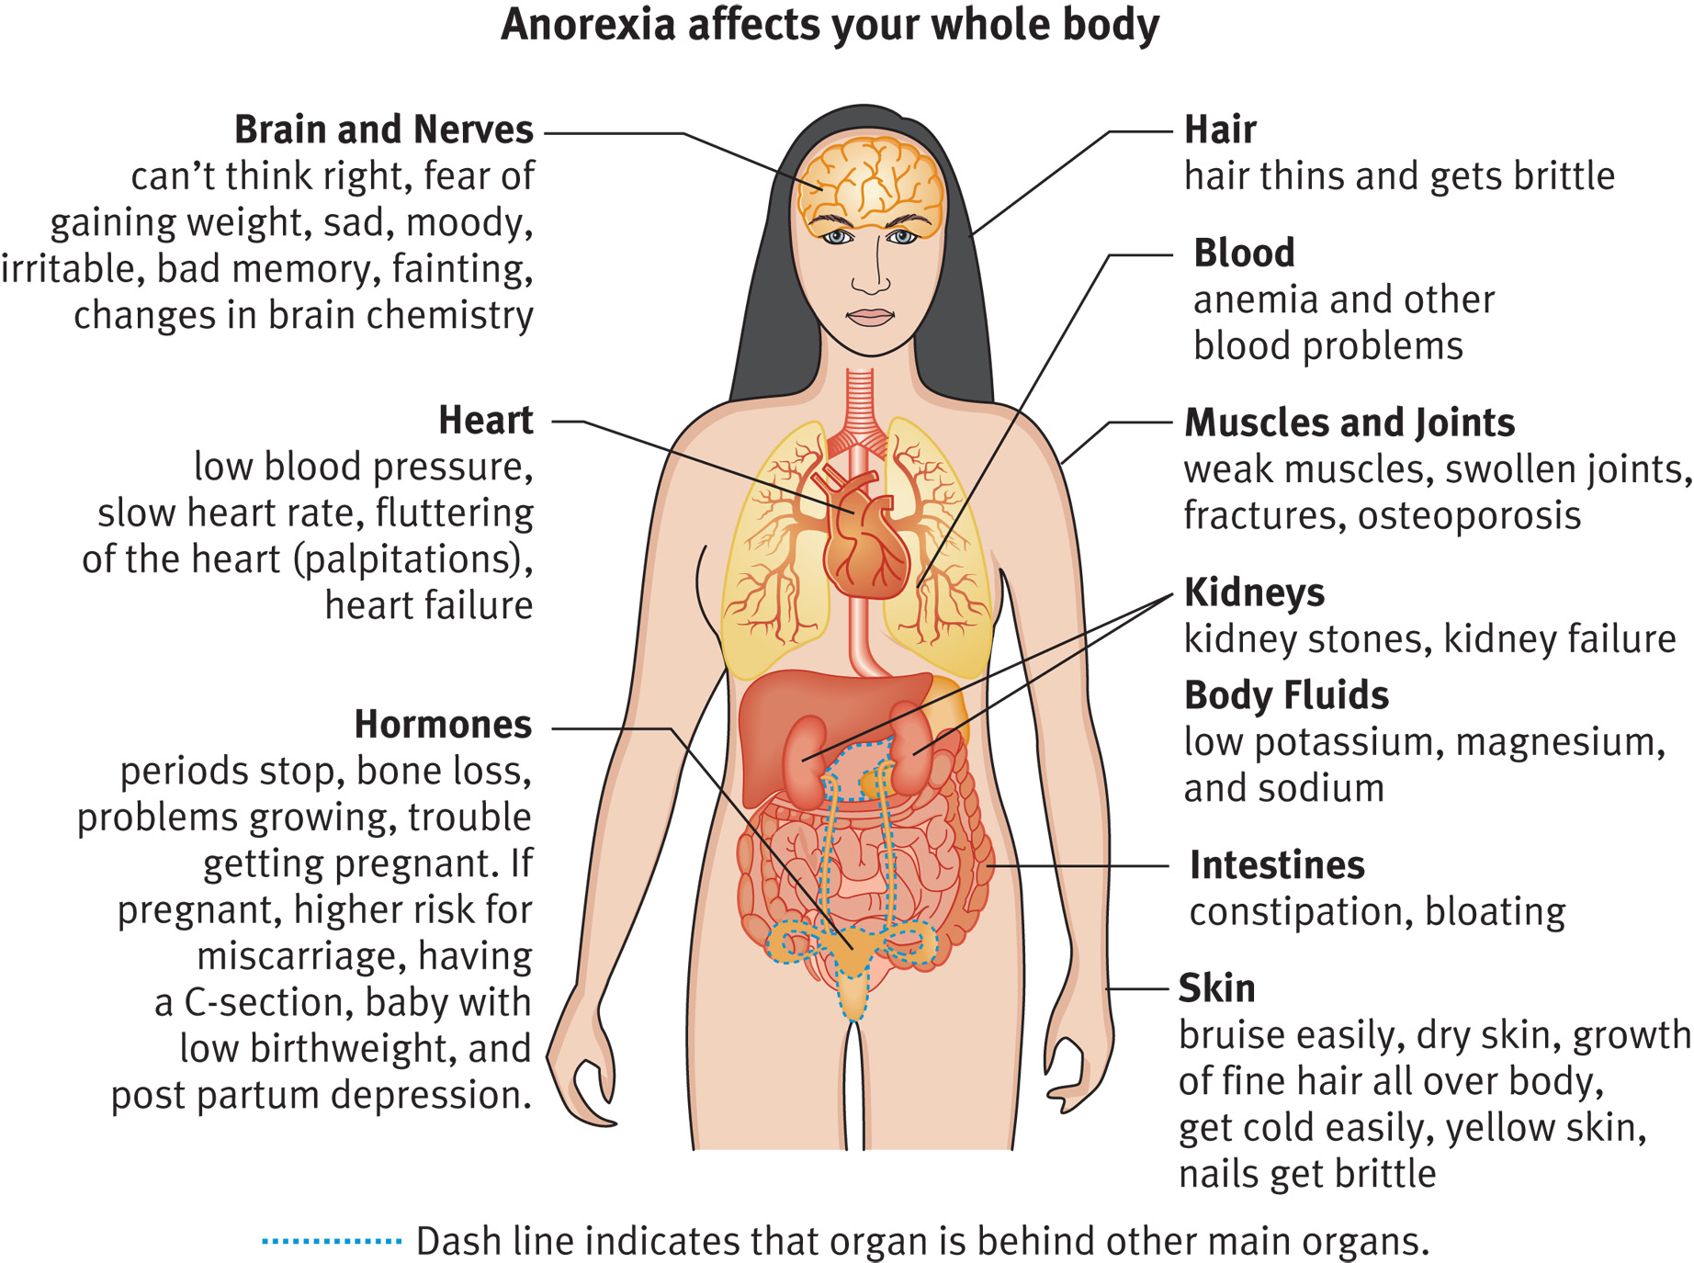
Medical Effects of Anorexia

Slide 14
ANOREXIA NERVOSA: Differential Diagnosis
Thyroid disease
Diabetes mellitus
Addison disease
Inflammatory bowel disease
Brain tumors/ Other malignancy
HIV
Drug/alcohol abuse
Depression
Schizophrenia
Personality disorders
Obsessive/compulsive disorders

Slide 15
ANOREXIA NERVOSA DIAGNOSIS: DETAILED HISTORY
Weight
Diet
Exercise
Body image
Self-induced binging; purging
Self-medication with laxatives, diuretics, or diet pills
Menstrual/puberty
Sexual/physical abuse history
Family history of psychiatric illness, alcoholism, eating disorders
Substance abuse, sexual behaviors, compulsive /impulsive behaviors

Slide 16
ANOREXIA NERVOSA: PHYSICAL EXAM
Significant weight loss or failure to make expected gain
Bradycardia, hypotension, orthostatic hypotension, hypothermia
Acrocyanosis, edema, cool mottled discoloration of extremities
Skin: lanugo, loss of scalp hair, jaundice, dry skin
Musculoskeletal weakness, loss of muscle mass
Cardiac arrhythmias

Slide 17
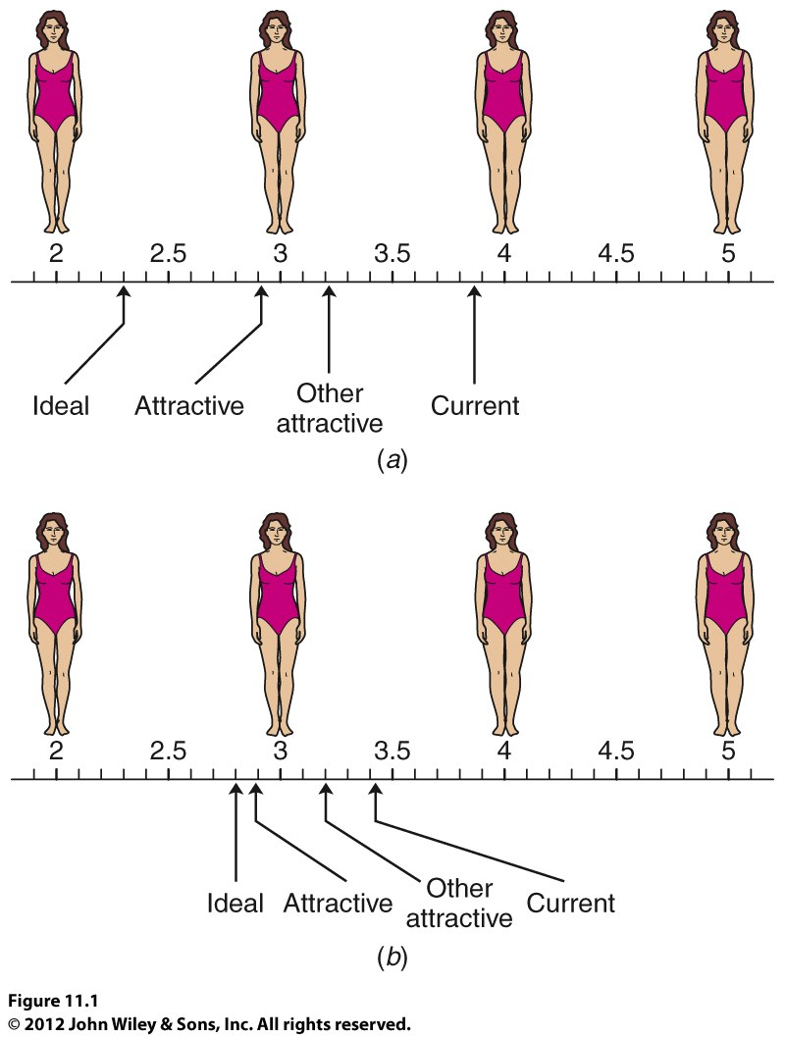
Assessment of Body Image
Copyright John Wiley & Sons, Inc.

Slide 18
ANOREXIA NERVOSA: LAB FINDINGS
Results of following are usually normal:
CBC: rare to find anemia
Lytes: unless associated with vomiting
BUN: low to normal even with dehydration
LFTs: increased with severe starvation due to fatty liver
Results of following sometimes abnormal
UA: alkaline with ketones and protein
Cholesterol: elevated
Amylase: elevated
ECG: bradycardia, low voltage & prolonged QT
Bone densitometry: may show osteopenia
Results usually abnormal
LH & FSH: low
TFTs: low
Cortisol: high

Slide 19
TREATMENT OF ANOREXIA NERVOSA

Slide 20
PROGNOSIS OF ANOREXIA
50-70% eventually recover
May often take 6 or 7 yrs/relapse common
Difficult to modify distorted view of self, especially in cultures that highly value thinness.
Anorexia is life threatening
Death rates 10x higher than general population
Death rates 2x higher than other psychological disorders

Slide 21
BULIMIA NERVOSA: DSM-IV Diagnostic Criteria
Recurrent episodes of binge eating
Binge characterized by both:
Eating in a discrete period of time, an amount of food larger than most people would eat during a similar period of time & under similar circumstances
A sense of lack of control over eating
Recurrent inappropriate compensatory behavior to prevent weight gain, e.g., self-induced vomiting, laxatives, diuretics, fasting, excessive exercise
Binging and inappropriate compensatory behaviors both occur at least twice a week for 3 months
Self evaluation is unduly influenced by body shape and weight
Disturbance doesn’t occur exclusively during episodes of AN
2 Types: (a). Purging and (b). Non-purging

Slide 22
BULIMIA NERVOSA: ETIOLOGY
Biologic factors:
1. Dysregulation of serotonin metabolism > binge eating of high-carbohydrate foods
2. Family hx of alcoholism & affective disorders, e.g. depression
Psychological factors:
- Hx of incest, sexual abuse, dysfunctional family interactions
Lead to feeling out of control, poor self-esteem & need comfort
Personality differences in AN and BN
-- AN: anxious, inhibited, controlled
-- BN: affectively labile, under controlled, active
Socio-cultural factors:
1. Strong pressures for thinness >dissatisfaction normal weight
2. May begin after unsuccessful dieting
3. “Contagion” factors in college dorms> bingeing/purging “parties”

Slide 23
Bulimia Nervosa: Clinical Presentation
Onset late adolescence or early adulthood
90% women/1 – 2% prevalence among women
Typically overweight that led to dieting
Comorbid with depression, PD’s, anxiety, substance abuse, conduct disorder
Suicide attempts and completions >general population but much lower than in anorexia nervosa
Bulimics typically have normal BMI
Physical Changes in Bulimia
Menstrual irregularities
Potassium depletion from purging
Laxative use depletes electrolytes, which can cause cardiac irregularities
Loss of dental enamel from stomach acids in vomit
Mortality rate of 4%

Slide 24
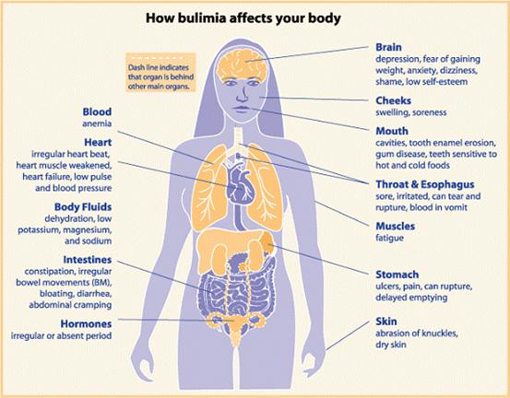
Medical Effects of Bulimia

Slide 25
Bulimia Nervosa: Differential Diagnosis
Thyroid disease
Diabetes mellitus
Addison disease
Inflammatory bowel disease
Brain tumors
Malignancy
HIV
Drug/alcohol abuse
Depression
Schizophrenia
Personality disorders
Obsessive/compulsive disorders

Slide 26
Bulimia Nervosa: Diagnosis--History
Weight history
Detailed diet history
Detailed exercise history
Body image history
History of self-induced binging; purging; self-medication with laxatives, diuretics, or diet pills
Detailed menstrual/puberty history
Sexual/physical abuse history
Family history of psychiatric illness, alcoholism, and eating disorders
History of substance abuse, sexual behaviors, compulsive/impulsive behaviors

Slide 27
Bulimia Nervosa: Physical Examination
Head & neck: bilateral parotid gland swelling, loss of tooth enamel (from acidic stomach contents), dental caries, subconjunctival hemorrhage (from forced vomiting)
Skin: scarring or hyperpigmentated calluses on knuckles (Russell’s sign); petechiae on face (from forced vomiting)
GI: abdominal distention, ileus, constipation, rectal bleeding, gastritis, esophagitis, esophageal tears
Pulmonary: aspiration pneumonia, pneumomediastinum
Cardiac: arrhythmias

Slide 28
Bulimia Nervosa: Prognosis
Variable course; many chronic fluctuation binge/purge behavior
~75% recover/10-20% remain symptomatic
Pts with sexual abuse hx, conflicting family environments, comorbid medical/psychiatric # or inability to seek/accept Rx > severe course
BN > responsive AN 60% BN vs. 50% AN recover in first 5 yrs
Potential lethal complications:
-- Esophageal tears from severe repetitive vomiting
-- Cardiac arrhythmias /hypokalemia due 2vomiting/diuretic abuse
-- Cardiomyopathy and death from ipecac use
Antidepressants effective in controlled short-term Rx of binge eating
12-month follow-up studies >recovery rates ~70% but relapses occur
CBT reduces bingeing /vomiting & associated psychopathology
-- individual and group therapy > effective than pharmacotherapy

Slide 29
Binge Eating Disorder

Slide 30
Treatment of Binge-Eating Disorder
Binge eating prognosis
60% in remission after 6 years

Slide 31
Eating Disorder Not Otherwise Specified (EDNOS)
A diagnostic category for eating disorders that fail to meet full criteria for either anorexia nervosa or bulimia nervosa
May have partial symptoms of either AN or BN
For example, all criteria for AN may be met except patient has regular menses OR significant weight loss but wt still in normal range
OTHERS
Night Eating Syndrome [NES] - morning anorexia, evening hyperphagia (often ass. with hypothalamus injury) & insomnia.
Sleep Eating Disorder (SED-NOS)

Slide 32
FEEDING AND EATING DISORDERS OF INFANCY OR EARLY CHILDHOOD

Slide 33
Feeding and Eating Disorders of Infancy /Childhood
Distinguished by problems with the process of eating and retaining food or eating inappropriate food.
Include:
Pica
Rumination disorder
Unspecified feeding disorder of infancy or early childhood

Slide 34
PICA
Diagnostic Criteria:
Persistent eating of nonnutritive, nonfood substances over a period of 1 month.
The eating of nonnutritive, nonfood substances is inappropriate to the developmental level of the individual.
Eating behavior not a culturally sanctioned practice
If the eating behavior occurs in the context of another mental or medical condition it is sufficiently severe to warrant additional clinical attention.
Typical substances ingested:
Vary with age and availability include - paper, soap, cloth, hair, string, soil, chalk, paint, gum, metal, pebbles, charcoal, ash, clay (geophagia), starch (amylophagia)
Epidemiology:
Pica onset can occur in *childhood (commonest), adolescence, or adulthood.
Minimum age of 2 years for pica Dx to exclude normal mouthing of objects by infants. Pica appears to affect both sexes equally.
Risk Factors: Neglect, lack of supervision & developmental delay.
Diagnostic Markers:
Abdominal radiography, ultrasound & CT scan DX intestinal obstructions.
Blood tests (CBC, UEC, LFTs, Toxicology) levels of poisoning (lead poisoning)
Failure to thrive Investigation.

Slide 35
PICA: Differential Diagnoses
Mental disorders (e.g. autism spectrum disorder, schizophrenia)
Kleine-Levin syndrome.
Anorexia nervosa.
Factitious disorder.
Nonsuicidal self-injury & nonsuicidal self-injury behaviors in personality disorders.
PICA: Treatment
The first step in the treatment of pica is determining the cause whenever possible.
Exposure to toxic substances, e.g., lead, must also be eliminated.
No definitive treatment exists for pica per se.
Treatments emphasize psychosocial, environmental, behavioral, and family guidance approaches

Slide 36
Rumination Disorder
Diagnostic Criteria:
Repeated regurgitation of food x1month
Not due to medical disorder
Not exclusive to another eating/feeding disorder
Out of proportion in occurs with another mental disorder
Predisposing factors in infants & young children:
Psychosocial problems such as lack of stimulation, neglect, stressful life situations, & problems in the parent-child relationship
Differential Diagnosis:
Anorexia nervosa, bulimia nervosa & gastrointestinal conditions characterized by gastro esophageal reflux or vomiting- e.g. gastro paresis, pyloric stenosis, hiatal hernia, Sandifer syndrome
Investigations:
CBC, UECs, thyroid tests, dexamethasone-suppression test, barium
studies, plain radiographs to r/o differential Dx

Slide 37
Rumination Disorder: Treatment
Evaluation of the mother-child relationship can reveal deficits that can be influenced by offering guidance to the mother.
Aversive e.g. Behavioral interventions e.g. squeezing lemon juice into the infant's mouth whenever rumination occurs, can be effective in diminishing the behavior.
This practice appears to be the most rapidly effective treatment, with rumination reportedly eliminated in 3 to 5 days.
Rumination may be decreased by the technique of withdrawing attention from the child whenever this behavior occurs.
Improvement of the child's psychosocial environment, increased TLC from the mother or caretakers.
If an infant is malnourished - a jejunal tube may be inserted
Surgical repair of any anatomical defects e.g. hiatal hernia.
Pharmacology:
Antiemetics - metoclopramide, cimetidine
Antipsychotics e.g., haloperidol cited to be helpful

Slide 38
Unspecified Feeding and Eating Disorders of Infancy or Early Childhood
DSM IV Diagnostic Criteria:
Feeding disturbance as manifested by persistent failure to eat adequately with significant failure to gain weight or significant loss of weight over at least 1 month.
The disturbance is not due to an associated gastrointestinal or other general medical condition (e.g., esophageal reflux).
The disturbance is not better accounted for by another mental disorder (e.g., Rumination Disorder) or by lack of available food.
The onset is before age 6 years.

