Slide 1
Antidepressant Drugs
By Pius Kigamwa

Slide 2
What are Antidepressants?
Drugs that are used to relieve or prevent psychic depression.
Work by altering the way in which specific chemicals, called neurotransmitters, work in our brains (i.e. in the case of depression, some of the neurotransmitter systems don’t seem to be working properly).
They increase the activity of these chemicals in our brains

Slide 3
Amine Hypothesis
1950: Reserpine → Induce depression
Study: Reserpine depletes storage or amine neurotransmitters such as serotonin and norepinephrine
Break-through: MAOI and TCA
Then: Depression ←→ Amine-dependent synaptic transmission
(Antidepressants → Amine by means of reuptake and metabolism)
Conclusion: Major model for the subsequent antidepressants, except Buproprion.

Slide 4
Biogenic Theory of Depression
The precise cause of affective disorders remains elusive.
Evidence implicates alterations in the firing patterns of a subset of biogenic amines in the CNS, Norepinephrine (NE) and Serotonin (5-HT).
↓ Activity of NE and 5 -HT systems?.

Slide 5
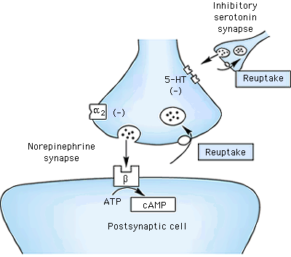
Amine neurotransmitters are
either degraded (metab)
or reuptaken
MAO
Mito
COMT

Slide 6
The monoamines
Dopamine
Epinephrine (adrenergic)
Norepinephrine (noradrenergic)
Serotonin

Slide 7
NE System
Almost all NE pathways in the brain originate from the cell bodies of neuronal cells in the locus coereleus in the midbrain, which send their axons diffusely to the cortex, cerebellum and limbic areas (hippocampus, amygdala, hypothalamus, thalamus).
Mood: -- higher functions performed by the cortex.
Cognitive function: -- function of cortex.
Drive and motivation: -- function of brainstem
Memory and emotion: -- function of the hippocampus and amygdala.
Endocrine response: -- function of hypothalamus.
α and β receptors.

Slide 8
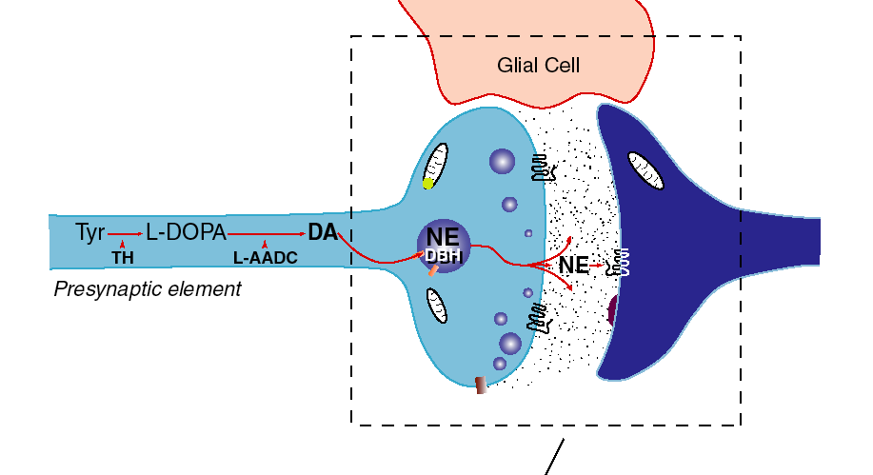
A synapse that uses norepinephrine (NE)

Slide 9
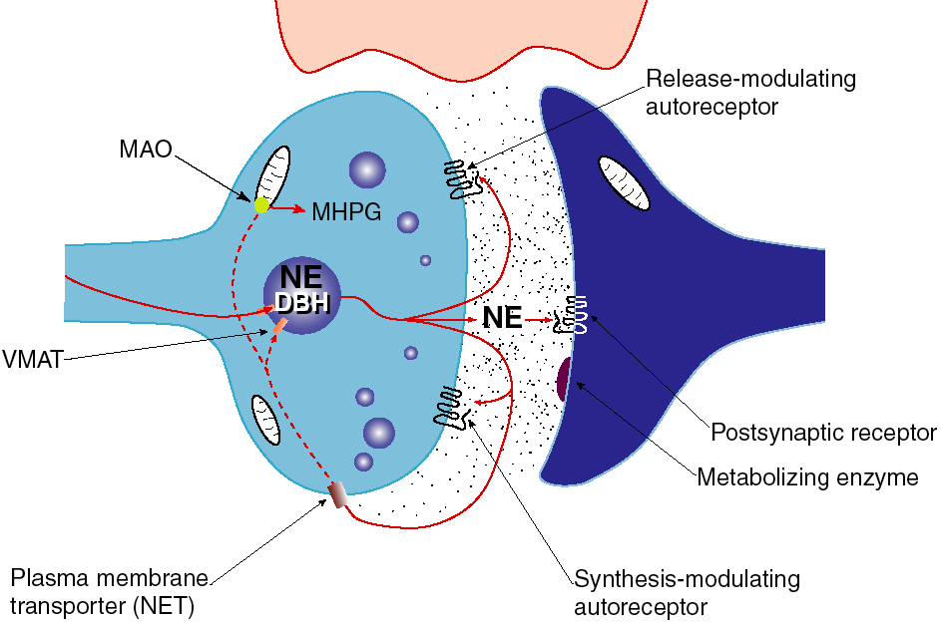
MAO Inhibitors
Monoamine oxidase, located on outer membrane
of mitochondria; deaminates catecholamines free in
nerve terminal that are not protected by vesicles
Antidepressant
Selective inhibitor,
reboxetine
Cocaine blocks the NET
Stimulant
Reuptake of NE

Slide 10
Serotonin System
As with the NE system, serotonin neurons located in the pons and midbrain (in groups known as raphe nuclei) send their projections diffusely to the cortex, hippocampus, amygdala, hypothalamus, thalamus, etc. --same areas implicated in depression. This system is also involve in:
Anxiety.
Sleep.
Sexual behavior.
Rhythms (Suprachiasmatic nucleus).
Temperature regulation.
CSF production.

Slide 11
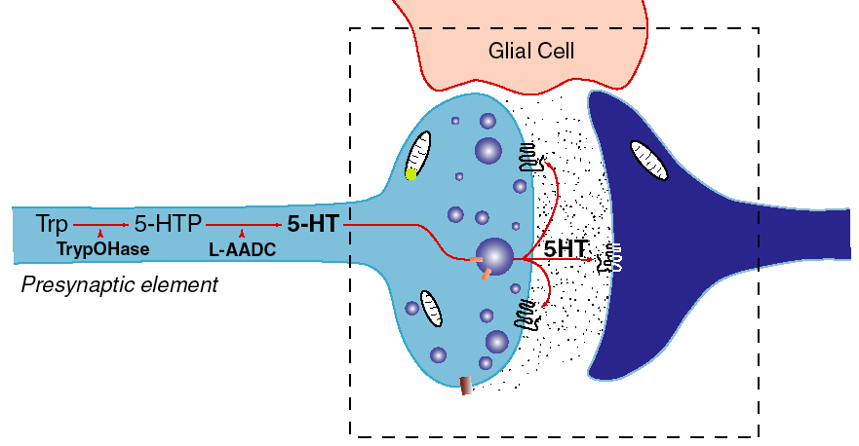
A synapse that uses serotonin/5-HT

Slide 12
Dopamine pathways do many things:
Control flow of blood through the brain
Motor control (nigrostriatal) system
Behavioural control
Dopamine is the brain’s motivational chemical. It works on
glutamate synapses to modulate their excitability.
A shortage of brain dopamine causes an indecisive
personality, unable to initiate even the body’s own
movement. Parkinson’s disease. Time stops.
L-DOPA therapy. ‘Awakenings’ film. (Oliver Sachs)
Excess dopamine, more arousal. Attention defecit
disorder. May cause schizophrenia.
Dopamine’s action is essential for drug addiction.

Slide 13
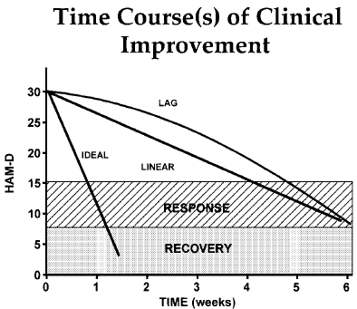

Slide 14
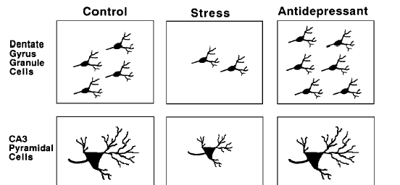
Chronic, severe

Slide 15
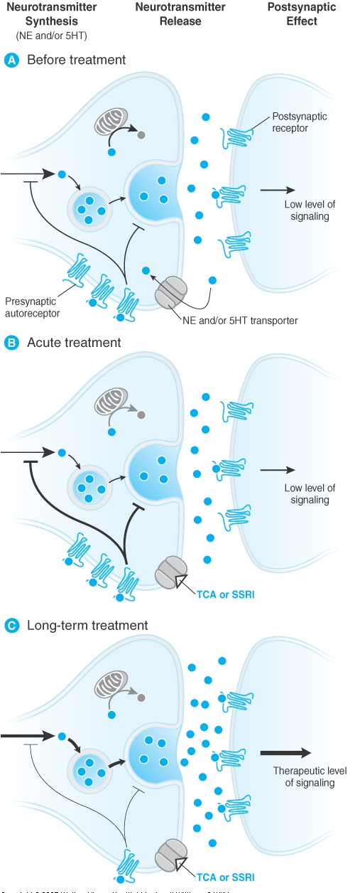
Mechanism for the Delay in
Onset of the therapeutic
Effect of Antidepressant
Medications.

Slide 16
Available Antidepressants
1) Tricyclics and Tetracyclics (TCA)
Imipramine Doxepin Desipramine Amoxepine Trimipramine
Maprotiline Clomipramine Amitriptyline Nortriptyline Protriptyline
2) Monoamine Oxidase Inhibitors (MAOIs)
Tranylcypramine Phenelzine Moclobemide
3) Serotonin Selective Reuptake Inhibitors (SSRIs) Fluoxetine Fluvoxamine Escitalopram
Sertraline Paroxetine Citalopram
4) Dual Serotonin and Norepinephrine Reuptake Inhibitor (SNRI)
Venlafaxine Duloxetine
5) Serotonin-2 Antogonist and Reuptake Inhibitors (SARIs)
Nefazodone Trazodone
6) Norepinephrine and Dopamine Reuptake Inhibitor (NDRI)
Bupropion
7) Noradrenergic and Specific Serotonergic Antidepressant (NaSSAs)
Mirtazapine
8) Noradrenalin Specific Reuptake Inhibitor (NRI)
Reboxetine
9) Serotonin Reuptake Enhancer
Tianeptine

Slide 17
1ST GENERATION ANTIDEPRESSANTS ; TRICYCLIC ANTIDEPRESSANTS
 |  |  |  |  | Block of Amine Pump for:
Drug |  | Sedation |  | Anti-muscarinic |  | Serotonin | Norepinephrine | Dopamine
Amitriptyline |  | +++ |  | +++ |  | +++ | ++ | 0
Amoxapine |  | ++ |  | ++ |  | + | ++ | +
Bupropion |  | 0 |  | 0 |  | +, 0 | +, 0 | ?
Citalopram |  | 0 |  | 0 |  | +++ | 0 | 0
Clomipramine |  | +++ |  | ++ |  | +++ | +++ | 0
Desipramine |  | + |  | + |  | 0 | +++ | 0
Doxepin (Sinequan) |  | +++ |  | +++ |  | ++ | + | 0
Fluoxetine (Prozac) |  | + |  | + |  | +++ | 0, + | 0, +
Fluvoxamine (Luvox) |  | 0 |  | 0 |  | +++ | 0 | 0
Imipramine (Tofranil) |  | ++ |  | ++ |  | +++ | ++ | 0
Maprotiline |  | ++ |  | ++ |  | 0 | +++ | 0
Mirtazapine² |  | +++ |  | 0 |  | 0 | 0 | 0
Nefazodone |  | ++ |  | +++ |  | +, 0 | 0 | 0
Nortriptyline |  | ++ |  | ++ |  | +++ | ++ | 0
Paroxetine (Seroxat) |  | + |  | 0 |  | +++ | 0 | 0
Protriptyline |  | 0 |  | ++ |  | ? | +++ | ?
Sertraline (Zoloft) |  | + |  | 0 |  | +++ | 0 | 0
Trazodone (Mesyrel) |  | +++ |  | 0 |  | ++ | 0 | 0
Venlafaxine (Efexor) |  | 0 |  | 0 |  | +++ | ++ | 0, +

