Slide 1
Biological Therapies
Level 4 (2015/2016)
Dr Judy Kamau

Slide 2
Background
Types of therapies (Treatments)
Physical treatments ( Biological)
Pharmacotherapy
ECT (Electroconvulsive therapy)
Surgery
Non Biological treatments ( Psychotherapy)

Slide 3
Background
History of treatments in Psychiatry
Mid 20th century- Insulin coma to treat morphine addiction and schizophrenia
1930’s- shock therapy (metronidazole 1930)
ECT 1950’s
1st antipsychotic, chlorpromazine-1952
Tricyclic antidepressants and MAO Inhibitors 1950’s:
Benzodiazepines: 1960’s
Psychoanalysis –first half of the 20th century

Slide 4
Pharmacotherapy

Slide 5
Introduction
Psychopharmacology: study of drugs that influence the human mental state and behaviour
Pharmacokinetics:
Absorption
Distribution
Metabolism
Excretion

Slide 6
Introduction
Neurotransmitters: endogenous chemicals in the human body responsible for transmission of nerve impulses between neurons and target cells across a synapse
For a signal to be transmitted across, an optimum amount of neurotransmitters in the synaptic space must be present
In mentally healthy individuals there is a balance between the amount of neurotransmitters in the synaptic space and the presynaptic neuron.
A disruption of this balance leads to mental and metabolic disorders

Slide 7
Introduction
Pharmacodynamics
Psychotropic drugs interfere with neurotransmitter function in several ways:
On neurotransmitter receptors
Storage
Release
Reuptake
Metabolism
Drugs can be agonists (mimic endogenous neurotransmitters) or antagonists (bind receptors and block the action of agonists)

Slide 8
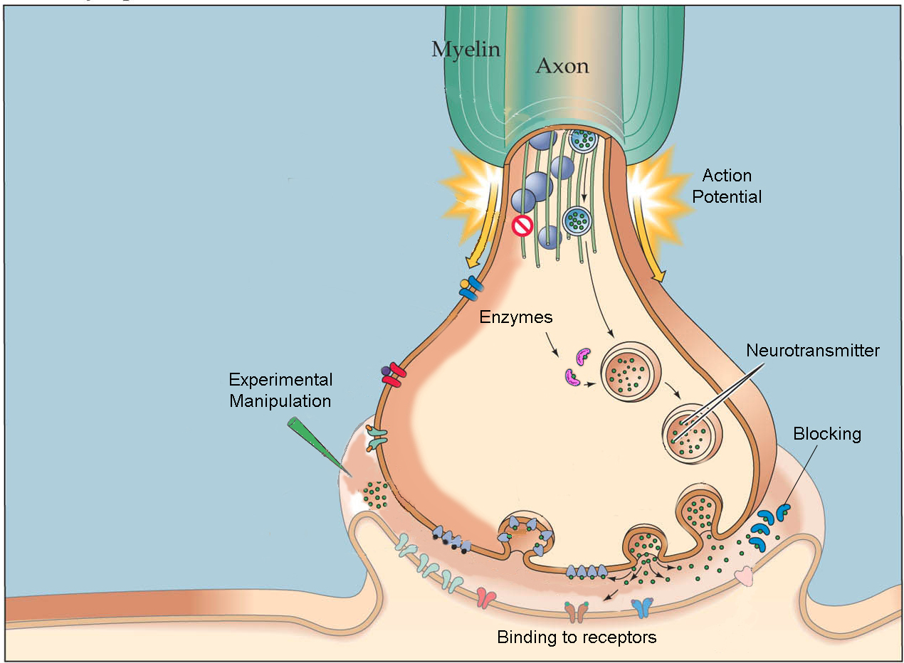

Slide 9
Introduction
Important neurotransmitters implicated in psychopharmacology include:
Acetylcholine: reduction implicated in Alzheimer's
Serotonin: regulates mood, anxiety and arousal
Dopamine: plays a role in Schizophrenia and Parkinson’s disease
Norepinephrine:
Epinephrine
Glutamate: Excitatory neurotransmitter
GABA: Inhibitory neurotransmitter

Slide 10
Prescribing principles
Thorough medical evaluation
Beware of side effects, current and previous and previous response
Inform family of benefits and risks, delay in therapeutic response
Start low and increase slowly (dosage)
Special considerations for special populations (children, geriatrics, pregnant and nursing women)
Beware of drug interactions

Slide 11
Classification
Anxiolytics and hypnotics
Antipsychotics
Antidepressants
Mood stabilizers
Prescription stimulants

Slide 12
Antipsychotics
Used to treat psychosis (disorders resulting from abnormal perception of reality accompanied by defective insight) e.g. In schizophrenia and mania.
Psychotic patients experience delusions, hallucinations, cognitive impairments, personality changes and thought disorders
Also useful for sedation and tranquilisation
Non psychotic indications: Tic disorders

Slide 13
Antipsychotics
Typical antipsychotics
(typically) Produce extrapyramidal side effects (EPSE)- Parkinsonism (muscle rigidity, tremor, bradykinesia), acute dystonic reactions, dyskinesia, akathasia, tardive dyskinesia
Atypical antipsychotics
Lower propensity to produce EPSE

Slide 14
Antipsychotics
Typical (1st generation):
Older (1950’s)
Propensity to cause extra-pyramidal side effects (EPSE) due to action on basal ganglia.
EPSE- Parkinsonism (muscle rigidity, tremor, bradykinesia), acute dystonic reactions, dyskinesia, akathasia, tardive dyskinesia

Slide 15
Antipsychotics
Examples of typical antipsychotics include:
Phenothiazines:
Chlorpromazine
Thioridazine
Fluphenazine
Thioxanthines:
Flupenthixol
Butyrophenones:
Haloperidol

Slide 16
Antipsychotics
Atypical (2nd generation):
Lower incidence of extrapyramidal side effects and prolonged elevated prolactin levels
Greater effects on negative symptoms of schizophrenia
Include: Clozapine, Risperidone, Olanzapine, Quetiapine, Aripiprazole, Sertindole, Amisulpiride, Ziprasidone

Slide 17
Antipsychotics
Mechanism of action:
Dopamine receptor blockade (D2)
This accounts for antipsychotic activity and propensity to cause extra-pyramidal side effects
Some atypical anti psychotics with low D2 receptor occupancy and high 5HT receptor occupancy

Slide 18
Antipsychotics
Depot antipsychotic drugs
Slow release preparations
Where compliance cannot be assured
Given I/M
Include: fluphenazine decanoate, flupenthixol decanoate, zuclopenthixol decanoate, Haloperidol decanoate

Slide 19
Antipsychotics
Side effects include:
Extra pyramidal side effects (anti-dopeminergic)
Acute dystonia, akathasia, parkinsonian syndrome, tardive dyskinesia
Anticholinergic effects:
dry mouth, urinary retention, constipation, blurred vision
Antiadrenergic effects:
Sedation, postural hypotension, inhibition of ejaculation
Cardiac: arrhythmias, prolongation of QT interval
Metabolic effects
Sensitivity reactions
Neuroleptic malignant syndrome
Muscle rigidity, breakdown of muscle fibres, fever, altered consciousness, death)
Amenorrhoea
Galactorhoea

Slide 20
Antidepressants
Indicated to treat the various symptoms of depressive disorders
According to the biogenic monoamine theory, depression results from a deficiency of monoamines (norepinephrine, serotonin) in certain brain areas
Exert antidepressant activity by increasing the availability of monoamines via:
Presynaptic inhibition of reuptake of 5HT, NE, Dopamine
Inhibition of monoamine oxidase reducing neurotransmitter breakdown
Increasing the availability of neurotransmitter precursors

Slide 21
Antidepressants
Initial resolution of depressive symptoms generally takes 10-20 days
Off label: Anxiety, Sleep disorders, OCD, Eating disorders, Neuropathic pain, Migraines, ADHD

Slide 22
Antidepressants
Tricyclic antidepressants
Inhibit reuptake of both 5HT & noradrenaline
Include: amitryptiline, clomipramine, imipramine
S/E: autonomic, psychiatric, cardiovascular, neurological, withdrawal effects
Toxic effects

Slide 23
Antidepressants
Monoamine oxidase (MAO) inhibitors & reversible monoamine oxidase inhibitors (RIMAs)
Inactivate enzymes that oxidise noradrenaline, 5HT, dopamine, tyramine (MAO A and MAO B)
Include: Phenelzine, Isocarboxazid, Tranylcypromine
Moclobemide- RIMA
Interactions with food and drugs
S/E: hypertensive crises, antimuscurinic, hepatotoxicity, insomnia, anxiety, weight gain, hypotension, ankle oedema

Slide 24
Antidepressants
Selective Serotonin Reuptake Inhibitors (SSRIs)
Inhibit the reuptake of 5-HT with high potency and selectivity leading to increased 5-HT in the synaptic cleft
Include: paroxetine, sertraline, fluoxetine, fluvoxamine, citalopram, escitalopram
Easier dosing
Better tolerance than TCAs & MAOs
Fewer anticholinergic side effects, low toxicity in overdose, not sedating
S/E: gastrointestinal, neuropsychiatric, sexual dysfunction, suicidal behaviour
Serotonin syndrome

Slide 25
Antidepressants
Other antidepressants:
Serotonin/noradrenaline reuptake inhibitors(SNRIs)
Venlafaxine, duloxetine
Tetracyclic antidepressants
MOA similar to TCA but with less anticholinergic side effects
Mianserin
Serotonin antagonist/ reuptake inhibitors (SARIs)
Trazodone

Slide 26
Antidepressants
Noradrenergic and specific serotonergic antidepressants (NaSSA)
Mirtazepine
Noradrenaline reuptake inhibitor (NARI)
Reboxetine
Noradrenergic and doperminergic reuptake inhibitor (NDRI)
Bupropion
Melatonin agonist and specific serotonin antagonist (MaSSA)
Aglomelatine
St John’s Wort: plant extract; may potentiate monoamine neurotransmission

Slide 27
Mood stabilizers
Effective for treating both mania and depression in bipolar patients.
Lithium
MOA: Intracellular signalling effects through second messengers. (inhibits formation of cAMP and attenuates formation of inositol lipid derived mediators
S/E: polyuria, polydypsia, weight gain, cognitive problems, tremor, hypothyroidism, GI problems, teratogenic
Narrow therapeutic index
Toxicity: marked tremor, nausea, diarrhoea, ataxia, drowsiness, confusion, seizures, coma,

Slide 28
Mood stabilizers
Anticonvulsants
Valproate/Valproic acid:
Acute mania, mixed episodes, prophylactic agent, rapid cycling bipolar
S/E: nausea, tremor, sedation, hair loss, weight gain, deranged LFTs. is teratogenic
Wide therapeutic index though can be fatal in overdose
Carbamazepine
Acute mania, bipolar depression; prophylactic agent
Interacts with many drugs: decreases plasma levels of antipsychotics, benzodiazepines, TCAs, hormonal contraceptives; levels can be decreased by: erythromycin, calcium channel blockers

Slide 29
Mood stabilizers
Anticonvulsants…
Lamotrigine
maintenance treatment
Especially for bipolar depression
Gabapentin
Used in non response

Slide 30
Anxiolytics
Used to curb anxiety
Benzodiazepines
Reduce anxiety, agitation and tension
Uses: anxiolytic, sedative, muscle relaxant, anticonvulsant
MoA: Enhance GABA neurotransmission
Are addictive
Should not be routinely prescribed for longer than a month

Slide 31
Anxiolytics
Benzodiazepines…
Long acting compounds preferable for management of anxiety. (half life more than 12 hours)
Include: diazepam, chlordiazepoxide, alprazolam, clonazepam
Side effect: headache, confusion, ataxia, blurred vision, GI disturbance, jaundice, paradoxical excitement……
Potentiate effects of alcohol
Cause dependence which is associated with a withdrawal syndrome- apprehension, insomnia, nausea, tremor heightened sensitivity to perceptual stimuli
Flumazenil is a benzodiazepine receptor antagonist, useful in reversing toxicity

Slide 32
Anxiolytics
Azapirones
Buspirone
Useful in treatment of Generalised Anxiety Disorder, not for panic disorder
Effects take several days to develop
MoA: stimulates 5-HT_{1A} receptor
Not sedative but associated with light headedness, nervousness headache

Slide 33
Anxiolytics
Antidepressant drugs:
TCA, SSRIs, MAOIs
Onset of effect much slower than of the benzos
Beta-adrenoceptor antagonists
Relieve autonomic symptoms of anxiety
Especially if main symptoms are tremors and palpitations
Include propranolol
Contraindicated in hypotension, bradycardia, heart block, bronchospasms

Slide 34
Hypnotics
Are used to improve sleep
Primary chronic insomnia is rare
Comorbidity is the rule
Non pharmacological methods tried first- Sleep Hygiene
The ideal hypnotic would increase the length and quality of sleep without residual effects the next morning.
Many anxiolytic drugs also act as hypnotics
Antihistamines and low doses of sedating anti depressants e.g. amitriptyline are also used to facilitate sleep

Slide 35
Hypnotics
Most enhance the action of GABA
Benzodiazepines:
shorter acting compounds lack hang over effects the next day (e.g. temazepam
Longer acting compounds produce some cognitive impairment the next day (e.g. flurazepam, nitrazepam)
Non benzodiazepine ligands: Zoplicone, Zolpidem zaleplon
Melatonin: not addictive; nudges one to sleep

Slide 36
Psychostimulants
Include:
Amphetamines- dextroamphetamine
Methylphenidate
MoA: increase the release and block the reuptake of dopamine and noradrenaline
Indications:
Narcolepsy
ADHD
Side effects: restlessness, insomnia, poor appetite, dizziness, tremor, palpitations, arrhythmias

Slide 37
Other biological treatments

Slide 38
Electroconvulsive therapy (ECT)
Introduced in the late 1930’s
Initially Cardiazol, or just passing an electric current into the brain
Now made safer with use of brief anaesthesia and muscle relaxants

Slide 39
Electroconvulsive therapy (ECT)
Indications:
Major depression
Not responding to antidepressants
With psychotic symptoms
With failure to eat or drink
Depressive stupor
High suicide risk
Schizoaffective depression
Catatonic schizophrenia
Mania not responding to drug treatment
Post- partum psychosis

Slide 40
Electroconvulsive therapy (ECT)
MoA:
Neurochemical effects of ECT- changes n the bran monoamine pathway
Down regulation of noradrenaline beta adrenoreceptors
Increased expression of D2 receptors
Side effects:
Retrograde amnesia
Anterograde amnesia
Brief disorientation
Headache

Slide 41
Neurosurgery for mental disorder
Began in 1936- work of Moniz- Nobel prize in 1949
Controversial
Indications :
Severe mood disorders, OCD, Severe anxiety disorders
Patient must want the operation
All reasonable treatments have completely failed
Patient remains ill but has capacity to provide consent
Stereotactic procedures used include:
Sub caudate tractotomy
Anterior cingulotomy
Limbic leucotomy
Anterior capsulotomy
Adverse effects; operative mortality, haemorrhage, hemiplegia, epilepsy, personality changes

Slide 42
Light therapy
Treatment of seasonal affective disorder
Used to ameliorate symptoms of winter depression due to effects on circadian and seasonal rhythms
Administered using a light box, 2 hours/30 minutes a day for 1-3 weeks
Dawn stimulating alarm clocks

Slide 43
Repetitive Transcranial magnetic stimulation (rTMS)
Experimental treatment for treatment resistant depression
An electromagnetic coil is placed on the scalp, pulses of current then produce a powerful magnetic field

Slide 44
QUESTIONS

