Slide 1
Bipolar Illness

Slide 2
Objectives
You should be able to
  Recognise the clinical features of bipolar disorder
  Describe the underlying pathology in bipolar disorder
  Assess a patient with bipolar disorder
  Manage a patient with bipolar illness

Slide 3
Historical perspective
Hippocrates: “amic” and “melancholic” patients
Aretaius of Capadocia (c. 150 BC)
Paul Aegina (625- 690 BC)
Jules Baillarger (1854): “la folie a double forme”
Jean-Pierre Falret (1854): “la folie circulaire”
Emil Kraeplin (1899): Manic Depressive Insanity

Slide 4
Bi polar Disorder Phases
Mania
Hypomania
Euthymia
Dysthymia
Depression

Slide 5
Mania: core diagnostic criteria
Increased activity or physical restlessness
Talkativeness (pressure of speech in mania)
Difficulty in concentration or distractibility (flight of ideas in mania)
Decreased need for sleep
Increased sexual energy
Overspending or other reckless behaviour (more pronounced in mania)
Increased sociability or over-familiarity
Increased self esteem or grandiosity

Slide 6
Other Features of Mania
Core Symptoms of Mania
Social
Disinihibition
Self confident
Making Plans
Aggression
Psychosis
Impulsivity

Slide 7
Mania: ICD 10 criteria
Increased activity or physical restlessness;
Increased talkativeness ('pressure of speech')
Flight of ideas or the subjective experience of thoughts racing;
Loss of normal social inhibitions resulting in behaviour which is inappropriate to the circumstances;
Decreased need for sleep
Inflated self-esteem or grandiosity
Distractibility or constant changes in activity or plans;
Behaviour which is foolhardy or reckless and whose risks the subject does not recognize e.g. spending sprees, foolish enterprises, reckless driving
Marked sexual energy or sexual indiscretions.

Slide 8
DSM-IV: Criteria for Manic Episode
A distinct period of abnormally and persistently elevated, expansive. or irritable mood, lasting at least 1 week (or any duration if hospitalization is necessary) ,
B. During the period of mood disturbance three (or more) of the following symptoms have persisted (four if the mood is only irritable) and have been present to a significant degree:
inflated self-esteem or grandiosity
decreased need for sleep (e.g. ,feels rested after only 3 hours of sleep)
more talkative than usual or pressure to keep talking
flight of ideas or subjective experience that thoughts are racing
distractibility (i.e., attention too easily drawn to unimportant or irrelevant external stimuli)
increase in goal-directed activity (either socially, at work or school, or sexually) or psychomotor agitation
excessive involvement in pleasurable activities that have a high potential for painful consequences (e .g., engaging in unrestrained buying sprees, sexual indiscretions, or foolish business investments)

Slide 9
Criteria for Manic Episode
C. The symptoms do not meet criteria for a Mixed Episode
D. The mood disturbance is sufficiently severe to cause marked impairment in occupational functioning or in usual social activities or relationships with others, or to necessitate hospitalization to prevent harm to self or others, or there are psychotic features.
E. The symptoms are not due to the direct physiological effects of a substance (e.g., a drug of abuse, a medication, or other treatment) or a general medical condition (e.g., hyperthyroidism).

Slide 10
DSM V Classification
Bipolar I Disorder
Bipolar II Disorder
Cyclothymic Disorder
Substance/ Medication Induced Bipolar Disorder
Bipolar and Related Disorder due to another Medical Condition
Unspecified Bipolar Related Disorder

Slide 11
Diagnostic Symptoms of Mania
Elevated
Irritable
Mood
Risks
Racing thoughts
Grandiosity
Distractible
Pressured speech

Slide 12
Mania: classification
Hypomania
  Mood is mildly elevated
  Symptoms do not lead to severe disruption of work or social rejection
  3 or more symptoms lasting at least 4 days (DSM IV)
Mania
  Mood is elevated out of keeping with the patient’s circumstances
  Symptoms may result in behaviour that is inappropriate and reckless
Mania with psychotic symptoms
  In addition to mania there are delusions (usually grandiose) or hallucinations usually 2nd person
Mixed affective states

Slide 13
Manic stupor
  Patients can rarely become mute and motionless
  Their facial expression my suggest elation and may begin from a state of manic excitement
  Patient’s memory for the events during stupor usually intact
Delirious mania
  features suggestive of a confusional state such as disorientation and visual hallucinations.

Slide 14
Depression symptoms
Low mood
Decreased interests or pleasure
Decreased energy or fatigue
Disturbed sleep
Decreased appetite or weight loss
Psychomotor retardation or agitation
Decreased confidence or self-esteem
Guilt or self-reproach
Decreased concentration
Deliberate self-harm or suicidal ideation

Slide 15
Depression
Depressed Mood
Anhedonia
Self Depreciation
Loss of Interest
Guilt
Hopelessness
Suicidal ideas/ plans

Slide 16
Classification of Bi polar Disorder
Bi polar 1 full manic and depressive episodes
Bi polar 2 one hypomanic and 1 full depression
Bi polar 3 Depressive episode with antidepressant induced mania
Bipolar depression
Mixed States
Rapid Cycling

Slide 17
Bipolar classification
ICD 10
  At least 2 episodes, one of which must be hypomanic, manic or mixed
DSM-IV
  A single manic or cyclothymic
  Bipolar I: 1 or more manic episodes or mixed episodes, with or without history of depressive episodes
  Bipolar II: one or more depressive episodes plus at least one hypomanic episode
Mixed episodes
  Both manic /hypomanic and depressive symptoms in a single episode present everyday for at least 1 week (DSM-IV) or two weeks (ICD 10)

Slide 18
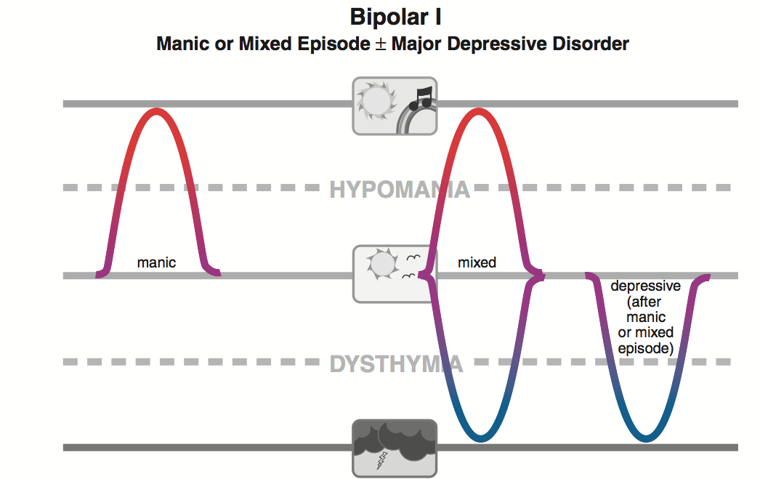

Slide 19
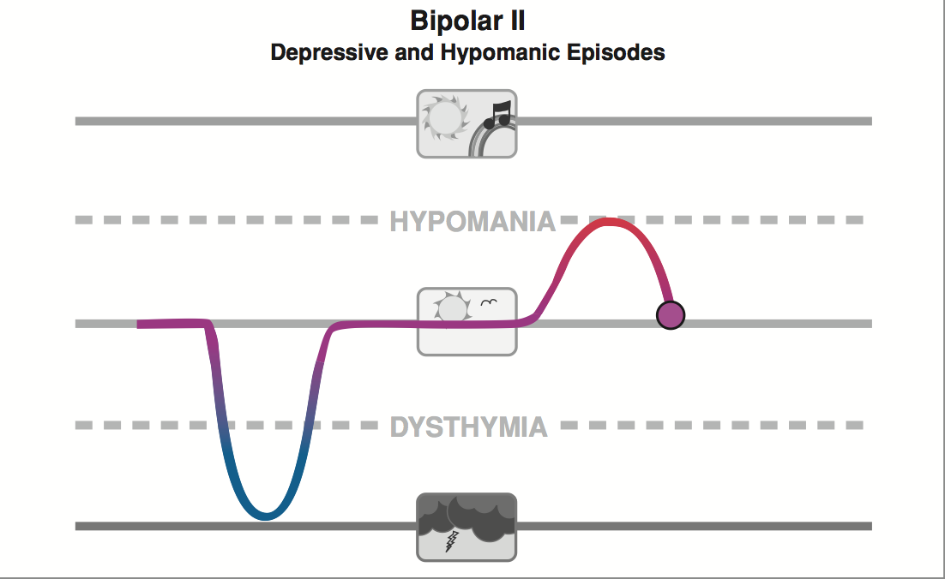

Slide 20
Bipolar classification
Rapid Cycling
  At least 4 distinct episodes of mood disorder per year (depressive, manic or mixed).
Rapid cycling is associated with
  Increased frequency in women
  Concomitant hypothyroidism
  Can be triggered by antidepressant drug treatment
  Lithium is relatively ineffective

Slide 21
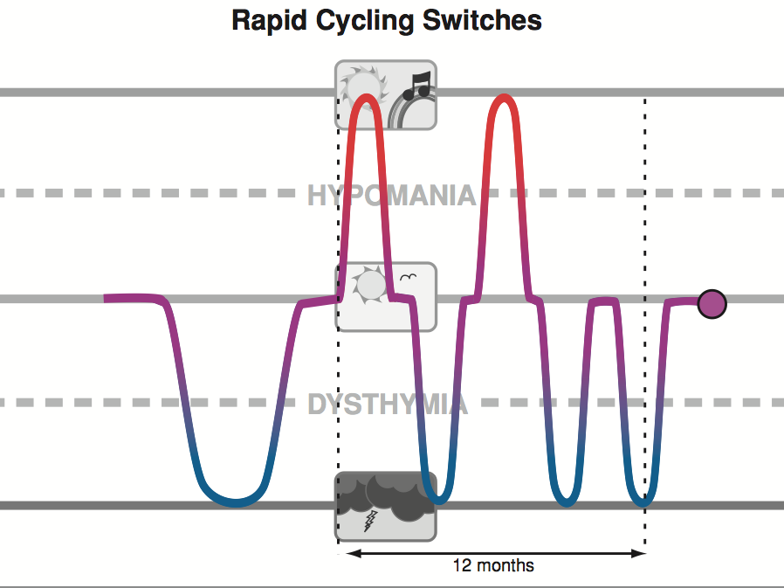

Slide 22
Epidemiology and course
Lifetime prevalence: 0.3 – 1.5%
  Bipolar I: 0.8%
  Bipolar II: 0.5%
Age of onset 15 – 50 years.
  Two peaks
    (15-19 years) and
    20-24 years mean 21 years
Bipolar II and rapid cycling more common in females
No significant racial difference

Slide 23
Course
Pattern
  1st episode in males often manic and in females depression
Untreated patients
  10 or more episodes may occur
Duration between episodes
  decreases up to 4th or 5th episode then stabilizes
Within the first 2 years after the 1st episode, 40 – 50% experience another manic attack

Slide 24
Aetiology ...
Genetic
  First degree relatives 7X more likely: 10-15% risk
  Children of parents affected: 50%
Neurotransmitters
  NA, DA, 5HT and glutamate
HPA axis
Abnormal programmed cell death (apoptosis)
  Cell death in critical neural networks
Kindling:
  electrophysiological kindling and behavioural sensitisation in injured neurones

Slide 25
Aetiology
Life events:
  a small excess of life events prior to relapse has been demonstrated
  Attainment of a goal
    normal feelings of happiness and well being can develop into a manic illness in predisposed people

Slide 26
Mania
Neurochemistry
Increased hyperactivity of monoamines
Out of tune circuits
Can be both depression and mania at same time
Dopamine, Noradrenalin, Serotonin and GABA
Role of Glutamate

Slide 27
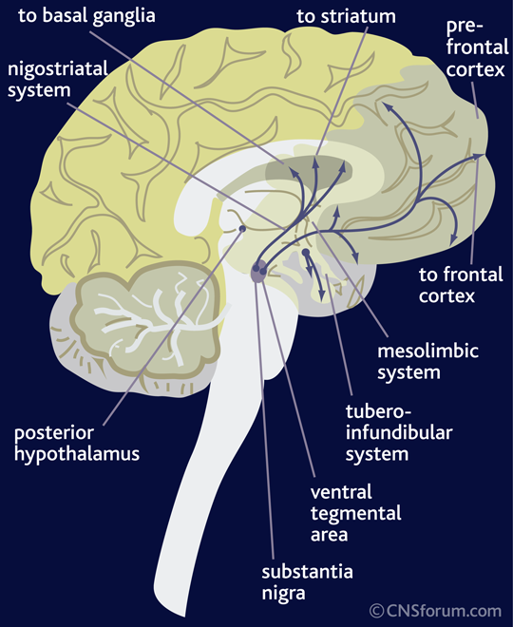
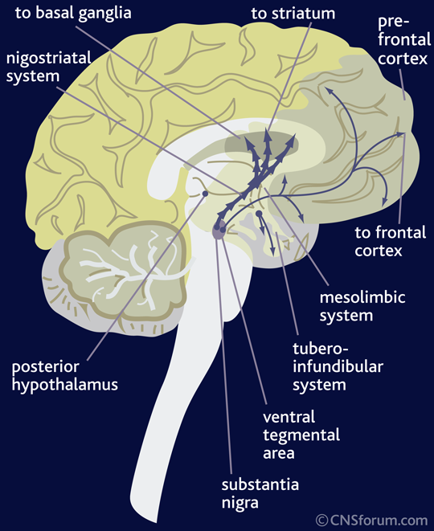
Dopamine pathways
Normal-------------------Mania
Notes:
The ventral tegmental and the tuberoinfindibular pathway remains unchanged

Slide 28
The Dopamine Pathways
Dopamine is transmitted via three major pathways in the brain.
In mania there is an increase in dopamine transmission from the substantia nigra to the neostriatum which is associated with increased sensory stimuli and movement.
the ventral tegmentum and the tubero-infundibular, remains unchanged in mania compared with a non-diseased brain.

Slide 29
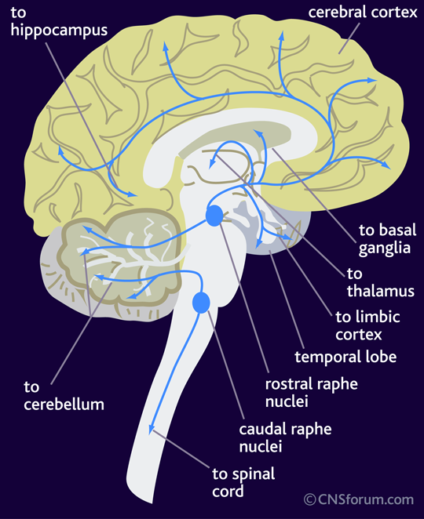
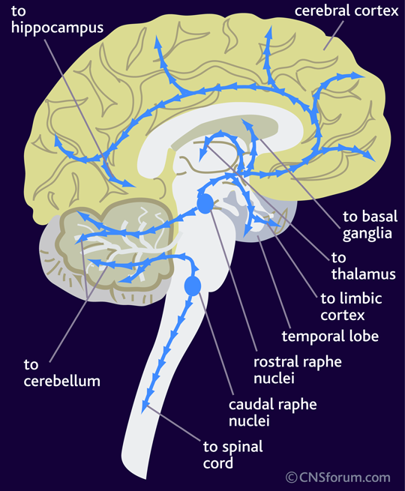
Serotonin Pathways normal--------------mania

Slide 30
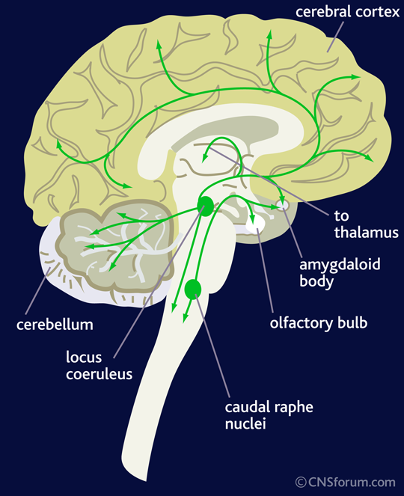
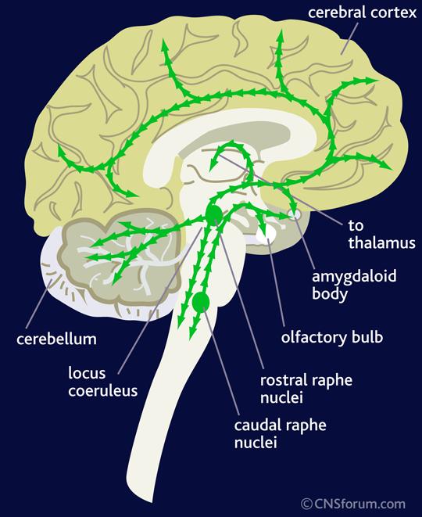
Noradrenaline pathways normal----------------mania

Slide 31
The noradrenaline pathways
The principal noradrenaline centres in the brain are the caudate nuclei and the locus coeruleus.
The transmission of noradrenaline from both of these centres to all areas of the brain is thought to be increased in mania compared with a non-diseased brain.

Slide 32
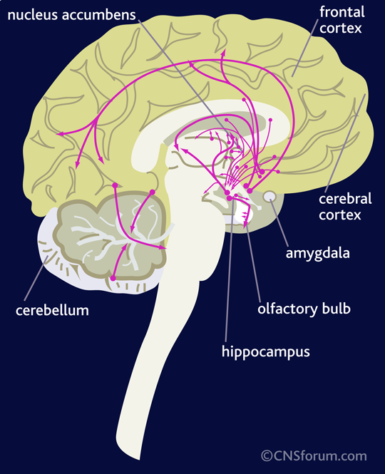

GABA Pathways
Normal---------------Mania

Slide 33
GABAergic pathways
GABA is the main inhibitory neurotransmitter in the central nervous system (CNS).
GABAergic inhibition is seen at all levels of the CNS, including the hypothalamus, hippocampus, cerebral cortex and cerebellar cortex.
GABA interneurones are abundant in the brain, with 50% of the inhibitory synapses in the brain being GABA mediated.
There is evidence of decreased GABA function in all GABAergic pathways in depressed and manic states.

Slide 34
Brain mapping for mania
SYMPTOM | REGION OF BRAIN
Elevated, irritable mood. | Pre-frontal cortex (5HT, NA, DA)
Grandiosity, risk taking, flight of ideas. | Pre-frontal cortex (5HT, NA). Nucleus accumbens (DA).
Decreased need for sleep | Hypothalamus, thalamus and basal forebrain (5HT, NA, DA).
Distractibility | Pre-frontal cortex (NA, DA).
Agitation | Striatum (5HT, DA).

Slide 35
Management
Where
  primary care, home treatment or hospitalisation?
Who
Establish diagnosis
History and additional information
Investigations
Medications
Address specific psychosocial stressors

Slide 36
Management: Information gathering
Sources of information:
  Patient
  Collateral (corroborative) history
  Primary physician (GP) records
  Hospital records
  Prison records (inmate records)

Slide 37
Specific management
Establish diagnosis and co-morbidity
  Associated factors
    Psychosis
    Catatonic symptoms
    Risk of suicide
    Risk of violence
    Substance use disorder
  Other co-morbidities:
    personality disorder, anxiety disorder, ADHD and conduct disorder

Slide 38
Medications that may cause mania
Psychotropic medication
  Antidepressants
  Other psychotropic medication
Anti-parkinsonian medication
Analgesics: buprenophine, codeine, indomethacin ...
Cardiovascular
Respiratory drugs
Anti-infection: anti-TB, chloroquin, ARVs
GIT drugs: cimetidine, ranitidine, metoclopromide
Steroids: ACTH, corticosteroids, dexamethasone
Others

Slide 39
Management: investigations
Physical exam
Routine
  Full haemogram, ESR,
  Glusose
  U&E
  Calcium
  TFTs
  LFTs
  Drug screen
  ECG
  Creatinine clearance
Others
  Urinary copper (Wilson’s disease)
  ANF (SLE)
  Infection screen (VDRL, HIV)
  CT/MRI scan

Slide 40
Specific treatment: manic phase
First line
  Lithium
  Antipsychotics
Second line
  Carbamazepine
  Valproate
  Lamotrigine
  Gabapentine
Third line
  ECT

Slide 41
Bipolar depression: treatments
Established
  Lithium
  Lithium and antidepressant
  Lamotrigine
  Olanzapine and fluoxetine
  Quetiapine
Alternatives
  Pramipexole (dopamine agonist)
  Valproate
  Carbamazepine
  Antidepressants

Slide 42
Specific treatment: depressed phase
SSRIs less prone to precipitate manic attacks compared to TCAs
Antipsychotics

Slide 43
Prophylaxis of bipolar disorder with drugs
Consider Lithium, olanzapine or valproate
The choice should depend on:
  response to previous treatments
  the relative risk, and known precipitants, of manic versus depressive relapse
  physical risk factors, e.g. renal disease, obesity and diabetes
  the patient’s preference and history of adherence
  gender (valproate should not be prescribed for women of child‐bearing potential)
  a brief assessment of cognitive state (such as the Mini‐Mental State Examination) for older people.

Slide 44
Morbidity and mortality
Control of acute manic episode usually possible within 2 weeks
Loss of work and productivity
  A number of famous actors, artists and musicians have had the disorder
Attempted suicide: 25 – 50%
Completed suicide: 10%

Slide 45
Prognostic factors
Poor
  Unemployment or poor employment history
  Alcohol abuse
  Psychotic features
  Depressive features
  Male sex
  Treatment non-compliance
Good
  Manic episodes of short duration
  Later age of onset
  Few thoughts of suicide
  Few psychotic symptoms
  Few co-morbid physical factors
  Good treatment response and compliance

Slide 46
Thank you

