Slide 1
DELIRIUM
By
Pius Kigamwa

Slide 2
DELIRIUM
-When Present –based on aetiology
Hence
-Delirium due to General medical condition
-Substance induced delirium
-Due to Multiple aetiologies
-Not otherwise specified
Predisposition:-
1) Elderly
2) Low Cerebral reserve
3) Post cardiotomy
4) Burn patients
Drugs dependency in withdrawal

Slide 5
EPIDEMIOLOGY
10% of all hospital in-Patients incidence varies with Setting-
30% of surgical ICU/ Coronary ICUs
20% of Severe burns
30-40% of hospitalized more than 65 yrs olds
High risk in Children
Pre-existing brain damage e.g. Dementia, Tumour , Cerebro-vascular- disease.
History of Delirium
Alcohol dependency
Diabetes Mellitus
Malnutrition
Sensory deprivation e.g. Black patch

Slide 10
CAUSES
INTRACRANIAL i.e. CNS Disease
Epilepsy + Post Ictal states
Brain trauma (esp. Concussion)
Infections- Meningitis /Encephalitis
Neoplasm’s
Vascular disorders e.g. CVA

Slide 11
EXTRA-CRANIAL
Drugs (ingestion or withdrawal + poisons
DRUGS
-Anticholinergics -Anticonvulsants
-Antihypertensives -Antiparkinsonian agents
-Cardiac glycosides -cimetidine
-Disulfiram -Insulin
-Opiates -Phencyclidine
-Salicylates -Steroids

Slide 12
EXTRA-CRANIAL
POISONS
-Carbon monoxide - Heavy metals
Sedatives/Hypnotics//Tranquilizers Alcohol.
ENDOCRINE DYSFUNCTIONS (HYPO OR HYPERFUNCTION)
- Pituitary, Pancreas,Adrenal, Parathyroid, Thyroid
DISEASE OF NON-ENDOCRINE ORGANS
Liver – Hepatic encephalopathy, Kidney- Uraemic encephalopathy-Lung – CO2, Narcosis,Hypoxia CVS-Heart failure, Arrythmias, Hypotension, Deficiency diseases-Thiamine,B12, folic Acid, Nicotinic Acid Pellagra 5DS- Systemic infections- fever,Sepsis Electrolyte imbalance of any cause- Post operative State, Trauma –head or general body

Slide 13
AETIOLOGY
Multifactorial - Combination of Individual, Situational and Pharmacological Variables.
Basic dysfunction in ….Dopamine Systems andAch.
Notable correlates
-Anticholinergic Toxicity …..EEG Slowing
-TCAs- Delirium in overdose-.disorientation, cognitive dysfunction + Hallucinations with characteristic
EEG Slowing
-High Transmission in Meso-limbic dopaminergic Pathway, thus Agitation + Delusions treatment = 1/V Haloperidol.

Slide 14
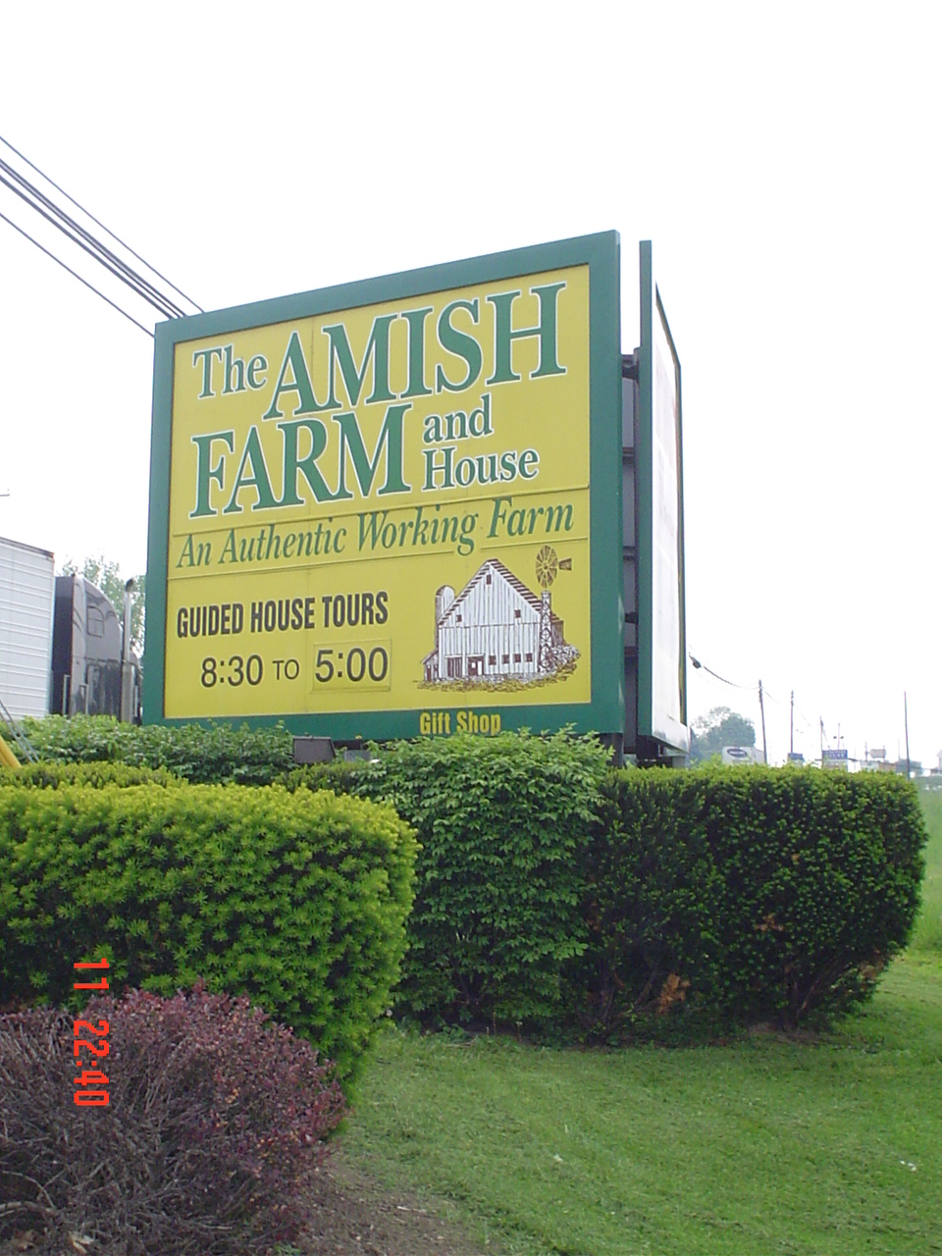

Slide 15
CLINICAL FEATURES
Clouded state of consciousness……….HALLMARK
Difficulty in Sustaining attention to both internal and external Stimuli
Sensory Misperceptions
Disordered Stream of thought
Disturbance of sleep/awake cycle
Altered level of Psychomotor activity
Features evolve over a short period, fluctuating over 24hr period
Affect-Anxiety, Irritability, Depression, Apathetic Suspicious
Delusions of Persecution
Defective grasp.e.g may drink from flower vase
Thought disorder-difficulty in focusing attention. Perservaration
Memory loss, Disorientation

Slide 16
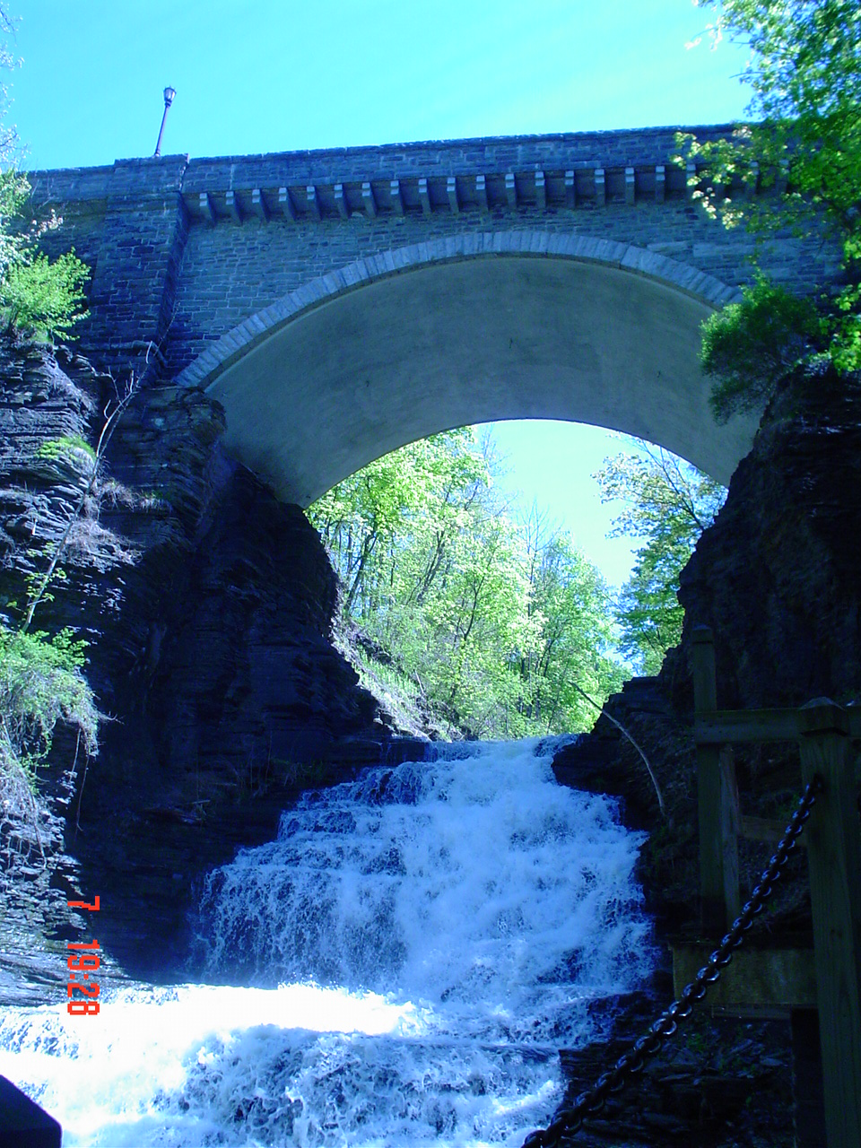
DIAGNOSIS
-Anxiety
-Dissociative States
-Malingering
-Epilepsy
-Mania
COURSE AND PROGNOSIS
Characteristically lasts < 1/52
10-30% Progress to Coma + Death
1 Year Mortality as high as 50%
Sign of impending death in 25% of cases

Slide 17
OBJECTIVE ASSESSMENT OF COGNITION
Orientation
Attention\Concentration
Memory
Abstraction
INVESTIGATIONS
- BLOOD ……FBC-differential + ESR
Blood Sugar
U/E + Ca
LFT
Arterial po2 + po2
Drug levels
TFTs
-URINE…………Glucose
Ketones
Cells
Protein
Drug screen
-ECG
-CXR , EEG , SCANS

Slide 18
TREATMENT
Basically treatment is Medical.
N.B Medical emergency-treat underlying cause.
-Symptomatic Treatment
-Management of environment
-Sedation for agitation , anxiety or violence drug of choice………..Haloperidol

Slide 21
