Slide 1
Depression

Slide 2
Objectives
You should be able to
Define and classify depressive illness
Diagnose depression
Manage a patient with depressive illness

Slide 3
Depression
Depression
Interest ↓
Energy ↓
Attention ↓
Guilt
Sleep ↓
Appetite↓
Self Depreciation
Suicidal ideas/ plans
Pessimism

Slide 4
Depression
Depressed mood to a degree that is definitely abnormal for the individual, present for most of the day and almost every day, largely uninfluenced by circumstances, and sustained for at least 2 weeks.
loss of interest or pleasure in activities that are normally pleasurable; decreased energy or increased fatiguability.
An additional symptom or symptoms from the following list should be present, to give a total of at least four:
    loss of confidence and self-esteem;
    unreasonable feelings of self-reproach or excessive and inappropriate guilt;
    recurrent thoughts of death or suicide, or any suicidal behaviour;
    complaints or evidence of diminished ability to think or concentrate, such as indecisiveness or vacillation;
    change in psychomotor activity, with agitation or retardation (either subjective or objective);
    sleep disturbance of any type;

Slide 5
Depression: classification
Dimensional
  Unipolar
  Bipolar
Severity
  Mild
  Moderate
  Severe
Symptoms
  Psychotic
  Somatic
  Neurotic
Aetiology
  Exogenous
  Endogenous

Slide 6
Mild Depressive episode
At least 2 weeks...but shorter periods if severe or rapid in onset.
At least two of:
  Depressed mood D
  Loss of interest and enjoyment I
  Increased fatigability (Energy) E
Plus two of:
  reduced self-esteem and self-confidence S
  reduced concentration and attention A
  ideas of guilt and unworthiness G
  bleak and pessimistic views of the future P
  diminished appetite A
  disturbed sleep S
  ideas or acts of self-harm or suicide S
Usually, some difficulty in functioning
Depression Interest Energy Self-confidence (-esteem) Attention Guilt Sleep Appetite Pessimistic Suicide

Slide 7
Moderate Depressive episode
At least 2 weeks...but shorter periods if severe or rapid in onset.
At least two of:
  Depressed mood
  Loss of interest and enjoyment
  Increased fatigability
Plus at least three of:
  reduced concentration and attention;
  reduced self-esteem and self-confidence;
  ideas of guilt and unworthiness
  bleak and pessimistic views of the future;
  ideas or acts of self-harm or suicide;
  disturbed sleep
  diminished appetite.
Usually, considerable difficulty functioning

Slide 8
Severe Depressive episode
At least 2 weeks...but shorter periods if severe or rapid in onset.
All three of:
  Depressed mood
  Loss of interest and enjoyment
  Increased fatigability
Plus at least four of:
  reduced concentration and attention;
  reduced self-esteem and self-confidence;
  ideas of guilt and unworthiness
  bleak and pessimistic views of the future;
  ideas or acts of self-harm or suicide;
  disturbed sleep
  diminished appetite.
Very unlikely to be able to function
Psychotic symptoms: hallucinations, delusions, depressive stupor.
  Mood congruent or incongruent.

Slide 9
Recurrent depressive episode
More than one episode lasting 2 weeks or more...separated by several months.
  Otherwise recurrent affective disorder
  (Recurrent brief depressive disorder)
    ~1/month
    <2weeks in duration (typically 2-3 days)
    Fulfil symptomatic criteria for mild, moderate, or severe
Absence of mania.
Hypomania acceptable if following treatment with antidepressant.

Slide 10
Persistent mood [affective] disorder
Rarely if ever sufficiently severe to reach hypomania or mild depression.
At least one year.
Eg. Dysthymia
Excludes bereavement (lasting <2y)

Slide 11
Somatic Syndrome ICD-10
“scientific status...questionable...can also be ignored”
At least four:
  Loss of interest or pleasure in activities
  Diurnal variation (worse in the mornings)
  EMW (2h)
  Psychomotor retardation/agitation
  Lack of emotional reactivity
  Weight loss (5% in one month)
  Loss of appetite
  Loss of libido
Mnemonic: DEAR (Depression, Early waking, Anergia, Retardation) WALI (weight ↓; Appetite↓; Libido ↓)

Slide 12
Depression: classification
Mild depressive episode
  2 or 3 symptoms
  Patient usually distressed but function not greatly affected
Moderate depressive episode
  4 or more symptoms
  Great difficulty in continuing with ordinary activities
Severe depressive episode without psychotic symptoms
  Several symptoms present: marked and distressing
  Loss of self esteem, ideas of worthlessness or guilt, suicidal ideas or acts; symptoms of the somatic type
Severe depressive episode with psychotic symptoms
  As above plus hallucinations, delusions, psychomotor retardation or stupor
  Ordinary social activities are impossible
  Hallucinations and delusions may or may not be mood congruent

Slide 13
Depressive symptoms of the somatic syndrome
Mood worse in the morning
Decreased interests or pleasure
Early morning wakening
Decreased appetite or weight loss
Psychomotor retardation or agitation
Decreased emotional reactivity
Decreased libido
Diurnal variation Early morning wakening Agitation Reactivity reduced Weight loss Appetite LIbido

Slide 14
Other mood disorders
Cyclothymia
  Persistent instability of mood with mood swings unrelated to life events
  Numerous periods of mild elation and depression
  Criteria for bipolar affective disorder or recurrent depression not met
Dysthymia
  Chronic depression of mood
  Not severe to meet diagnosis of bipolar disorder or depression

Slide 15
Epidemiology
Unipolar depression
  The 4th leading cause of disease burden in the world
  M:F ratio = 1:2
  Incidence: 1 per 100 men and 3 per 100 women
  Point prevalence 7.1%
  Average age of onset: around 30s

Slide 16
Epidemiology
  Higher prevalence in working class than middle class women
  Marital status: divorced > bereaved > unhappily married > single > happily married
  No difference in ethnic groups
  Rate of major depression increased with earlier onset in past 10 years
  Suicide rates in the young increased in past 2 decades

Slide 17
Aetiology
Biological
  Genetic
  Biochemical theories
    Biogenic amines
    Cortisol
Psychosocial
  Environmental factors
  Life events
Learning theories
  Conditioned response (Wolpe)
  Learned helplessness (Seligman)
  Cognitive model (Beck)
Psychoanalytic - Freud

Slide 18
Biological: Genetic
Heritability not as great as in bipolar illness
MZ:DZ concordance 54%:24%
Family studies: 2-3% increase if one parent has depression
Abnormalities in
  C5 serotonin transporter gene
  C11 tyrosine hydroxylase
  Chr Xp MAO enzyme

Slide 19
Biological: hormones
Cortisol secretion –
  increased and longer lasting suppression of cortisol in dexamethasone suppression test (60%)
25% show blunted TSH response to TRH stimulation

Slide 20
Biological: neurotransmitters
Biochemical theories
  Monoamine hypothesis (biogenic amine hypothesis)
  Serotonergic hypothesis
  Noradrenergic
  Dopaminergic hypothesis
Other
  Cholinergic
  GABA (gamma-amino butyrate-ergic theories

Slide 21
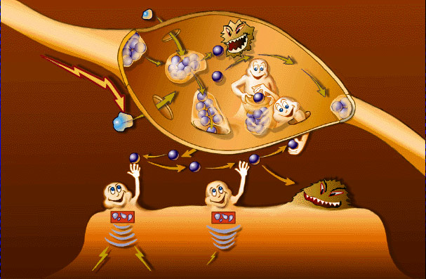

Slide 22
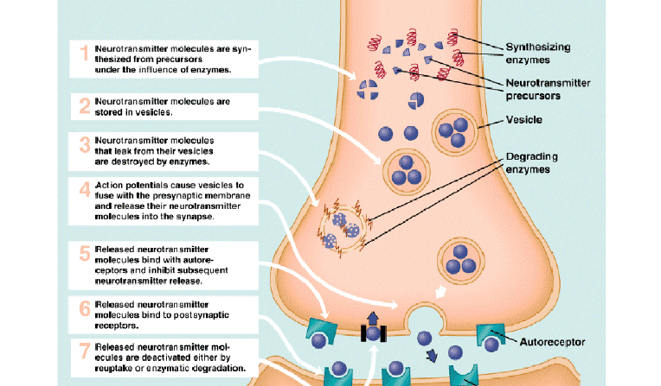
Inter-neuronal
Synapse Function

Slide 23
Aetiology: psychosocial
Vulnerability factors (Brown & Harris):
Risk is increased if a provoking factor is present
  Loss of mother before age 11
  Lack of a confiding relationship
  Having 3 or more children at home under the age of 14
  Not working outside the home

Slide 24
Aetiology: psychosocial
Life events (Holmes & Rahe)
  Sudden changes which may be positive or negative which disrupt normal social life
70% of depressive episodes are preceded by life events
Precipitating role not causal

Slide 25
Life events
Death of a spouse (100)
Divorce (73)
Marital separation (65)
Jail term (63)
Death of a close family member (63)
Personal injury or illness (53)
Marriage (50)
Being sacked from a job (47)

Slide 26
Learning theories
Wolpe: depression is a conditioned response to repetitive loss
Seligman: Depression develops when reward or punishment is no longer contingent on the actions of the organism
Beck: cognitive model of depression
  Cognitive triad
  Schemas
  Cognitive errors

Slide 27
Cognitive model of depression
Cognitive triad: negative view of
  Self
  Current situation
  Future
Schemas: stable cognitive patterns forming the basis for the interpretation of situations
Cognitive errors
  Beliefs in negative concepts
  Cognitive distortions: arbitrary inference, selective abstraction, overgeneralisation, personalisation, magnification and minimisation, dichotomous thinking

Slide 28
Management of depression

Slide 29
Management
Where
  primary care, home treatment or hospitalisation?
Who
Establish diagnosis
History and additional information
Investigations
Medications
Address specific psychosocial stressors

Slide 30
Stepped care model
Recognition in primary care and general hospital setting
Treatment of mild depression in primary care
Treatment of moderate depression to severe depression in primary care
Treatment of depression by mental health specialists
In-patient treatment for depression

Slide 31
Information gathering
Sources of information:
  Patient
  Collateral (corroborative) history
  Primary physician (GP) records
  Hospital records
  Prison records (inmate records)

Slide 32
Investigations
Physical exam
Routine
  Full haemogram, ESR,
  Glusose
  U&E
  Calcium
  TFTs
  LFTs
  Drug screen
  ECG
  Creatinine clearance
Others
  Urinary copper (Wilson’s disease)
  ANF (SLE)
  Infection screen (VDRL, HIV)
  CT/MRI scan

Slide 33
Depression in medical setting
Pharmacological factors
  Steroids
  Contraception
  Substance use/withdrawal
  Cimetidine, indomethacin
  Phenothiazines
  Thallium; cycloserine
  Vincristine; vinblastine

Slide 34
Depression in medical setting
Endocrine disorders
  Hypothyroidism
  Hyperthyroidism
  Hypopituitarism
  Addison’s disease, Cushing disease
  Diabetes mellitus
Infections
  Tertiary syphilis
  toxoplasmosis
  Influenza; viral pneumonia
  Viral hepatitis
  Infectious mononeucleosis
  HIV infection/AIDS

Slide 35
Depression in medical setting
Collagen
  Rheumatoid arthritis, SLE
Nutritional
  Pellagra, pernicious anaemia
Neurological
  Multiple sclerosis
  Parkinson’s disease
  Head trauma
  Complex partial seizures
  Sleep apnoea
  Cerebral tumours
  Cerebrovascular disorder
Neoplastic
  Abdominal malignancies (pancreatic cancer)
  Disseminated carcinomatosis

Slide 36
Diagnosis and related factors
Establish diagnosis and co-morbidity
  Associated factors
    Psychosis
    Catatonic symptoms
    Risk of suicide
    Risk of violence
    Substance use disorder
  Other co-morbidities:
    Medical
    personality, anxiety and conduct disorders

Slide 37
DSM V classification
Disruptive mood disorders
Major depressive episode
Persistent Depressive disorder (dysthymia)
Premenstrual dysphoric disorder
Substance/medication induced depressive disorder
Depressive disorder due to another medical condition
Other specified depressive disorder
Unspecified depressive disorder

Slide 38
DSM V: Depression specifiers
With anxious distress
Mild (2 symptoms)
Moderate (3 symptoms)
Moderate – severe (4-5 symptoms)
Severe (4-5 symptoms with motor agitation)
With mixed features
With melancholic features

Slide 39
Mild Depressive episode
At least 2 weeks...but shorter periods if severe or rapid in onset.
At least two of:
  Depressed mood D
  Loss of interest and enjoyment I
  Increased fatigability E
Plus two of:
  reduced self-esteem and self-confidence;
  reduced concentration and attention;
  ideas of guilt and unworthiness
  bleak and pessimistic views of the future;
  diminished appetite.
  disturbed sleep
  ideas or acts of self-harm or suicide;
Usually, some difficulty in functioning
Depression Interest Energy Self-confidence (-esteem) Attention Guilt Pessimistic Suicide Sleep Appetite

Slide 40
Mild depression
Watchful waiting: 2 weeks
Sleep/anxiety management
Guided self-help
Computerised CBT
Psychososical interventions
  Problem solving therapy
  Brief CBT
  Counselling
Antidepressants
  Not routinely recommended
  Use if other interventions fail
  Use if there is previous hx of moderate to severe depression

Slide 41
Moderate Depressive episode
At least 2 weeks...but shorter periods if severe or rapid in onset.
At least two of:
  Depressed mood
  Loss of interest and enjoyment
  Increased fatigability
Plus at least three of:
  reduced concentration and attention;
  reduced self-esteem and self-confidence;
  ideas of guilt and unworthiness
  bleak and pessimistic views of the future;
  ideas or acts of self-harm or suicide;
  disturbed sleep
  diminished appetite.
Usually, considerable difficulty functioning

Slide 42
Severe Depressive episode
At least 2 weeks...but shorter periods if severe or rapid in onset.
All three of:
  Depressed mood
  Loss of interest and enjoyment
  Increased fatigability
Plus at least four of:
  reduced concentration and attention;
  reduced self-esteem and self-confidence;
  ideas of guilt and unworthiness
  bleak and pessimistic views of the future;
  ideas or acts of self-harm or suicide;
  disturbed sleep
  diminished appetite.
Very unlikely to function
Psychotic symptoms: hallucinations, delusions, disorganised thinking, grossly disorganised or abnormal motor behaviour (depressive stupor).
  Mood congruent or incongruent.

Slide 43
Moderate-severe depression
Offer antidepressants routinely
  First line: SSRIs
  Continue for ≥ 6 months after remission
  Continue for 2 years if ≥ 2 episodes in recent past
Psychological treatment
  CBT
  IPT
  Couple-focussed therapy

Slide 44
Resistant cases
Switch to another antidepressant after 1 month (if there is partial response wait 6 weeks)
Choose another SSRI or mirtazapine
Include moclobemide (washout period), reboxetine, lofepramine
Other TCAs (except dosulepin) and venlafaxine for more severe depression

Slide 45
Options in treatment-resistance
Antidepressants with CBT (16-20 sessions over 6-9 months)
Venlafaxine
Augmentation
  Lithium (continue for 6 months, stop lithium first)
  Antidepressants
    SSRI + mirtazapine
    SSRI + mianserine (risk of agranulocytosis)
  Antipsychotics in psychotic depression
  Not recommended:
    carbamazepine, lamotrigine, buspirone, pindolol, valproate, thyroid supplements, benzodiazepines
  Phenelzine (especially atypical depression)
  ECT

Slide 46
Depression in Bipolar disorder
SSRIs less prone to precipitate manic attacks compared to TCAs
Antipsychotics

Slide 47
Prophylaxis of bipolar disorder with drugs
Consider Lithium, olanzapine or valproate
The choice should depend on:
  response to previous treatments
  the relative risk, and known precipitants, of manic versus depressive relapse
  physical risk factors, e.g. renal disease, obesity and diabetes
  the patient’s preference and history of adherence
  gender (valproate should not be prescribed for women of child‐bearing potential)
  a brief assessment of cognitive state (such as the Mini‐Mental State Examination) for older people.

Slide 48
Morbidity and mortality
Loss of work and productivity
  A number of famous actors, artists and musicians have had the disorder
Attempted suicide: 25 – 50%
Completed suicide: 10%

Slide 49
Prognosis
Within the first 2 years after the 1st episode, 40 – 50% experience another manic attack
Cycling between mania and depression accelerates with age

Slide 50
Prognostic factors
Poor
  Unemployment or poor employment history
  Alcohol abuse
  Psychotic features
  Depressive features
  Male sex
  Treatment non-compliance
Good
  Manic episodes of short duration
  Later age of onset
  Few thoughts of suicide
  Few psychotic symptoms
  Few co-morbid physical factors
  Good treatment response and compliance

Slide 51
Thank you

