Slide 1
Health Belief System in Mental Health
BY RA OKOTH
DEPT OF PSYCHIATRY
UON.

Slide 2
Culture includes:
Belief systems
Value orientations
Religious practices
Medical practices
Organization of society
Structure of families
Society’s need for control and order
Political philosophies
Legal systems
Economic resources

Slide 3
Cultural belief systems affect:
Which deviant behaviors are considered to be illness
Notions of etiology (causation)
Notions of appropriate treatment
Ideas about who is an appropriate healer
How people seek help
How people receive care

Slide 4
Cultural belief systems can be divided into:
Western vs. non-Western
  Individualistic orientation: places high value on personal autonomy
  Collectivist orientation: places high value on interdependence
Modern vs. traditional

Slide 5
Attributions
People in cultures that are individualistically oriented tend to attribute cause of mental illness to something within themselves—personal responsibility
People in cultures that have a collectivist orientation tend to attribute cause of mental illness to something outside the self—the responsibility of forces beyond their control

Slide 6
Result of attribution?
Personal responsibility for illness>>low self-esteem, guilt, social withdrawal—but also can influence individual to take actions on own behalf
External responsibility for illness>>sense of helplessness, lack of power to do anything—but no loss of self-esteem or guilt

Slide 7
Social status and mental health
Within each culture, “minority group” status affects self-evaluation, opportunities available, and quality of life, e.g.:
  Socioeconomic status
  Gender
  Age
  Color
  Ethnicity
  Religion
  Sexual orientation
  Caste
  Immigration status

Slide 8
Social status and mental health
Those who are members of groups that are devalued/discriminated against/oppressed by their society are more at-risk of developing mental illness, especially if there is a biological vulnerability, e.g
  Asian American immigrants
  African Americans
  Native Americans
  Hispanics
  Other immigrant groups, refugees especially

Slide 9
Acculturation
Individual members of minority cultural groups more at-risk if they are moving away from traditional culture—becoming acculturated.
Traditional cultural beliefs and practices can have a protective effect. Loss of traditional cultural beliefs but lack of acceptance into dominant culture puts individuals in an unstable, high-risk situation.

Slide 10
Therapy
Return to cultural roots to find meaning
Bicultural effectiveness training /aware

Slide 11
Universal modes of mental illness?
All cultures appear to have similar types of mental illnesses (e schizophrenia), with similar symptoms ( cognitive defects, asocial behaviors)
Interpretation of symptoms may differ markedly
  Meaning of symptoms
  Source of symptoms
  Duration of symptoms
  Curability
Content of psychotic delusions, hallucinations incorporates cultural elements—differs from culture to culture

Slide 12
Stress and mental illness: alternative hypotheses
Stressful life events can trigger mental illness
Biological vulnerability alone can trigger mental illness
Diathesis-stress hypothesis: stressful environmental events trigger biological vulnerability and lead to mental illness
  Even in utero events

Slide 13
Culture-bound syndromes
Specific forms of mental illness found only in specific cultural settings:
  Koro
  Windigo psychosis
  Arctic hysteria
  Latah
  Susto or espanto
These disorders may be related to local diet, climate, etc.
Notes:
Koro: mental disturbance found in souther China, Southeast Asia, India: man’s belief that his penis is shrinking into his abdomen
Windigo: Cree eskimos and Ojibwa of Canada: cannibalistic delusions—victim believes he has been transformed into a giant monster that eats human flesh
Arctic hysteria: Polar Eskimos. Person ay scream for hours, imitating animal cry, thrashing about on snow nude.
Latah: Southeast Asia: women who break into obscenities and echolalia following event that startles them, follow commands automatically
Susto: Latin-American Indians: fear state of sudden fright attributed to loss of soul by action of spirits, evil eye, or sorcery. Weakness, loss of appetite, sleeplessness, nightmares, trembling.

Slide 14
International studies show:
Agreement on core symptom clusters across cultures
Comparable incidence rates across cultures
Cultural variables may have significant effect on how mental illnesses manifest themselves and on course of illness
Compelling evidence that there is a genetic factor in schizophrenia and major affective disorders.

Slide 15
International Pilot Study of Schizophrenia
Sponsored by World Health Organization (WHO)—1990’s
Interviewed first-contact patients in Columbia, Czechoslovakia, Denmark, India, Nigeria, Taiwan, United Kingdom, former Soviet Union, and United States
Found no noticeable differences in incidence and prevalence of schizophrenia between developed and developing countries.

Slide 16
International Pilot Study of Schizophrenia (continued)
However, follow-up studies 2 and 5 years later showed:
  Course of illness significantly better in developing countries than in technologically advanced countries. Good outcomes:
    58% in Nigeria, 51% in India
    7% in Moscow, 6% in Denmark

Slide 17
Why outcomes better in developing countries?
In developing countries:
  Lower stress
  Higher social support
  Cultural belief systems that externalize causality
  Greater opportunities for social reintegration and normalized work roles in rural areas
  Extended kinship networks
  Fewer problems accepting interdependence

Slide 18
Expressed Emotion Research
Interactions in the family may have an effect on course of illness
  High EE families: emotional over-involvement, high degree of critical comments, hostility
  Low EE families: calm, empathic, respectful, accepting
  Psychoeducation programs train high EE families to become low EE
  Such psychoeducation programs help prevent relapse. (Psychoeducation programs helpful for all families—focus on providing state-of-the-art information about illness, support, behavior management techniques, problem-solving strategies.

Slide 19
Mental health service delivery systems
Developed nations can afford to develop broad-based networks of services.
Developing nations, with scarcer resources, have developed creative service delivery systems:
  Integrated mental and physical health care in India
  ARO village system—a model rehabilitation system in African countries

Slide 20
Traditional vs. Biomedical
Healing Systems
Both traditional and biomedical healing systems are used in many countries.
Traditional healing systems are usually the first used in most non-Western countries.
  Presume some imbalance in life forces.
  Imbalance can be corrected by ritual, religious or otherwise. Intercession of a supernatural power, invoked by healer.
  In one study in Puerto Rico, patients rated spiritists as more effective than mental health professionals.

Slide 21
Rehabilitation, Quality of Life,
Self-Help
As deinstitutionalization progresses around the world, there is more of an emphasis on rehabilitation and enhancing quality of life for people affected by mental illness.
  Italian experiment, e.g.
Advocacy and consumer self-help
  Organizations have grown world-wide
  Mostly family members but also consumers
  These organizations encourage self-help and also advocate for more resources.

Slide 22
Historical Origins of the Model
Lewin’s Field Theory (1935)
  Introduced the concept of barriers to and facilitators of behavior change
U.S. Public Health Service (1950’s)
  Group of social psychologists trying to explain why people did not participate in prevention and screening programs.
  Two major influences from learning theory:
    Stimulus Response Theory
    Cognitive Theory

Slide 23
Stimulus Response Theory
Learning results from events which reduce the psychological drives that cause behavior (reinforcers)
In other words, we learn to enact new behaviors, change existing behaviors, and reduce or eliminate behaviors because of the consequences of our actions.
Reinforcers, punishments, rewards

Slide 24
Cognitive Theory
Emphasize the role of subjective hypotheses and expectations held by the individual.
Beliefs, attitudes, desires, expectations, etc.
Influencing beliefs and expectations about the situation can drive behavior change, rather than trying to influence the behavior directly.

Slide 25
Value-Expectancy Theory
Expectancy: person believes that increased effort leads to improved performance
Instrumentality: person believes that improved performance leads to a certain outcome or reward
Outcomes: person values that reward or outcome

Slide 26
HEALTH BELIEF MODEL(HBM)
HBM is a value-expectancy theory
Based on these assumptions:
  People desire to avoid illness or get well
  People believe that a specific health action that is available to him or her will prevent illness
  People believe that they can successfully take a recommended health action
Initial development based on probability-based studies of 1200 adults
  People who believed they were susceptible AND believed in the benefits of early detection were much more likely to be screened for TB.

Slide 27
Components of HBM
Perceived Susceptibility: how likely do you think you are to have this health issue?
Perceived Severity: how serious a problem do you believe this health issue is?
Perceived Benefits: how well does the recommended behavior reduce the risk(s) associated with this health issue?
Perceived Barriers: what are the potential negative aspects of doing this recommended behavior?

Slide 28
Additional Components of HBM
Cues to Action: factors which cause you to change, or want to change. (not systematically studied)
Self-Efficacy: one’s “conviction that one can successfully execute the behavior required to produce the outcomes” (Bandura, 1977).
  As the health concerns of the nation have shifted to lifestyle-related conditions, self-efficacy has taken on greater importance, both as an independent construct, and as a component of HBM

Slide 29
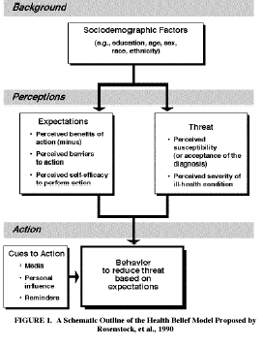

Slide 30
Individual Perceptions
Modifying Factors
Likelihood of Action
Demographics
Personality
SES
Knowledge
Perceived Benefits
minus
Perceived Barriers
Perceived Susceptibility
Perceived Severity
Perceived threat
Likelihood of
Behavior change
Cues to Action
  Education
  Symptoms
  Media

Slide 31
Life Span with and Without Mental Disorders
Ben Druss, MD
Notes:
Here it is again but includes a separate category for any mental illness compared to those in public sector who often have SMI

Slide 32
Past Year SMI Among Adults
18 and Older
18-25
26-49
50+
Male
Female
Data courtesy of SAMHSA
Notes:
Many patients die before the age of 50 reflecting the mortality from all causes. Data from SAMHSA

Slide 33
Preventable Causes of Death
N Engl J Med. 2007 Sep 20;357(12):1221-8.

Slide 34
Cardiovascular Disease Risk Factors
Modifiable Risk Factors | Estimated Prevalence and Relative Risk (RR)
 | Schizophrenia |  | Bipolar Disorder
Obesity |  | 45–55%, 1.5-2X RR¹ |  | 26%⁵
Smoking |  | 50–80%, 2-3X RR² |  | 55%⁶
Diabetes |  | 10–14%, 2X RR³ |  | 10%⁷
Hypertension |  | ≥18%⁴ |  | 15%⁵
Dyslipidemia |  | Up to 5X RR⁸ |  | 42%
Metabolic syndrome |  | ^{43%} |  | 37%
1. Davidson S, et al. Aust N Z J Psychiatry. 2001;35:196-202. 2. Allison DB, et al. J Clin Psychiatry. 1999; 60:215-220.
3. Dixon L, et al. J Nerv Ment Dis. 1999;187:496-502. 4. Herran A, et al. Schizophr Res. 2000;41:373-381.
5. MeElroy SL, et al. J Clin Psychiatry. 2002;63:207-213. 6. Ucok A, et al. Psychiatry Clin Neurosci. 2004;58:434-437.
7. Cassidy F, et al. Am J Psychiatry. 1999;156:1417-1420. 8. Allebeck. Schizophr Bull. 1999;15(1)81-89. 9. VanCampfort, AJP, 2013

Slide 35


Cumulative Effect of Many Problems
Modifiable risk factors:
Smoking, weight
and inactivity
Social isolation/Vulnerability
Violence
Unemployment/
poverty
Lack of access
to care
Medication/
Polypharmacy
Separate silos of care
Notes:
Medications, especially the atypical antipsychotic drugs, effect on weight gain, dyslipidemia and glucose metabolism
High rates of smoking, lack of weight management/nutrition, and physical inactivity
Lack of access to/utilization of preventive community healthcare, including health promotion services and resources
Poverty
Social isolation – increases the risk of premature death
Separation of health and mental health into separate systems at the federal, state and local level with lack of coordinated infrastructure.

Slide 36
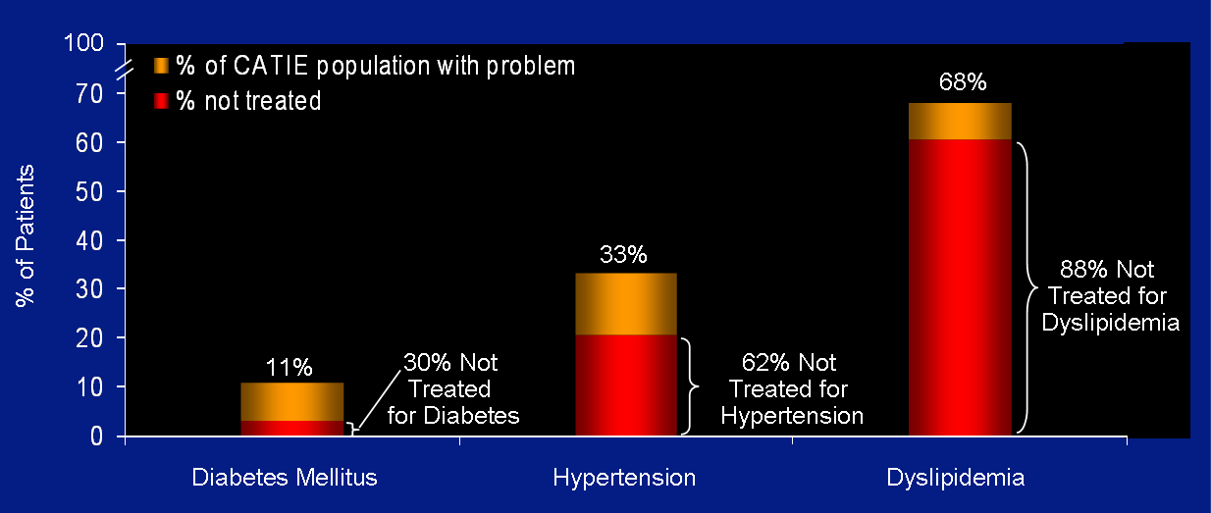
Rates of Non-treatment
Nasralla, et al Schizophrenia Research 2006(86)

Slide 37
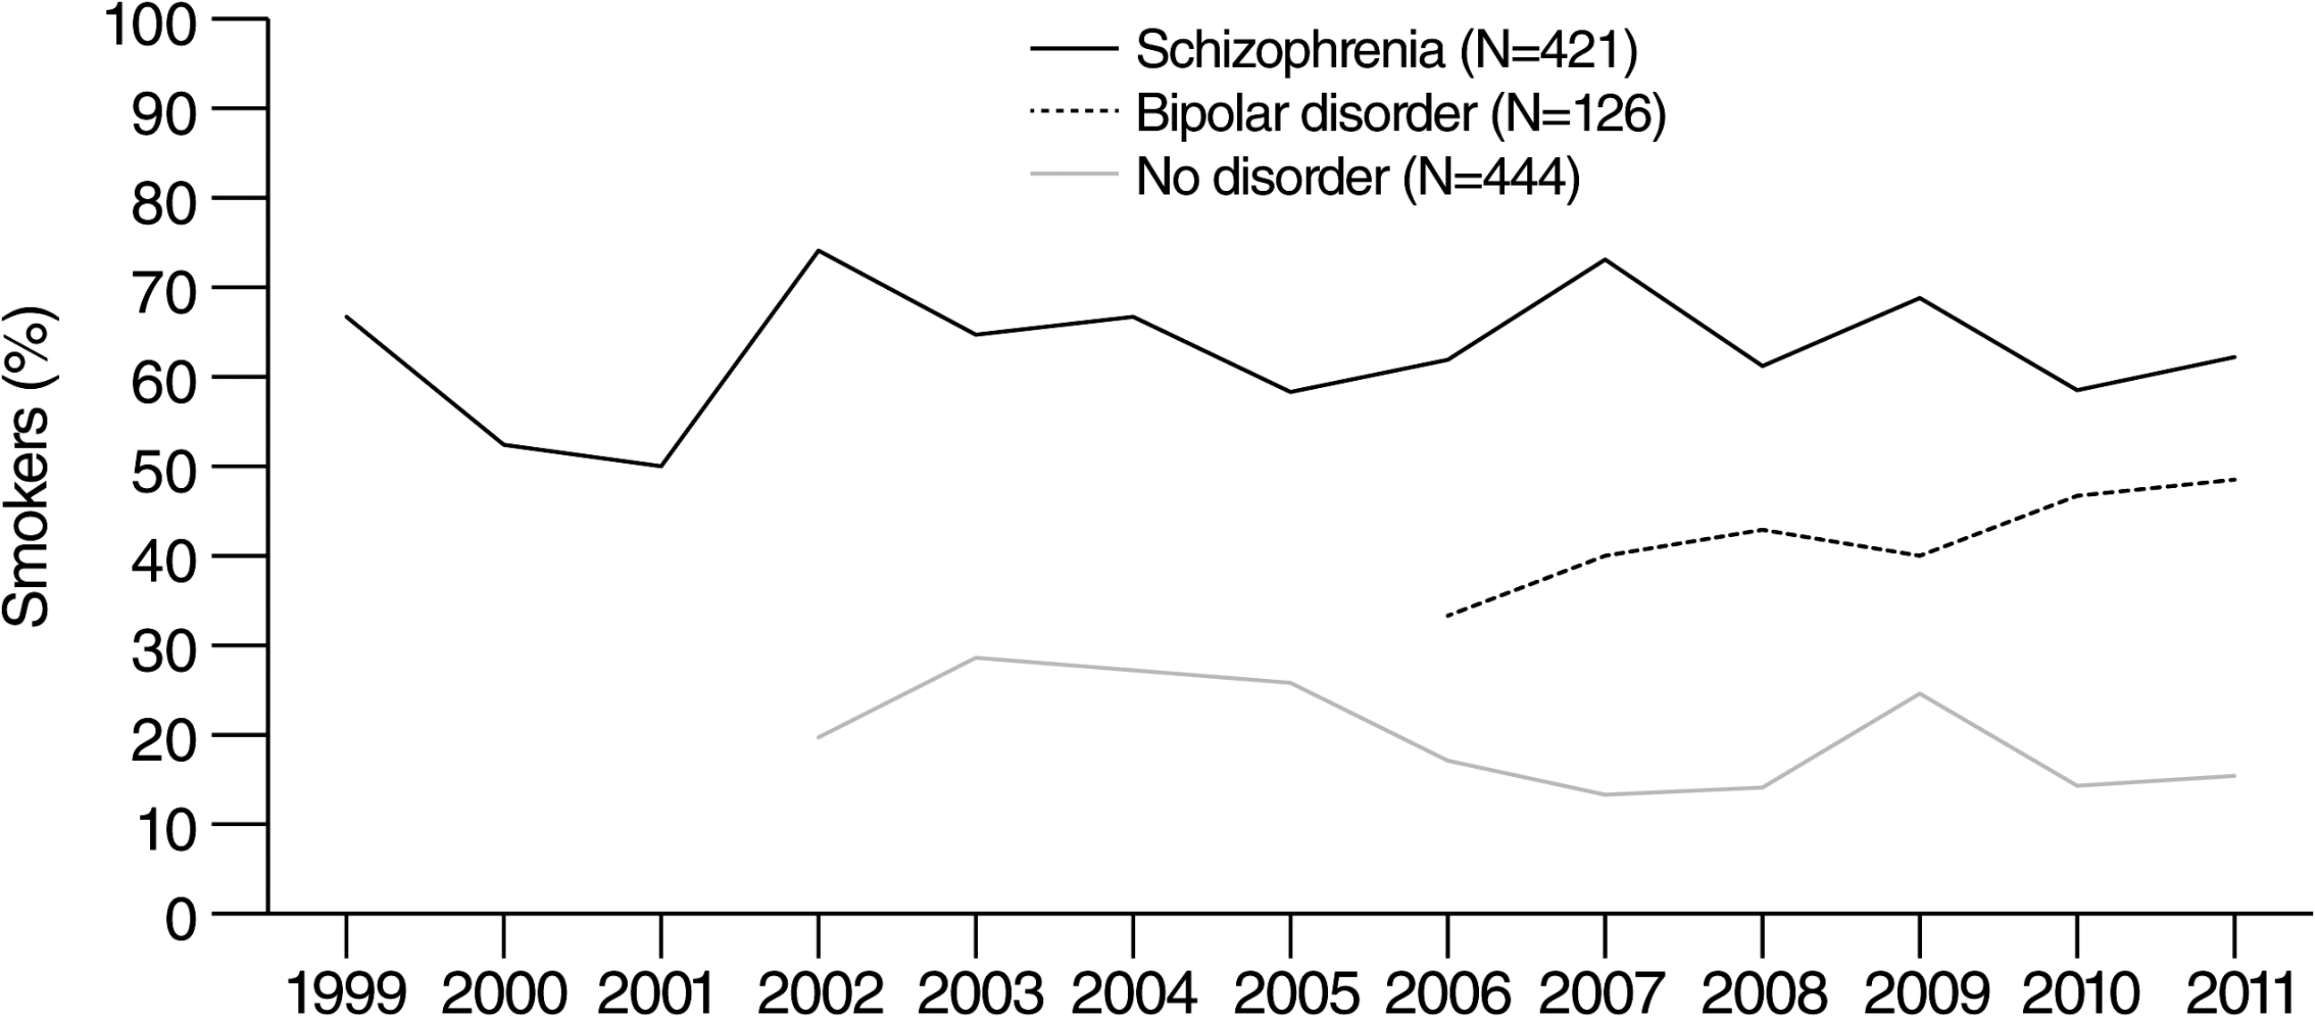
Cigarette Smoking Among Persons With Schizophrenia or Bipolar Disorder
Data are not shown for the bipolar disorder sample prior to 2007 or for the control group (no psychiatric illness) for 2004 because N<10 for each of these years for these groups. Number of persons in each of the other groups, by year, follows. For schizophrenia: 1999, 15; 2000, 21; 2001, 10; 2002, 27; 2003, 34; 2004, 15; 2005, 48; 2006, 21; 2007, 26; 2008, 49; 2009, 77; 2010, 41; 2011, 37. For bipolar disorder: 2007, 15; 2008, 14; 2009, 20; 2010, 30; 2011, 33. For the no-disorder control group: 2002, 71; 2003, 28; 2005, 66; 2006, 35; 2007, 45; 2008, 64; 2009, 61; 2010, 35; 2011, 39
Psychiatric Services. 2013;64(1):44-50. doi:10.1176/appi.ps.201200143

Slide 38
History of SMI Nomenclature
In 1993, at the request of the Senate, the National Advisory Mental Health Council enumerated and operationalized “severe mental disorders.” They were published in the American Journal of Psychiatry.
Includes schizophrenia, schizoaffective disorders, bipolar disorder, autism, and severe forms of depression, panic disorder, and obsessive-compulsive disorder.
Fuller Torrey, MD

Slide 39
Definition: Serious Mental Illness (SMI)
A mental, behavioral, or emotional disorder (excluding substance use and developmental disorders)
Functional disability in areas of social and occupational functioning
Functional impairment that substantially interferes with or limits one or more major life activities – GAF <50
1:20 of general US population has an SMI (vs. 1:5 for all mental illnesses)
SAMHSA
Notes:
Evolved from “Chronically Mentally Ill”
Chronically mentally ill used to identify pts who lived in long-term institutions or hospitals. After passage of Kennedy’s Community Mental Health Centers Act in 1963, deinstitutionalization and increased use of antipsychotics moved care of CMI patients from institutions to communities. Also, with successful treatment, some pts were no longer chronic.

Slide 40
Global Assessment of Functioning (GAF) Score
61 – 100 No symptoms. Superior functioning in a wide range of activities - Mild symptoms (e.g., depressed mood and mild insomnia) OR some difficulty in social, occupational, or school.
51 - 60 Moderate symptoms (e.g., flat affect and circumstantial speech, occasional panic attacks) OR moderate difficulty in social, occupational, or school functioning
41 - 50 Serious symptoms (e.g., suicidal ideation, severe obsessional rituals) OR any serious impairment in social, occupational, or school functioning
31 - 40 Some impairment in reality testing or communication (e.g., speech is at times illogical, or irrelevant) OR major impairment in several areas
21 - 30 Behavior is considerably influenced by delusions or hallucinations OR serious impairment in communication or judgment (e.g., sometimes incoherent, acts inappropriately, suicidal preoccupation) OR inability to function in almost all areas (e.g., stays in bed, no job)
11 - 20 Some danger of hurting self or others (e.g., suicide attempts without clear expectation of death; frequently violent; manic excitement) OR occasionally fails to maintain hygiene, OR severe impairment in communication (e.g., largely incoherent or mute)
1 - 10 Persistent danger of severely hurting self or others (e.g., recurrent violence) OR persistent inability to maintain minimal personal hygiene OR serious suicidal act with clear expectation of death.
DSM-IV TR
Notes:
This scale was recently eliminated from DSM V but is useful in assessing level of functioning

Slide 41
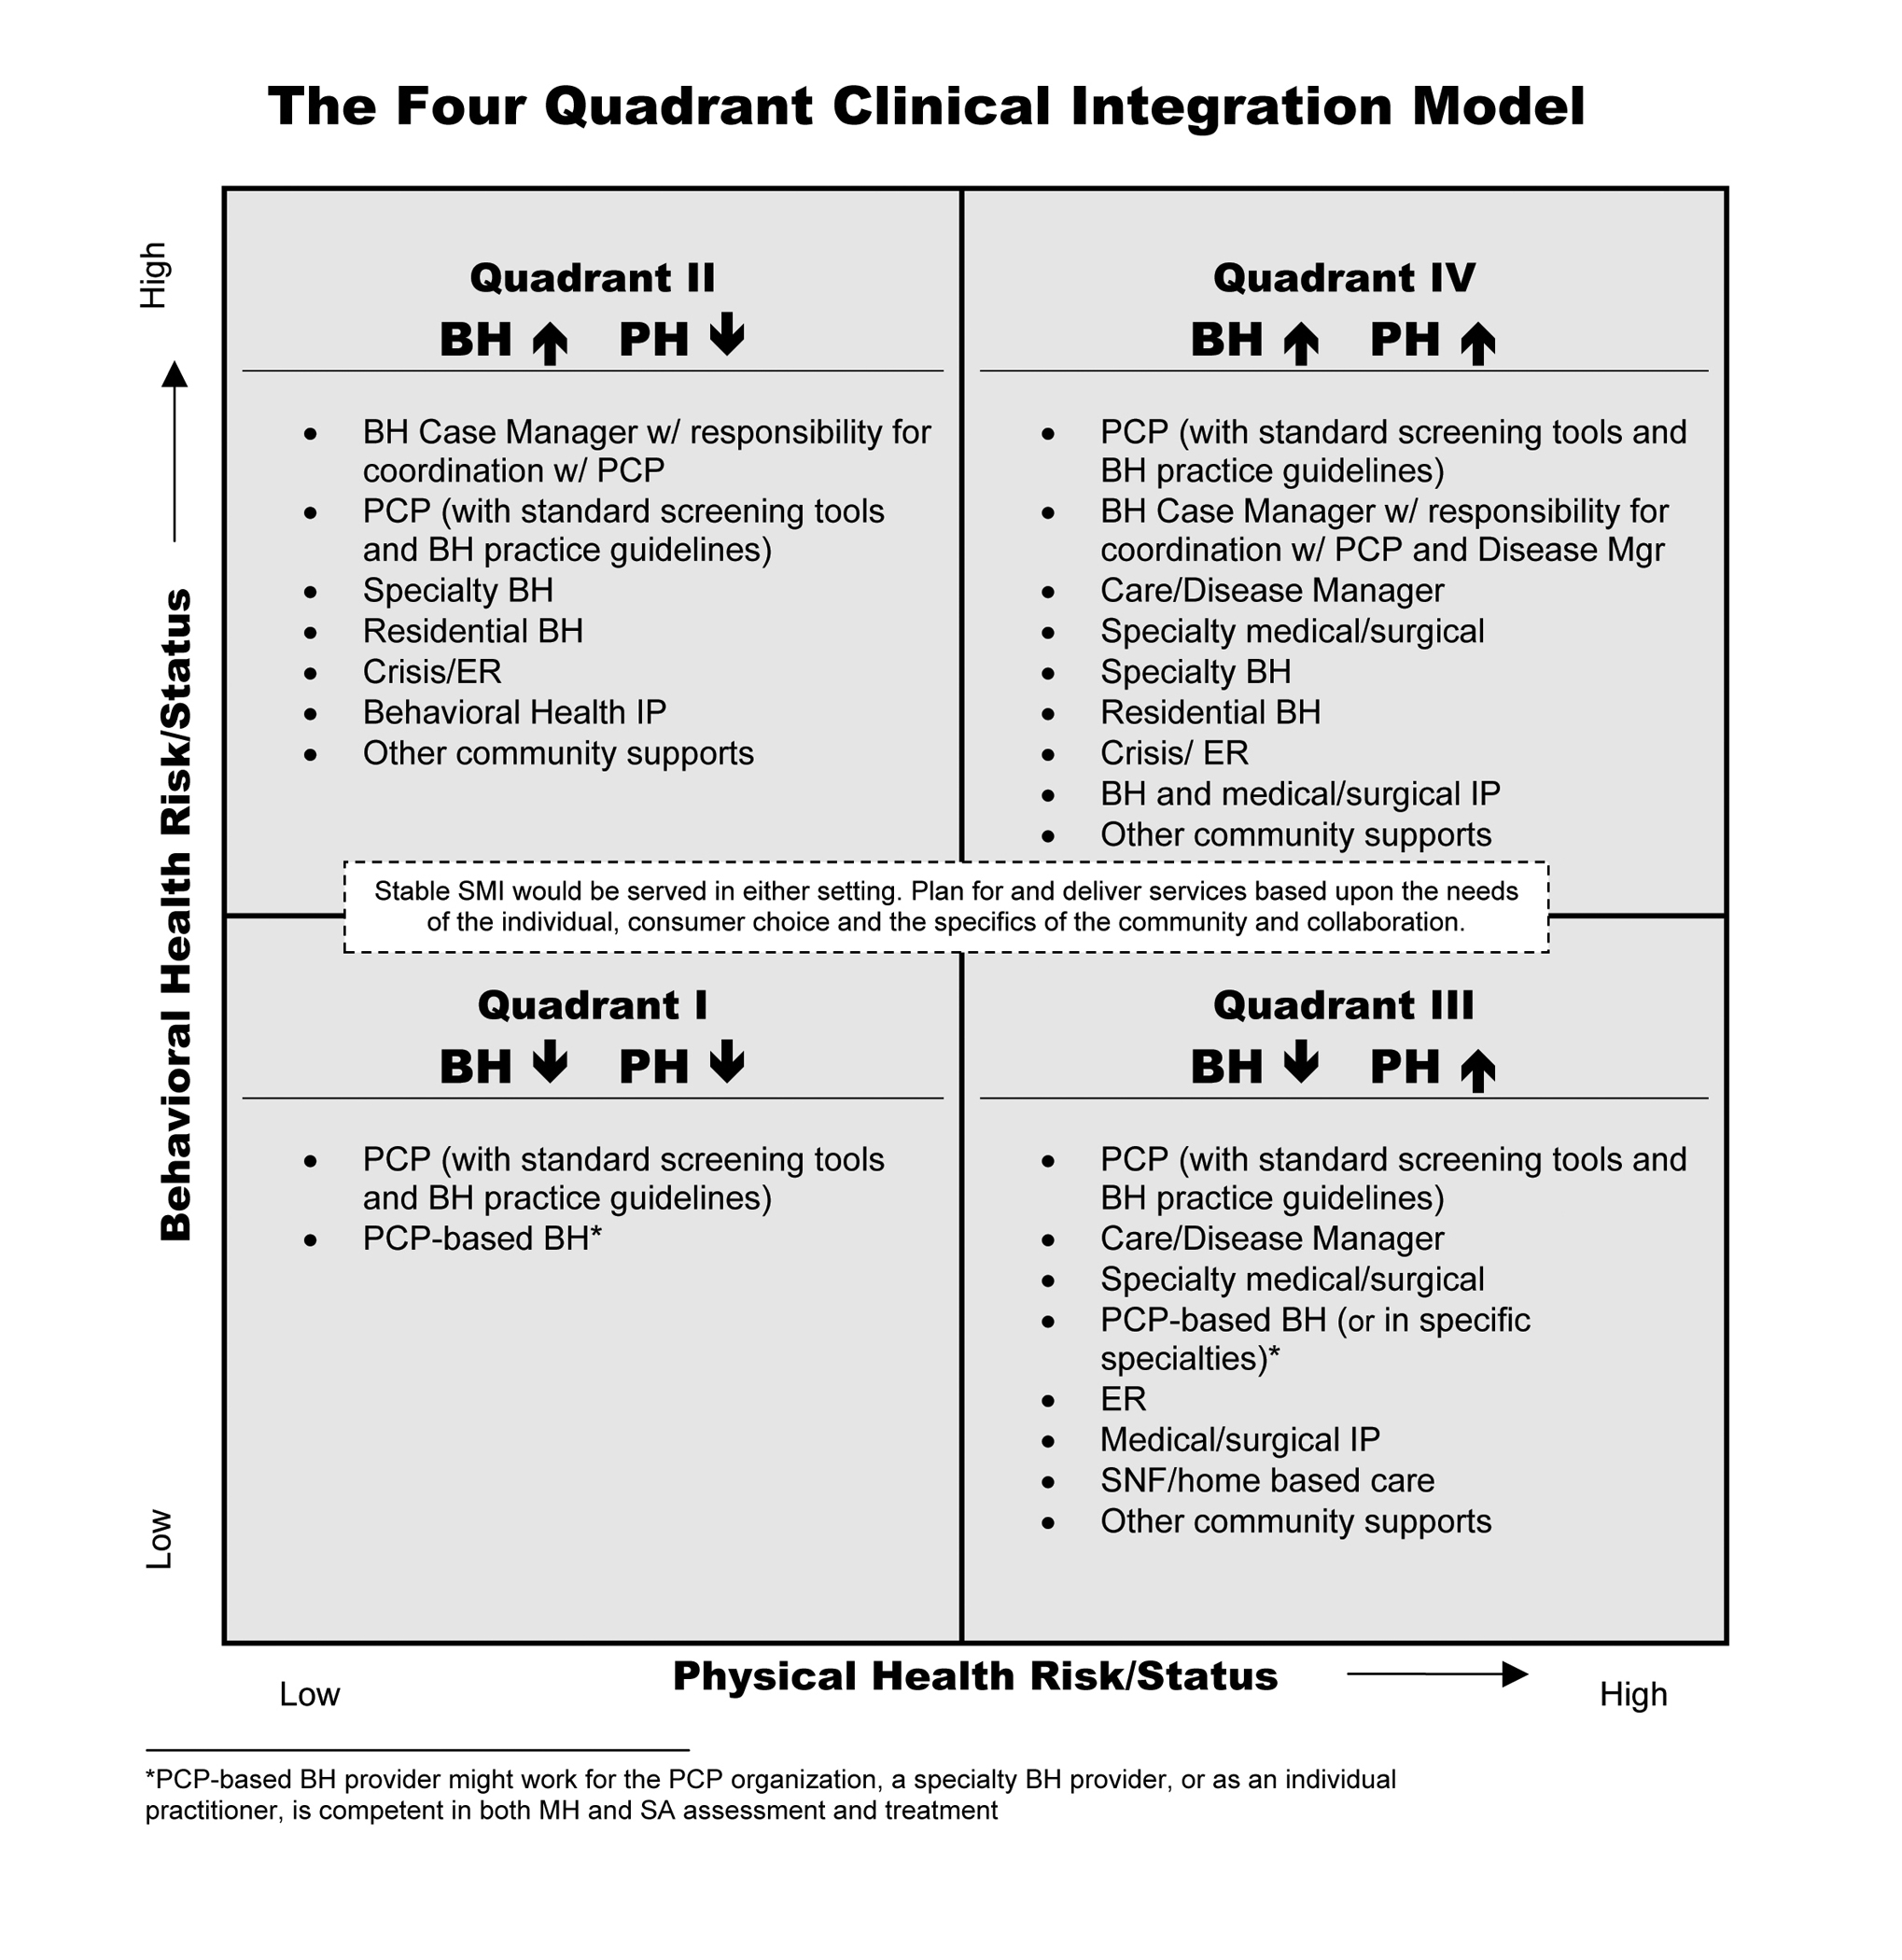
Four Quadrant Model
Notes:
The Four Quadrant model was developed to help consider the location and types of services that could be provided to best meet the needs of patients. Quadrant IV represents the population in public settings with SMI

Slide 42
Common Diagnosis: SMI
Major depression
Bipolar disorder
Anxiety: Severe OCD, PTSD
Schizophrenia
Borderline personality disorder
Notes:
Note: Bipolar disorder accounts for only 1-6% of all mood disorders, compared to 15-20% major depression.

Slide 43
What Causes Mental Illness?
Genetics
Environment

Slide 44
Diagnostic Criteria: Schizophrenia
Positive symptoms – at least two
  Hallucinations – auditory most common
  Delusions – paranoid, somatic, grandiose
  Disorganized speech
  Grossly disorganized or catatonic behavior
Negative symptoms
  Flat affect – blank look, lack of expression
  Lack of motivation/drive/desire to pursue goals
  Lack of additional, unprompted content seen in normal speech patterns – monotone, monosyllabic
Social/Occupational Dysfunction
DSM V 2013
Notes:
Specific criteria. Disorganized behavior refers to actions such as grimacing, postures, odd statements, unpredictable or inappropriate emotional responses, behaviors that appear bizarre and have no purpose, lack of inhibition or impulse control. Catatonia includes a reduction in movements and speech to the point of almost ceasing these activities. Resistance to change position and may sometimes hold an awkward or uncomfortable position for hours.

Slide 45
Bipolar Disorder
Bipolar I Disorder is mainly defined by
Manic or mixed episodes that last at least seven days
Severe manic symptoms that need immediate hospital care
Episodes of depression, typically lasting at least two weeks.
Bipolar II Disorder is defined by shifting back and forth between
Episodes of depression
Hypomanic episodes - less severe form of mania
Mania: high energy, reduced sleep, euphoria, risk taking, irritable, talkative, racing thoughts, grandiose, increased activity
DSM V
Notes:
Hypomania is a less severe form of mania where patients often feel good, have more energy, are more productive. Can evolve to manic episode in some.
If accompanied by psychosis is considered mania and not hypomania

Slide 46
Schizoaffective Disorder
Schizophrenia + Bipolar disorder
An uninterrupted period of illness where at some point there is either a manic, depressed or mixed episode for the majority of the disorder’s duration after Criteria A for schizophrenia has been met
DSM V 2013
Notes:
Schizoaffective DO represents a hybrid of the two. Tih

Slide 47
Borderline Personality Disorder
Personality disorder: A lifelong pattern in the way a person thinks, feels, and behaves that is exceptionally rigid, extreme, maladaptive, damaging to self or others, and leads to social and/or occupational impairment.

Slide 48
Depression and Anxiety Disorders
Meet criteria for SMI when:
Depression complicated by
  treatment resistance – failure to respond to medications or therapy
  psychosis
Anxiety complicated by
  treatment resistance
  co-morbid with personality disorder
Notes:
While disorders such as schizophrenia are known to be included in the SMI realm, and depression and anxiety are usually not, sometimes depression and anxiety can reach a level of severity where they would be considered as serious mental illnesses

Slide 49
Other Psychiatric Comorbidity with SMI
Depression – 25%
  Suicide
    10% of depressed patients with schizophrenia
    5% (all causes)
Trauma – 29% PTSD
Substance Use Disorders
  47% of SMI population use alcohol
  44% Cannabis
  50 – 80% use tobacco products
Buckley, PF et al: 2009, Padgett, D.K., and E.L. Struening 1992, Carey KB, CareyMP, Simons JS. 2003, Kaylee H, Taylor M: 2010
Notes:
In addition to SMI, other behavioral health disorders can be diagnosed in addition

Slide 50
Comorbid Alcohol Disorders
Diagnosis | Lifetime Prevalence of Alcohol abuse or dependence
Bipolar I | 46.2%
Bipolar II | 39.2%
Schizophrenia | 33.7%
Panic Disorder | 28.7%
Unipolar Depression | 16.5%
General Population | 13.8%
Regier DA et al. JAMA, 1990
Notes:
This study shows slightly different rates of alcohol use and compares with other mental illnesses

Slide 51
Barriers to Providing Primary Care to Psychiatric Populations
Cultural
Mental health staff and patients not used to incorporating primary care as part of job
Financial
Rarely funded
Billing medical services challenging
Motivational
Lack of perceived need for care
Organizational
Devoting space, time, and money
Logistical
Clinic location not always close proximity, which is crucial to success
Space limitations
Specialists do not cross boundaries
High no show rate, take extra time
Different languages
Psychiatric staff not provided resources to provide care (medical assistants to take vitals before appointments, blood pressure cuffs, scales)
Mental health staff feel time pressure to address screening, vital signs and may feel “out of scope of practice”
Lack of motivation as part of negative symptoms of schizophrenia
Behavioral health EHRs may lack capacity to track physical health indicators
Not perceived as part of the mission
Not always in same building
Notes:
This slide transitions the audience to a discussion of reasons why there are healthcare issues in this population and proceeds in subsequent slides to look at this in more detail

Slide 52

Patient Level Factors
Lack of motivation,
apathy
Cognitive impairment
Lack of perceived need for health care
Poverty
Comorbidity
Fear and distrust
Poor social, communication skills
Lack of access
to care
Notes:
There are a number of factors leading to struggles with getting the healthcare needed

Slide 53

Provider Level Factors
Why bother?
“Just treat the Schizophrenia and leave the rest.”
Attribute physical sx to mental illness and miss the problems
Lack of Knowledge about specific disorders
Take too long, high no-show, impacts bottom line
Fear and Distrust
Discomfort
Lester HE. BMJ, doi.1136/bmj.38440.418426.8F 2005

Slide 54
Cost of Health Complexity
Patient Type
% of Patients
% of Costs
100
90
80
70
60
50
40
30
20
10
Acute Illness
Self-resolving illness
Low grade acute illness
Low
1/3
Serious Chronic Illness
Chronic diseases
Moderate to severe acute illness
SMI population here
Health Complexity
Multiple diagnoses
Physical & mental health co-morbidity
High health service use
Impairment and disability
Personal, social, financial upheaval
Health system issues
Medium
1/3
High
1/3
Adapted from Meier DE, J Pall Med, 7:119-134, 2004

Slide 55
The Wagner Chronic Care Model
Community
Health System
Resources and Policies
Health Care Organization
Clinical
Information
Systems
Self-
Management
Support
Delivery
System
Design
Decision
Support
PRODUCTIVE
INTERACTIONS
Prepared,
Proactive,
Multidisciplinary
Practice Team
Informed,
Activated
Patient/family
Improved Outcomes

Slide 56
Principles of Effective Integrated
Behavioral Healthcare
Person-Centered Team Care / Collaborative Care
Colocation is not Collaboration. Team members learn to work differently.
Measurement-Based Treatment to Target
Population-Based Care
All patients tracked in a registry: no one “falls through the cracks.”
Evidence-Based Care
Accountable Care
Treatments are actively changed until the clinical goals are achieved.
Treatments used are ‘evidence-based.’
Providers are accountable and reimbursed for quality of care and clinical outcomes, not just the volume of care provided.

Slide 57
Notes:
Changes in blood pressure, glucose and cholesterol are promising

Slide 58
Person-Centered Collaborative Care Opportunities
Behavioral Health in Primary Care Settings
Primary Care in Behavioral Health Settings
Notes:
This slide begins and introduction to collaborative care

Slide 59

Lexicon for Integrated Care
Patient- Centered Care
Integrated Care
Coordinated Care
Shared Care
Collaborative Care
Co-located Care
Integrated Primary Care or Primary Care in Behavioral Health
Behavioral Health Care
Patient-Centered Medical Home
Mental Health Care
Substance Abuse Care
Primary Care
Adapted from: Peek, CJ - A family tree of related terms used in behavioral health and primary care integration

Slide 60
Lexicon – Integrated Care
The care that results from a practice team of primary care and behavioral health clinicians, working with patients and families, using a systematic and cost-effective approach, to provide patient-centered care for a defined population.
This care may address:
Mental health and substance abuse conditions
Health behaviors (including their contribution to chronic medical issues)
Life stressors and crisis
Stress related physical symptoms
Ineffective patterns of health care utilization
http://integrationacademy.ahrq.gov/lexicon
Notes:
Definition of Integrated Care from the Agency for Health Research and Quality

Slide 61
Standard Framework of Integration
COORDINATION
We discuss patients, exchange information if needed
Collaboration from a distance
CO-LOCATION
We are in the same facility, may share some functions/staffing, discuss patients
INTEGRATION
System–wide transformation, merged practice, frequent communication as a team
Doherty et al, 2013
Notes:
There are different ways to approach how primary care and behavioral health come in contact with each other and this slide demonstrates that spectrum

Slide 62
Core Principles of Collaborative Care
Patient-Centered Care Teams
Team-based care: effective collaboration between PCPs and behavioral health providers.
Measurement-Based Treatment to Target
Population-Based Care
Behavioral health patients tracked in a registry: no one “falls through the cracks.”
Measurable treatment goals clearly defined and tracked for each patient.
Treatments are evidence-based.
Treatments are actively changed until the clinical goals are achieved.
Nurses, social workers, psychologists, psychiatrists, licensed counselors, pharmacists, and medical assistants can all play an important role.
Evidence-Based Care
AIMS 2010
Notes:
These 4 principles are widely used to describe what is needed to make integration effective

Slide 63
Tasks Related to Principles
Find Patients:
Screening, identification and determination of medical diagnoses
Track Patients:
Systematic follow-up and use of registry
Program Oversight and Quality Improvement:
Review outcomes, determine priorities, make adjustments
Treat Patients:
- Evidence-based treatment of medical and mental health conditions
- Heath behavior change
- Timely treatment adjust
Notes:
This slide shows how the Core Principles are adapted to care in the behavioral health setting

Slide 64
Roles for PCPs in Behavioral Health Settings
Direct Care
Chronic medical conditions
Preventive care
Collaboration
Psychiatric providers
Care managers, case managers
Population-Based Care
Establishing priorities
Track outcomes, adjust care
Education
Leader
Non-medical staff
Patients
Champion healthcare change
Help shape system of care
Notes:
A look at the roles for PCPs – this will be a theme for the remainder of the Modules given the introduction in Module 1

Slide 65
Reflection and Discussion
What outcomes do we hope to achieve by addressing the health issues in the SMI population?
Is this “tomorrow’s model?”

Slide 66
Post Test Questions
The premature mortality seen in the general SMI population is estimated to be:
  25 – 30 years
  20 – 25 years
  15 – 20 years
  10 – 15 years
What percent of illness contributing to this early mortality is preventable?
  20%
  40%
  60%
  80%
What are the leading illnesses that contribute to early mortality in the public SMI population?
  Cardiovascular diseases
  Infectious diseases
  Cancers
  All of the above

Slide 67
Post Test Answers
The premature mortality seen in the general SMI population is estimated to be:
  25 – 30 years
  20 – 25 years
  15 – 20 years
  10 – 15 years
What percent of illness contributing to this early mortality is preventable?
  20%
  40%
  60%
  80%
What are the leading illnesses that contribute to early mortality in the public SMI population?
  Cardiovascular diseases
  Infectious diseases
  Cancers
  All of the above

Slide 68
References
Colton CW, Manderscheid RW. Prev Chronic Dis [serial online] 2006 Apr
Parks, J, NASMHPD Directors Report , Morbidity and Mortality in People with Serious Mental Illness, 2006
Davidson S, et al. Aust N Z J Psychiatry. 2001;35:196-202. 2. Allison DB, et al. J Clin Psychiatry. 1999; 60:215-220.
3. Dixon L, et al. J Nerv Ment Dis. 1999;187:496-502. 4. Herran A, et al. Schizophr Res. 2000;41:373-381.
5. MeElroy SL, et al. J Clin Psychiatry. 2002;63:207-213. 6. Ucok A, et al. Psychiatry Clin Neurosci. 2004;58:434-437.
Nasralla, et al Schizophrenia Research 2006(86)
Psychiatric Services. 2013;64(1):44-50. doi:10.1176/appi.ps.201200143
Spollen JJ.Perspectives in Serious Mental Illness. www.medscape.com
McDevitt J et al. Clinical practice recommendations-Evidenced-based guidelines for integrated care.2002
Buckley, PF et al: Psychiatric Comordities and Schizophrenia, Schizophrenia Bulletin, 2009, 35(2), 383-402
Carey KB, Carey MP, Simons JS. Correlates of substance use disorder among psychiatric outpatients: focus on cognition, social role functioning, and psychiatric status. J Nerv Ment Dis. 2003;191(5):300-8.
Kaylee H, Taylor M: 2010; Suicide and schizophrenia: a systematic review of rates and risk factors:. J Psychopharmacol. 2010 November; 24(4_supplement): 81–90.
Regier DA et al. JAMA, 1990
Lester HE. BMJ, doi.1136/bmj.38440.418426.8F 2005
Meier DE, J Pall Med, 7:119-134, 2004
Adapted from: Peek, CJ - A family tree of related terms used in behavioral health and primary care integration http://integrationacademy.ahrq.gov/lexicon 2012

Slide 69
The University of Nairobi
Questions or Comments Please…

