Slide 1
HUMAN DEVELOPMENT
ADULTS

Slide 2
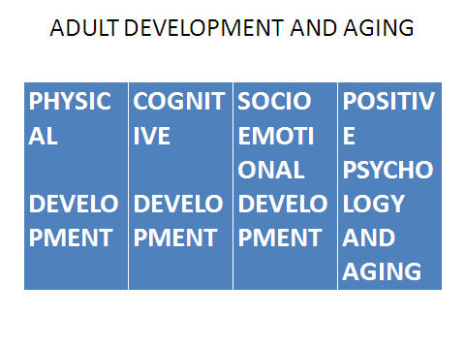
HUMAN DEVELOPMENT LESSON 4

Slide 3
PHYSICAL DEVELOPMENT
PEAK DEVELOPMENT=20S
MAXIMUM PHYSICAL HEALTH=30S-
40-50 YRS DETERIORATION
AGING
PIGMENTATION,
WRINKLES,
LOOSE HEIGHT I/2IN PER DECADE, OSTEOPOROSIS,
20%BODY WT IS FAT,(10% IN ALDOLESCENT)

Slide 4
HUMAN DEVELOMENT
AGING WORSENED BY BAD LIFESTYLES-
SMOKING,
ALCOHOL,
DRUGS
DIET
LACK OF EXERCISE

Slide 5
HUMAN DEVELOPMENT
CHRONIC DISEASES IN LATE ADULTHOOD-
ARTHRITIS,
HYPERTENSION,
ALHZEIMERS DEMENTIA
IN >65YRS
LACK OF ACETYL-CHOLINE
NEUROTRANSMITTER
DENDRITES GROW UP 90S IN MAJORITY

Slide 6
PHYSCICAL DEVELOPMENT
MALES
FEMALES
LOW TESTESTRONES
EQUIVALENT OF MENOPAUSE
HOWEVER FERTILITY CONTINUES IN MALES IN LATE ADULTHOOD
HAIR CHANGES
SPARCITY
COLOUR-GREYING
IN 50S
LOW OESTROGENS
FERTILITY DIMINSHES
=MENOPAUSE
HAIR CHANGES
SPARCITY
COLOUR-GREYING

Slide 7
COGNITIVE DEVELOPMENT
PIAGETS OPERATIONAL STAGE IS ATTAINED IN LATE ALDOLESENCE LOGICAL THOUGHT IS APLIED IN ADULTHOOD
ADULTS THINK IN MORE REFLECTIVE WAYS ADOLESENCE THINKING IS ABSOLUTE THIS WAY OR THAT WAY.

Slide 8
INTELLIGENCE
FLUID
CRYSTALLIZED
ONES ABILTY TO REASON ABSTRACTLY
MAXIMAUM IN MIDDLE ADULTHOOD AND DECLINES THEREAFTER.
SPEED TO PROCESS INFORMATION IS MAXIMUM IS MAXIMUM
AN INDIVIDUALS ACCUMALATED INFORMATION AND VERBAL SKILLS
INCREASES IN MIDDLE AND INTO LATE ADULTHOOD
WISDOM=EXPERT KNOWLEDGE ABOUT THE PRACTICAL ASPECTS OF LIFE
SPEED TO PROCESS INFORMATION DECLINES

Slide 9
SOCIOEMOTIONAL DEVELOPMENT
INTIMACY VS ISOLATION;EARLY ADULTHOOD | GENERATIVITY VS STAGANATION;MIDDLE ADULHOOD | INTERGRITY VS DESPAIR LATE ADULTHOOD
HEALTHY RELATIONSHIPS INTIMATE CLOSE RELATIONSHIP WITH A PARTNER= ACHIEVMENT OF INTIMACY IF NOT ONE BECOMES SOCIALLY ISOLATED | GENERATIVITY=ASSIT AND GUIDE THE YOUNG TO LEAD USEFUL LIVES STAGNATION= FEELING OF HAVING DONE NOTHING TO HELP NEXT GENERATION | INTERGRITY IS ACHIEVED IF ONE HAS ACCOMPLISHED,HAS NEGOTIATED ALL STAGES WELL DESPAIR= NEGATIVE ACCOMPLISHMENT
INVOLVE
WORK
LOVE
CAREER
INTMACY

Slide 10
CONTEXTS OF SOCIOEMOTIONAL DEVELOPMENT
JOB AND THEN CAREER
MARRIAGE/COMITMENT
PERSONAL IDENTITY
MIDDLE LIFE CONCIOUSNESS/CRISIS-
BEING ACTIVE-SOCIO NETWORKS

Slide 11
CONTEXTS OF SED
2O=30S
30S
1.JOB AND THEN CAREER
BY 40S MIDDLE LIFE- REEXAMINE THE ACCOMPLIHMENTS
2.MARRIAGE/COMITMENT
WHAT MAKES MARRIAGE WORK(BY GOTTMAN 1994)
NUTURING FONDNESS AND ADMIRATION
TURNING TOWARDS EACH OTHER AS FRIENDS
GIVING UP SOME POWERS
SOLVING CONFLICTS TOGETHERS

Slide 12
CONTEXTS OF SOCIOEMOTIONAL DEVELOPMENT
MIDDLE AGE-40-65 YRS
LATE ADULTHOOD
3.PERSONAL IDENTITY
WHAT LIFE IS ALL ABOUT
ROLE IN HELPING NEXT GENERATION
BEING ACTIVE-SOCIO NETWORKS
MORE SATISFIED

Slide 13
POSITIVE PSYCHOLOGY AND AGING
SUCCESFUL AGING
GOOD LIFESTYLES-EXERCISES
STABLE MARRIAGES
GOOD COPING SKILLS

