Slide 1
HUMAN DEVLOPMENT 1
LEVEL 1

Slide 2
LEARNING GAOLS
EXPLAIN HOW PSYCHOLOGISTS THINK ABOUT DEVELOPMENT

Slide 3
HOW PSYCHOLOGISTS THINK ABOUT DEVELOPMENT
AS CHILDREN WE ALL TRAVELLED SOME COMMON PATH
HOWEVER THERE ARE INDIVIDUAL VARIATIONS
NO ONE ELSE IN THE WORLD HAS THE SAME FEATURES EG FINGERPRINTS

Slide 4
KEY QUESTIONS ABOUT DEVELOPMENT
WHAI IS DEVELOPMENT
DO EARLY EXPERINCES RULE US FOR LIFE
HOW DO NATURE AND
NATURE INFLUENCE DEVELOPMENT

Slide 5
WHAT IS DEVELOPMENT?
1
THE PATTERN OF CHANGE
2
IN HUMAN CAPABILITIES
3
THAT BEGIN AT CONCEPTION AND CONTINUES THROUGH OUT THE LIFE SPAN

Slide 6
WHAT IS DEVWHELOWHAT IS WHDEVELOPMENT ?
PMENT ?
WHAT IS DEVELOPMENT ?
WHAT IS DWHAT IS DEVELOPMENT ?
EVELOPMENT ?
1.PHYSICAL PROCESS-CHANGES IN BIOLOGICAL NATURE=MATURATION
2. COGNITIVE PROCESS –CHANGES IN THOUGHT,INTELLIGENCE,LANGUAGE
3.SOCIALEMOTINAL PROCESS—CHANGES IN RELATIONS,EMOTIONS ,PERSONALITY

Slide 7
DO EARLY EXPERIENCES RULE US FOR LIFE
EARLY EXPERIENCE DOCTRINE-FIXATED AND PERMANENT MAKEUP
POWER OF LATER EXPERIENCE-CHILDREN ARE MALLEABLE
EARLY EXPERIENCE CREATE A FOUNDATION FOR LATER EXPERINCE,BOTH MAKE IMPORTANT CONTRIBUTIONS TO DEVELOPMENT

Slide 8
HOW DO NATURE AND NURTURE INFLUENCE DEVELOPMENT
NATURE=AN ORGANISMS BIOLOGICAL INHERITANCE
NURTURE=AN ORGANISMS ENVIRONMENTAL EXPERIENCES
DEVELOPMENT IS INTERACTION OF THE TWO
SOME INDIVIDUALS GO BEYOND THE TWO

Slide 9
CHILD DEVELOPMENT
PRENATAL DEVELOPMENT
PHYSICAL DEVELOMENT
COGNITIVE DEVLOMENT
SOCIAL EMOTIONAL PHYSICAL DEVLOMENT
POSITIVE PSYCHOLOGY AND CHILDREN DEVLOPMENT

Slide 10
PRENATAL DEVELOPMENT
AT 4 WKS EMBRYO 1 CM HEAD EYES EARS BEGIN TO SHOW
AT 8 WKS 4 CMS END OF EMBROYNIC PHASE HEART BEAT MUSCLES ACT SEX DFFERNTIAN
AT 4 ½ MONTHS 18 CMS , THUMB COMES CLOSE TO MOUTH SUCKING RELEX ORGANS DEVELOPS

Slide 11
PRENATAL DEVELOPMENT
GERMINAL PERIOD WKS 1-2
EMBROYNIC PERIOD WKS 3 THROUGH 8
FETAL PERIOD MONTH 2 THROUGH 8

Slide 12
PHYSICAL DEVELOPLMENT
GRASPING
SUCKING
STEPPING
STATRLE
PERSISTENT REFLEXES
COUGH
BLINKING
YAWNING
VOLUNTARY CONTROL OF MANY BEHAVIOURS FOLLOW.
DEVELOPMENTAL ACCOMPLISHMENTS IN GROSS MOTOR SKILLS DURING THE FIRST 15 MONTHS
THE BRAIN
DENDRITIC SPREADING THERE IS INCREASE IN CONNECTIONS OVER THE COURSE OF THE FIRST 2 YRS

Slide 13
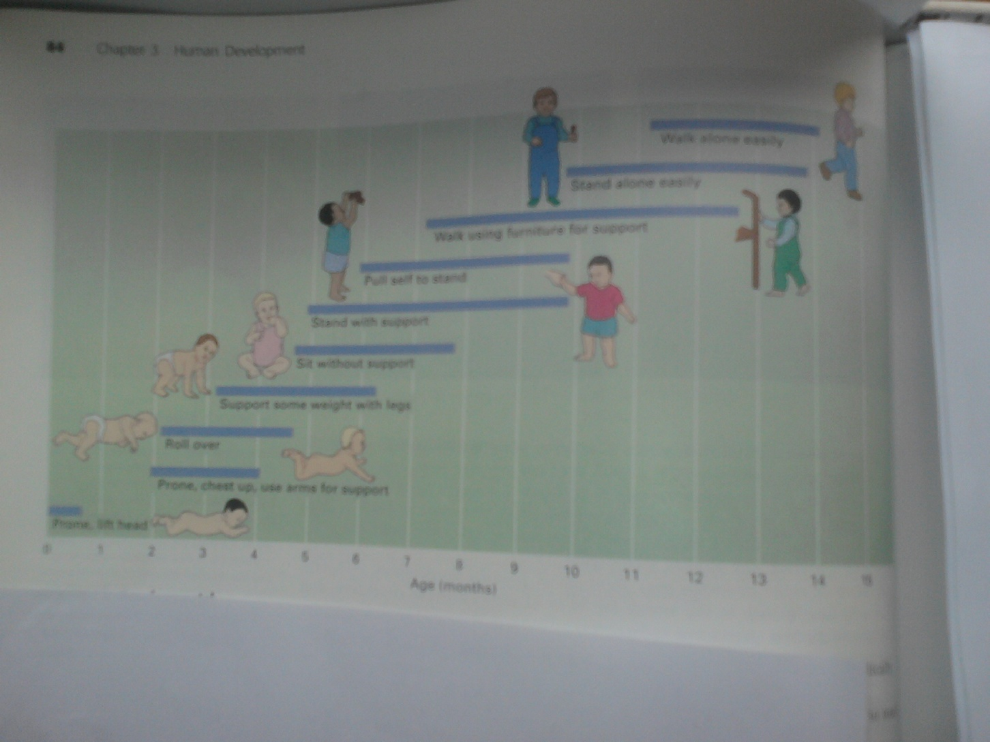
MOTOR SKILLS DURING THE FIRST 15 MONTHS

Slide 14
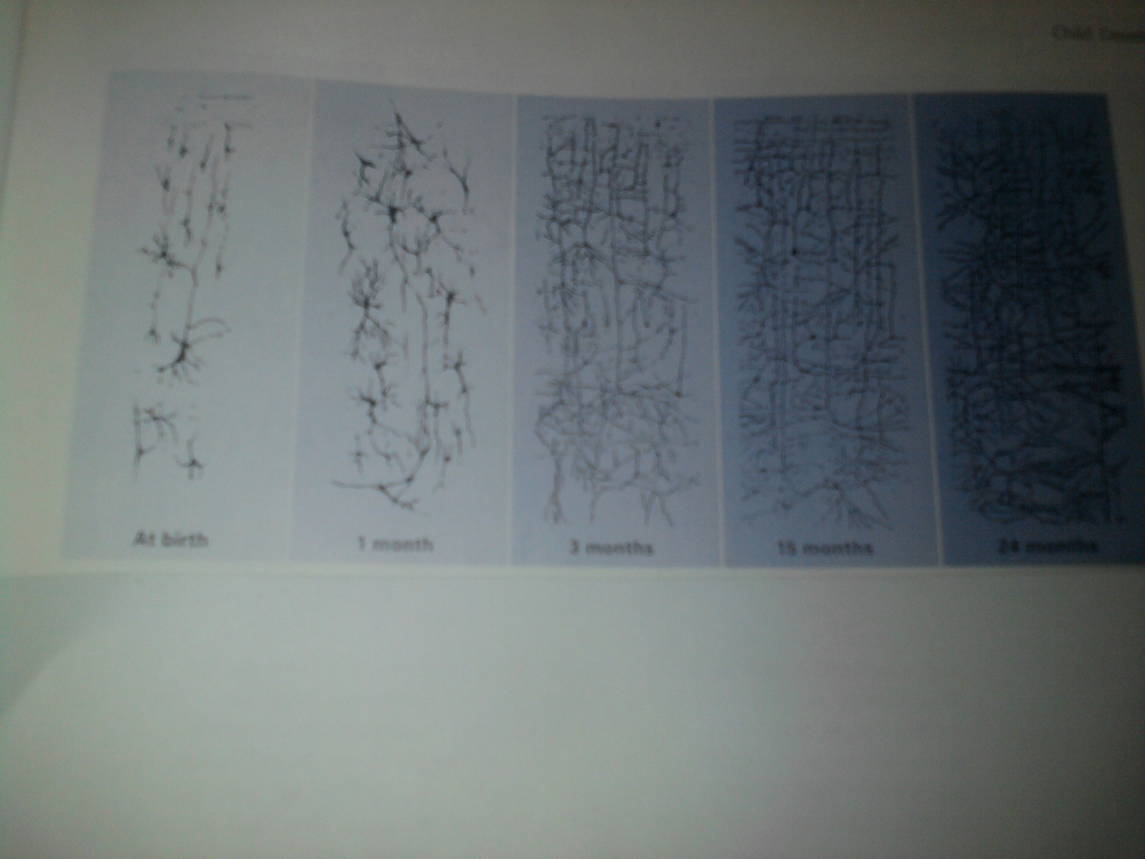
THE BRAIN

Slide 15
COGNITIVE DEVLOPMENT IN CHILDHOOOD
INVOLVE
THOUGHT ,INTELLIGENCE,LANGUAGE
CHILDREN ACTIVELY CONSTRUCT THEIR WORLD. USING SCHEMAS
SCHEMA=A FRAME WORK IN PERSONS MIND THAT ORGANIZES AND INTERPRETS INFORMATION
ASSIMILATION=INCORPORATING NEW INFORMATION INTO EXISTING KNOWLEDGE
ACCOMNDATION=ADJUSTING SCHEMAS TO TAKE NEW INFORMATION INTO ACOUNT.

Slide 16
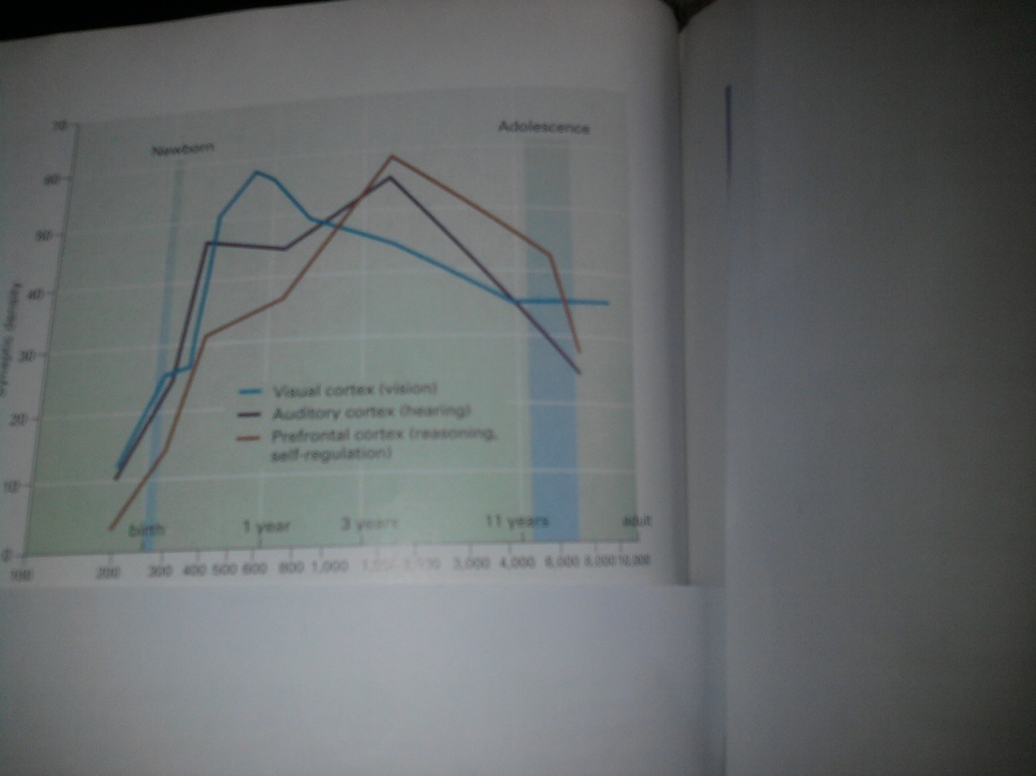
SYNAPTIC DENSITY FROM INFANCY TO ADULTHOOD
THE GRAPH SHOWS THE DRAMTIC INCREASE IN SYNAPTIC DENSITY AND THEN PRUNING ,IN THREE REGIONS OF THE BRAIIN
GREEN =VISUAL CORTEX
PURPLE= AUDITORY CORTEX
BROWN=PREFONTAL CORTEX(REASONING AN DSELF REGULATION)

Slide 17
PIAGET’S THEORY OF COGNITIVE DEVELOPMENT
STAGES 1&4
STAGES 2 &4
1.SENSORIMOTOR STAGE
BIRTH TO 2 YRS
FROM REFLEX TO SYMBOLIC THOUGHT
OBJECT PERMANCE-ABILITY TO UNDERSTAND OBJECTS EVEN WHEN THEY CAN BE SEEN DIRECTLY
3. CONCRETE OPERATIONAL STAGE
7-11 YRS
REASON
CLASSIFY OBJECTS
2. PREOPERATIONAL STAGE
4. HYPOTHETICAL DECFORMAL OPERATIONAL STAGE
11YRS THROUGH ADULTHOOD
ABSTRACT THINKING,
IDEALISTIC
LOGICAL
2-7 YRS
WORDS AND IMAGES EVOLVE
HYPOTHETICAL DEDUCTIVE REASONING

Slide 18
SOCIOECONOMIC DEVELOPMENT
1.ERIKSONS THEORY
2.ATTACHMENT IN INFANCY
4.TEMPERAMENT
5.PARENTING
6.THE WIDER SOCIALWORLD
7.GENDER DEVELOPMENT
8. MORAL DEVELOPMENT

Slide 19
6.THE WIDER SOCIALWORLD
1.PEERS
2.SCHOOL
3. QUALITY OF NEIGHBOURHOO
4. THE BROADER CULTURE
ALL INFLUENCE DEVELOPMENT
BEYOND THE FAMILY

Slide 20
ERIKSONS STAGES OF SOCIOECONOMIC DEVELOPMENT
STAGES 1,3,5,7
STAGES 2,4,6,8.
1.TRUST VS MISTRUST
BIRTH TO 1 ½ YRS
BASIC NEED IS SENSITIVE RESPONSIVE CAREGIVERS, TRUSTED ONES
3.INTIATIVE VS GUILT
5.IDENTITY VS IDENTITY CONFUSION
7. GENERARITY VS STAGNATION
AGE 3-5 –PRESCHOOL YRS
RESPONSIBILITY
MADE TO FEEL ANXIOUS DUE TO INCOMPETENT GUIL FORMS
10-20 YRS
FINDING OUT WHO THEY ARE
ALLOWS ATTACHMENT TO DEVELOP
2.AUTONOMY VS SHAME/DOUBT
UP TO 3 YRS
4.INDUSTRY VS V S INFERIOTY
MASTERING KNOWLEDGE
6.INTIMACY VS ISOLATION
8.INTERGRIKTY VS DESPAIR
SENSE OF FREEDOM
IF PUNSHIED A LOT THEY DEVELPO SHAME
MAY FEEL INADQUATE IF NOT VERY COMPETENT
20S AND 30S
INTIMATE REALTIONS FORMS OR FAILS
LIFE ACHIEVEMNTS \
POSITIVE =INERGRITY
NEAGATIVE =DESPAIR

Slide 21
ATTACHMENT IN INFANCY
FREUD-ORAL STATSFACTION FROM BREASTFEEDING
“CONTACT COMFORT” IS THE CRUCIAL ELEMENT IN ATTACHMENT(WIRE AND CLOTH ARTIFICIAL MOTHERS EXPERIMENT HARRY HARROW 1958)
IMPRINTING (LORENZ 1903-1989)THE TENDANCY OF AN INFANT ANIMAL TO FORM AN ATTACHEMENT TO THE FIRST MOVING OBJECT IT SEES OR HEARS
6 TO 7 MONTHS ARE CRUCIAL IN HUMAN ATTACHMENT(JOHN BOWLBY)
SECURE ATTACHMENT(RESPONSIVE CAREGIVERS)
ATTACMENTS CAN BE TO MULTIPLE CARE GIVERS IN AFRFICAN CULTURES
THE CLOSE EMOTINAL BOND BETWEEN AN INFANT AN D ITS CAREGIVER
THE BASIS FROM WHICH TO EXPLORE THE ENVIRONMENT

Slide 22
TEMPERAMENT
THE EASY CHILD
THE DIFFICULT CHILD
SLOW TO WARM UP CHILD
AN INDIVIDUALS BEHAVIROAL STYLE AND CHARACTERISTIC WAY OF RESPAONDING

Slide 23
5.PARENTING
1. AUTHORITARIAN
PUNITIVE,RESTRICTIVE
3
NEGLECTFUL
UNINVOLVED PARENT
3.
AUTHORITATIVE
INDEPENDENCE BUT WITH RESTRICTIONS
4.
INDULGENT
PLACES NO LIMITS
TYPES OF PARENTING BY DIANA BAUMRID()1971
THE IDEAS ABOUT THE BEST WAY TO REAR CHILDREN

Slide 24
6.THE WIDER SOCIALWORLD
1.PEERS
2.SCHOOL
3. QUALITY OF NEIGHBOURHOO
4. THE BROADER CULTURE
ALL INFLUENCE DEVELOPMENT
BEYOND THE FAMILY

Slide 25
7. MORAL DEVELOPMENT
LEVEL 1 PRECONVENTIAL
STAGE 1 CHIDREN OBEY PARENTS
STAGE 2
PURSUE OWN INTERESTS
LEVEL 2 CONVENTIONAL
STAGE 3 TRUST,CARING LOYATY
STAGE 3
SOCIAL ORDER LAW JUSTICE AND DUTY
LEVEL 3 POSTCONVENTIONAL LEVEL
STAGE 5VALUES RIGHTS AND PRINCIPLES TRANSCEND LAW
STAGE 6
LAW AND CONSCIENCE
COSCIENCE PREDOMINATE
INVOLVES CHANGES WITH AGE IN THOUGHTS, FEELNGS I AND BEHAVIOUR REGARDING THE PRINCIPLES AND VALUES THAT GUIDE WHAT PEOPLE SHOULD DO

Slide 26
GENDER DEVELOPMENT/GENDER ROLES
NATURE
NURTURE
GENDER
GD=THE SOCIAL AND PSYCHCOLOGICAL ASPECTS OF BEING A FEMALE OR MALE
GR=EXPECTATIONS FOR HOW FEMALES AND MALES SHOULD THINK ,FEEL AND ACT

Slide 27
CHARACTERITICS OF RESILENT CHILD
INDIVIDUAL
INTELLIGENT APPEALING EAY GOING SELF ESTEEM TALENTS FAITH SOCIABLE
FAMILY
SUPPORTIVE FAMILY,ECONOMIC ADVANTAGES ,AUTHORITATIVE PARENTING,WARM HOME STRUCTURE
WIDER WORLD
SUPPORTIVE POSITIVE ADULTS,SUPPORTIVE ORGANIZATIONS

