Slide 1
Iatrogenic disorders and amyloidosis
05th feb 2008

Slide 2
Internet definition
The term iatrogenic is defined as “ induced in a patient by a physician’s activity, manner or therapy i.e. a complication of treatment

Slide 3
Iatrogenic diseases
Definition:
These are diseases that follow some form of prescribed treatment. Therefore involve the medical practitioner
Examples- Adult respiratory distress syndrome (diffuse alveolar damage)
Pulmonary thromboembolism
Radiation injury
Anaphyllactic reaction
Retrolental fiboplasia

Slide 4
Adult respiratory distress syndrome
The incidence locally is not recorded
The USA reports about 150,000 cases per annum
The mortality rate in the USA is 60%
Causes are numerous
Iatrogenic causes- oxygen toxicity
Acetylsalicylic acid overdose
Multiple transfusions
Cardiopulmonary bypass
Haemodialyses
Surgery- prolonged

Slide 5
pathogenesis
Acute alveolar injury by the insulting agent
There is diffuse damage of the alveolar capillary walls
Damage of the alveolar with exudation of protein rich fluid into the alveolar space, hyaline membrane formation
Failure of gaseous exchange , hence the respiratory failure
Out come is diffuse healing by fibrosis and not resolution as seen in CCF oedema

Slide 6
pathogenesis
The damage is caused by cytokines, oxygen free radicals, complement and eicosanoids (20 carbon polyunsaturated fatty acids-5,8,11,14eicosatetraenoic acid)
In haemodialysis and bypass, the alternative pathway of the complement system is activated by the membranes of these devices
Free radicals cause direct injury in oxygen toxicity

Slide 7
pathology
Alveolar oedema
Hyaline membrane
Type two alveolar macrophages in the exudate
Interstitial oedema and inflammatory infiltrate
Diffuse fibrosis
Firm heavy gelatinous lungs, exudate, may or may not show focal consolidation

Slide 8
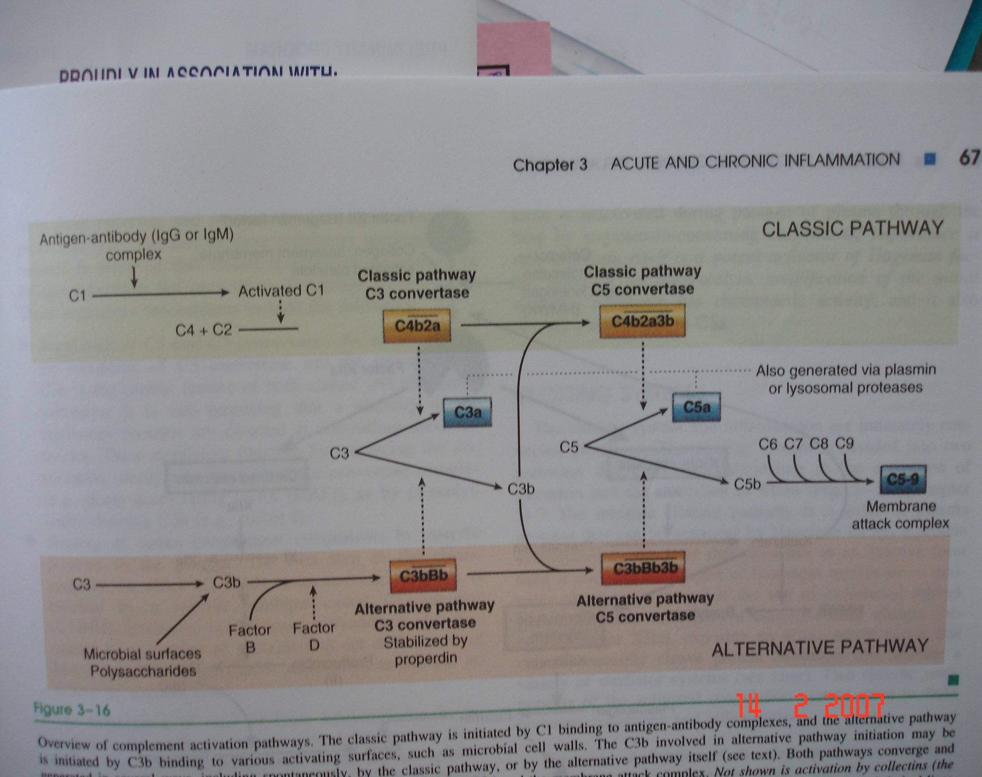

Slide 9
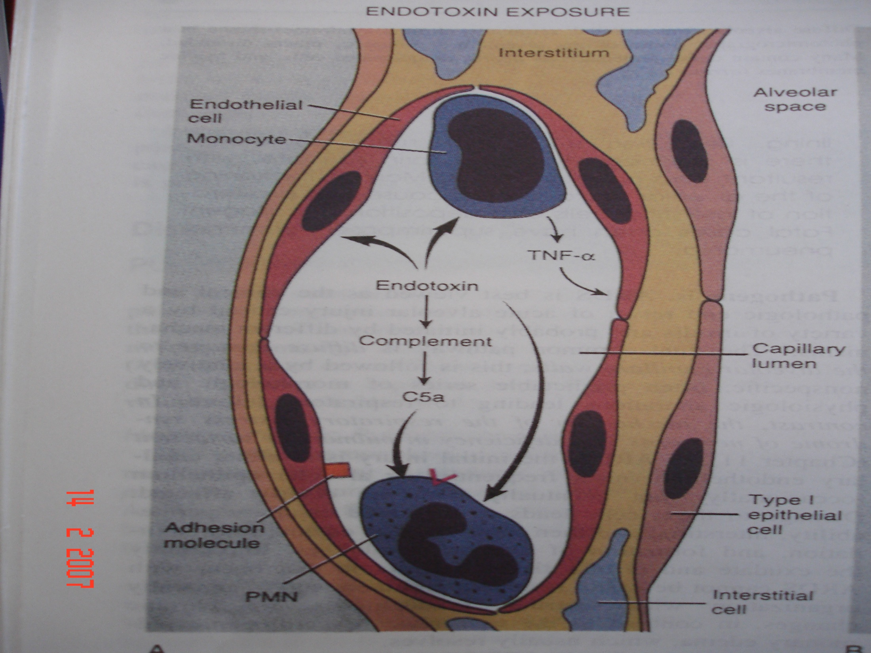

Slide 10
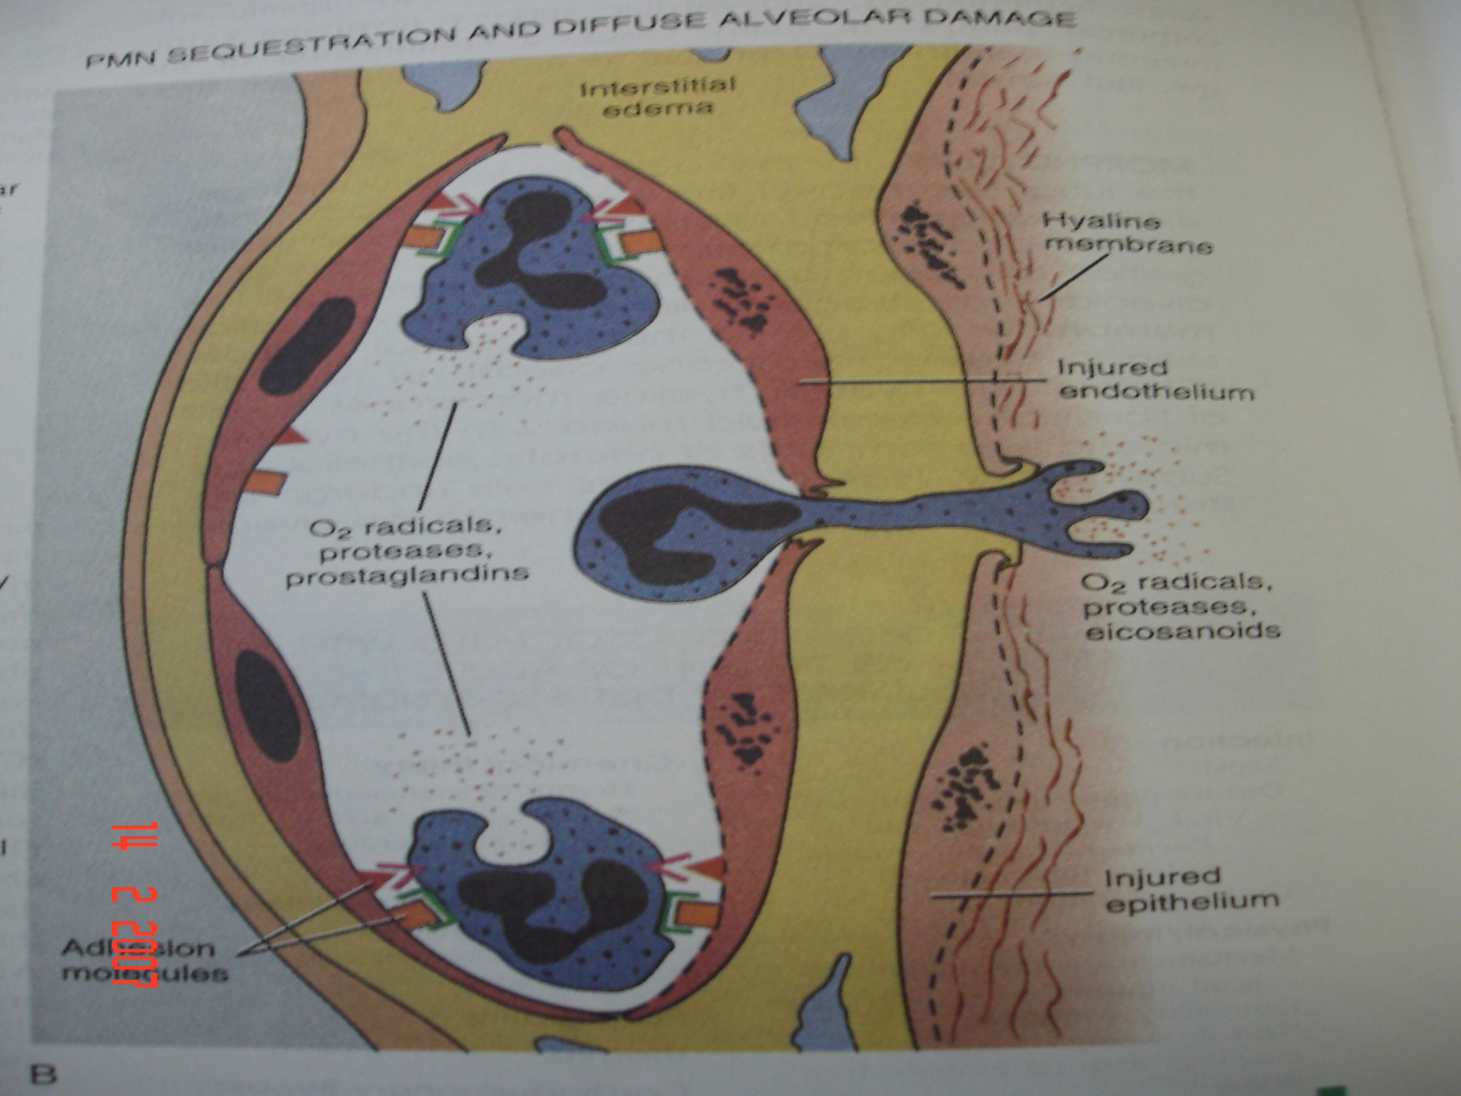

Slide 11
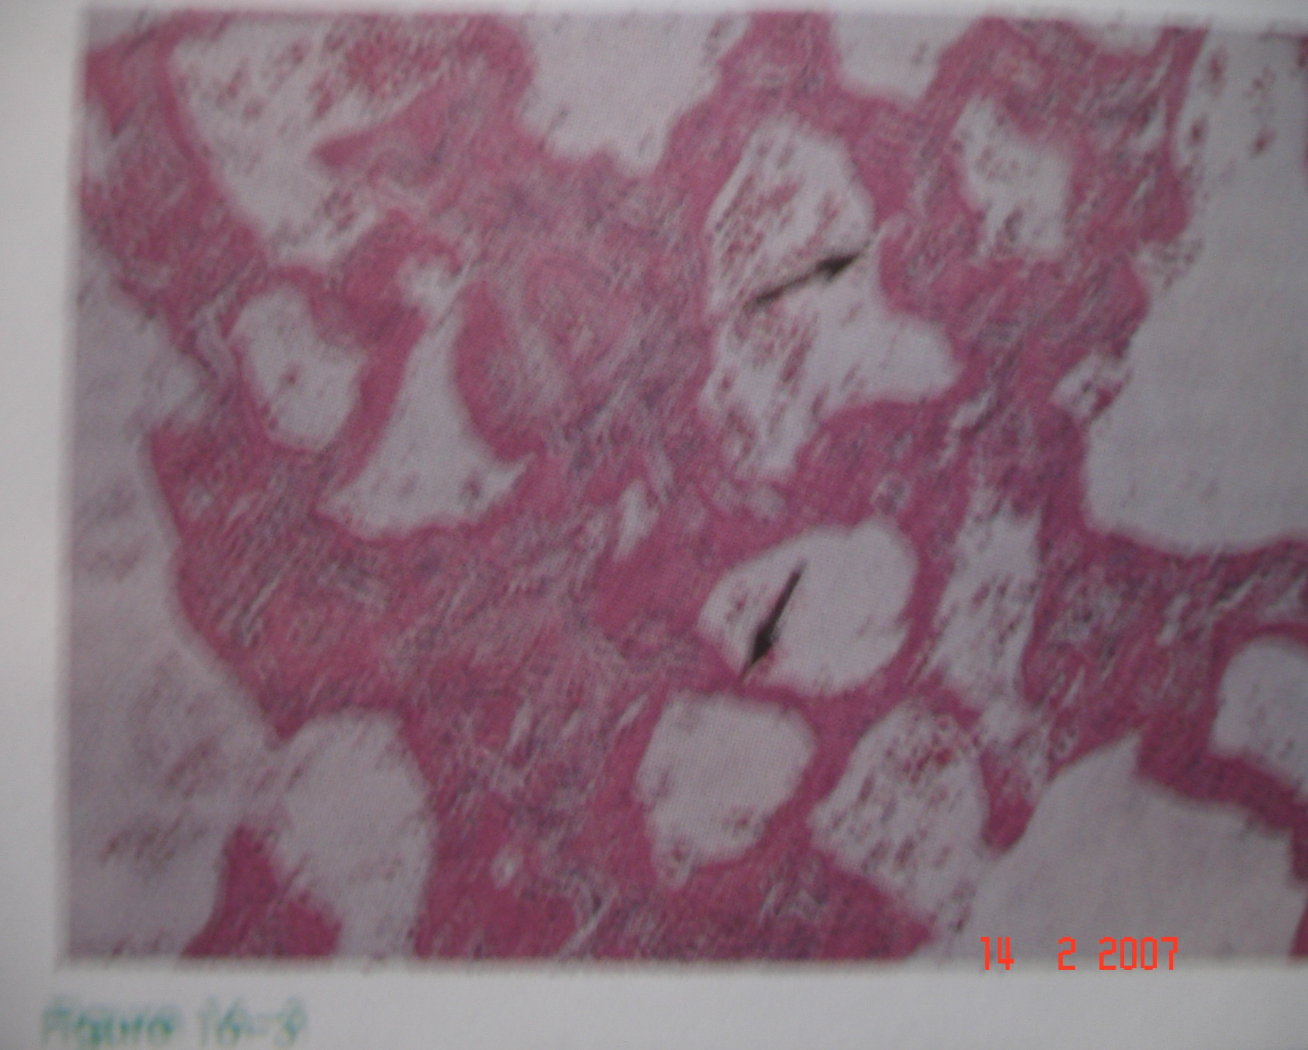

Slide 12
Clinical outcome
Profound dyspnoe with normal Xrays
Cyanosis hypoxia, respiratory acidosis
Later diffuse bilateral infiltrate on Xrays
Death in a few hours
Nitric oxide has been tried as a potent pulmonary vasodilator

Slide 13
Pulmonary thromboembolism
Surgery with or without imobilisation
Oral contraception
Indwelling vascular catheters and prosthesis e.g artificial heart valves
Bedrest (immobilisation)
Bypass surgery

Slide 14
Pulmonary thromboembolism
Almost always arise from sites far from the pulmonary artery, e.g the deep cuff veins-95% cases
May follow pulmonary hypertension or atherosclerosis in-situ
1% in all mortalities
30% in patients dying from severe burns, trauma-eg surgery
10%- all dying acutely in hospitals

Slide 15
pathogenesis
The virchows triad
Endothelial injury
Stasis and
Hypercoagulability- e.g. protein C and S deficiency
Endothelial injury leads to exposure of collagen to the platelets and
Aggregation
Release of ADP and thromboxane A2
RECRUITE more platelets-I plug
Activation of coagulation factors-platelet phospolipids and tissue factor
Thrombin activation
Fibrin polymerisation- II PLUG
Trapped rbcs
Propagation to the proximal circulation

Slide 16
PATHOGENESIS
The clot may be dislodged during procedures or movement to ascend to the pulmonary circulation

Slide 17
pathology
Occlusion by large thrombus
Pulmonary hypertension
Pulmonary infarction
Alveolar haemorrhages
Raised red infarct with pleural exudation
Pale , then brown composed of haemosiderrin
Necrosis
Acute inflammatory cell infiltrate

Slide 18
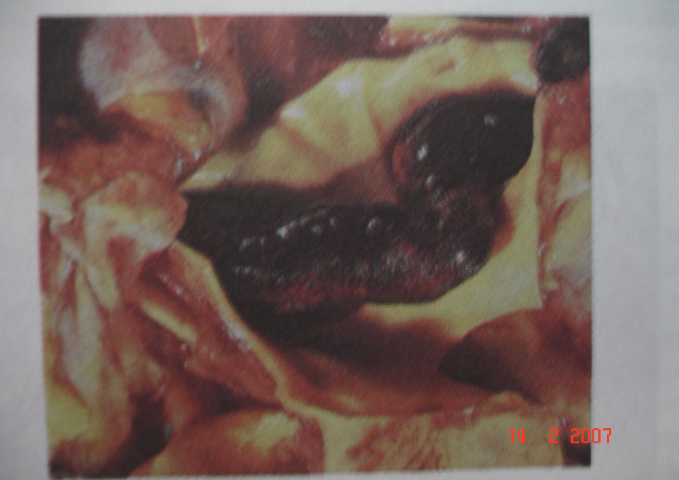

Slide 19
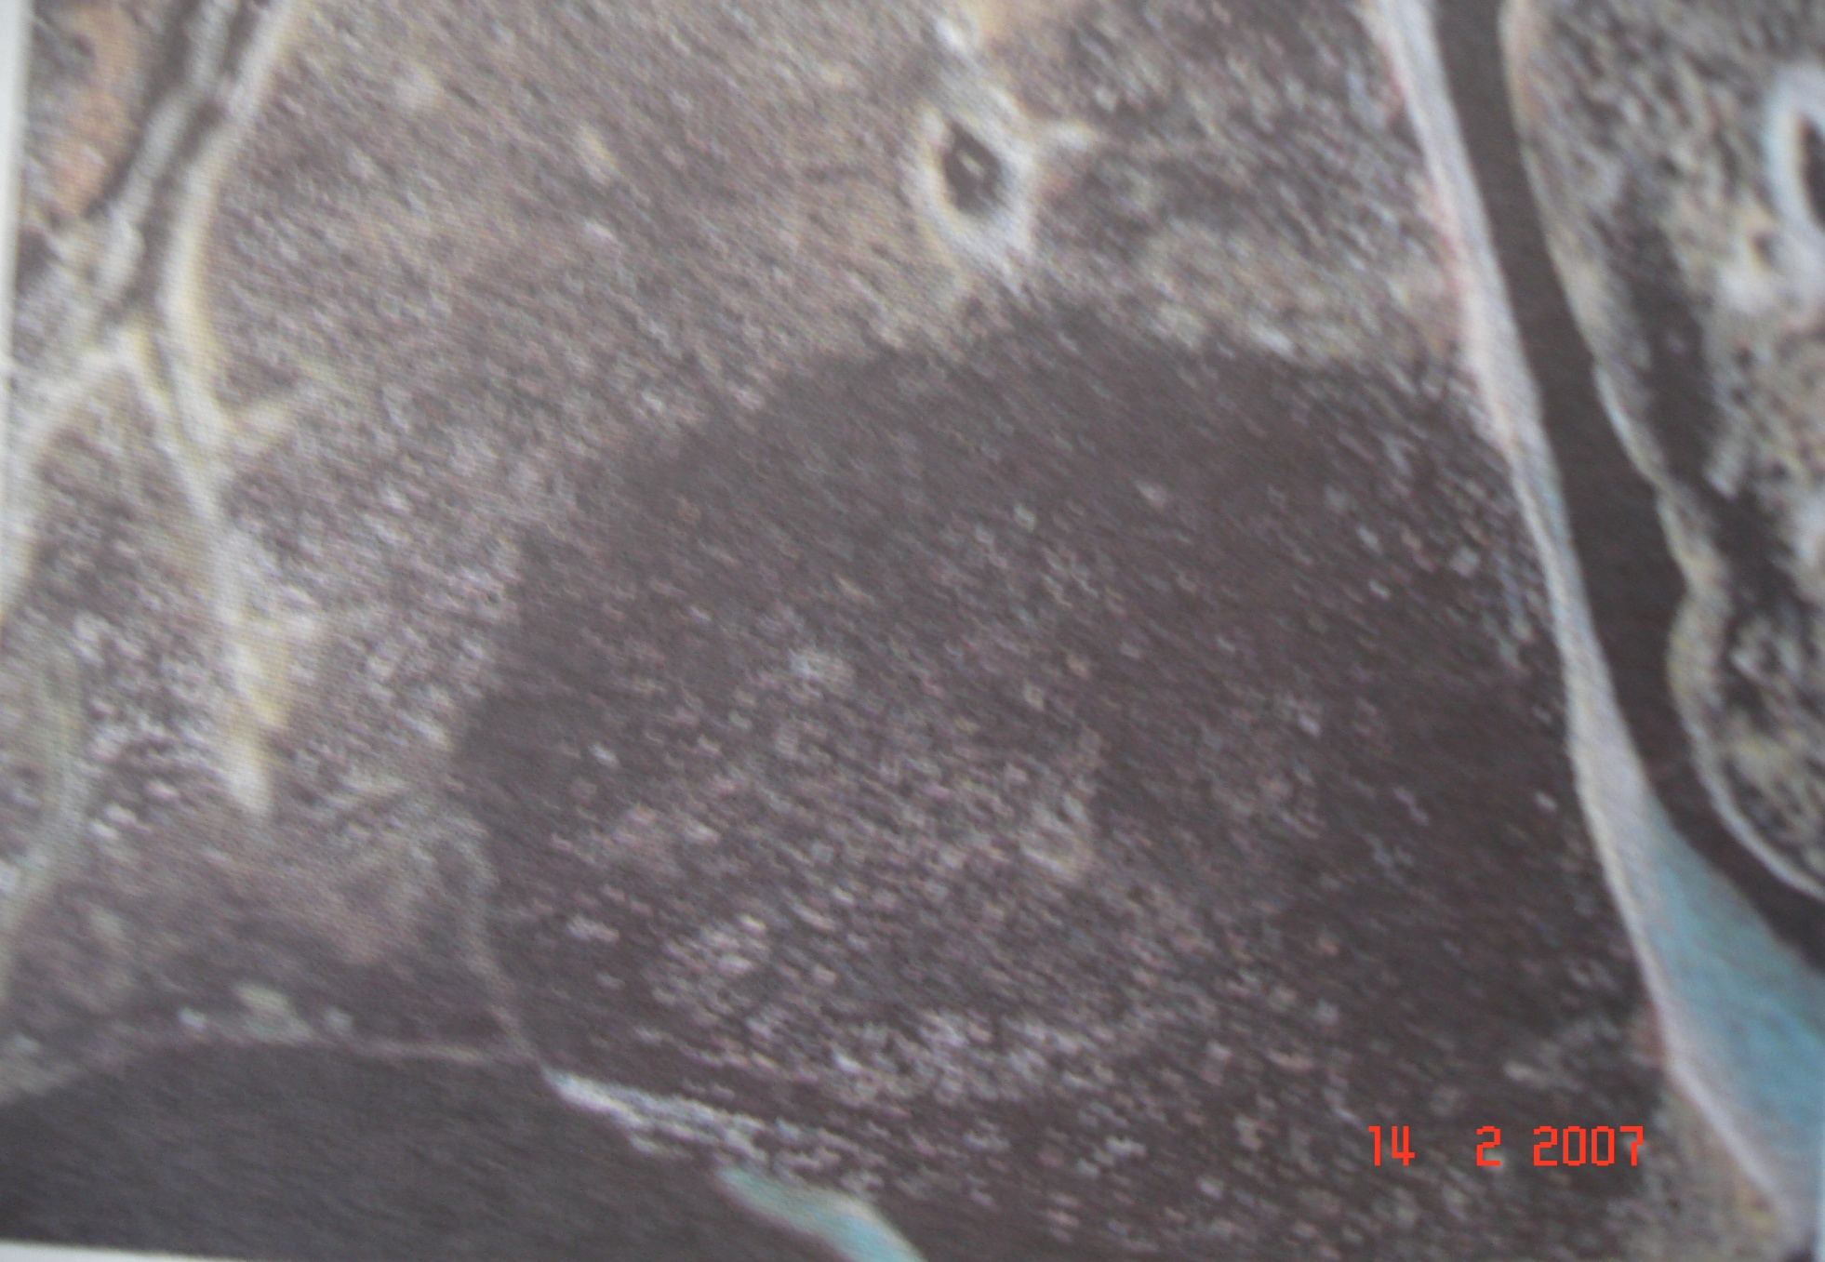
Pulmonary infarct-after PTE

Slide 20
Retrolental fibroplasia
Blindness in premature neonates in ventilators in the 40s and 50s
Depends on the duration of exposure, the prematurity and Norrie disease gene
Injury to the retinal arteries which mature late
Reports on full-term neonates have been made

Slide 21
pathology
Vasoobliteration
Thought to be due to lack of VEGF (VASCULAR ENDO GF)
Vasoproliferation
Retinal detachment, haemorrhage

Slide 22
Amyloidosis
Def: the deposition of pathologic proteinaceous substance in between tissues and organs in wide variety of clinical setting
Seen with routine stains as an amorphous eosinophilic material deposited in tissue with atrophy of the adjacent cells

Slide 23
classification
Based on the type of proteins
Or the clinical presentation
7.5-10nm Protein, EM and crystallography –shows cross B-pleated sheets
Serum-P component composed of preteoglycans and highly sulfated gycosaminoglycans
TYPES
1.AL- AMYLOID light chain- myeloma derived
2.AA (amyloid associated)- non-Immunoglubulin protein sythesised in the liver
3.AB- amyloid seen in Alzheimers disease

Slide 24
Primary amyloidosis
4.AL type, usually systemic
Multiple myeloma patients- malignant B cells produce abnormal ammounts of Ig,
M-protein
Kappa and labda light chains (Bence jones proteins)- also produced
10% of these patients develop AMYLOIDOSIS

Slide 25
AL primary AMYLOIDOSIS
Do not have MM
AL type
Modest increase in plasma cells

Slide 26
Reactive systemic amyloidosis
AA type
Secondary type
Associated with inflammatory conditions
TB, Bronchiectasis, chronic osteomyelitis,
Rheumatoid arthritis
Ankylosing spondylosis
Chronic inflammatory bowel disease e.g regional enteritis and ulcerative colitis
i.v drug abuse
Renal cell carcinoma and Hodgkins disease

Slide 27
Others
Haemodialysis associated-60-80% of long term dialyses pts
B2 microglobulin production
This protein cannot be filtered thro the cuprophane dialysis membrane hence accumulation

Slide 28
Heredofamilial amyloidosis
Familial mediterranean fever- autosomal recessive
Affects mainly the joints
Mainly seen in Americans, Jews and Arabs
AA protein

Slide 29
others
Localized amyloidosis
Endocrine
ageing

Slide 30
pathogenesis
Not clear-POSTULATES
Elevated SAA synthesized in the liver under influence of cytokines-IL 1 and IL 6
ENZYME defect resulting in incomplete destruction of the SAA THUS generating insoluble AA molecules
Genetically determined abnormality in the SAA protein making un-degradable by the monocytes

Slide 31
Pathogenesis and pathology
In Myeloma- these are products of light chains degradation
Involves any organ-kidney, liver, spleen , lymphnodes, heart, tongue, skin etc
Organomegally, waxy and firm
Painting with iodine imparts a yellow colour
Congo red stain under flourescent light shows a green birefringence
Kidney- peritubular deposits with thicked BM, capillary narrowing

Slide 32
Complications of Amyloidosis
Renal failure
Heart failure
Liver failure etc

