Slide 1
Psychosocial Risk Factors and Behavioral Interventions in Cardiovascular Disease

Slide 2
“ For every affection of the mind that is attended with either pain or pleasure, hope or fear, is the cause of an agitation whose influence extends to the heart, and there induces change from the natural constitution,in the temperature, the pulse and the rest”
- Dr William Harvey, 1962

Slide 3
The term “Psychosocial” broadly categorizes factors which are:
Psychologic – e.g, anxiety, depression
Psychosocial – e.g., work stress, discrimination, emotional support
Social-structural – e.g., socioeconomic status, social integration, neighborhood effects

Slide 4
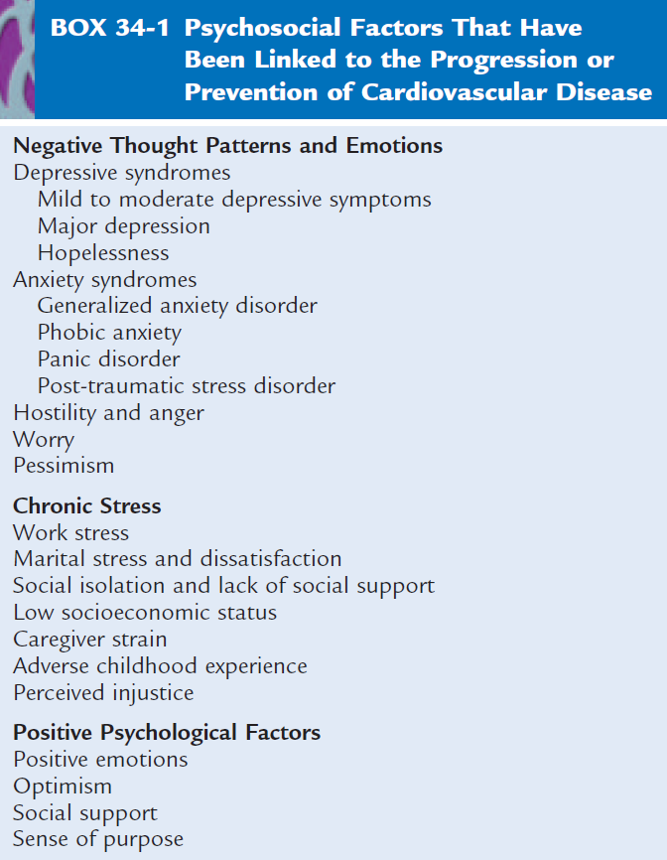

Slide 6
Depression
Estimated prevalence of major depression is 14%, but up to 30% in cardiac patients
Characterized by a depressed mood and combination of other symptoms such as weight change, sleep disturbance, insomnia, fatigue, feelings of guilt, worthlessness, and/or hopelessness.
Depression can stimulate the autonomic nervous system and HPA axis. It is also proinflammatory and is associated with increases in CRP, fibrinogen, IL-6 and other inflammatory measures, independent of BMI and other risk factors.
Of all psychosocial factors, evidence of association with CVD is strongest for depression.

Slide 7
Depression: Evaluation
Measurement can be done by:
Beck Depression Inventory
DSM-IV
Depression and CVD
Frasure-Smith et al (JAMA 1993) reported a 4-fold increase in mortality during 6 months following acute MI from depression in cardiac patients.
Meta-analysis examining depression as a factor in development of CHD in healthy individuals showed a risk factor-adjusted RR=2.69 for CHD incidence ( Rugulies, Am J Prev Med 2002).

Slide 8
Depression and CHD

Slide 9
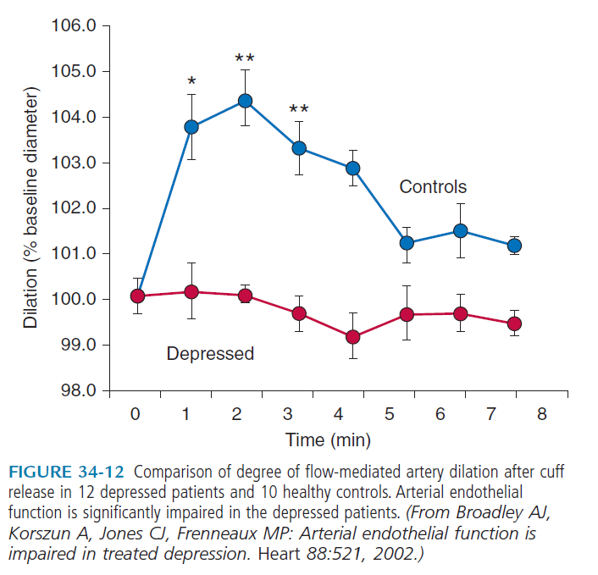

Slide 10
Anxiety and CHD
Anxiety is characterized by heightened levels of perceived fear and nervousness
Clear relation to sudden cardiac death in a dose-dependent fashion
32-year follow-up of men in the Normative Aging Study who reported two or more phobic anxiety symptoms had a 3.2-fold increased risk of fatal CHD and 5.7-fold increased risk of sudden death.
Ventricular arrhythmia may be the underlying mechanism

Slide 11
Post Traumatic Stress Disorder (PTSD)
A retrospective study of men who have served in the military shows a stepwise relation between symptoms of PTSD and nonfatal MI and cardiac death (Kubzansky, Gen Psychiat 2007).
Study of 1059 women shows relation between PTSD and incident CHD (Kubzansky, Health Psychol 2009).
Boscarino evaluated 4328 men who served in Vietnam war; PTSD associated with more than a two-fold increased risk of subsequent cardiac mortality, independent of depression symptoms (Psychosom Med 2008).

Slide 12

Pessimism and Optimism
Optimists tend to see negative events
as temporary and positive events are
more permanent; negative events
are attributed to external causes rather
than self-condemnation.
Pessimists have an opposite
explanatory style to events.
One study of 7216 subjects showed the
extent of pessimism to be directly related to the risk of all-cause mortality (Grodbardt, Psychosom Med 2009)
In the largest such study, the Women’s Health Initiative showed among 97,253 women that those those who were optimistic had a 30% lower rate of cardiac mortality (Tindle, Circulation 2009)

Slide 13
Personality Constructs: Type A Behavior Pattern
The Type A behavior pattern includes a hard-driving, time-patient, and hostile behavior.
Friedman and Rosenman showed the Type A Behavior Pattern to be related to both CAD risk and recurrent MI; however subsequent studies showed no relationship, so this has been of diminished interest.
The Recurrent Coronary Prevention Project did show intervention from counselling on Type A behavior to reduce recurrent MI rates and cardiac deaths (Friedman et al., Am Heart J 1986)

Slide 14

Hostility
Reflects emotional (anger, contempt),
behavioral (verbal and physical
aggression), and cognitive (cynicism, mistrust)
factors.
Hostility is associated with heightened cardiovascular reactivity and higher blood pressure.
Higher prevalence in those with lower SES; has been suggested as a mechanism linking low SES with CVD outcomes.
May be a stronger indicator of incident CHD than of recurrent CHD or its progression.

Slide 15
Social Relations
Vast literature on social networks,
social support, and CVD
Alameda County Study showed those who lacked ties to others (index of contacts with friends and relative, marital status, and church membership) were 1.9-3.1 times more likely to die over 9 years, including from ischemic heart disease and other causes.
A large study in Tecumseh, Michigan found a strong positive association in men, but not women between social support and mortality,. Even after adjustment for other risk factors.
US Physicians Study showed socially isolated men had a 1.8-fold significantly greater risk of fatal CHD in multivariable analysis/.

Slide 16
Positive Emotions and Well-Being
Recent research has focused on positive psychological factors.
Positive emotions have been defined to include happiness and states of being that reflect a positive engagement with the environment such as curiosity and interest.
This gives the individual increased ability to cope with stress.
Metaanalyses involving 70 studies shows positive well-being to be associated with lower mortality (Chida, Psychosom Med 2008).
A study of 1238 elderly persons showed those who identified with a higher purpose in life had a 40% lower risk of mortality over 2.7 years (Boyle, Psychosom Med 2009).

Slide 17
Effects of Psychosocial Intervention
in the cardiac rehab setting, a metaanalysis of 23 randomized trials showed all-cause mortality to be 28% lower in those trials that included psychosocial interventions compared to those who did not (Linden, Eur Heart J 2007), but reduction in mortality seen only in those who effectively reduced psychological distress.

Slide 18
Summary
Evidence of associations between a number of psychosocial factors--including depression, anxiety, hostility, social networks and support, and occupational stress with cardiovascular disease.
Adverse psychosocial characteristics to cluster with traditional biological and behavioral risk factors
The highest levels of psychosocial risk are generally found among the socially disadvantaged.

Slide 19
Summary (cont.)
Results of large-scale clinical trials of psychosocial interventions have been mixed with respect to their impact on CVD outcomes.
Screening of certain psychosocial factors, especially depression, is recommended in the primary and secondary prevention setting.
Greater consideration of psychosocial influences on cardiovascular outcomes and behavioral risk factors may enhance clinical efforts to improve both primary and secondary prevention outcomes.

