Slide 1
REHABILITATION IN PSYCHIATRY

Slide 2
Definition
Rehabilitation is the process of restoring an individual to the highest level of functioning possible.

Slide 3
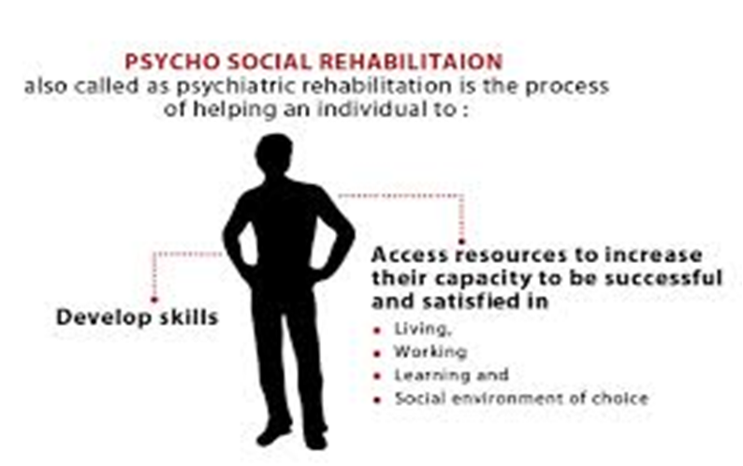

Slide 4
Objectives of PSR
To enable patients achieve their optimal functioning.
To enable patients live independently.
To empower patients to understand and manage their illness effectively
To encourage involvement of families in care of patients

Slide 5
Strategies in PSR
Help patients with long admission in hospital return to the community
Support the chronic mentally ill within the community to reduce prolonged stay in hospital
Rectify the patient’s social environment
Prevent or treat the disabilities induced by mental illness
Re-integrate patients into community life as soon as possible.

Slide 6
Problems in PSR
Financial problems
Family problems
Lack of community support
Difficulties in vocational rehabilitation
Lack of job opportunities
Hospital as shelter or dumping site
Expressed emotions and relapse
Societal insensitivity

Slide 7
Rehabilitation Process
Rehabilitation process begins at admission to hospital and includes:
Medical intervention
Patients require medication for the symptoms of their disease.
Psychological intervention
Individual, group, supportive psychotherapy and behavioral programs
Social intervention
Social support, social skills training.

Slide 8
Disciplines involved in the PSR
The following are involved:
The psychiatrist – Physical intervention
The clinical psychologist – Psychological intervention
Psychiatric social worker – Social intervention
Occupational therapist – Occupational intervention

Slide 9
Effective Rehabilitation depend upon
Accurate diagnosis
The patients deficits, assets and strengths
Skills and performance in personal, domestic and vocation.
Psychological, physical and social needs
These needs have to be addressed.
The biopsychosocial approach in management.

Slide 10
Techniques in rehabilitation
Admission to hospital
Counseling
Psychotherapy
Social support
Environmental manipulation
Community care
De-institutionalization

Slide 11
Social skills training
Prevention
  Community psychiatry – promotion of mental health
  Based on public health principles (primary, secondary and tertiary prevention)
Creation of awareness – through public education
Follow-up and referral

Slide 12
Types of Rehabilitation
Rehabilitation
Community Based
Hospital Based

Slide 13
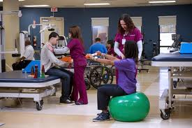
Hospital Based Rehabilitation
Services provided
Medication
Nursing care
Occupational therapy
Psychotherapy
Physical therapy (ECT)
Counselling
Peer support group

Slide 14

Community Based Rehabilitation
Services provided
Community support
Family support
Occupational therapy
Community psychiatry
Group therapy
De-institutionalization
Social skills training
Self-help groups
Prevention

Slide 15
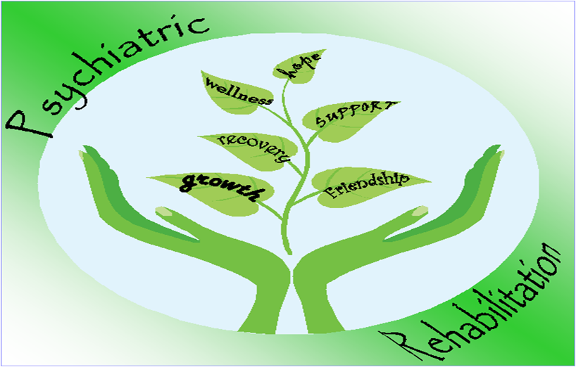
Components of PSR

Slide 16
Summary
Psychosocial or Rehabilitation in psychiatry is the process by which the individual is helped to return to his/her former normal functioning
Achieved through hospital based care and community based care by use of rehabilitation techniques.

Slide 17
Reference
Corrigan P.W., Mueser K. T., Bond G.R., Drake R.E., Solomon P., (2009), “Principles and Practice of Psychiatric Rehabilitation”. An Empirical Approach. The Guilford Press. New York.

Slide 18
THANK YOU!

Slide 19
Professor Anne Obondo, Associate Professor, Department of Psychiatry

