Slide 1
DEMENTIA
PIUS KIGAMWA
1

Slide 2
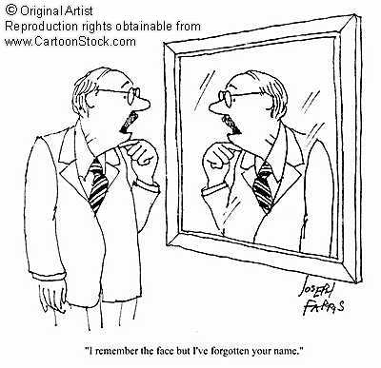
2

Slide 3
3

Slide 4
4

Slide 5
Dementia is a brain disease. It is not part of normal ageing.
Forgetting names, misplacing keys or getting lost in a familiar place may not simply be signs of old age. There could be an underlying medical condition
“Dementia refers to a group of symptoms including memory loss and loss of independent function

Slide 6
“It is not part of normal ageing but is due to brain disease, where there is a degeneration of specific brain regions.”
Sufferers may find their mental capacity declining progressively along with a reduction in their ability to function normally.
Dementia has early signs that are insidious, and patients are usually unable to pinpoint exactly when the symptoms first appeared.

Slide 7
7

Slide 8
8

Slide 9
9

Slide 10
10

Slide 11
11

Slide 12
12

Slide 13
13

Slide 14
14

Slide 15
15

Slide 16
16

Slide 17
17

Slide 18
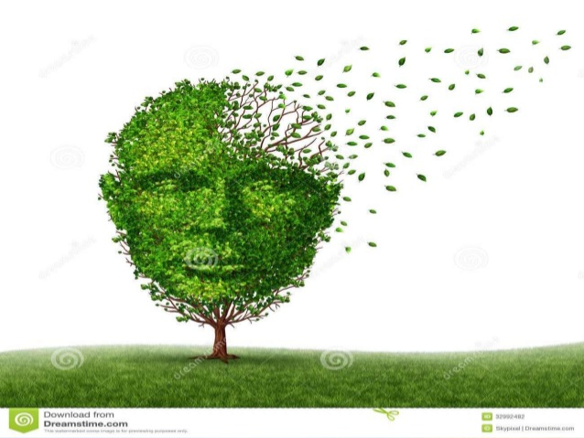
18

Slide 19
19

Slide 20
20

Slide 21
21

Slide 22
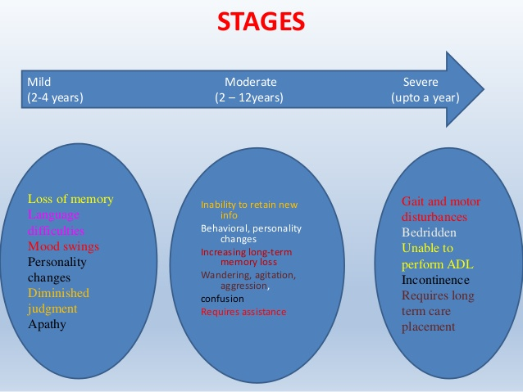
22

Slide 23
23

Slide 24
24

Slide 25
25

Slide 26
26

Slide 27
27

Slide 28
Feeding
Dressing
Washing and bathing
Moving and handling
Mobility
Safety in the home
Telecare technology
Advance care planning

