Slide 1
Classification of Psychiatric Disorders
Level IV 2019
M. Mathai

Slide 2
Objectives
By the end of the lecture the student should be conversant with the
two commonly used systems of classifications of Psychiatric disorders
ICD and the DSM (DSM IV)

Slide 3
Introduction
Classification: A process of reduction of complex phenomena into categories
Classification of disorders is based on knowledge of etiology or pathophysiology
Classification of psychiatric disorders unlike other medical conditions has been hampered by inadequate knowledge of the biological basis
Current classification of mental disorders consists of specific mental disorders grouped together- on the basis of some shared phenomenological characteristics.

Slide 4
Why Classify Mental Disorders
The ultimate purpose of classification is to improve treatment and prevention efforts
The 3 main aims of classification of mental disorders are communication, control, and comprehension.
Classification is only useful tool among users if there is a high level of agreement

Slide 5
Communication
Globally Health workers, researchers and users of Psychiatry can communicate with each other about the disorders with which they deal.
Using names of categories- summarizes a great deal of information: clinical features, disease progress, and prognosis. And treatment strategies

Slide 6
Control
Control of mental disorders- prevention of their occurrence or the modification of their course with treatment.

Slide 7
Comprehension
Classification should provide comprehension of the causes of mental disorders and the processes involved in their development and maintenance.
Comprehension leads to more effective treatment and prevention

Slide 8
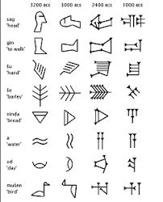

Historical Background
The First documented description of Mental Illness goes as far back as 3000 BC in Ancient Egypt- Sumarians and Hindu writings

Slide 9
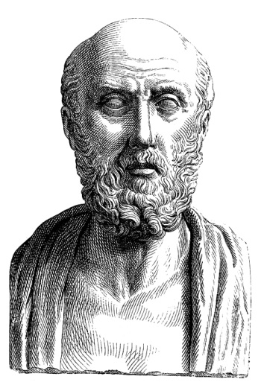
Ct
Hippocrates (approximately 460 to 370 BC) is usually regarded as the one who introduced the concept of psychiatric illness into medicine.
He described acute mental disturbances with fever, acute mental disturbances without fever chronic disturbance without fever

Slide 10
Philippe Pinel (1745 to 1826), a French physician, recognized four fundamental clinical types:
mania
Melancholia
Dementia
Idiotism

Slide 11
Kraepelin (1856 to 1926)- viewed mental illnesses as organic disease entities that could be classified on the basis of knowledge about their causes, courses, and outcomes.
He recognized manic and depressive disturbances as 2 phases of the same disorders characterized by relapses and remissions manic-depressive psychosis
Chronic deteriorating illness called dementia praecox, with a distinct form – Paranoia.
Introduced the concepts of psychogenic neuroses and psychopathic personalities
Eugen Bleuler later renamed Dementia praecox schizophrenia.

Slide 12
Disorders/ syndromes
In the absence of clear biological aetiological causes, most of the disorders or diseases diagnosed are syndromes /collections of symptoms that tend to appear together and seem to have a characteristic course and outcomes

Slide 13
Modern Classifications
There are currently two widely established Systems for classifying mental disorders
1. International Classification of Diseases (ICD- 10) produced by the World Health Organization
The Diagnostic and Statistical Manual of Mental Disorders (DSM) Currently DSM V
produced by the American Psychiatric Association (APA).

Slide 14
ICD
The ICD) is an international standard diagnostic classification for a wide variety of health conditions. The ICD-10 states that mental disorder is "not an exact term", although is generally used "...to imply the existence of a clinically recognisable set of symptoms or behaviours associated in most cases with distress and with interference with personal functions.

Slide 15
ICD- Mental and Behavioural disorders
F0: Organic, including symptomatic, mental disorders
F1: Mental and behavioural disorders due to use of psychoactive substances
F2: Schizophrenia, schizotypal and delusional disorders
F3: Mood [affective] disorders
F4: Neurotic, stress-related and somatoform disorders
F5: Behavioural syndromes associated with physiological disturbances and physical factors
F6: Disorders of personality and behaviour in adult persons
F7: Mental retardation
F8: Disorders of psychological development
F9: Behavioural and emotional disorders with onset usually occurring in childhood and adolescence
In addition, a group of "unspecified mental disorders".

Slide 16
DSM-IV- Tr (2000)
Consists of five axes (domains) on which disorder can be assessed. The five axes are:
Axis I: Clinical Disorders (all mental disorders except Personality Disorders and Mental Retardation)
Axis II: Personality Disorders and Mental Retardation
Axis III: General Medical Conditions (must be connected to a Mental Disorder)
Axis IV: Psychosocial and Environmental Problems (for example limited social support network)
Axis V: Global Assessment of Functioning (Psychological, social and job-related functions are evaluated on a continuum between mental health and extreme mental disorder)The main categories of disorder in the DSM are:

Slide 17
DSM IV Disorders
Disorders usually first diagnosed in infancy, childhood or adolescence
Delirium, dementia and Amnestic and other cognitive disorders
Mental disorder due to a general medical condition not elsewhere classified
Substance –related Disorders
Schizophrenia and other Psychotic disorders
Mood Disorders
Anxiety Disorders
Somatoform disorders
Factitious disorders
Dissociative disorders
Sexual and gender identity
Eating disorders
Sleep disorders
Impulse-control disorders
Adjusment disorders
Personality Disorders
Other conditions that may be a focus of clinical attention

Slide 18
AXIS I
Clinical Disorders: (all mental disorders listed above except Personality Disorders and Mental Retardation)

Slide 19
AXIS II.
Personality disorders and mental retardation Paranoid, Schizoid Personality disorder Schizotypal, Antisocial Borderline Histrionic Narcissistic Avoidant Dependent Obsessive-compulsive

Slide 20
Axis III
General medical conditions
Infectious and parasitic diseases
Diseases of the genitourinary system
Neoplasms
Endocrine nutritional and metabolic diseases
Complications of pregnancy, childbirth, and the puerperium
immunity disorders
Diseases of the skin and subcutaneous tissue
Diseases of the musculoskeletal Diseases of the blood and blood-forming organs system
Congenital anomalies Diseases of the nervous system and sense organs Diseases of the circulatory
Certain conditions originating in the perinatal period
Symptoms signs and ill defined system Diseases of the respiratory Symptoms,

Slide 21
Axis IV
Psychosocial and environmental problems -Problems with primary support group
Problems related to the social environment- Educational problems Occuppational problems Housing problems
Economic problems
Problems with access to health care services
Problems related to interaction with the legal system/crime
Other psychosocial and environmental problems

Slide 22
AXIS V. Global Assessment of Functioning Global Assessment of Functioning (GAF)
Within normality
100-91: No symptoms. High level functioning
90-81: Absent or minimal symptoms. – Functioning
80-71: If present-Symptoms transient usually related to understandable stressors
Mild to moderate
70-61: mild symptoms
60-51: moderate symptoms- moderate dysfunction
50-41: Serious symptoms- Severe Dysfunction
40-31: Severe impairment in reality testing or communication
Psychotic level
30-21: Behaviour considerably influenced by delusions or hallucinations
20-11: Some danger of hurting self and others
10-1: Persistent danger of hurting self and others

Slide 23
DSM V
The APA has revised DSM IV to DSM V
DSM uses a nonaxial diagnostic criteria
The department has decided to continue using the DSM IV- Multiaxial diagnosis for undergradutes to emphasis the psychosocial dimensions of mental illness

