Slide 1
Trauma- and stressor-related disorders
Level IV
2019
M. Mathai

Slide 2
Objectives
After this lecture the student should be able to
Describe- the human emotional and behavioural response to serious threat
The psychopathological conditions associated with traumatic stress
Make a diagnosis of such conditions as well as important differentials

Slide 3
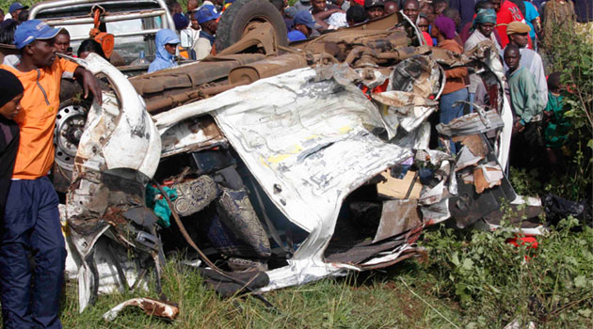
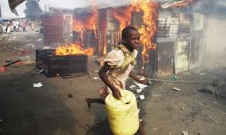
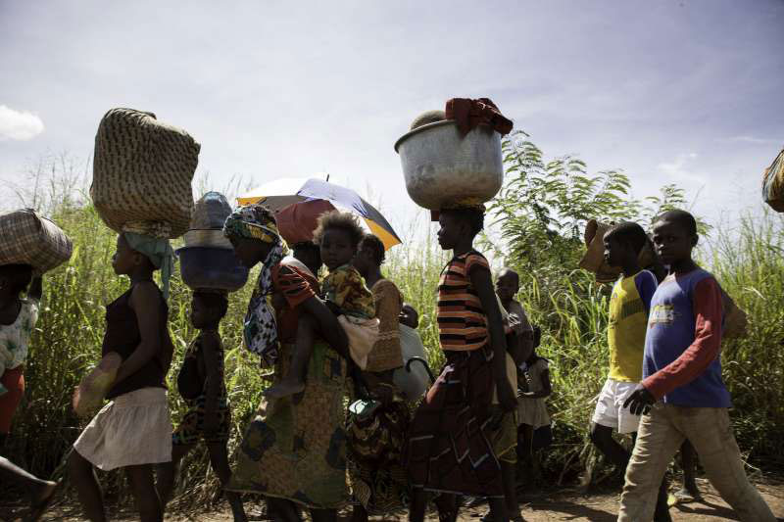
Trauma

Slide 4
Introduction
All living things – specifically known, for animals are prone to experiencing adverse environmental conditions that endanger life.
In the higher animals- threat activates a physiological response that prepares the animal for- FIGHT, FLGHT, FREEZE. This is associated with cognitive and emotional responses of fear and anxiety.
In Humans exaggerated response to threat and stress or continued reaction long after the threat is over- is associated with disabling and distressing psychological as well as biological consequences including chronically elevated cortisol levels which impact other systems including CVS and immunity.
In addition to anxiety other common human responses to stressors include: low mood, anhedonia, irritability, anger and even aggression.
Not surprising that some conditions (PTSD &ASD) under this category- were previously categorised under anxiety disorder

Slide 5
Introduction II
Trauma- and stressor-related disorders include disorders in which exposure to a traumatic or stressful event is listed explicitly as a diagnostic criterion.
Disorder include:
Reactive attachment disorder
Disinhibited social engagement disorder
Posttraumatic stress disorder (PTSD)
Acute stress disorder
Adjustment disorders

Slide 6
Reactive attachment disorder
Disorder in childhood characterised by a persistent consistent pattern of emotionally withdrawn behaviour towards adults –
Minimally seeking comfort or responding to comfort when distressed.
Minimal social responsiveness to others
Minimal positive affect in interaction with others
Episodes of unexplained irritability, sadness, or fearfulness - even during non-threatening interactions with adult caregivers
Does not meet criteria for autism spectrum disorder.

Slide 7
Co- occuring disorders
Developmental delays in language and cognition
May have features of neglect- malnutrition
Differential disorders-
Autism Spectrum Disorder
Intellectual disability
depressive disorders in childhood

Slide 8
Disinhibited social engagement disorder
Unlike the reactive disorder, Disinhibited social engagement is:
An attachment disorder in which a child Actively approaches and interacts with unfamiliar people

Slide 9
Specific Symptoms of Disinhibited Social Engagement Disorder
A pattern of behavior in which a child actively approaches and interacts with unfamiliar adults and exhibits at least 2 of the following:
Reduced or absent reticence in approaching and interacting with unfamiliar adults.
Overly familiar verbal or physical behavior (that is not consistent with culturally sanctioned and with age-appropriate social boundaries).
Diminished or absent checking back with adult caregiver after venturing away, even in unfamiliar settings.
Willingness to go off with an unfamiliar adult with minimal or no hesitation.

Slide 10

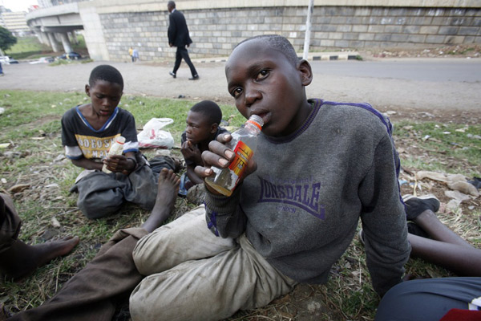

Slide 11
Social context in the attachement disorders
In both Reactive attachment and disinhibited social engagement:
The child has experienced a pattern of extremes of insufficient care as evidenced by at least one of the following:
Social neglect or deprivation in the form of persistent lack of having basic emotional needs for comfort, stimulation, and affection met by caregiving adults.
Repeated changes of primary caregivers that limit opportunities to form stable attachments (e.g., frequent changes in foster care).
Rearing in unusual settings that severely limit opportunities to form selective attachments (e.g., institutions with high child-to-caregiver ratios).

Slide 12

Post Traumatic Stress Disorder (PTSD)
PTSD is the development of Persistent emotional, cognitive and behavioural symptoms in response to a serious traumatic event that threatens security or physical integrity of the individual or of a loved one and where the symptoms persists > 1 month
Such experiences may include: a natural catastrophe, accident, battle, criminal assault, rape etc

Slide 13
Post Traumatic Stress Disorder (PTSD)
PTSD is a reaction to severe traumatic with symptoms > 1 month that meet the following diagnostic criteria
Criterion A: stressor (one required)
The person was exposed to: death, threatened death, actual or threatened serious injury, or actual or threatened sexual violence, in the following way(s):
Direct exposure
Witnessing the trauma
Learning that a relative or close friend was exposed to a trauma
Indirect exposure to aversive details of the trauma, usually in the course of professional duties (e.g., first responders, medics)

Slide 14
Criterion B: intrusion symptoms (one required)
The traumatic event is persistently re-experienced in the following way(s):
Unwanted upsetting memories
Nightmares
Flashbacks
Emotional distress after exposure to traumatic reminders
Physical reactivity after exposure to traumatic reminders

Slide 15
Criterion C: avoidance (one required
Avoidance of trauma-related stimuli after the trauma, in the following way(s):
Trauma-related thoughts or feelings
Trauma-related external reminders

Slide 16
Criterion D: negative alterations in cognitions and mood (two required)
Negative thoughts or feelings that began or worsened after the trauma, in the following way(s):
Inability to recall key features of the trauma
Overly negative thoughts and assumptions about oneself or the world
Exaggerated blame of self or others for causing the trauma
Negative affect
Decreased interest in activities
Feeling isolated
Difficulty experiencing positive affect

Slide 17
Criterion E: alterations in arousal and reactivity
Trauma-related arousal and reactivity that began or worsened after the trauma, in the following way(s):
Irritability or aggression
Risky or destructive behavior
Hypervigilance
Heightened startle reaction
Difficulty concentrating
Difficulty sleeping

Slide 18
Other Criteria
Criterion F: duration (required)
Symptoms last for more than 1 month
Criterion G: functional significance (required)
Symptoms create distress or functional impairment (e.g., social, occupational).
Criterion H: exclusion (required)
Symptoms are not due to medication, substance use, or other illness.

Slide 19
Acute Stress Disorder
Acute Stress Disorder is a caused by trauma (traumatic stress) and lasts at least 3 days.
The traumatic experiences may be of the same intensity or less as would cause PTSD but the symptoms disappear after a few days < 1 month

Slide 20
A S D Diagnostic criteria DSM V
A. Exposure to actual or threatened death, serious injury, or sexual violation in one (or more) of the following ways:
Direct exposure
Witnessing the trauma
Learning that a relative or close friend was exposed to a trauma
Indirect exposure to aversive details of the trauma, usually in the course of professional duties (e.g., first responders, medics)
Note: This does not apply to exposure through electronic media, television, movies, or pictures unless this exposure is work related.

Slide 21
B. Presence of nine (or more) of the following symptoms from any of the five categories of :
Intrusion
negative mood
Dissociation
Avoidance
arousal

Slide 22
C. Duration - >3 days< 1 month
D. The disturbance causes clinically significant distress or impairment in social, occupational
E. Not attributable to the physiological effects of a substance (e.g., medication or aocohol) or other medical condition (e.g., mild traumatic brain injury) and is not better explained by brief psychotic disorder

Slide 23
PTSD & ASD in Children
Intrusion: In children, repetitive play may occur in which themes or aspects of the traumatic event(s) are expressed. Recurrent distressing dreams in which the content and/or affect of the dream are related to the events(s).
Intrusion: In children older than 6, there may be frightening dreams without recognizable content. Dissociative reactions (e.g., flashbacks) in which the individual feels or acts as if the traumatic event(s) were recurring. (Such reactions may occur on a continuum, with the most extreme expression being a complete loss of awareness of present surroundings).
In children, trauma-specific re-enactment may occur in play. Intense or prolonged psychological distress or marked physiological reactions in response to internal or external cues that symbolize or resemble an aspect of the traumatic events.

Slide 24
Adjustment Disorder
When someone has difficulty coping with a stressor.
The DSM-5 defines adjustment disorder as “the presence of emotional or behavioral symptoms in response to an identifiable stressor(s) occurring within 3 months of the onset of the stressor(s)” (American Psychiatric Association, 2013).

Slide 25
Diagnostic criteria
Exposure: Identifiable stressor within 3 months
One or both of these criteria exist:
Distress that is out of proportion with expected reactions to the stressor
Symptoms must be clinically significant—they cause marked distress and impairment in functioning
Further, these criteria must be present:
Not an escalation of an existing mental condition
The reaction isn’t part of normal bereavement
Once the stressor is removed or the person has begun to adjust and cope, the symptoms must subside within six months

Slide 26
Subtypes of adjustment
There are six subtypes of adjustment disorder delineated in the DSM-5.
Depressed mood
Anxiety
Mixed
Disturbance of conduct
Mixed disturbance of emotions and conduct
unspecified

Slide 27
Differentiating Adjustment disorders from other conditions
As seen Adjustment disorders mimics other psychiatric conditions – but it is usually transient and therefore treatment is different
Important to remember is symptoms must occur in response to a stressor and must happen first, before a diagnosis of anxiety disorder, depression, or other mental health disorder.
Although Adjustment disorder can result from stressors of any severity, sometimes relatively mild, sometimes severe, the symptoms of adjustment disorder don’t quite reach the level of those that occur in PTSD and ASD

