Slide 1
OSCE 004
BEST OF LUCK

Slide 2
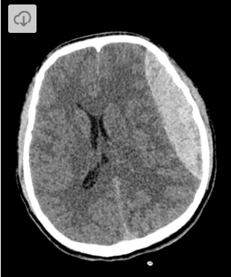
QN OO1

Slide 3
INTERPRET THE ABOVE IMAGE
DESCRIBE THE MANAGEMENT OF SUCH A PATIENT

Slide 4
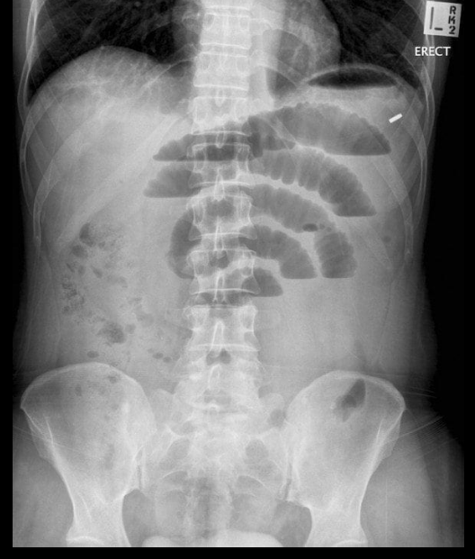
QN 002

Slide 5
INTERPRET THE ABOVE IMAGE
DESCRIBE THE MANAGEMENT
LIST THREE COMPLICATIONS OF THE ABOVE PATHOLOGY

Slide 6
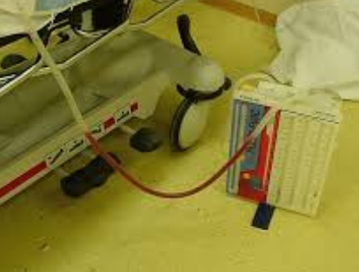
QN 003

Slide 7
NAME THE ABOVE EQUIPEMENT
DESCRIBE THE INSERTION
LIST 5 INDICATIONS
LIST 5 COMPLICATIONS

